Slide 1
Modelica Crash Course
Typical mistakes and debugging

Slide 2
Content
Typical mistakes
Debugging

Slide 3
Typical mistakes
No pressure boundary
=> Only pressure differences
=> No absolute pressure defined

Slide 4
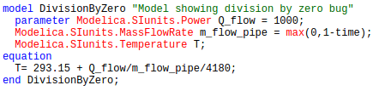
Typical mistakes
Division by zero
Model error - division by zero: (0.00023923444976076556*Q_flow) / (m_flow_pipe) = (0.239234) / (0)
Integration terminated before reaching "StopTime" at T = 1

Slide 5
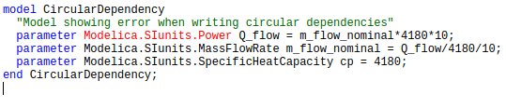
Typical mistakes
Parameters:
Unset parameters -> The following parameter doesn't have any value
Circular dependencies ->
Error: Scalar system is always singular for Q_flow = (0.0)/(0.0) = 0/0
Error: Failed to start model.

Slide 6
Typical mistakes
Media
No medium defined
Component type specifier BaseProperties is a partial type.
File: /media/psf/Home/Documents/Software/IDEAS-git/IDEAS/Fluid/Interfaces/ConservationEquation.mo, line 21
Component context: rad.vol.dynBal.medium
Component declared as Medium.BaseProperties medium in Modelica.Media.Interfaces.PartialMedium

Slide 7
Typical mistakes
Media
Inconsistent media
The quantity of fan.port_b.m_flow is "MassFlowRate.SimpleLiquidWater" and the quantity of rad.port_a.m_flow is "MassFlowRate.SimpleAir". In connect(fan.port_b, rad.port_a)

Slide 8
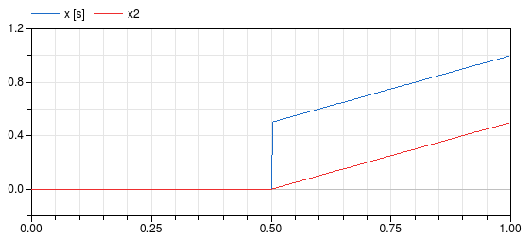
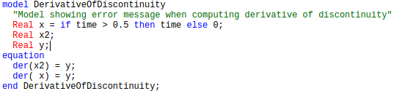
Typical mistakes
Derivative of discontinuous change

Slide 9
Typical mistakes
Syntax errors
=> Error message from Dymola
http://modref.xogeny.com
Code examples in IDEAS
http://book.xogeny.com

Slide 10
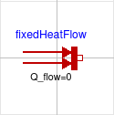
Typical mistakes
Not connecting ports
Modelica default: flow variable = 0
Part of the problem for Real elements is overdetermined.
There are 1 scalar equations too many in the set:
fixedHeatFlow.port.Q_flow = 0.0;
fixedHeatFlow.port.Q_flow = 0.0;
which was derived from
fixedHeatFlow.port.Q_flow = -fixedHeatFlow.Q_flow*(1+fixedHeatFlow.alpha*( fixedHeatFlow.port.T-fixedHeatFlow.T_ref));

Slide 11
Typical mistakes
Not connecting ports
Modelica default: flow variable = 0
fixedHeatFlow.port.T=29;
It has 2 scalar unknowns and 3 scalar equations

Slide 12
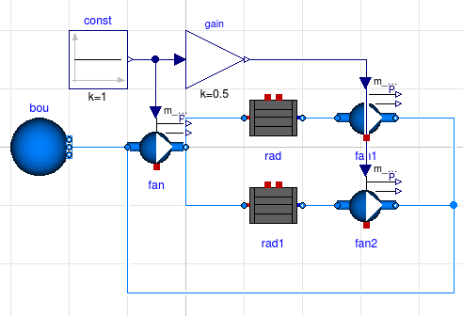
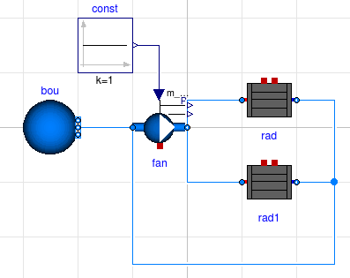
Typical mistakes
Inconsistent equations
Parallel branches:

Slide 13
Content
Typical mistakes
Debugging

Slide 14
Debugging
Model stage?
Check -> syntax
Translation -> mathematical inconsistencies
Compilation -> related to libraries
Initialization -> initial equations / initial algorithms
Simulation -> local mathematical inconsistencies

Slide 15
Debugging
Tips:
Read error message!
Split up model in smaller parts
Remove model parts
Use sufficiently high output resolution
Choose solver accuracy well
Use simplified boundary conditions
Bug reports:
https://github.com/open-ideas/IDEAS/issues

Slide 16
Debugging
Dsmodel files:
Generates dsmodel.mof file containing ‘flattened’ code

