Slide 1

Comparative Oncology Database
Shawn Rupp
Maley Lab Meeting
April 6, 2021

Slide 2
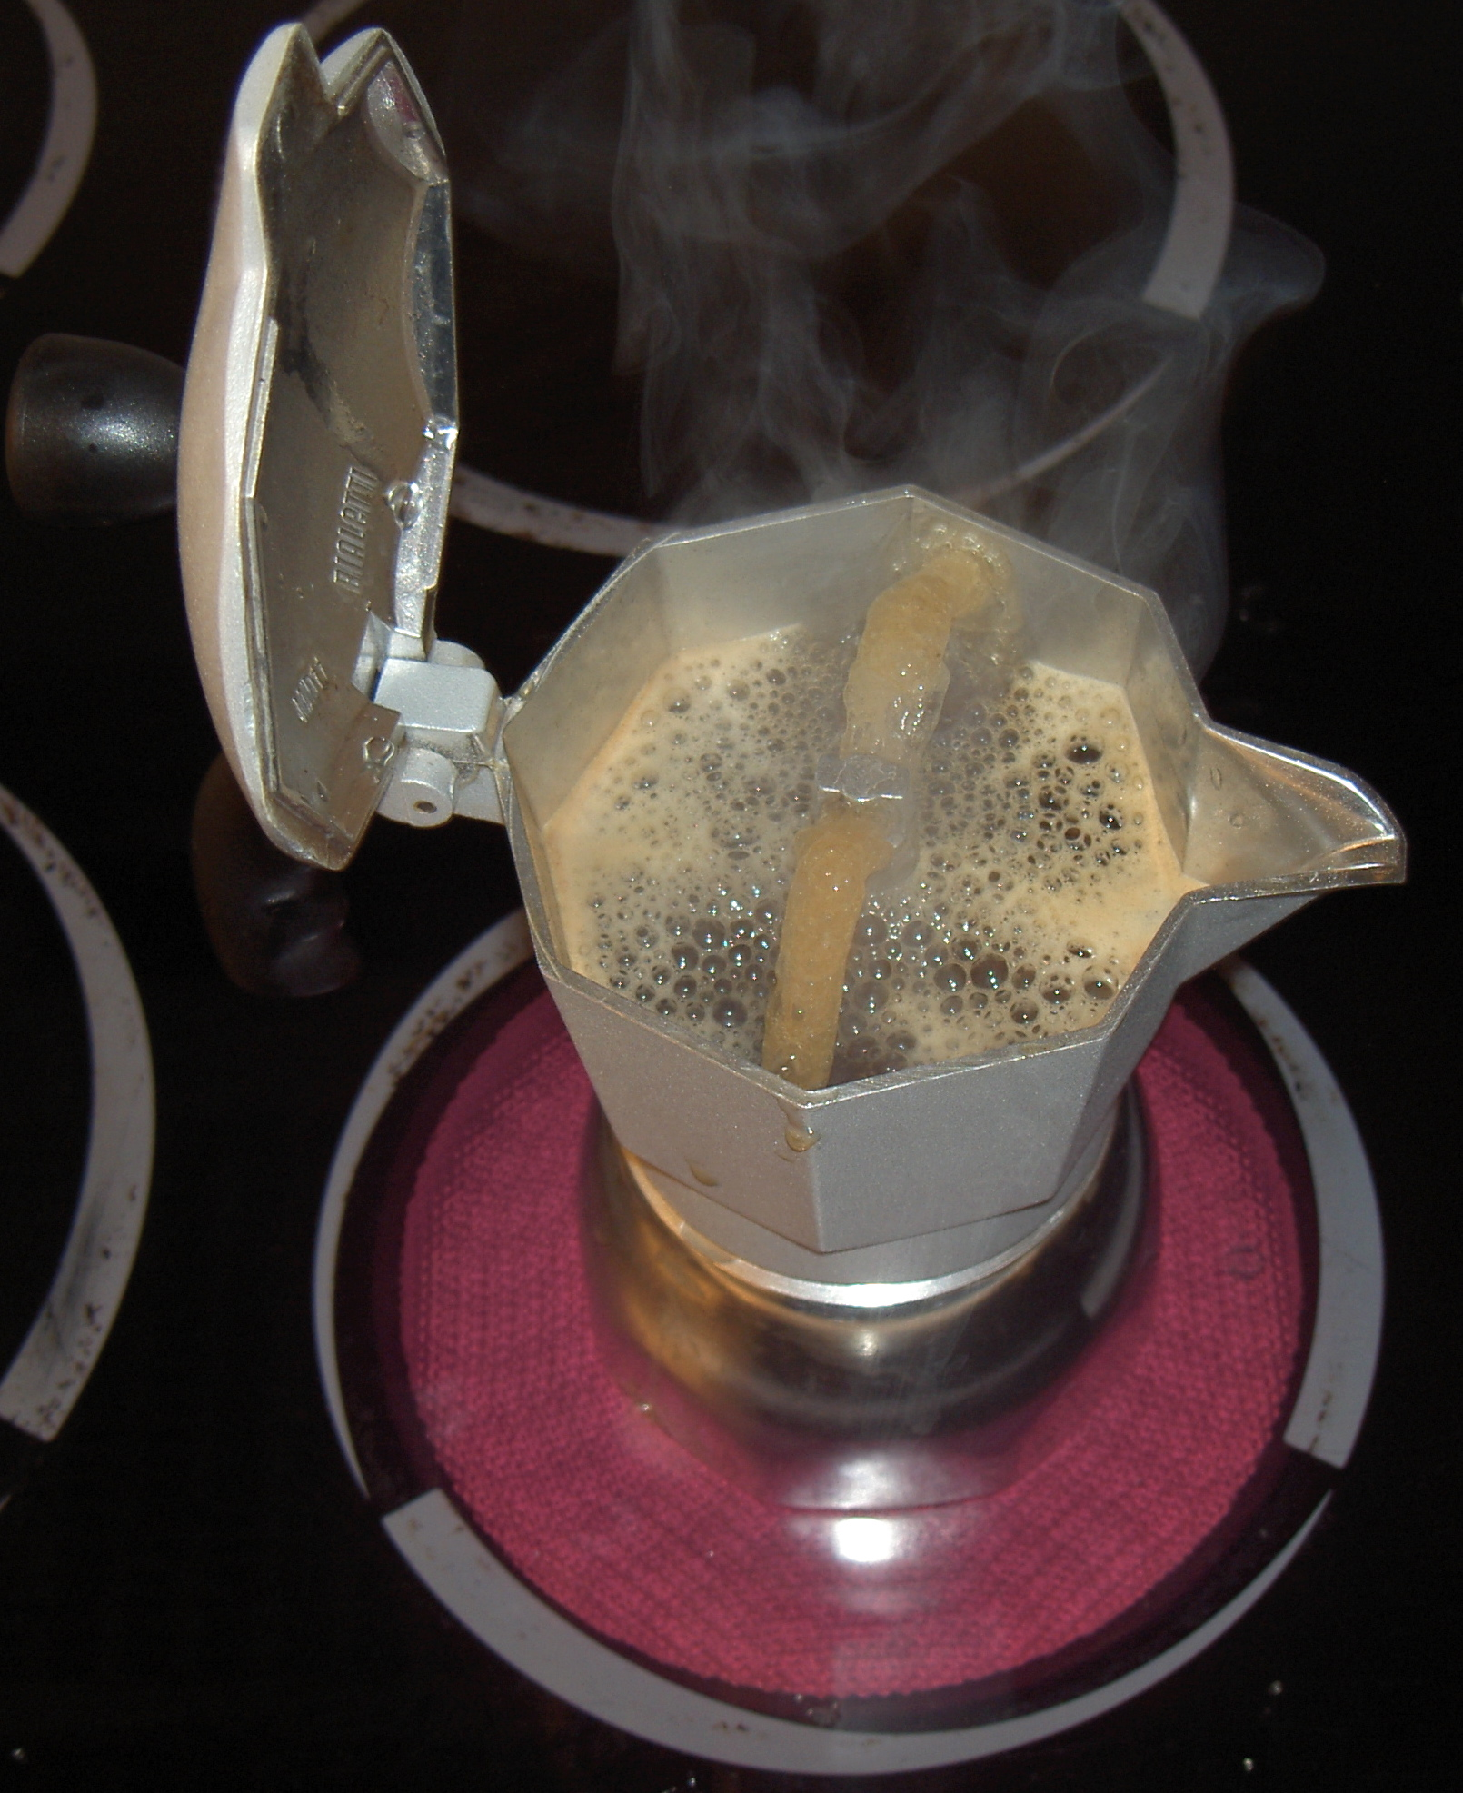
The Problem
Data is in different formats
Missing data
Missing fields
Inconsistent formats
Errors
By Berteun Damman (That's I) - Self-photographed, Public Domain, https://commons.wikimedia.org/w/index.php?curid=295395

Slide 3

Why an SQL Database?
Standardized data format
Password protection
Data is stored in a binary format
MySQL data can be parsed quickly
Can be hosted on a web server
Automatic backups

Slide 4

Why Go?
Easy to code in
Built-in support for sql databases and web servers
Fast

Slide 5
What Does It Look Like?
Denominators
taxa_id
Noncancer
Diagnosis
ID
Masspresent
Hyperplasia
Necropsy
Metastasis
Patient
ID
Sex
Age
Infant
Castrated
taxa_id
source_id
source_name
Date
Year
Comments
Unmatched
sourceID
name
sex
age
date
masspresent
necropsy
comments
Service
Taxonomy
taxa_id
Kingdom
Phylum
Class
Orders
Family
Genus
Species
Source
Common
taxa_id
Name
Curator
Tumor
ID
primary_tumor
Malignant
Type
Location
Life_history
taxa_id
female_maturity
male_maturity
Gestation
Weaning
Infancy
litter_size
litters_year
interbirth_interval
birth_weight
weaning_weight
adult_weight
growth_rate
max_longevity
metabolic_rate
Accounts
account_id
Account
submitter_name
Source
ID
service_name
Zoo
Aza
Institute
Approved
account_id

Slide 6
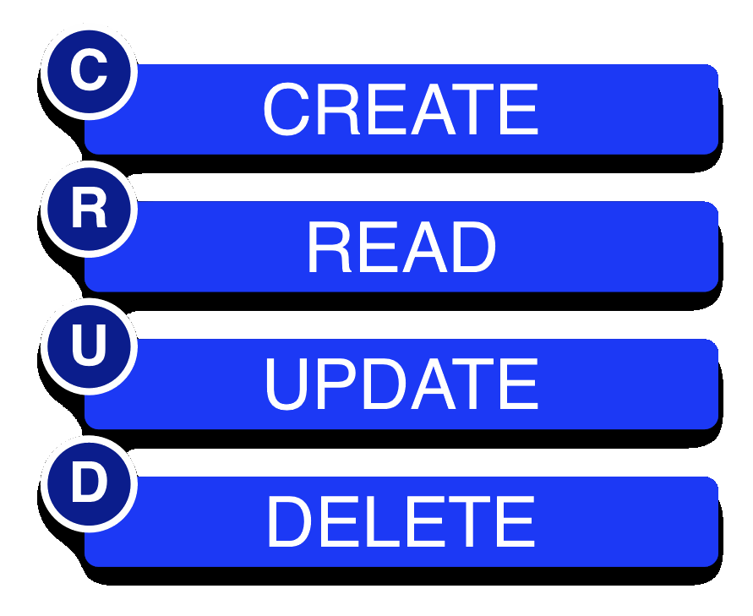
What Does It Do?
CRUD:
Additional functions:
  Summarizes cancer rates
  Returns patient records given (almost) any search field.

Slide 7
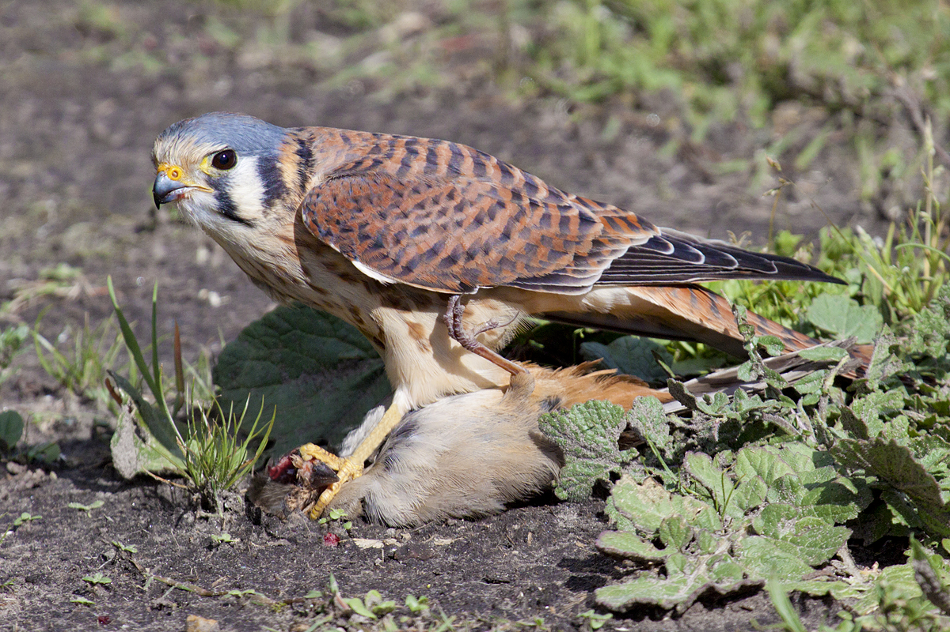
Organizing Input Data
Identifying taxa: Kestrel search
Extracting diagnoses and standardizing format: compOncDB parse
By Bill Bouton from San Luis Obispo, CA, USA - American Kestrel, Falco sparverius, femaleUploaded by snowmanradio, CC BY-SA 2.0, https://commons.wikimedia.org/w/index.php?curid=20316433

Slide 8
compOncDB
./compOncDB command {flags} {args...}
--help {command} Show help {for given command}
version Prints version info and exits.
backup Backs up database to local machine.
new Initializes new tables in new database.
parse Parse and organize records for upload to the database.
upload Upload data to the database.
update Update or delete existing records from the database.
extract Extract data from the database and perform optional analyses.
search Searches database for matches to given term.
cancerrates Calculate neoplasia prevalence for species.

Slide 9
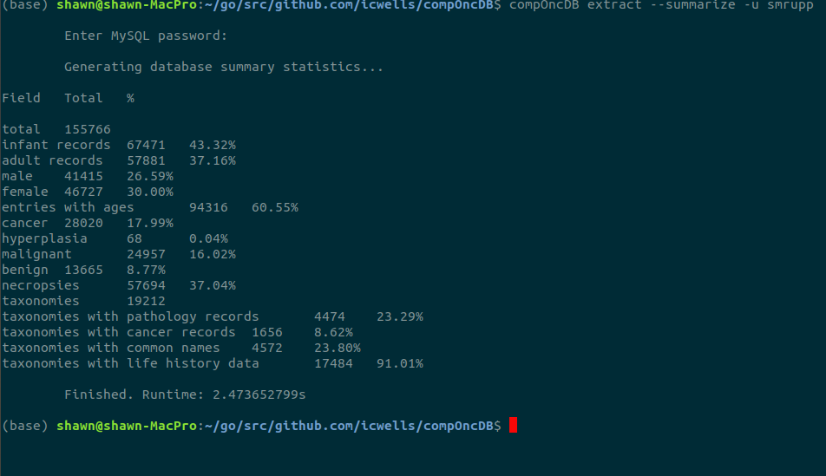
Extract
Database-wide output options
Summarize database statistics
Calculate cancer rates by species
Print entire tables

Slide 10
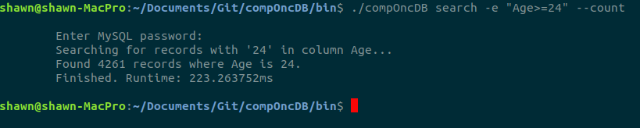
Search
Any taxonomic level
Any attribute with given value
Any numerical attribute < or > given value
Extracts complete records

Slide 11
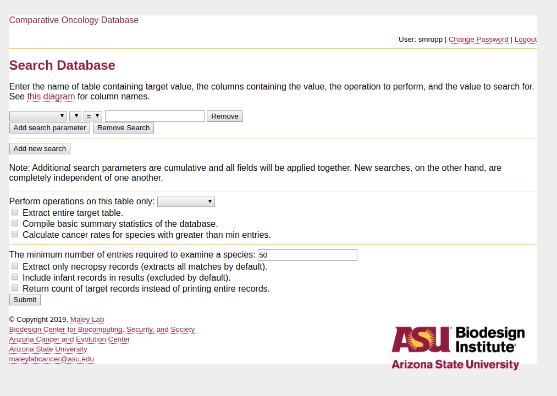
Web Interface
Database-wide output options
Summarize database statistics
Calculate cancer rates by species
Print entire tables

Slide 12
Future Directions
Additional features
Flexible output options
More data

Slide 13

Acknowledgments
The Maley Lab
  Valerie Harris
  Zachary Compton
Amy Body - UCSB
Arizona Cancer Evolution Center
NCI

