Slide 1
UCS503P — SOFTWARE ENGINEERING PROJECT | 2026–27
Digital Hostel Laundry
Management System
A mobile-first system that digitizes the complete hostel laundry lifecycle — submission, processing, notification and QR-verified pickup.
PRESENTED BY
Riddhi Dhawan 1024030943 Icy Aggarwal 1024030823 Devansh Dhawan 1024030822
Project Guide: Stuti Chug · Department of Computer Science and Engineering
Thapar Institute of Engineering and Technology, Patiala
Notes:
Good morning. We are presenting the Digital Hostel Laundry Management System, built for UCS503P. It is a React Native and Node.js application that replaces the manual hostel laundry register with a tracked, verifiable digital workflow.

Slide 2
OVERVIEW
What we will cover
01
Problem & Existing System
02
Objectives & Scope
Why manual laundry handling fails at hostel scale
What the system will and will not do
03
Requirement Analysis
04
System Design
Actors, stakeholder inputs, FR and NFR
Architecture, UML models and DFDs
05
Database & Tech Stack
06
Implementation & Testing
Relational schema and chosen technologies
What is built and verified so far
07
Status, Challenges, Limitations
08
Future Work & Conclusion
An honest picture of the current phase
The roadmap to a complete system
2
Notes:
We will move from the problem and requirements, through the design models, to what is actually implemented and tested, and finally to limitations and future work.

Slide 3
SECTION 2
Problem Statement
Hostel laundry is still run on paper registers, verbal tokens and informal recognition. At hostel scale, this breaks down in six recurring ways.
1
2
3
No visibility
No digital record
No structured queue
Students cannot check status without walking to the laundry counter.
Nothing reliably links a batch of clothes to the student who submitted it.
Staff manage incoming and outgoing batches from memory, especially at peak.
4
5
6
Unverified pickup
No complaint trail
No operational data
Collection rests on informal recognition — no guard against duplicate or wrong handover.
Missing or damaged items are raised verbally and rarely tracked to resolution.
Administrators have no aggregated view of turnaround, volume or repeat issues.
3
Notes:
These six problems came directly out of our discussions with students and with the hostel laundry staff. Note the fourth one — unverified pickup — it is the problem that drove the QR design.

Slide 4
SECTION 5
The Existing System
How it works today
Consequences
Students hand laundry directly to hostel staff. The handover is recorded in a physical register — if at all — or simply remembered. No receipt or token is issued, and there is no record of what was submitted, when, or in what condition.
No visibility into request status
No accountability when items go missing
No structured queue for staff
No verified pickup at collection
Paper register → Memory → Verbal handover
The entire chain of custody depends on recollection, so any dispute becomes one person's word against another's.
No complaint trail to resolution
No operational data for administrators
4
Notes:
The key point: these are not small inconveniences. Every one of them is a direct consequence of there being no persistent record of the transaction.

Slide 5
SECTION 3
Project Objectives
1
2
3
4
Track requests
Structure staff work
Verify collection
Restrict access
Give students a mobile interface to submit laundry and track status in real time.
Give staff a queue-based workflow to verify, tag, batch and process laundry.
Introduce single-use QR pickup tokens to prevent unauthorized or duplicate collection.
Allow only verified institutional users via email-domain OTP authentication.
5
6
7
8
Track complaints
Notify automatically
Enable oversight
Design to scale
Let students raise complaints linked to a request, and staff or admins resolve them.
Push status changes — received, processing, ready, collected — to the student.
Give administrators a central view of hostels, users, activity and complaints.
Layered client–server architecture and a schema that supports the full workflow.
5
Notes:
Eight objectives. The first two are about visibility for the two main actors, the third is the verification problem, and the last is the engineering objective — designing so the remaining modules do not require a redesign.

Slide 6
SECTION 6
Proposed System
Every laundry request becomes a distinct record — linked to the student, its items and a complete status history — so its state is always verifiable rather than remembered.
Submitted
Verified
Processing
Returned
Ready for Pickup
Collected
The laundry request state transitions maintained by the system
1
Login
2
Submit
3
Verify & batch
Student authenticates with an institutional email, verified by OTP.
Student records items and quantities as a laundry request.
Staff verify and tag the request, grouping requests into processing batches.
4
Process & log
5
Notify & activate
6
Scan & close
Each transition through washing, ironing and return is updated and logged.
The student is notified and a QR pickup token is activated for the request.
Staff scan and validate the token, mark it collected, and block reuse.
6
Notes:
The state chain at the top is the heart of the system. Every transition is written to a status history table, which is what makes the record verifiable instead of anecdotal.

Slide 7
SECTION 4
Scope of the Project
IN SCOPE
OUT OF SCOPE
Mobile application (React Native / Expo) for students and laundry staff
Backend API (Node.js / Express) mediating all data access and business logic
Institutional-email OTP authentication via Supabase Authentication
Relational PostgreSQL schema covering users, hostels, requests, items, status history, batches, tokens, complaints, notifications and audit logs
Full laundry lifecycle: submission → verification → processing → return → ready → QR collection
Complaint-management workflow and in-app notifications
Administrative view for users, hostels, complaints and activity
Payment or billing integration for laundry services
Integration with external or commercial laundry vendors
SMS-based OTP delivery — the design uses email OTP only
Multi-institution or multi-campus deployment
Dedicated QR scanning hardware beyond the staff device camera
7
Notes:
Bounding the scope was deliberate. Billing and vendor integration would have doubled the data model without demonstrating anything new about the workflow problem we set out to solve.

Slide 8
SECTION 7
Actors & Requirement Gathering
1
2
3
Student
Laundry Staff
Administrator
Submits laundry requests, tracks status, receives notifications, presents the QR code at pickup and files complaints.
Verifies incoming requests, processes and updates status, manages pickup batches and scans QR codes to confirm collection.
Manages users and hostels, and monitors complaints and overall laundry activity across the hostel system.
How requirements were gathered
Team discussions
Staff interviews
Translation
to define the intended student-facing laundry lifecycle
with the hostel laundry coordinator on real handling practice
of operational needs into functional requirements and the QR design
8
Notes:
The staff interviews mattered most. Left to ourselves we would have designed a purely student-facing app and missed the collection-verification requirement entirely — that came from the staff, not from us.

Slide 9
SECTION 8
Functional Requirements
Student
Laundry Staff
Administrator
Register and log in with an institutional email verified by OTP
Submit a laundry request specifying item types and quantities
View current status and full history of each request
Receive notifications on status changes
View and present a QR-based pickup token
Submit a complaint linked to a specific request
View an incoming queue of laundry requests
Verify and tag a laundry request
Group requests into processing batches
Update status through processing and return
Scan and validate a QR pickup token and record collection
Prevent a pickup token from being used more than once
View and respond to linked complaints
Manage hostel and user records
View aggregated laundry activity across hostels
Monitor and track resolution of complaints
Access audit logs of significant system actions
9
Notes:
Seventeen functional requirements across three roles. Requirement six on the staff side — a token cannot be reused — is the one that is enforced in the backend rather than the client, and we will come back to why.

Slide 10
SECTION 9
Non-Functional Requirements
Security
Usability
Reliability
Performance
Access restricted to verified institutional emails via OTP; pickup tokens are single-use.
A student should submit a request and check status in minimal steps.
Status transitions and token validation are recorded consistently and can be trusted over recollection.
Login, status check and submission should respond within a few seconds under normal load.
Scalability
Maintainability
Availability
All business rules live in the backend, so the client cannot bypass them.
The schema covers all entities from the outset, so new modules need no data-model redesign.
Frontend and backend are independent components communicating over a REST API.
Backend and Supabase-hosted database remain available through hostel operating hours.
10
Notes:
Scalability here is a design-time claim, not a load test. We designed the full schema up front specifically so the remaining modules would not force a migration.

Slide 11
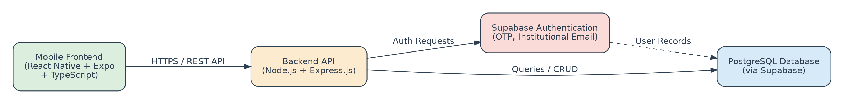
SECTION 10
System Architecture
A layered client–server architecture separating the mobile frontend, backend logic, and data and authentication services.
Figure 10.1 — System Architecture
Mobile Frontend
Backend API
Supabase Auth
PostgreSQL
React Native + Expo + TypeScript. Presents student and staff interfaces; talks to the backend over HTTPS.
Node.js + Express. Exposes REST endpoints, applies validation and business rules, mediates all data access.
Handles OTP generation and verification for institutional email addresses.
Stores users, hostels, requests, items, status history, batches, tokens, complaints, notifications, audit logs.
11
Notes:
Keeping business logic in the backend rather than the mobile client means the institutional-domain check and the single-use token rule are enforced centrally and cannot be bypassed by modifying the app.

Slide 12
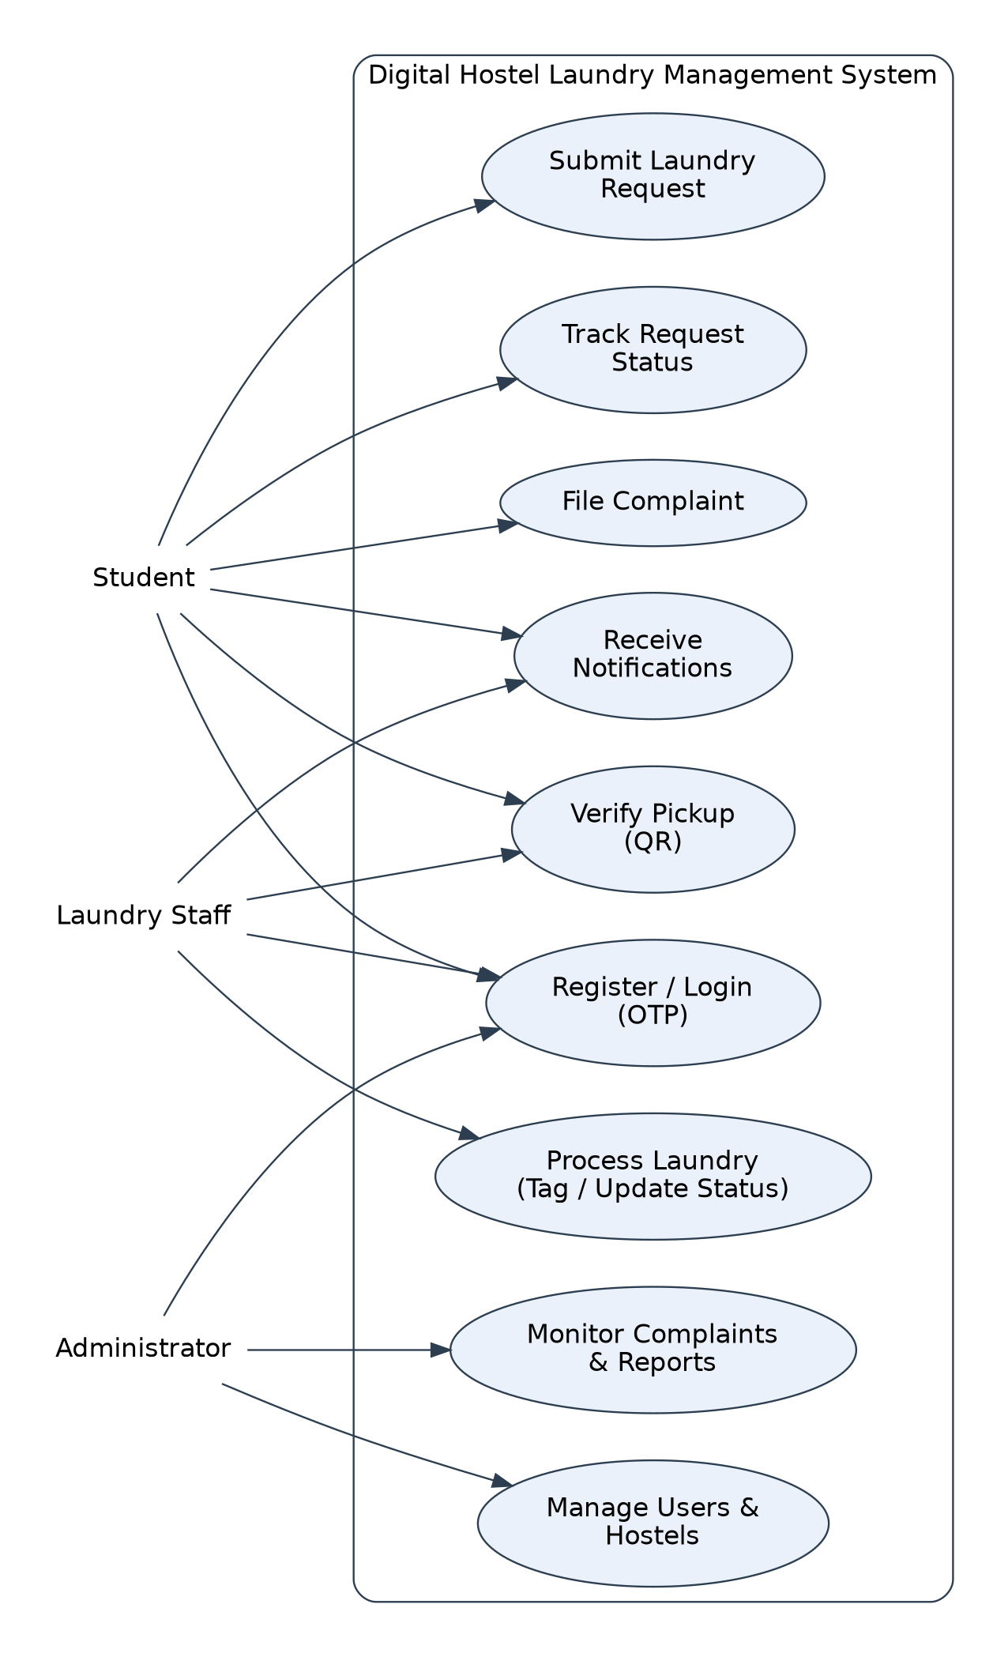
SECTION 12
Use Case Diagram
What the diagram establishes
1
Three actors, one system boundary
Student, Laundry Staff and Administrator each interact with a distinct but overlapping set of use cases.
2
Student use cases
Login, submit request, track status, view QR token, receive notifications, file complaint.
3
Staff use cases
View queue, verify and tag, batch, update status, scan QR and confirm collection, respond to complaints.
4
Administrator use cases
Manage users and hostels, monitor activity and complaints, access audit logs.
5
Shared authentication
All three actors enter through the same OTP-based login, differing only in role after verification.
Figure 12.1 — Use Case Diagram
12
Notes:
Note that all three actors share one authentication use case. That decision is what let us implement login once and have it serve every role.

Slide 13
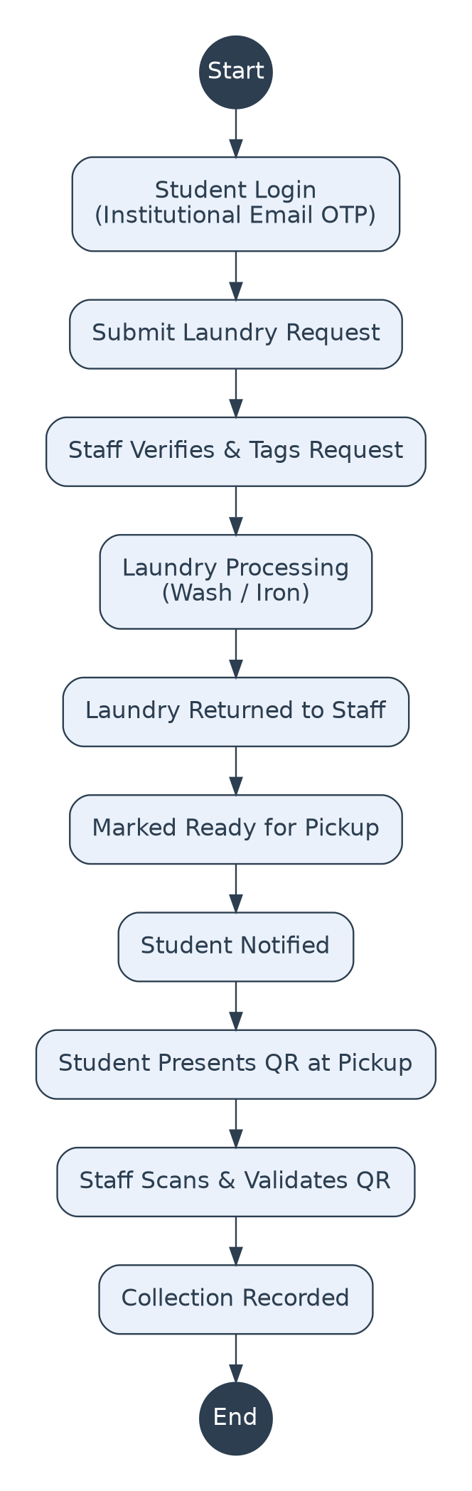
SECTION 13
Activity Diagram — Laundry Lifecycle
From login to verified collection
The activity diagram models the complete lifecycle described in Section 6, showing where control passes between the student, the system and the laundry staff.
Student side
Log in → submit request → receive notification → present QR at the counter.
Staff side
Receive and verify → tag and batch → wash and iron → return → mark ready for pickup.
Decision point
At collection the token is validated; an already-used token is rejected, not accepted again.
Exception path
At any stage the student can branch off to raise a complaint linked to that specific request.
Figure 13.1
13
Notes:
The decision point at collection is the one that turns a design intention into an enforceable rule — the token check has to fail closed.

Slide 14
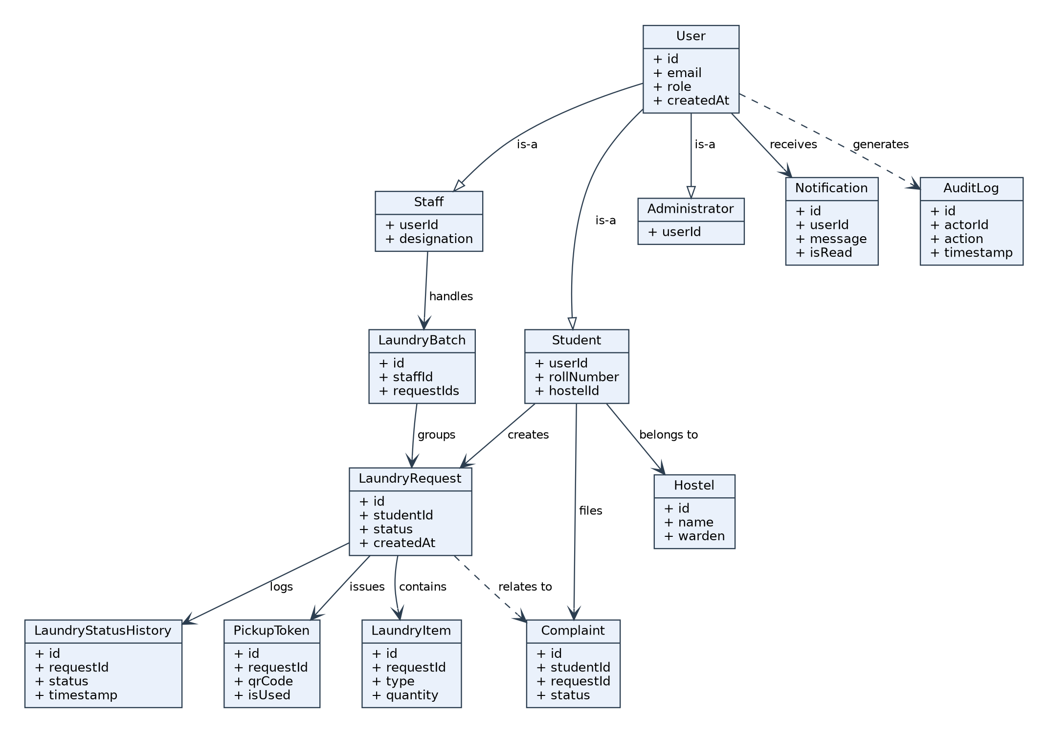
SECTION 14
Class Diagram
Model highlights
One User, three roles
User specializes into Student, Staff and Administrator — a shared authentication record.
Request as the hub
LaundryRequest connects items, status history, pickup token and complaints.
Append-only history
LaundryStatusHistory logs every transition instead of overwriting status.
Single-use token
PickupToken carries an isUsed flag, making reuse detectable at the data layer.
Figure 14.1 — Class Diagram
14
Notes:
The isUsed flag on PickupToken is small but important — the single-use guarantee is expressed in the data model, not only in application code.

Slide 15
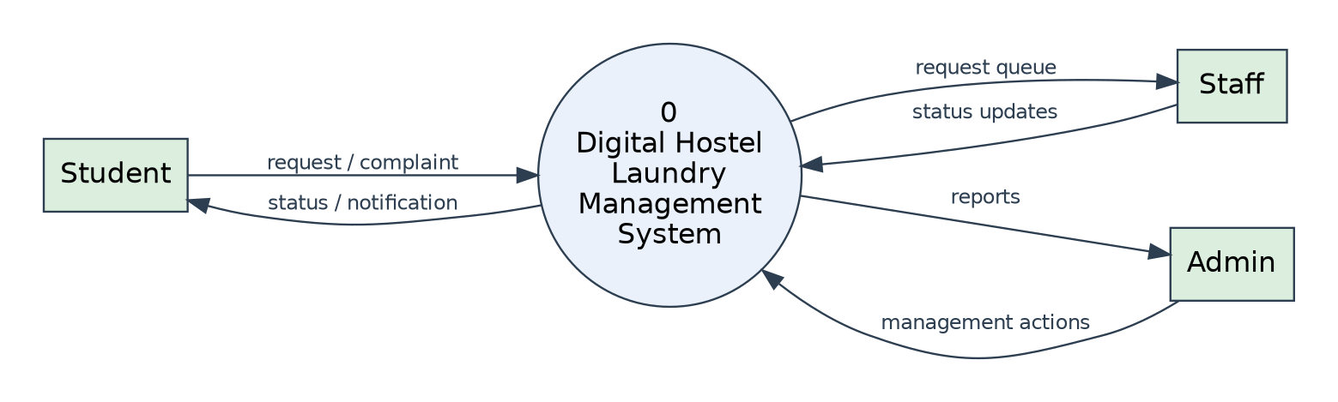
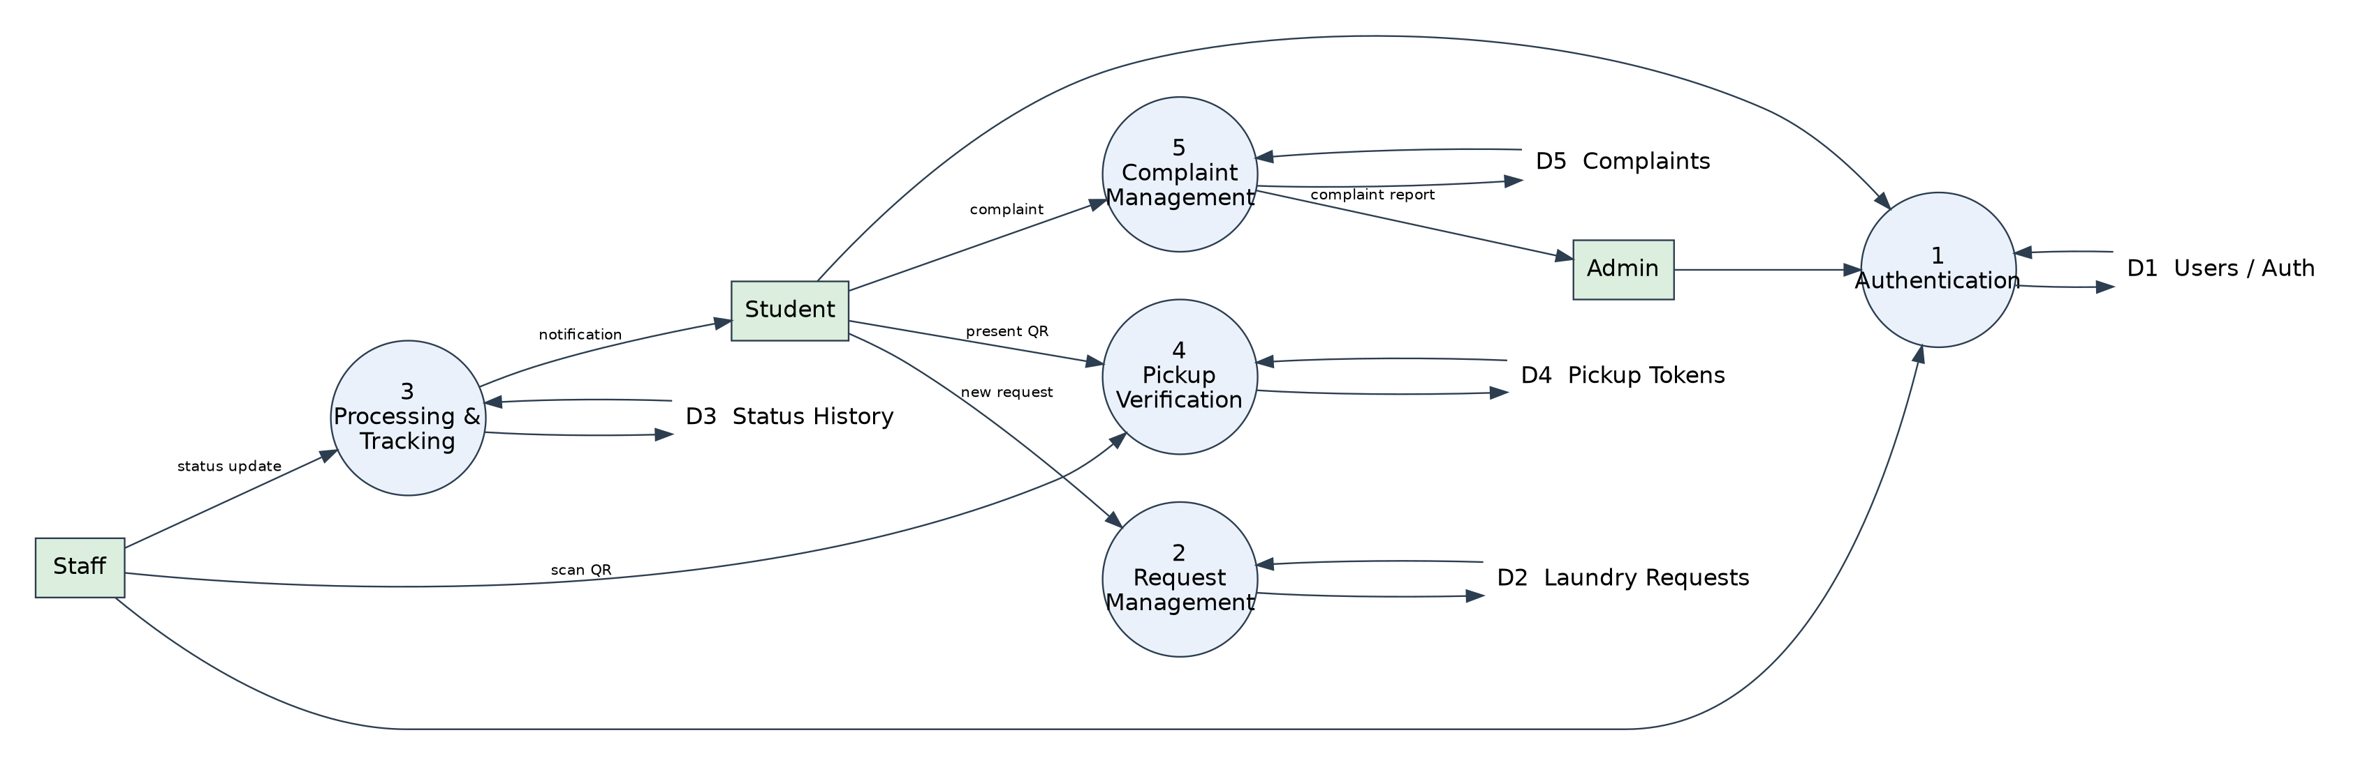
SECTION 15
Data Flow Diagrams
LEVEL 0 — CONTEXT DIAGRAM
The system as a single process, exchanging data with its three external actors.
LEVEL 1 — PROCESS DECOMPOSITION
Authentication, request management, processing and tracking, pickup verification and complaint management, with the data stores each reads and writes.
Figures 15.1 and 15.2 — DFD Levels 0 and 1
15
Notes:
Level 1 is where the five functional processes appear as separate units. That decomposition is also roughly how the backend routes are organised.

Slide 16
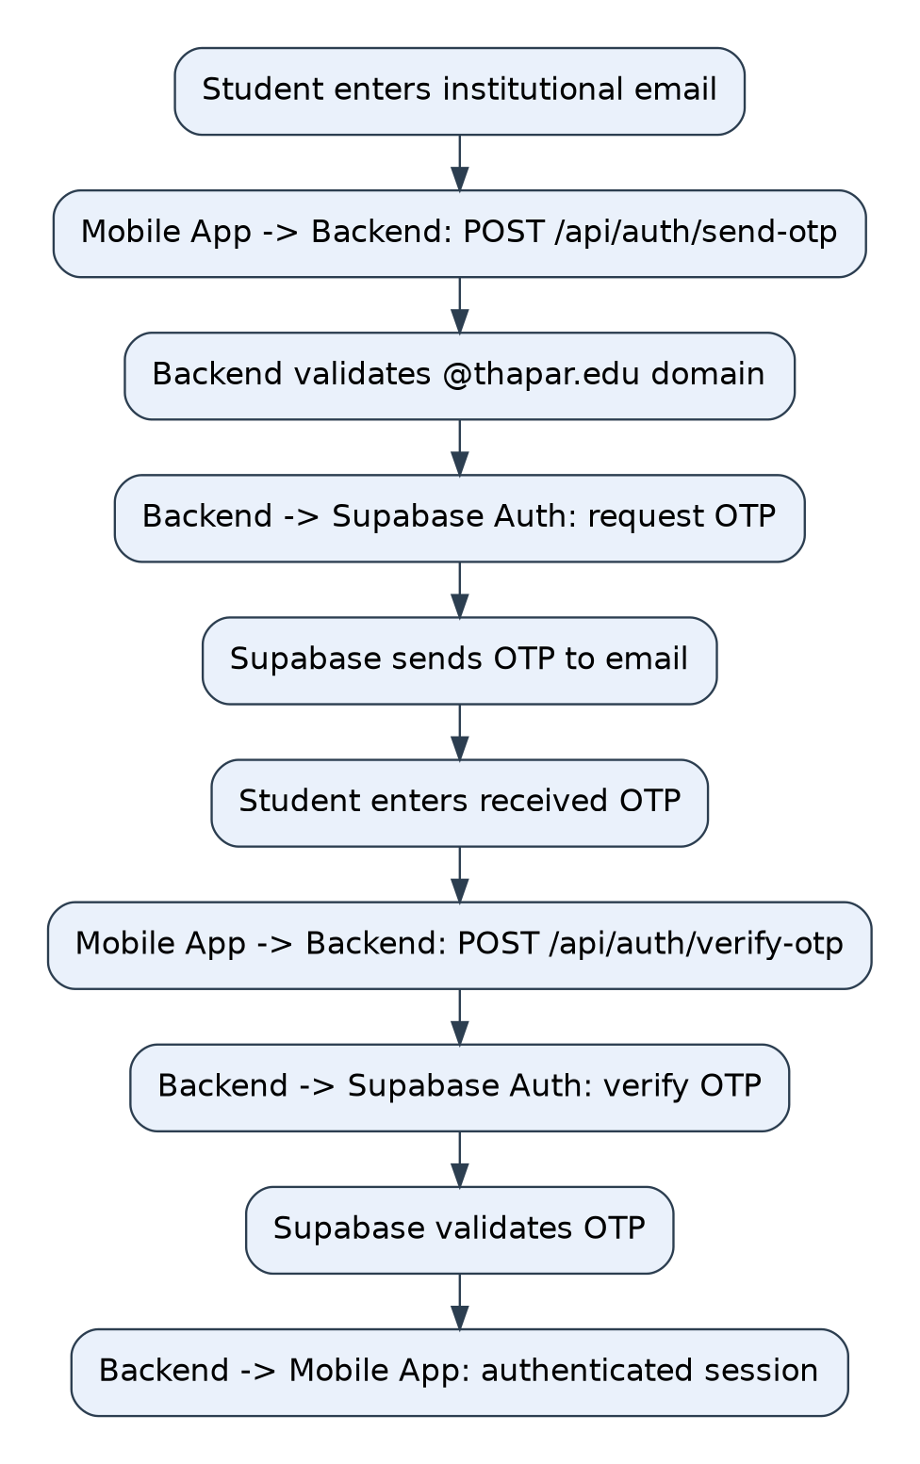
SECTION 16
Sequence Diagram — OTP Authentication
The one flow that is fully implemented
This diagram traces the interaction between the mobile app, the Express backend and Supabase Authentication for both send-OTP and verify-OTP.
1
App sends the email address to the backend
2
Backend validates the institutional domain (@thapar.edu)
3
Backend asks Supabase to issue an OTP; the user receives it by email
4
App sends email and OTP back to the backend
5
Backend forwards the verification request to Supabase Auth
6
Supabase validates and returns an authenticated session to the client
Figure 16.1
16
Notes:
Steps one to three are send-OTP, four to six are verify-OTP. Both endpoints are live and tested — we will show the test cases shortly.

Slide 17
SECTION 17
Database Design
A relational schema on PostgreSQL via Supabase, designed for the complete intended system so later modules need no fundamental redesign.
Users
Students
Staff
Administrators
Base authentication and profile record shared by all roles
Roll number and associated hostel
Laundry-staff designation records
Administrator account records
Hostels
Laundry Requests
Laundry Items
Status History
Hostel records students are associated with
Core record of a submission and its current status
Individual items and quantities within a request
Append-only log of status transitions
Laundry Batches
Pickup Tokens
Complaints
Notifications
Grouping of requests processed together
Single-use QR tokens issued per request
Student issues linked to a request, with resolution
In-app messages on status or complaint changes
Plus an Audit Logs table for traceability of significant actions. Currently configured and tested: Users and Hostels, with verified Supabase connectivity.
17
Notes:
Thirteen entities in total. Only Users and Hostels are actually populated and queried today — the rest are designed and will be created alongside their modules.

Slide 18
SECTION 18
Technology Stack
MOBILE FRONTEND
BACKEND
AUTHENTICATION
React Native · Expo
TypeScript · Expo Router
Node.js · Express.js
Supabase Authentication
Cross-platform from one codebase, with file-based routing.
Lightweight REST layer holding all validation and business rules.
Managed OTP issue and verification against institutional email.
DATABASE
VERSION CONTROL
CONFIGURATION
PostgreSQL via Supabase
Git · GitHub
dotenv
Relational integrity for requests, tokens and status history.
Branch-per-member workflow with pull requests into main.
Service credentials kept out of application source code.
18
Notes:
Supabase gave us managed Postgres and managed auth together, which meant we could spend our time on the workflow rather than on building an OTP service from scratch.

Slide 19
SECTION 19
Implementation — Structure
Repository layout
Backend server — server.js
UCS503P-202627-Laundry-Management-System/
├── code/
│ ├── frontend/ React Native + Expo
│ │ └── src/
│ │ ├── app/ routes & screens
│ │ ├── components/ shared UI
│ │ ├── constants/ theme
│ │ └── hooks/ custom hooks
│ └── backend/ Node.js + Express
│ ├── routes/
│ │ ├── authRoutes.js
│ │ └── studentRoutes.js
│ └── server.js
├── docs/ requirements, database,
│ diagrams
├── journals/ weekly team journals
└── project-report-final/
1
Environment configuration
Credentials loaded through dotenv, outside the source.
2
Express initialization
Application created and configured for JSON requests.
3
Supabase client
Client initialized for the project's Supabase services.
4
Route registration
Authentication routes mounted under /api/auth.
5
Connectivity test
/api/test-db queries the hostels table to verify the chain.
6
Server startup
Express listens on the configured development port 5000.
19
Notes:
The split between frontend and backend is not cosmetic — it is what allows the two of us working on different layers to develop independently against an agreed API.

Slide 20
SECTION 19.5
Authentication — Implemented
Supabase Authentication with an institutional email OTP mechanism. Two endpoints, both live and tested.
POST /api/auth/send-otp
POST /api/auth/verify-otp
User enters institutional email
User enters the received OTP
Frontend sends email to the backend
Frontend sends email and OTP
Backend validates the @thapar.edu domain
Backend requests Supabase verification
Supabase issues and sends the OTP
Supabase validates the OTP
User receives the OTP by email
Authenticated session returned to the client
Domain validation happens in the backend, so restricting access to institutional users cannot be bypassed by the client app.
20
Notes:
This is the first feature that works end to end: app to Express to Supabase and back. It also gives us the session that role-based access for student, staff and admin will build on.

Slide 21
SECTIONS 19.7 & 20
API Endpoints & Testing
IMPLEMENTED ENDPOINTS
AUTHENTICATION TEST CASES
Method | Endpoint | Purpose
POST | /api/auth/send-otp | Send OTP to institutional email
POST | /api/auth/verify-otp | Verify OTP and authenticate user
GET | /api/test-db | Test backend–database connectivity
Test case | Expected result
Valid @thapar.edu address | OTP request accepted
Email outside permitted domain | Request rejected
Valid OTP submitted | User authenticated
Incorrect OTP submitted | Authentication rejected
/api/test-db request | Database query executed
What testing covers today
Planned once modules land
Endpoint accessibility and request handling
Institutional email validation
OTP issue and verification via Supabase
Backend → Supabase → PostgreSQL connectivity
Functional, integration and workflow testing
Security testing of QR verification and access control
Usability testing with students and staff
End-to-end: login → submission → processing → QR collection
21
Notes:
Testing at this stage validates the infrastructure rather than the workflow, because several modules do not exist yet. We are stating that plainly rather than claiming coverage we do not have.

Slide 22
SECTION 21
Implementation Status
Twenty-three tracked components across design and implementation. The distribution below reflects the actual state of the project today.
COMPLETED
Requirement analysis, stakeholder study, and all five design models — use case, activity, class, DFD and sequence.
IMPLEMENTED
Supabase and PostgreSQL setup, Express backend, connectivity test, institutional email validation, OTP send and verify, React Native + Expo foundation.
DESIGNED / PENDING
QR pickup, complaints, notifications, admin dashboard and the full database schema are specified but not yet built.
The schema is designed and connectivity works — the operational CRUD layer for laundry requests does not exist yet.
22
Notes:
Fourteen of twenty-three components are done — seven design artefacts completed and seven implementation items working. We are deliberately distinguishing designed from implemented throughout this deck.

Slide 23
SECTION 22
Challenges Encountered
1
2
3
Understanding the real workflow
Stakeholder coordination
Reliable collection verification
A software workflow cannot be designed on assumptions. We had to learn how laundry is actually received, identified, processed, returned and collected before modelling any of it.
Obtaining permissions and arranging discussions with laundry personnel consumed development time in the early phase — but it produced realistic requirements.
Associating a physical laundry order with the correct student and giving staff a way to verify handover is what led directly to the QR pickup token design.
4
5
Requirements into models
Development vs documentation
The hardest problems in this phase were about the domain, not the code.
Converting operational needs into formal artefacts — actors, use cases, activities, classes, data flows, entities and APIs — took several iterations.
With work happening in parallel on different layers, keeping the report consistent with the actual codebase was an ongoing effort.
23
Notes:
If there is one lesson from this phase, it is that we spent more effort understanding the problem than writing code — and the QR design would not exist otherwise.

Slide 24
SECTION 23
Current Limitations
These reflect the current stage of development rather than flaws in the system design.
1
Incomplete laundry workflow
2
Staff module pending
Student submission and tracking are not yet fully implemented.
The staff interface and complete staff APIs are yet to be built.
3
QR pickup pending
4
Complaint module pending
Designed in full; implementation and validation are outstanding.
Included in the design, not yet implemented.
5
Notification system pending
6
Administrative interface pending
Part of the architecture, requires implementation and integration.
The admin dashboard remains future development.
7
End-to-end testing pending
8
Frontend scope
Possible only once the remaining modules are integrated.
The app establishes the foundation; the full UI is under development.
24
Notes:
We list these openly. The architecture and schema anticipate every one of them, which is why they are additions rather than redesigns.

Slide 25
SECTION 24
Future Work
1
2
3
4
Student module
Laundry staff module
QR-based pickup
Notifications
Dashboard, request creation and item entry, tracking and history, status visualization, complaint submission.
Incoming queue and verification, tagging and processing, ready-for-pickup management, QR scanning, complaint handling.
Token generation and activation, staff scan and validation, collection recorded, reuse blocked.
Received, processing, returned, ready for pickup, collection completed and complaint updates.
5
6
7
8
Complaint management
Administrative dashboard
Comprehensive testing
Deployment
Description, related request, submission time, status, resolution and staff or admin actions.
User and hostel management, activity monitoring, complaint and audit-log access, system reporting.
Unit, integration, functional, authentication, database, workflow, security, usability and end-to-end.
Production database and secure configuration, backend deployment, mobile build, monitoring and maintenance.
25
Notes:
This is the plan for the next phase, roughly in dependency order — the student and staff modules first, because QR pickup and notifications sit on top of them.

Slide 26
SECTIONS 25 & 26
Expected Impact & Conclusion
Expected impact
Conclusion
Reduced dependence on manual records
We have completed the major requirement-analysis and system-design activities and established the technical foundation for implementation: defined actors, functional and non-functional requirements, the complete laundry workflow, database modelling, UML and DFD representations, and a layered architecture.
Better visibility of laundry status for students
Structured, verifiable historical records
Reliable collection verification at handover
The Expo frontend is initialized, the Express backend is running and connected to Supabase, and institutional-email OTP authentication works end to end — the first functional feature of the application.
Timely information through notifications
Better operational organisation for staff
Centralised monitoring across hostels
The project demonstrates requirement analysis, stakeholder interaction, system modelling, relational design, client–server architecture, API development, authentication and collaborative version control.
Traceability of key actions through audit logs
Actual impact will need to be evaluated after deployment, through user feedback and usage data.
26
Notes:
To close: the design is complete, the foundation works, and the remaining modules build on it rather than replace it.

Slide 27
Thank You
Questions and feedback are welcome
PROJECT REPOSITORY
github.com/icy-agarwal/UCS503P-202627-Laundry-Management-System
Riddhi Dhawan · Icy Aggarwal · Devansh Dhawan
Notes:
Thank you. Happy to take questions — particularly on the QR verification design or the decision to keep all validation in the backend.

