Slide 1
Minesweeper
School of Mathematics, Nankai University
Icyblade Dai and his friends
2013-09-05

Slide 2
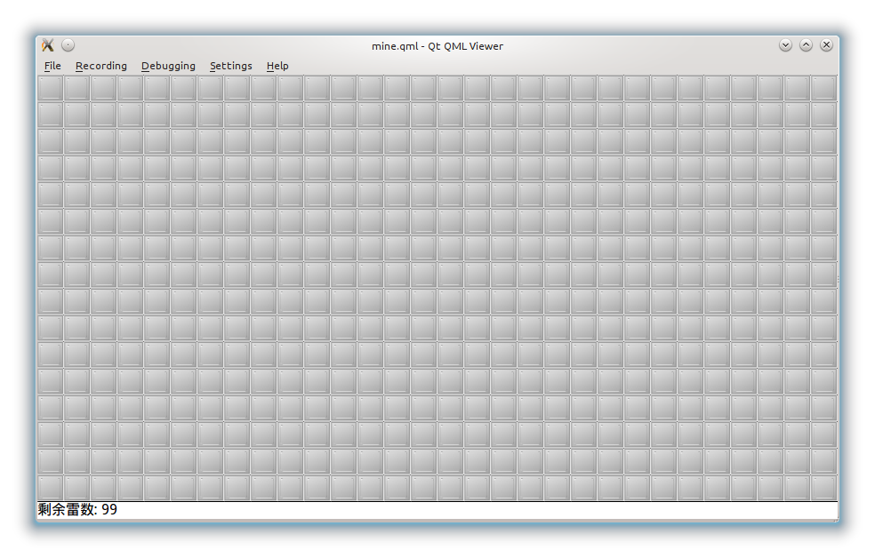
Overview

Slide 3
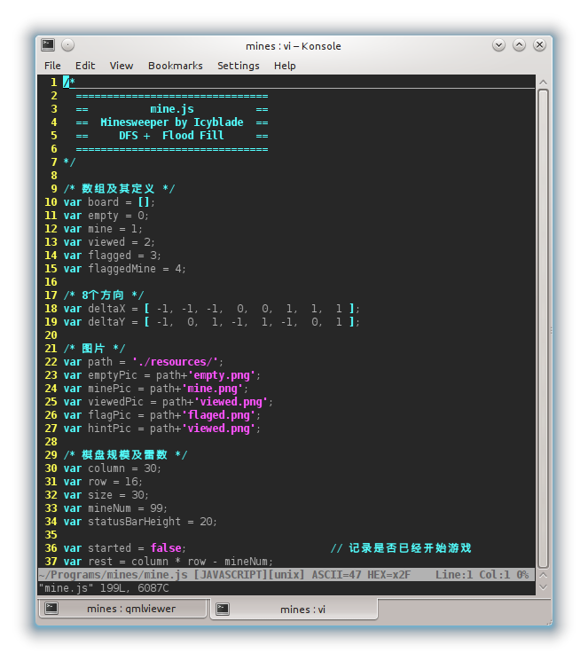
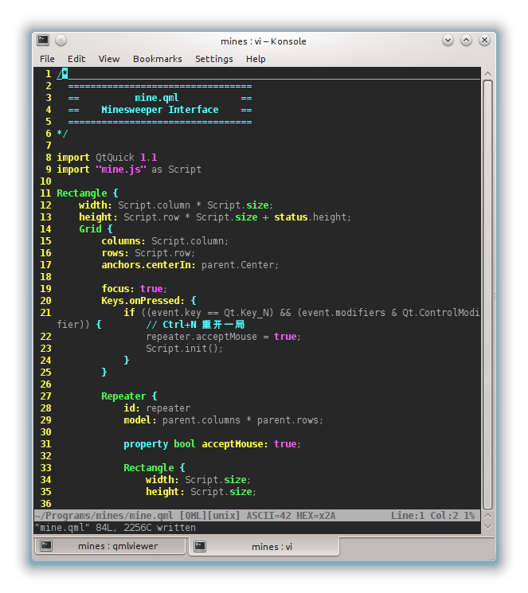
Overview

Slide 4

Main Algorithm
Flood Fill
Flood fill, also called seed fill, is an algorithm that determines the area connected to a given node in a multi-dimensional array. It is used in the "bucket" fill tool of paint programs to fill connected, similarly-colored areas with a different color, and in games such as Go and Minesweeper for determining which pieces are cleared. When applied on an image to fill a particular bounded area with color, it is also known as boundary fill.
recursive flood-fill with 4 directions

Slide 5
Main Algorithm
Where is Flood Fill
function clicked(index) { // index of current block
/* blah blah */
mines_around_current_block → cnt
if (cnt != 0) {
current_block.image ← NUMBER
} else {
current_block.image ← VIEWED
for (var d = 0; d < 8; d++)
click offset: (x + deltaX[d], y + deltaY[d])
}
/* blah blah */
}

Slide 6
Main Algorithm
Where is Flood Fill
var deltaX = [-1, -1, -1, 0, 0, 1, 1, 1 ];
var deltaY = [-1, 0, 1, -1, 1, -1, 0, 1 ];

Slide 7
Main Algorithm
Where is Flood Fill
clicked(getIndex(x+deltaX[d], y+deltaY[d]));
==>
clickedSeq.push(getIndex(x+deltaX[d],y+deltaY[d]));

Slide 8
Main Algorithm
Where is Flood Fill
Timer {
interval: 200;
running: true;
repeat: true;
onTriggered: Script.displayNext();
}
Timer {
id :timerClrCur
interval: 100;
running: false;
repeat: false;
onTriggered: Script.clearCur();
}

Slide 9
Main Algorithm
Where is Flood Fill
curPic ← path+'current.png'
mineNum ← 10
clickedSeq,curDisplayed
function displayNext() {
curDisplayed++;
if (curDisplayed >= clickedSeq.length)
return;
clicked(clickedSeq[curDisplayed]);
repeater.itemAt(clickedSeq[curDisplayed]).value = curPic;
timerClrCur.start();
}

Slide 10
Main Algorithm
Where is Flood Fill
function clearCur() {
var x = Math.floor(clickedSeq[curDisplayed] / column);
var y = clickedSeq[curDisplayed] % column;
if (board[x][y] == mine) {
value ← minePic;
} else if (empty){
value ← emptyPic
} else if (flagged || flaggedMine) {
value ← flagPic;
} else {
Value ← viewedPic;
}
}

Slide 11
Main Algorithm
Where is Flood Fill
Example:

Slide 12
Program
tree ./
./
├── enim.js
├── enim.qml
├── mine.js
├── mine.qml
├── README.md
├── resources
│ ├── 1.png
│ ├── 2.png
│ ├── 3.png
│ ├── 4.png
│ ├── 5.png
│ ├── 6.png
│ ├── 7.png
│ ├── 8.png
│ ├── current.png
│ ├── empty.png
│ ├── flaged.png
│ ├── mine.png
│ └── viewed.png
└── TODO

Slide 13
Program: mine.qml
mine.qml is used for the interface

Slide 14
Program: mine.qml
onClicked: {
if (mouse.button == Qt.LeftButton) {
Script.clicked(index);
} else if (mouse.button == Qt.RightButton) {
Script.flag(index);
}
}
onDoubleClicked: {
Script.hint(index);
}
if ((event.key == Qt.Key_N) && (event.modifiers & Qt.ControlModifier)) {
repeater.acceptMouse = true;
Script.init();
}

Slide 15
Program: mine.qml
Timer {
id: timer
interval: 200;
running: false;
repeat: false;
onTriggered: Script.clearHint();
}

Slide 16
Program: mine.qml
Text {
id: status
x: 0
y: 480
width: Script.column * Script.size
height: Script.statusBarHeight;
text: "剩余雷数: "+Script.mineNum;
font.family: "WenQuanYi Micro Hei"
font.pixelSize: Script.statusBarHeight * 0.8;
}

Slide 17
Program: mine.qml
Timer {
id: timer
interval: 200;
running: false;
repeat: false;
onTriggered: Script.clearHint();
}

Slide 18
Program: mine.js
mine.qml is the core

Slide 19
Program: mine.js
/* 数组及其定义 */
var board = [];
var empty = 0;
var mine = 1;
var viewed = 2;
var flagged = 3;
var flaggedMine = 4;
/* 8个方向 */
var deltaX = [-1, -1, -1, 0, 0, 1, 1, 1 ];
var deltaY = [-1, 0, 1, -1, 1, -1, 0, 1 ];
/*记录是否已经开始游戏 */
var started = false;
var rest = column * row - mineNum;

Slide 20
Program: mine.js
/* 图片 */
var path = './resources/';
var emptyPic = path+'empty.png';
var minePic = path+'mine.png';
var viewedPic = path+'viewed.png';
var flagPic = path+'flaged.png';
var hintPic = path+'viewed.png';
/* 棋盘规模及雷数 */
var column = 30;
var row = 16;
var size = 30;
var mineNum = 99;
var statusBarHeight = 20;
var flaggedNum = 0;

Slide 21
Program: mine.js
function getBlock(x, y) {出
if (x<0 || x>=row || y<0 || y>=column)
return -1;
return board[x][y];
}
/* 获取 board 数组中对应的标号 */
function getIndex(x, y) {
if (x<0 || x>=row || y<0 || y>=column)
return -1;
return x * column + y;
}

Slide 22
Program: Script.init
flaggedNum = 0;
status.text = "剩余雷数: "+(mineNum-flaggedNum);
/* 把 board 和界面图片全部初始化为 empty */
for (var i = 0; i < row; i++) {
board[i] = [];
for (var j = 0; j < column; j++) {
board[i][j] = empty;
repeater.itemAt(getIndex(i,j)).value = emptyPic;
}
}

Slide 23
Program: Script.init
/* 随机生成雷记录进 board */
for (var i = 0; i < mineNum; i++) {
var x, y;
do {
x = Math.floor(Math.random() * row);
y = Math.floor(Math.random() * column);
} while ((board[x][y] == mine) || (getIndex(x, y) == index))
board[x][y] = mine;
}

Slide 24
Program: Script.clicked
if (!started) {
init(index);
started = true;
}
if (index == -1) return;
/* 获取 index 对应的横纵坐标 */
var x = Math.floor(index / column);
var y = index % column;
if (x < 0 || x > row || y < 0 || y > column)
return;

Slide 25
Program: Script.clicked
if (board[x][y] == mine) {
console.log("BOMB!");
/* 爆了后显示出所有的雷 */
for (var i = 0; i < row; i++) {
for (var j = 0; j < column; j++) {
if (board[i][j] == mine)
repeater.itemAt(getIndex(i, j)).value = minePic;
}
}
repeater.acceptMouse = false; // 禁止鼠标操作
return;
}

Slide 26
Program: Script.clicked
/* board[x][y] == flagged || flaggedMine || viewed */
if (board[x][y] != empty) return;
board[x][y] = viewed;
rest--;
if (rest == 0)
console.log("Win!");

Slide 27
Program: Script.clicked
var cnt = 0; // 记录当前 block 点出来的数字
for (var d = 0; d < 8; d++) {
var value = getBlock(x + deltaX[d], y + deltaY[d]);
if (value == mine || value == flaggedMine)
cnt++;
}
if (cnt != 0) {
repeater.itemAt(getIndex(x, y)).value = path+cnt+".png";
} else {
repeater.itemAt(getIndex(x, y)).value = viewedPic;
for (var d = 0; d < 8; d++)
clicked(getIndex(x+deltaX[d],y+deltaY[d]));
}

Slide 28
Program: Script.flag
var x = Math.floor(index / column);
var y = index % column;
if (board[x][y] == empty) {
board[x][y] = flagged;
repeater.itemAt(index).value = flagPic;
flaggedNum++;
status.text = "剩余雷数: "+Math.abs(mineNum - flaggedNum);
} else if (board[x][y] == mine) {
/* blahblah */
} else if (board[x][y] == flagged) {
/* blahblah */
} else if (board[x][y] == flaggedMine) {
/* blahblah */
}

Slide 29
Program: Script.hint
var x = Math.floor(index / column);
var y = index % column;
if (board[x][y] != viewed) return;
var flagCnt = 0, mineCnt = 0;
for (var d = 0; d < 8; d++) {
var value=getBlock(x+deltaX[d],y+deltaY[d]);
if (value == flagged || value == flaggedMine)
flagCnt++;
if (value == mine || value == flaggedMine)
mineCnt++;
}

Slide 30
Program: Script.hint
if (mineCnt == flagCnt) {
for (var d = 0; d < 8; d++)
clicked(getIndex(x+deltaX[d],y+deltaY[d]));
} else {
for (var d = 0; d < 8; d++) {
var index=getIndex(x+deltaX[d],y+deltaY[d]);
var value=getBlock(x+deltaX[d],y+deltaY[d]);
if (value == empty || value == mine) {
repeater.itemAt(index).value = hintPic;
hintArr.push(index);
}
}
repeater.acceptMouse = false;
timer.start();
}

Slide 31
Program: Script.clearHint
for (var i = 0; i < hintArr.length; i++)
repeater.itemAt(hintArr[i]).value = emptyPic;
hintArr.length = 0;
repeater.acceptMouse = true; // 启用鼠标操作

Slide 32
return 0;
Thank you
1210005 Yuchao Dai

