Slide 1

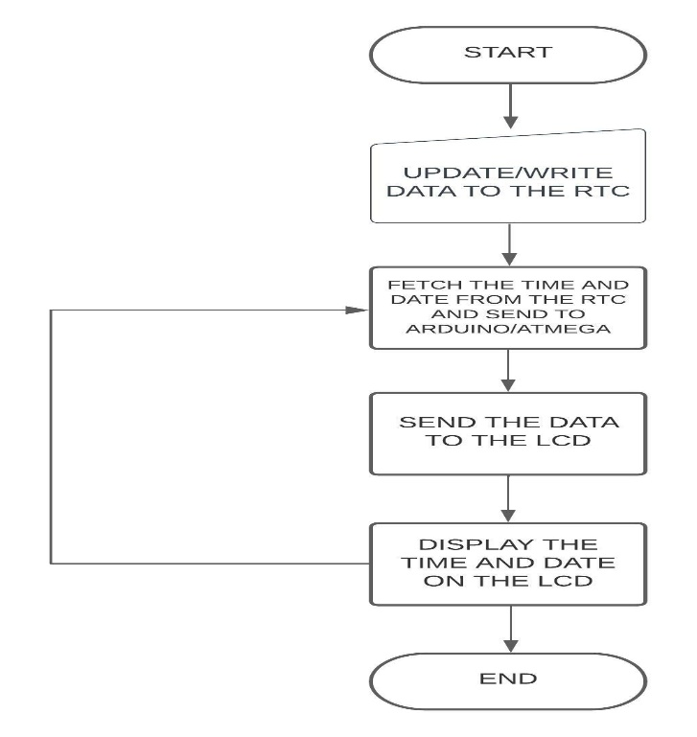
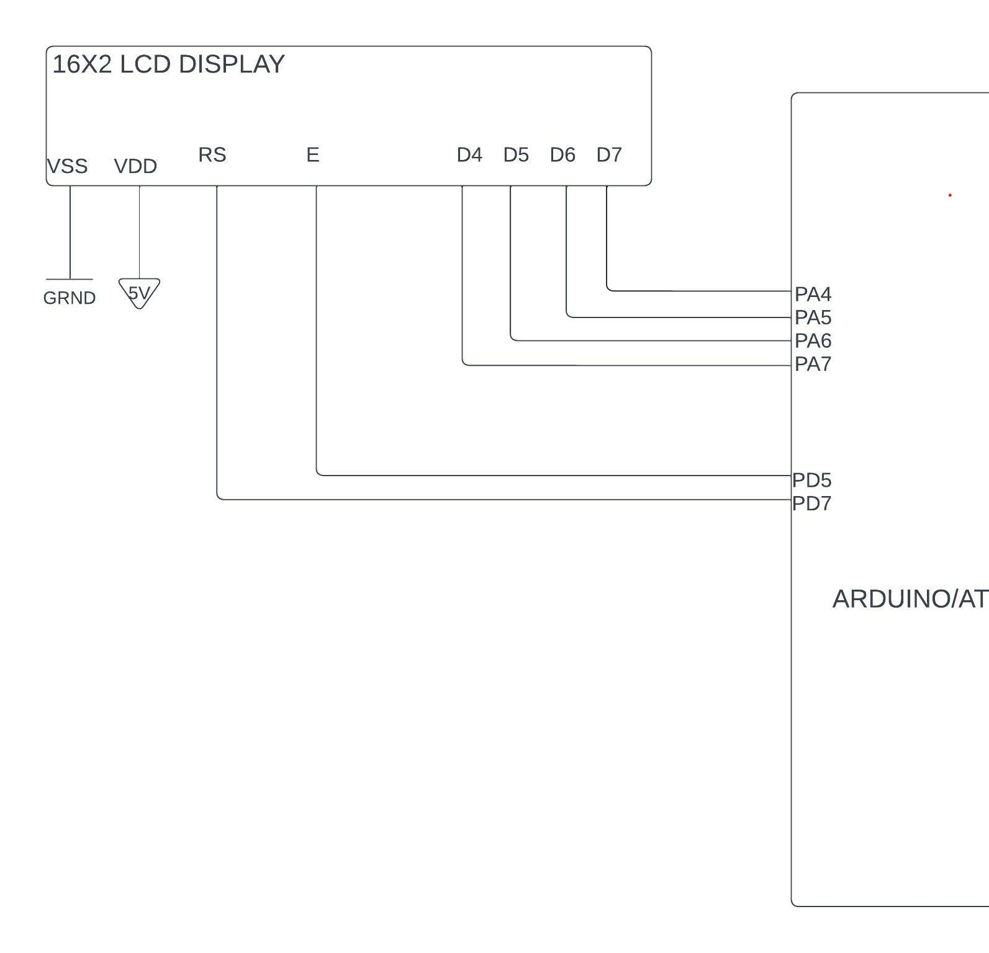
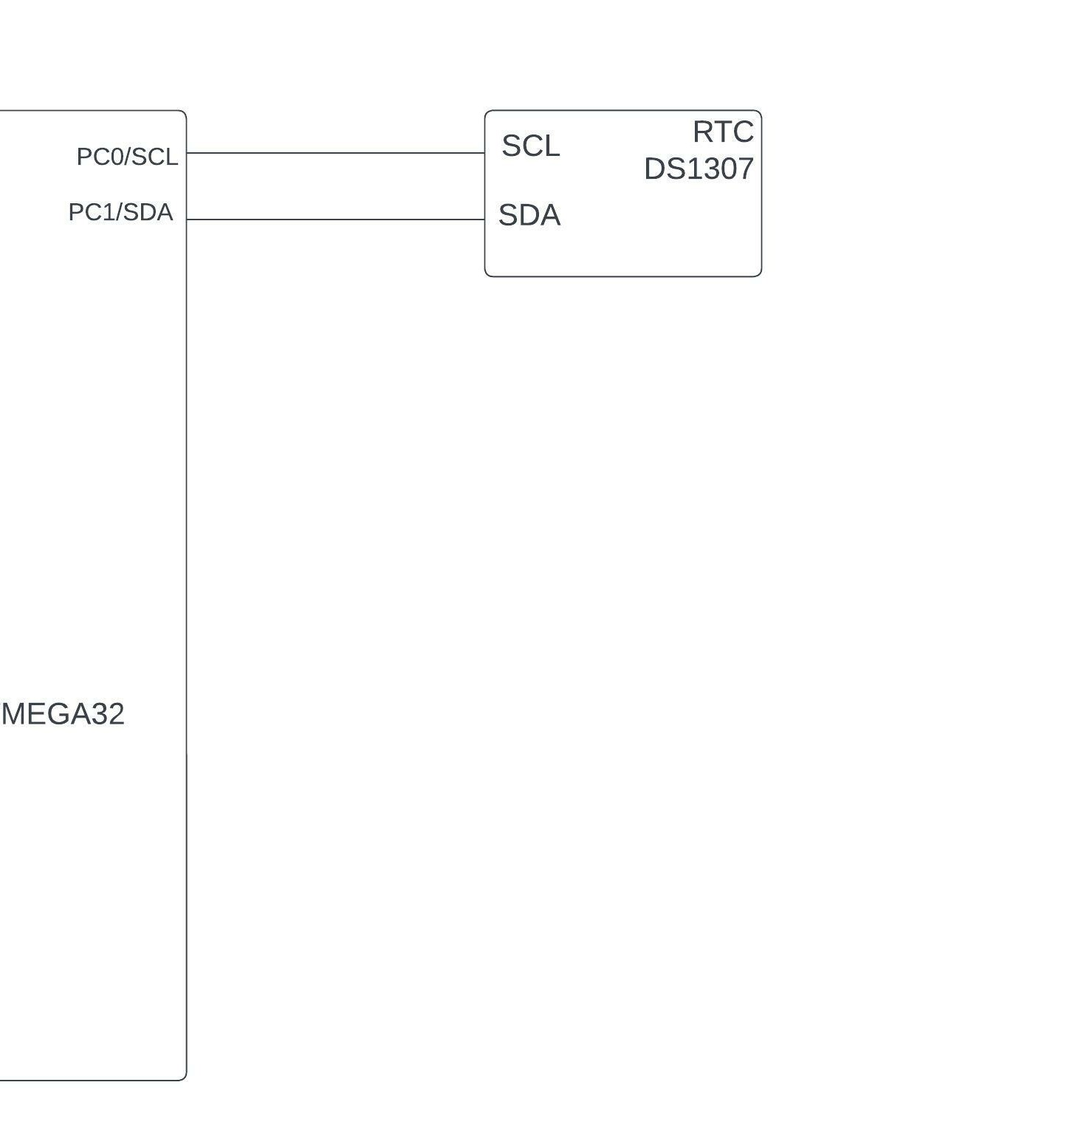
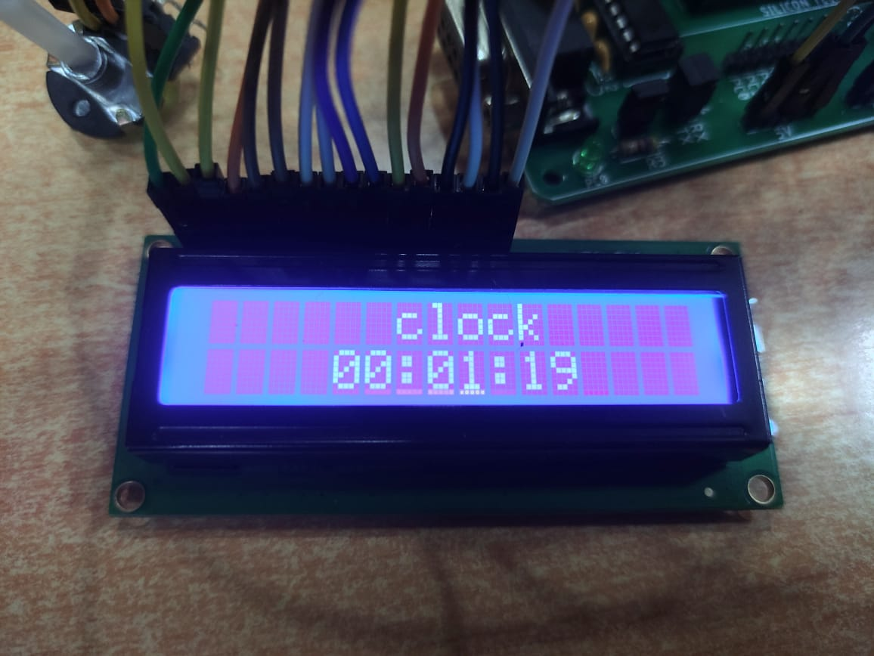
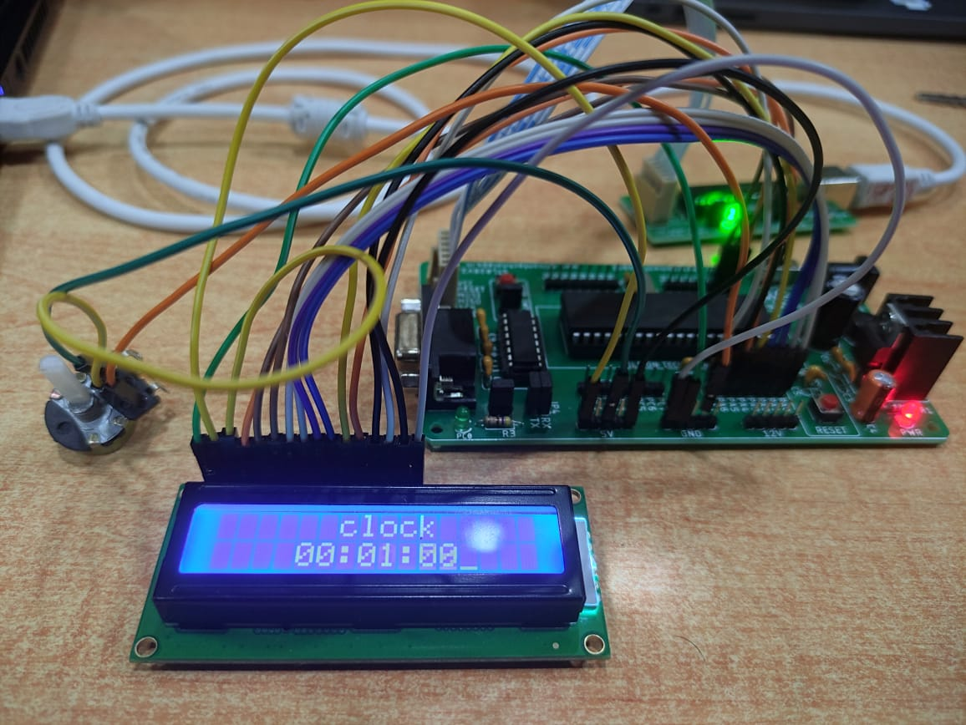
section-B
DIGITAL WALL
CLOCK
Sudeep Pingulkar(01fe20bcs070)
Siddhant Saptasagar(01fe20bcs101)
Sushma A.S(01fe20bcs091)
Reemak Dawe(01fe20bcs066)
School of Computer Science and Engineering
Problem statement
Methodology
The AIM of the project is to display time on LCD based screen using AVR Microcontroller Atmega32 and DS1307RTC
1)Digital Clock on ATMEGA 32
>This system consists of a LCD screen which is controlled by using ATMEGA32. The properties of a clock are passed on to LCD by Arduino UNO through the ‘FOR’ loop of the program code. >When the power supply is ON, the clock displays the initialized time on the LCD & once it enters in OFF state, the time gets reset to the initialized time.
2)Digital Clock with DS1307 RTC on Arduino UNO
>This system consists of a 16X2 LCD screen, Arduino UNO & DS1307 RTC chip which keeps track of the seconds, minutes, hours, day, month and year. This chip feeds the AVR with the real time parameters. The fed parameters are then displayed in the simple LCD screen. The RTC is programmed initially with the desired values such as seconds, minutes, hours and so on through I2C interface. After writing into the chip , it starts tracking the time which will be read and displayed in the LCD screen. It contains a 3V cell due to which it runs even after power failure & when power is reconnected, it displays the real time irrespective to the time and duration it was in off state.
Results
Flow chart Block diagram
The Time is displayed on the lcd in format Hour:Minutes:Seconds
Digital Wall clock on PCB using AVR Microcontroller Atmega32 and DS1307RTC
Objectives
Implementing of Digital Clock with AVR Atmega32 Microcontroller and 16X2 LCD screen.
To make a digital clock using RTC such even after power failure & when power is reconnected, it displays the real time irrespective to the time and duration it was in off state.
Applications & Contribution
Conclusions
Digital clock tends to make the user's life easier as even if the clock stays in OFF state for a longer period, it will be not necessary for the user to set time again & again.
Sudeep :LCD interfacing,AVR coding,Proteus.
Sushma :Model Designing,report/poster.
Siddhant :AVR/linux coding , LCD interfacing.
Reemak: Proteus simulation,report/poster.
The automated digital clock system will reduce human effort and will give an advanced and accurate time as a result.
References
1)www.electrosome.com/interfacing-lcd-atmega32-microcontroller-atmel-studio
2)https://youtu.be/E6wkvTG2Ofs
Literature survey
As the technology is getting more advanced ,to cope with that our project of Digital wall clock helps to read accurate time and gives stable performance than the traditional clock.

