Slide 1
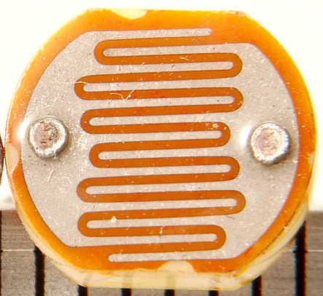
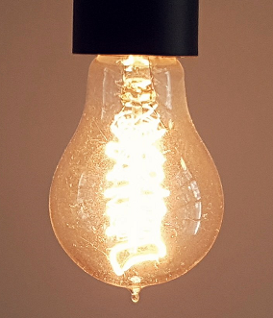

Scalable IoT with Accessors <name list>
IoT is at the “Personal Flowchart of Things” stage.
Given a stream of data from networked devices, define if/then rules.
How to scale to Internet of Everything? Need support for:
Extreme heterogeneity: Device capabilities, physical scale, interactions
Control systems: Real-time, control loops
Robustness: Testing, graceful degradation, security
We can’t micromanage our way out of this…
Dark?

