Slide 1

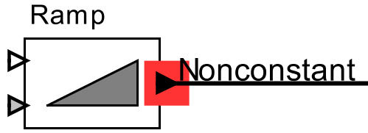
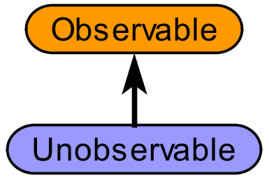
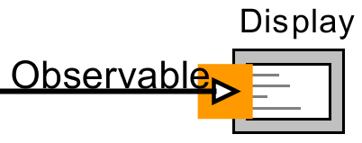
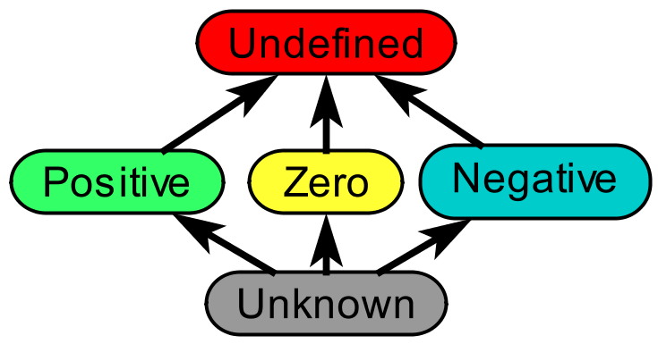
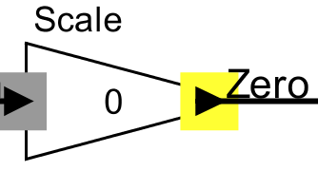
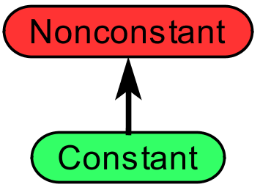
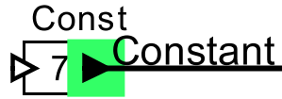
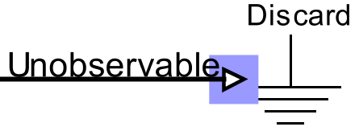
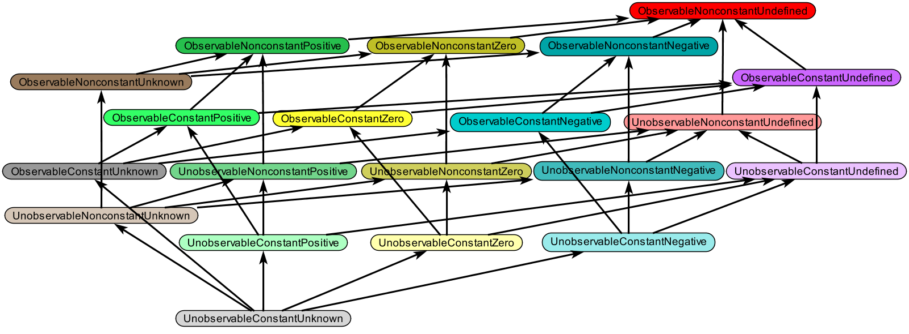
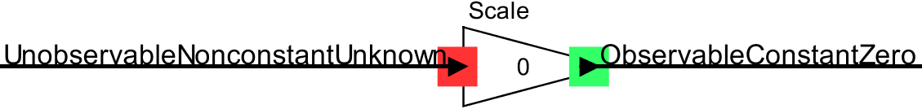
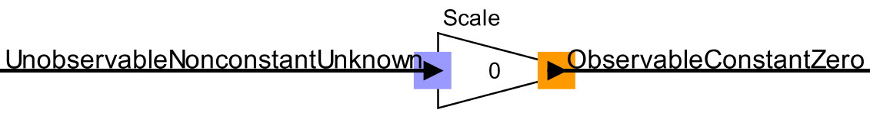
Lattice Composition
Elizabeth Latronico,
Charles Shelton (Bosch)
Ben Lickly, Edward Lee (Berkeley)
Learn more!
Try the ptolemy.data.ontologies package
Publication: “Scalable Semantic Annotation using
Lattice-based Ontologies”, MODELS 2009
Motivation
Ontologies can be used to analyze models. The developer defines lattices plus actor constraint rules. Here are some examples:
Constant / Non-constant Observability Abstract Interpretation (for scalar values)
If an ontology is a lattice, the Rehof and Mogensen algorithm performs model analysis in linear time (“Tractable Constraints in Finite Semilattices”, 1996)
(Linear to the number of constraints, for finite height lattices)
Why compose lattices?
A product lattice can be more powerful than a set of orthogonal individual lattices
(Click and Cooper, “Combining Analyses, Combining Optimizations”, 1995)
The original rules from all sub-lattices are inherited
The developer writes a few new rules taking advantage of all sub-lattices
This approach Supports multiple developers, Minimizes dependencies, and Gives maximum analysis power
Current status and objectives
The product lattice is:
Automatically created from sub-lattices
Checked to ensure that the result is also a lattice
The output of a Ramp actor can change
The input to a Display actor is observable
The output of a
multiplication by zero
is zero
A Const actor’s
output is constant
A Discard actor’s input
can not be observed
Product Lattice
The output of a multiply
by zero is constant
The input to a multiply be zero operation is unobservable
Remaining challenges include:
Allowing the user to edit the product lattice, especially Top and Bottom concepts
Some concepts in the product lattice don’t make sense. Allow users to note these with acceptance criteria
Combining finite and infinite width lattices
Combining inherited and new rules and ensuring monotonicity
February 17, 2011
Center for Hybrid and Embedded Software Systems

