Slide 1

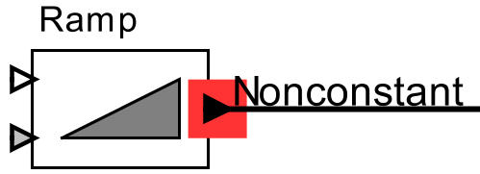
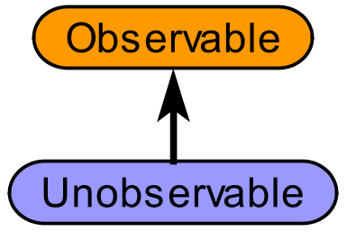
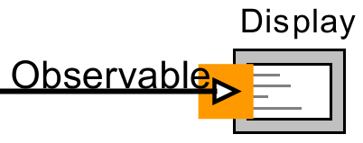
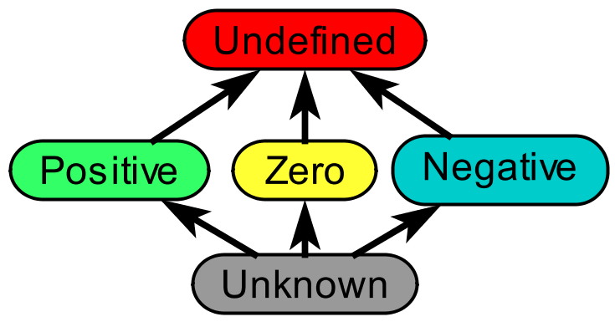
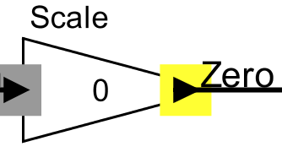
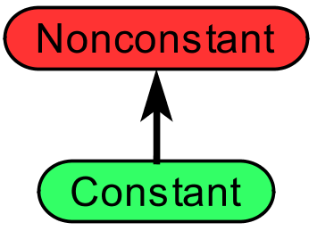
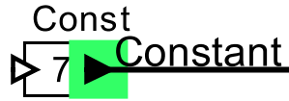
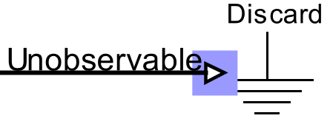
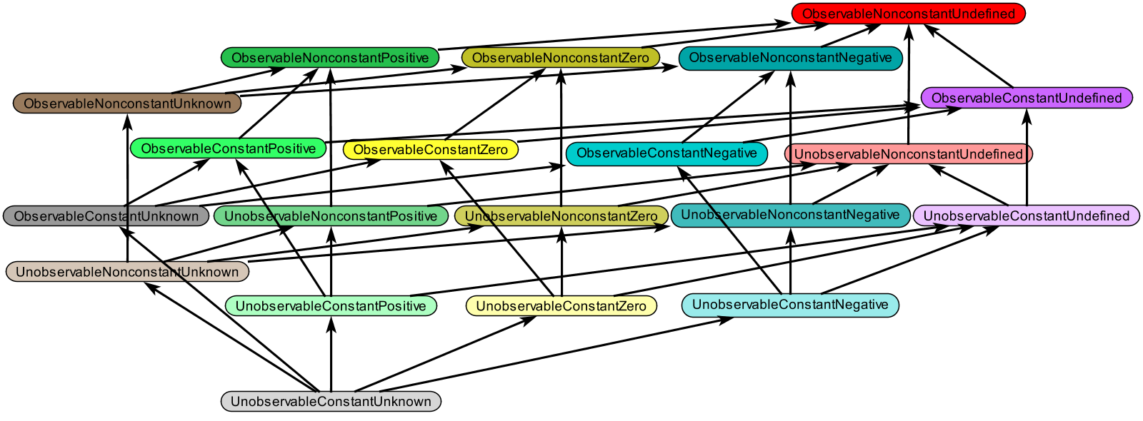
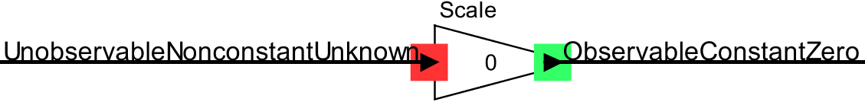
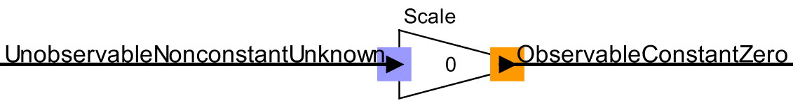
Lattice Composition for Ontology Analysis
Elizabeth Latronico,
Charles Shelton (Bosch)
Ben Lickly, Edward Lee (Berkeley)
Learn more!
Try the ptolemy.data.ontologies package.
Publication: “Scalable Semantic Annotation using
Lattice-based Ontologies”, MODELS 2009
Motivation
Ontologies can be used to analyze models. A developer defines lattices plus actor constraint rules. Here are some examples:
Constant / Non-constant Observability Abstract Interpretation (for scalar values)
If an ontology is a lattice, the Rehof and Mogensen algorithm performs model analysis in linear time (“Tractable Constraints in Finite Semilattices”, 1996).
(Time is linear in the number of constraints, for finite height lattices.)
Why compose lattices?
A product lattice can be more powerful than a set of orthogonal individual lattices
(Click and Cooper, “Combining Analyses, Combining Optimizations”, 1995).
The original rules from all sub-lattices are inherited.
The developer writes a few new rules taking advantage of all sub-lattices.
This approach Supports multiple developers, Minimizes dependencies, and Gives maximum analysis power.
Current status and objectives
The product lattice is:
Automatically created from sub-lattices.
Checked to ensure that the result is also a lattice.
The output of a Ramp actor can change.
The input to a Display actor is observable.
The output of a
multiplication by zero
is zero.
A Const actor’s
output is constant.
A Discard actor’s input
can not be observed.
Product Lattice
The output of a multiply
by zero is constant.
The input to a multiply be zero operation is unobservable.
Remaining challenges include:
Allowing the user to edit the product lattice, especially Top and Bottom concepts.
Some concepts in the product lattice don’t make sense. Allow users to note these with acceptance criteria.
Combining finite and infinite width lattices.
Combining inherited and new rules and ensuring monotonicity.
February 17, 2011
Center for Hybrid and Embedded Software Systems

