Slide 1


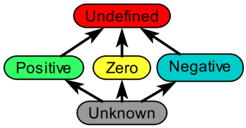
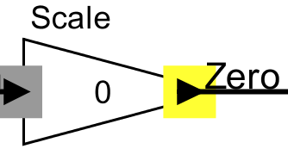
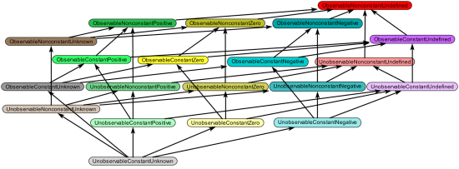
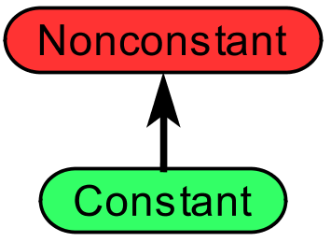
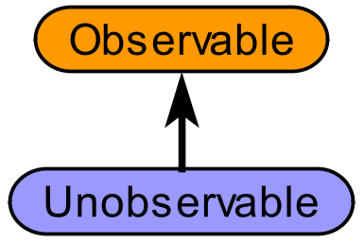


Lattice Composition for Ontology Analysis
How to support multiple developers while maintaining separation of concerns?
Lattice composition to the rescue!
  Compute cross-product
  of individual ontologies
  Inherit most rules
  from sub-ontologies
  Add a few rules for
  composed ontology
“I invented the
perfect ontology
and analysis rules
for my problem.“
“I’d like to combine Ben’s ontology with another for better analysis. I’ll just create one big ontology.“
“Oh no! I have to rewrite
all of my rules to use
the big ontology.
I’ll never graduate <sigh>.“
The output of a
multiplication by zero
is zero.
x
x
=
“Perfect! My
original ontology
is unmodified.”
“Great! Auto-composition and inheriting rules
saves me a lot of time.”
Elizabeth Latronico, Charles Shelton (Bosch), Ben Lickly, Edward Lee (Berkeley) | 2/9/2011 | © 2011 Robert Bosch LLC and affiliates. All rights reserved.

