Slide 1
Modeling an Internal Combustion Engine Under Sliding Mode Control as a Hybrid System
Jay Barton

Slide 2
References and Acknowledgments
Primary References:
“Reducing Automotive Engine Speed Fluctuations at Idle”; Shim, Park, Khargonekar, Ribbens; IEEE Transactions on Control Systems Technology, 1996
“Injector Characteristics Estimation for Spark Ignition Engines”; Benvenuti, Di Benedetto, Rossi, Sangiovanni-Vincentelli; Proceedings of the 37th IEEE Conference on Decision and Control, 1998
“A Hybrid Approach to the Fast Positive Force Transient Tracking Problem in Automotive Engine Control”; Balluchi, Di Benedetto, Pinello, Sangiovanni-Vincentelli; Proceedings of the 37th IEEE Conference on Decision and Control, 1998
“Automotive Engine Control and Hybrid Systems: Challenges and Opportunities”; Balluchi, Benvenuti, Di Benedetto, Pinello, Sangiovanni-Vincentelli; Proceedings of the IEEE, 2000
Special Thanks to (conspired, perspired, and nearly expired with):
Xiaojun Liu
Christopher (?)
Claudio Pinello

Slide 3


Engine/Controller Block Diagram
φ_{sp}
φ_{co}
Emissions Constraints
Acceleration Constraints
T_{i}
Fuel
Injector
T_{L}
Controller
T
-
T_{net}
Drive
Train
ω_{cs,des}
Cylinder(s)
+
+
e
α_{des}
Stepper
Motor
α
Intake
Manifold
Human
Driver
-
φ_{cs}
ω_{cs}

Slide 4
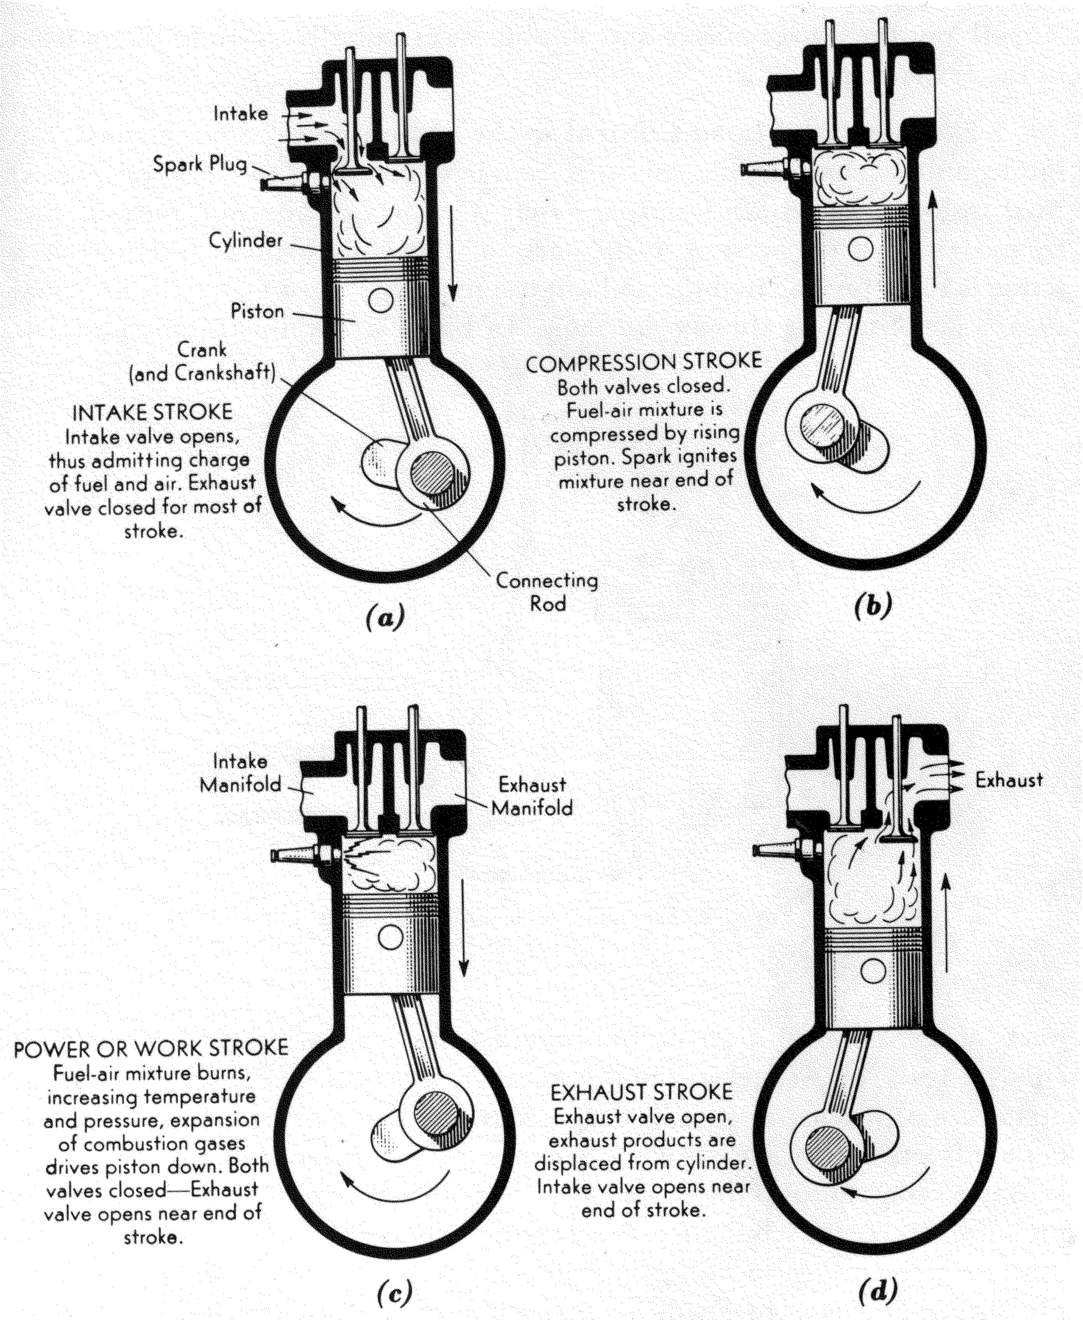
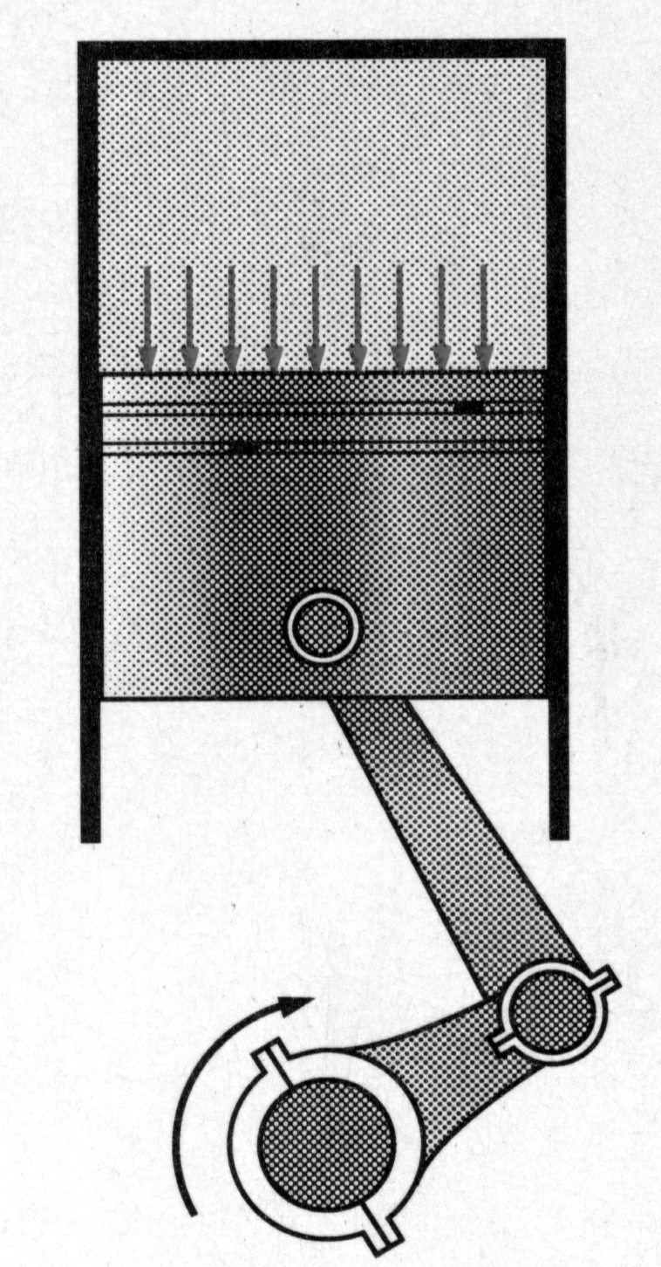
The Four Stroke Cycle
φ_{co}
Piston Offset Angle

Slide 5
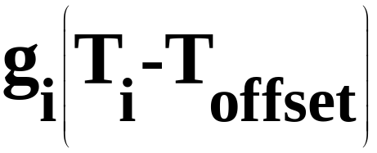
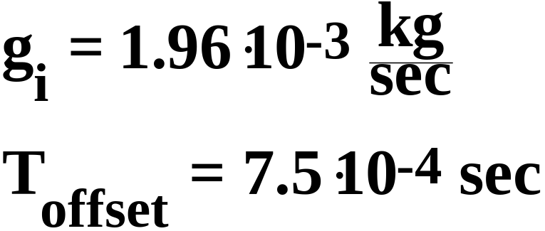
Fuel Injector
T_{i}
m_{f}

Slide 6
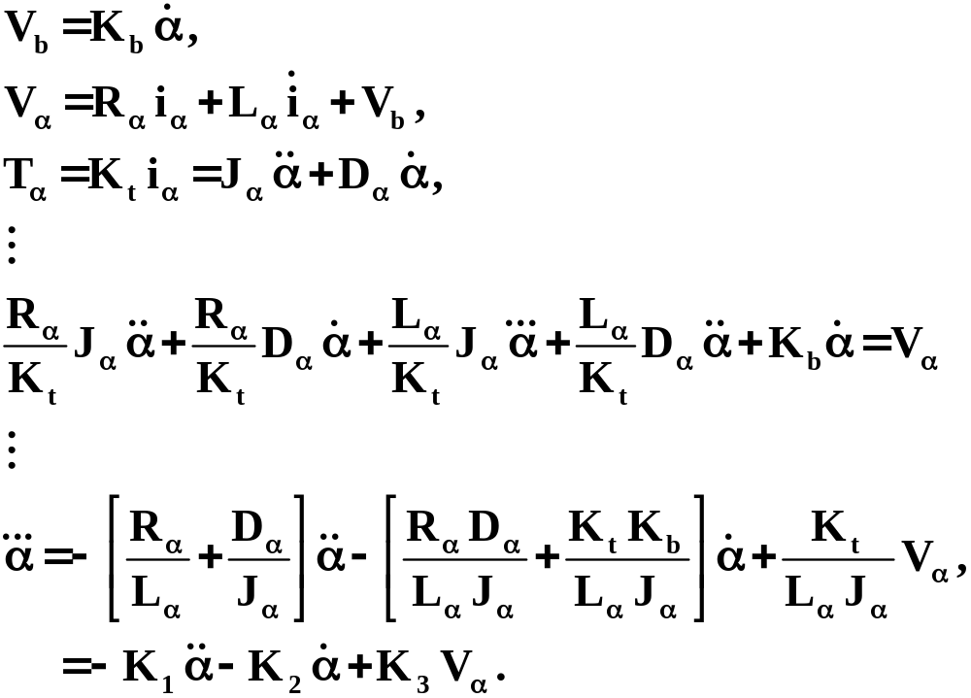
Motor Governing Equations

Slide 7






Stepper Motor Block Diagram
K₃
-
α_{des}
+
-
V_{α}
G
K₁
+
-
K₂
Motor

Slide 8
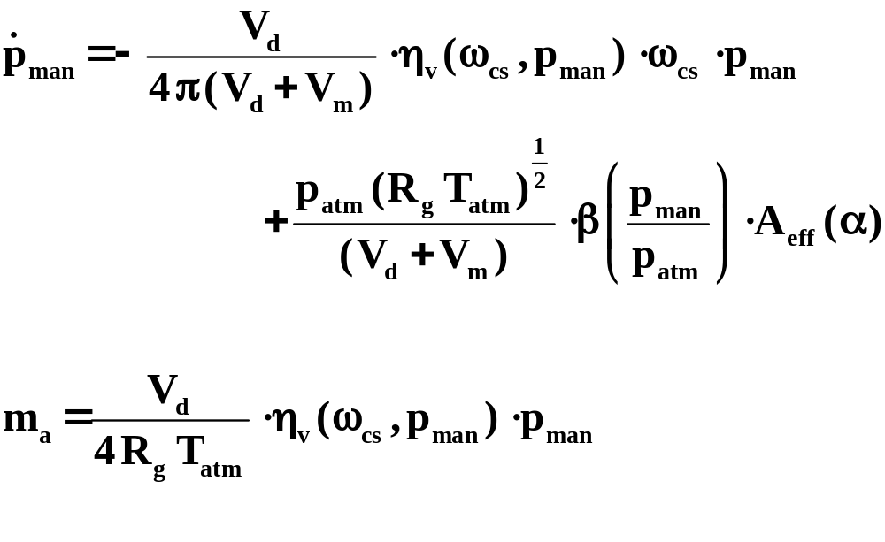
Intake Manifold Governing Equations

Slide 9
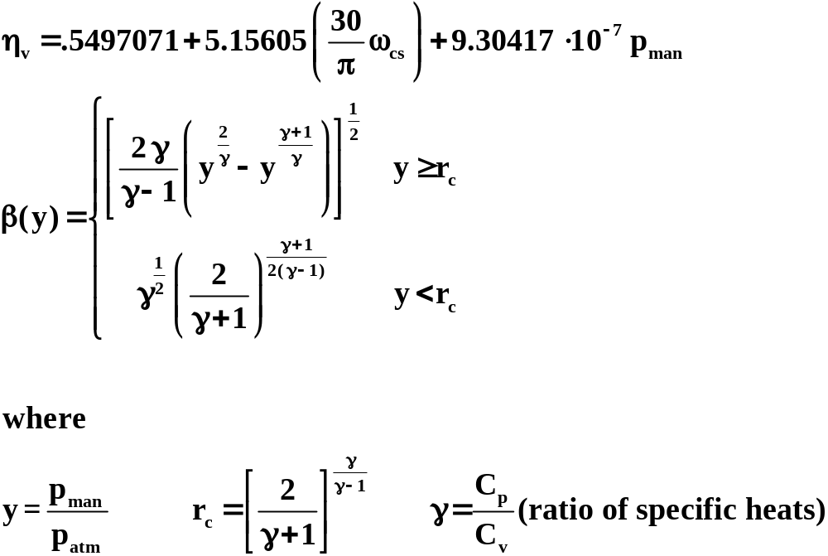
Intake Manifold Governing Equations

Slide 10
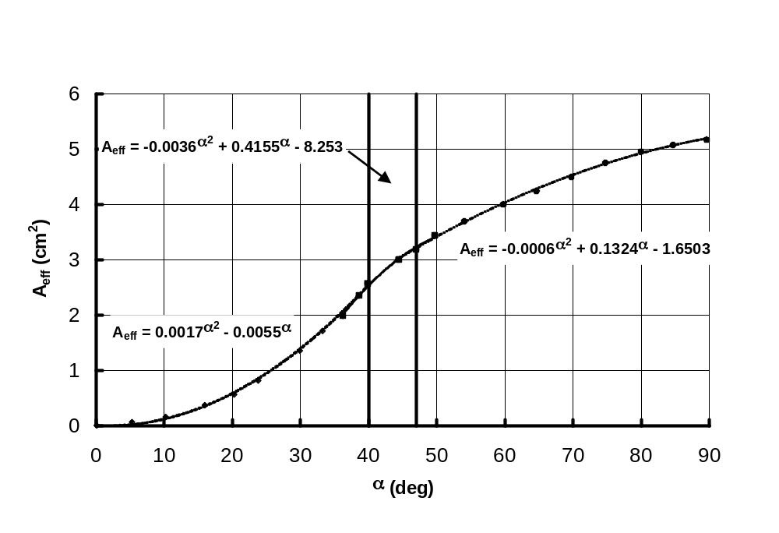
Intake Manifold Governing Equations
Effective Throat Area

Slide 11


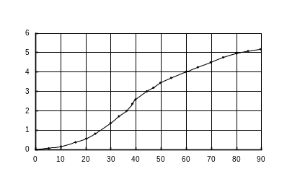
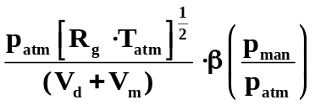
Intake Manifold Block Diagram
m_{a}
ω_{cs}
+
p_{man}
+
α

Slide 12


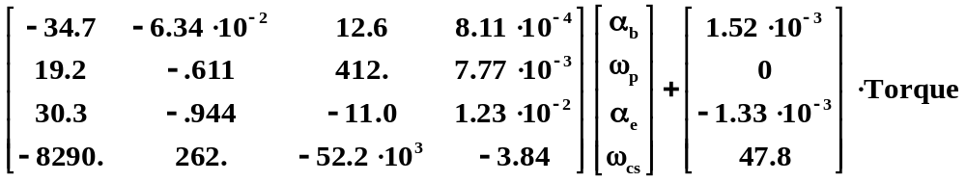









Drive Train Block Diagram
Torque
6

Slide 13
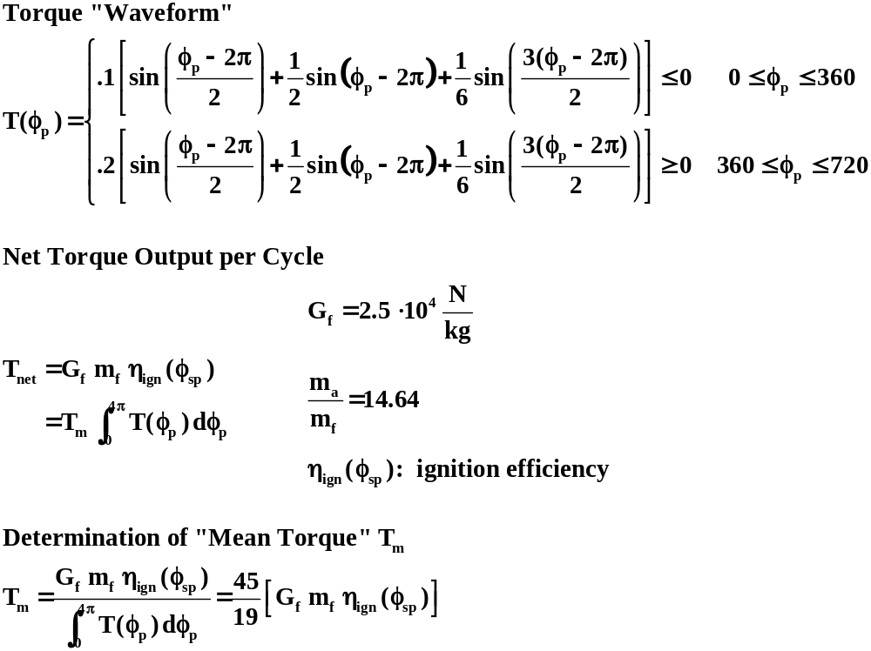
Torque Generation

Slide 14
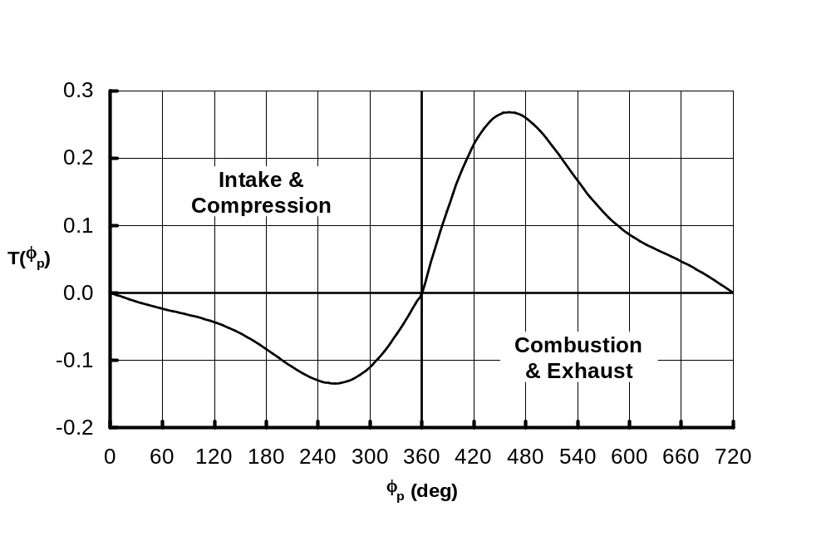
Torque Waveform

Slide 15
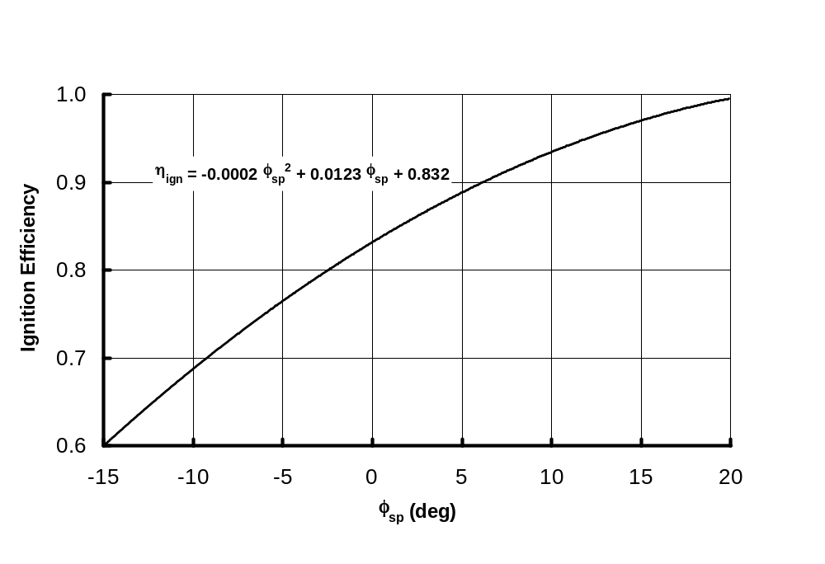
Ignition Efficiency

Slide 16


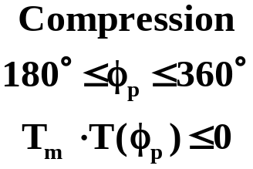
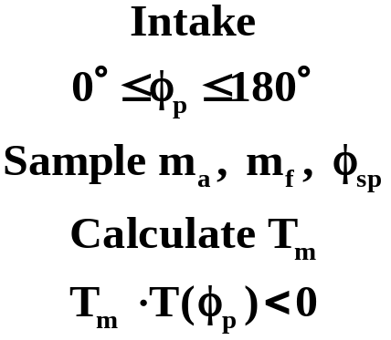
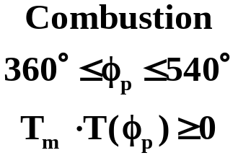
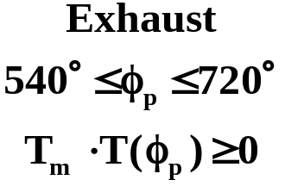



Cylinder Model
φ_{sp}
m_{f}
Torque
m_{a}
φ_{co}
φ_{cs}
+
-
φ_{p}

Slide 17
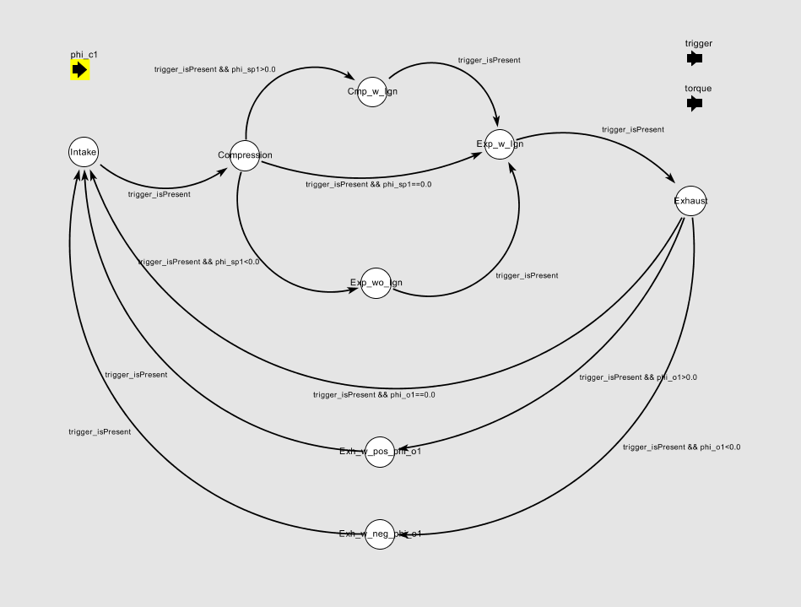
Cylinder Module in Ptolemy

