Slide 1
Process-Based Software Components for Networked Embedded Systems
Edward A. Lee, PI
UC Berkeley
Core Technical Team (Mobies, SEC, and GSRC):
Christopher Hylands, Mary P. Stewart, Joern Janneck, Sonia Sachs,
Elaine Cheong, Chamberlain Fong, Jie Liu, Xiaojun Liu,
Stephen Neuendorffer, Brian K. Vogel, Paul Whitaker, Yuhong Xiong
Mobies PI Meeting
New Orleans, January 23-25, 2001

Slide 2
Status Update
Ptolemy II version 1.0 alpha available soon
  A platform that can promote collaboration
  Open source, open architecture
  Rated code (red, yellow, green)
  Core code is very high quality (green)
  Code is written to be read
  Extensible GUI (all red, currently)
Commercial support organization
  recently formed: Agile Design

Slide 3
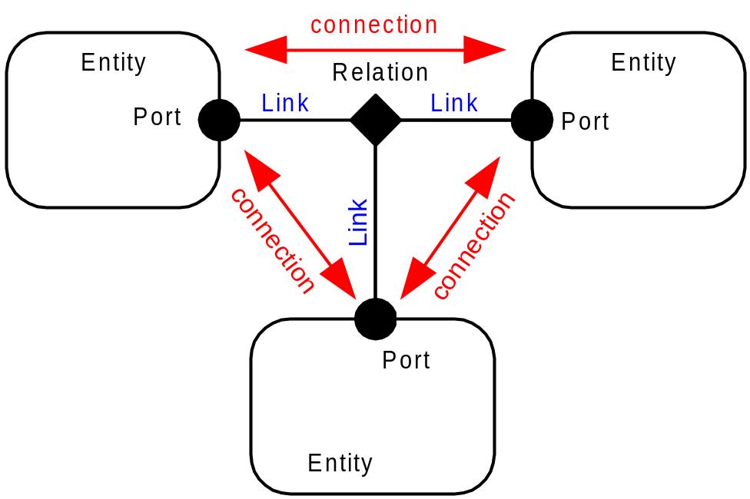
Components and their Relationships
The Ptolemy II kernel provides an abstract syntax - clustered graphs - that is well suited to a wide variety of component-based modeling strategies, ranging from state machines to process networks.

Slide 4
Hierarchy - Construct components from finer grain components.
dangling
Relation
transparent
AtomicEntity
Port
opaque Port
transparent
Port
transparent CompositeEntity
toplevel CompositeEntity

Slide 5
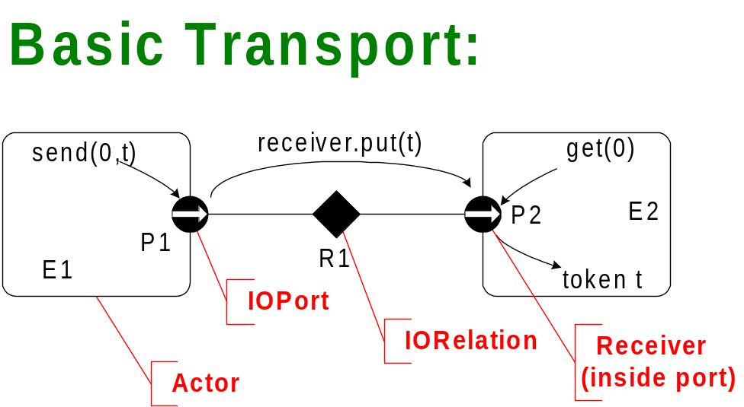
Actor Package – Infrastructure for Producer/Consumer Components
Services in the Infrastructure:
broadcast
multicast
busses
mutations
clustering
parameterization
typing
polymorphism

Slide 6
Domains – Provide semantic models for component interactions
CSP – concurrent threads with rendezvous
CT – continuous-time modeling
DE – discrete-event systems
DDE – distributed discrete events
FSM – finite state machines
DT – discrete time (cycle driven) *
Giotto – synchronous periodic *
PN – process networks
RTOS – priority-driven reactive models *
SDF – synchronous dataflow
SR – synchronous/reactive **
* New domains in Ptolemy II
** Not yet available in Ptolemy II

Slide 7
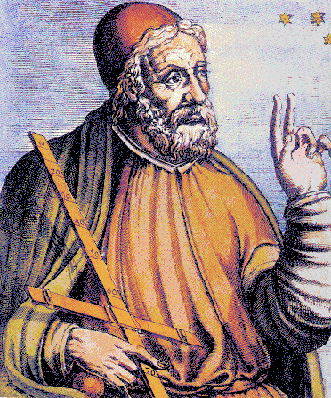
Ptolemy II – Our Software Laboratory
Ptolemy II –
Emphasis is on building a framework supporting experimentation with models of computation and their interactions.
http://ptolemy.eecs.berkeley.edu

Slide 8
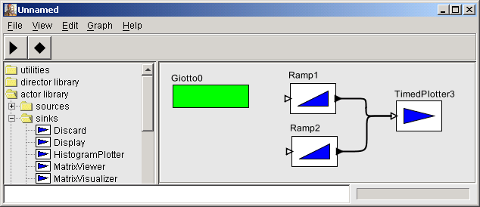
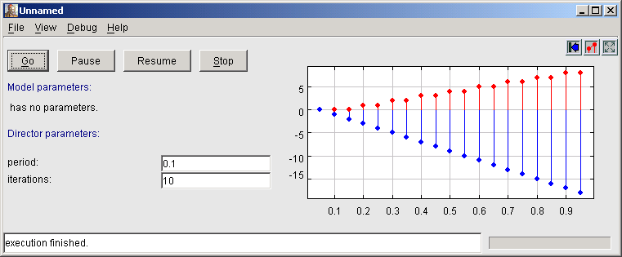
Exploring Giotto Semantics
Giotto is an experimental hard-real time modeling domain developed by Tom Henzinger and his group. Ptolemy II is being used to study its semantics.

Slide 9
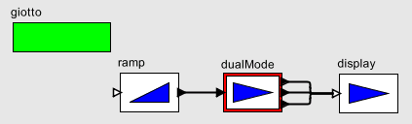
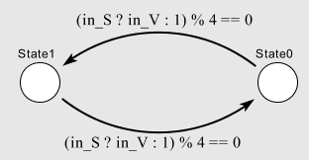
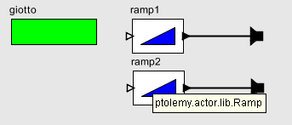
Modal Giotto Model
The FSM domain in Ptolemy II can be combined with the Giotto director to get modal synchronous models.

Slide 10
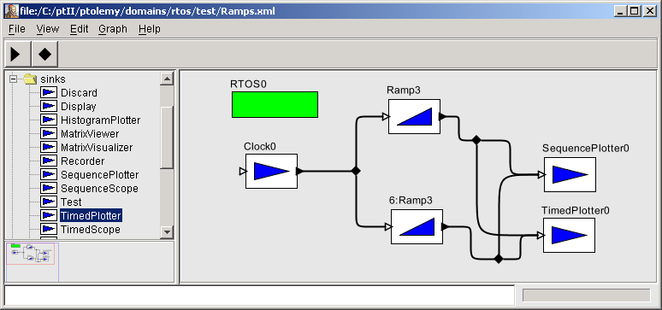
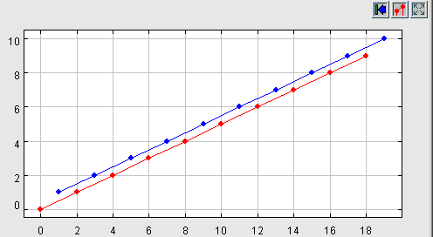
Exploring Hierarchical RTOS Semantics
Working with the Boeing SEC team, we created a (very) preliminary RTOS domain with semantics similar to OCP build 1.

Slide 11
Hierarchical Real-Time Scheduling
Non preemptive
  + Allows precise interactions with other domains
  + Allows precise mode changes
  + (More) predictable behavior
  - Requires fine-grain partitioning of components
Issues
  Document precise semantics
    How are equal priorities handled?
  Plug-in API for scheduling
    Dynamic priorities & soft real time
  Delegation of coarse-grain computations
    To classical real-time processes (?)

Slide 12
RTOS-Based Design is a Fixed
Three-Level Hierarchy
Network
RTOS
RTOS
process
process
process
process
Problems:
  With priority-based preemptive scheduling, how can you get precise mode changes?
  Given a validated design for a subsystem, how do you insert it in a system without invalidating it?
This approach is not compositional!

Slide 13
Hierarchical, Compositional Models
Domain
Schedulers (Directors) are nested hierarchically, each interacting with components through the Executable interface. Directors themselves implement this same interface, so the model is compositional.
Domain
Domain

Slide 14
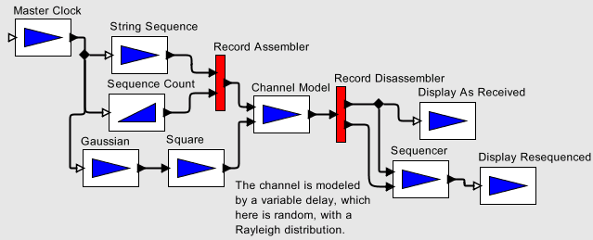
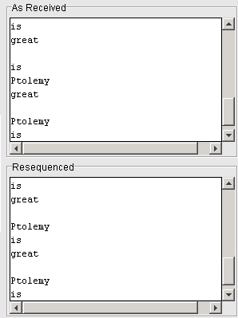
More Mature Domain 1:
Discrete Events
The DE domain uses an event queue to process events in chronological order, as in VHDL, Verilog, and a number of network simulation languages.

Slide 15
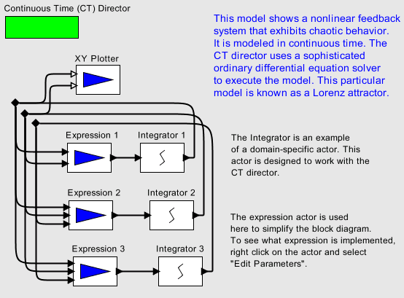
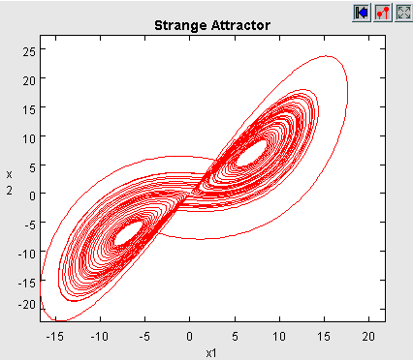
More Mature Domain 2:
Continuous Time
CT uses an ODE solver to model continuous-time systems.

Slide 16
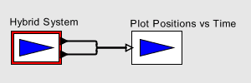
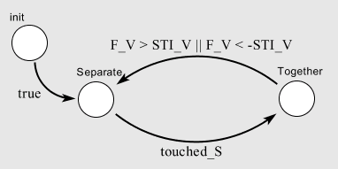
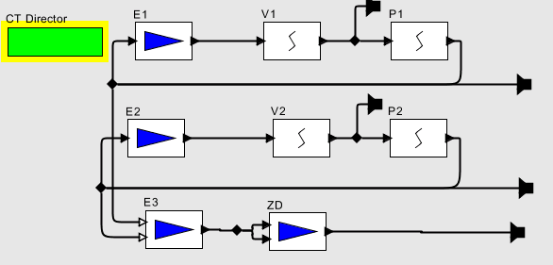
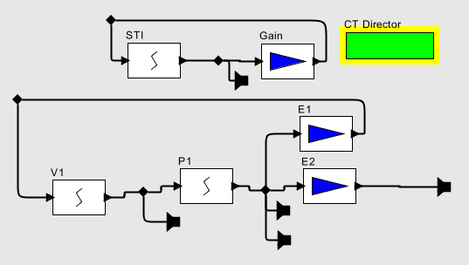
Hybrid System Models:
CT + FSM

Slide 17
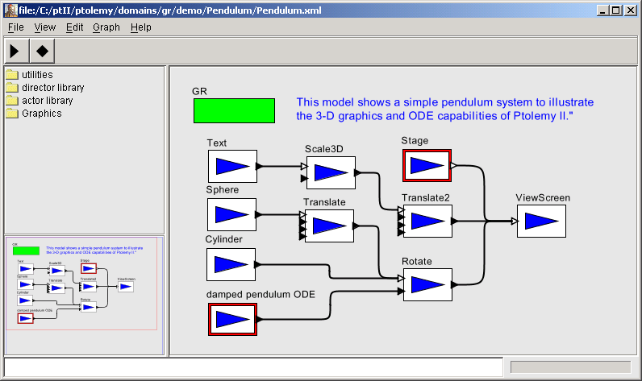
Experimental Domain-Specific Domain:
GR, for 3D Graphics
The top level domain is GR, synchronous semantics tuned to 3-D graphics

Slide 18
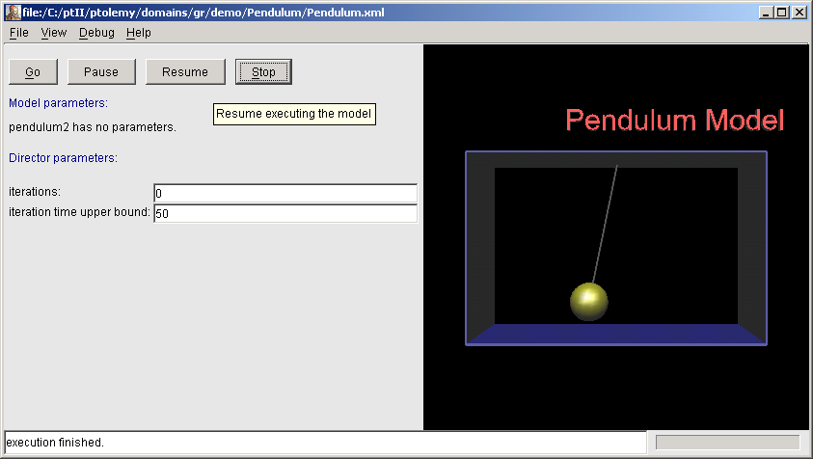
Animated Pendulum Model
The pendulum model drives transformations of the graphics model components, and Java3D is used to render the result.

Slide 19
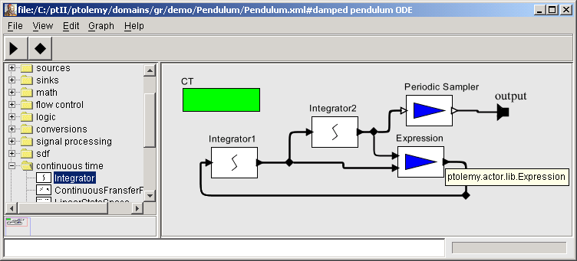
Physical Dynamics Realized in CT
The pendulum dynamics are modeled in the CT domain, which uses an ODE solver, as in Simulink.

Slide 20
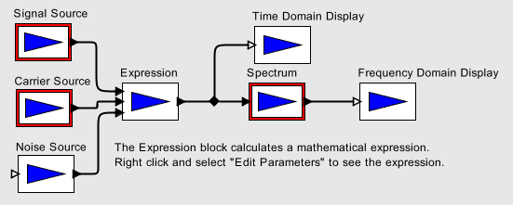
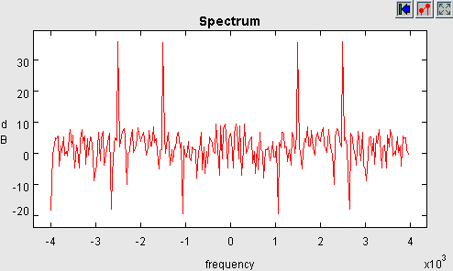
More Mature Domains 3:
Synchronous Dataflow
The SDF domain does static dataflow analysis to construct compile-time schedules, and analyze for deadlock and bounded memory.

Slide 21
Hierarchical Heterogeneity and the Concept of “Domain”
Directors are domain-specific. A composite actor with a director becomes opaque. The Manager is domain-independent.
Opaque
Transparent
Composite
Composite
M: Manager
Actor
Actor
E0
D1: local director
E2
D2: local director
E3
E1
E4
E5
P1
P2
P5
P6
P3
P4
P7

Slide 22
Hierarchical Heterogeneity vs.
Amorphous Heterogeneity
Hierarchical
Amorphous
Color is a communication protocol only, which interacts in unpredictable ways with the flow of control.
Color is a domain, which defines both the flow of control and interaction protocols.

Slide 23
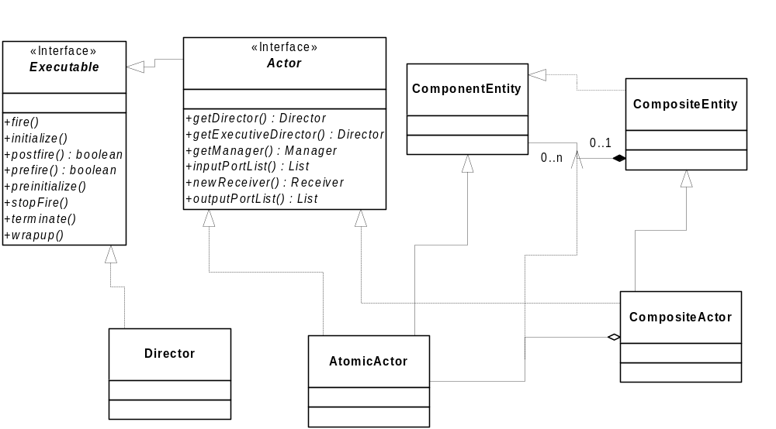
Basic Object Model for
Executable Components

Slide 24
Contrast with Current Practice
Processes or threads under RTOS control
  two or three level hierarchy
  limited control over flow of control (priorities)
  not compositional
UML notations for concurrency
  Active objects (threads, not compositional)
  Sequence diagrams (not scalable nor compositional)
  Statecharts (specialized synchronous concurrency)

Slide 25
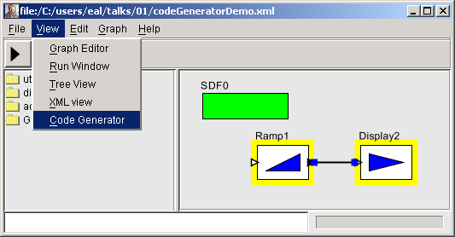
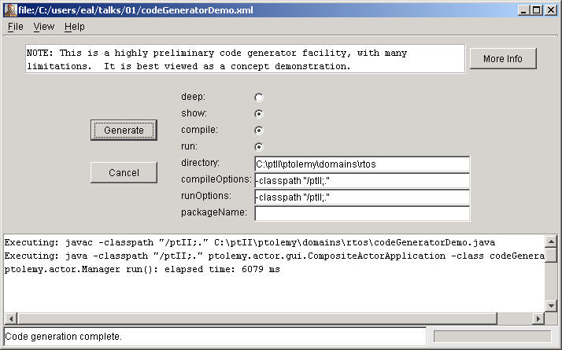
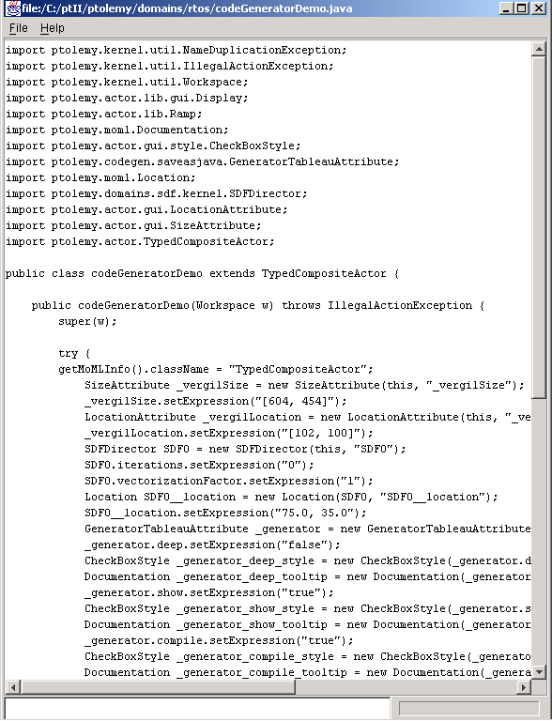
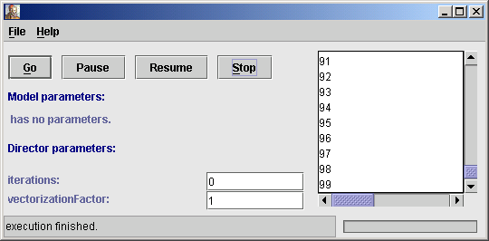
Preliminary Code Generator
“Shallow” and “Deep”
Code generator produces Java code from block diagrams.

Slide 26
Near Term Plans
Higher-order functions (with input from Yale & OGI)
Code generator solidification
System-level types codification
Visual interface solidification (esp. for FSMs)
Giotto semantics solidification
Giotto code generator for TTA
Hierarchical RTOS domain
Publish and subscribe to CORBA Event Channel
  (we have this for JavaSpaces)
Synchronous/Reactive domain
Dynamic Dataflow domain

Slide 27
Higher-Order Functions RFC
Token whose value is a model
  An actor with ports and parameters
Parameter values can be models
Apply actor with “model” parameter
Apply actor with “model” input port
Map combinator actor
Zip combinator actor
…
Our expectation is that these will vastly improve the expressiveness of visual syntaxes.

