Slide 1
The Future of
Embedded Software
Edward A. Lee
Professor, Chair of EE, and Associate Chair of EECS
UC Berkeley
ARTEMIS 2006 Annual Conference
Graz, Austria
May 22-24, 2006
Notes:
System-Level Design Languages: Orthogonalizing the Issues
Presenter: Edward A. Lee, UC Berkeley
Abstract:
System-level design languages (SLDLs) need to be equally comfortable with hardware, software, and problem-level models. The requirements are too broad to be adequately addressed by any single solution that we would recognize as a “language.” But the prospect of needing (or continuing to need) to use multiple incompatible languages to achieve a single system design is grim. In this talk, I outline an approach to achieving interoperability without a single monolithic standard language. Instead, orthogonal properties of a language are created and standardized separately. Specifically, an SLDL is divided into an abstract syntax, a system of syntactic transformations, a concrete syntax, an actor semantics, a semantics for the interaction of actors,and a type system. Each of these are roughly independent dimensions of a language, and two languages, tools, or frameworks may share identical designs in one or more dimensions. Interoperability can be achieved where practical, but does not become a straightjacket where impractical.

Slide 2
Abstract
While advances in software and hardware techniques of recent years have made things smaller, faster, and cheaper, they have done less to make things more predictable, precise, and safe. For embedded systems, these criteria are often more important, or even critical, to successful application of technologies. In this talk, I will examine the challenges facing the technical community in adapting software and hardware design methods to focus on predictability, precision, and safety. Particularly challenging are achieving understandable and predictable concurrency and timing precision in software-based systems.

Slide 3
Why Embedded Software?
Why Now?
“Information technology (IT) is on the verge of another revolution. Driven by the increasing capabilities and ever declining costs of computing and communications devices, IT is being embedded into a growing range of physical devices linked together through networks and will become ever more pervasive as the component technologies become smaller, faster, and cheaper... These networked systems of embedded computers ... have the potential to change radically the way people interact with their environment by linking together a range of devices and sensors that will allow information to be collected, shared, and processed in unprecedented ways. ... The use of [these embedded computers] throughout society could well dwarf previous milestones in the information revolution.”
National Research Council Report
Embedded Everywhere

Slide 4
The Key Obstacle to Progress:
Gap Between Systems and Computing
Traditional dynamic systems theory needs to adapt to better account for the behavior of software and networks.
Traditional computer science needs to adapt to embrace time, concurrency, and the continuum of physical processes.

Slide 5
The Next Systems Theory:
Simultaneously Physical and Computational
The standard model:
Embedded software is software on small computers. The technical problem is one of optimization (coping with limited resources).
The Berkeley model:
Embedded software is software integrated with physical processes. The technical problem is managing time and concurrency in computational systems.

Slide 6

Obstacles in Today’s Technology:
Consider Real Time
Electronics Technology Delivers Timeliness…
… and the overlaying software abstractions discard it.

Slide 7
Computation in the 20th Century
f : {0,1}∗ → {0,1}∗
A computation is a function that maps a finite sequence of bits into a finite sequence of bits.
No time
No concurrency

Slide 8
A Few 20th Century Innovations that Rely on Time Being Irrelevant
Programming languages
Caches
Virtual memory
Dynamic dispatch
Speculative execution
Power management (voltage scaling)
Memory management (garbage collection)
Just-in-time (JIT) compilation
Multitasking (threads and processes)
Networking (TCP)
Theory (computability, complexity)

Slide 9
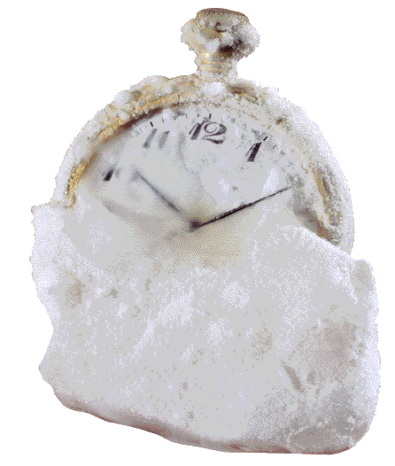
Some Approaches Addressing
Timeliness in Software
Put time into programming languages
  Promising start: Giotto, Discrete-event models, timed dataflow models
Rethink the OS/programming language split
  Promising start: TinyOS/nesC
Rethink the hardware/software split
  Promising start: FPGAs with programmable cores
Memory hierarchy with predictability
  Promising start: Scratchpad memories vs. caches
Memory management with predictability
  Promising start: Bounded pause time garbage collection
Predictable, controllable deep pipelines
  Promising start: Pipeline interleaving + stream-oriented languages
Predictable, controllable, understandable concurrency
  Promising start: Synchronous languages, SCADE
Networks with timing
  Promising start: Time triggered architectures, time synchronization
Computational dynamical systems theory
  Promising start: Hybrid systems, schedulability analysis

Slide 10
Obstacles in Today’s Technology:
Consider Concurrency
The most common concurrency model is based on:
threads,
semaphores, and
mutual exclusion locks
But…
These methods date to the 1960’s (e.g. [Dijkstra]).
Tauntingly simple rules (e.g. always grab locks in the same order [Lea]) are impossible to apply in practice.
Formal methods can expose flaws, but cannot make programs understandable.

Slide 11
Obstacles in Today’s Technology:
Consider Concurrency
Sutter and Larus observe:
“humans are quickly overwhelmed by concurrency and find it much more difficult to reason about concurrent than sequential code. Even careful people miss possible interleavings among even simple collections of partially ordered operations.”
H. Sutter and J. Larus. Software and the concurrency revolution. ACM Queue, 3(7), 2005.
Does this mean that it is hard for humans to reason about concurrency?
If so, we would not be able to function in the (highly concurrent) physical world.

Slide 12
Most Concurrent Software is Built
Using Threads
Threads are sequential processes that share memory.
Threads are either the implicit or explicit model in
  Most real-time operating systems (RTOS’s)
  Device drivers
  Most concurrent programs in C++ or Java

Slide 13
Consider a Simple Example
“The Observer pattern defines a one-to-many dependency between a subject object and any number of observer objects so that when the subject object changes state, all its observer objects are notified and updated automatically.”
Design Patterns, Eric Gamma, Richard Helm, Ralph Johnson, John Vlissides (Addison-Wesley Publishing Co., 1995. ISBN: 0201633612):

Slide 14
Example: Observer Pattern in Java
public void addListener(listener) {…}
public void setValue(newValue) {
myValue = newValue;
for (int i = 0; i < myListeners.length; i++) {
myListeners[i].valueChanged(newValue)
}
}
Will this work in a multithreaded context?
Thanks to Mark S. Miller for the details of this example.

Slide 15
Example: Observer Pattern
With Mutual Exclusion (Mutexes)
public synchronized void addListener(listener) {…}
public synchronized void setValue(newValue) {
myValue = newValue;
for (int i = 0; i < myListeners.length; i++) {
myListeners[i].valueChanged(newValue)
}
}
Javasoft recommends against this. What’s wrong with it?

Slide 16
Mutexes using Monitors are Minefields
public synchronized void addListener(listener) {…}
public synchronized void setValue(newValue) {
myValue = newValue;
for (int i = 0; i < myListeners.length; i++) {
myListeners[i].valueChanged(newValue)
}
}
valueChanged() may attempt to acquire a lock on some other object and stall. If the holder of that lock calls addListener(), deadlock!

Slide 17
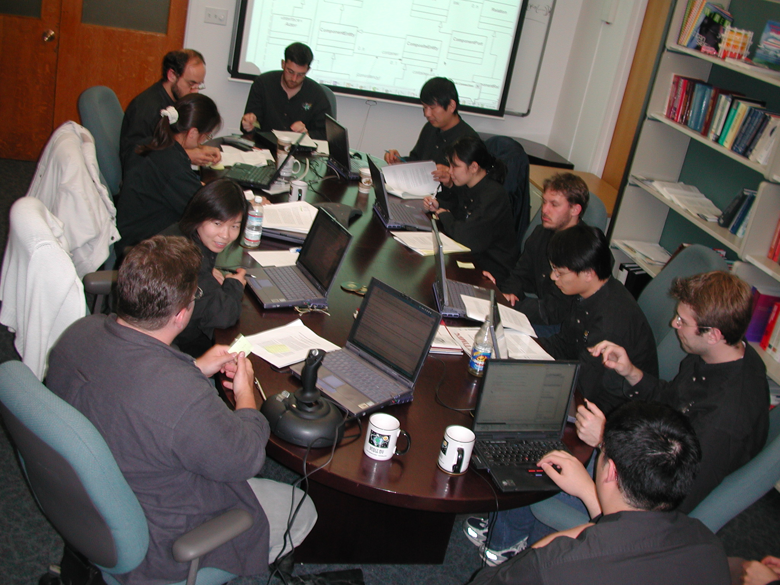
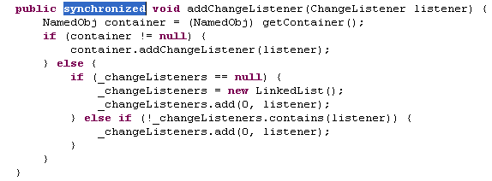
A Story: Ptolemy Project Code Review Introduced Deadlock

Slide 18
Simple Observer Pattern Becomes
Not So Simple
public synchronized void addListener(listener) {…}
public void setValue(newValue) {
synchronized(this) {
myValue = newValue;
listeners = myListeners.clone();
}
for (int i = 0; i < listeners.length; i++) {
listeners[i].valueChanged(newValue)
}
}
while holding lock, make copy of listeners to avoid race conditions
notify each listener outside of synchronized block to avoid deadlock
This still isn’t right.
What’s wrong with it?

Slide 19
Simple Observer Pattern:
How to Make It Right?
public synchronized void addListener(listener) {…}
public void setValue(newValue) {
synchronized(this) {
myValue = newValue;
listeners = myListeners.clone();
}
for (int i = 0; i < listeners.length; i++) {
listeners[i].valueChanged(newValue)
}
}
Suppose two threads call setValue(). One of them will set the value last, leaving that value in the object, but listeners may be notified in the opposite order. The listeners may be alerted to the value changes in the wrong order!

Slide 20
Such Problems can Linger Undetected in Code for a Very Long Time: Another Typical Story
/**
CrossRefList is a list that maintains pointers to other CrossRefLists.
…
@author Geroncio Galicia, Contributor: Edward A. Lee
@version $Id: CrossRefList.java,v 1.78 2004/04/29 14:50:00 eal Exp $
@since Ptolemy II 0.2
@Pt.ProposedRating Green (eal)
@Pt.AcceptedRating Green (bart)
*/
public final class CrossRefList implements Serializable {
…
protected class CrossRef implements Serializable{
…
// NOTE: It is essential that this method not be
// synchronized, since it is called by _farContainer(),
// which is. Having it synchronized can lead to
// deadlock. Fortunately, it is an atomic action,
// so it need not be synchronized.
private Object _nearContainer() {
return _container;
}
private synchronized Object _farContainer() {
if (_far != null) return _far._nearContainer();
else return null;
}
…
}
}
Code that had been in use for four years, central to Ptolemy II, with an extensive test suite with 100% code coverage, design reviewed to yellow, then code reviewed to green in 2000, causes a deadlock during a demo on April 26, 2004.

Slide 21

What it Feels Like to Use the synchronized Keyword in Java
Image “borrowed” from an Iomega advertisement for Y2K software and disk drives, Scientific American, September 1999.

Slide 22
Families of Possible Solutions
Train programmers to use threads.
Improve software engineering processes.
Identify and apply design patterns.
Quantify quality of service.
Verify system properties formally.
None of these deliver a rigorous, analyzable, and understandable model of concurrency.

Slide 23
A stake in the ground…
Nontrivial software written with threads, semaphores, and mutexes is incomprehensible to humans.

Slide 24
Succinct Problem Statement
Threads are wildly nondeterministic.
The programmer’s job is to prune away the nondeterminism by imposing constraints on execution order (e.g., mutexes).

Slide 25
Improve Threads?
Or Replace Them?
Improve threads
  Pruning tools (mutexes, semaphores, …)
  OO programming
  Coding rules (Acquire locks in the same order…)
  Libraries (Stapl, Java 5.0, …)
  Patterns (MapReduce, Transactions, …)
  Formal verification (Blast, thread checkers, …)
  Enhanced languages (Split-C, Cilk, Guava, …)
  Enhanced mechanisms (Promises, futures, …)
Change concurrency models

Slide 26
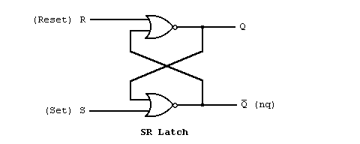
Threads are Not the Only Possibility:
1st example: Hardware Description Languages
e.g. VHDL:
entity latch is
port (s,r : in bit;
q,nq : out bit);
end latch;
architecture dataflow of latch is
begin
q<=r nor nq;
nq<=s nor q;
end dataflow;

Slide 27
Threads are Not the Only Possibility:
2nd example: Sensor Network Languages
Typical usage pattern:
hardware interrupt signals an event.
event handler posts a task.
tasks are executed when machine is idle.
tasks execute atomically w.r.t. one another.
tasks can invoke commands and signal events.
hardware interrupts can interrupt tasks.
exactly one monitor, implemented by disabling interrupts.
e.g. nesC/TinyOS
interface provided
Component 1
interface used
command invoked
event handled
command implemented
event signaled
interface provided
Component 2
Command implementers can invoke other commands or post tasks, but do not trigger events.
interface used

Slide 28
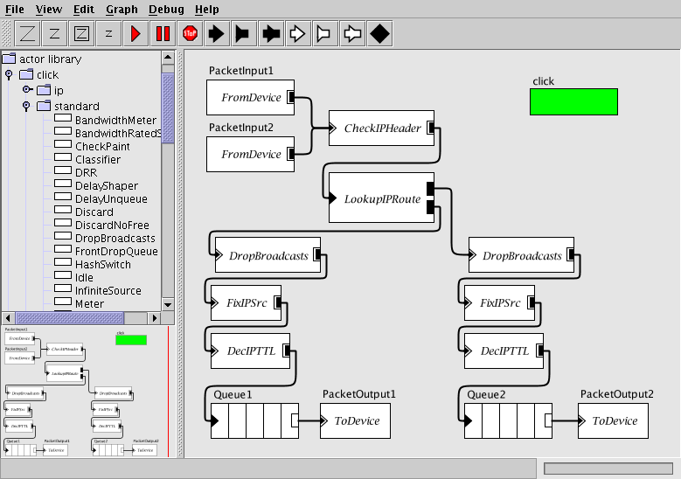
Threads are Not the Only Possibility:
3rd example: Network Languages
Typical usage pattern:
queues have push input, pull output.
schedulers have pull input, push output.
thin wrappers for hardware have push output or pull input only.
agnostic output port
push output port
push input port
pull output port
Click with a visual syntax in Mescal

Slide 29
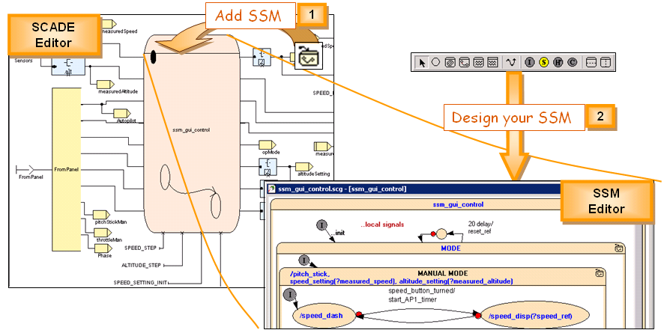
Threads are Not the Only Possibility:
4th example: Synchronous Languages
Typical usage pattern:
specify tasks aligned to a master “clock” and subclocks
clock calculus checks for consistency and deadlock
decision logic is given with hierarchical state machines.
synchronous signal value
state machine giving decision logic
Lustre/SCADE, from http://www.esterel-technologies.com/

Slide 30
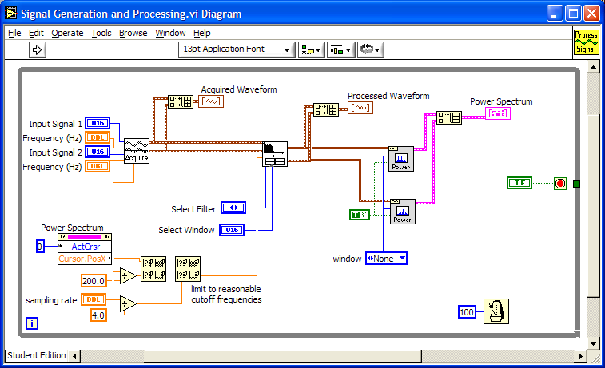
Threads are Not the Only Possibility:
5th example: Instrumentation Languages
e.g. LabVIEW, Structured dataflow model of computation

Slide 31
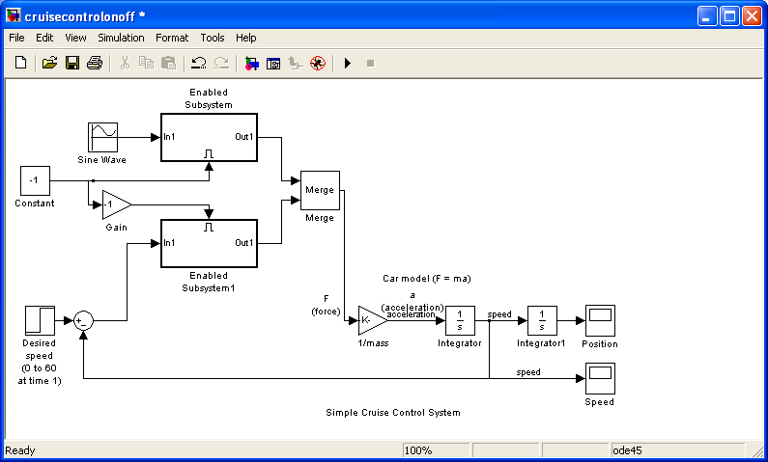
Threads are Not the Only Possibility:
6th example: Continuous-Time Languages
Typical usage pattern:
model the continuous dynamics of the physical plant
model the discrete-time controller
code generate the discrete-time controller
continuous-time signal
Simulink + Real-Time Workshop

Slide 32
A Common Feature
None is mainstream in computing.
All are domain-specific.
Emphasis on concurrent composition with determinism:
  Composability
  Security
  Robustness
  Resource management
  Evolvability
Compared with message passing schemas, such as PVM, MPI, OpenMP, these impose stricter interaction patterns that yield determinism in the face of concurrency.

Slide 33
Many of These and Other Concurrent Component Models are Actor Oriented
The established: Object-oriented:
class name
What flows through an object is sequential control
data
methods
call
return
Things happen to objects
The alternative: Actor oriented:
Actors make things happen
actor name
data (state)
What flows through an object is streams of data
parameters
ports
Input data
Output data

Slide 34
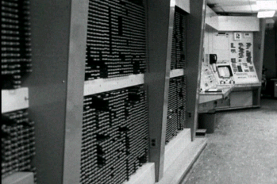
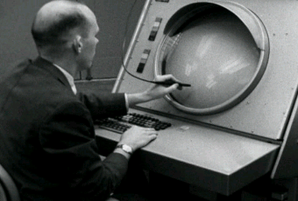
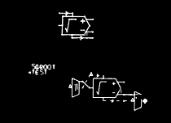
The First (?) Actor-Oriented Platform
The On-Line Graphical Specification of Computer Procedures
W. R. Sutherland, Ph.D. Thesis, MIT, 1966
MIT Lincoln Labs TX-2 Computer
Bert Sutherland with a light pen
Bert Sutherland used the first acknowledged object-oriented framework (Sketchpad, created by his brother, Ivan Sutherland) to create the first actor-oriented programming framework.
Partially constructed actor-oriented model with a class definition (top) and instance (below).

Slide 35
Recall the Observer Pattern
“The Observer pattern defines a one-to-many dependency between a subject object and any number of observer objects so that when the subject object changes state, all its observer objects are notified and updated automatically.”

Slide 36
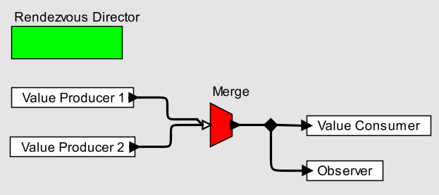
Observer Pattern using CSP-like Rendezvous
Each actor is a process, communication is via rendezvous, and the Merge explicitly represents nondeterministic multi-way rendezvous.
The above diagram is an expression in a composition language with a visual syntax.

Slide 37
Now that we’ve made a trivial design pattern trivial, we can work on more interesting aspects of the design.
E.g., suppose we don’t care how long notification of the observer is deferred, as long as the observer is notified of all changes in the right order?

Slide 38
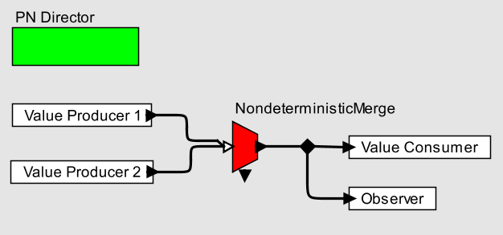
Observer Pattern using Process Networks [Kahn 1974] Extended with Nondeterministic Merge
Each actor is a process, communication is via streams, and the NondeterministicMerge explicitly merges streams nondeterministically.

Slide 39
Suppose further that we want to explicitly specify the timing of producers?

Slide 40
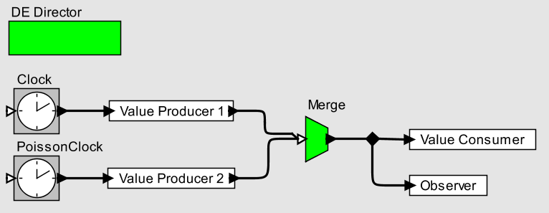
Observer Pattern using Discrete Events
Messages have a (semantic) time, and actors react to messages chronologically. Merge now becomes deterministic.

Slide 41
Instead of a Program Being…
f : B∗∗ → B∗∗

Slide 42
… a Program Can Be
f : (T → B∗)^{P} → (T → B∗)^{P}
For some partially ordered set T.
A computation is a function that maps an evolving pattern of bits into an evolving pattern of bits.
Composition of concurrent components becomes function composition, resulting in well-founded determinate computation (composability!)

Slide 43
Challenges
Computation is deeply rooted in the sequential paradigm.
  Threads appear to adhere to this paradigm, but throw out its essential attractiveness.
Programmers are reluctant to accept new syntax
  Regrettably, syntax has a bigger effect on acceptance than semantics, as witnessed by the wide adoption of threads.
Only general purpose languages are interesting
  A common litmus test: must be able to write the compiler for the language in the language.

Slide 44
Opportunities
New syntaxes can be accepted when their purpose is orthogonal to that of established languages.
  Witness UML, a family of languages for describing object-oriented design, complementing C++ and Java.
Composition languages can provide capabilities orthogonal to those of established languages.
  The syntax can be noticeably distinct (as in the diagrams shown before).
Patterns of composition can be codified
  E.g.: MapReduce.

Slide 45
So What is the Future of
Embedded Software?
THREADS
I don’t know…
But I know what it should be:
Foundational architectures that combine software and models of physical dynamics with composition languages that have concurrency and time in a rigorous, composable, semantic framework.

Slide 46
Conclusion
Many innovations in computation lose timing predictability.
If timing predictability is important, many things have to change.
Threads are the dominant concurrency model for programmers.
Threads discard the most essential features of programs.
Threads are incomprehensible to humans.
Threads ≠ concurrency.
Deterministic aims should be achieved with deterministic means.
Nondeterminism should be used judiciously and explicitly.
Actor orientation offers alternative component models.
Composition languages can realize actor models.
There are opportunities for language design.

