Slide 1
PTIDES: Programming Temporally Integrated Distributed Embedded Systems
Yang Zhao, EECS, UC Berkeley
Edward A. Lee, EECS, UC Berkeley
Jie Liu, Microsoft Research
2006 Conference on IEEE-1588
NIST, Gaithersburg, MD, USA
October 2 - 4, 2005.

Slide 2
Time in Distributed Systems
It was true that “A distributed system can be characterized by the fact that the global state is distributed and that a common time base does not exist.” [1]
Distributed system programming often needs to access information about time.
  Estimate the time at which events occur
  Detect process failures
  Synchronize activities of different systems
In the past, time synchronization has been a relatively expensive service.
  Use imprecise clocks.
  Use logical time/virtual time.
[1] Friedemann Mattern, “Virtual Time and Global States of Distributed Systems”, 1988

Slide 3

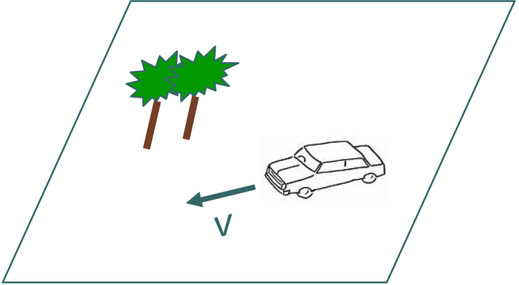
Time in Distributed Systems
A large part of difficulty in programming distributed embedded systems is due to imprecise clocks.
Camera1
@t1
Camera2
@t1
Camera1
Camera2

Slide 4
Time in Distributed Systems
Logical time or virtual time is about ordering of events:
  e < e’ (event e happens before e’) if t(e) < t(e’) .
Now, time synchronization offers a consistent global notion of time.
  It is meaningful to talk about the metric nature of time: t(e’) – t(e)
Time synchronization could greatly change the design of distributed systems!

Slide 5
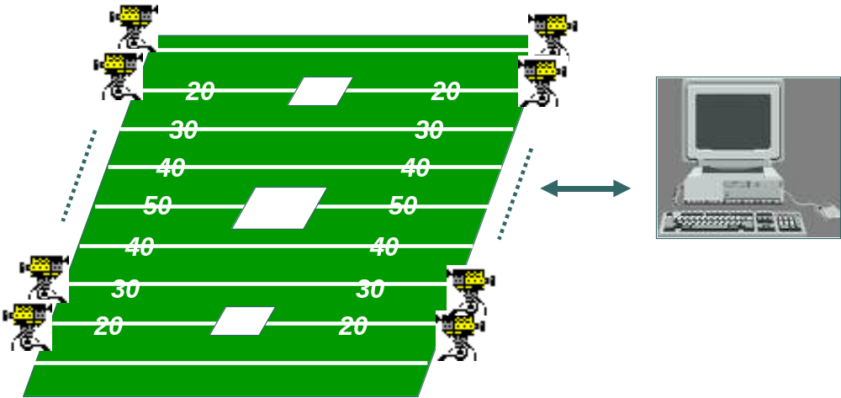

Motivating Example
Camera has computer-controlled zoom and focus capabilities.
Zoom and focus take time to set up, and the camera should not take picture during this period.
The video of each camera is synchronized and time stamped
  All the views of some interesting moment can be played back in sequence
  How often a camera takes picture is also controlled by the computer.
e: zoom camera at t
e’: take picture at t’
If t – t’ < , then e should be dropped.

Slide 6
How to Design the Application?
Challenges include: computation and timing relation between events to be realized in software
Prevailing software methods abstract away time, replacing it with ordering. Moreover,
  Order not specified as part of the interface definition.
  It can be difficult to control the order in concurrent systems.
Need programming languages that include time and concurrency as first-class properties.
  Elevating time to the programming language level
    Time is part of the semantics of programs
  Augmenting software component interfaces with timing information

Slide 7
Discrete Event Systems
Dynamic systems that evolve in accordance to events
  The state of the system changes only when an event occurs
  Events are associated with time
    Ex. arrival of a packet, completion of a job, failure of a machine
DE models have been used for modeling physical systems including:
  Hardware systems (VHDL, Verilog)
  Manufacturing systems
  Communication networks (OPNET, NS-2)
  Transportation systems
  Stock market

Slide 8
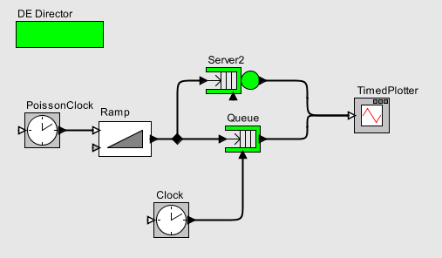
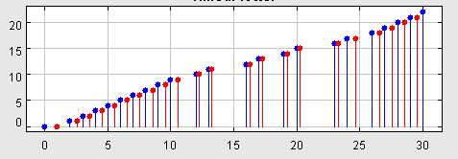
Discrete Event Modeling in Ptolemy II
DE Director implements timed semantics using an event queue
Reactive actors
Event source
Signal
Time line

Slide 9
Motivating Example
Camera has computer-controlled zoom and focus capabilities.
Zoom and focus take time to set up, and the camera should not take picture during this period.
The video of each camera is synchronized and time stamped
  All the views of some interesting moment can be played back in sequence
  How often a camera takes picture is also controlled by the computer.
e: zoom camera at t
e’: take picture at t’
If t – t’ < , then e should be dropped.

Slide 10
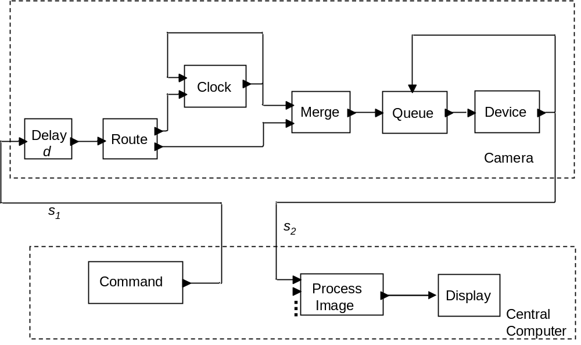
DE Model for the Example

Slide 11
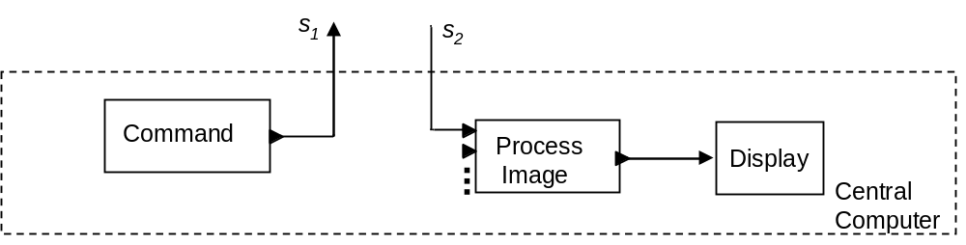


DE Model on the Central Computer
v
v = 2: zoom in camera.
2
1
t_{m}
1
2
3
zoom in all
t_{r} = 2

Slide 12
DE Model on the Central Computer
v
v = 2: zoom in camera.
4
v = 2: zoom in camera.
v > 2: change period p to (v-2)*p.
3
2
1
t_{m}
1
2
3
4
5
6
double period
t_{r} = 5.5

Slide 13
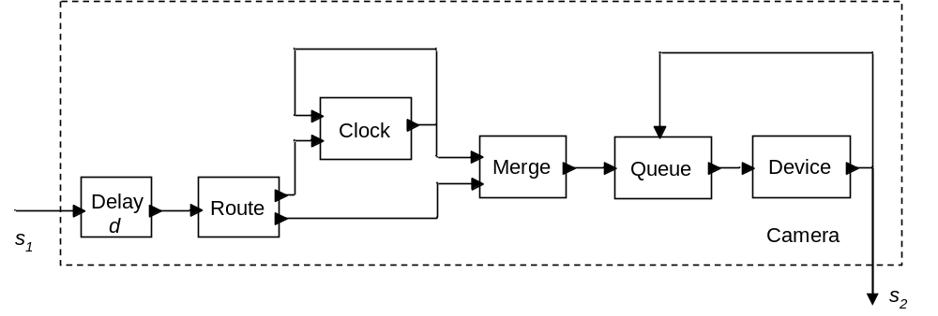
DE Model for the Cameras
v
v
4
4
3
3
2
2
1
t_{m}
1
t_{m}
1
2
3
4
5
6
1
2
3
4
5
6
Assume d = 1

Slide 14
DE Model for the Cameras
v
4
3
2
1
t_{m}
1
2
3
4
5
6
v
2
1
t_{m}
1
2
3
v
4
3
2
1
t_{m}
1
2
3
4
5
6
Assume d = 1

Slide 15
DE Model for the Cameras
v
v
1
t_{m}
4
1
8
9
10
2
3
4
5
6
3
7
2
1
t_{m}
1
2
3
4
5
6

Slide 16
DE Model for the Cameras
v
1
t_{m}
1
8
9
10
2
3
4
5
6
7
v
2
1
t_{m}
1
2
3
v
2
1
t_{m}
1
8
9
10
2
3
4
5
6
7
e: zoom camera at t
e’: take picture at t’
If t – t’ < =1, then e should be dropped.

Slide 17
DE Model for the Cameras
v
2
1
t_{m}
1
8
9
10
2
3
4
5
6
7
Ex. v = 1, t_{m} = 1: take a picture at t_{r} = 1.
v = 2, t_{m} = 3: zoom in camera at t_{r} = 3.

Slide 18
DE Model for the Cameras
v
v
v
2
4
4
1
t_{m}
3
3
1
8
9
10
2
3
4
5
6
2
2
7
1
t_{m}
1
t_{m}
1
2
3
4
5
6
1
2
3
4
5
6
Event at s₁ is received at real time t_{m} < t_{r} <= t_{m} + D
D is the up-bound of network delay
d should greater than D

Slide 19
Challenges in Executing the Model
Not be practical nor efficient to use a centralized event queue to sort events in chronological order.
Do the techniques developed for distributed DE simulation work?
  Conservative? Optimistic?
Our approach: events only need to be processed in time-stamp order when they are causally related.

Slide 20
DE Model for the Example
v
1
t_{m}
Deadline missed!
1
2
3
Received at real time t_{r} > 3
Assure no event with time
stamp t_{m} < 3 at t_{r} = 3

Slide 21
Challenges in Executing the Model
Not be practical nor efficient to use a centralized event queue to sort events in chronological order.
Do the techniques developed for distributed DE simulation work?
  Conservative? Optimistic?
Our approach: events only need to be processed in time-stamp order when they are causally related.

Slide 22
Intuition on Out of Order Execution
v
1
t_{m}
Received by real time
t_{r} < 3-d+D
1
2
3
1
?
t_{m}
1
2
3
1
?
t_{m}
1
3-d
If there is an event with time
stamp t_{m} <= 3-d at t_{r} <= 3-d
D : is the up bound of network delay; d > D

Slide 23
Intuition on Out of Order Execution
We can always safely process an event e at the first input of Merge by t_{r} > t_{m} - d + D
v
1
t_{m}
1
2
3
D : is the up bound of network delay; d > D

Slide 24
Relevant Dependency Analysis
Relevant dependency analysis gives a formal framework for analyzing causality relationships to determine the minimal ordering constraints on processing events.
It capture the idea that events only need to be processed in time-stamp order when they are causally related.
Can preserve the deterministic behaviors specified in DE models without paying the penalty of totally ordered executions.
Yang Zhao, Edward A. Lee and Jie Liu "Programming Temporally Integrated Distributed Embedded Systems’’, UCB/EECS-2006-82, May 28, 2006

Slide 25

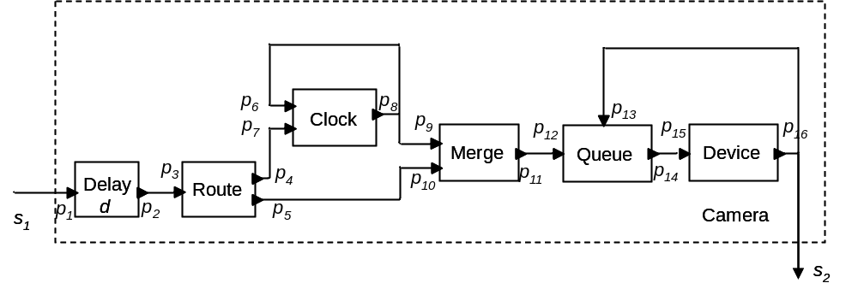

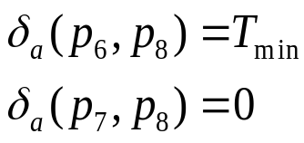

Causality Interface
[Zhou--Lee]
Causality interface of a component declares the dependency between input and output.

Slide 26
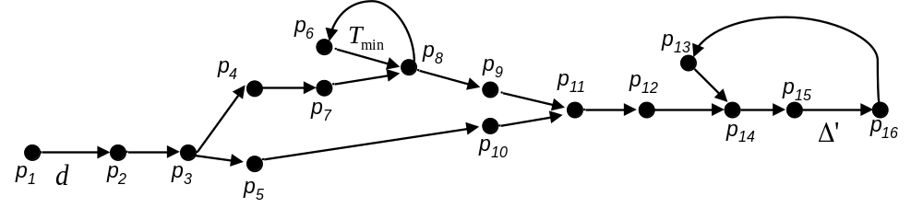
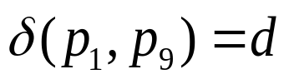
Causality Interface Composition

Slide 27
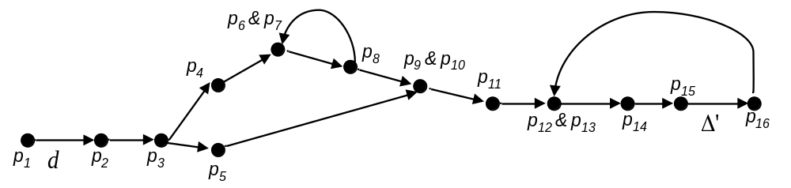
Relevant Dependency
Relevant dependency on any pair of input ports p1 and p2 specifies whether an event at p1 will affect an output signal that may also depend on an event at p2.

Slide 28
Relevant Dependency
d( p₁, p₆) = d means any event with time stamp t at p₂ can be processed when all events at p₁ are known up to time stamp t − d.

Slide 29
Relevant Order
Relevant dependencies induce a partial order, called the relevant order, on events.
e₁ <_{r} e₂ means that e1 must be processed before e2.
If neither e₁ <_{r} e₂, nor e₂ <_{r} e₁, i.e. e₁ ||_{r} e₂, then e₁, e₂ can be processed in any order.
This technique can be adapted to distributed execution.

Slide 30
Conclusion
Time synchronization can greatly change the way distributed systems are designed.
Discrete-event model can be used as a programming model to explicitly specify and manipulate time relations between events.
It is challenging to design distributed systems to make sure they are executable.
Causality analysis can be used to determine when events can be processed out of order to improve executability.
Work in progress:
  statically check whether a system design is executable.
  Implementing a runtime environment on P1000 by Agilent.

