Slide 1







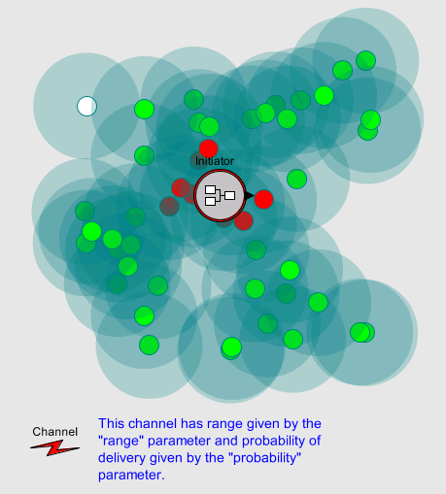
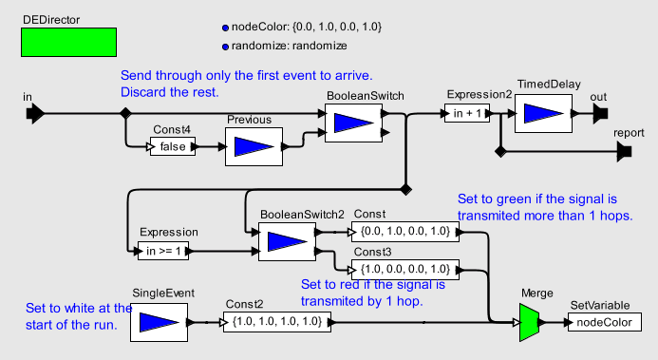






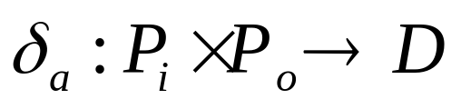


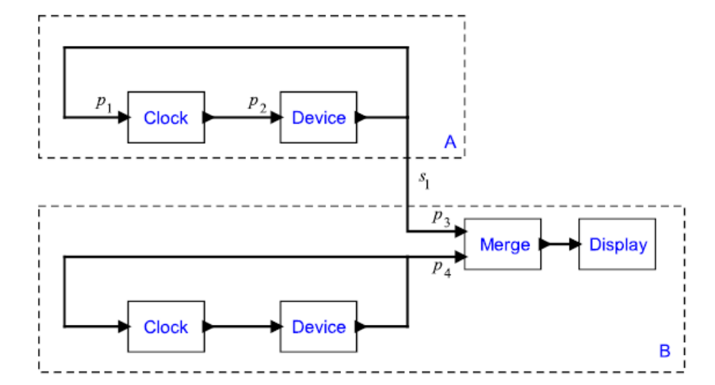
PTIDES: Programming Temporally Integrated Distributed Embedded Systems
DCOSS2006
Yang Zhao*, Edward Lee*, Jie Liu† (*EECS, UC Berkeley, †Microsoft Research)
This work extends discrete-event models with the capability of mapping certain events to physical time and proposes them as a programming model, called PTIDES. We seek analysis tools and execution strategies that can preserve the deterministic behaviors specified in DE models without paying the penalty of totally ordered executions.
PTIDES
Uses model time to define execution semantics, and constraints that bind certain model time events to physical time.
  PTIDES programs are constructed as networks of actors.
  The interface of actors contains ports.
  Designate a subset of the input ports to be real-time ports. Time-stamped events must be delivered to these ports before physical-time exceeds the time stamp.
The global notion of time that is intrinsic in DE models is used as a binding coordination agent.
The focus here is not about speed of execution but rather about timing determinism.
The dependency graph for computing the causality interface of a composition of actors.
p₇
p₆
p₁
A
p₂
p₅
C
p₇
p₅
p₄
p₃
p₄
p₆
p₂
p₉
p₈
B
p₉
p₁
p₃
p₈
Discrete-Event (DE) Systems
Typically used for modeling physical systems where atomic events occur on a time line. Examples:
  VHDL
  OPNET Modeler
  NS-2
  VisualSense
Time is only a modeling property, DE systems are primarily used in performance modeling and simulation.
Relevant Dependency
Relevant dependency on any pair of input ports p₁ and p₂ specifies whether an event at p₁ will affect an output signal that may also depend on an event at p₂.
d( p₁, p₂) = r means any event with time stamp t₂ at p₂ can be processed when all events at p₁ are known up to time stamp t₂ −r.
d( p₁, p₂) = means that events at p2 can be processed without knowing anything about events at p1.
model of a sensor node
p₇
Relevant Dependency Analysis
Relevant dependency analysis gives a formal framework for analyzing causality relationships to determine the minimal ordering constraints on processing events. The key idea is that events only need to be processed in time-stamp order when they are causally related.
p₅ & p₆
p₄
p₂
p₃ & p₈
p₉
p₁
Time Synchronization
Provides a convenient coordination mechanism for coordinated actions over distances.
  NTP (standard networks, ~ms)
  IEEE1588 (Ethernet, ~ns)
  RBS (wireless network)
A key question that arises in the face of such technologies is how they can change the way software is developed.
Causality Interface
Declares the dependency that output events have on input events.
D is an ordered set associated with the min ( ) and plus ( ) operators.
The dependencies between any two ports in a composition can be determined by using ( ) for serial composition and ( ) for parallel composition.
c
Relevant Order
Relevant dependencies induce a partial order, called the relevant order, on events.
e1 <r e2 means that e1 must be processed before e2.
If neither e1 <r e2, nor e2 <r e1, i.e. e1 ||r e2, then e1, e2 can be processed in any order.
This technique can be adapted to distributed execution.
Towards Deployability Analysis
A key requirement for preserving runtime determinism of PTIDES programs is that each event with model time t at a real-time port must be received before the physical time exceeds t − .
When the execution time is negligible comparing to the network delays and setup time, deployability checking becomes straightforward by using the relevant order.
A full analysis, when the execution time is not negligible is ongoing.
Motivating Example
At two distinct sensor nodes A and B we need to generate precisely timed samples under the control of software. Moreover, the devices that generate these samples provide some sensor data to the software after generating the event.
A distributed DE model to be executed on a two-sensor, time-synchronized platform A and B is shown in the right figure.
June 18 – 20, 2006
PTIDES wait for no man

