Slide 1
Concurrent Semantics without the Notions of State or State Transitions
Edward A. Lee
Robert S. Pepper Distinguished Professor
Chair of EECS
UC Berkeley
Invited talk
FORMATS 2006: 4-th International Conference on Formal Modelling and Analysis of Timed Systems,
September 26, 2006
Notes:
System-Level Design Languages: Orthogonalizing the Issues
Presenter: Edward A. Lee, UC Berkeley
Abstract:
System-level design languages (SLDLs) need to be equally comfortable with hardware, software, and problem-level models. The requirements are too broad to be adequately addressed by any single solution that we would recognize as a “language.” But the prospect of needing (or continuing to need) to use multiple incompatible languages to achieve a single system design is grim. In this talk, I outline an approach to achieving interoperability without a single monolithic standard language. Instead, orthogonal properties of a language are created and standardized separately. Specifically, an SLDL is divided into an abstract syntax, a system of syntactic transformations, a concrete syntax, an actor semantics, a semantics for the interaction of actors,and a type system. Each of these are roughly independent dimensions of a language, and two languages, tools, or frameworks may share identical designs in one or more dimensions. Interoperability can be achieved where practical, but does not become a straightjacket where impractical.

Slide 2

System State
The notion of system state depends on an idealized abstraction, that an observer can “simultaneously” observe all parts of a system.
This abstraction depends on the
Newtonian-physical abstraction of
time, which has a “global variable”
t with the same value everywhere.

Slide 3
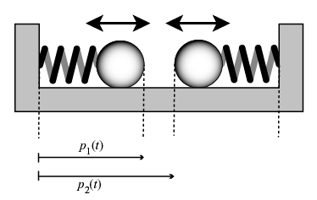
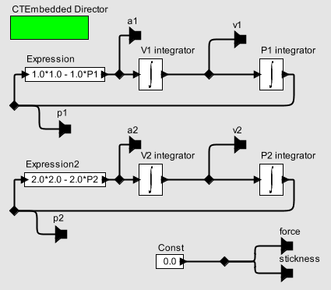
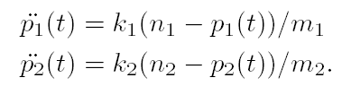
E.g. Differential Equation Models of Systems use the Newtonian-Physical Abstraction
The variable t is shared by all components in the model.

Slide 4
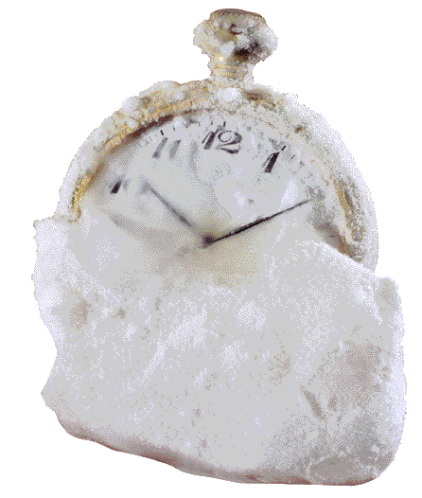
But Networked Software-Based Systems Don’t Do This!
No observer that can simultaneously observe all parts of a system.
There is no common notion of time.
Should we patch the models?
  network time synchronization?
  nondeterministic interleavings?

Slide 5
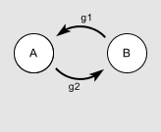
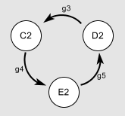
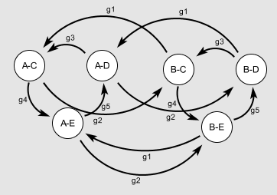
Transition System Models of Software with Nondeterministic Interleavings
My claim: For most purposes, the resulting nondeterminism is not an interesting property of the system.
When it is an interesting property, then the system may be badly designed.
×
=

Slide 6
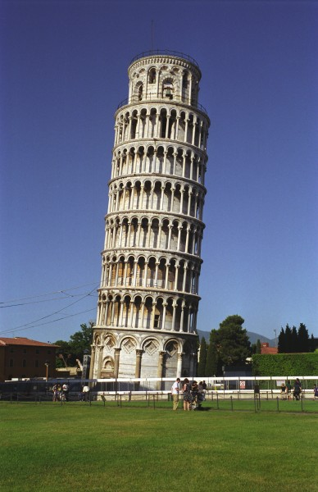
Is the Notion of System State a
Good Foundation?
If poor foundations lead to problems (such as intractable models), is the right solution to patch the models, or to fix the foundations?
Need to question the foundations of computation for concurrency.

Slide 7
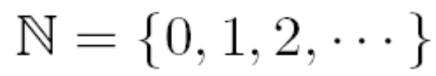


A Look at “Computation”
Some Notation
Natural numbers:
Sequences of bits (finite and infinite):
Functions on sequences of bits:

Slide 8



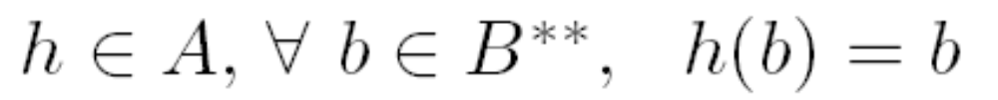

A Look at “Computation”
Imperative Machines
Imperative machine =
Actions:
Halt action:
Control function:

Slide 9
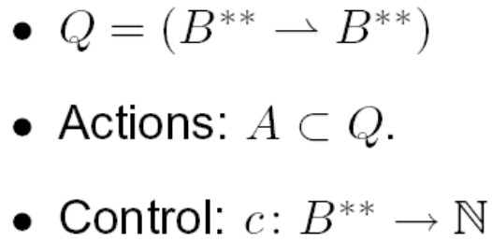

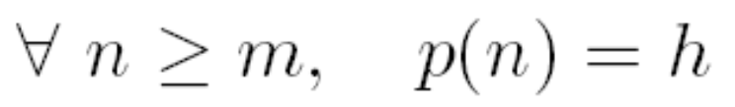

A Look at “Computation”
Programs and Threads
Sequential Program of length m:
Thread:
Initial state:

Slide 10
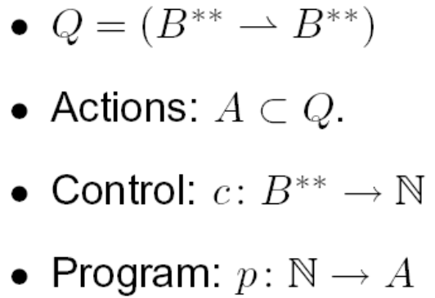

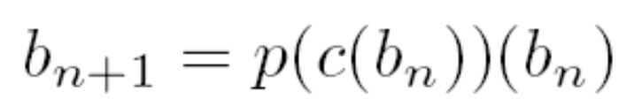
A Look at “Computation”
A Single Thread
initial state:
sequential
composition
final state: b_{N}

Slide 11
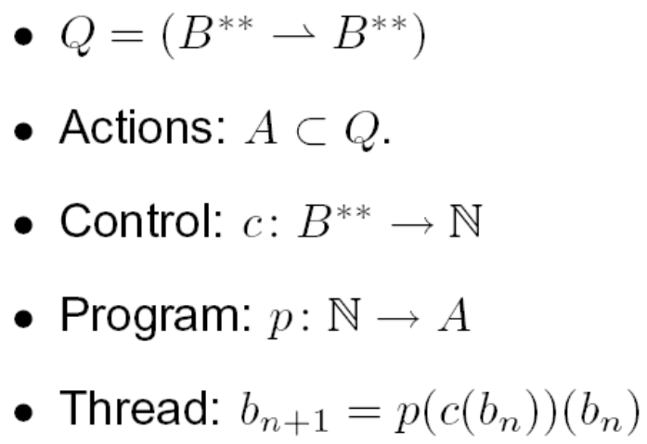

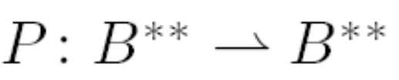

Computable
Functions
A program
defines a (partial or total) function
that is defined on all initial states
for which the program terminates.

Slide 12
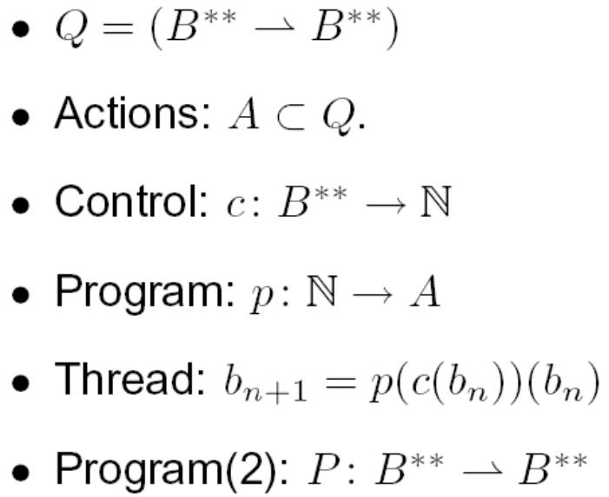
Observations
The set of (finite)
programs is countable.
The set of functions Q is not countable.
Many choices of A ⊂ Q yield the same subset of Q that can be computed by terminating programs:
  the “effectively computable” functions.
Program composition by procedure call is function composition (neat and simple).

Slide 13
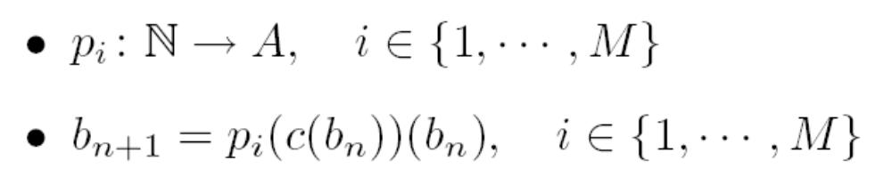
Program Composition by Interleaving Threads
Multiple threads:
The essential and appealing properties of computation are lost:
Programs are no longer functions
Composition is no longer function composition.
Very large numbers of behaviors may result.
Can’t tell when programs are equivalent.
Sadly, this is how most concurrent computation is done today.

Slide 14

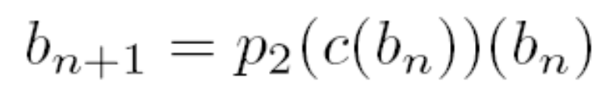
Nondeterministic
Interleaving
suspend
another thread can change the state
resume
Apparently, programmers find this model appealing because nothing has changed in the syntax of programs.

Slide 15
Given This, Transition Systems with Nondeterministic Interleavings Seem Like the Right Model for Concurrent Software!
Threads are widely used in programming
Threads are accurately modeled by nondeterministic interleaving of state transitions systems.
Distributed software leverages the threads model.
But…
Threads are a bad idea because the nondeterminism is (mostly) spurious.
When it isn’t, programs are incomprehensible and unreliable.

Slide 16
My Claim
Having an abstraction that matches current practice is good.
Having an abstraction that matches current practice that is bad is less clear…

Slide 17
To See That Current Practice is Bad, Consider a Simple Example
“The Observer pattern defines a one-to-many dependency between a subject object and any number of observer objects so that when the subject object changes state, all its observer objects are notified and updated automatically.”
Design Patterns, Eric Gamma, Richard Helm, Ralph Johnson, John Vlissides (Addison-Wesley Publishing Co., 1995. ISBN: 0201633612):

Slide 18
Observer Pattern in Java
public void addListener(listener) {…}
public void setValue(newValue) {
myValue = newValue;
for (int i = 0; i < myListeners.length; i++) {
myListeners[i].valueChanged(newValue)
}
}
Will this work in a multithreaded context?
Thanks to Mark S. Miller for the details of this example.

Slide 19
Observer Pattern
With Mutual Exclusion (Mutexes)
public synchronized void addListener(listener) {…}
public synchronized void setValue(newValue) {
myValue = newValue;
for (int i = 0; i < myListeners.length; i++) {
myListeners[i].valueChanged(newValue)
}
}
Javasoft recommends against this. What’s wrong with it?

Slide 20
Mutexes are Minefields
public synchronized void addListener(listener) {…}
public synchronized void setValue(newValue) {
myValue = newValue;
for (int i = 0; i < myListeners.length; i++) {
myListeners[i].valueChanged(newValue)
}
}
valueChanged() may attempt to acquire a lock on some other object and stall. If the holder of that lock calls addListener(), deadlock!

Slide 21
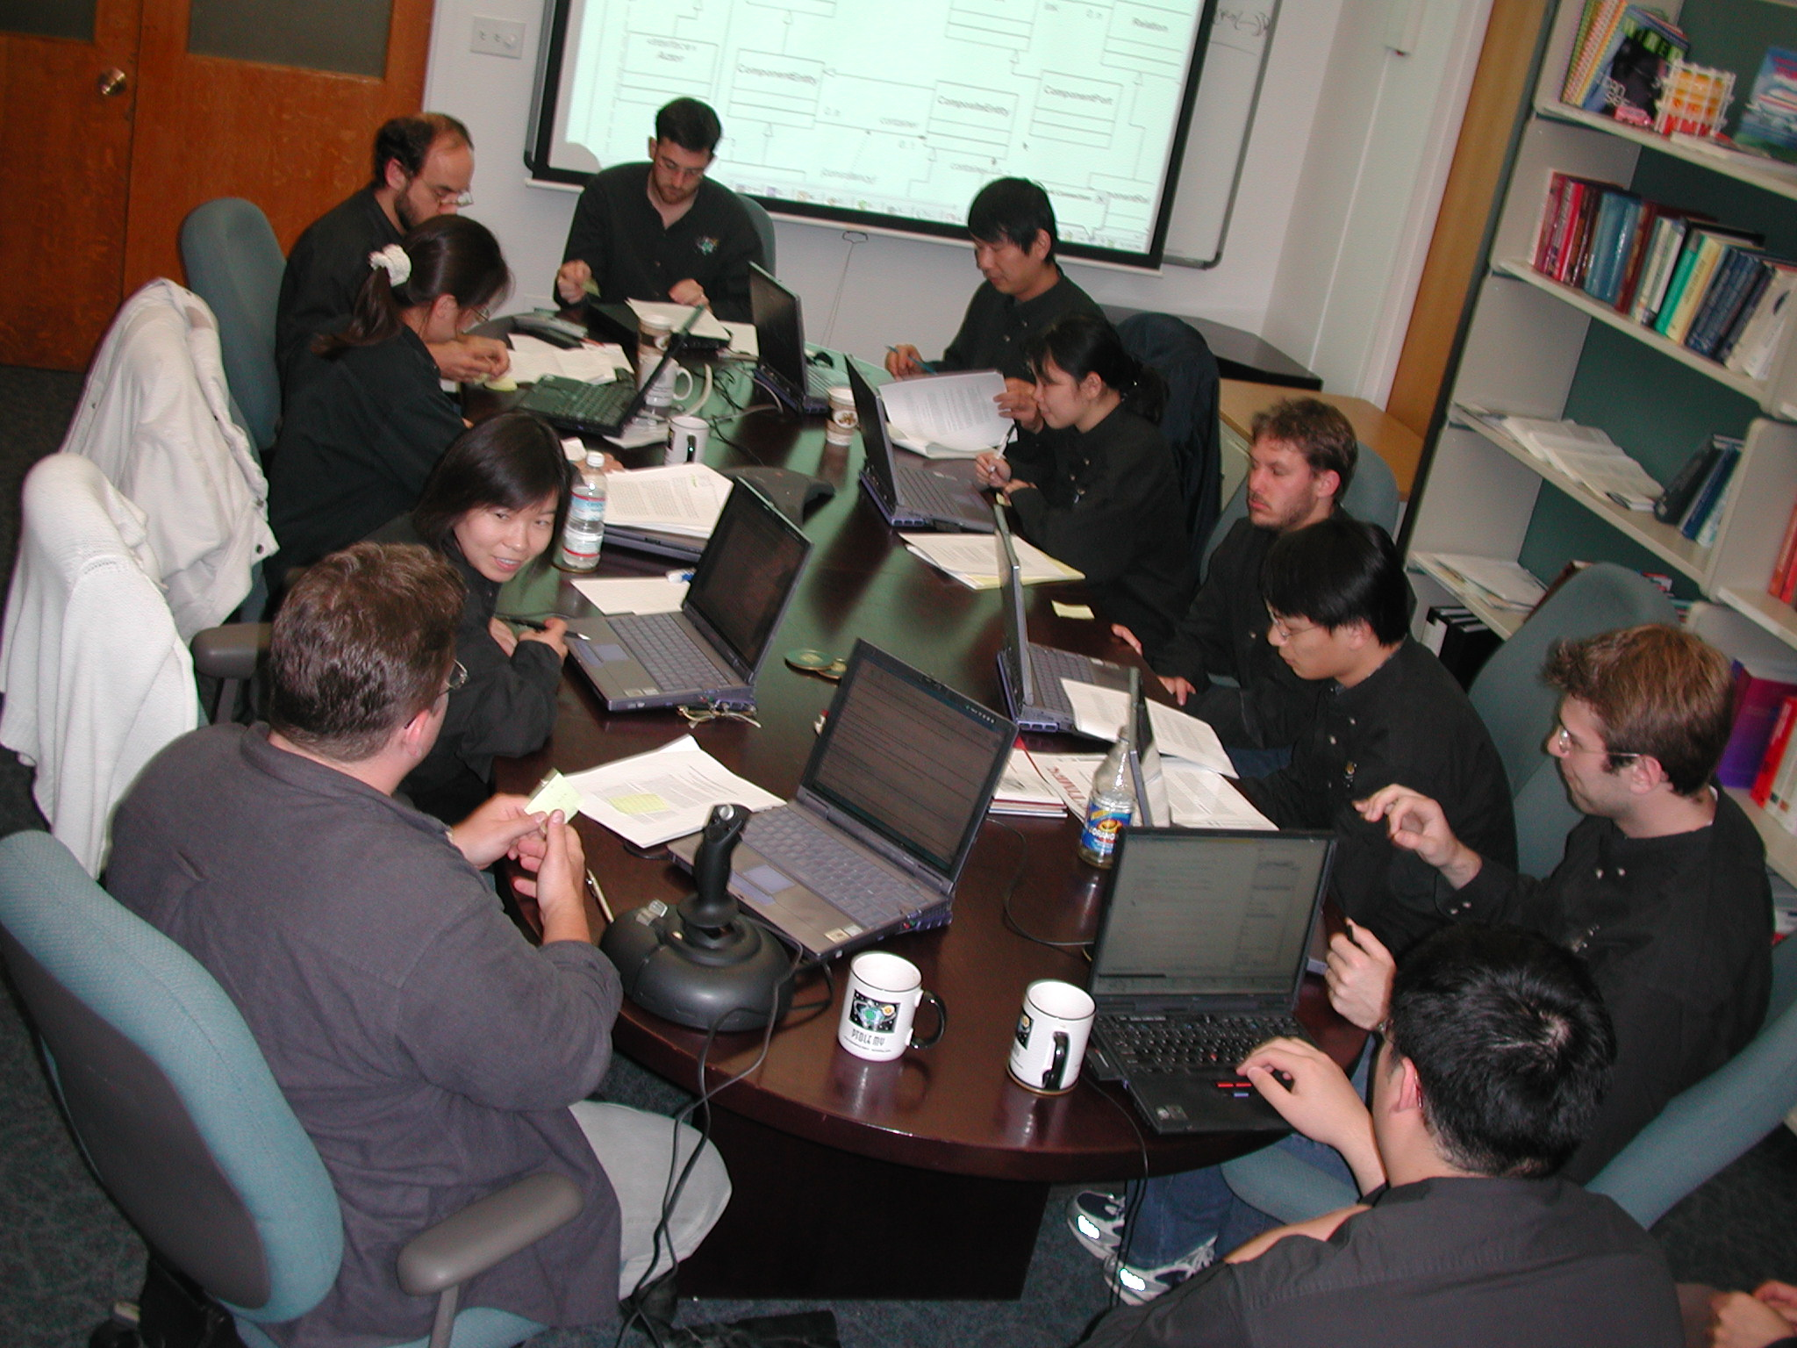
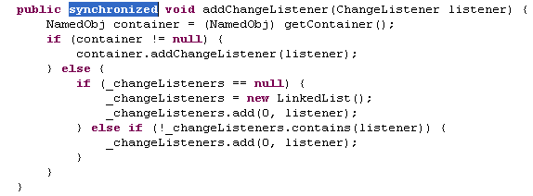
After years of use without problems, a Ptolemy Project code review found code that was not thread safe. It was fixed in this way. Three days later, a user in Germany reported a deadlock that had not shown up in the test suite.

Slide 22
Simple Observer Pattern Becomes
Not So Simple
public synchronized void addListener(listener) {…}
public void setValue(newValue) {
synchronized(this) {
myValue = newValue;
listeners = myListeners.clone();
}
for (int i = 0; i < listeners.length; i++) {
listeners[i].valueChanged(newValue)
}
}
while holding lock, make copy of listeners to avoid race conditions
notify each listener outside of synchronized block to avoid deadlock
This still isn’t right.
What’s wrong with it?

Slide 23
Simple Observer Pattern:
How to Make It Right?
public synchronized void addListener(listener) {…}
public void setValue(newValue) {
synchronized(this) {
myValue = newValue;
listeners = myListeners.clone();
}
for (int i = 0; i < listeners.length; i++) {
listeners[i].valueChanged(newValue)
}
}
Suppose two threads call setValue(). One of them will set the value last, leaving that value in the object, but listeners may be notified in the opposite order. The listeners may be alerted to the value changes in the wrong order!

Slide 24
If the simplest design patterns yield such problems, what about non-trivial designs?
/**
CrossRefList is a list that maintains pointers to other CrossRefLists.
…
@author Geroncio Galicia, Contributor: Edward A. Lee
@version $Id: CrossRefList.java,v 1.78 2004/04/29 14:50:00 eal Exp $
@since Ptolemy II 0.2
@Pt.ProposedRating Green (eal)
@Pt.AcceptedRating Green (bart)
*/
public final class CrossRefList implements Serializable {
…
protected class CrossRef implements Serializable{
…
// NOTE: It is essential that this method not be
// synchronized, since it is called by _farContainer(),
// which is. Having it synchronized can lead to
// deadlock. Fortunately, it is an atomic action,
// so it need not be synchronized.
private Object _nearContainer() {
return _container;
}
private synchronized Object _farContainer() {
if (_far != null) return _far._nearContainer();
else return null;
}
…
}
}
Code that had been in use for four years, central to Ptolemy II, with an extensive test suite with 100% code coverage, design reviewed to yellow, then code reviewed to green in 2000, causes a deadlock during a demo on April 26, 2004.

Slide 25
My Claim
Nontrivial concurrent software written with threads is incomprehensible to humans and cannot be trusted!
Maybe better abstractions would lead to better practice…

Slide 26
Succinct Problem Statement
Threads are wildly nondeterministic.
The programmer’s job is to prune away the nondeterminism by imposing constraints on execution order (e.g., mutexes) and limiting shared data accesses (e.g., OO design).

Slide 27
Succinct Solution Statement
Instead of starting with a wildly nondeterministic mechanism and asking the programmer to rein in that nondeterminism, start with a deterministic mechanism and incrementally add nondeterminism where needed.
The question is how to do this and still get concurrency.

Slide 28


We Need to Replace the
Core Notion of “Computation”
Instead of
we need
where is a partially or totally ordered set.
We have called this the “tagged signal model”
[Lee & Sangiovanni-Vincentelli, 1998]. Related models:
  Interaction Categories [Abramsky, 1995]
  Interaction Semantics [Talcott, 1996]
  Abstract Behavioral Types [Arbab, 2005]

Slide 29
A Consequence:
Components Are No Longer Procedure-Based
The established: Object-oriented:
class name
What flows through an object is sequential control
data
methods
call
return
Things happen to objects
The alternative: “Actor oriented:”
Actors make things happen
actor name
data (state)
What flows through an object is evolving data
parameters
ports
Input data
Output data

Slide 30
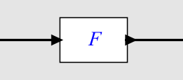
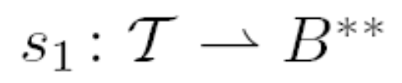

Actors and Signals
If computation is
then a program is an “actor:”
Given an input “signal”
it produces an output “signal”

Slide 31




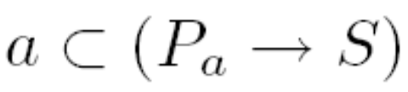




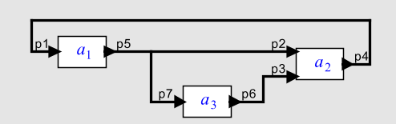
A General Formulation
Signals:
Ports:
Behavior:
Actor with ports is
Connector between ports is
where such that
Note that nondeterministic actors are easily embraced by the model.
Principle: Put nondeterminism only where you need it!

Slide 32
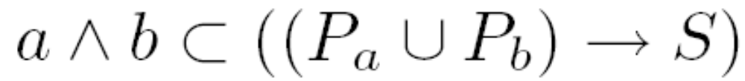
Composition of Components
Given two actors a with ports P_{a} and
b with ports P_{b}, the composition is an actor
where
Note that nondeterministic actors are easily embraced by the model.
Principle: Composition itself does not introduce nondeterminsm!

Slide 33

Structure of the Tag Set
The algebraic properties of the tag set are determined by the concurrency model, e.g.:
  Process Networks
  Synchronous/Reactive
  Time-Triggered
  Discrete Events
  Dataflow
  Rendezvous
  Continuous Time
  Hybrid Systems
  …
Associated with these may be a richer model of the connectors between actors.

Slide 34
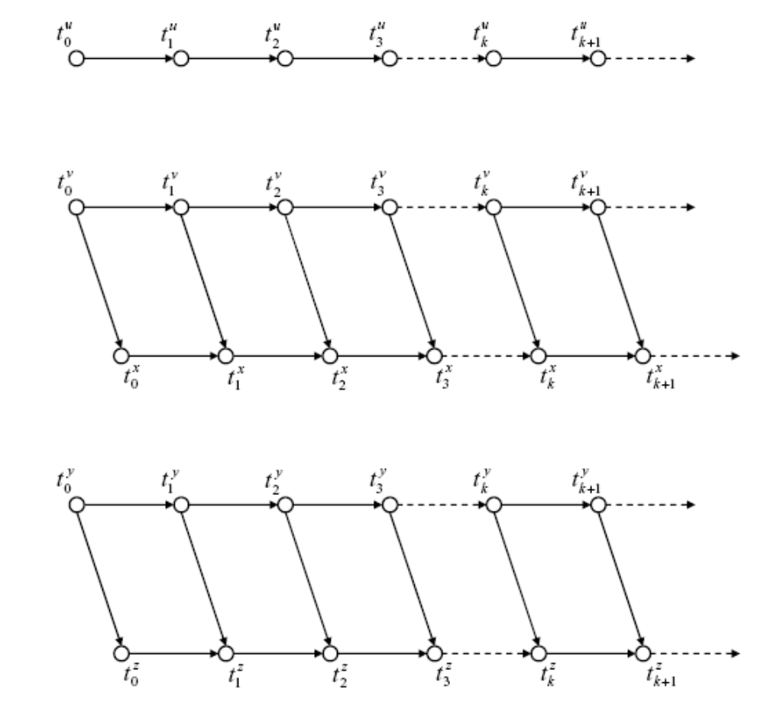
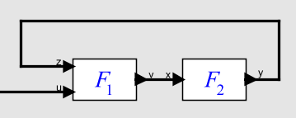


Example of a Partially Ordered Tag Set T for Kahn Process Networks
Ordering constraints on tags imposed by communication:
signal
actor
u
v
x
Each signal maps a totally ordered subset of into values.
y
z
Example from Xiaojun Liu, Ph.D. Thesis, 2005.

Slide 35
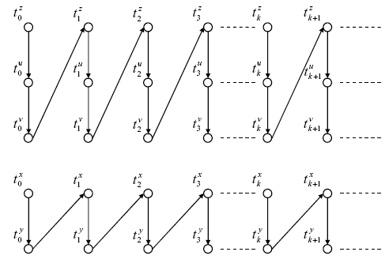
Example: Tag Set T for
Kahn Process Networks
Ordering constraints on tags imposed by computation:
z
Actor F1(in z, u; out v)
{
repeat {
t1 = receive(z)
t2 = receive(u)
send(v, t1 + t2)
}
}
u
v
Actor F2(in x; out y)
{
repeat {
t = receive(x)
send(v, t)
}
}
x
y
Composition of these constraints with the previous reveals deadlock.
Example from Xiaojun Liu, Ph.D. Thesis, 2005.

Slide 36

By “Timed Systems” We Mean Those with Totally Ordered Tag Sets
Tag set is totally ordered.
  Example: T = , with lexicographic order (“super dense time”).
Used to model
  hardware,
  continuous dynamics,
  hybrid systems,
  embedded software
Gives semantics to “cyber-physical systems”.
See [Liu, Matsikoudis, Lee, CONCUR 2006].

Slide 37
The Catch…
This is not what (mainstream)
programming languages do.
This is not what (mainstream) software component technologies do.
The second problem is easier to solve…

Slide 38
Actor-Oriented Design
The established: Object-oriented:
class name
What flows through an object is sequential control
data
methods
call
return
Things happen to objects
The alternative: “Actor oriented:”
Actors make things happen
actor name
data (state)
What flows through an object is evolving data
parameters
ports
Input data
Output data

Slide 39
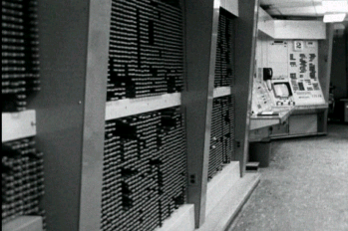

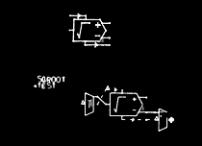
The First (?) Actor-Oriented Programming Language
The On-Line Graphical Specification of Computer Procedures
W. R. Sutherland, Ph.D. Thesis, MIT, 1966
MIT Lincoln Labs TX-2 Computer
Bert Sutherland with a light pen
Bert Sutherland used the first acknowledged object-oriented framework (Sketchpad, created by his brother, Ivan Sutherland) to create the first actor-oriented programming language (which had a visual syntax).
Partially constructed actor-oriented model with a class definition (top) and instance (below).

Slide 40
Examples of Actor-Oriented “Languages”
CORBA event service (distributed push-pull)
ROOM and UML-2 (dataflow, Rational, IBM)
VHDL, Verilog (discrete events, Cadence, Synopsys, ...)
LabVIEW (structured dataflow, National Instruments)
Modelica (continuous-time, constraint-based, Linkoping)
OPNET (discrete events, Opnet Technologies)
SDL (process networks)
Occam (rendezvous)
Ptolemy (various, Berkeley)
Simulink (Continuous-time, The MathWorks)
SPW (synchronous dataflow, Cadence, CoWare)
…
Many of these are domain specific.
Many of these have visual syntaxes.
The semantics of these differ considerably,
but all can be modeled as
with appropriate choices of the set T.

Slide 41
Recall the Observer Pattern
“The Observer pattern defines a one-to-many dependency between a subject object and any number of observer objects so that when the subject object changes state, all its observer objects are notified and updated automatically.”

Slide 42
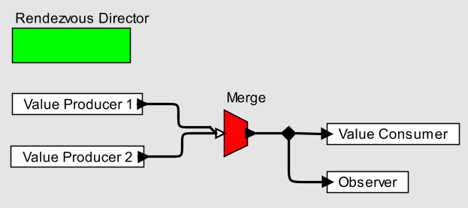
Observer Pattern using an Actor-Oriented Language with Rendezvous Semantics
Each actor is a process, communication is via rendezvous, and the Merge explicitly represents nondeterministic multi-way rendezvous.
This is realized here in a coordination language with a visual syntax.

Slide 43
Recall The Catch …
This is not what (mainstream)
programming languages do.
  What to do here?
This is not what (mainstream) software component technologies do.
  Actor-oriented components

Slide 44
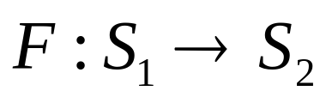
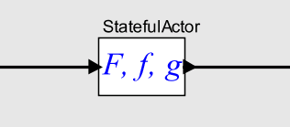
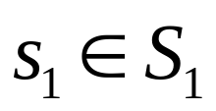
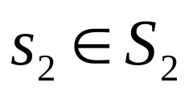
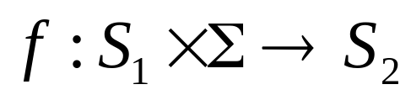
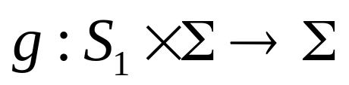
Reconciling Imperative and Actor Semantics:
Stateful Actor Abstract Semantics
An actor is a function from input signals to output signals. That function is defined in terms of two functions.
Signals are monoids (can be incrementally constructed) (e.g. streams, discrete-event signals).
state space
A port is either an
input or an output.
The function f gives outputs in terms of inputs and the current state. The function g updates the state.

Slide 45
The Solution
Actor-oriented component architectures implemented in coordination languages that complement rather than replace existing languages.
Semantics of these coordination languages should not and need not resort to state transitions.
See the Ptolemy Project for explorations of several such (domain-specific) languages: http://ptolemy.org

Slide 46
A Challenge for the
FORMATS Community
To develop notions of operational semantics, equivalence, and verification that do not rely on transition systems, simulation/bisimulation, and model checking, all of which presuppose a strong notion of system state.
Weak versions of these are available…
Can they be made strong enough?

