Slide 1
Incremental Checkpointing with Application to Distributed Discrete Event Simulation
Thomas Huining Feng and Edward A. Lee
{tfeng, eal}@eecs.berkeley.edu
Center for Hybrid and Embedded Software Systems
EECS, UC Berkeley
Winter Simulation Conference 2006
Monterey, CA
December 3-6, 2006

Slide 2
Outline
Background: heterogeneous model simulation with Ptolemy II
Problem: state recovery for backtracking
Approach: automatic state recovery with incremental checkpointing
Application: optimistic Time Warp simulation
Conclusion

Slide 3
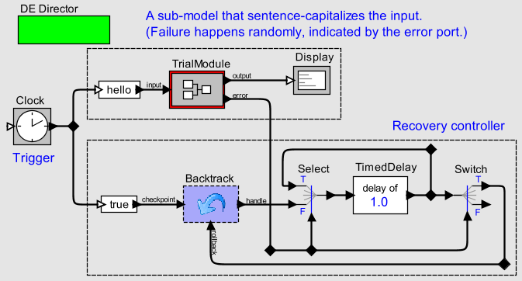
Ptolemy II Background
Hierarchical composition of actors.
Ports connected with relations.
The scheduler determines the semantics.
Users may define actors in Java.
class Select extends Actor {
public boolean prefire() {…}
public void fire() {…}
public boolean postfire() {…}
}

Slide 4
Model State
Situations requiring state recovery:
e.g., optimistic Time Warp simulation (Jefferson 1985).
A model’s run-time state:
Model’s State
class Accumulator extends Actor {
private int sum;
Port input, output;
...
void fire() {
int value = input.get();
sum = sum + value;
output.send(0, sum);
}
}
Actor1’s
State
Scheduler’s
State
(schedule, queues, etc.)
Actor2’s
State

Slide 5
Problems of State Recovery (1)
We could recover the sceduler’s state with a careful design of the simulation environment.
But how to recover actors’ states?
  Provide programmers with a library of state saving/recovery functions.
  Complicated user interaction.
  Make assumptions on the states,
  and provide automatic recovery.
  Not flexible.
Model’s State
Actor1’s
State
Scheduler’s
State
(schedule, queues, etc.)
Actor2’s
State

Slide 6
Problems of State Recovery (2)
The extra cost usually prevents us from creating as many checkpoints as we want.
Domino effect:
snapshot
snapshot
snapshot
snapshot
P1
P2

Slide 7
Our Approach to State Recovery
Correctness can be proved easily.
Incremental.
Small constant cost for checkpoint creation.
  Allow to create checkpoint whenever it may be needed.
The program is slowed down gracefully.
  Real-time property can be proved.

Slide 8
Java Analysis and Transformation
Use an analyzer to identify the states in the Java code.
Use a transformer to
modify the program.
class Accumulator extends Actor {
private int sum;
Port input, output;
...
void fire() {
int value = input.get();
sum = sum + value;
output.send(0, sum);
}
}
state
update
class Accumulator extends Actor {
private int sum;
Port input, output;
...
void fire() {
int value = input.get();
$ASSIGN$sum(sum + value);
output.send(0, sum);
}
}

Slide 9
Simple Assignment Transformation
For each Java class:
$ASSIGN$sum first saves sum’s current value, and then performs the Java assignment.
class Accumulator extends Actor {
private int sum;
Port input, output;
...
void fire() {
int value = input.get();
sum = sum + value;
output.send(0, sum);
}
}
class Accumulator extends Actor {
private int sum;
Port input, output;
...
void fire() {
int value = input.get();
$ASSIGN$sum(sum + value);
output.send(0, sum);
}
int $ASSIGN$sum(int v) {
... // save current sum
return sum = v;
}
}

Slide 10
Simulating Assignment with Function
Assignments are expressions.
Function call precisely simulates assignment.
Inlining as a compiler optimization.
class Accumulator extends Actor {
private int sum;
Port input, output;
...
void fire() {
int value = input.get();
output.send(0,
sum = sum + value);
}
}
class Accumulator extends Actor {
private int sum;
Port input, output;
...
void fire() {
int value = input.get();
output.send(0,
$ASSIGN$sum(sum + value));
}
int $ASSIGN$sum(int v) {
... // record sum
return sum = v;
}
}

Slide 11
Operators that Update Operands
$update$sum handles
all the Java operators,
including +=, -=, ++, --,
etc.
class Accumulator extends Actor {
private int sum;
Port input, output;
...
void fire() {
value = input.get();
output.send(0, sum += value);
}
}
class Accumulator extends Actor {
private int sum;
Port input, output;
...
void fire() {
value = input.get();
output.send(0, $UPDATE$sum(0, value));
}
/* Simulate Java operators.
int $UPDATE$sum(int type, int v) {
... // record sum
switch (type) {
case 0: return sum += v;
case 1: return sum -= v;
case 2: return sum ++; // v ignored
case 3: return sum --;
case 4: return ++ sum;
case 5: return -- sum;
...
default: return error();
}
}
}

Slide 12
Array Operations
class StringStack {
private String[] array;
private int index;
...
void push(String s) {
array[index++] = s;
}
String pop() {
return array[index--];
}
void clean() {
index = 0;
array = new String[MAX];
}
void copy(StringStack stack) {
stack.array =
(String[]) array.clone();
stack.index = index;
}
}
class StringStack {
private String[] array;
private int index;
...
void push(String s) {
$ASSIGN$array($UPDATE$index(2, 0), s);
}
String pop() {
return array[$UPDATE$index(3, 0)];
}
void clean() {
$ASSIGN$index(0);
$ASSIGN$array(new String[MAX]);
}
void copy(StringStack stack) {
stack.$ASSIGN$array(
(String[]) array.clone());
stack.$ASSIGN$index(index);
}
...
}

Slide 13
Checkpoint Control
To create a checkpoint:
long handle = createCheckpoint();
To recover state:
rollback(handle);
To discard a checkpoint:
discard(handle);
Application to threaded systems, e.g., Ptolemy II:
Hierarchical composition of (sub-)models.
An actor does not directly reference other actors.

Slide 14
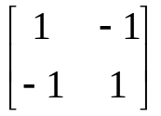
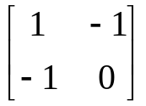
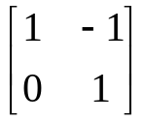
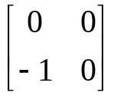
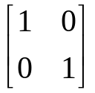
Data Structure
record
null
null
record
prev_ptr
checkpoint
prev_ptr
cp_ptr
id = 1
cp_ptr
int handle1 = createCheckpoint();
$ASSIGN$x(2); // x = 2;
$ASSIGN$x(3); // x = 3;
$ASSIGN$y(0, 1, -1); // y[0][1] = -1;
int handle2 = createCheckpoint();
$UPDATE$x(2, 0); // x++;
$ASSIGN$y(1, 0, -1); // y[1][0] = -1;
$ASSIGN$y(1, 1, 0); // y[1][1] = 0;
$ASSIGN$y(0, new int[2]); // y[0] = new int[2];
rollback(handle1);
x = 3, y =
field = “x”
field = “y[0][1]”
x = 4, y =
x = 4, y =
x = 4, y =
x = 4, y =
x = 1, y =
x = 2, y =
x = 3, y =
value = 1
value = 0
record
record
prev_ptr
checkpoint
prev_ptr
cp_ptr
id = 2
cp_ptr
field = “x”
field = “y[1][0]”
value = 3
value = 0
record
prev_ptr
cp_ptr
field = “y[1][1]”
value = 1
record
prev_ptr
cp_ptr
y[0]
field = “y[0]”
[1, -1]
value = →

Slide 15
Stateful Java Classes
Hashtable, List, Random, Set, Stack, etc.
Get the source (Hashtable, Map, …) from Sun (alternatively, GCJ):
Apply the same transformation:
java.util.Hashtable → ptolemy.backtrack.java.util.Hashtable
Fix references:
package java.util;
class Hashtable implements Map {
...
}
import java.util.Hashtable;
class A extends Actor {
private Hashtable table;
...
}
import ptolemy.backtrack.java.util.Hashtable;
class A extends Actor {
private Hashtable table;
...
}

Slide 16
Use Case: Recoverable Model Execution
A DE model that autonomously recovers from error

Slide 17
Application to Time Warp Simulation
On receiving an event: create a checkpoint and record the handle.
Process the event.
When inconsistency happens:
  Detect the event that caused this problem.
  Recover the state right before the event was processed.
  Re-process the events since that time in a better order.

Slide 18
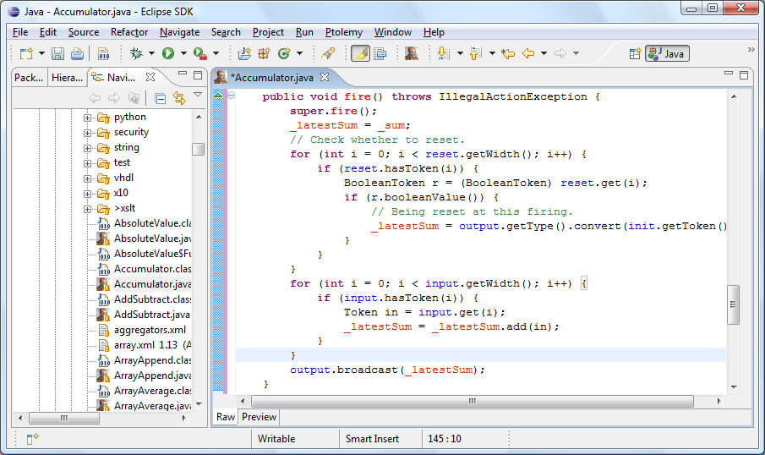
Development Environment

Slide 19
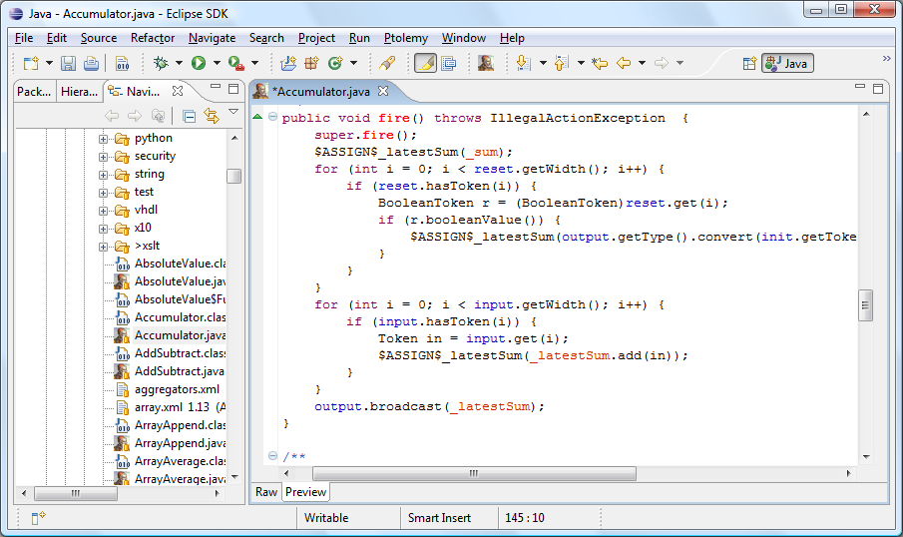
Development Environment

Slide 20
Conclusion
Easily proved correct using operational semantics of the Java language. (Refer to the paper.)
High-performance backtracking mechanism.
  Checkpoint creation incurs a small constant cost.
  Rollback and discard operations are linear in the updates.
Precisely roll back to any execution point (assuming enough memory).
Applicable to real-time systems by slowing them down gracefully.
  Proportional slowdown because of the constant extra cost per update.

