Slide 1
Restricting Navigable Airspace: The SoftWalls Approach
Edward A. Lee
UC Berkeley
Collaborators:
Adam Cataldo
Ian Mitchell
Shankar Sastry
NASA Langley
June 11, 2003

Slide 2
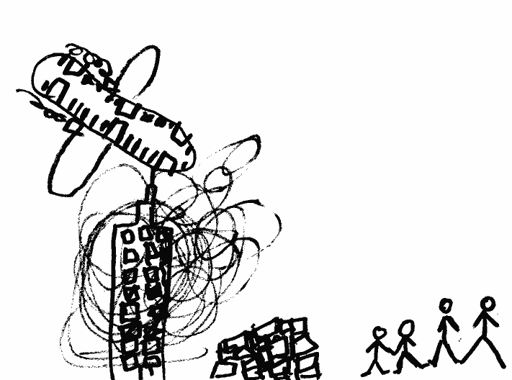
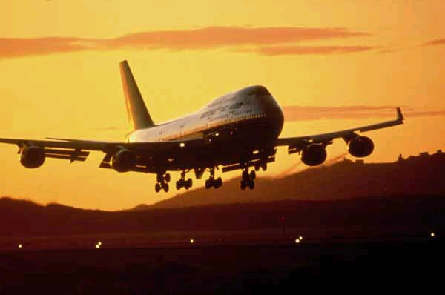
Motivation
Reduce reliance on
Anti-aircraft batteries
Scrambled fighters
Armed air marshals or pilots
Cockpit fortifications
drawing by Helen Lee-Righter, age 5, Sept. 11, 2001.
A weapon of
mass destruction?

Slide 3
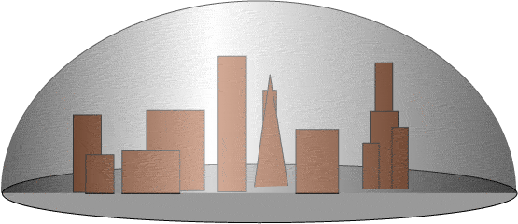

Basic Idea
Protect airspaces using on-board avionics
Non-networked solution
Non-hackable solution
Maximize pilot authority

Slide 4
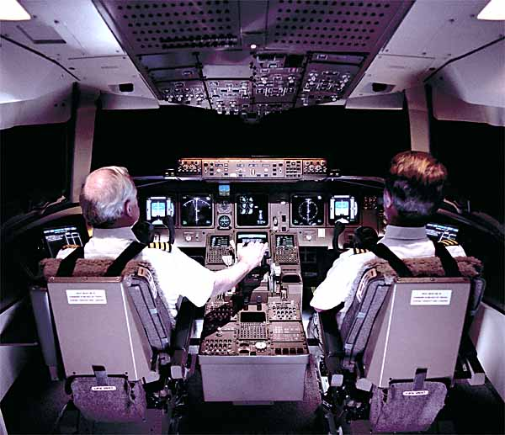
Key Design Objective
Maximize pilot authority, subject to the constraint that the aircraft does not enter pre-defined “no fly zones.”
Since pilot always has authority, we cannot change the dynamics of the aircraft.

Slide 5
Contrast with Autonomous Control
Pilot
Aircraft
Autonomous
controller
Switch to autonomous control (or control from the ground) when a threat is detected.

Slide 6
SoftWalls is not autonomous control
Pilot
Aircraft
+
Softwalls
Introduce bias to the pilot control when a threat is detected

Slide 7
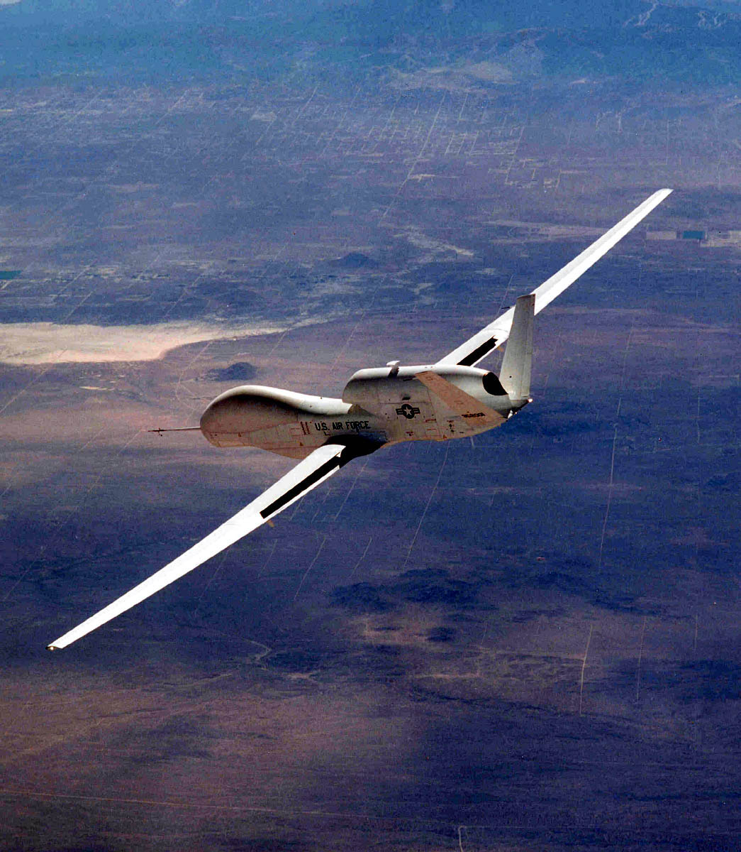
Relation to Unmanned Aircraft
SoftWalls is not an unmanned strategy
  pilot authority is maintained
Related to ground avoidance technologies
  but cannot be advisory

Slide 8
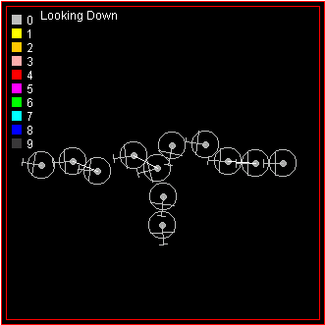

Relation to Collision Avoidance
Like having mobile “no-fly zones” around aircraft
  TCAS & ACAS
  but cannot be advisory
Potential field methods for air-traffic control
  emphasis in these is on fully-automatic, trajectory-driven control.
Honeywell TCAS
Rockwell conflict resolution

Slide 9
Typical Trajectories
(in Two Dimensions)
oblivious pilot
uncooperative pilot
cooperative pilot
No-fly
zone
Even under the maximum control bias, the pilot can make a sharper turn away from the no-fly zone.
Bias starts

Slide 10
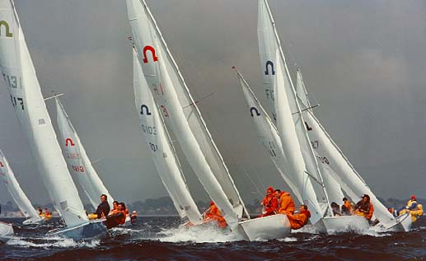

Sailing Analogy – Weather Helm
with turned rudder
with straight rudder
force of the wind on the sails
turned rudder keeps the trajectory straight
Even with weather helm, the craft responds to fine-grain control as expected.

Slide 11
Objections
Reducing pilot control is dangerous
  reduces ability to respond to emergencies

Slide 12
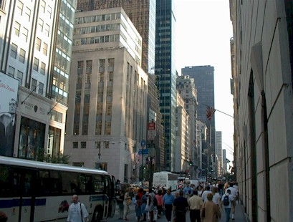
There is No Emergency That Justifies Attempting to Land on Fifth Avenue

Slide 13
Also…
Does not reduce pilot authority as much as:
anti-aircraft fire
air-to-air missiles
automatic landing systems
control from the ground
a hijacker in full control

Slide 14
Objections
Reducing pilot control is dangerous
  reduces ability to respond to emergencies
There is no override
  switch in the cockpit

Slide 15
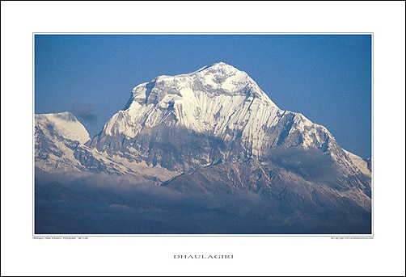
There is Also No Override Switch that Allows a Pilot to Fly Through This

Slide 16
Objections
Reducing pilot control is dangerous
  reduces ability to respond to emergencies
There is no override
  switch in the cockpit
Localization technology could fail
  GPS can be jammed

Slide 17
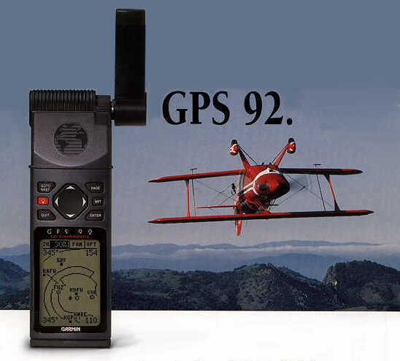
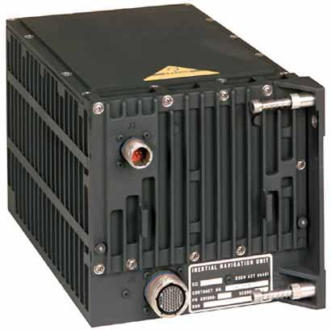
Localization Backup
Inertial navigation
Integrator drift limits accuracy range

Slide 18
Objections
Reducing pilot control is dangerous
  reduces ability to respond to emergencies
There is no override
  switch in the cockpit
Localization technology could fail
  GPS can be jammed
Deployment could be costly
  Software certification? Retrofit older aircraft?

Slide 19
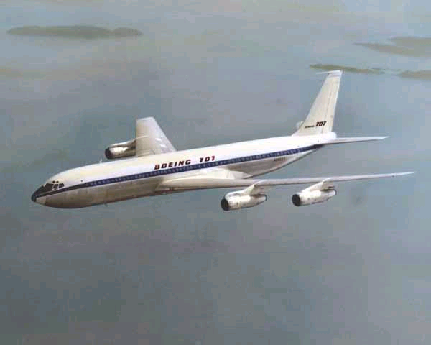
Deployment
Fly-by-wire aircraft
  a software change
Older aircraft
  autopilot level?
Phase in
  prioritize airports

Slide 20
Objections
Reducing pilot control is dangerous
  reduces ability to respond to emergencies
There is no override
  switch in the cockpit
Localization technology could fail
  GPS can be jammed
Deployment could be costly
  how to retrofit older aircraft?
Complexity
  software certification

Slide 21
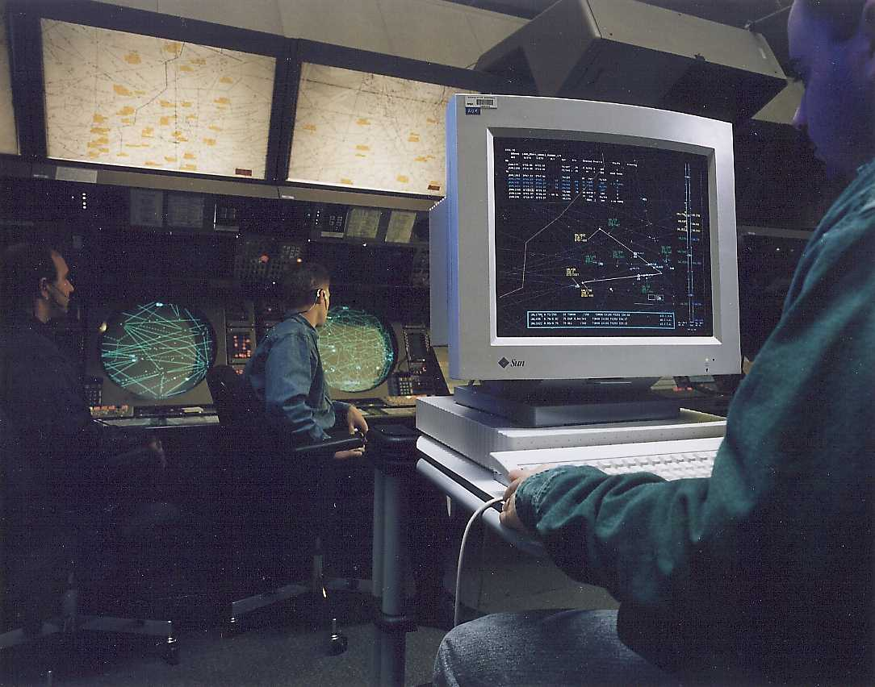
SoftWalls is Not Nearly as Complex as
Air Traffic Control

Slide 22
Objections
Reducing pilot control is dangerous
  reduces ability to respond to emergencies
There is no override
  switch in the cockpit
Localization technology could fail
  GPS can be jammed
Deployment could be costly
  how to retrofit older aircraft?
Deployment could take too long
  software certification
Fully automatic flight control is possible
  throw a switch on the ground, take over plane

Slide 23
Potential Problems with Ground Control
Human-in-the-loop delay on the ground
  authorization for takeover
  delay recognizing the threat
Security problem on the ground
  hijacking from the ground?
  takeover of entire fleet at once?
Requires radio communication
  hackable
  jammable

Slide 24
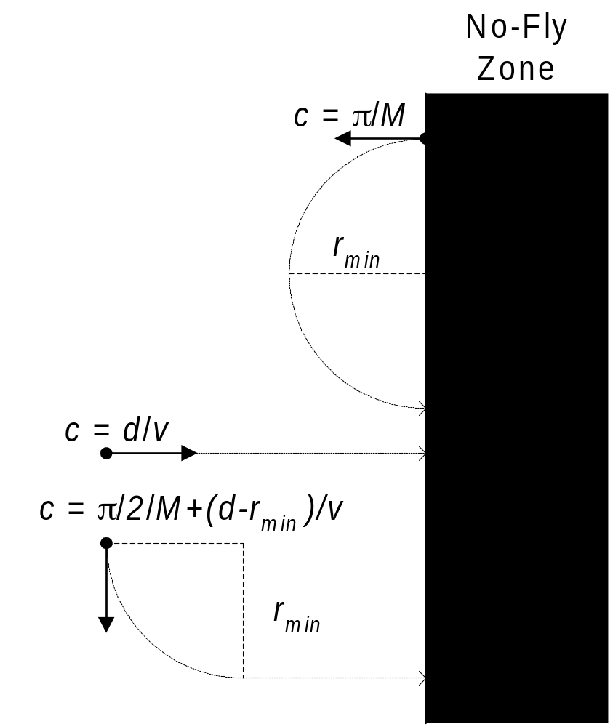
First Version of a Controller
Based on Criticality – Time to Wall
Measure of time to wall in the worst case (most uncooperative pilot)
This assumes the pilot turns toward the
wall at the
maximum rate
due to Xiaojun Liu

Slide 25
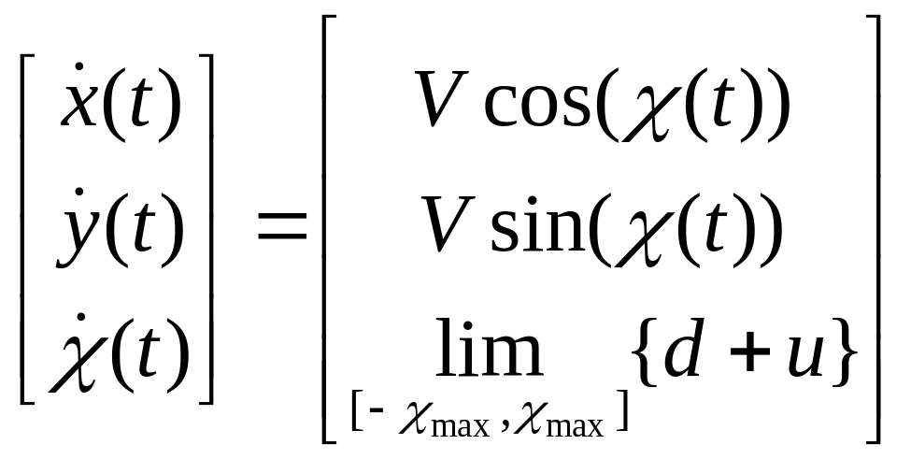
Criticality Based on (Over) Simplified Aircraft Dynamics Model (2-D)
Simple constant-speed car-like model:
  Makes tests/computations faster
  Easier to visualize
V
χ
pilot input
bias input

Slide 26
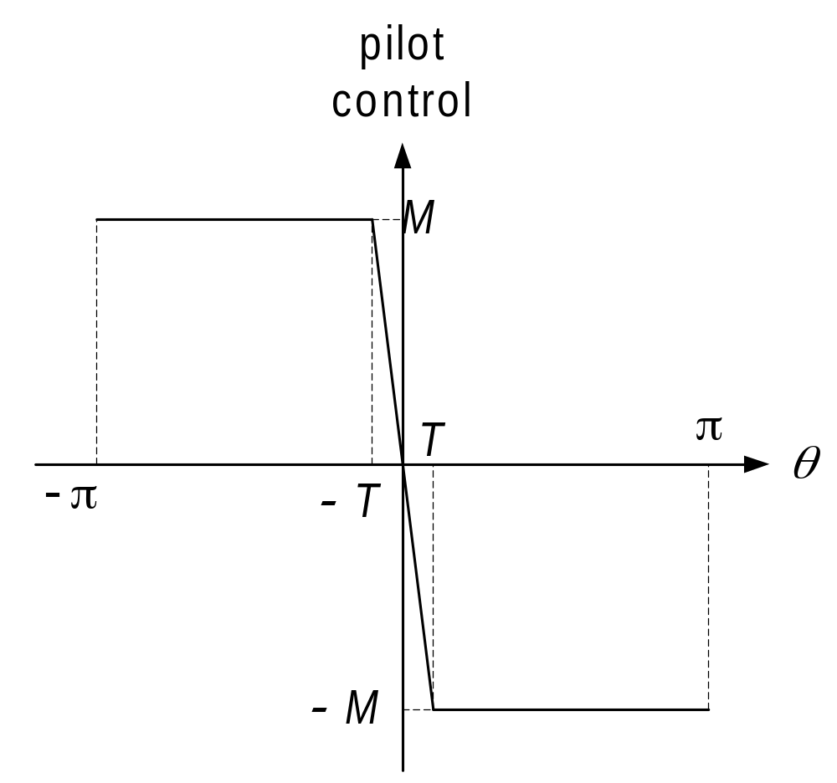
Maximally Uncooperative Pilot Model
Assume θ = 0 is heading towards the wall
This pilot steers maximally towards the wall

Slide 27
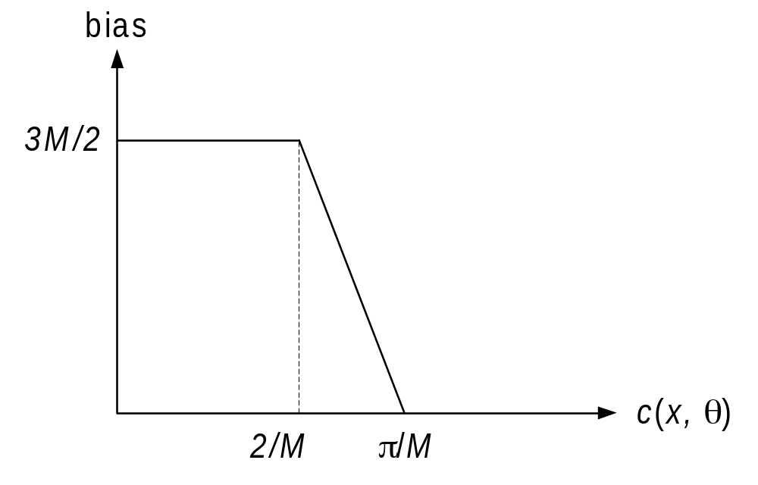
Bias from Criticality-Based Controller
If time to wall is less than π/M, the bias rises
  at the wall, heading away is OK
At 2/M it saturates.
  still can avoid wall with half-maximum turn.

Slide 28
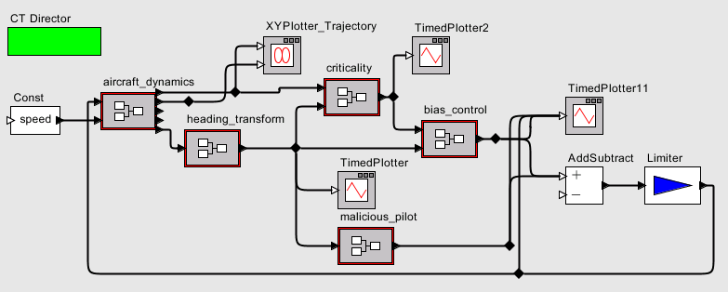
Simulation Model
aircraft model
bias control
criticality calculation
pilot model

Slide 29
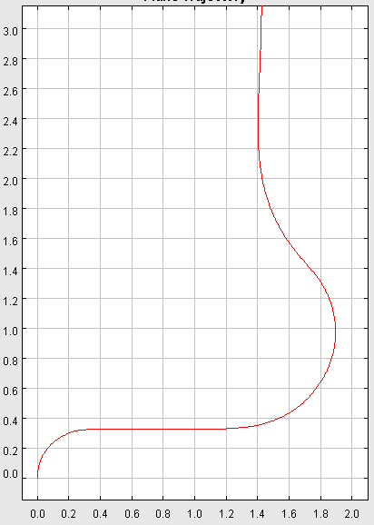
Simulation for
Maximally Uncooperative Pilot
Assumptions (pulled out of a hat):
speed: 0.1 miles/sec = 360 miles/hour
saturated turn: 2π/20 radians/sec
min turning radius: speed/M = 0.32 miles
pilot regains steerage
towards wall
pilot controls saturate
bias starts, pilot counteracts
pilot turns towards the wall
the wall
nautical miles

Slide 30
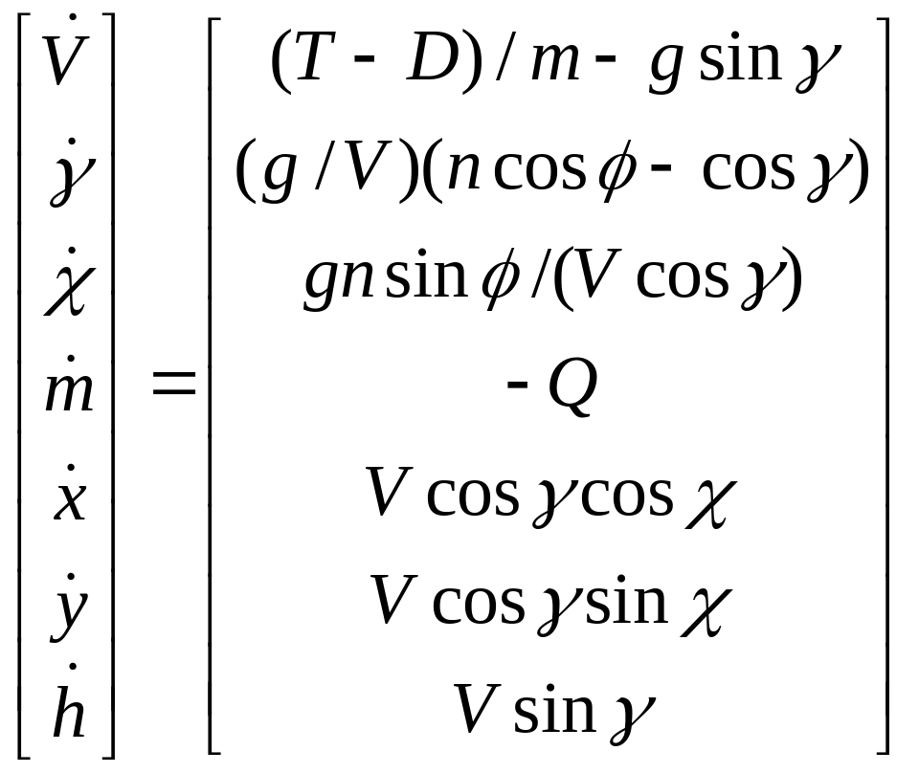
More Sophisticated Aircraft Model
2. More realistic model (Menon, Sweriduk, Sridhar) includes:
  Thrust T
  Drag D
  Mass m
  Flight Path Angle γ
  Bank Angle φ
  Fuel Flow Rate Q
  Lift L
  Load Factor n
  Height h

Slide 31
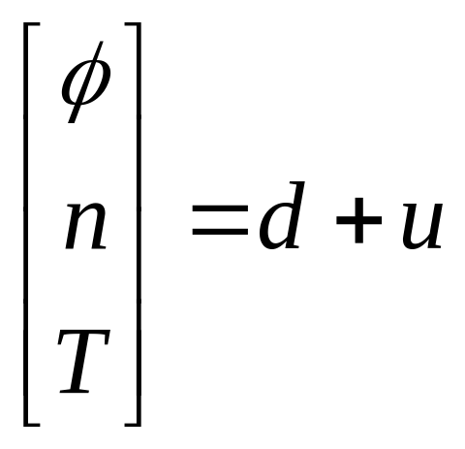
More Sophisticated Pilot Input Model
rudder and ailerons
control input
elevator
throttle
pilot input

Slide 32


More Sophisticated Controller
Based on Reachable Sets
Approach due to Mitchell, Tomlin, Sastry
Suppose we have the dynamics:
where x is the state, u is the control input, and d is the disturbance (the pilot)
Let X be the set of all possible states
Let G be an unsafe region of states, called the target set, where
Identify where in the state space a bias needs to be applied.

Slide 33
Reachable Set
set of all states that can be reached by applying some control input
starting at a point
in the state space
reachable set

Slide 34
Backwards Reachable Set
set of all initial states that can reach the final
point for some control input
backwards
reachable set
given a final point
in the state space

Slide 35
Backwards Reachable Set
Backwards reachable set
No-fly zone
States that can
reach the no-fly
zone when control is applied
Can prevent aircraft from entering no-fly zone
Safe States

Slide 36
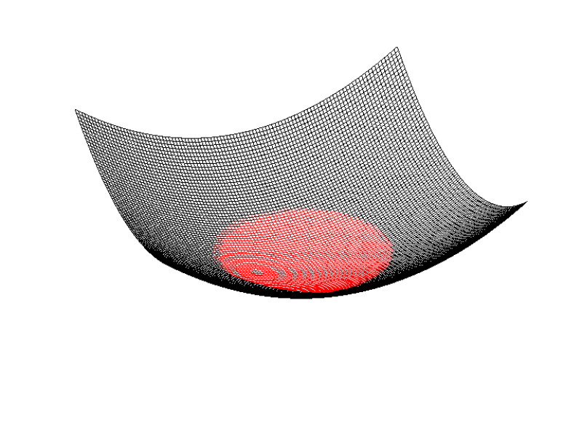
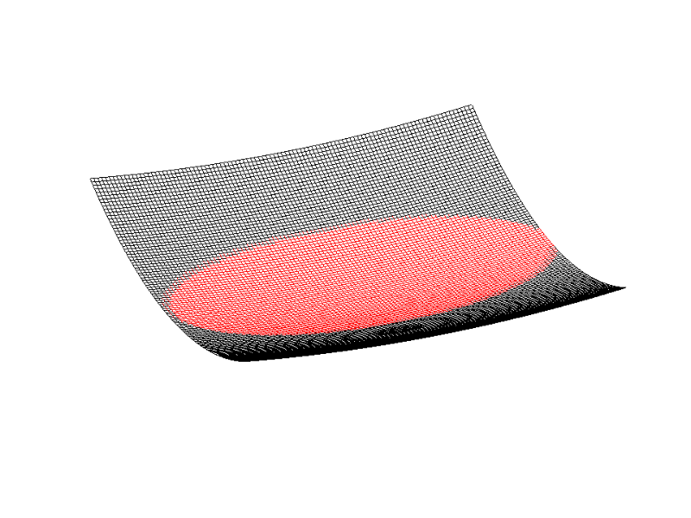
Implicit Surface Functions
implicit surface function
for no-fly zone
implicit surface function
for backwards reachable set
No-fly zone
Backwards Reachable Set

Slide 37
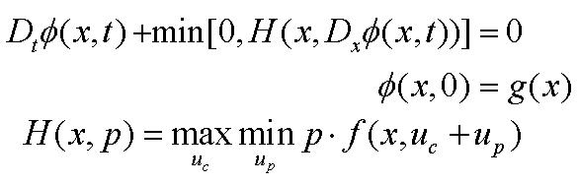
Analytical Solution
Hamilton-Jacobi-Isaacs PDE
backwards reachable set implicit surface function
no-fly zone implicit surface function
Evans & Souganidis--1984
v
dynamics

Slide 38
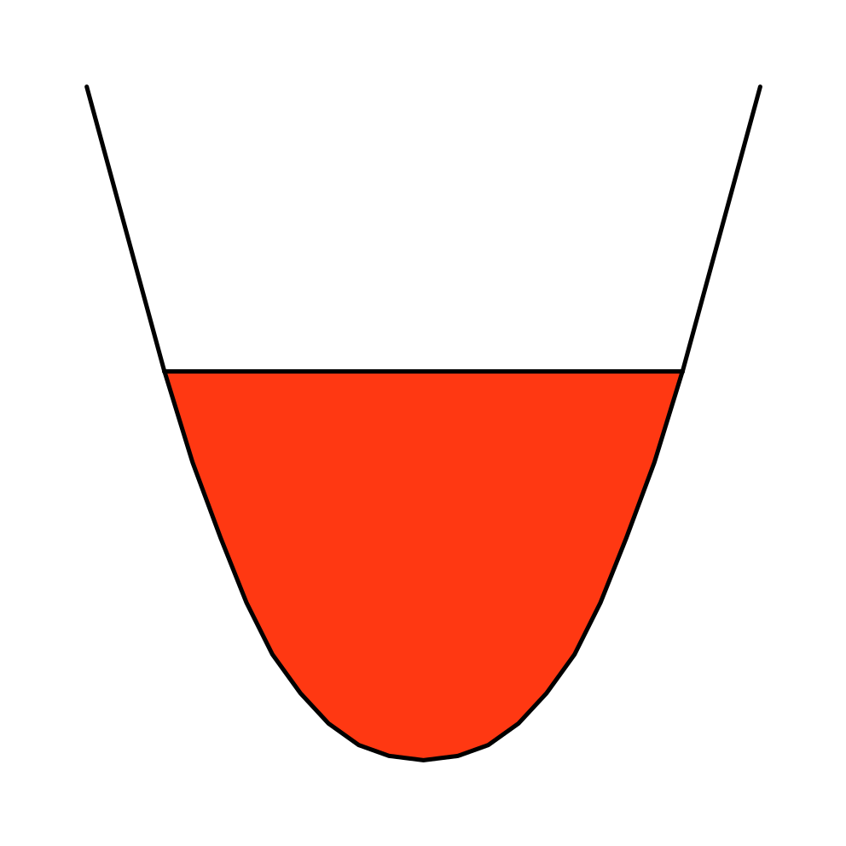
Control from Implicit Surface Function
Control decreases to zero
Safe States
Safe States
Control at
boundary
Backwards
Reachable
Set

Slide 39
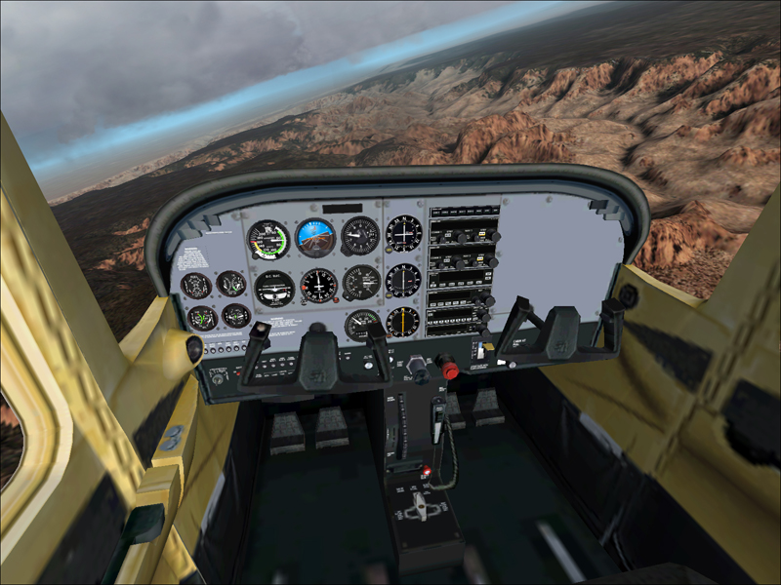
Possible Starting Point for Evaluation:
Simulation Interface
We are working on a SoftWalls interface for Microsoft Flight Simulator
Real-time controller created in Ptolemy II

Slide 40
Advantages of SoftWalls
No human-in the loop in threat detection and response.
No hackable communications from the ground.
Enforcement is far gentler than anti-aircraft batteries or air-to-air missiles.
Pilot authority is maintained far better than alternative solutions.
No force feedback to pilot controls (and hence, no pilot-aircraft struggle).

Slide 41
Questions and Risks
Can GPS be spoofed?
Will pilots need training or practice dealing with the bias?
Can older aircraft be retrofitted (preferably without force feedback)?
How does drift in inertial navigation systems affect the system parameters?
Do we need mobile no-fly zones (e.g. for
Air Force One)?

Slide 42
References
Edward A. Lee, "Soft Walls - Modifying Flight Control Systems to Limit the Flight Space of Commercial Aircraft," Revised from Technical Memorandum UCB /ERL M001/31, University of California, Berkeley, CA 94720, October 3, 2001.
http://ptolemy.eecs.berkeley.edu/papers/01/softwalls2/
J. Adam Cataldo, Edward A. Lee, and Xiaojun Liu, "Preliminary Version of a Two-Dimensional Technical Specification for Softwalls," Technical Memorandum UCB/E RL M02/9, University of California, Berkeley, CA 94720, April 17, 2002.
http://ptolemy.eecs.berkeley.edu/papers/02/prelim2Dsoftwalls

