Slide 1
Making Concurrency Mainstream
Edward A. Lee
Professor, Chair of EECS
UC Berkeley
Joint Invited Talk
CONCUR: Concurrency Theory &
FMICS: Formal Methods for Industrial Critical Systems
Bonn, Germany, August 27, 2006
Notes:
System-Level Design Languages: Orthogonalizing the Issues
Presenter: Edward A. Lee, UC Berkeley
Abstract:
System-level design languages (SLDLs) need to be equally comfortable with hardware, software, and problem-level models. The requirements are too broad to be adequately addressed by any single solution that we would recognize as a “language.” But the prospect of needing (or continuing to need) to use multiple incompatible languages to achieve a single system design is grim. In this talk, I outline an approach to achieving interoperability without a single monolithic standard language. Instead, orthogonal properties of a language are created and standardized separately. Specifically, an SLDL is divided into an abstract syntax, a system of syntactic transformations, a concrete syntax, an actor semantics, a semantics for the interaction of actors,and a type system. Each of these are roughly independent dimensions of a language, and two languages, tools, or frameworks may share identical designs in one or more dimensions. Interoperability can be achieved where practical, but does not become a straightjacket where impractical.

Slide 2
Concurrency in Software Practice,
As of 2006
Threads
  Shared memory, semaphores, mutexes, monitors…
Message Passing
  Synchronous, asynchronous, buffered, …
Everything else, regrettably, remains largely in the domain of research…

Slide 3
The Buzz
“Multicore architectures will (finally) bring parallel computing into the mainstream. To effectively exploit them, legions of programmers must emphasize concurrency.”
The vendor push:
“Please train your computer science students to do extensive multithreaded programming.”

Slide 4
Is this a good idea?

Slide 5
My Claim
Nontrivial software written with threads, semaphores, and mutexes are incomprehensible to humans and cannot and should not be trusted!

Slide 6
Consider a Simple Example
“The Observer pattern defines a one-to-many dependency between a subject object and any number of observer objects so that when the subject object changes state, all its observer objects are notified and updated automatically.”
Design Patterns, Eric Gamma, Richard Helm, Ralph Johnson, John Vlissides (Addison-Wesley Publishing Co., 1995. ISBN: 0201633612):

Slide 7
Observer Pattern in Java
public void addListener(listener) {…}
public void setValue(newValue) {
myValue = newValue;
for (int i = 0; i < myListeners.length; i++) {
myListeners[i].valueChanged(newValue)
}
}
Will this work in a multithreaded context?
Thanks to Mark S. Miller for the details of this example.

Slide 8
Observer Pattern
With Mutual Exclusion (Mutexes)
public synchronized void addListener(listener) {…}
public synchronized void setValue(newValue) {
myValue = newValue;
for (int i = 0; i < myListeners.length; i++) {
myListeners[i].valueChanged(newValue)
}
}
Javasoft recommends against this. What’s wrong with it?

Slide 9
Mutexes are Minefields
public synchronized void addListener(listener) {…}
public synchronized void setValue(newValue) {
myValue = newValue;
for (int i = 0; i < myListeners.length; i++) {
myListeners[i].valueChanged(newValue)
}
}
valueChanged() may attempt to acquire a lock on some other object and stall. If the holder of that lock calls addListener(), deadlock!

Slide 10
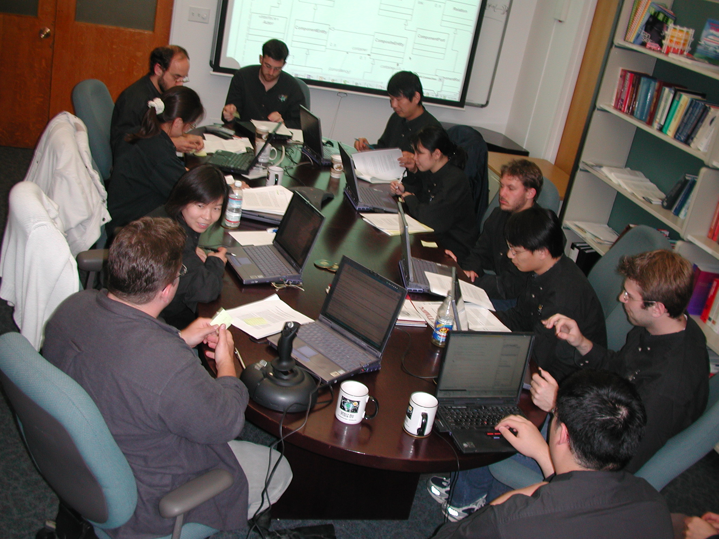
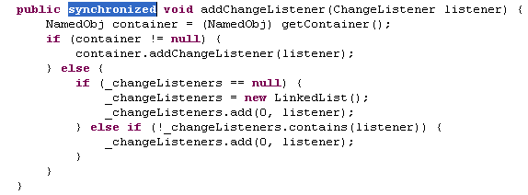
After years of use without problems, a Ptolemy Project code review found code that was not thread safe. It was fixed in this way. Three days later, a user in Germany reported a deadlock that had not shown up in the test suite.

Slide 11
Simple Observer Pattern Becomes
Not So Simple
public synchronized void addListener(listener) {…}
public void setValue(newValue) {
synchronized(this) {
myValue = newValue;
listeners = myListeners.clone();
}
for (int i = 0; i < listeners.length; i++) {
listeners[i].valueChanged(newValue)
}
}
while holding lock, make copy of listeners to avoid race conditions
notify each listener outside of synchronized block to avoid deadlock
This still isn’t right.
What’s wrong with it?

Slide 12
Simple Observer Pattern:
How to Make It Right?
public synchronized void addListener(listener) {…}
public void setValue(newValue) {
synchronized(this) {
myValue = newValue;
listeners = myListeners.clone();
}
for (int i = 0; i < listeners.length; i++) {
listeners[i].valueChanged(newValue)
}
}
Suppose two threads call setValue(). One of them will set the value last, leaving that value in the object, but listeners may be notified in the opposite order. The listeners may be alerted to the value changes in the wrong order!

Slide 13
If the simplest design patterns yield such problems, what about non-trivial designs?
/**
CrossRefList is a list that maintains pointers to other CrossRefLists.
…
@author Geroncio Galicia, Contributor: Edward A. Lee
@version $Id: CrossRefList.java,v 1.78 2004/04/29 14:50:00 eal Exp $
@since Ptolemy II 0.2
@Pt.ProposedRating Green (eal)
@Pt.AcceptedRating Green (bart)
*/
public final class CrossRefList implements Serializable {
…
protected class CrossRef implements Serializable{
…
// NOTE: It is essential that this method not be
// synchronized, since it is called by _farContainer(),
// which is. Having it synchronized can lead to
// deadlock. Fortunately, it is an atomic action,
// so it need not be synchronized.
private Object _nearContainer() {
return _container;
}
private synchronized Object _farContainer() {
if (_far != null) return _far._nearContainer();
else return null;
}
…
}
}
Code that had been in use for four years, central to Ptolemy II, with an extensive test suite with 100% code coverage, design reviewed to yellow, then code reviewed to green in 2000, causes a deadlock during a demo on April 26, 2004.

Slide 14

What it Feels Like to Use the synchronized Keyword in Java
Image “borrowed” from an Iomega advertisement for Y2K software and disk drives, Scientific American, September 1999.

Slide 15
Perhaps Concurrency is Just Hard…
Sutter and Larus observe:
“humans are quickly overwhelmed by concurrency and find it much more difficult to reason about concurrent than sequential code. Even careful people miss possible interleavings among even simple collections of partially ordered operations.”
H. Sutter and J. Larus. Software and the concurrency revolution. ACM Queue, 3(7), 2005.

Slide 16



If concurrency were intrinsically hard, we would not function well in the physical world
It is not concurrency that is hard…

Slide 17
…It is Threads that are Hard!
Threads are sequential processes that share memory. From the perspective of any thread, the entire state of the universe can change between any two atomic actions (itself an ill-defined concept).
Imagine if the physical world did that…

Slide 18
The Following are Only Partial Solutions
Training programmers to use threads.
Improve software engineering processes.
Devote attention to “non-functional” properties.
Use design patterns.
None of these deliver a rigorous, analyzable, and understandable model of concurrency.

Slide 19
We Can Incrementally Improve Threads
Object Oriented programming
Coding rules (Acquire locks in the same order…)
Libraries (Stapl, Java 5.0, …)
Patterns (MapReduce, …)
Transactions (Databases, …)
Formal verification (Blast, thread checkers, …)
Enhanced languages (Split-C, Cilk, Guava, …)
Enhanced mechanisms (Promises, futures, …)
But is it enough to refine a mechanism
with flawed foundations?

Slide 20
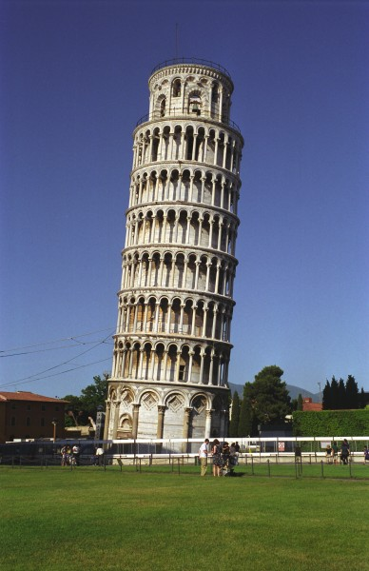
Do Threads Have a Sound Foundation?
If the foundation is bad, then we either tolerate brittle designs that are difficult to make work, or we have to rebuild from the foundations.
Note that this whole enterprise is held up by threads

Slide 21
Succinct Problem Statement
Threads are wildly nondeterministic.
The programmer’s job is to prune away the nondeterminism by imposing constraints on execution order (e.g., mutexes) and limiting shared data accesses (e.g., OO design).

Slide 22
Succinct Solution Statement
Instead of starting with a wildly nondeterministic mechanism and asking the programmer to rein in that nondeterminism, start with a deterministic mechanism and incrementally add nondeterminism where needed.
Under this principle, even the most effective of today’s techniques (OO design, transactions, message passing, …) require fundamental rethinking.

Slide 23
Problems with the Foundations
The 20-th century notion of “computation”:
Bits: B = {0, 1}
Set of finite sequences of bits: B∗
Computation: f : B∗→ B∗
Composition of computations: f • f '
Programs specify compositions of computations
Threads augment this model to admit concurrency.
But this model does not admit concurrency gracefully.

Slide 24
Composition of Computations
initial state: b₀ ∈ B∗
sequential
composition
b_{n} = f_{n} ( b_{n-1} )
final state: b_{N}

Slide 25
When There are Threads,
Everything Changes
A program no longer computes a function.
b_{n} = f_{n} ( b_{n-1} )
suspend
another thread can change the state
resume
b'_{n} = f_{n} ( b'_{n-1} )
Apparently, programmers find this model appealing because nothing has changed in the syntax.

Slide 26
Instead of a Program Specifying…
f : B∗ → B∗

Slide 27
… a Program Should Specify
f : (T → B∗)^{n} → (T → B∗)^{n}
This is a function from the set of tuples of (possibly partial) functions from T to B∗ into itself, for some partially ordered set of tags T.
Composition of concurrent components now becomes function composition.
This is called the “tagged signal model”
[Lee & Sangiovanni-Vincentelli, 1998]

Slide 28
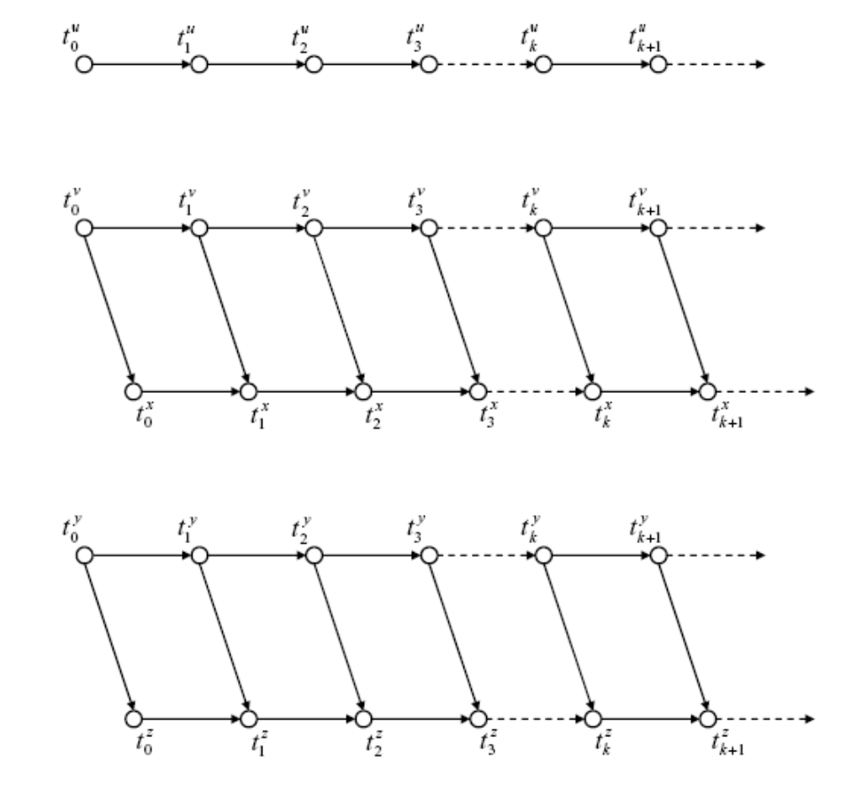
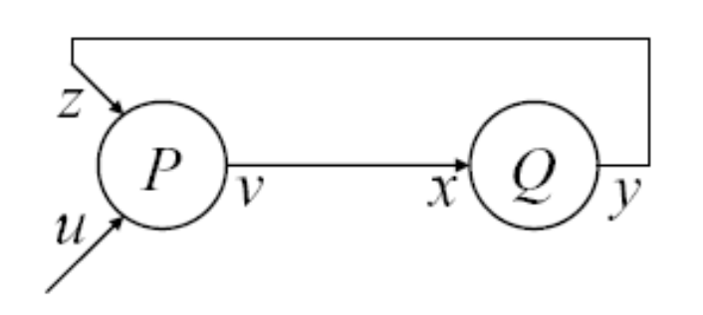
Example: Tag Set T for
Kahn Process Networks
Ordering constraints on tags imposed by communication:
signal
process
u
v
x ∈ (T → B∗)
x
Each signal maps a totally ordered subset of T into values.
y
z
Example from Xiaojun Liu, Ph.D. Thesis, 2005.

Slide 29
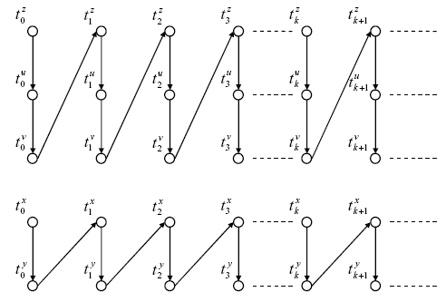
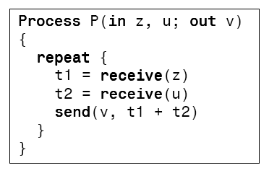
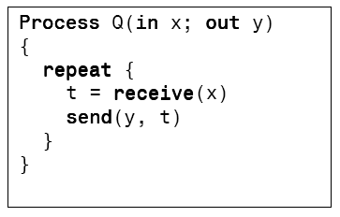
Example: Tag Set T for
Kahn Process Networks
Ordering constraints on tags imposed by computation:
z
u
v
x
y
Composition of these constraints with the previous reveals deadlock.
Example from Xiaojun Liu, Ph.D. Thesis, 2005.

Slide 30

A Rich Family of Examples:
Timed Concurrent Systems
Tag set is totally ordered.
  Example: T = , with lexicographic order (“super dense time”).
Used to model
  hardware,
  continuous dynamics,
  hybrid systems,
  embedded software
Gives semantics to “cyber-physical systems”.
See [Liu, Matsikoudis, Lee, CONCUR 2006].

Slide 31
The Catch…
f : (T → B∗)^{n} → (T → B∗)^{n}
This is not what (mainstream)
programming languages do.
This is not what (mainstream) software component technologies do.
Let’s tackle the second problem first…

Slide 32
Object Oriented vs. Actor Oriented
The established: Object-oriented:
class name
What flows through an object is sequential control
data
methods
call
return
Things happen to objects
The alternative: Actor oriented:
Actors make things happen
actor name
data (state)
What flows through an object is evolving data
parameters
ports
Input data
Output data

Slide 33
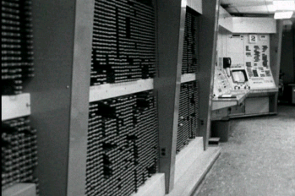

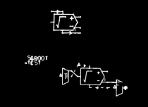
The First (?) Actor-Oriented Programming Language
The On-Line Graphical Specification of Computer Procedures
W. R. Sutherland, Ph.D. Thesis, MIT, 1966
MIT Lincoln Labs TX-2 Computer
Bert Sutherland with a light pen
Bert Sutherland used the first acknowledged object-oriented framework (Sketchpad, created by his brother, Ivan Sutherland) to create the first actor-oriented programming language (which had a visual syntax).
Partially constructed actor-oriented model with a class definition (top) and instance (below).

Slide 34
Examples of Actor-Oriented “Languages”
CORBA event service (distributed push-pull)
ROOM and UML-2 (dataflow, Rational, IBM)
VHDL, Verilog (discrete events, Cadence, Synopsys, ...)
LabVIEW (structured dataflow, National Instruments)
Modelica (continuous-time, constraint-based, Linkoping)
OPNET (discrete events, Opnet Technologies)
SDL (process networks)
Occam (rendezvous)
Simulink (Continuous-time, The MathWorks)
SPW (synchronous dataflow, Cadence, CoWare)
…
Many of these are domain specific.
Many of these have visual syntaxes.
The semantics of these differ considerably,
but all can be modeled as
f : (T → B∗)^{n} → (T → B∗)^{n}
with appropriate choices of the set T.

Slide 35
Recall the Observer Pattern
“The Observer pattern defines a one-to-many dependency between a subject object and any number of observer objects so that when the subject object changes state, all its observer objects are notified and updated automatically.”

Slide 36
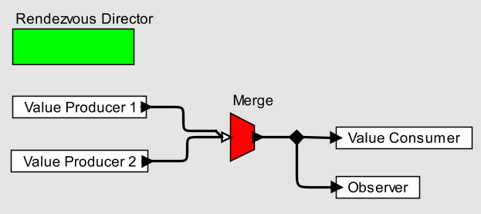
Observer Pattern using an Actor-Oriented Language with Rendezvous Semantics
Each actor is a process, communication is via rendezvous, and the Merge explicitly represents nondeterministic multi-way rendezvous.
This is realized here in a coordination language with a visual syntax.

Slide 37
Now that we’ve made a trivial design pattern trivial, we can work on more interesting aspects of the design.
E.g., suppose we don’t care how long notification of the observer is deferred, as long as the observer is notified of all changes in the right order?

Slide 38
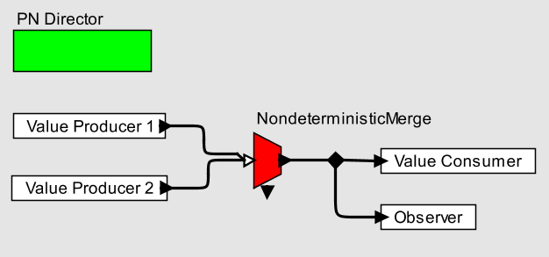
Observer Pattern using an Actor-Oriented Language with Kahn Semantics (Extended with Nondeterministic Merge)
Each actor is a process, communication is via streams, and the NondeterministicMerge explicitly merges streams nondeterministically.
Again a coordination language with a visual syntax.

Slide 39
Suppose further that we want to explicitly specify the timing of producers?

Slide 40
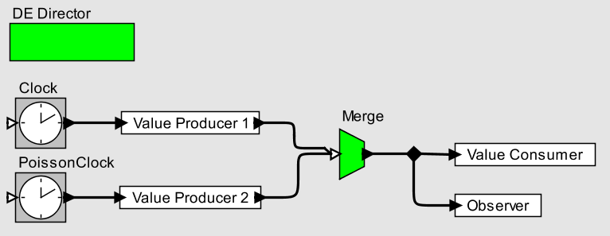
Observer Pattern using an Actor-Oriented Language with Discrete Event Semantics
Messages have a (semantic) time, and actors react to messages chronologically. Merge now becomes deterministic.
Again a coordination language with a visual syntax.

Slide 41
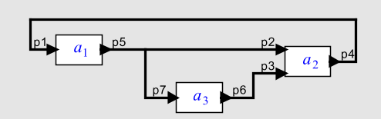
Composition Semantics
The model of computation determines the set T:
Process Networks
Synchronous/Reactive
Time-Triggered
Discrete Events
Dataflow
Rendezvous
Continuous Time
…
Each actor is a function:
Composition in three forms:
Cascade connections
Parallel connections
Feedback connections
The nontrivial part of this is feedback, but this community knows how to handle that.
f : (T → B∗) ^{n} → (T → B∗) ^{n}

Slide 42
Recall The Catch …
f : (T → B∗)^{n} → (T → B∗)^{n}
This is not what (mainstream)
programming languages do.
  What to do here?
This is not what (mainstream) software component technologies do.
  Actor-oriented components

Slide 43
Nothing!
(Almost)

Slide 44
Do Not Ignore the Challenges
Computation is deeply rooted in the sequential paradigm.
  Threads appear to adhere to this paradigm, but throw out its essential attractiveness.
Programmers are reluctant to accept new syntax.
  Regrettably, syntax has a bigger effect on acceptance than semantics, as witnessed by the wide adoption of threads.
Only general purpose languages get attention.
  A common litmus test: must be able to write the compiler for the language in the language.

Slide 45
Opportunities
New syntaxes can be accepted when their purpose is orthogonal to that of established languages.
  Witness UML, a family of languages for describing object-oriented design, complementing C++ and Java.
Coordination languages can provide capabilities orthogonal to those of established languages.
  The syntax can be noticeably distinct (as in the diagrams shown before).
Actor-oriented design can be accomplished through coordination languages that complement rather than replace existing languages.

Slide 46
The Solution
Actor-oriented component architectures implemented in coordination languages that complement rather than replace existing languages.
With good design of these coordination languages, this will deliver understandable concurrency.
See the Ptolemy Project for explorations of several such languages: http://ptolemy.org

Slide 47
Conclusion
Transformation of bits is the foundation of computation.
Threads are the foundation of concurrent programming practice.
The foundations are flawed.
  Threads discard the most essential features of computation.
  Threads are incomprehensible to humans.
  They appeal because they make (almost) no changes to syntax.
Concurrent computation needs a new foundation.
  Actor oriented component models.
  Coordination languages with actor semantics.
  Visual syntaxes to seduce users.
  These have a chance of acceptance!

Slide 48
References
The Ptolemy Project: http://ptolemy.org
X. Liu, E. Matsikoudis, and E. A. Lee, "Modeling Timed Concurrent Systems," in CONCUR 2006 - Concurrency Theory, Bonn, Germany, (LNCS 4137, Springer), August 27-30, 2006.
E. A. Lee, "The Problem with Threads," Computer, vol. 39, pp. 33-42, 2006.
X. Liu and E. A. Lee, "CPO Semantics of Timed Interactive Actor Networks," UC Berkeley, Berkeley, CA, Technical Report EECS-2006-67, May 18 2006.
A. Cataldo, E. A. Lee, X. Liu, E. Matsikoudis, and H. Zheng, "A Constructive Fixed-Point Theorem and the Feedback Semantics of Timed Systems," in Workshop on Discrete Event Systems (WODES), Ann Arbor, Michigan, July 10-12, 2006.
X. Liu, "Semantic Foundation of the Tagged Signal Model," EECS Department, University of California, Berkeley, CA, PhD Thesis December 20 2005.
E. A. Lee, "Concurrent Models of Computation for Embedded Software: Lecture Notes for EECS 290N," EECS Department, University of California, Berkeley, CA, Technical Report UCB/ERL M05/2, January 4 2005.
E. A. Lee and A. Sangiovanni-Vincentelli, "A Framework for Comparing Models of Computation," IEEE Transactions on Computer-Aided Design of Circuits and Systems, vol. 17, pp. 1217-1229, 1998.

