Slide 1
Actor Networks
Edward A. Lee
Robert S. Pepper Distinguished Professor
Chair of EECS
UC Berkeley
Invited Talk
Workshop Foundations and Applications of
Component-based Design
Seoul, Korea, Oct. 26, 2006
Notes:
System-Level Design Languages: Orthogonalizing the Issues
Presenter: Edward A. Lee, UC Berkeley
Abstract:
System-level design languages (SLDLs) need to be equally comfortable with hardware, software, and problem-level models. The requirements are too broad to be adequately addressed by any single solution that we would recognize as a “language.” But the prospect of needing (or continuing to need) to use multiple incompatible languages to achieve a single system design is grim. In this talk, I outline an approach to achieving interoperability without a single monolithic standard language. Instead, orthogonal properties of a language are created and standardized separately. Specifically, an SLDL is divided into an abstract syntax, a system of syntactic transformations, a concrete syntax, an actor semantics, a semantics for the interaction of actors,and a type system. Each of these are roughly independent dimensions of a language, and two languages, tools, or frameworks may share identical designs in one or more dimensions. Interoperability can be achieved where practical, but does not become a straightjacket where impractical.

Slide 2
Key Concepts in Model-Based Design
Specifications are executable models.
Models are composed to form designs.
Models evolve during design.
Deployed code is generated from models.
Modeling languages have formal semantics.
Modeling languages themselves are modeled.
For general-purpose software, this is about
Object-oriented design
For embedded systems, this is about
Time
Concurrency

Slide 3
What We Have Learned
Embedded systems
demand a different approach to computation.

Slide 4
Instead of a Program Specifying…
f : {0,1}∗ → {0,1}∗
… a (partial) function from bit sequences to bit sequences …

Slide 5
… A Program Should Specify
f : [T → {0,1}∗]^{P} → [T → {0,1}∗]^{P}
“actor”
“signal”
“signal”
…where T is a (partially) ordered set representing time, precedence ordering, causality, synchronization, etc.

Slide 6
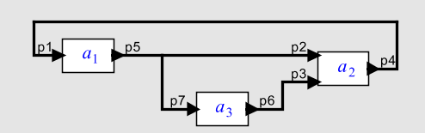
This Leads to What We Call
Actor-Oriented Component Composition
x ∈ [T → {0,1}*]
Some of the Possible
Models of Computation:
Time-Triggered
Discrete Events
Dataflow
Rendezvous
Synchronous/Reactive
Continuous Time
Mixtures of the above
…
Cascade connections
Parallel connections
Feedback connections
If actors are functions on signals, then the nontrivial part of this is feedback.

Slide 7
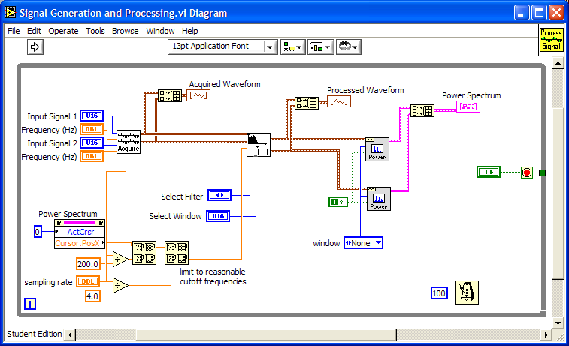
Examples of Actor-Oriented “Languages”
CORBA event service (distributed push-pull)
LabVIEW (dataflow, National Instruments)
Modelica (continuous-time, Linkoping)
OPNET (discrete events, Opnet Technologies)
Occam (rendezvous)
ROOM and UML-2 (dataflow, Rational, IBM)
SCADE and synchronous languages (synchronous/reactive)
SDL (process networks)
Simulink (Continuous-time, The MathWorks)
SPW (synchronous dataflow, Cadence, CoWare)
VHDL, Verilog (discrete events, Cadence, Synopsys, ...)
…
Many of these are domain specific.
Many of these have visual syntaxes.
The semantics of these differ considerably,
but all can be modeled as
f : [T → {0,1}∗]^{P} → [T → {0,1}∗]^{P}
with appropriate choices of the set T.

Slide 8
The Catch…
f : [T → {0,1}∗]^{P} → [T → {0,1}∗]^{P}
This is not what (mainstream) programming languages do.
This is not what (mainstream) software component technologies do.
This is not what (most) semantic theories do.
Let’s deal with this one first…

Slide 9
How much Theory is Based on f : {0,1}∗ → {0,1}∗ ?
Effectively computable functions [Turing, Church]
Operational semantics as sequences of transformations of state [Various]
Denotational semantics as functions mapping a syntax into a function that maps state into state [Winskel]
Equivalence as bisimulation [Milner]
Verification as model checking [Various]
…
See [Lee, FORMATS 2006] for further discussion of this.

Slide 10
Our Approach to a More Suitable Theory:
The Tagged Signal Model
[Lee & Sangiovanni-Vincentelli, 1998]
A set of values V and a set of tags T
An event is e ∈ T × V
A signal s is a set of events. I.e. s ⊂ T × V
A functional signal is a (partial) function s: T → V
The set of all signals S = 2^{T × V}
Related models:
  Interaction Categories [Abramsky, 1995]
  Interaction Semantics [Talcott, 1996]
  Abstract Behavioral Types [Arbab, 2005]

Slide 11





Actors, Ports, and Behaviors
An actor has N ports P
A behavior is a tuple of signals σ = S ^{N}
An actor is a set of behaviors A ⊂ S ^{N}

Slide 12


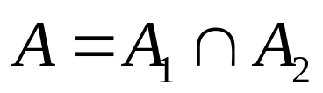
Actor Composition
Composition is simple intersection
A₁ ⊂ S ⁴
A₂ ⊂ S ⁴

Slide 13
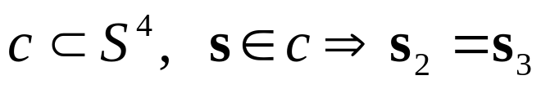
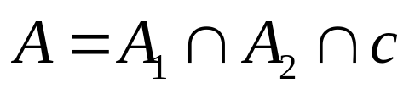
Connectors
Connectors are (typically) trivial actors.
c
A

Slide 14
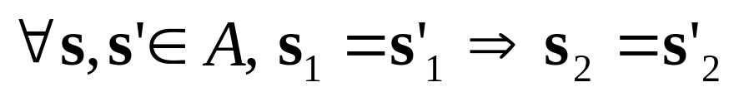
Functional Actors
Ports become inputs or outputs.
Actors become functions from inputs to outputs.
A ⊂ S ⁴

Slide 15
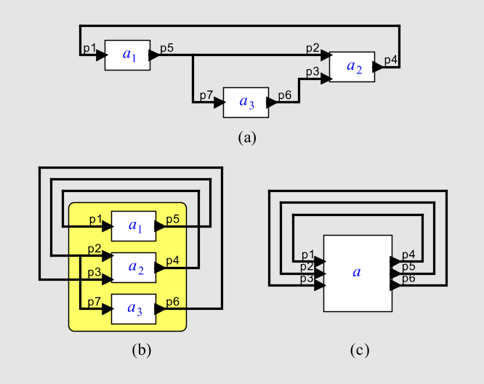
For Functional Actors, Arbitrary Composition has a Fixed-Point Semantics

Slide 16
Structure of the Tag Set
The algebraic properties of the tag set T are determined by the concurrency model, e.g.:
  Process Networks
  Synchronous/Reactive
  Time-Triggered
  Discrete Events
  Dataflow
  Rendezvous
  Continuous Time
  Hybrid Systems
  …
Associated with these may be a richer model of the connectors between actors.

Slide 17
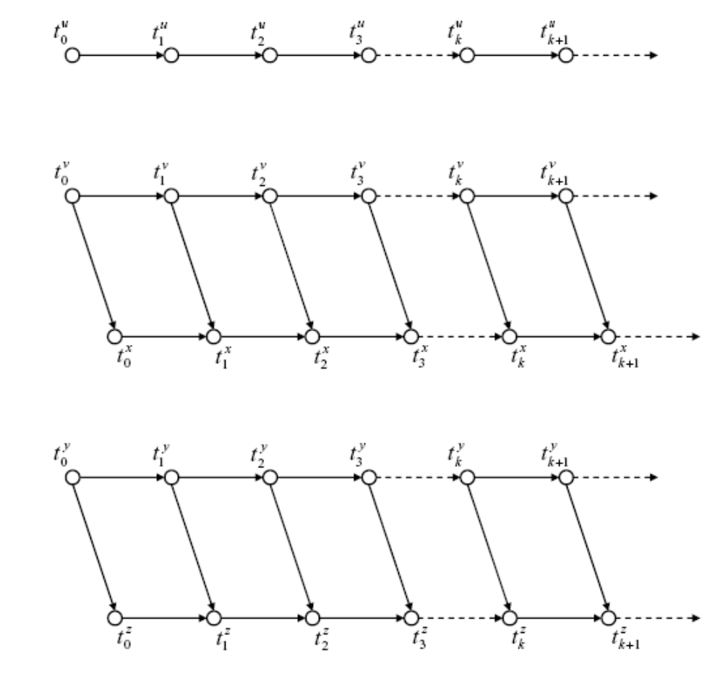
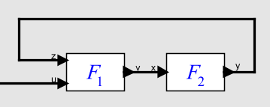
Example of a Partially Ordered Tag Set T for Kahn Process Networks
Ordering constraints on tags imposed by communication:
signal
actor
u
v
s: T → V
x
Each signal maps a totally ordered subset of T into values.
y
z
Example from Xiaojun Liu, Ph.D. Thesis, 2005.

Slide 18
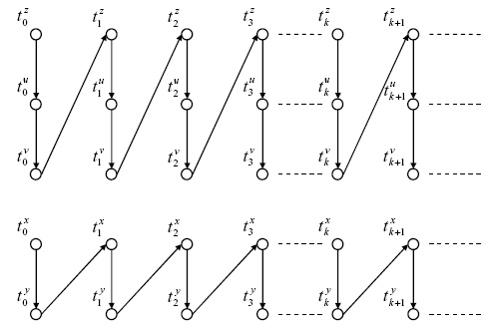
Example: Tag Set T for
Kahn Process Networks
Ordering constraints on tags imposed by computation:
z
Actor F1(in z, u; out v)
{
repeat {
t1 = receive(z)
t2 = receive(u)
send(v, t1 + t2)
}
}
u
v
Actor F2(in x; out y)
{
repeat {
t = receive(x)
send(v, t)
}
}
x
y
Composition of these constraints with the previous reveals deadlock.
Example from Xiaojun Liu, Ph.D. Thesis, 2005.

Slide 19


Totally Ordered Tag Sets
Example: T =
(synchronous languages)
Example: T = , with lexicographic order (“super dense time”).
  Used to model
    hardware,
    continuous dynamics,
    hybrid systems,
    embedded software
See [Liu, Matsikoudis, Lee, CONCUR 2006].

Slide 20
Recall The Catch…
f : [T → {0,1}∗]^{P} → [T → {0,1}∗]^{P}
This is not what (mainstream) programming languages do.
This is not what (mainstream) software component technologies do.
This is not what (most) semantic theories do.
Let’s look at the second problem next…

Slide 21
Actor-Oriented Design
Established component interactions:
class name
What flows through an object is sequential control
data
methods
call
return
Things happen to objects
The alternative: “Actor oriented:”
Actors make things happen
actor name
data (state)
What flows through an object is evolving data
parameters
ports
Input data
Output data

Slide 22
The Key To Success:
Separation of Concerns
Abstract Syntax
Concrete Syntax
Syntax-Based Static Analysis: e.g. Type Systems
Abstract Semantics
Concrete Semantics
Semantics-Based Static Analysis: e.g. Verification

Slide 23
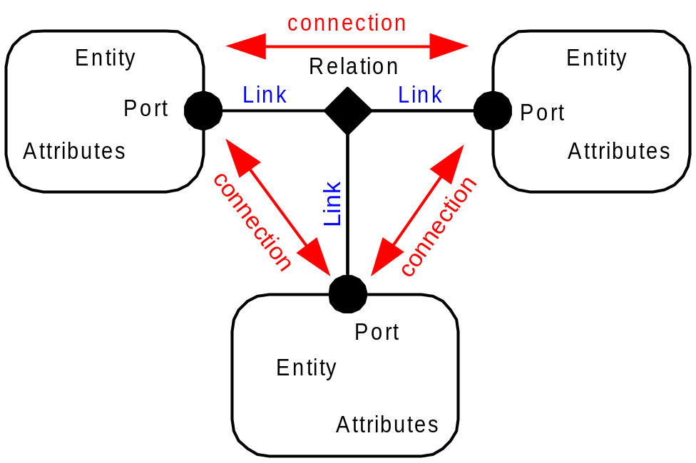
An Abstract Syntax
Entities
Attributes on entities (parameters)
Ports in entities
Links between ports
Width on links (channels)
Hierarchy
Abstract syntaxes can be formalized.
See [Jackson and Sztipanovits, EMSOFT 2006]

Slide 24
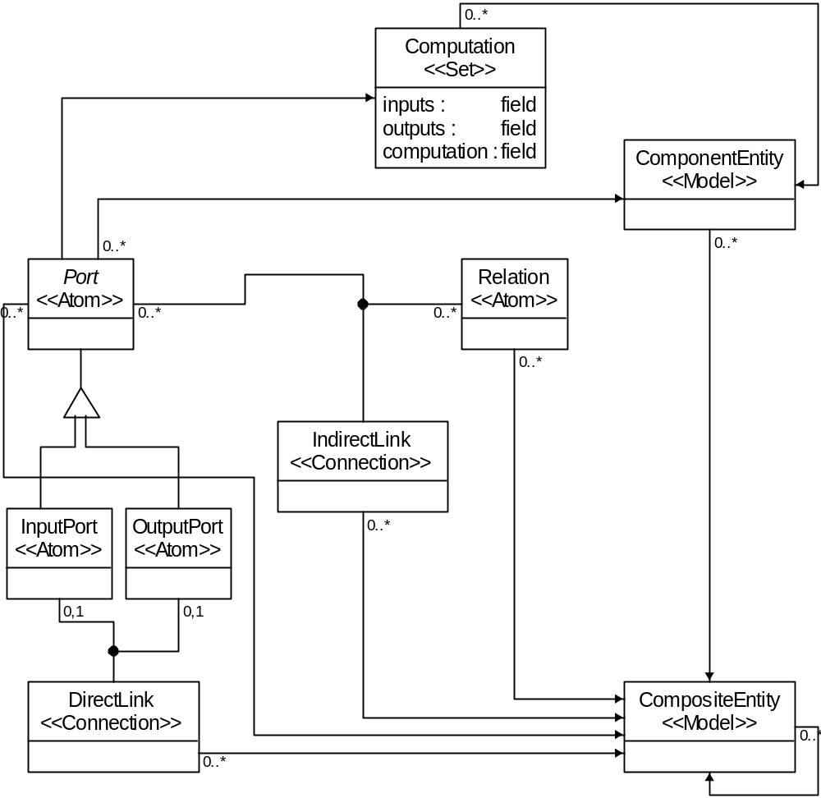
Meta-Modeling of an Abstract Syntax
Using GME (from Vanderbilt) an abstract syntax is specified as an object model (in UML) with constraints (in OCL), or alternatively, with MOF.
Such a spec can be used to synthesize visual editors and models transformers.
Meta-model of Ptolemy II abstract syntax, constructed in GME by H. Y. Zheng.

Slide 25
The Key To Success:
Separation of Concerns
Abstract Syntax
Concrete Syntax
Syntax-Based Static Analysis: e.g. Type Systems
Abstract Semantics
Concrete Semantics
Semantics-Based Static Analysis: e.g. Verification

Slide 26
Concrete Syntax
Example concrete syntax in XML:
...
<entity name="FFT" class="ptolemy.domains.sdf.lib.FFT">
<property name="order" class="ptolemy.data.expr.Parameter" value="order">
</property>
<port name="input" class="ptolemy.domains.sdf.kernel.SDFIOPort">
...
</port>
...
</entity>
...
<link port="FFT.input" relation="relation"/>
<link port="AbsoluteValue2.output" relation="relation"/>
...
XML and XSLT have made concrete syntax even less important than it used to be. Going a step further, GReAT (from Vanderbilt) works with GME to synthesize model transformers from meta models.

Slide 27
The Key To Success:
Separation of Concerns
Abstract Syntax
Concrete Syntax
Syntax-Based Static Analysis: e.g. Type Systems
Abstract Semantics
Concrete Semantics
Semantics-Based Static Analysis: e.g. Verification
See [Lee and Neuendorffer, MEMOCODE 2004] and [Xiong, PhD Thesis, 2002] for actor-oriented type systems.

Slide 28
The Key To Success:
Separation of Concerns
Abstract Syntax
Concrete Syntax
Syntax-Based Static Analysis: e.g. Type Systems
Abstract Semantics
Concrete Semantics
Semantics-Based Static Analysis: e.g. Verification

Slide 29
Where We Are Headed
An Abstract Semantics
A Finer Abstract Semantics
A Concrete Semantics
(or Model of Computation)

Slide 30
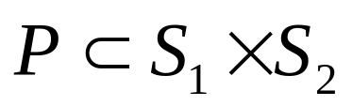
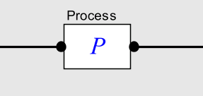
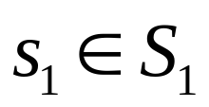
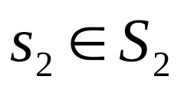
Tagged Signal Abstract Semantics
Tagged Signal Abstract Semantics:
an actor is a subset of the signals with which it interacts.
signal is a set of events.
port may be an input or an output,
or neither or both. It is irrelevant.
This outlines a general abstract semantics that gets specialized. When it becomes concrete you have a
model of computation.

Slide 31
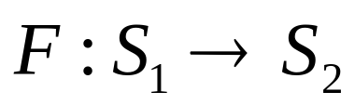
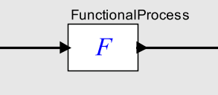
A Finer Abstraction Semantics
Functional Abstract Semantics:
An actor is now a function from input signals to output signals.
port is now either an
input or an output (or both).
This outlines an abstract semantics for deterministic producer/consumer actors.

Slide 32
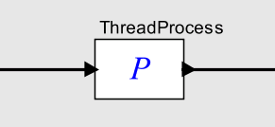
Another Finer Abstract Semantics
Process Networks Abstract Semantics:
sets of signals are monoids, which allows us to incrementally construct them. E.g.
stream
event sequence
rendezvous points …
An actor is a sequence of operations on its signals where the operations are the associative operation of a monoid
Actor is not necessarily functional (can be nondeterministic).
port is either an
input or an output or both.
This outlines an abstract semantics for actors constructed as processes that incrementally read and write port data.

Slide 33
Concrete Semantics that Conform with the Process Networks Abstract Semantics
Communicating Sequential Processes (CSP) [Hoare]
Calculus of Concurrent Systems (CCS) [Milner]
Kahn Process Networks (KPN) [Kahn]
Nondeterministic extensions of KPN [Various]
Actors [Hewitt]
Some Implementations:
Occam, Lucid, and Ada languages
Ptolemy Classic and Ptolemy II (PN and CSP domains)
System C
Metropolis

Slide 34
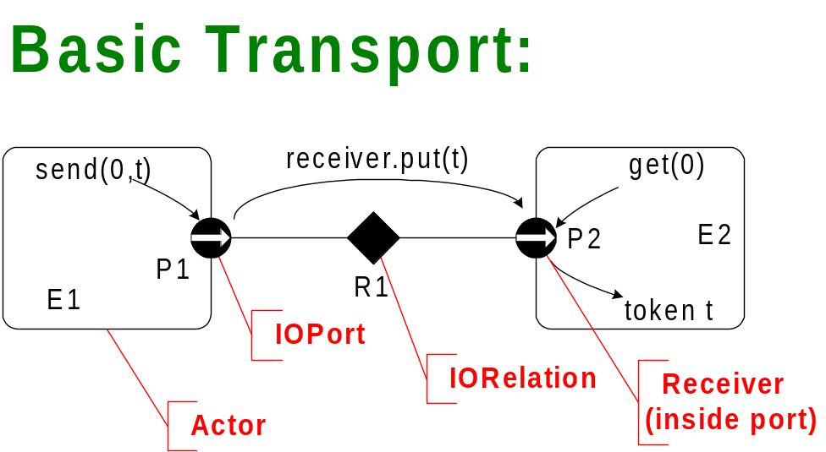
Process Network Abstract Semantics has a Natural Software Implementation
execution control
data transport
init()
fire()

Slide 35
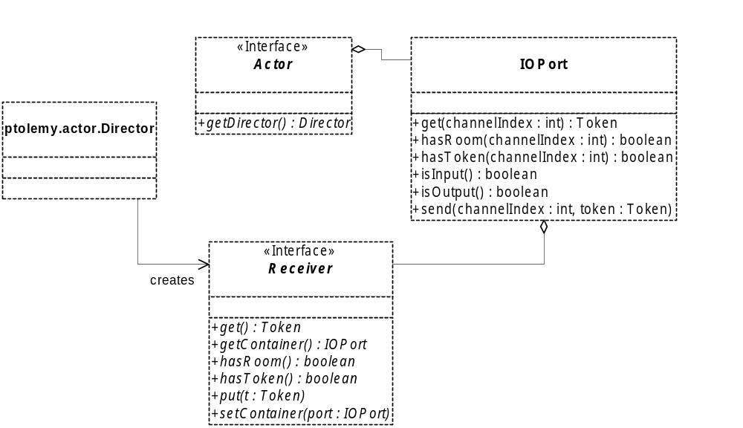
Process Network Abstract Semantics in Ptolemy II
actor contains ports
port contains receivers
receiver implements communication
director creates receivers
monoid operation to incrementally construct signals

Slide 36
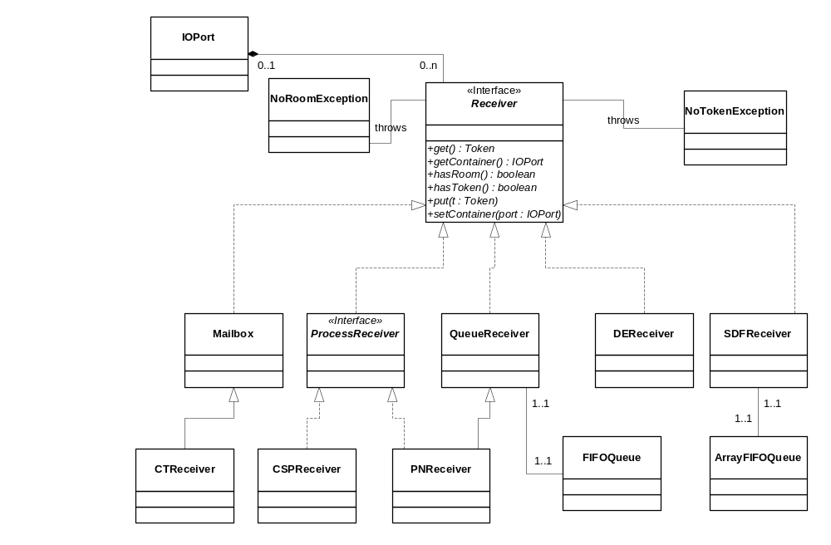
Several Concrete Semantics
Refine this Abstract Semantics
communicating sequential processes
Kahn process networks

Slide 37
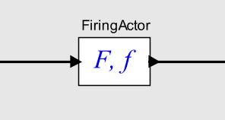
A Still Finer Abstract Semantics
Firing Abstract Semantics:
An actor is still a function from input signals to output signals, but that function now is defined in terms of a firing function.
signals are in monoids (can be incrementally constructed) (e.g. streams, discrete-event signals).
port is still either an
input or an output.
The process function F is the least fixed point of a functional defined in terms of f.

Slide 38
Models of Computation that Conform to the Firing Abstract Semantics
Dataflow models (all variations)
Discrete-event models
Time-driven models (Giotto)
In Ptolemy II, actors written to the firing abstract semantics can be used with directors that conform only to the process network abstract semantics.
Such actors are said to be behaviorally polymorphic.

Slide 39
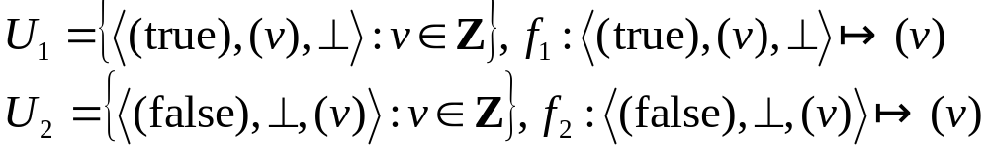
Actor Language for the
Firing Abstract Semantics: Cal
Cal is an actor language designed to provide statically inferable actor properties w.r.t. the firing abstract semantics. E.g.:
Inferable firing rules and firing functions:
actor Select () S, A, B ==> Output:
action S: [sel], A: [v] ==> [v]
guard sel end
action S: [sel], B: [v] ==> [v]
guard not sel end
end
Thanks to Jorn Janneck, Xilinx

Slide 40
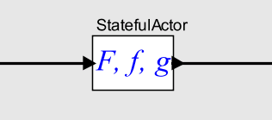
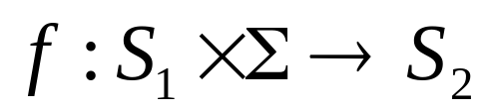
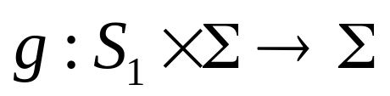
A Still Finer Abstract Semantics
Stateful Firing Abstract Semantics:
An actor is still a function from input signals to output signals, but that function now is defined in terms of two functions.
signals are monoids (can be incrementally constructed) (e.g. streams, discrete-event signals).
state space
port is still either an
input or an output.
The function f gives outputs in terms of inputs and the current state. The function g updates the state.

Slide 41
Models of Computation that Conform to the Stateful Firing Abstract Semantics
Synchronous reactive
Continuous time
Hybrid systems
Stateful firing supports iteration to a fixed point, which is required for hybrid systems modeling.
In Ptolemy II, actors written to the stateful firing abstract semantics can be used with directors that conform only to the firing abstract semantics or to the process network abstract semantics.
Such actors are said to be behaviorally polymorphic.

Slide 42
Where We Are
Tagged Signal Semantics
Process Networks Semantics
Firing Semantics
Stateful Firing Semantics

Slide 43
Where We Are
Tagged Signal Semantics
Process Networks Semantics
Firing Semantics
Giotto
Kahn process
networks
Stateful Firing Semantics
synchronous/
reactive
discrete
events
hybrid systems
continuous
time

Slide 44
Meta Frameworks: Ptolemy II
Tagged Signal Semantics
Process Networks Semantics
Firing Semantics
dataflow
Ptolemy II emphasizes construction of “behaviorally polymorphic” actors with stateful firing semantics (the “Ptolemy II actor semantics”), but also provides support for broader abstract semantic models via its abstract syntax and type system.
Kahn process
networks
Stateful Firing Semantics
synchronous/
reactive
discrete
events
hybrid systems
continuous
time

Slide 45
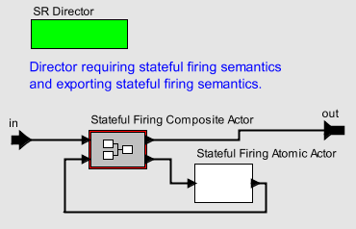
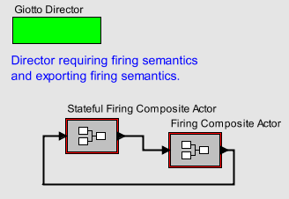
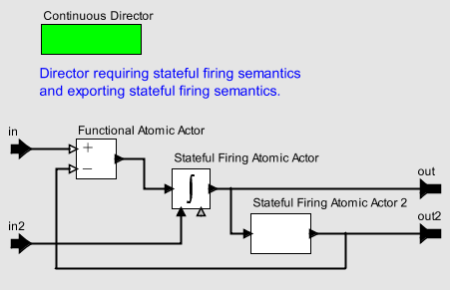
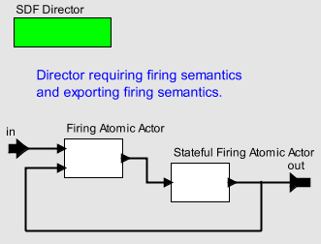
A Consequence:
Heterogeneous Composition Semantics
Models of computation can be systematically composed.

Slide 46
The Key To Success:
Separation of Concerns
Abstract Syntax
Concrete Syntax
Syntax-Based Static Analysis: e.g. Type Systems
Abstract Semantics
Concrete Semantics
Semantics-Based Static Analysis: e.g. Verification

Slide 47
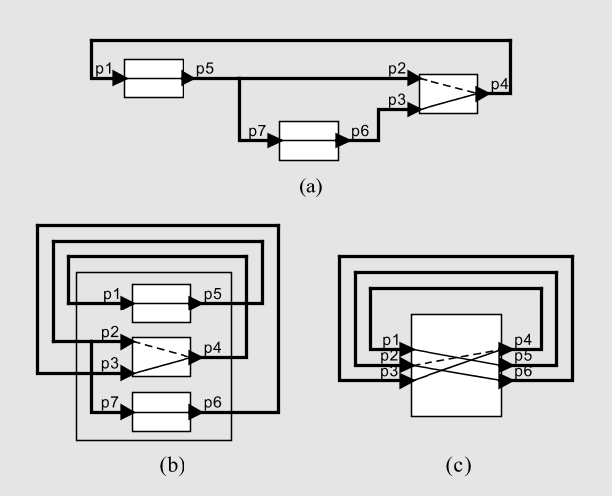
Interface Algebra for Causality Analysis
An algebra of interfaces provides operators for cascade and parallel composition and necessary and sufficient conditions for causality loops, zero-delay loops, and deadlock.
See [Zhou and Lee, EMSOFT 2006]

Slide 48
Recall The Catch…
f : [T → {0,1}∗]^{P} → [T → {0,1}∗]^{P}
This is not what (mainstream) programming languages do.
This is not what (mainstream) software component technologies do.
This is not what (most) semantic theories do.
Let’s look at the first problem last…

Slide 49
Programming Languages
Imperative reasoning is simple and useful
Keep it!
The problem is that timing is unpredictable.
Fix this at the architecture level:
  Replace cache memories with scratchpads
  Replace dynamic dispatch with pipeline interleaving
  Define decidable subsets of standard language
  Deliver rigorous, precise, and tight WCET bounds.

Slide 50

Conclusion
The time is right to create the 21-st century theory of (embedded) computing.

