Slide 1
Discrete Event Models:
Getting the Semantics Right
Edward A. Lee
Robert S. Pepper Distinguished Professor
Chair of EECS
UC Berkeley
With thanks to Xioajun Liu, Eleftherios Matsikoudis, and Haiyang Zheng
Invited Keynote Talk
Winter Simulation Conference
December 4, 2006
Monterey, CA
Notes:
System-Level Design Languages: Orthogonalizing the Issues
Presenter: Edward A. Lee, UC Berkeley
Abstract:
System-level design languages (SLDLs) need to be equally comfortable with hardware, software, and problem-level models. The requirements are too broad to be adequately addressed by any single solution that we would recognize as a “language.” But the prospect of needing (or continuing to need) to use multiple incompatible languages to achieve a single system design is grim. In this talk, I outline an approach to achieving interoperability without a single monolithic standard language. Instead, orthogonal properties of a language are created and standardized separately. Specifically, an SLDL is divided into an abstract syntax, a system of syntactic transformations, a concrete syntax, an actor semantics, a semantics for the interaction of actors,and a type system. Each of these are roughly independent dimensions of a language, and two languages, tools, or frameworks may share identical designs in one or more dimensions. Interoperability can be achieved where practical, but does not become a straightjacket where impractical.

Slide 2
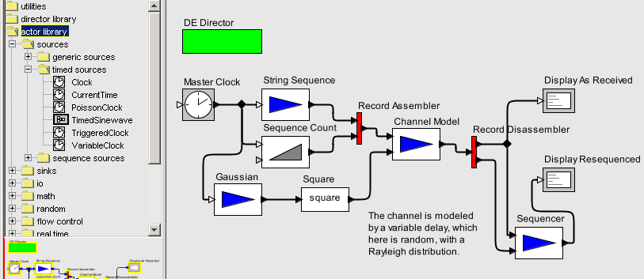
Ptolemy II: Our Laboratory for Studying Concurrent Models of Computation
Concurrency management supporting dynamic model structure.
Director from an extensible library defines component interaction semantics or “model of computation.”
Type system for communicated data
Extensible component library.
Visual editor for defining models

Slide 3
Some Models of Computation
Implemented in Ptolemy II
This talk will focus on Discrete Events (DE)
CSP – concurrent threads with rendezvous
CT – continuous-time modeling
DE – discrete-event systems
DDE – distributed discrete events
DDF – dynamic dataflow
DPN – distributed process networks
DT – discrete time (cycle driven)
FSM – finite state machines
Giotto – synchronous periodic
GR – 2-D and 3-D graphics
PN – process networks
SDF – synchronous dataflow
SR – synchronous/reactive
TM – timed multitasking
But will also establish connections with Continuous Time (CT), Synchronous Reactive (SR) and hybrid systems (CT + FSM)

Slide 4
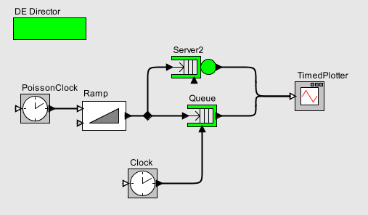
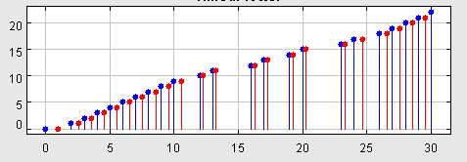
Discrete Events (DE): A Timed Concurrent Model of Computation
DE Director implements timed semantics using an event queue
Actors communicate via “signals” that are marked point processes (discrete, valued, events in time).
Actor (in this case, source of events)
Reactive actors produce output events in response to input events
Plot of the value (marking) of a signal as function of time.

Slide 5
Our Applications of DE
Modeling and simulation of
  Communication networks (mostly wireless)
  Hardware architectures
  Systems of systems
Design and software synthesis for
  Sensor networks (TinyOS/nesC)
  Distributed real-time software
  Hardware/software systems

Slide 6
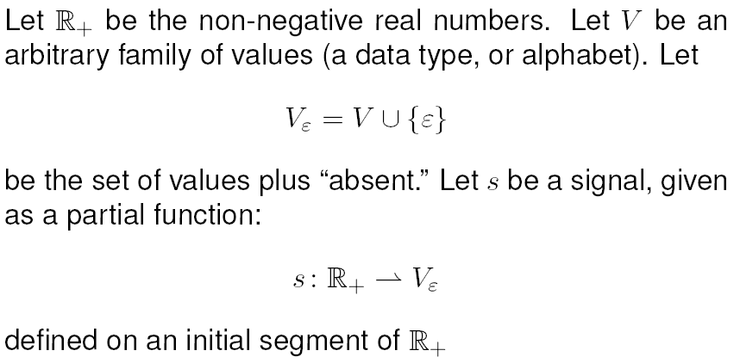
First Attempt at a Model for Signals

Slide 7


First Attempt at a Model for Signals
This model is not rich enough because it does not allow a signal to have multiple events at the same time.

Slide 8
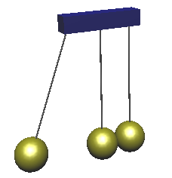
Example Motivating the Need for Simultaneous Events Within a Signal
Newton’s Cradle:
Steel balls on strings
Collisions are events
Momentum of the middle ball has three values at the time of collision.
This example has continuous dynamics as well
(I will return to this)
Other examples:
Batch arrivals at a queue.
Software sequences abstracted as instantaneous.
Transient states.

Slide 9
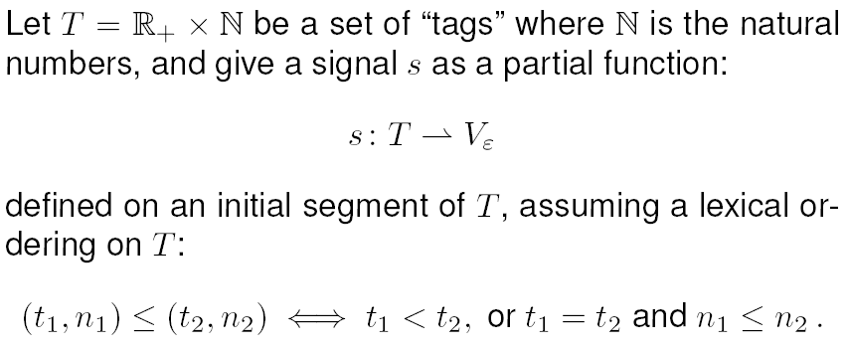
A Better Model for Signals:
Super-Dense Time
This allows signals to have a sequence of values at any real time t.

Slide 10
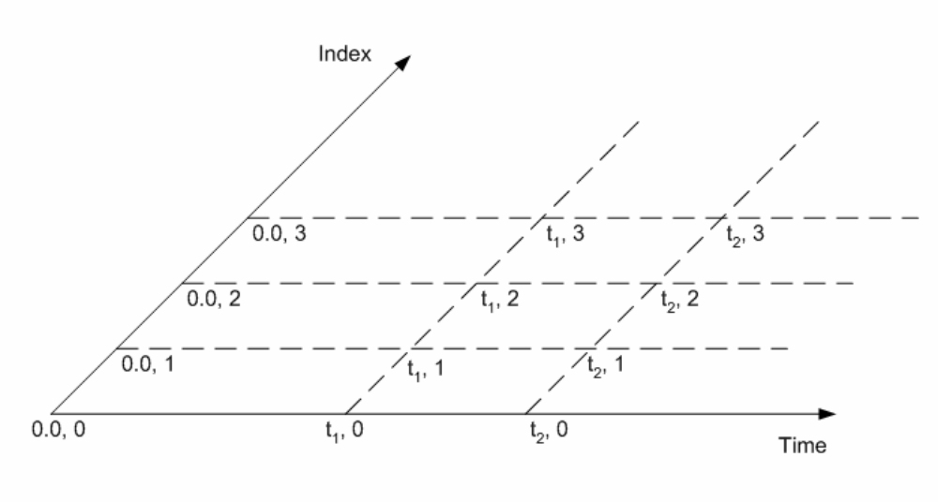
Super Dense Time

Slide 11

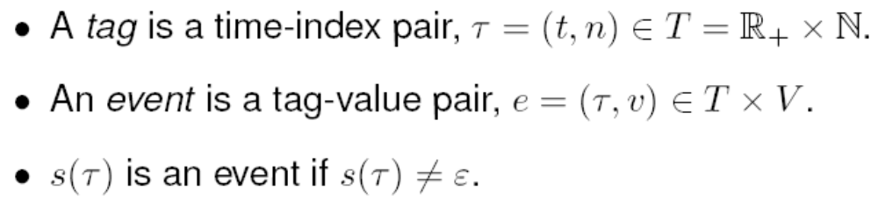
Events and Firings
Operationally, events are processed by presenting all input events at a tag to an actor and then firing it.
However, this is not always possible!

Slide 12
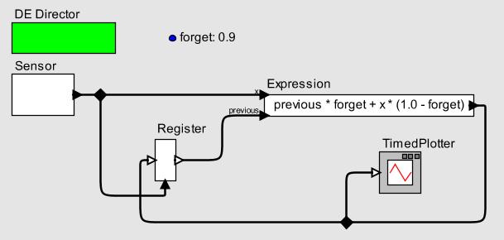
A Feedback Design Pattern
trigger input port
data input port
In this model, a sensor produces measurements that are combined with previous measurements using an exponential forgetting function.
The feedback loop makes it impossible to present the Register actor with all its inputs at any tag before firing it.

Slide 13
Solving Feedback Loops
Possible solutions:
All actors have time delay
Some actors have time delay,
and every directed loop must have an actor with time delay.
All actors have delta delay
Some actors have delta delay
and every directed loop must have an actor with delta delay.
Although each of these solutions is used, all are problematic.
The root of the problem is simultaneous events.

Slide 14
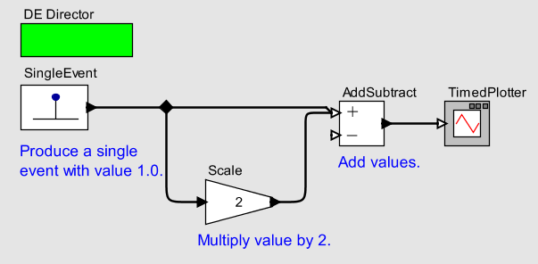
Consider “All Actors Have Time Delay”
If all actors have time delay, this produces either:
Event with value 1 followed by event with value 2, or
Event with value 1 followed by event with value 3.
(the latter if signal values are persistent).
Neither of these is likely what we want.

Slide 15
Consider “All Actors Have Delta Delay”
With delta delays, if an input event is ((t, n), v), the corresponding output event is ((t, n+1), v’). Every actor is assumed to give a delta delay.
This style of solution is used in VHDL.

Slide 16
Consider “All Actors Have Delta Delay”
If all actors have a delta delay, this produces either:
Event with value 1 followed by event with value 2, or
Event with value 1 followed by event with value 3
(the latter if signal values are persistent, as in VHDL).
Again, neither of these is likely what we want.

Slide 17
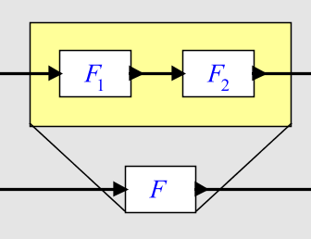
More Fundamental Problem: Delta Delay Semantics is Not Compositional
The top composition of two actors will have a two delta delays, whereas the bottom abstraction has only a single delta delay.
Under delta delay semantics, a composition of two actors cannot have the semantics as a single actor.

Slide 18
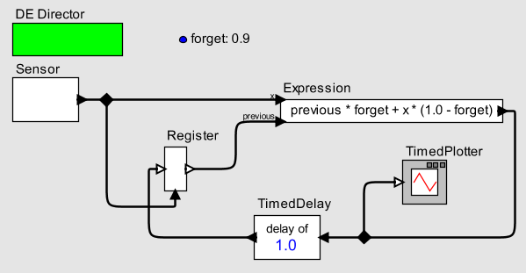
Consider “Some actors have time delay, and every directed loop must have an actor with time delay.”
Any non-zero time delay imposes an upper bound on the rate at which sensor data can be accepted. Exceeding this rate will produce erroneous results.

Slide 19
Consider “Some actors have delta delay, and every directed loop must have an actor with delta delay.”
trigger input port
data input port
The output of the Register actor must be at least one index later than the data input, hence this actor has at least a delta delay.
To schedule this, could break the feedback loop at actors with delta delay, then do a topological sort.

Slide 20
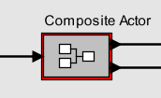
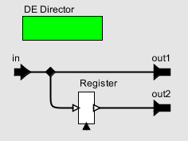
Naïve Topological Sort is not Compositional
Breaking loops where an actor has a delta delay and performing a topological sort is not a compositional solution:
Does this composite actor have a delta delay or not?

Slide 21
Our Answer: No Required Delay, and Feedback Loops Have Fixed Points Semantics
Output is a single event with value 3.0
Given an input event ((t, n), v), the corresponding output event is
((t, n), v’). The actor has no delay.
The challenge now is to establish a determinate semantics and a scheduling policy for execution.

Slide 22


How Does This Work?
Execution of Ptolemy II Actors
Flow of control:
Initialization
Execution
Finalization

Slide 23
How Does This Work?
Execution of Ptolemy II Actors
Flow of control:
Initialization
Execution
Finalization
Post tags on the event queue corresponding to any initial events the actor wants to produce.

Slide 24
How Does This Work?
Execution of Ptolemy II Actors
Flow of control:
Initialization
Execution
Finalization
Iterate
If (prefire()) {
fire();
postfire();
}
Only the postfire() method can change the state of the actor.

Slide 25
How Does This Work?
Execution of Ptolemy II Actors
Flow of control:
Initialization
Execution
Finalization

Slide 26
Definition of the Register Actor (Sketch)
class Register {
private Object state;
boolean prefire() {
if (trigger is known) { return true; }
}
void fire() {
if (trigger is present) {
send state to output;
} else {
assert output is absent;
}
}
void postfire() {
if (trigger is present) {
state = value read from data input;
}
}
Can the actor fire?
React to trigger input.
data input port
trigger input port
Read the data input and update the state.

Slide 27
Execution of a DE Model (Conceptually)
Start with all signals empty. Initialize all actors (some will post tags on the event queue).
Take all earliest tag (t, n) from the event queue.
Mark all signals unknown at tag (t, n).
Prefire and fire the actors in any order. If enough is known about the inputs to an actor, it may make outputs known at (t, n).
Keep firing actors in any order until all signals are known at (t, n).
When all signals are known, postfire all actors (to commit state changes).
Any actor may now post a tag
(t’, n’) > (t, n) on the event queue.
Key questions:
Is this right?
Can this be made efficient?
The answer, of course, is yes to both.
This scheme underlies synchronous/reactive languages (Esterel, Lustre, Signal, etc.)

Slide 28
Where We Are
Proposed:
Superdense time
Zero delay actors
Execution policy
Now: Show that it’s right.
Conditions for uniqueness (Scott continuity)
Conditions for liveness (causality)

Slide 29
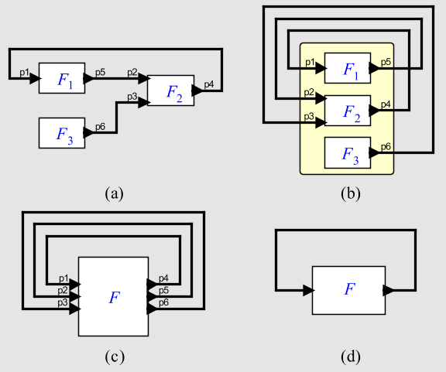
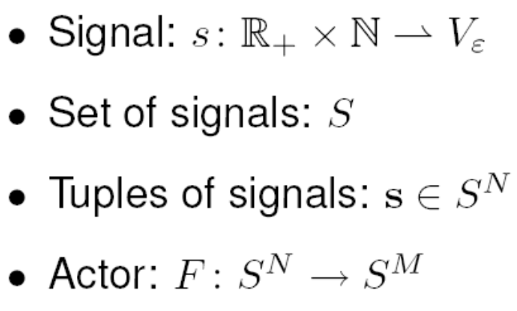
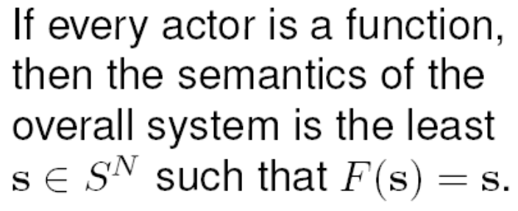
Observation: Any Composition is a
Feedback Composition
s ∈ S ^{N}
We have a least fixed point semantics.

Slide 30
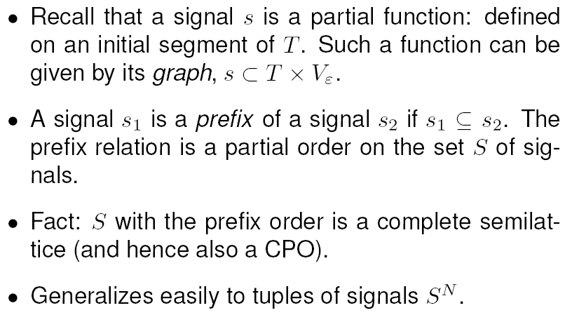
Prefix Order**

Slide 31
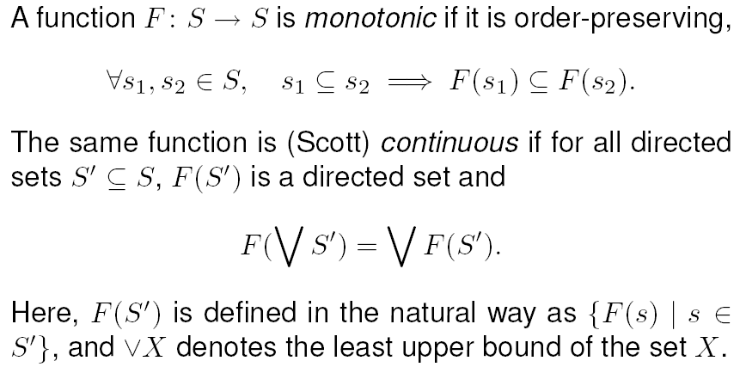

Monotonic and Continuous Functions**
Every continuous function is monotonic, and behaves as follows: Extending the input (in time or tags) can only extend the output.

Slide 32
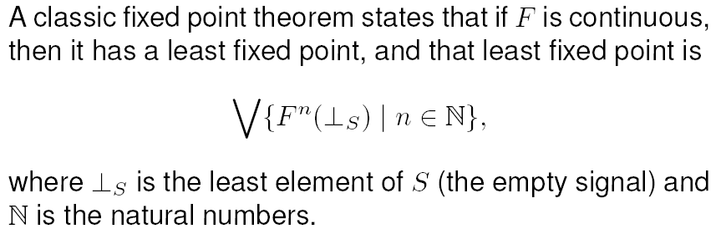

Knaster-Tarski Fixed-Point Theorem**
Start with empty signals.
Iteratively apply function F.
Converge to the unique solution.

Slide 33
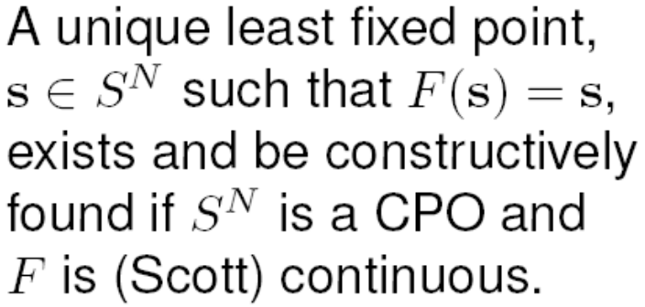
Summary: Existence and Uniqueness of the Least Fixed Point Solution.
s ∈ S ^{N}
Under our execution policy, actors are usually (Scott) continuous.

Slide 34
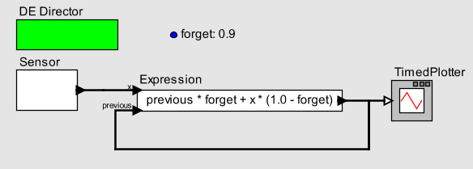
But: Need to Worry About Liveness:
Deadlocked Systems
Existence and uniqueness of a solution is not enough.
The least fixed point of this system consists of empty signals. It is deadlocked!

Slide 35
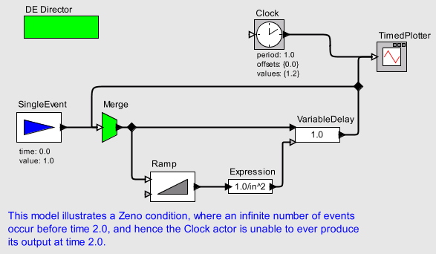
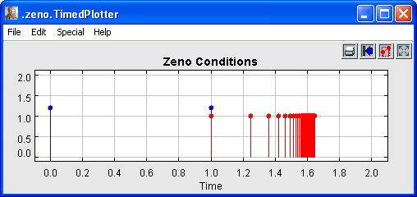
Another Liveness Concern:
Zeno Systems
DE systems may have an infinite number of events in a finite amount of time. These “Zeno systems” can prevent time from advancing.
In this case, our execution policy fails to implement the Knaster-Tarski constructive procedure because some of the signals are not total.

Slide 36
Liveness
A signal is total if it is defined for all tags in T.
A model with no inputs is live if all signals are total.
A model with inputs is live if all input signals are total implies all signals are total.
Liveness ensures freedom from deadlock and Zeno.
Whether a model is live is, in general, undecidable.
We have developed a useful sufficient condition based on causality that ensures liveness.

Slide 37
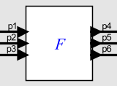
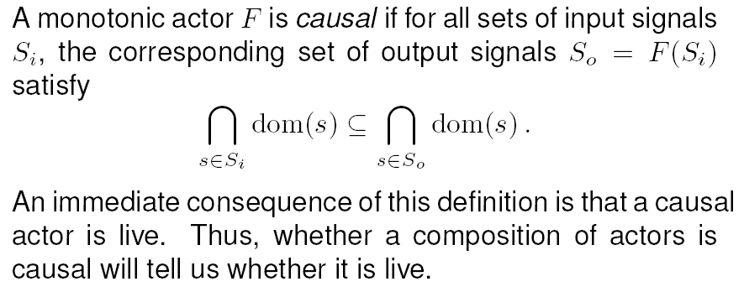
Causality Ensures Liveness of an Actor
Causality does not imply continuity and continuity does not imply causality. Continuity ensure existence and uniqueness of a least fixed point, whereas causality ensures liveness.

Slide 38
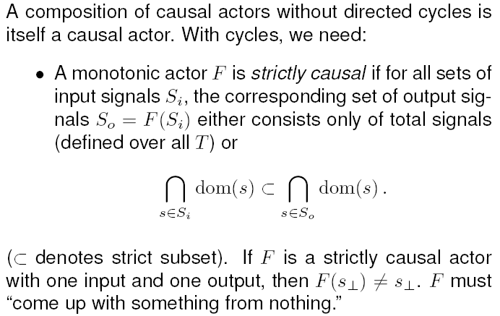
Strict Causality Ensures Liveness of a Feedback Composition

Slide 39
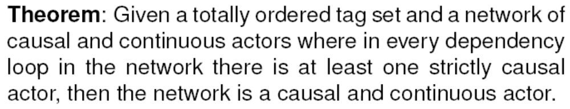
Continuity, Liveness, and Causality
This gives us sufficient, but not necessary condition for freedom deadlock and Zeno.

Slide 40
Recall Deadlocked System
The feedback loop has no strictly causal actor.

Slide 41
Feedback Loop that is Not Deadlocked
This feedback loop also has no strictly causal actor, unless…
We aggregate the two actors as shown into one.

Slide 42
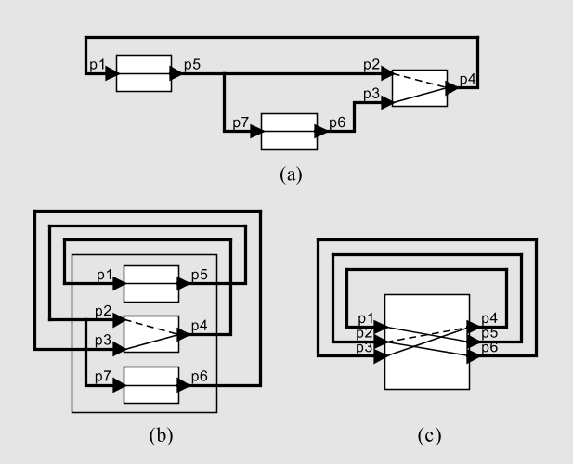
Causality Interfaces Make Scheduling of Execution and Analysis for Liveness Efficient
A causality interface exposes just enough information about an actor to make scheduling and liveness analysis efficient.
An algebra of interfaces enables inference of the causality interface of a composition.

Slide 43
Models of Computation
Implemented in Ptolemy II
Done
CSP – concurrent threads with rendezvous
CT – continuous-time modeling
DE – discrete-event systems
DDE – distributed discrete events
DDF – dynamic dataflow
DPN – distributed process networks
DT – discrete time (cycle driven)
FSM – finite state machines
Giotto – synchronous periodic
GR – 2-D and 3-D graphics
PN – process networks
SDF – synchronous dataflow
SR – synchronous/reactive
TM – timed multitasking
But will also establish connections with Continuous Time (CT) and hybrid systems (CT + FSM)
SR is a special case of DE where time has no metric.

Slide 44
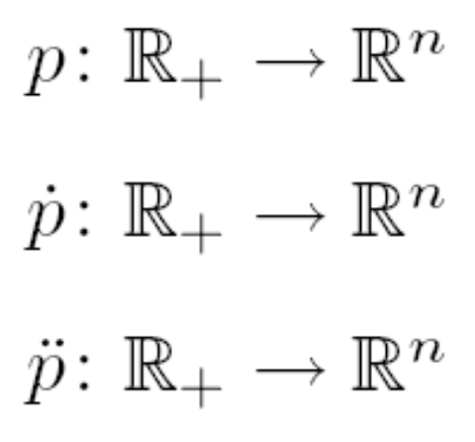

Standard Model for
Continuous-Time Signals
In ODEs, the usual formulation of the signals of interest is a function from the time line (a connected subset of the reals) to the reals:
Such signals are continuous at t ∈ if (e.g.):

Slide 45
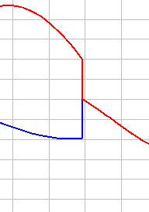
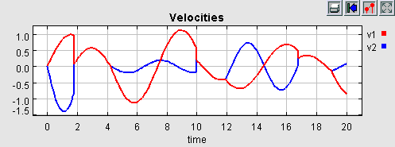
Piecewise Continuous Signals
In hybrid systems of interest, signals have discontinuities.
Piecewise continuous signals are continuous at all
t ∈ \ D where D ⊂ is a discrete set.¹
¹A set D with an order relation is a discrete set if there exists an order embedding to the integers.

Slide 46
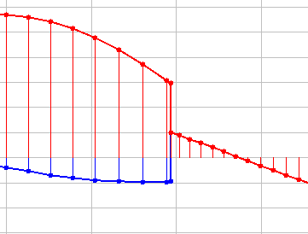
Operational Semantics of Hybrid Systems
A computer execution of a hybrid system is constrained to provide values on a discrete set:
Given this constraint, choosing T ⊂ as the domain of these functions is an unfortunate choice. It makes it impossible to unambiguously represent discontinuities.

Slide 47
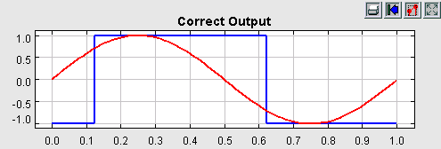
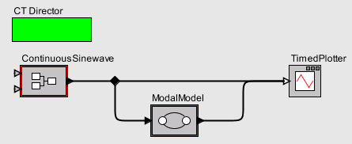
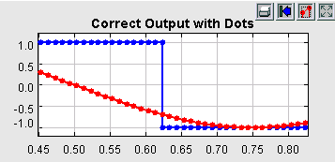
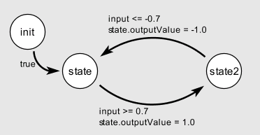
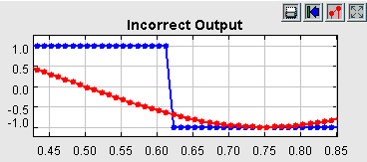
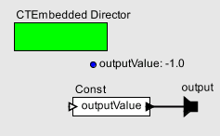
Discontinuities Are Not Just
Rapid Changes
Discontinuities must be semantically distinguishable from rapid continuous changes.

Slide 48
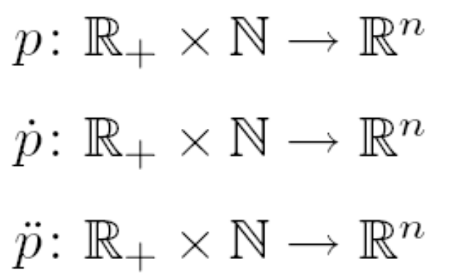
Solution is the Same:
Superdense Time
This makes it quite easy to construct models that combine continuous dynamics with discrete dynamics.

Slide 49
Ideal Solver Semantics
[Liu and Lee, HSCC 2003]
In the ideal solver semantics, an ODE governing the hybrid system has a unique solution for intervals [t_{i} , t_{i+1}), the interval between discrete time points. A discrete trace loses nothing by not representing values within these intervals.
t₀
t₁
t₂
t₃
...
t
t_{s}
Common fixed point semantics enables hybrid discrete/continuous models.

Slide 50
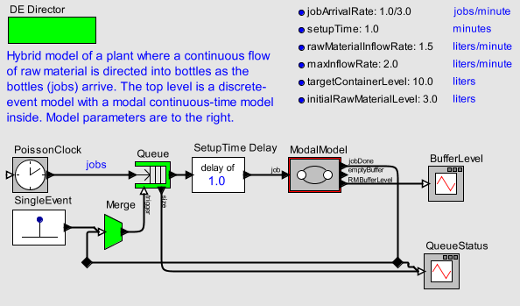
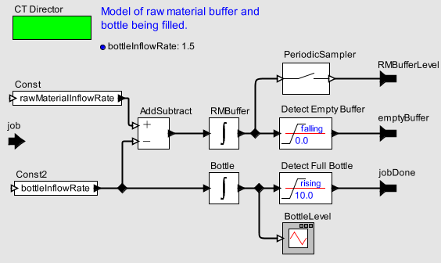
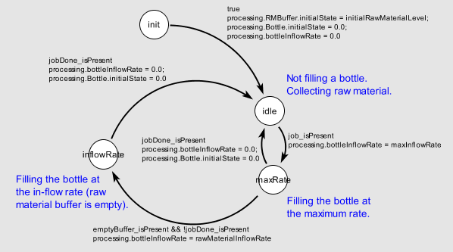
The Hybrid
Plant Model
This model is a hierarchical mixture of three models of computation (MoCs): DE, FSM, and CT.

Slide 51
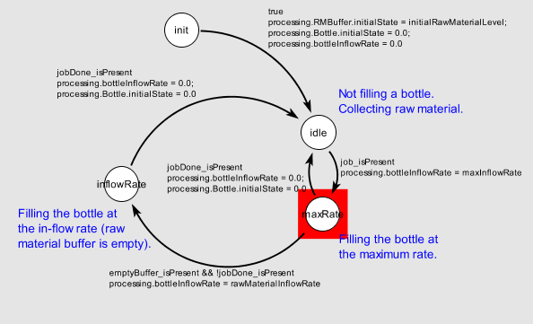
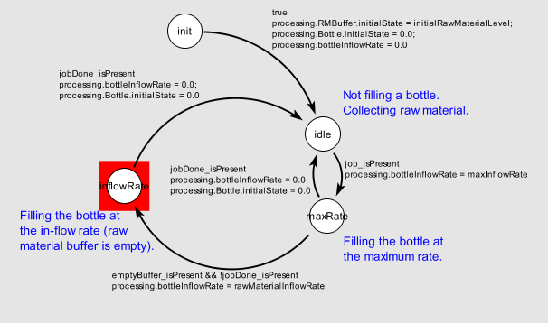
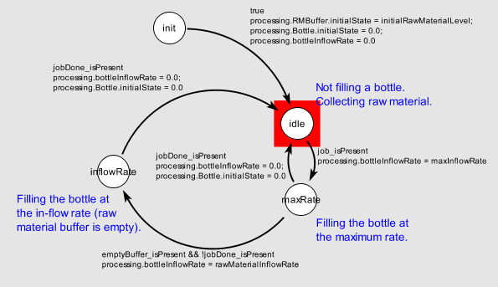
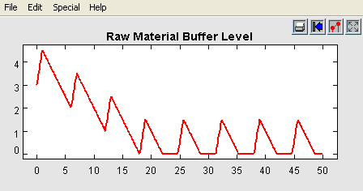
The Hybrid
Plant Model
Raw material buffer filling during setup time
Bottle filling at maximum rate
Raw material buffer filling during setup time
Bottle filling at limited rate

Slide 52
Conclusions
We have given a rigorous semantics to discrete-event systems that leverages principles from synchronous/reactive languages and admits interoperability with both SR and continuous-time models.

Slide 53
Further Reading
[1] X. Liu and E. A. Lee, "CPO Semantics of Timed Interactive Actor Networks," UC Berkeley, Berkeley, CA, Technical Report EECS-2006-67, May 18 2006.
[2] X. Liu, E. Matsikoudis, and E. A. Lee, "Modeling Timed Concurrent Systems," in CONCUR 2006 - Concurrency Theory, Bonn, Germany, 2006.
[3] A. Cataldo, E. A. Lee, X. Liu, E. Matsikoudis, and H. Zheng, "A Constructive Fixed-Point Theorem and the Feedback Semantics of Timed Systems," in Workshop on Discrete Event Systems (WODES), Ann Arbor, Michigan, 2006.
[4] E. A. Lee, "Modeling Concurrent Real-time Processes Using Discrete Events," Annals of Software Engineering, vol. 7, pp. 25-45, March 4th 1998 1999.
[5] E. A. Lee, H. Zheng, and Y. Zhou, "Causality Interfaces and Compositional Causality Analysis," in Foundations of Interface Technologies (FIT), Satellite to CONCUR, San Francisco, CA, 2005.

Slide 54
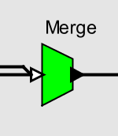



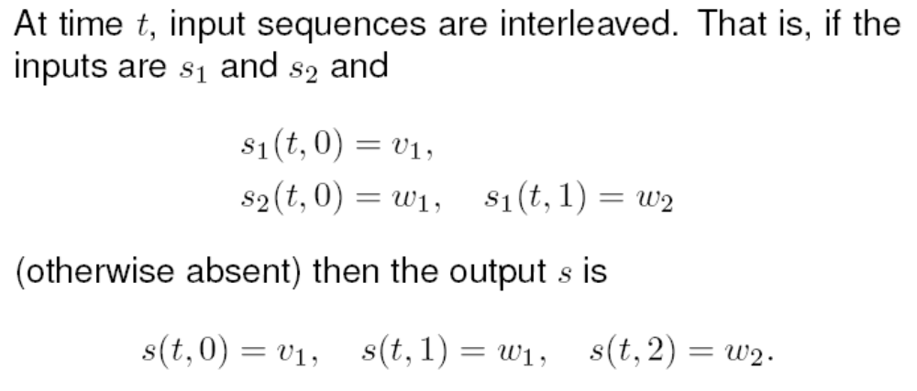
Semantics of Merge

Slide 55
Implementation of Merge
private List pendingEvents;
fire() {
foreach input s {
if (s is present) {
pendingEvents.append(event from s);
}
}
if (pendingEvents has events) {
send to output (pendingEvents.first);
pendingEvents.removeFirst();
}
if (pendingEvents has events) {
post event at the next index on the event queue;
}
}

