Slide 1

A smart system for Personalized Interior Design and Augmented Reality Try-On
Presented By:-
Mohitha Bandi (22WUO0105037)
Pailla Bhavya (22WUO0105020)
T. Harshavardhan Reddy(2WUO0105023)
Supervised by:-
Dr. Bhargav Prajwal Pathri,
Assistant Professor,
Woxsen University.

Slide 2

Introduction
Interior design makes spaces look good and comfortable, but many people struggle to imagine furniture in their homes.
90% of users struggle to visualize furniture in their rooms before purchasing. This leads to wrong choices and dissatisfaction.
We want to built a smart system that makes interior design more accurate, interactive, and user-friendly, reducing mistakes and improving satisfaction.
Our system bridges this gap by combining Computer Vision (CV) + Augmented Reality (AR) + Generative AI.

Slide 3
Problem Statement
Many people struggle with choosing the right interior design, as they cannot clearly imagine how furniture will look or fit in their rooms.
There is no personalized recommendation system that adapts designs based on actual room conditions.
Users do not have a proper “try-before-you-buy” feature to test how furniture will look in their real space.

Slide 4
Objectives
To create a system that can understand and analyze room images by detecting furniture, layout, and other details using computer vision.
To suggest personalized furniture and interior styles that suit the user’s preferences as well as the existing setup of the room.
To allow users to visualize the redesigned room in real time through Augmented Reality (AR), helping them make better design choices.

Slide 5
Literature Review
Name of the Paper | Algorithm Used | Implementation in our project
RoomNet: End-to-End Room Layout Estimation | Uses SegNet-based network to find room layout from a single image | We use it to detect walls and corners from room photos.
Flat2Layout: Flat Representation for Estimating Layout of General Room Types | Flat layout encoding with dynamic programming to get room shape | Helps us work with different room shapes, not just simple ones.
Transcending Dimensions using Generative AI: Real-Time 3D Model Generation in AR | Uses Generative AI and object detection to create 3D models from 2D images | We use it to make 3D furniture models for AR visualization.
Augmented Reality in Interior Design | AR + 3D Furniture Models + Web XR | Helps us place and view 3D furniture in their real rooms using AR that run directly in a web browser

Slide 6
Novelty
Our project is different because it goes beyond giving normal design suggestions.
The system can understand the room’s structure, furniture, and lighting and then recommend designs that match the user’s personal style.
We combine CV + AR + AI models in one pipeline, so users can not only see furniture but also interactively try, adjust, and visualize designs in their own room.
It introduces a “smart try-before-you-buy” feature, helping users avoid wrong choices and reducing furniture returns.

Slide 7
Proposed Methodology
Data Preparation – Collect room images, preprocess (resize, augment, normalize), and build ETL pipeline with annotations.
Computer Vision Models – Train ResNet for room classification and YOLOv8 for furniture detection.
Personalized Recommendations – Suggest styles, furniture, and optimized layouts.
AR Try-On – Allow users to virtually place furniture and see 3D/AR visualization using Web XR(Web Extended Reality-API).
Feedback & Improvement – Collect user feedback and refine future recommendations.

Slide 8
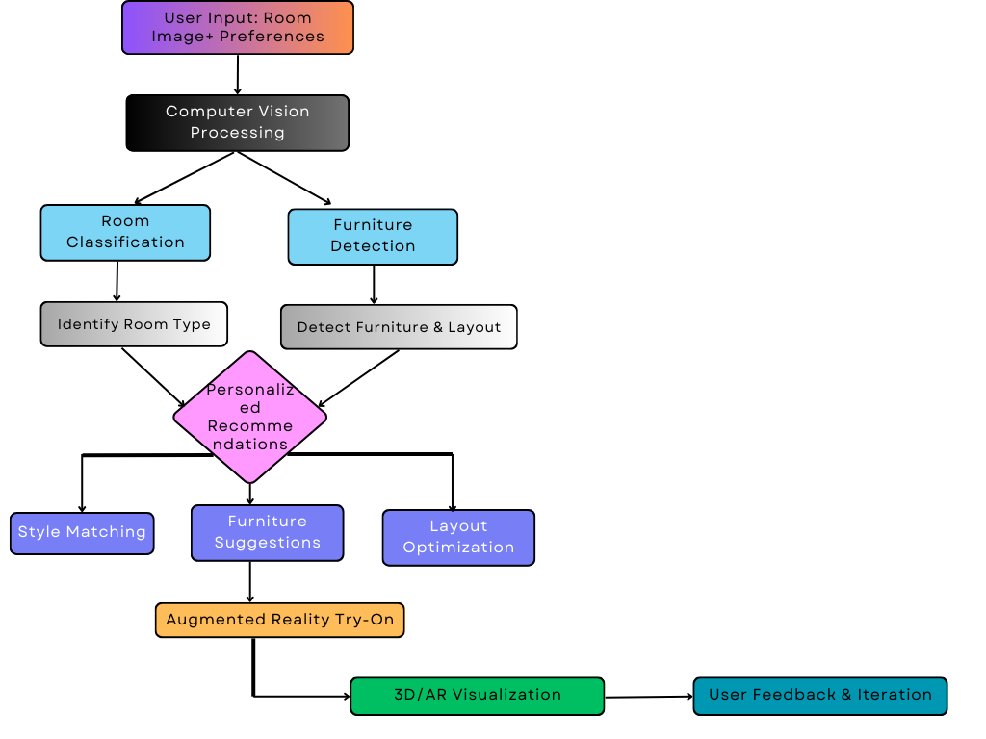
Work Flow

Slide 9
Tools and Technologies
Programming Language & ML : Python, PyTorch, Scikit-learn.
Computer Vision: ResNet, YOLOv8, OpenCV
Visualization: Matplotlib
Frontend : Html, CSS, JS etc.,
Backend & Deployment: Flask, Docker
Database: MongoDB
Generative AI Models: For generating and recommending new designs
Augmented Reality SDKs/Tools - Web XR(Web Extended Reality-API)
Operating System: Windows

Slide 10
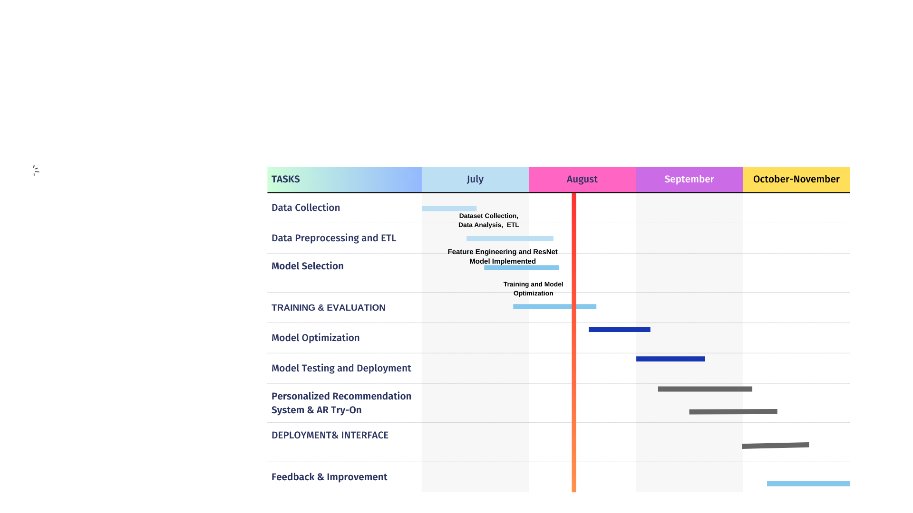
Timeline / Work Plan

Slide 11
Current Progress
Dataset collected (3348 images across 9 classes).
Preprocessing, ETL pipeline, and annotation structure completed.
EDA performed (class distribution, image size analysis).
Room classification model (ResNet) trained.
YOLOv8 dataset prepared.
Furniture detection training ongoing.
Recommendation & AR module yet to be implemented.

Slide 12
Challenges Faced
Dataset Collection and Imbalanced dataset.
Ensuring correct annotation format for YOLOv8.
Maintaining clean ETL pipeline for large data.
Training models with high accuracy required multiple iterations.

Slide 13
Thank You

