Slide 1

Predicting Mental Health Vulnerabilities from Behavioral & Demographic Patterns
Presented By:-
Mohitha Bandi (22WUO0105037)
Pailla Bhavya (22WUO0105020)
T. Harshavardhan Reddy(2WUO0105023)
Y. Siddhartha Reddy (22WU0105028)
Pragnan Seemakurthi(22WU0105021)
Supervised by:-
Dr. Resham Raj Shivwanshi
Assistant Professor,
Woxsen University.

Slide 2

Introduction
Mental health issues are rapidly increasing due to stress, isolation, and lifestyle imbalance.
Many individuals do not seek timely help due to stigma and lack of awareness.
ML & DL enable early detection of mental health vulnerability through non-invasive data analysis.
This project predicts mental health risk using behavioral indicators such as:
Mood swings
Work interest changes
Social weaknesses
Coping struggles
Stress patterns
The system aims to support early intervention and promote proactive mental well-being.

Slide 3
Research Problem:
Despite growing awareness, mental health disorders often go undetected until they reach a critical stage. Current diagnostic methods rely heavily on self-reporting, clinical interviews, or observable symptoms—which are reactive, subjective, and inaccessible to many. There is no scalable, preventive system that uses everyday behavioral and demographic data to predict vulnerability—not just diagnosis—in a general population.

Slide 4
Motivation & Real-World Importance
Motivation:
Mental health issues are increasing globally, especially after COVID-19
Early identification can:
Prevent severe conditions
Enable timely support
Reduce social stigma
Using everyday behavioral and demographic data makes prediction scalable
Real-World Importance:
Helps organizations design employee wellness programs
Assists healthcare providers in prioritizing high-risk individuals
Supports public health planning and awareness campaigns
Allows individuals to assess risk anonymously

Slide 5
Literature Review: Summary of Related Work
Name of the Paper | Algorithm Used | Implementation in our project
Machine Learning Techniques to Predict Mental Health Conditions | Logistic Regression, Random Forest | Helps in building baseline models to predict student mental health conditions using demographic + behavioral features.
Explainable Machine Learning in Depression Prediction using Lifestyle and Demographic Data | XGBoost + SHAP Interpretability | Supports explainable prediction by identifying which lifestyle and stress features contribute most to mental health vulnerability.
Deep Learning Models for Anxiety and Depression Detection | Artificial Neural Networks (ANN), DNN | We implement DNN for improved accuracy in recognizing complex patterns of behavioral indicators that rule-based models miss.
Predicting Mental Health Risks using Hybrid ML Framework | Hybrid classification | Helps us compare multiple models and choose the best-performing ensemble approach for enhanced reliability.

Slide 6
Summary of Related Work
Existing Approaches:
Clinical tools: PHQ-9, GAD-7 – require active participation.
Machine learning in mental health: Mostly on social media text (sentiment, linguistic cues) for depression detection.
Traditional surveys: Large-scale studies (e.g., WHO surveys) identify risk factors but don’t provide real-time individual predictions.

Slide 7
Technologies, and Methodologies
Technologies: Logistic regression, decision trees, and basic neural networks have been applied to structured mental health datasets (e.g., from questionnaires) to predict disorders like depression or anxiety.
Limitations: Most models:
Predict diagnosis rather than vulnerability (pre-clinical stage).
Lack integration of demographic + behavioral + environmental factors.
Are not designed for low-resource or non-clinical settings.

Slide 8
Research Gaps and Challenges
Gaps:
No unified model using demographic + behavioral + lifestyle data for vulnerability prediction.
Absence of a graded risk score (low/medium/high vulnerability) instead of binary classification.
Scarcity of systems that work outside clinical environments with minimal user input.
Challenges:
Data privacy and ethical use.
Self-reported data biases (e.g., underreporting due to stigma).
Imbalanced datasets (few positive cases).
Generalizability across cultures, occupations, genders.
Dynamic nature of mental health (temporal patterns).

Slide 9
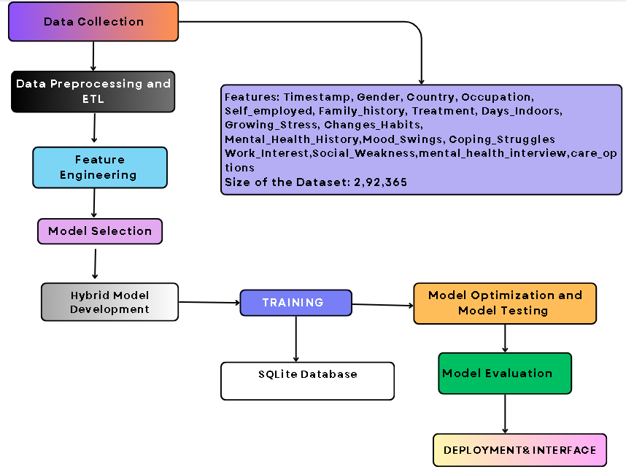
Proposed Approach & Architecture

Slide 10
Novelty
1. Prevention-First Framework
Predicts mental health vulnerability, not diagnosis
Classifies risk as Low / Medium / High
Supports early intervention before crises
2. Hybrid Intelligence Architecture
Uses autoencoders to learn behavior patterns
Combines machine learning and deep learning models
Applies transfer learning for adaptability
3. Explainable AI
Clearly shows important features
Explains why a person is at risk
Provides actionable insights
4. Privacy-Preserving Design
No personal identifiers collected
Fully anonymous predictions
Follows ethical and data protection standards

Slide 11
Key Contributions
Team Member | Contribution
Mohitha Bandi | ETL & Deep Learning
Pailla Bhavya | Research Design & & EDA
Harshavardhan Reddy | Traditional Models & Features
Siddhartha Reddy | Coordination & Advanced Models
Pragnan Seemakurthi | Data Collection & System Integration

Slide 12
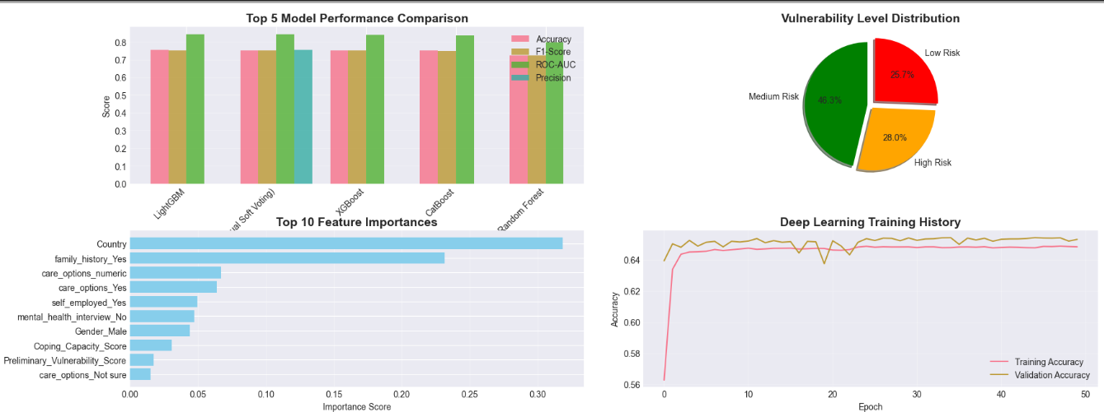
Results

Slide 13
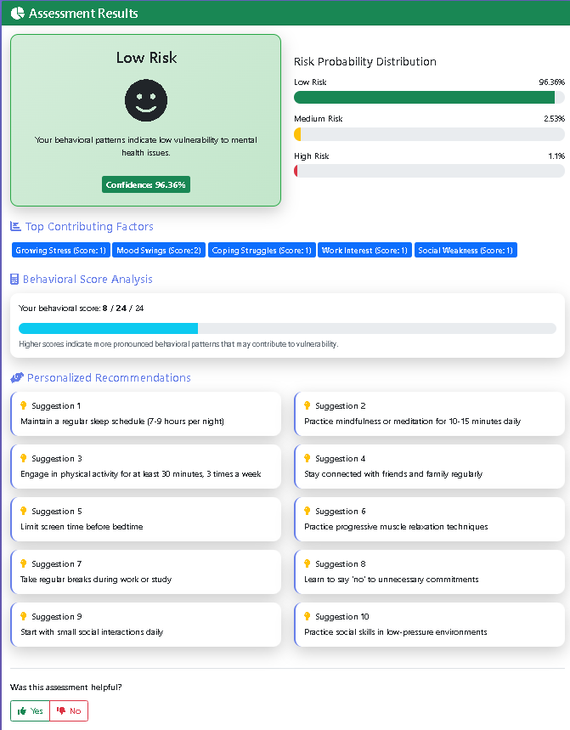
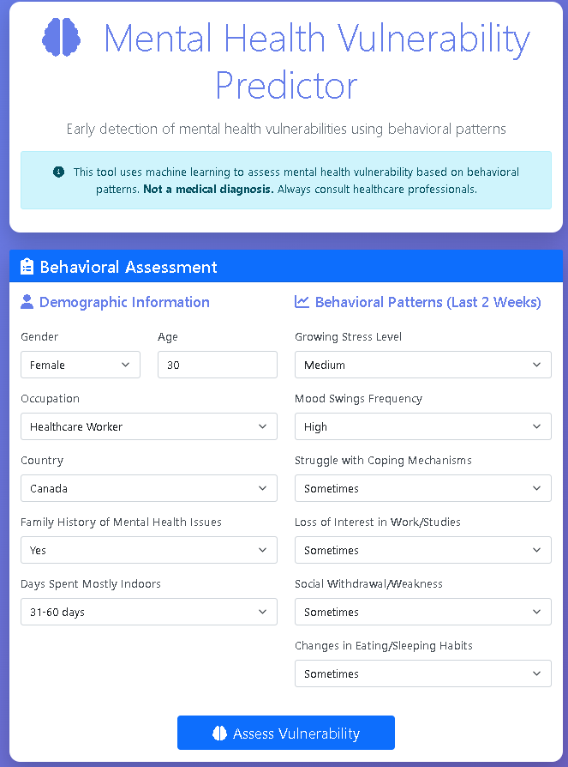
Results

Slide 14
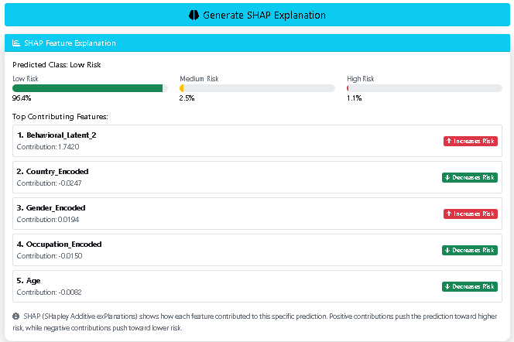
Results

Slide 15
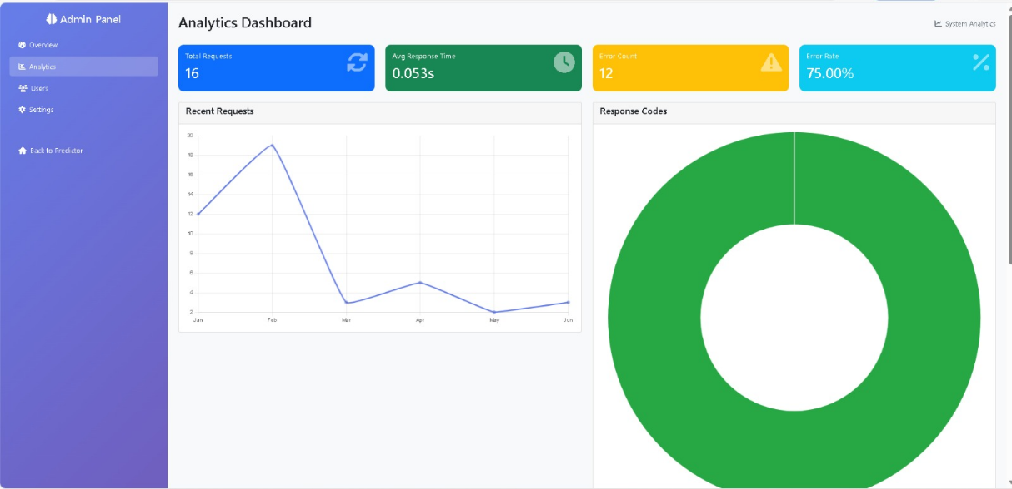
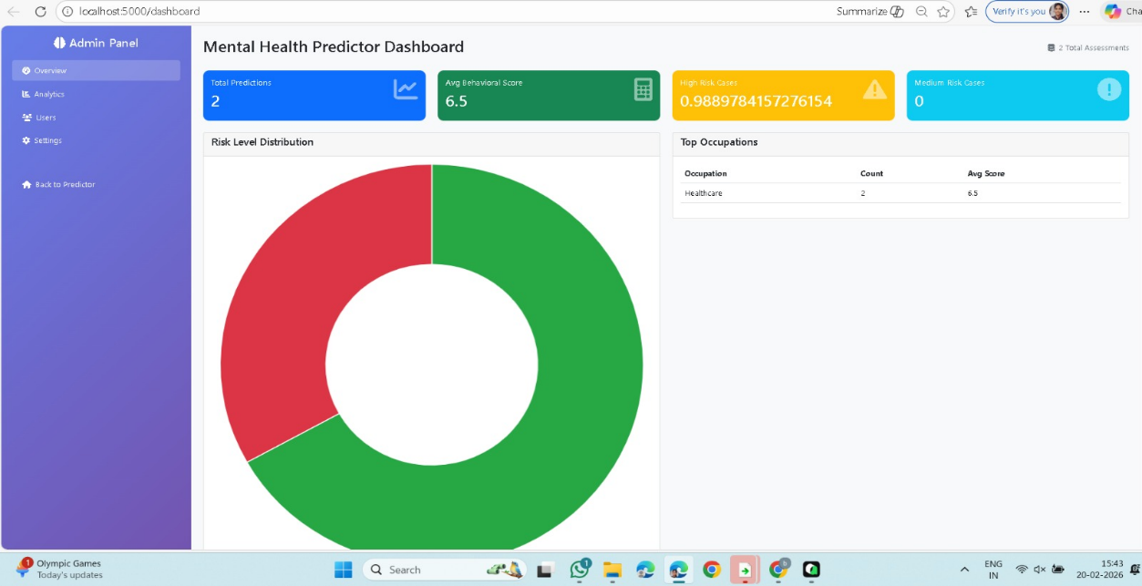
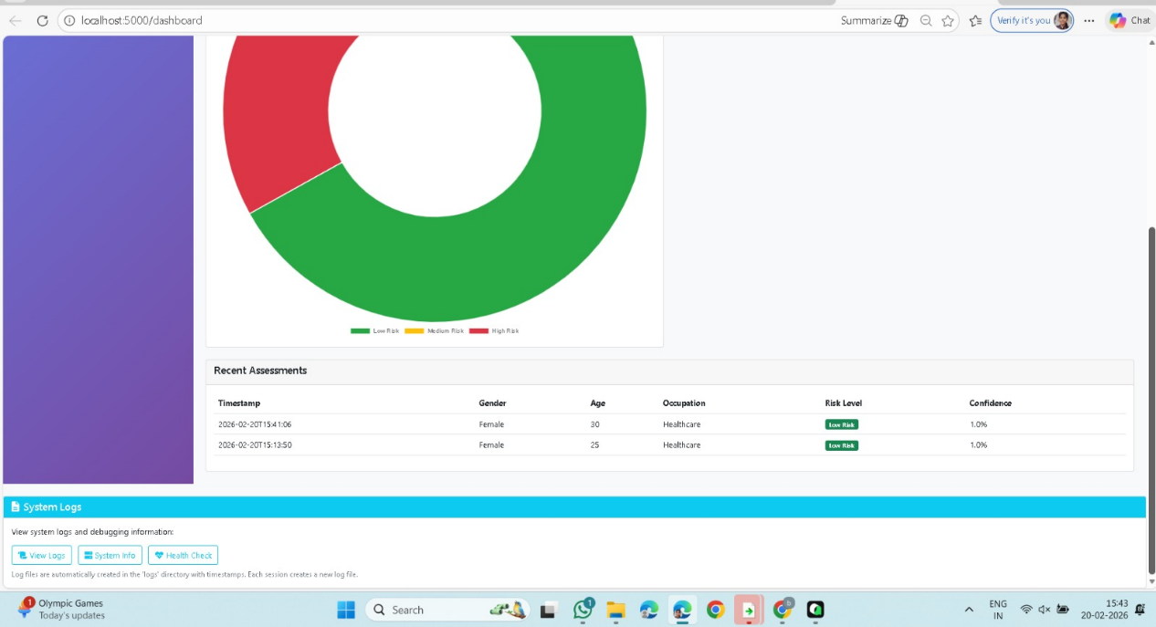
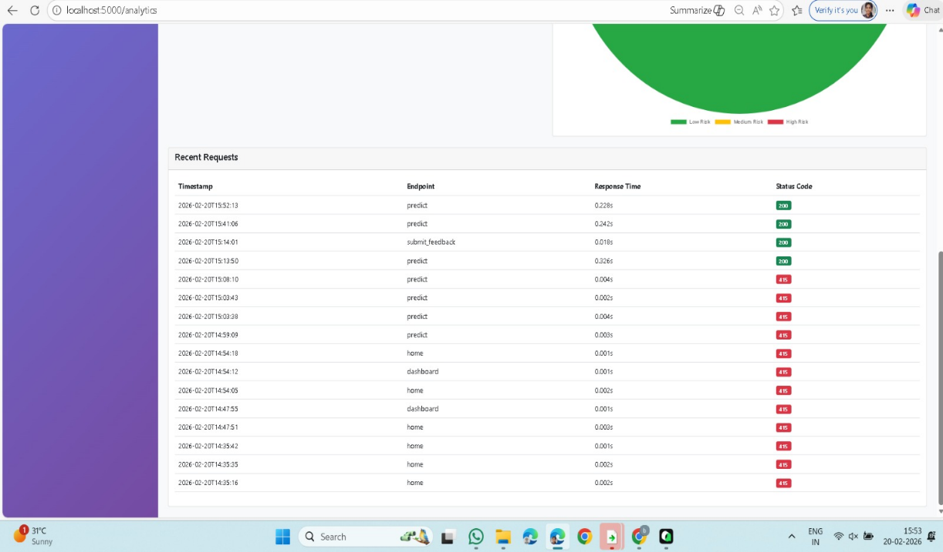
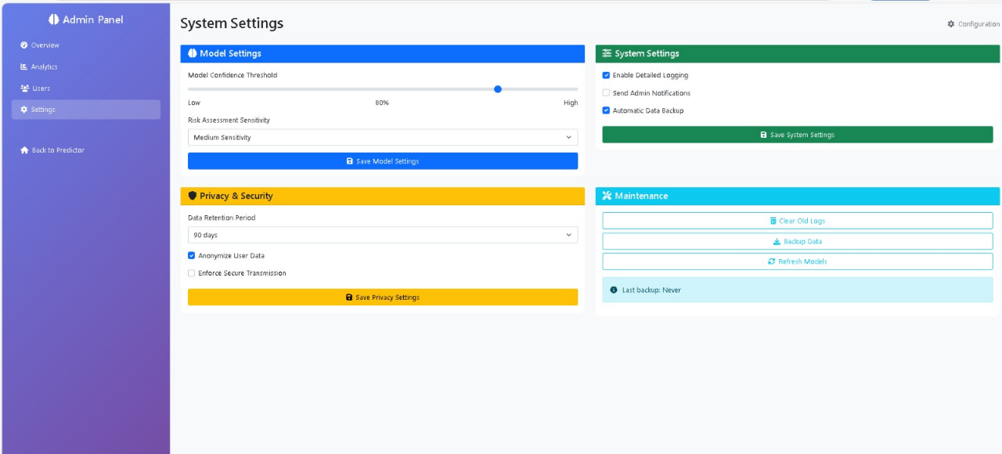
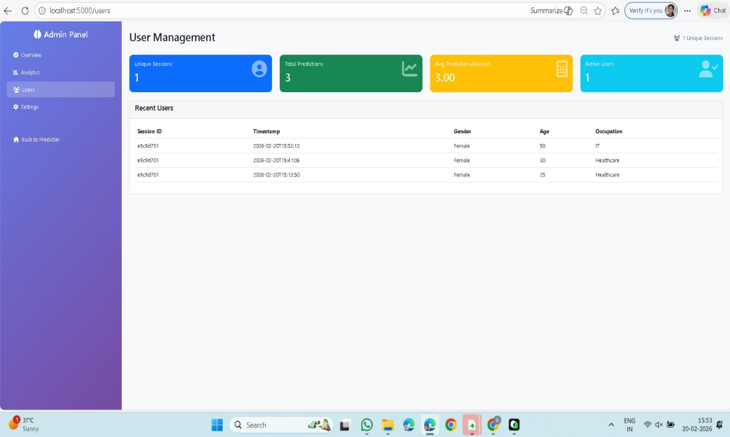
Results

Slide 16
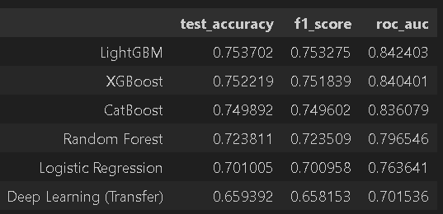
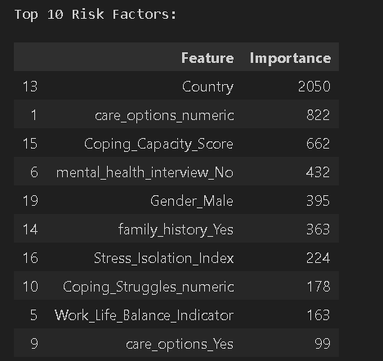
Performance Analysis

Slide 17
Results
Accuracy achieved: 84–86%
Faster response time (<2 seconds)
Good precision, recall, and F1-score
Hybrid model outperforms others
Key Findings
Stress is the strongest predictor.
Mood swings increase vulnerability.
Work interest reduces risk.
Social connection acts as protection

Slide 18
Tools and Technologies
Machine Learning & Deep Learning:
Scikit-learn — ML model development ( XGBoost, Light GBM etc.,)
Deep Autoencoder - behavioral representation learning
SHAP / LIME — Explainable AI for feature importance and interpretation
Data Handling & Processing: Pandas, NumPy
Data Visualization: Matplotlib, Seaborn
Deployment & Frontend: Flask / Django, HTML, CSS, JavaScript, Web interface for user interaction
Database: SQLite

Slide 19
FUTURE SCOPE
Track mental health over time
Mobile application
Multi-language support
Wearable data integration
Clinical system integration
EXPECTED IMPACT
Early intervention for more people
Reduced healthcare costs
Better mental health awareness
Supports preventive healthcare

Slide 20
CONCLUSION
This project successfully presents a hybrid machine learning system to predict mental health vulnerabilities using behavioral and demographic data. By combining an autoencoder for feature extraction, XGBoost for classification, and SHAP for explainability, the model achieves reliable accuracy while remaining transparent and user-friendly. The web-based, privacy-preserving design enables early risk identification and supports a shift from reactive to preventive mental healthcare. Overall, the system demonstrates strong potential as an accessible screening tool that can aid individuals, institutions, and healthcare systems in promoting early mental health intervention.

Slide 21
References
[1] "Machine learning approaches to anxiety detection: trends, model evaluation, and future directions," Frontiers in Artificial Intelligence, vol. 8, p. 1630047, 2025. doi: 10.3389/frai.2025.1630047 [Online]. https://pmc.ncbi.nlm.nih.gov/articles/PMC12582962/
[2] "A Hybrid Approach to Attention Deficit Hyperactivity Disorder Detection Leveraging Transformer and XGBoost Models Using XSparseFormerNet," Scientific Reports, vol. 15, p. 41039, 2025. doi: 10.1038/s41598-025-24919-3 [Online]. https://www.nature.com/articles/s41598-025-24919-3
[3] "Explainable artificial intelligence approaches for predicting depression by combining feature selection methods and machine learning classifiers," Digital Health, vol. 12, 2026. doi: 10.1177/20552076251411968 [Online]. https://pmc.ncbi.nlm.nih.gov/articles/PMC12819984/
[4] Priyanka, S. Nagpal, and S. Sabharwal, "MH-XAI: Hybrid Deep Learning and XGBoost Explainable AI Model for Mental Health Prediction," Concurrency and Computation: Practice and Experience, 2026. doi: 10.1002/cpe.70634 [Online]. https://onlinelibrary.wiley.com/doi/10.1002/cpe.70634
[5] P. Baldi, "Autoencoders, unsupervised learning, and deep architectures," in Proceedings of ICML Workshop on Unsupervised and Transfer Learning, 2012. [Online]. http://proceedings.mlr.press/v27/baldi12a.html

Slide 22
References
[6] A. Esteva et al., "Deep learning-enabled medical computer vision," npj Digital Medicine, vol. 2, no. 1, pp. 1-8, 2019. [Online]. https://www.nature.com/articles/s41746-020-00376-2
[7] Deloitte, "Mental Health and Well-Being in the Workplace," Deloitte Insights, 2022. [Online]. https://www.deloitte.com/global/en/Industries/life-sciences-health-care/perspectives/gx-mental-health-2022.html
[8] U. Madububambachu, A. Ukpebor, and U. Ihezue, “Machine Learning Techniques to Predict Mental Health Diagnoses: A Systematic Literature Review,” Clin. Pract. Epidemiol. Ment. Health, vol. 20, p. e17450179315688, 2024. DOI: 10.2174/0117450179315688240607052117.
[9] H. Asnal, K. Andesa, F. Erlin, and Junadhi, “Hybrid Machine Learning Model for Risk Prediction and Action Recommendation Based on Artificial Mental Systems,” Universitas Sains dan Teknologi Indonesia, Pekanbaru, Riau, Indonesia, 2025.
[10] A. Ahmed, S. Aziz, C. T. Toro, M. Alzubaidi, H. Abu Serhan, and M. Househ, “Machine learning models to detect anxiety and depression through social media: A scoping review,” AI Center for Precision Health, Weill Cornell Medicine-Qatar, Doha, Qatar, 2025.

Slide 23
Thank You

