Slide 1

Deep chat: Customizable Chatbot with API and LLM Integration
Presented By:-
Mohitha Bandi (22WUO0105037)
Pailla Bhavya (22WUO0105020)
T. Harshavardhan Reddy(2WUO0105023)
Thumma Manojna Reddy(22WUO0104134)
Supervised by:-
Dr. Ram Murat Singh,
Assistant Professor,
Woxsen University.

Slide 2

Introduction
AI and ML advancements have enhanced chatbot interactions in various fields.
Many chatbots lack flexibility, seamless integration.
Our project uses LLMs for more natural and meaningful conversations.
We focus on creating a user-friendly chatbot with easy deployment.
We also integrate Retrieval-Augmented Generation (RAG) to provide accurate, context-aware responses.

Slide 3
Objectives
Our aim is to develop a flexible chatbot that provides accurate responses by fine-tuning an LLM on a domain-specific dataset.
Ensuring accurate, efficient, and lightweight chatbot performance through fine-tuning, optimization, and LoRA integration.
Integrate RAG to enable dynamic information retrieval from PDFs.

Slide 4
Methodology
Data Preparation: Load QA dataset and PDFs, then split the content into smaller, readable chunks.
Embedding & Storage: Convert text chunks into vector form and store them in a Chroma database for fast retrieval.
Model Fine-Tuning: Use TinyLlama and fine-tune it efficiently with your data using LoRA(Low-rank adaptation).
RAG Setup: Connect the fine-tuned model with ChromaDB to retrieve relevant chunks when a question is asked.
Evaluation & Monitoring: Track training performance and log progress after each epoch.
RAG Inference: Ask a question → fetch related content → get a smart answer from the model.

Slide 5


Workflow:-
DATASET
DATA PREPROCESSING
Model Selection & Deployment
MODEL OPTIMIZATION
Question and Answer Dataset
+
PDFs
Load & preprocess dataset +Chunking
Split into train/val set
Fine-tune with data
(TinyLlama/TinyLlama-1.1B-Chat-v1.0 + RAG)
Apply 4-bit quant.
Use LoRA tuning
DEPLOYMENT& INTERFACE
TRAINING & EVALUATION
ChromaDB Vector Store
Deep Chat
Query + Relevant Answer
Save trained model
Implement chatbot interface
Train the Model on data
Monitor performance
Vector Embedding via Sentence Transformer

Slide 6
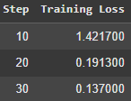
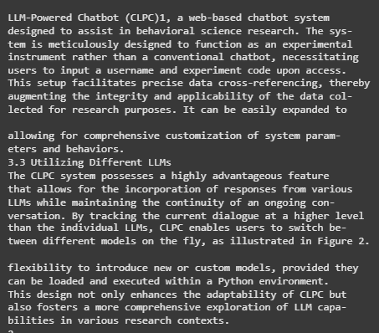
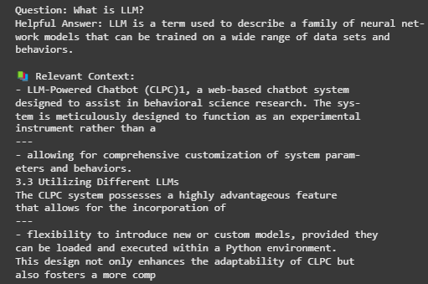
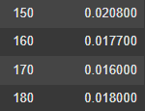
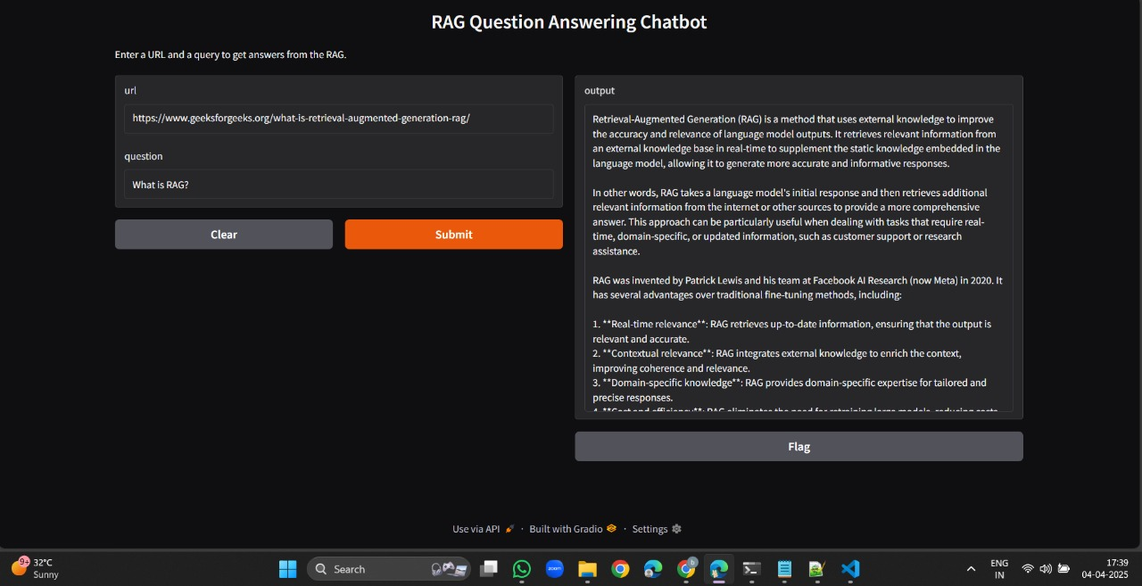
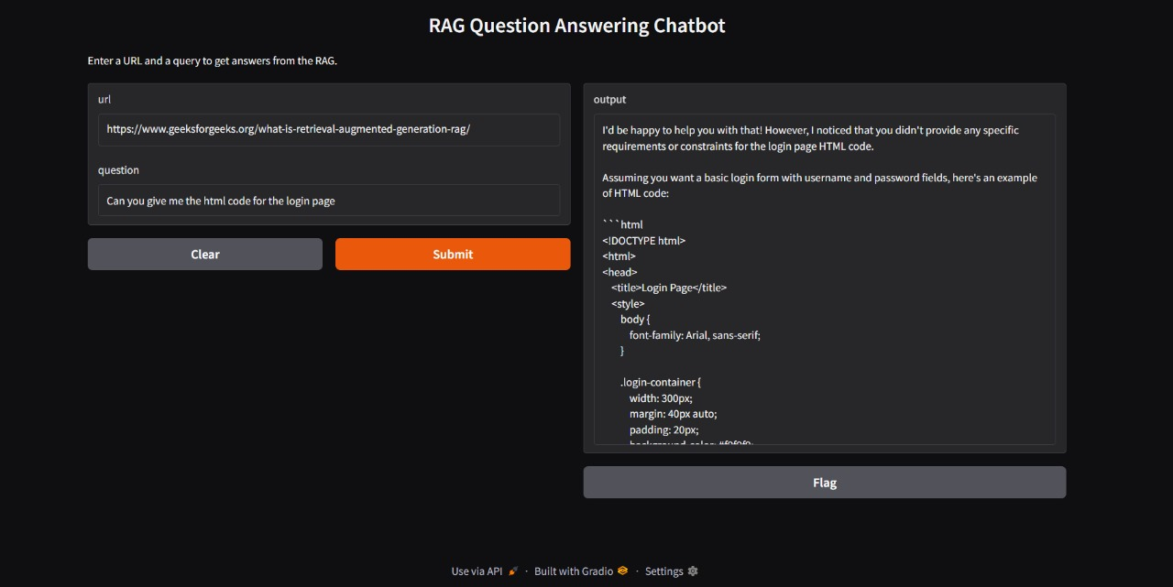
Implementation from the Feedback

Slide 7
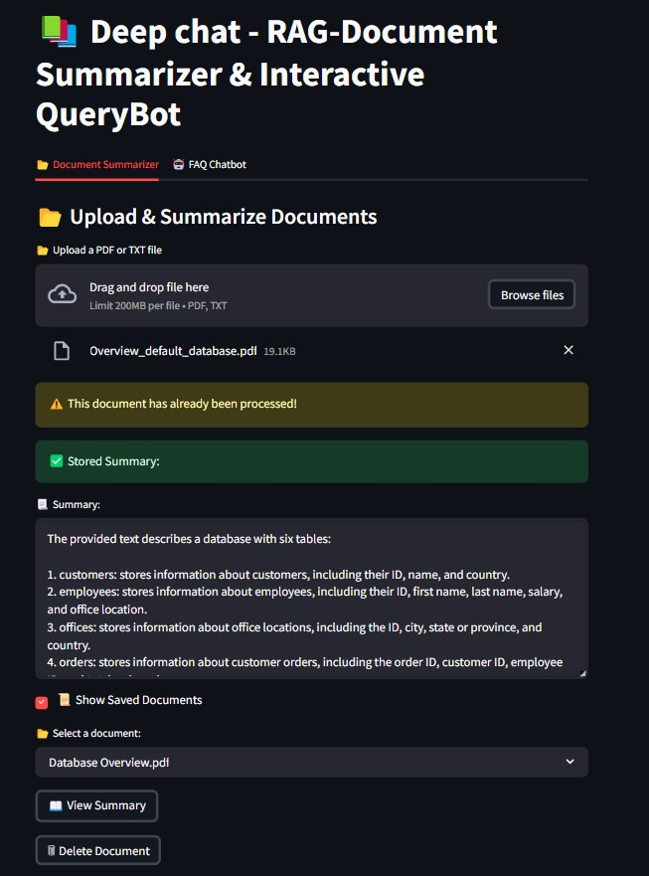
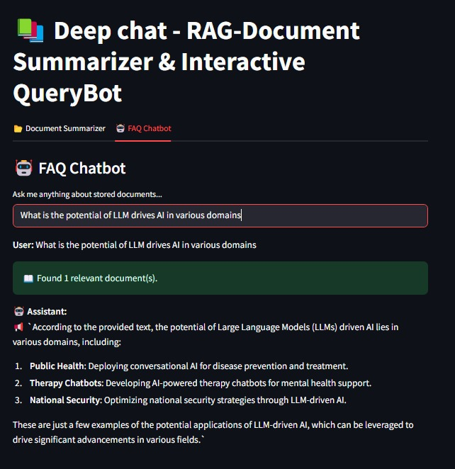
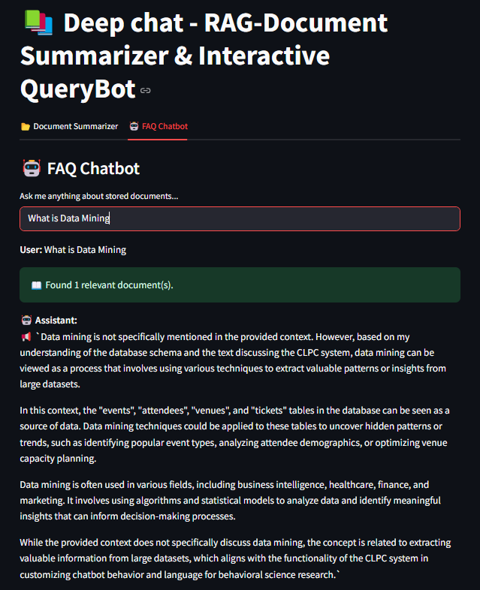
Implementation from the Feedback

Slide 8
Future Work
Image Summarization: Develop a feature to convert visual content into textual summaries.
Enable querying over tables, images, and mixed media documents.
Provide data visualizations from tables in documents.
Support multi-modal input (images, tables)
On-Device Deployment – Enable browser-based and mobile-friendly.

Slide 9
Software Requirements
Programming Language: Python
Libraries:
Transformers – Load and fine-tune TinyLlama
SentenceTransformers – Generate document embeddings
LangChain – Build the RAG pipeline (split, embed, retrieve, query)
Pandas – Read and preprocess the CSV dataset
ChromaDB – Vector store for fast semantic search
PyPDF – Extract text from PDFs
Tools:
Streamlit – Build the chatbot UI (with built-in CSS support)
Ollama – Run local LLMs in your environment
Operating System: Windows

Slide 10
Conclusion
Deep Chat provides a powerful and flexible solution for intelligent document interaction using LLMs and RAG. By combining real-time summarization, customizable Q&A, and fine-tuned language models, our system demonstrates the practical potential of AI in enterprise, education, and research environments.

Slide 11
References:-
M. S. Salim et al., "LLM based QA chatbot builder: A generative AI-based chatbot builder for question answering," SoftwareX, vol. 29, Article 102029, February 2025.
B. Johnson et al., "Unleashing LangChain, RAG, and Performance-Optimized LLM," ScienceDirect, 2024.
C. Lee et al., "A Complete Survey on LLM-based AI Chatbots," ResearchGate, 2024.
E. Chen et al., "An experimental hybrid customized AI and generative AI chatbot," Springer, 2024.

Slide 12
Thank You

