Slide 1
Applicative Project-1
Natural Disaster Prediction and Analysis
Supervisor:
Dr. Ayushi Arya Mam
SOT-School of Technology
Woxsen University
By:
1) Mohitha Bandi (22WU0105037)
2) Pilla Bhavya (22WU0105020)
3) Y. Siddhartha Reddy (22WU0105028)
4) T. Harshavardhan Reddy (22WU0105023)

Slide 2
Applicative Project-1
Natural Disaster Prediction and Analysis
Contents:
Abstract
Introduction
Methodology
Proposed System
- Work Flow
Software Requirements
Results
Conclusion

Slide 3
Applicative Project-1
Abstract
The "Natural Disaster Prediction and Analysis" project aims to develop an innovative approach to predict and analyze natural disasters, such as floods, using machine learning and data analytics. Our project seeks to address the urgent need for advanced predictive models that can provide early warnings and enable proactive response measures. Climate change is a major challenge today, largely caused by the rising levels of greenhouse gases like carbon dioxide and methane. In flood-prone areas of India, it is crucial to have effective early warning systems to minimize flood risks. We aim to develop accurate prediction models that can alert communities in advance. Our project highlights the importance of using data to improve disaster response and management, helping to reduce the impact of floods and build a more sustainable future.

Slide 4
Applicative Project-1
Introduction
Among the natural disasters, floods are the most destructive, causing massive damage to human
life, infrastructure, agriculture, and the socioeconomic system.
India, like many Southeast Asian countries, experiences heavy rainfall throughout the year due to its tropical climate.
Challenges in Prediction: Predicting floods is difficult due to the changing climate and requires complex models. Traditional models (physical and statistical) have limitations in terms of accuracy and computation.
Accurate prediction is crucial for effective disaster management.
Our project uses machine learning to improve disaster forecasting.
We aim to analyze data, identify patterns, and make more accurate predictions.
Our goal is to contribute to a more sustainable disaster management system that saves lives.

Slide 5
Applicative Project-1
Methodology
Setup Flask Application: Create a Flask app to handle requests and serve the UI.
Develop User Interface: Design web UI using HTML, CSS, JavaScript, and Bootstrap.
Data Collection: Gather historical flood and rainfall data. Preprocess the data.
Model Development: Split data into features (X) and target (y).
Train a machine learning model: Random Forest - using a preprocessing pipeline.
Implement Prediction Logic: Create predict_flood function to validate user input and prepare data for prediction. Predict flood occurrence based on user inputs.
Added Alerts: Compared predicted rainfall with average monthly and annual rain fall. Generate alerts if rainfall exceeds thresholds.
Integrating APIs: Use Weather API to fetch current weather data.
Implementing Geo Location : API to get user’s current location.
Display Results: Showing prediction results and alerts on the UI.

Slide 6
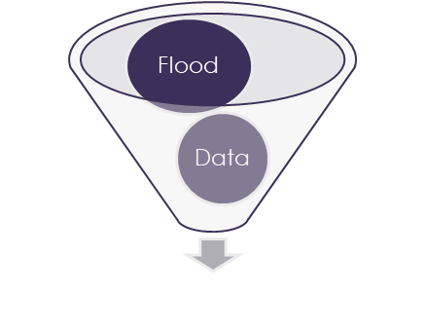

Applicative Project-1
Proposed System – Work Flow
DATASET
DATA PREPROCESSING
FEATURE EXTRACTION
ML MODEL
Training and Testing Data
Handle missing data
Categorical data into int
Label Encoders
Eliminate excess features
Reorder Columns
Scale Data
Historical Data approach
Threshold Approach
KNN
Logistic Regression
Decision Tree
Random Forest
MODEL EVALUATION
Training and Testing Accuracy Score
Training and Testing Classification Report
PREDICTION AND INTERPRETATION
Predict the Best Model
Evaluate Performance

Slide 7


Applicative Project-1
Proposed System – Work Flow
Training Data
Machine Learning Model
Features
Flask
Prediction
Input Features
Output Predictions
Website

Slide 8
Applicative Project-1
Software Requirements
Programming Language:- Python
Data Processing: Pandas, NumPy
Libraries: Scikit-learn etc.,
Visualization: Matplotlib, Seaborn, Plotly
Tools- Flask
UI - HTML,CSS, Bootstrap
Operating System: Windows

Slide 9
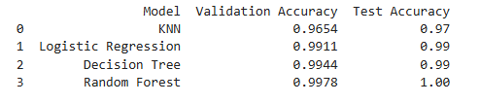
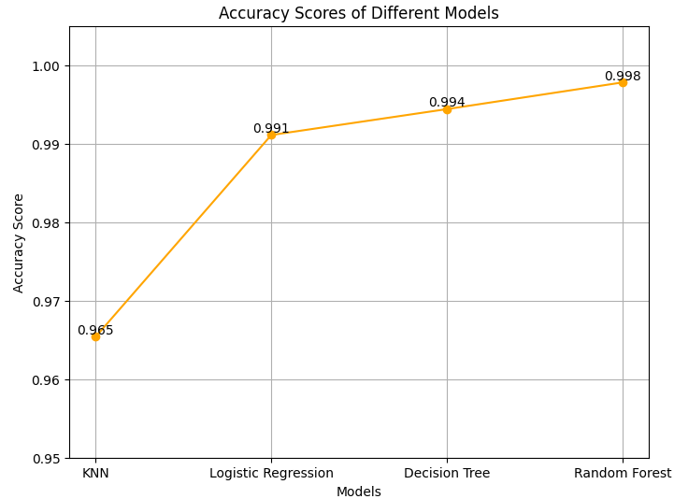
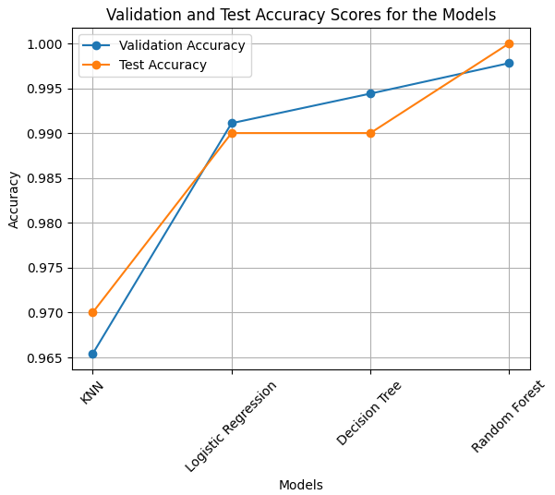
Applicative Project-1
Results

Slide 10
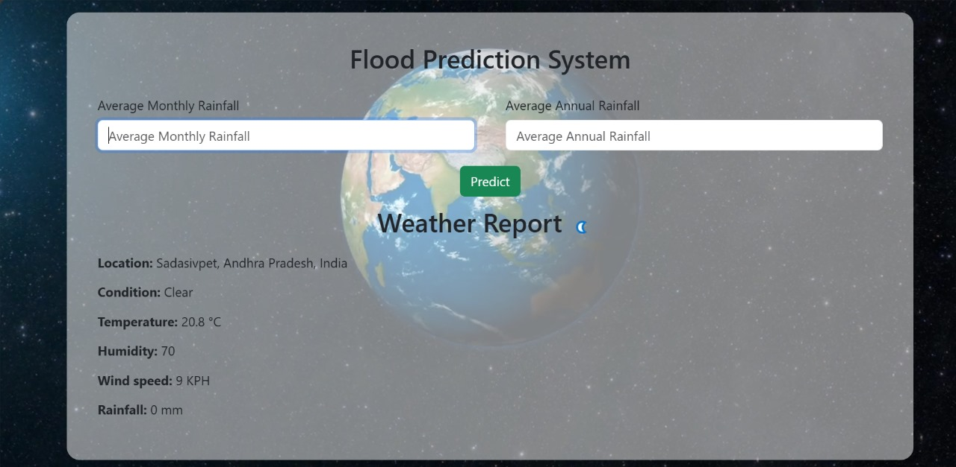
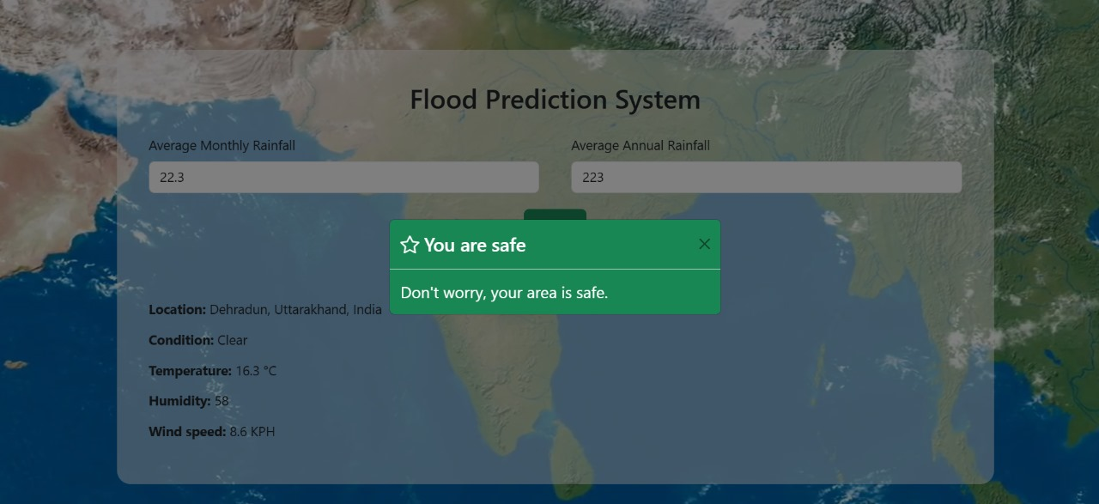
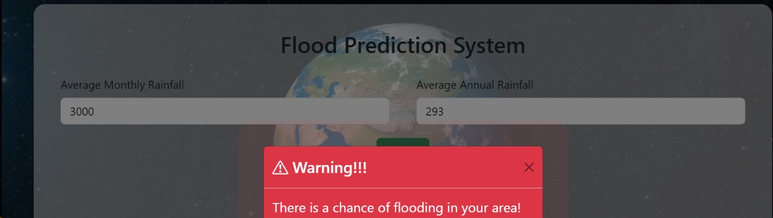
Applicative Project-1
Results

Slide 11
Applicative Project-1
Conclusion
Our project shows how machine learning and data can improve flood prediction and make it more accessible. Using a Random Forest model and Flask, combined with rainfall data and location data, the system makes flood predictions easy to understand and use. The alert system warns people if rainfall crosses safe levels, giving them time to prepare and reducing flood risks. Our project highlights the importance of data-driven solutions in addressing climate-related challenges, paving the way for more sustainable disaster management systems.

Slide 12
Applicative Project-1
Thanking You

