Slide 1

Python for Data Science
Testing, Databases, Streamlit & FastAPI

Slide 2

Introduction to Software Testing
Software testing means checking that your code does what it should. Testing is your safety net — it catches bugs before they reach users.
Manual Testing
Automated Testing
A human clicks through the app by hand. Slow, but good for visual checks.
Code runs tests automatically. Fast, repeatable, and ideal for Data Science pipelines.
🚀 Real-World Failures
✅ Why Testing Matters in Data Science
NASA Mars Climate Orbiter (1999) — unit mismatch destroyed the spacecraft
Therac-25 radiation machine — software bug caused patient overdoses
Knight Capital (2012) — bug caused a $440 million loss in 45 minutes
Catches data pipeline errors early
Ensures model outputs are correct
Makes code trustworthy for stakeholders
👨‍🏫 Instructor Note: Ask students: "Have you ever used an app that crashed or gave a wrong answer?" Use their examples to make testing feel personal.

Slide 3

pytest — Install, Write & Run Your First Tests
pytest is a popular Python testing tool. It's simple, powerful, and widely used in industry.
Install
Create Test File
Write Tests
Run pytest
Follow this workflow every time you add new code.
📦 Install & Folder Structure
✏️ Your First Test Function
pip install pytest
def add(a, b):
return a + b
def test_add():
result = add(2, 3)
assert result == 5
my_project/
├── calculator.py
└── test_calculator.py
Test files must start with test_ so pytest finds them automatically.
Every test function must start with test_. Inside, call your function and assert the expected result.
🖥️ Running Tests in the Terminal
pytest # Run all tests
pytest test_calc.py # Run one file
pytest -v # Verbose output
✅ PASSED
❌ FAILED
⚠️ ERROR
Test succeeded — output matches expectation.
Test found a bug — read the error message below.
Test code crashed — check for typos or import issues.
👨‍🏫 Instructor Note: Have students run pytest --version to confirm installation. Then walk through creating test_calculator.py together.

Slide 4

Assertions — The Heart of Every Test
An assertion checks whether a condition is True. If it's False, the test fails and shows an error.
assert Keyword — How It Works
Assertion Examples by Type
assert condition, "error message"
# Example:
x = 10
assert x == 10, "x should be 10"
# Math
assert 3 + 2 == 5
# Strings
name = "Alice"
assert name.upper() == "ALICE"
# Lists
nums = [1, 2, 3]
assert len(nums) == 3
# Booleans
is_active = True
assert is_active is True
If the condition is True → test passes. If False → test fails with the message.
🐛 Common Mistake #1 — Wrong Operator
🐛 Common Mistake #2 — Floating Point
🔍 Debugging a Failed Test
When a test fails, pytest shows: (1) which test failed, (2) the assert line, (3) expected vs. actual value. Read from top to bottom — the answer is always there.
assert x = 5 # WRONG — single = assigns
assert x == 5 # CORRECT — double == compares
assert 0.1 + 0.2 == 0.3 # May fail!
assert abs((0.1+0.2)-0.3) < 0.0001 # Safe
👨‍🏫 Instructor Note: Intentionally write a failing test live and walk through the error output together. This builds debugging confidence early.

Slide 5
Pydantic — Validate Your Data Like a Pro
Data validation means checking that incoming data has the right types and values. Pydantic is a Python library that does this automatically using type hints.
Define your model → feed it raw data → Pydantic validates and tells you what's wrong.
📦 Install & BaseModel Example
pip install pydantic
from pydantic import BaseModel, Field
class Student(BaseModel):
name: str = Field(..., min_length=1)
age: int = Field(..., gt=0, lt=150)
email: str
gpa: float = Field(default=0.0, ge=0.0, le=4.0)

Slide 6

Databases & CRUD Operations
A database is an organized system for storing and retrieving data.
Think of it as a digital filing cabinet that millions of people can use at the same time.
SQL Databases
NoSQL Databases
Structured tables with rows and columns. Best for structured data.
Flexible, document-based storage. Best for unstructured or changing data.
PostgreSQL, MySQL, SQLite
Banking, accounting, inventory
MongoDB, Redis, Firebase
Social media, real-time apps, catalogs
Create (INSERT)
🔄 The CRUD Lifecycle
Read (SELECT)
🐍 CRUD with Python (SQLite)
import sqlite3
conn = sqlite3.connect("students.db")
cur = conn.cursor()
# CREATE
cur.execute(
"INSERT INTO students (name, age) VALUES (?, ?)",
("Maya", 20)
)
# READ
cur.execute("SELECT * FROM students")
rows = cur.fetchall()
# UPDATE
cur.execute(
"UPDATE students SET age = 21 WHERE name = ?",
("Maya",)
)
# DELETE
cur.execute(
"DELETE FROM students WHERE name = ?",
("Maya",)
)
conn.commit()
conn.close()
Delete (DELETE)
Update (UPDATE)
Every database application follows this cycle. Master CRUD and you
can build almost any data-driven app.
🌍 Real-World Database Examples
🏦 Banking
Every transaction is stored, validated, and auditable.
🛒 E-Commerce
Products, orders, and user profiles all live in databases.
📱 Social Media
Posts, likes, and messages are retrieved from databases in milliseconds.
👨‍🏫 Instructor Note: Use SQLite for class — it requires no server setup. Have students build a mini student database with all four CRUD operations.

Slide 7

Git, GitHub & Collaborating on Code
Git is a version control system — it tracks every change you make to your code. GitHub is a website where you store your Git projects and collaborate with others.
Write Code
Push
Make changes and save files locally
Run git push to upload to GitHub
Commit
Pull Request
Run git add and git commit to snapshot
Open PR for review and merge
This workflow keeps your code safe, shareable, and reviewable by teammates.
🛠️ Essential Git Commands
🌐 Getting Started with GitHub
git init # Start tracking a project
git add . # Stage all changes
git commit -m "message" # Save a snapshot
git push # Upload to GitHub
git pull # Download updates
git branch # List branches
git checkout -b new-feat # Create new branch
Install Git from git-scm.com
Create a free account at github.com
Click New Repository → give it a name
Copy the URL and run git clone [url]
Add files, commit, and push!
🐛 Beginner Mistake — Forgetting to Commit
🐛 Beginner Mistake — Pushing Secrets
✅ Best Practice — Small Commits
Always run git commit after git add. Uncommitted changes can be lost.
Never commit passwords or API keys. Add a .gitignore file to exclude sensitive files.
Commit often with clear messages like "fix: correct typo in login". Small commits are easier to review and undo.
👨‍🏫 Instructor Note: Have every student create a GitHub account and push a "Hello World" repo before the next class. This removes the setup barrier early.

Slide 8
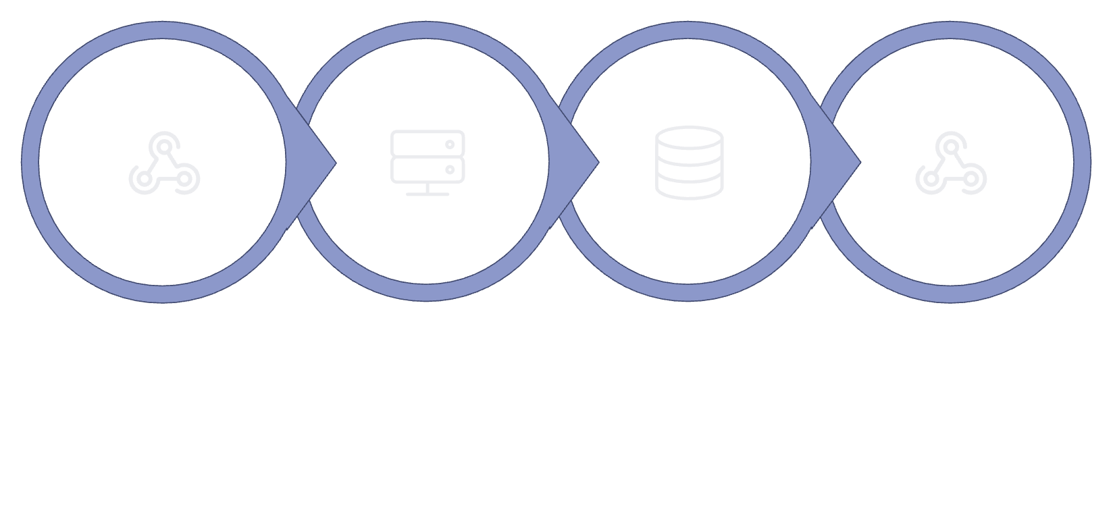
APIs & FastAPI — Building Your First Web API
An API (Application Programming Interface) lets two programs talk to each other. Think of it as a waiter — you send a request, it fetches data, and returns a response.
Client Request
Receive & Process
Query DB / Logic
Return JSON
Every time you use an app, API calls are happening behind the scenes.
⚡ FastAPI — Modern & Beginner-Friendly
🚀 Run & Test Your API
pip install fastapi uvicorn
uvicorn main:app --reload
from fastapi import FastAPI
from pydantic import BaseModel
app = FastAPI()
class Item(BaseModel):
name: str
price: float
@app.get("/")
def read_root():
return {"message": "Hello World"}
@app.post("/items")
def create_item(item: Item):
return {"item": item, "status": "created"}
Visit http://127.0.0.1:8000/docs — FastAPI auto-generates an interactive docs page!
GET — Read data (safe, no changes)
POST — Create new data
PUT — Update existing data
DELETE — Remove data
FastAPI + Pydantic = automatic validation AND docs. Two birds, one stone!
👨‍🏫 Instructor Note: Run the example live and open /docs in the browser. Let students try POST requests with different data — the instant feedback is powerful.

Slide 9

Streamlit — Build Data Apps in Pure Python
Streamlit lets you turn a Python script into a beautiful, interactive web app — no HTML, CSS, or JavaScript needed. Perfect for showcasing Data Science projects.
Write Script
Open Browser
Create Python file using st. commands
App launches automatically in browser
Run App
Share or Deploy
Execute: streamlit run app.py in terminal
Share link or deploy app online
From script to live app in under 60 seconds.
📊 Your First Streamlit App
🛠️ Run & Explore Widgets
import streamlit as st
import pandas as pd
import numpy as np
st.title("My First Data App")
name = st.text_input("Enter your name")
st.write(f"Hello, {name}!")
df = pd.DataFrame(
np.random.randn(20, 3),
columns=["A", "B", "C"]
)
st.line_chart(df)
if st.button("Click me"):
st.success("Button clicked!")
pip install streamlit
streamlit run app.py
st.text_input()
st.slider()
Text box for user input
Draggable number slider
st.selectbox()
st.button()
Dropdown menu
Clickable button
🎯 Mini Project — Student Data Dashboard
Build a Streamlit app that loads a CSV of student grades, displays a bar chart of scores, and lets users filter by name using a dropdown.
👨‍🏫 Instructor Note: Walk through building the dashboard together. Students love seeing their data come alive interactively — it's a great confidence booster.

Slide 10
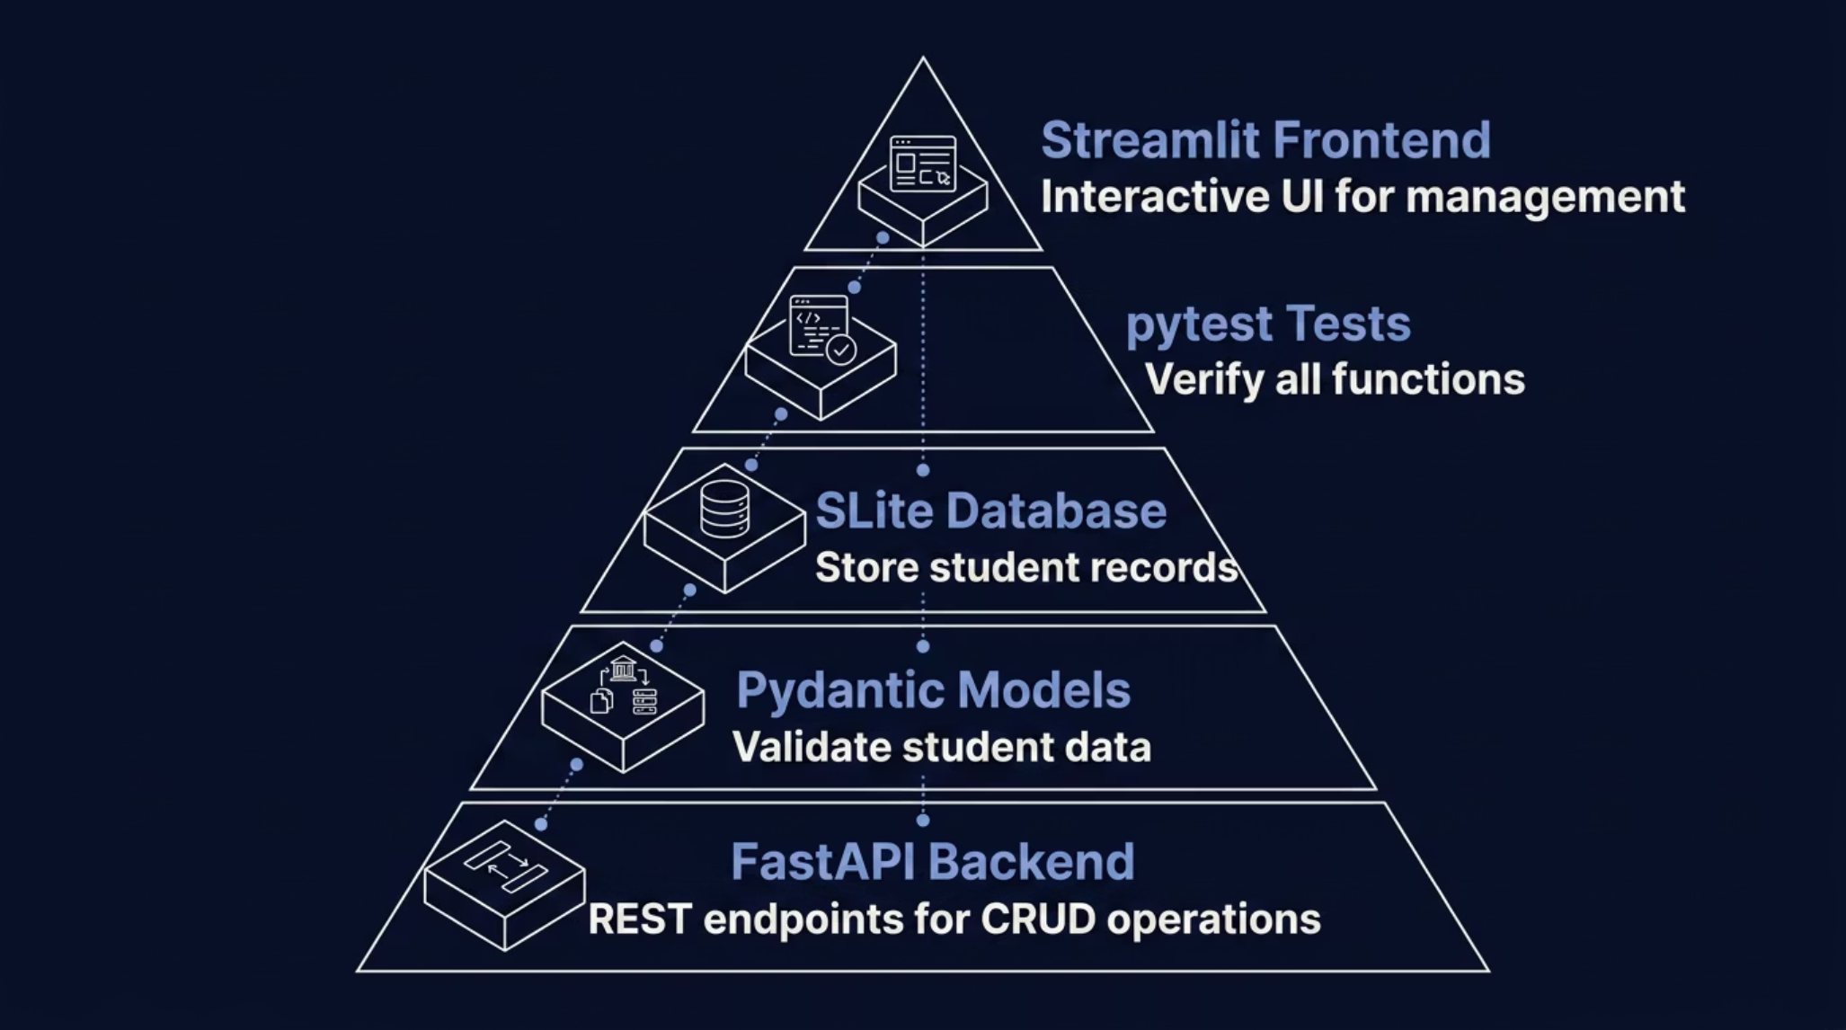

Mini Project — Build a Complete Data Science App
Let's combine everything: FastAPI for the backend, Pydantic for validation, pytest for testing, SQLite for the database, and Streamlit for the frontend.
📁 Project Folder Structure
🚀 Step-by-Step Build Order
student_app/
├── main.py # FastAPI app
├── models.py # Pydantic models
├── database.py # SQLite functions
├── test_main.py # pytest tests
├── app.py # Streamlit UI
└── requirements.txt
Define Student model with Pydantic
Write SQLite CRUD functions
Build FastAPI endpoints (GET, POST, PUT, DELETE)
Write pytest tests for each endpoint
Create Streamlit dashboard to display data
Run all tests with pytest — fix failures
Push final code to GitHub
✅ You've Learned
🔜 What's Next
💡 Final Tip
Testing with pytest, data validation with Pydantic, databases with SQLite, version control with Git/GitHub, APIs with FastAPI, and apps with Streamlit.
Explore Data Science libraries (pandas, NumPy, scikit-learn), deploy your app to the cloud, and keep building real projects.
Write tests as you code, commit to Git often, and never stop experimenting. Every bug is a lesson!
👨‍🏫 Instructor Note: This mini project can span 2–3 class sessions. Encourage pair programming and GitHub collaboration to simulate real-world workflows.

Slide 11

Introduction to FastAPI
FastAPI is a modern, fast (high-performance) web framework for building APIs with Python 3.7+ based on standard Python type hints. It's designed for speed, robustness, and ease of use, making it ideal for data science applications.
1
High Performance
On par with NodeJS and Go due to Starlette and Pydantic.
2
Developer Experience
Easy to learn and use, minimizing development time.
3
Automatic Docs
Generates interactive API documentation (Swagger UI & ReDoc).
4
Data Validation
Leverages Pydantic for robust request and response validation.
APIs in Data Science
In data science, APIs are crucial for bringing models to life. They allow you to:
Serve trained machine learning models for real-time predictions.
Provide data access to various applications and dashboards.
Integrate with other services and build complex data pipelines.

Slide 12

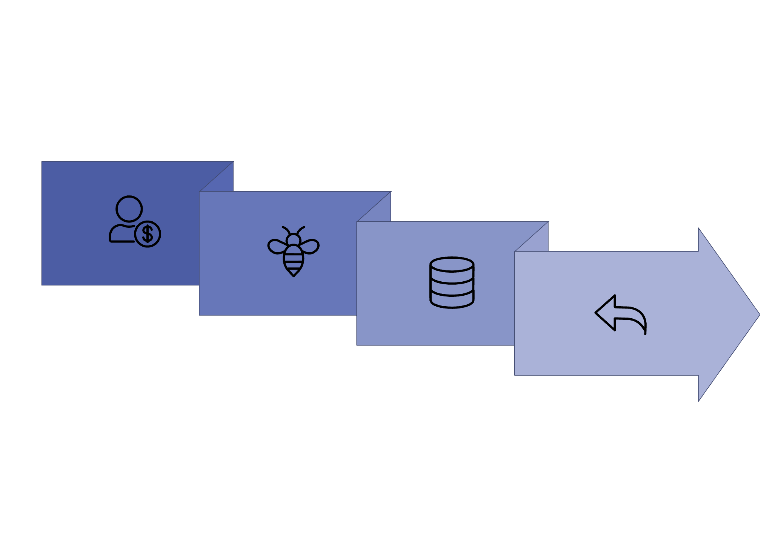
Creating API Endpoints
API endpoints are specific URLs (routes) that applications interact with to access or modify data. Each endpoint performs a distinct operation, forming part of the request-response cycle.
API Endpoint
Return Response
Client Request
DB / Logic
@app.get() — Retrieve Data
@app.post() — Create Data
Used for fetching data from the server. These requests are idempotent and safe, meaning they don't change server state.
Used for sending data to the server to create a new resource. These requests typically change server state and are not idempotent.
from fastapi import FastAPI
app = FastAPI()
# Hello API Endpoint
@app.get("/hello")
def say_hello():
return {"message": "Hello, FastAPI!"}
# Student API Endpoint (with path parameter)
@app.get("/students/{student_id}")
def get_student(student_id: int):
return {"student_id": student_id, "name": f"Student {student_id}"}
from pydantic import BaseModel
class Product(BaseModel):
name: str
price: float
description: str | None = None
# Product API Endpoint
@app.post("/products")
def create_product(product: Product):
# In a real app, save 'product' to a database
return {"message": "Product created successfully", "product": product.dict()}
An endpoint combines a route (like /hello) with an HTTP method (like GET or POST).

Slide 13
Request and Response Models
Pydantic models are essential for defining the structure and ensuring the validity of data exchanged between your FastAPI application and clients. They serve a dual purpose: input validation and response serialization.
Input Validation
Request Body
Response Model
Automatically checks incoming data against your model's schema, raising errors for invalid types or missing fields.
Defines the expected structure of data sent from the client to the API (e.g., for creating or updating resources).
Specifies the structure of data sent from the API to the client, ensuring consistent output and data filtering.
Example: User Registration API
Let's define separate models for creating a user and for the data returned after creation, ensuring passwords are never exposed.
from pydantic import BaseModel
from fastapi import FastAPI
app = FastAPI()
# 1. Input Model: How a client sends user data
class UserCreate(BaseModel):
username: str
password: str # Password required for creation
email: str | None = None
# 2. Output Model: How the API returns user data
class UserResponse(BaseModel):
username: str
email: str | None = None # Password excluded from response
@app.post("/users/", response_model=UserResponse)
def create_user(user: UserCreate):
# In a real app: hash password, save to DB
# For demo, just return the user data
return user # FastAPI converts UserCreate to UserResponse
Explanation
UserCreate: This BaseModel defines what fields are expected when a client sends a request to register a new user. username and password are required. email is optional.
UserResponse: This model defines the structure of the data that the API will send back to the client after a user is created. Notice it intentionally excludes the password field for security.
@app.post("/users/", response_model=UserResponse): This decorator defines a POST endpoint. The response_model=UserResponse tells FastAPI to automatically convert the returned data into the UserResponse format before sending it back.
def create_user(user: UserCreate):: The input user parameter is type-hinted with UserCreate. FastAPI will automatically validate the incoming request body against this model.
Pydantic's BaseModel makes your API self-documenting and robust, handling validation errors automatically.

Slide 14
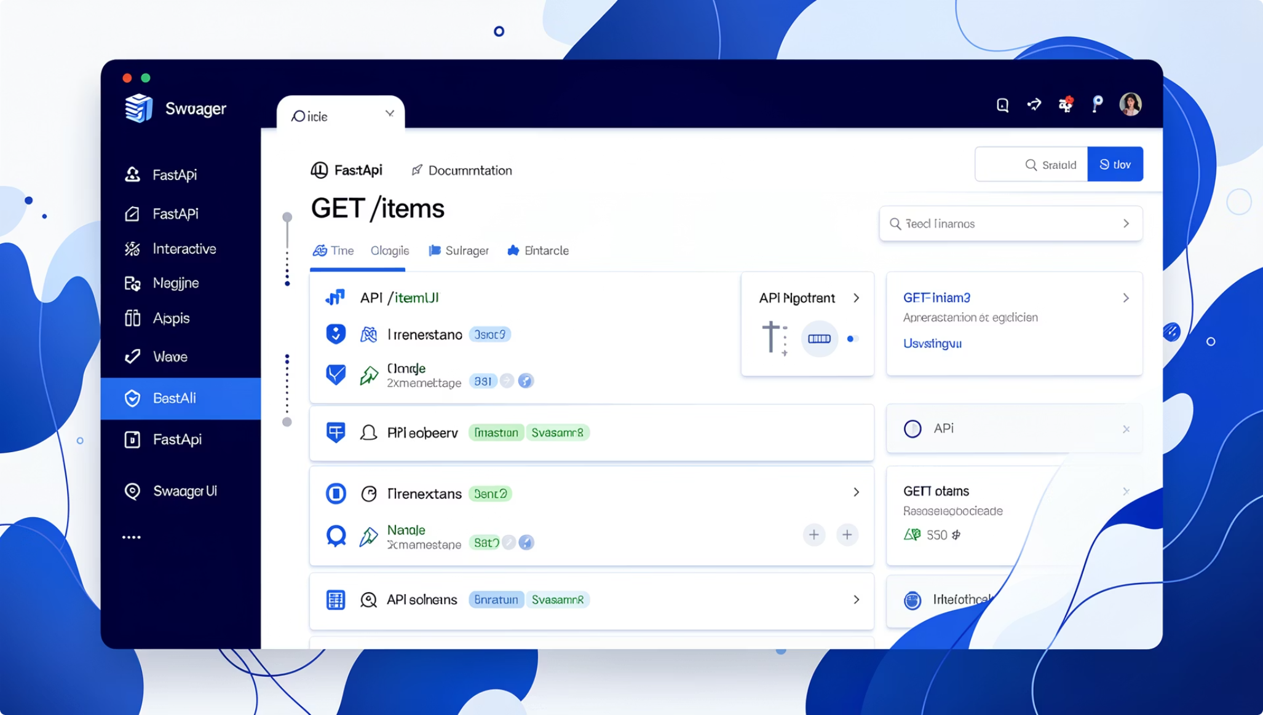
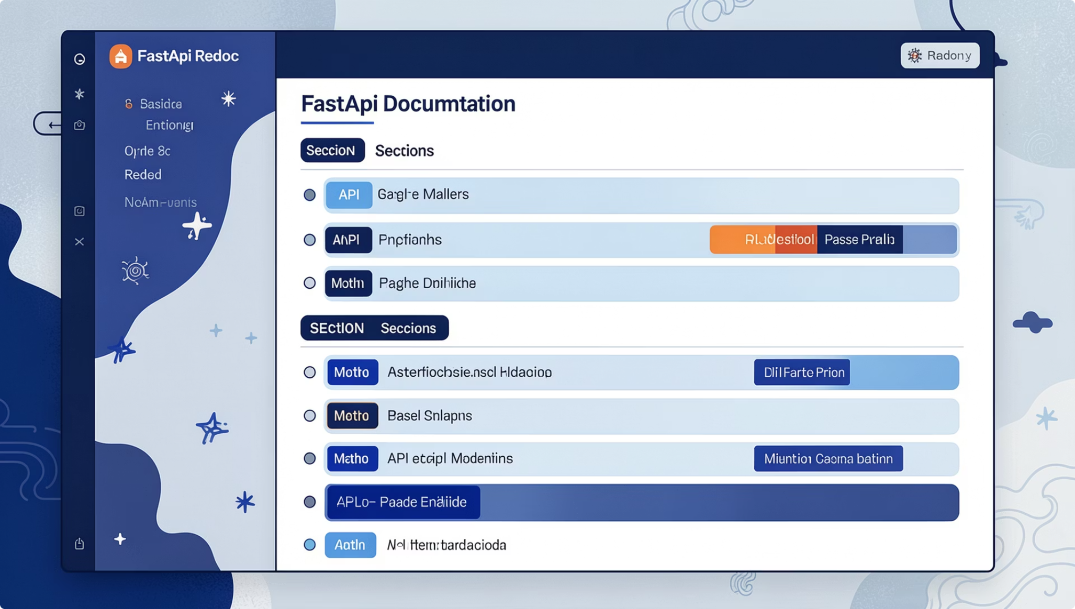
SECTION 21
Running FastAPI Applications
FastAPI applications are typically served using an ASGI server like Uvicorn. Uvicorn is a lightning-fast ASGI server, perfect for production and development, thanks to its auto-reloading capabilities.
uvicorn main:app --reload
uvicorn
main:app
--reload
The command to start the Uvicorn server.
Refers to the Python file main.py and the FastAPI application instance named app within it (e.g., app = FastAPI()).
An optional flag that enables auto-reloading. Uvicorn will restart the server automatically whenever you make changes to your code, speeding up development.
Accessing Your API Locally
Once Uvicorn starts, your FastAPI application will be accessible via your web browser or API clients, typically at http://127.0.0.1:8000 or http://localhost:8000.
Interactive API Documentation (Swagger UI)
FastAPI automatically generates interactive API documentation using Swagger UI. This allows you to explore and test your API endpoints directly from your browser. Access it by navigating to /docs.
Alternative Documentation (ReDoc)
FastAPI also provides an alternative, more concise documentation interface powered by ReDoc. It offers a cleaner, single-page view of your API. Access it at /redoc.
FastAPI's built-in documentation tools (Swagger UI and ReDoc) are invaluable for development and collaboration, providing clear, up-to-date API specifications without extra effort.

Slide 15

Analytics App Project: FastAPI + Streamlit Dashboard
Let's bring everything we've learned together! This mini-project will guide you through building a complete, end-to-end data analytics dashboard. We'll leverage FastAPI for a robust backend and Streamlit for an interactive, user-friendly frontend to visualize and analyze your data.
Key Features
Upload CSV File
Data Summary
Seamlessly load your datasets directly into the application.
Get quick insights into your data's structure, types, and initial rows.
Generate Charts
Display Statistics
Create dynamic and customizable visualizations for better understanding.
View key statistical metrics like mean, median, min, max, and more.
Interactive Filtering
Explore your data with real-time filters and drill-down capabilities.

Slide 16
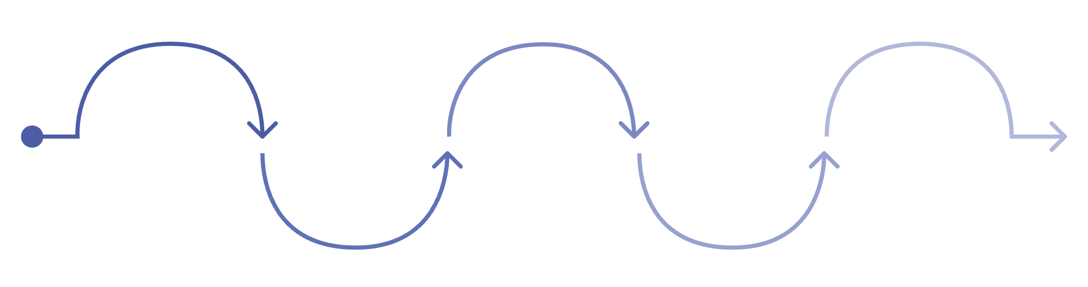
Connecting Frontend and Backend
In our data science application, Streamlit acts as the interactive frontend, providing the user interface, while FastAPI serves as the powerful backend, handling data processing, model inference, and API logic. Communication between them is crucial for a dynamic user experience.
FastAPI Receive
FastAPI Response
Streamlit Request
Processing
Streamlit Update
Endpoint accepts and validates data
Model inference and data transformation
Return JSON with results
User action triggers API call
UI refreshes with new output
This diagram illustrates the fundamental client-server interaction: the Streamlit application (client) initiates requests, the FastAPI application (server) processes them, and then sends back responses, which Streamlit uses to update the user interface.
import streamlit as st
import requests
# Assume your FastAPI app is running on http://127.0.0.1:8000
FASTAPI_BASE_URL = "http://127.0.0.1:8000"
st.title("Streamlit Frontend with FastAPI Backend")
# Example 1: Fetching data from a simple GET endpoint
st.header("Fetch /items endpoint")
if st.button("Get Items from FastAPI"):
try:
response = requests.get(f"{FASTAPI_BASE_URL}/items/")
if response.status_code == 200:
items = response.json()
st.success("Successfully fetched items:")
st.json(items)
else:
st.error(f"Error fetching items: {response.status_code} - {response.text}")
except requests.exceptions.ConnectionError:
st.error("Could not connect to FastAPI backend. Is it running?")
# Example 2: Sending data to a POST endpoint (conceptual)
st.header("Post /users endpoint (conceptual)")
user_name = st.text_input("Enter a username to create:")
if st.button("Create User"):
if user_name:
payload = {"name": user_name, "email": f"{user_name}@example.com"}
# In a real app, you'd define a POST endpoint in FastAPI
# response = requests.post(f"{FASTAPI_BASE_URL}/users/", json=payload)
st.info(f"Conceptually sending: {payload} to FastAPI /users endpoint")
st.success("User creation request sent (conceptually).")
else:
st.warning("Please enter a username.")
API Integration Example
Streamlit applications communicate with FastAPI backends primarily using HTTP requests.
Python's popular requests library is typically used for this purpose.
Explanation
requests.get(url): This function sends an HTTP GET request to the specified FastAPI endpoint.
response.json(): If the FastAPI endpoint returns JSON data, this method parses the response body into a Python dictionary or list.
Error Handling: It's good practice to include basic error handling to gracefully manage cases where the API call fails or returns an unexpected status.
st.write(): Streamlit functions are used to display the received data directly in the web application.
This client-side Python code within Streamlit leverages the standard requests library to send HTTP calls, acting as a bridge between your user interface and the backend data and logic.

Slide 17
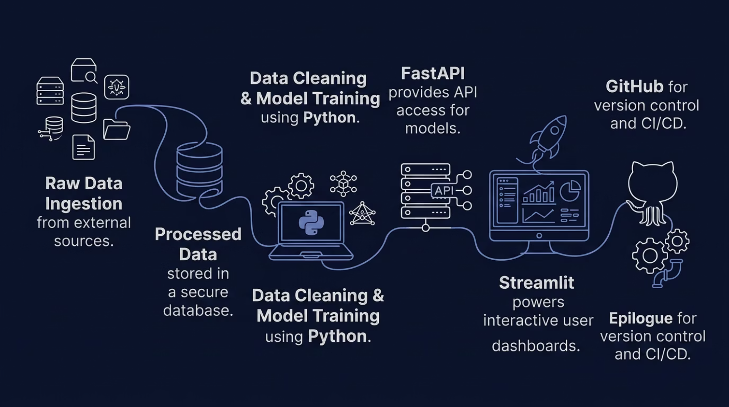
Complete Python Data Science Stack Review
Let's recap the powerful ecosystem of tools we've explored, demonstrating how they integrate to form a robust, end-to-end solution for data science applications. From foundational programming to deployment, each component plays a critical role in a real-world workflow.
Key Technologies in Our Stack
Python Basics
Visualization
APIs
The foundational programming language for data manipulation, analysis, and algorithm development.
Tools like Matplotlib, Seaborn, and Plotly to create insightful charts and graphs from data.
Interfaces for different software components to communicate, enabling modular and scalable applications.
Testing
Databases
Streamlit
Ensuring the reliability and correctness of code, critical for robust data science models and applications.
Structured storage for efficient management, retrieval, and persistence of large datasets.
A framework for building interactive, web-based data dashboards and frontends in pure Python.
FastAPI
GitHub
A modern, high-performance web framework for building backend APIs that handle data processing and model serving.
A platform for version control, collaborative development, and project management of codebases.
Understanding the interplay between these technologies is crucial for constructing functional and maintainable data science solutions. From data ingestion and processing to model deployment and interactive visualization, each tool contributes to a seamless workflow.
Real-World Data Science Workflow: End-to-End Architecture
This architectural overview illustrates how raw data is transformed into actionable insights through a series of interconnected stages. FastAPI acts as the bridge between the data backend (databases, Python processing) and the interactive frontend (Streamlit), all managed and version-controlled via GitHub.

Slide 18
Python Data Science Stack: Quick Reference
Testing & Validation
Development & Deployment
pytest - Run Tests
Git & GitHub - Version Control
pytest
git init # Initialize new repo
git add . # Stage changes
git commit -m "message" # Commit changes
git push # Upload to GitHub
git clone URL # Download repo
Use assert to check expected output within test functions:
def test_add():
assert 2 + 3 == 5
Streamlit - Frontend Apps
Pydantic - Data Validation
import streamlit as st
st.title("My App")
st.write("Hello")
st.text_input("Enter Name")
st.button("Submit")
from pydantic import BaseModel
class Student(BaseModel):
name: str
age: int
Run Streamlit app:
streamlit run app.py
Automatically validates user input based on defined models.
Database CRUD Operations
Create → Add new data
Read → Retrieve existing data
Update → Modify records
Delete → Remove data
FastAPI - Backend APIs
from fastapi import FastAPI
app = FastAPI()
@app.get("/")
def home():
return {"message":"Hello"}
Run FastAPI server:
uvicorn main:app --reload
This cheat sheet serves as a quick reference for the syntax and commands of the essential tools in our Python data science stack.

