Slide 1
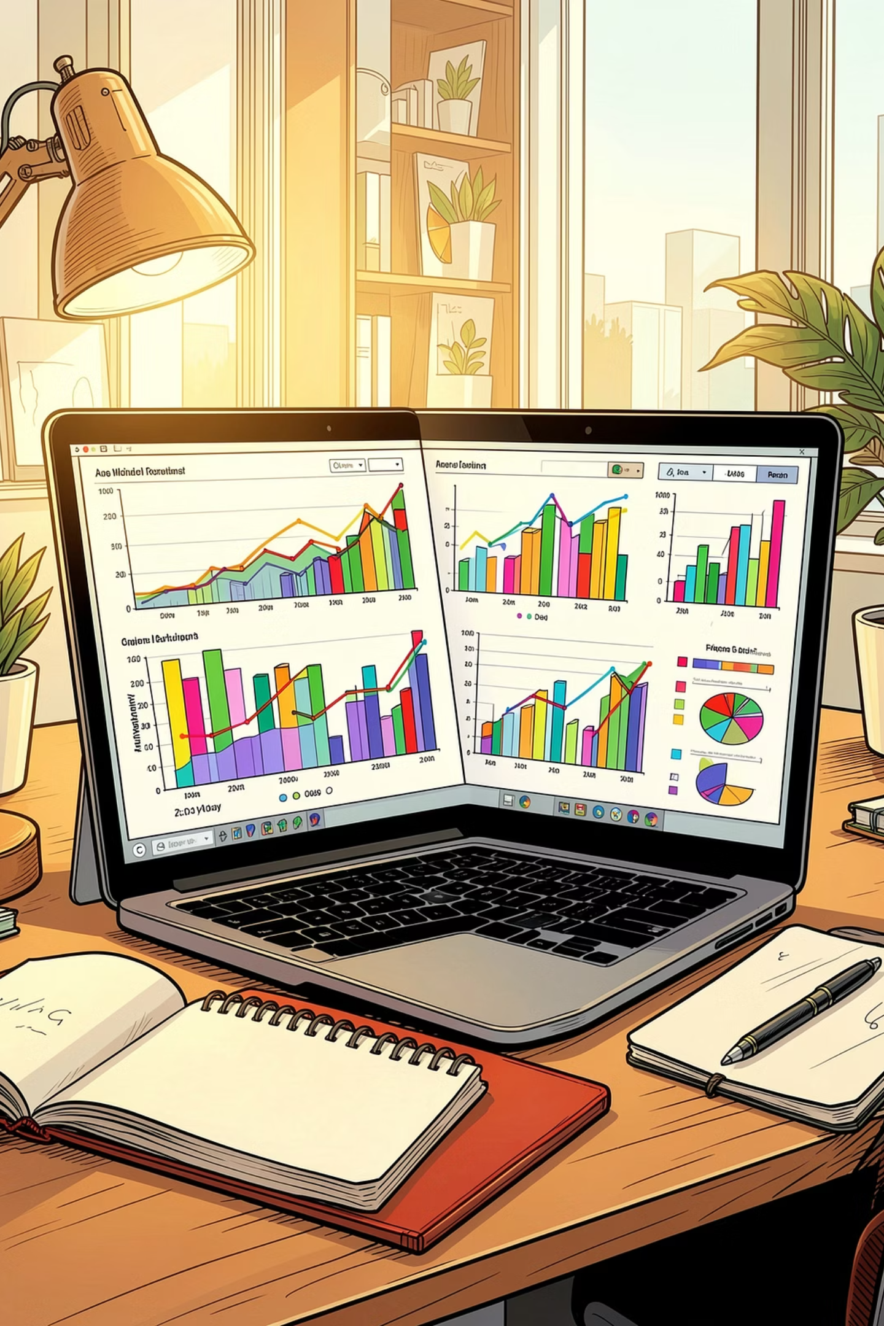
Excel
Data Visualization, Conditional Formatting & PivotTables
Turn raw numbers into clear, colorful.

Slide 2
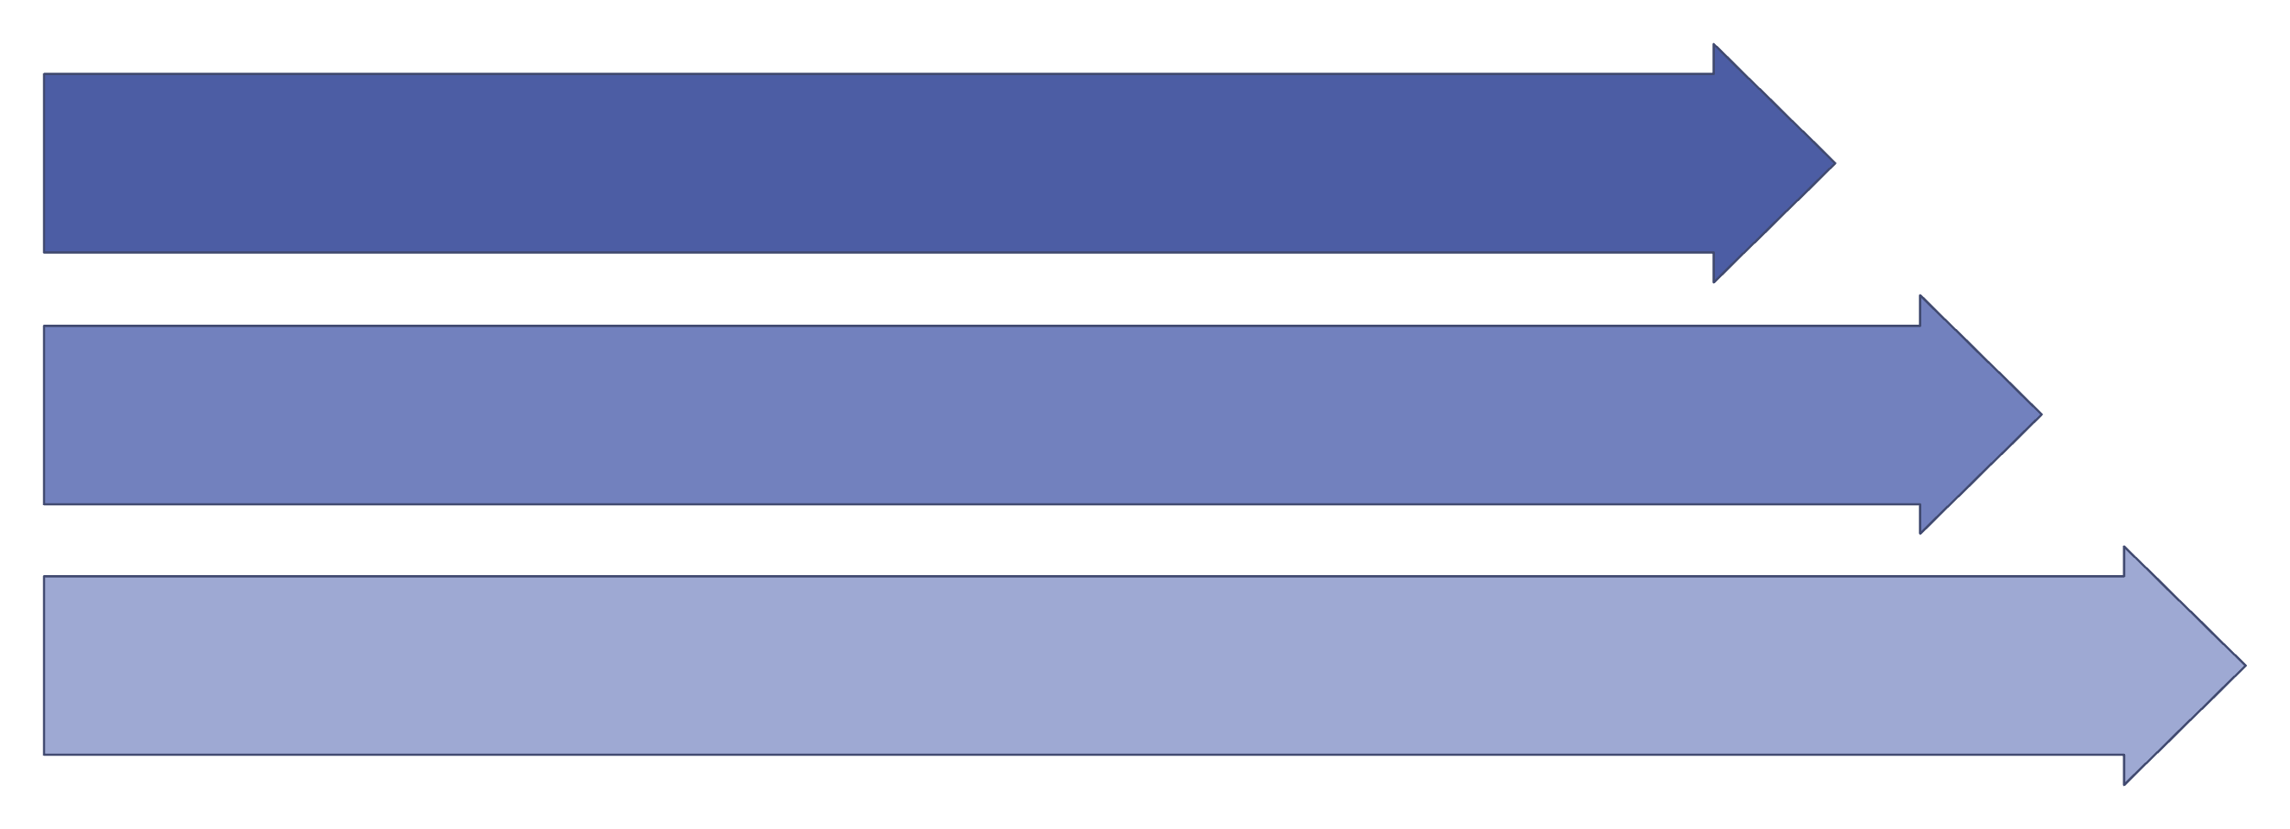
PART 1 · DATA VISUALIZATION
What Is Data Visualization?
Data visualization turns raw numbers into charts and graphs so patterns become clear at a glance. Think of it as translating a spreadsheet into a picture your brain reads instantly.
Raw Data
Analysis
Decision
Used in hospitals, pharmacies, schools, and businesses — anywhere decisions depend on data.
Before vs. After Visualization
❌ Raw Data
✅ Visual Data
Rows of numbers — hard to spot trends or
compare values quickly.
A chart reveals trends, highs, and lows in seconds.

Slide 3
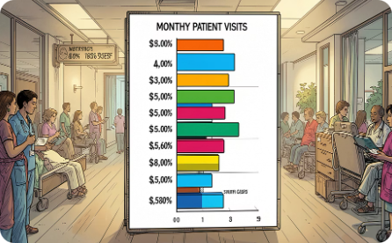
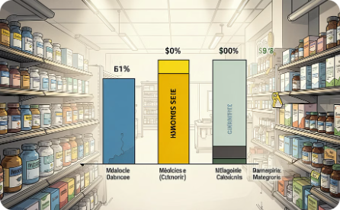
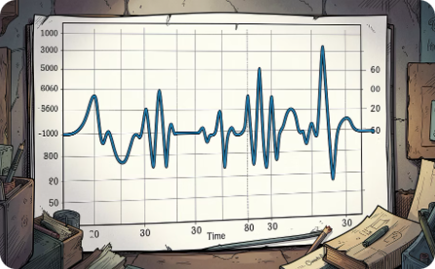
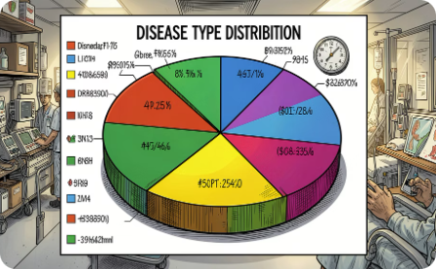
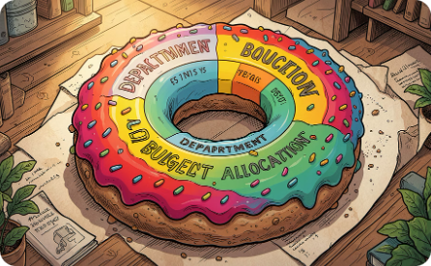
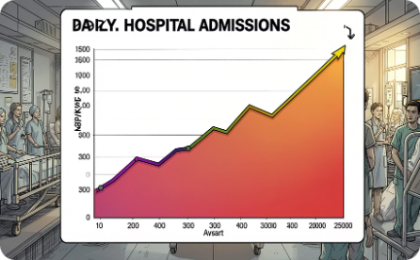

PART 2 · BASIC CHARTS
6 Essential Charts
Each chart tells a different story. Pick the right one for your data.
Column Chart
Bar Chart
Line Chart
Pie Chart
Compare values across categories. Example: Monthly patient visits.
Horizontal comparison. Example: Medicine sales by category.
Track trends over time. Example: Temperature monitoring.
Show parts of a whole. Example: Disease types in a hospital.
Doughnut Chart
Area Chart
Multi-category percentages. Example: Department budgets.
Trends with volume. Example: Daily hospital admissions.
💡 Beginner Tip: Select your data first, then go to Insert → Charts to pick your chart type.

Slide 4
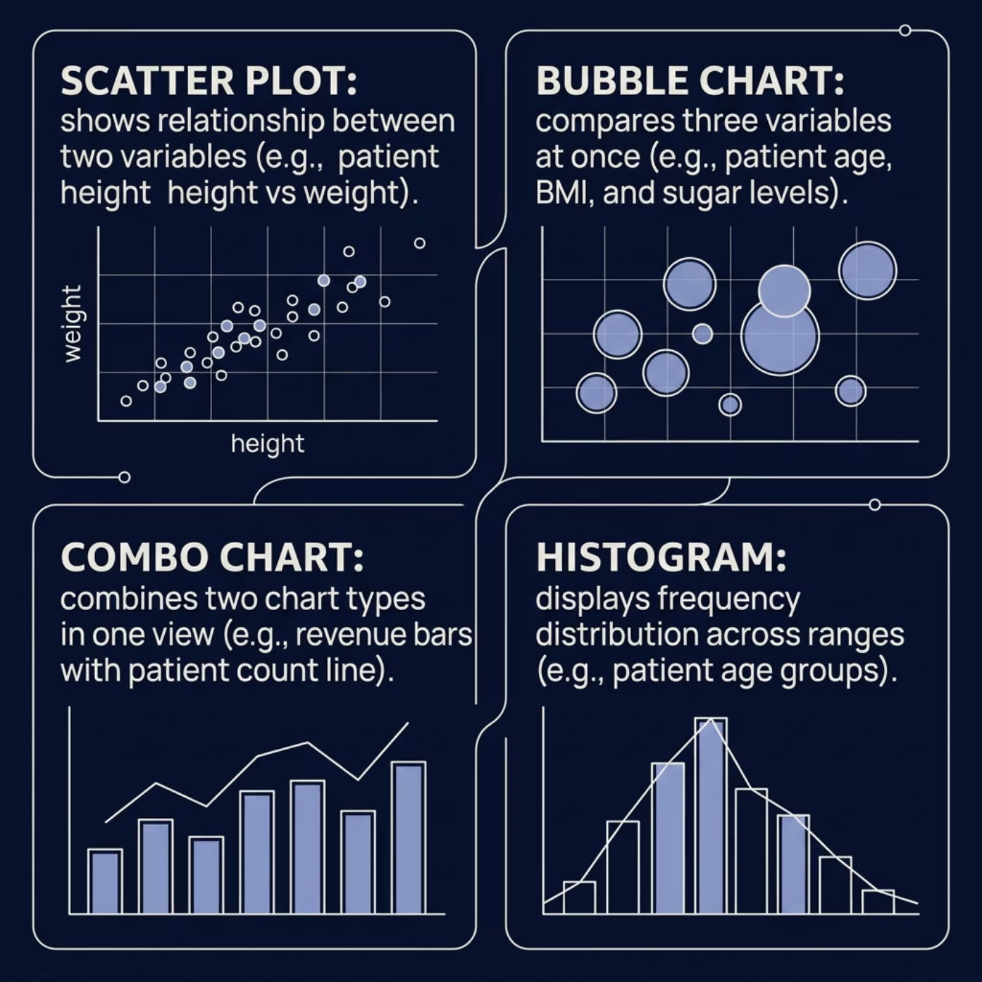


PART 3 · ADVANCED & STATISTICAL CHARTS
Going Deeper: Advanced & Statistical Charts
Statistical Charts
Box & Whisker
Shows data spread and outliers. Example: Blood pressure ranges.
Waterfall
Tracks gains and losses. Example: Hospital income vs. expenses.
Funnel
Visualizes process stages. Example: Patient appointment flow.
📊 Pro Tip: Use Combo Charts to show two metrics together — like revenue (columns) and patient count (line) on one chart.

Slide 5
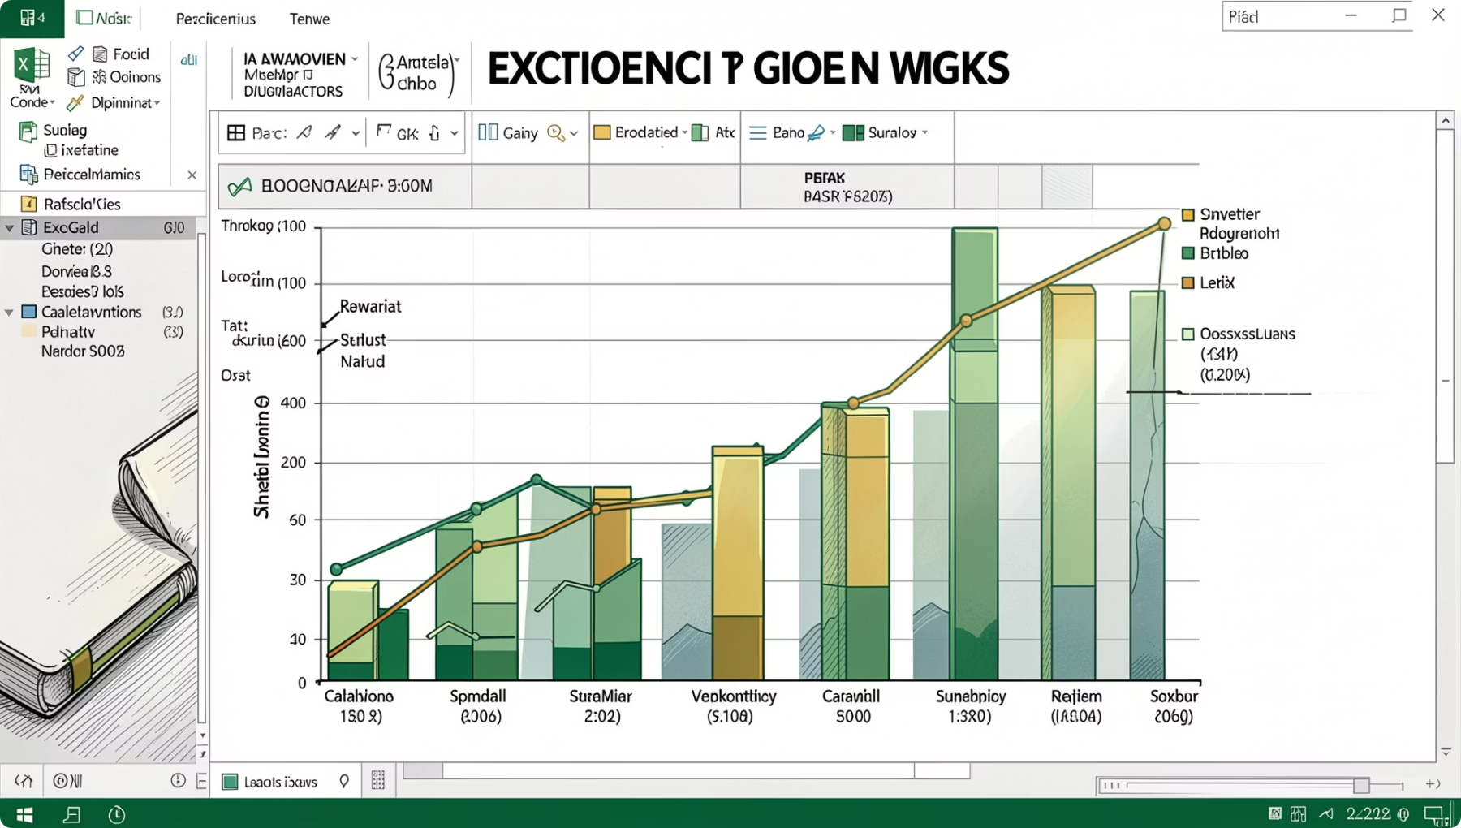

PART 4 · CHART FORMATTING
Formatting & Styling Your Charts
A well-formatted chart is clear, professional, and easy to read. Every element has a purpose.
Title
Tells viewers what the chart shows
Axes
Label X and Y axes clearly
Legend
Identifies each data series by color
Data Labels
Show exact values on the chart
Gridlines
Help readers estimate values
🎨 Style Tip: Use Chart Styles and Color Themes under the Design tab. Stick to 2–3 colors for a clean, professional look — especially in medical dashboards.

Slide 6
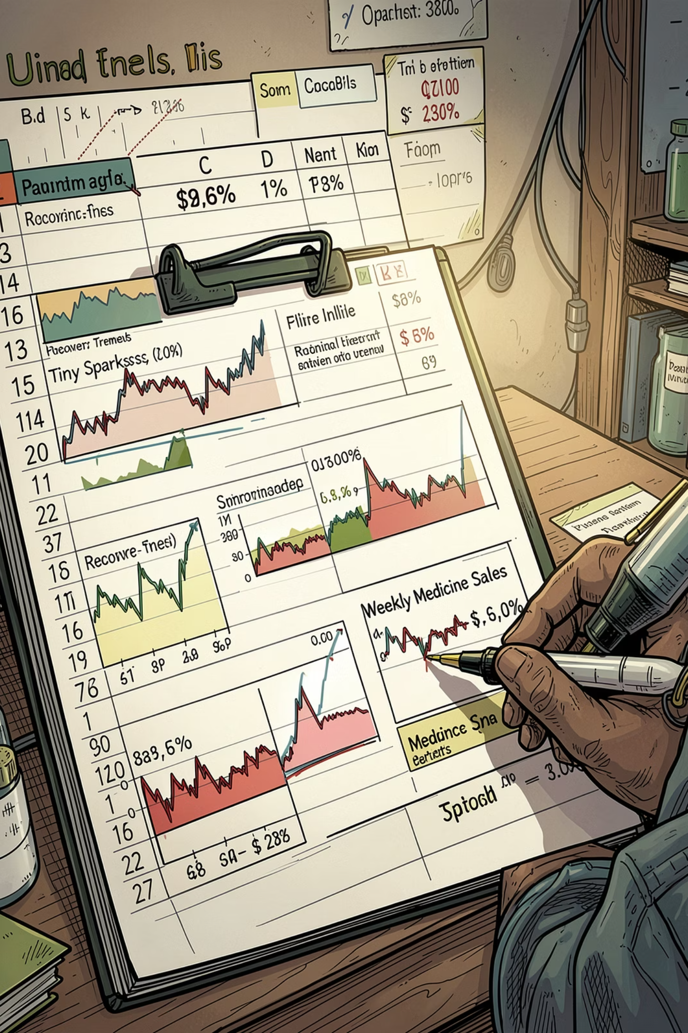

PART 5 · SPARKLINES
Sparklines: Mini Charts Inside Your Cells
Sparklines are tiny charts that fit inside a single cell — perfect for showing trends alongside your data without taking up space.
Line Sparkline
Column Sparkline
Shows a trend over time. Example: Daily patient recovery rates.
Compares values as mini bars. Example: Weekly medicine sales.
Win/Loss Sparkline
Shows positive vs. negative outcomes. Example: Test pass/fail results.
📍 How to Insert: Select a cell → Insert → Sparklines → choose your type → select your data range.

Slide 7
PART 6 · CONDITIONAL FORMATTING
Conditional Formatting: Make Data Speak Visually
Automatically change cell colors based on their values — spot patterns and flag issues instantly.
Highlight Cell Rules
Top/Bottom Rules
Color cells above/below a value. Example: Highlight fever temps above 100°F.
Flag the highest or lowest values. Example: Top 10 patients by bill amount.
Data Bars
Color Scales
Visual bars inside cells showing magnitude. Example: Stock level indicators.
Heatmap-style gradients. Example: Test score distributions.
Icon Sets
Custom Formulas
Add arrows, signals, or ratings. Example: Up/down trend indicators.
Use =A1>100, =TODAY(), or =IF() for custom rules. Example: Expired medicine alerts.

Slide 8
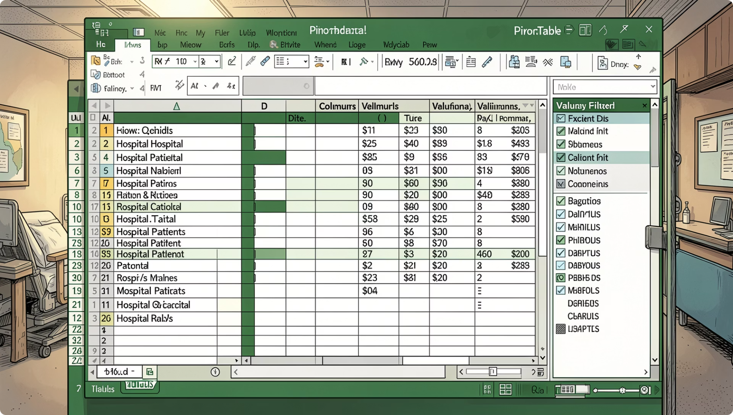
PART 7 · PIVOTTABLES
PivotTables: Summarize Thousands of Rows Instantly
A PivotTable summarizes large datasets without formulas. Drag fields to rearrange your view instantly.
Rows
Columns
Values
Filters
Categories listed down the side (e.g., Department)
Headers across the top (e.g., Month)
Numbers to calculate (e.g., Sum of Sales)
Narrow what's shown (e.g., One doctor)
📍 Create One: Select your data → Insert → PivotTable → drag fields into Rows, Columns, and Values.

Slide 9

PART 7 · PIVOTTABLES CONTINUED
PivotTable Calculations & Grouping
Calculation Types
Grouping Data
Group dates by Month, Quarter, or Year to see trends over time.
Sum
Count
Total medicine sales
Number of patients
📅 Example: Group admission dates by month to spot seasonal patterns.
Average
% of Total
Average patient age
Department contribution

Slide 10
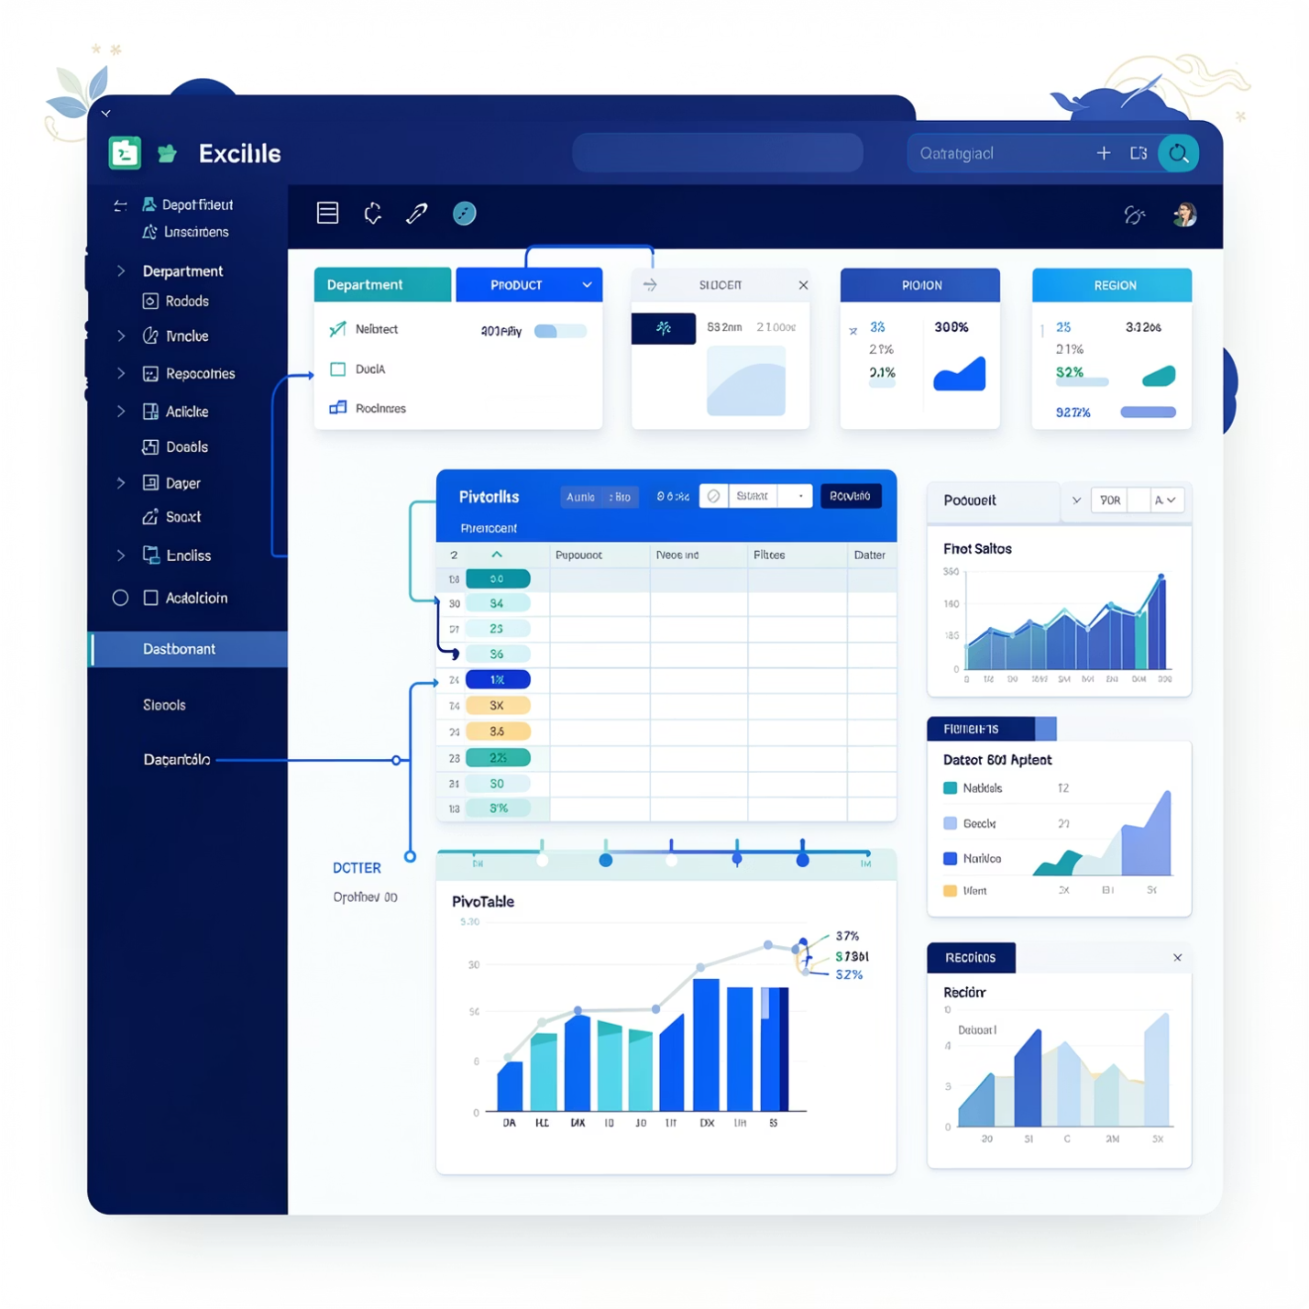

PART 8 · INTERACTIVE FILTERS
Slicers & Timelines: Interactive Filtering
Go beyond basic filters. Slicers and Timelines turn your data into dynamic, clickable dashboards, making exploration intuitive for everyone.
Slicers
Interactive buttons to filter PivotTables and PivotCharts by categories like Department, Product, or Region.
Timelines
Dedicated date filters for PivotTables, enabling quick analysis across Years, Quarters, Months, or Days.
✨ Dashboard Filtering Examples: Use a Slicer for Doctor Name and a Timeline for Admission Date to instantly see a doctor's patient load over specific periods.

Slide 11
Excel Data Visualization & PivotTables – Quick Cheat Sheet
📊 Data Visualization
🖍 Conditional Formatting
Converts raw data into charts for easy understanding. Identifies trends, patterns, and comparisons. Essential for fields like healthcare, finance, and business reports.
Automatically changes cell colors based on values to highlight patterns and issues.
📈 Common Charts
Highlight Rules
Top/Bottom Rules
Chart Type
Best Use
Detect important values.
Find highest/lowest values.
Column
Compare values
Bar
Category comparison
Data Bars
Color Scales
Line
Show trends
Visual comparison (magnitude).
Heatmap effects.
Pie/Doughnut
Percentage share
Area
Trend with volume
Icon Sets
Useful Formulas
Scatter
Relationship analysis
Status indicators (arrows, signals).
=A1>100, =TODAY(), =IF().
Bubble
3-variable analysis
Combo
Multiple data types
📑 PivotTables
🎨 Chart Formatting
Summarizes large data quickly and creates reports without complex formulas.
Add: Titles, Axes, Legends, Data Labels.
Use color themes for readability.
Keep charts simple and clean.
Main Areas: Rows, Columns, Values, Filters.
Calculations: Sum, Count, Average, % of Total.
⚡ Sparklines
🎛 PivotTable Tools
Mini charts inside cells for quick trend analysis.
Grouping: By Month, Quarter, Year for trends.
Slicers: Interactive filters by category.
Timelines: Date filtering for periods.
PivotCharts: Dynamic charts linked to PivotTables.
Refresh: Update reports automatically.
Line, Column, Win/Loss.

