Slide 1

Advanced Excel
Data Control, Dynamic Arrays, and Power Query

Slide 2


Data Validation: Keeping Data Clean
Data Validation prevents users from entering incorrect data into your spreadsheets. Think of it as a digital guardrail that ensures accuracy before mistakes happen.
Dropdown Lists
Restricts entry to a predefined list of options, such as Department names (Sales, HR, IT).
Numeric & Date Limits
Restricts cells to whole numbers (e.g., age 18-65) or specific date ranges for project timelines.
Custom Formulas
Uses logical formulas to enforce advanced rules, like preventing duplicate student ID entries.
Key Shortcut: Press Alt + A + V + V to open the Data Validation dialog instantly.

Slide 3
Custom Data Validation Rules
When basic limits aren't enough, custom formulas allow you to build sophisticated business rules directly into your cells.
Rule 1: Prevent Duplicate Entries
How It Works
Ensure every ID or email entered in a column is completely unique.
Formula: =COUNTIF($A$2:$A$100, A2)=1
Excel evaluates the custom formula for every entry. If the formula returns TRUE, the entry is allowed. If it returns FALSE, Excel blocks the entry and triggers an alert.
Rule 2: Restrict Text Starters
Force entries to start with specific codes, such as product codes starting with "PRD-".
Formula: =LEFT(A2,4)="PRD-"

Slide 4

UX Design: Alerts & Input Messages
Guide your users before they make mistakes, and politely correct them when they do. This turns a frustrating spreadsheet into a professional application.
1
2
The Input Message
The Error Alert
A helpful tool tip that appears when a user clicks on the cell. Use this to explain the entry requirements (e.g., "Please enter your 8-digit employee ID").
The popup window that appears when invalid data is submitted. You can customize the Title and Error Message to make troubleshooting easy.
Pro Tip: Use the "Stop" style alert to completely block bad data. "Warning" and "Information" styles show popups but still let users bypass the rule.

Slide 5


Dynamic Dropdowns & Named Ranges
Simplify complex forms by making a second dropdown change its options automatically based on what was selected in the first dropdown.
The Secret: INDIRECT()
This function translates text into a functional cell reference.
Syntax:
=INDIRECT(A2)
If A2 contains "Fruit", Excel looks for a Named Range called "Fruit" to populate the second dropdown list.

Slide 6
The Dynamic Array Revolution
Traditional Excel formulas return a single value. Dynamic Arrays "spill" an entire set of results into neighboring cells automatically using a single formula.
Function
Syntax
Real-World Example Use Case
FILTER()
=FILTER(Array, Include)
Extract all students who passed the final exam.
SORT()
=SORT(Array, [Index], [Order])
Instantly sort a sales list from highest to lowest revenue.
UNIQUE()
=UNIQUE(Array)
Extract a clean list of unique customer regions with no duplicates.
The Spill Operator (#): Reference a dynamic range by adding # to the starting cell (e.g., =E2#).

Slide 7
Advanced Dynamic Arrays
Generate data grids, extract specific slices of tables, or discard unnecessary rows and columns with minimal effort.
SEQUENCE()
TAKE() & DROP()
CHOOSECOLS()
Generates a list of sequential numbers.
=SEQUENCE(10, 1, 100, 10)
Result: 100, 110, 120... up to 190
Extracts or removes rows/columns from a range.
=TAKE(A2:C100, 5)
Result: Keeps only the top 5 rows of data
Extracts specific columns from a large dataset.
=CHOOSECOLS(A2:Z100, 1, 3, 5)
Result: Pulls only columns A, C, and E

Slide 8

Modern Text Functions
Forget complex, legacy formulas like MID and FIND. Modern Excel makes string parsing intuitive, quick, and highly reliable.
TEXTSPLIT()
TEXTBEFORE() & TEXTAFTER()
Splits text strings into columns or rows using a specific delimiter (e.g., comma, space).
Formula: =TEXTSPLIT(A2, "@")
Example: Splits "user@email.com" into "user" and "email.com"
Extracts everything before or after a target character.
Formulas:
=TEXTBEFORE(A2, " ") (Get first name)
=TEXTAFTER(A2, " ") (Get last name)

Slide 9


Power Query: The Ultimate ETL Tool
Power Query is Excel's built-in data cleaning engine. It allows you to import, transform, and clean messy data automatically with zero formulas required.
Why Businesses Use Power Query
Repeatable Steps: Power Query records your cleaning steps (like a macro) so you can clean tomorrow's data with a single click.
Massive Scalability: Easily handles millions of rows from CSVs, SQL databases, folder paths, and web pages.
Safety: Your original source files remain completely untouched and safe.

Slide 10

Importing Data with Power Query
Power Query simplifies the often-tedious process of bringing data into Excel. Connect directly to a wide range of sources with just a few clicks, making data acquisition both fast and reliable.
From CSV
Effortlessly bring in tabular data from comma-separated value files, commonly used for raw data exports.
From Excel
Connect to other workbooks, individual sheets, or named tables within Excel files, maintaining data integrity.
From Web
Scrape tables or structured data from web pages directly into Excel, useful for live updates or public datasets.

Slide 11
Power Query Transformations
Once your data is imported, Power Query offers a powerful suite of transformations to clean, shape, and refine your datasets without writing a single complex formula.
Filter Rows
Sort Data
Effortlessly narrow down your dataset by keeping only the rows that meet specific conditions, like sales above a certain value or specific product lines.
Organize your information by arranging rows in ascending or descending order based on one or more columns, critical for structured analysis.
Remove Duplicates
Split Columns
Automatically identify and eliminate redundant entries, ensuring each record is unique and your analysis is based on clean data.
Break down a single column into multiple new columns based on a delimiter (like a comma or space) or a fixed number of characters, perfect for parsing text.

Slide 12

Power Query Advanced Features
Beyond basic imports, Power Query offers powerful tools for comprehensive data shaping and refinement, automating complex tasks.
Add Custom Columns
Create new calculated fields using intuitive M-language formulas, such as deriving profit from sales and cost, or combining text from multiple columns.
Replace Values
Cleanse data by automatically finding and replacing specific text, numbers, or even entire cells. This is essential for standardizing entries or correcting typos across large datasets.
Change Data Types
Ensure data integrity and enable correct calculations by accurately converting columns to their appropriate formats (e.g., text to number, date to date/time, boolean). Crucial for reliable analysis.

Slide 13
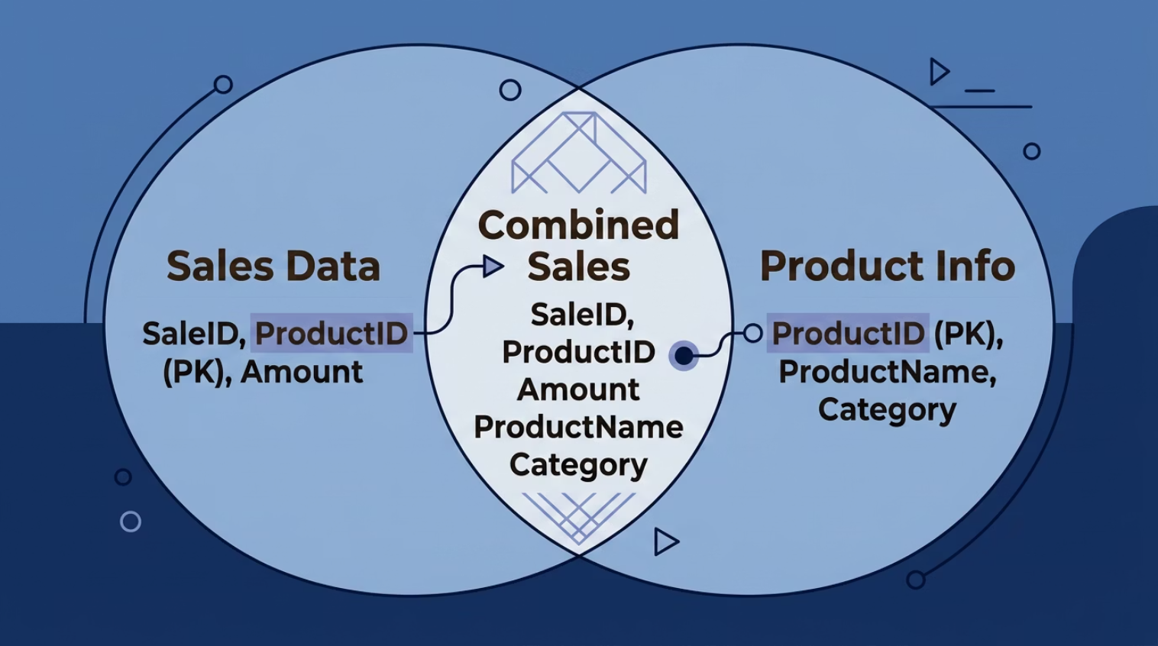


Merge & Append Queries: Combining Data
Power Query offers intuitive ways to combine datasets, whether you need to link related information or stack similar data from multiple sources.
Merge Queries: Joining Data
Append Queries: Stacking Data
Similar to a VLOOKUP() or SQL JOIN, Merge Queries combine columns from two tables horizontally based on a common identifier.
Append Queries stack two or more tables vertically, consolidating rows from multiple sources into a single, longer table. This requires identical column headers across all tables.
Scenario: You have a Sales table with ProductIDs and a separate Products table with ProductName and Category. Merge them to add product details to each sale record.
Scenario: You receive monthly sales reports with the same structure. Append them to create a master sales report for the entire year.

Slide 14

Refreshing Power Query Connections
Power Query provides robust mechanisms to keep your imported data current, ensuring your analyses are always based on the latest information.
1
2
Why Refreshing is Crucial
Setting Up Automatic Updates
Data sources are dynamic. Regularly refreshing your Power Query connections guarantees that any changes in the source systems—new rows, updated values, or modified structures—are accurately reflected in your Excel workbook. This is vital for maintaining data integrity and making informed decisions.
Beyond manual refreshes, Power Query allows you to schedule automatic updates. Configure your queries to refresh on workbook open, at specific time intervals, or through external scripts. This automation minimizes manual effort and provides continuous, up-to-date insights.

Slide 15

LET() and LAMBDA() Functions – Reusable & Smarter Formulas
What is LET() Function?
The LET() function allows you to assign names to values or calculations inside a formula.
Why do we use LET()?
Makes formulas easier to read
Reduces repeated calculations
Improves performance in large worksheets
Helps beginners understand formulas step-by-step
Syntax:
$$LET\left(n , a , me1value1calculation\right)$$
Example:
Output: 20

Slide 16

What is LAMBDA() Function?
LAMBDA() lets users create their own custom reusable Excel functions without VBA/macros.
Why advanced users use it?
Reuse formulas many times
Create custom business formulas
Reduce long repetitive formulas
Build mini functions inside Excel
Syntax:
$$LAMBDA\left(p , arametercalculation\right)$$
Example:
$$=LAMBDA\left(x , x∗2\right)\left(5\right)$$
Output:
10

Slide 17
Important Functions
Dynamic Arrays
=FILTER(A2:C10,B2:B10="Sales")
=SORT(A2:C10,2,1)
=UNIQUE(A2:A20)
=SEQUENCE(5)
=RANDARRAY(3,2)
Lookup Array Functions
=CHOOSECOLS(A1:E10,1,3)
=TAKE(A1:D20,5)
=DROP(A1:D20,2)
Modern Text Functions
=TEXTSPLIT(A1,",")
=TEXTBEFORE(A1,"@")
=TEXTAFTER(A1,"-")
Named Ranges
Create readable formulas
Example:
=SUM(Sales_Data)
Dependent Dropdown
=INDIRECT(A2)
Creates linked dropdown lists
Spill Range Operator
=E2#
References entire spilled array
Advanced Excel – Quick Cheat Sheet
Power Query
Used For:
Importing Data
Cleaning Data
Merging Tables
Removing Duplicates
Automatic Refresh
Data Sources:
CSV
Excel
Web
LET() & LAMBDA()
LET() =LET(x,10,x*2)
Stores variables inside formulas
LAMBDA()
Create custom reusable functions
Power Pivot & Data Model
Connect multiple tables
Handle large datasets
Build advanced reports & dashboards
Data Validation
Restrict user input in cells
Types:
  Whole Number
  Decimal
  List (Dropdown)
  Date Range
Custom Formula Example:
=COUNTIF(A:A,A2)=1
(Prevents duplicates)

