Slide 1
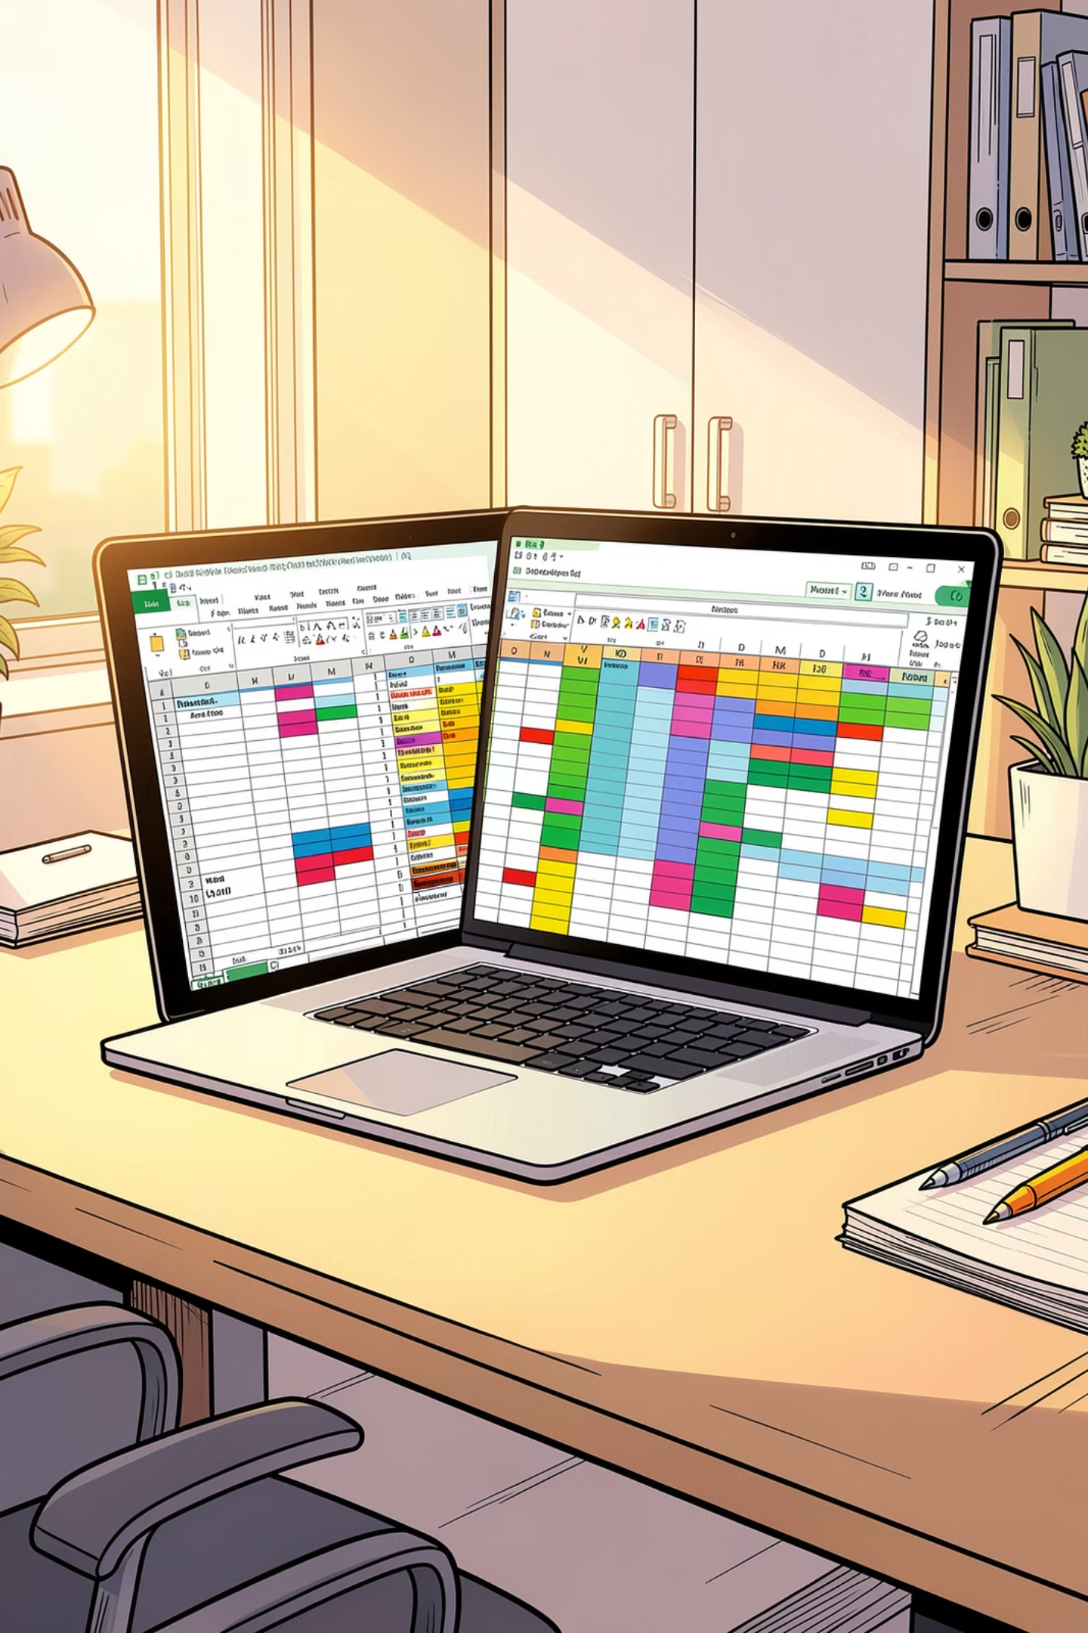
Mastering Excel VBA & Automation

Slide 2
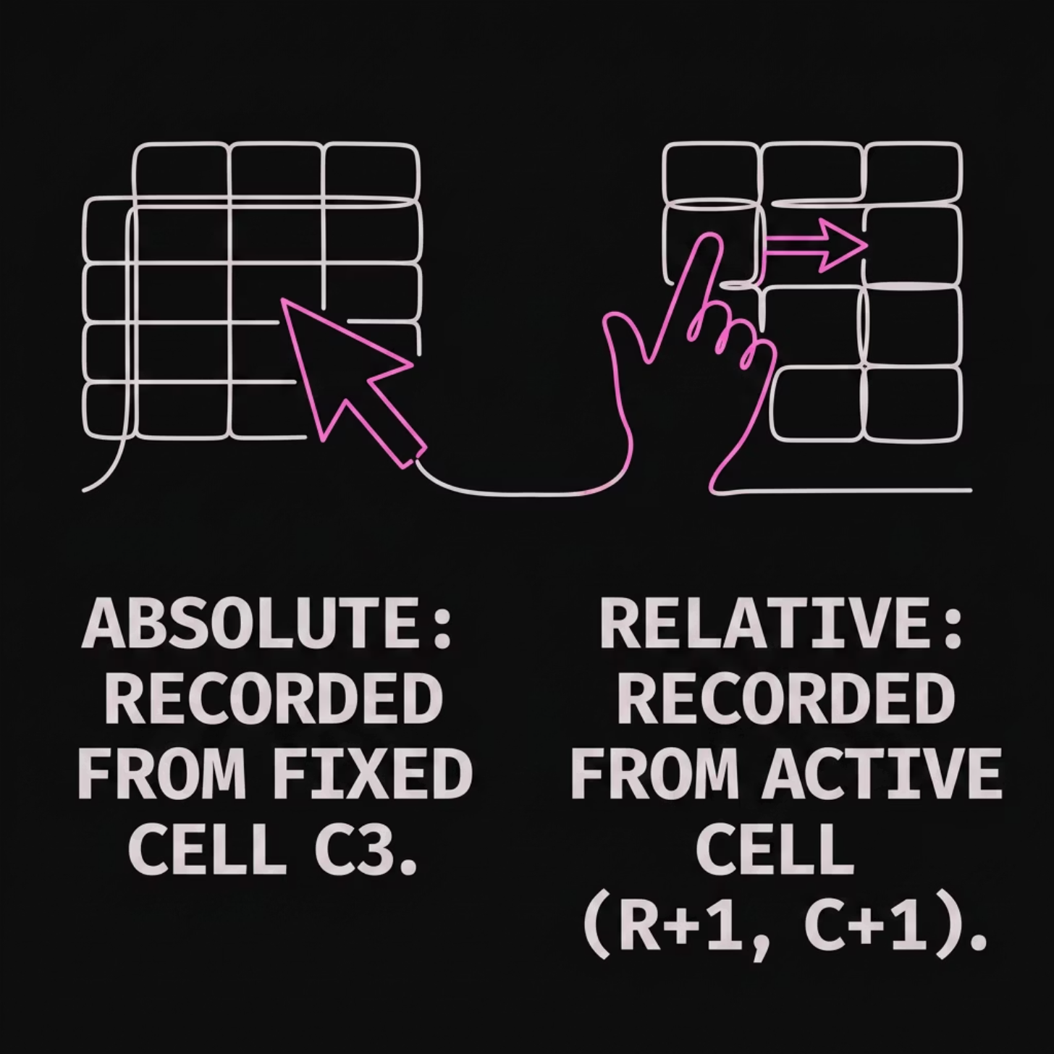


1. Introduction to Macros & Recording
A Macro is a series of recorded instructions that automates repetitive tasks. Instead of performing the same formatting steps daily, you record them once and run them with a single click.
Absolute vs. Relative References
Absolute: Always runs actions on the exact same cells (e.g., cell A1), regardless of where you start.
Relative: Performs actions relative to your active selected cell. Crucial for moving down rows dynamically.
Shortcut: Press Alt + T + M + R to quickly start recording a macro.

Slide 3
2. Managing & Running Your Macros
Before diving into code, you need to set up your workspace. The Developer Tab is your command center, and workbook security settings ensure your automation runs safely.
1
2
3
Enable the Developer Tab
Macro Security Basics
Save as .XLSM
Set Macro Settings to "Disable all macros with notification" to prevent malicious code from running automatically.
Standard .xlsx workbooks strip out code. Always save your file as an Excel Macro-Enabled Workbook (.xlsm).
Right-click the Ribbon > Customize Ribbon > Check the Developer box to reveal advanced automation tools.

Slide 4

3. Assigning Macros to Custom Buttons
Make your automated workbooks accessible to non-technical users by linking your macros to interactive on-sheet shapes and buttons.
The Automation Workflow
Insert Button
Transform dry code into a simple, single-click application interface that anyone can navigate.
Assign Macro
Click to Run

Slide 5
4. Inside the VBA Editor (Alt + F11)
The VBA Editor (Visual Basic for Applications) is where your recorded macros live and where you can write custom code from scratch.
Project Explorer
Properties Window
Immediate Window
Displays all open workbooks, worksheets, and Modules (the folders where your written VBA code resides).
Allows you to modify specific characteristics of selected objects, such as renaming worksheets or hiding them.
An essential debugging sandbox. Press Ctrl + G to open it and test single lines of code instantly.

Slide 6

5. Variables, Data Types & Ranges
Variables act as temporary storage containers in computer memory. Ranges allow your code to interact directly with spreadsheet cells.
' 1. Declaring variables with specific data types
Dim studentName As String ' For text
Dim totalMarks As Integer ' For whole numbers
Dim finalSalary As Double ' For decimals
Dim isPassed As Boolean ' For True/False
' 2. Referencing and writing to worksheet cells
Range("A1").Value = "Student Name"
Cells(1, 2).Value = "Grade"
ActiveCell.Value = "Selected cell content"
Beginner Mistake: Forgetting to declare variables. Always place Option Explicit at the very top of your module to force variable declaration and catch typos!

Slide 7
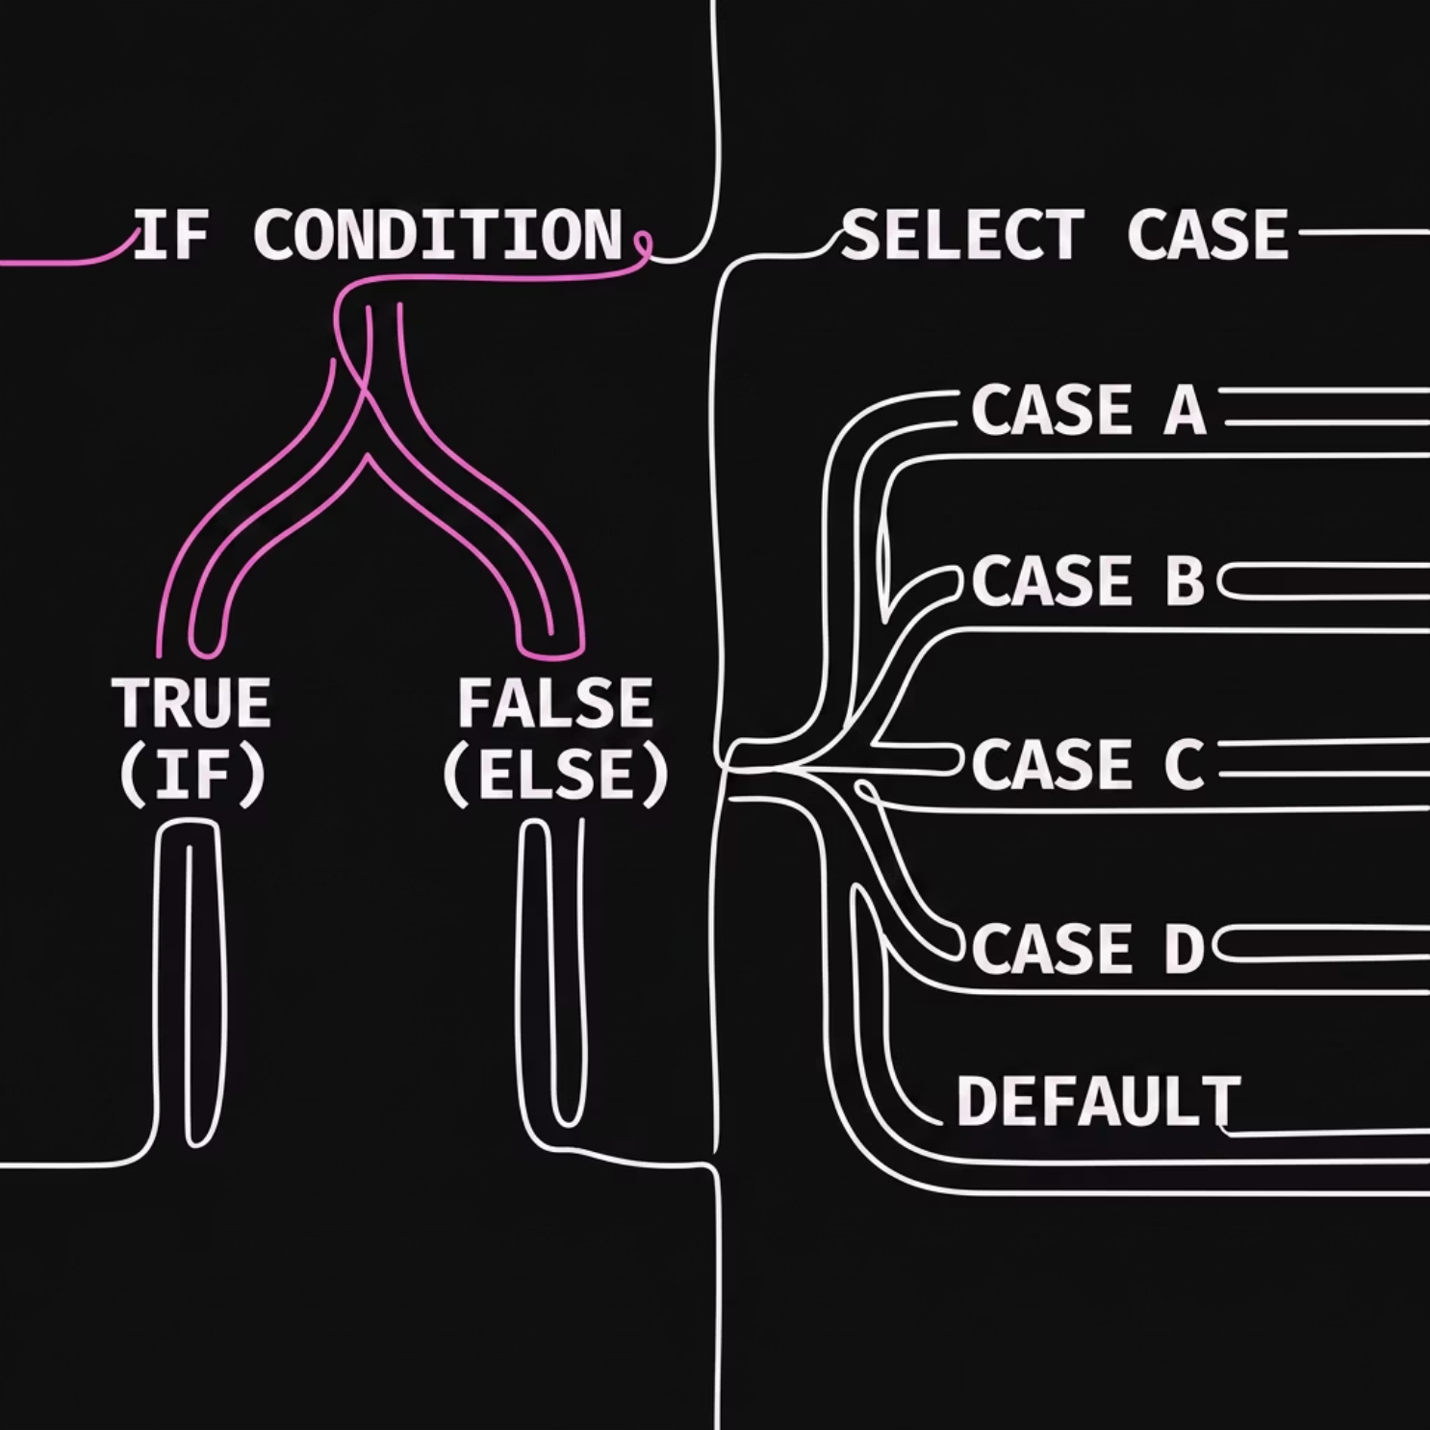

6. Decision Making & Conditional Logic
Control flow structures allow your macro to make decisions based on cell values, mimicking human intelligence.
If/Then/Else vs. Select Case
Use If/Else for simple binary checks. Use Select Case when you have multiple outcomes based on a single variable's value.
' Example If Statement
If marks >= 35 Then
MsgBox "Pass"
Else
MsgBox "Fail"
End If

Slide 8
7. Automating Repetitive Tasks with Loops
Loops are the real powerhouse of VBA, allowing you to repeat actions over thousands of rows of data in fractions of a second.
For...Next
For Each
Do While / Until
Repeats code a set number of times. Perfect when you know the start and end rows.
Loops through every object in a collection, such as all worksheets or selected cells.
Repeats while/until a condition is met. Great for processing unknown amounts of rows.
For i = 1 To 10
Cells(i, 1).Value = i
Next i
For Each ws In Worksheets
ws.Tab.Color = vbRed
Next ws
Do While ActiveCell <> ""
' Process data
Loop

Slide 9
8. Functions, Forms & Error Handling
Elevate your skills by building custom formulas, creating user interactive forms, and bulletproofing your code against runtime errors.
User Defined Functions (UDFs)
UDF & Form Components
Write custom formulas to handle complex business calculations that standard Excel formulas can't.
MsgBox: Prompts user with alerts.
InputBox: Requests text inputs.
Form Controls: Adds dropdowns, checkboxes, and buttons directly onto grid layouts.
Function CalculateTax(income As Double) As Double
CalculateTax = income * 0.15
End Function
Robust Error Handling
Prevent annoying Excel crashes with custom error routing:
On Error GoTo ErrorHandler
' Code that might fail here...
Exit Sub
ErrorHandler:
MsgBox "An error occurred. Check file paths!"

Slide 10
Working with Ranges in VBA
In VBA, a Range refers to one or more cells that you want to interact with. Understanding how to precisely target cells is fundamental for writing effective and accurate automation scripts.
Range("A1")
Cells(row, column)
ActiveCell
This method uses the familiar A1-style notation to reference a single cell or a contiguous group of cells. It's intuitive for fixed cell addresses.
This method references cells using their row and column numbers, making it ideal for dynamic loops and iterating through data.
Refers to the currently selected cell on the active worksheet. This is often used when your macro needs to perform an action relative to where the user's cursor is positioned.
Cells(1, 1).Value = "Excel"
Cells(rowVariable, colVariable).Font.Bold = True
Cells(ActiveSheet.Rows.Count, "A").End(xlUp).Select
Range("A1").Value = "Hello"
Range("B2:D5").ClearContents
Range("MyNamedRange").Select
ActiveCell.Value = "Selected Cell"
ActiveCell.Offset(1, 0).Select ' Moves down one row
ActiveCell.Interior.Color = vbYellow

Slide 11
Working with Worksheets, Workbooks, & User Interaction
Beyond individual cells, VBA allows you to programmatically manage entire sheets and workbooks, as well as interact with the user through pop-up messages and input prompts.
Managing Sheets & Workbooks
VBA MsgBox & InputBox
Automate tasks like creating new sheets, renaming existing ones, opening external files, and saving your work with VBA commands.
Use these built-in functions to display information to the user or gather simple input, making your macros interactive.
' Add a new worksheet and rename it
Worksheets.Add.Name = "Report"
' Rename an existing sheet
Worksheets("Sheet1").Name = "Data Entry"
' Open an existing workbook
Workbooks.Open "C:\Path\To\MyFile.xlsx"
' Save the active workbook
ActiveWorkbook.Save
' Save as a new file name or format
ActiveWorkbook.SaveAs "NewReport.xlsm"
' Simple informational message
MsgBox "Process Completed Successfully!"
' Message with custom title and icons
MsgBox "Are you sure?", vbYesNo + vbQuestion, "Confirmation"
' Get text input from the user
Dim userName As String
userName = InputBox("Enter your name:", "User Input")
' Get a number from the user
Dim quantity As Integer
quantity = InputBox("Enter quantity:", "Order Details")

Slide 12
9. Advanced VBA: Error Handling & UDFs
As your macros grow in complexity, robust error handling becomes critical, and User Defined Functions (UDFs) unlock new levels of customization directly within your worksheets.
VBA Error Handling
User Defined Functions (UDFs)
Prevent your macros from crashing by gracefully managing unexpected errors. There are two primary strategies:
UDFs are custom functions you write in VBA that can be used directly as formulas in your Excel worksheets, just like built-in functions such as SUM or AVERAGE.
Companies use UDFs to:
On Error GoTo [Label]
Redirects macro execution to a specified line label when an error occurs, allowing you to define a specific error recovery routine.
Automate complex, proprietary calculations.
Simplify repetitive formula entry for end-users.
Create specialized tools that integrate seamlessly with Excel's formula engine.
Sub DivideNumbers()
On Error GoTo ErrorHandler
Dim num1 As Double, num2 As Double, result As Double
num1 = Range("A1").Value
num2 = Range("A2").Value
result = num1 / num2
MsgBox "Result: " & result
Exit Sub
ErrorHandler:
MsgBox "An error occurred: Cannot divide by zero or invalid input.", vbCritical
End Sub
Example Custom Formula: =SquareNum(5)
This simple UDF calculates the square of any number provided as an argument.
Function SquareNum(x As Double) As Double
' This function calculates the square of a number.
SquareNum = x * x
End Function
On Error Resume Next
Once this code is in a standard module, you can type =SquareNum(A1) into any cell to use your custom function.
Ignores the line of code that caused the error and continues execution with the next line. Use with caution and only when you anticipate and are willing to skip minor, non-critical errors.
Sub ClearEmptySheets()
On Error Resume Next
Dim ws As Worksheet
For Each ws In ThisWorkbook.Worksheets
If Application.CountA(ws.Cells) = 0 Then
ws.Delete
End If
Next ws
On Error GoTo 0 ' Resets error handling
End Sub
Caution: Overusing On Error Resume Next can mask underlying issues, making debugging difficult. Always use it judiciously and reset error handling with On Error GoTo 0 when no longer needed.

Slide 13

Dashboard Design & Security Principles
Building effective dashboards requires thoughtful design, while robust security measures are paramount to protect sensitive data and workbook integrity.
Workbook & Sheet Protection
Form Controls in Excel
Implement these measures to control user interaction and safeguard your data and formulas from accidental or malicious changes.
Enhance user interaction and dashboard functionality by embedding interactive elements directly onto your worksheets.
Password Protection
Button
Secure workbooks, sheets, or even specific ranges with passwords to prevent unauthorized access or modification.
Execute macros with a single click, automating complex tasks instantly.
Allow Edit Ranges
ComboBox
Define specific, unlocked ranges within a protected sheet that certain users can still modify.
Provide a dropdown list of options, allowing users to select from predefined choices.
Locking Formulas
CheckBox
Prevent users from viewing or altering your intellectual property embedded in worksheet formulas.
Enable binary choices (true/false, on/off) for filtering data or toggling features.
Hiding Sheets
Conceal sensitive data or intermediate calculation sheets from end-users, with options for 'Very Hidden' via VBA.
Excel Dashboard Design Principles
Craft intuitive and impactful dashboards by following best practices for layout, navigation, and data visualization.
KPI Cards: Prominently display key performance indicators with clear metrics and trends.
Strategic Charts: Use appropriate chart types to visualize data effectively and reveal insights.
Intuitive Layout: Organize information logically, guiding the user's eye through the narrative.
Navigation Buttons: Implement clear buttons or hyperlinks for easy movement between dashboard sections or reports.
Dynamic Concepts: Incorporate slicers, timelines, and other interactive elements for personalized data exploration.

Slide 14

9. Dashboard Design & Security Principles
Bring everything together. Protect sensitive company data while designing functional, visual, and highly interactive business dashboards.
1. Dashboard KPI Cards
2. User Access & Protection
3. Dynamic Navigation
Display core metrics (e.g., Total Sales, Active Users) in prominent, easy-to-read cards linked to clean, aggregated pivot tables.
Assign macros to custom header shapes so users can seamlessly click to jump between reports, dashboards, and settings tabs.
Lock formula ranges to prevent accidental edits. Protect the sheets using ActiveSheet.Protect Password:="1234".
Key Shortcut: Press F5 inside the VBA Editor to run your code instantly for testing.

Slide 15
10. Sharing, Collaboration & Best Practices
Effective collaboration and robust development practices are essential for creating scalable, maintainable, and user-friendly Excel solutions.
Excel Collaboration Features
VBA & Workbook Best Practices
Leverage built-in Excel tools to work together efficiently and track contributions.
Ensure your VBA projects and Excel files are robust, readable, and resilient to errors.
01
Share Workbook (Legacy)
Naming Conventions
Allows multiple users to edit the same workbook simultaneously, though modern co-authoring is now widely used.
Implement consistent and descriptive naming for variables, procedures, and objects (e.g., `btnCalculate`, `strUserName`) to improve code readability and maintainability.
Track Changes
02
Monitor modifications made by collaborators, reviewing who changed what, when, and where within the workbook.
Documentation
Utilize clear comments within your VBA code to explain logic and purpose. Provide comprehensive user instructions for complex workbooks and dashboards.
Comments
Add notes and facilitate discussions directly within cells or ranges, providing context and streamlining feedback.
03
Error-Proofing
Design macros and formulas to anticipate common user mistakes (e.g., incorrect input, missing data) and handle unexpected scenarios gracefully, preventing crashes.

Slide 16
Excel VBA & Dashboarding – Quick Cheat Sheet
This summary provides key concepts and syntax for rapid reference in your automation and dashboard projects.
VBA ESSENTIALS
DASHBOARD & SECURITY
1
2
Workbook Protection
Macros
VBA Editor
Secure sheets, lock cells, hide formulas, and password protect files to control access.
Automate repetitive tasks. Record them via Developer tab. Run with ALT + F8.
Access with ALT + F11 for coding. Use F5 to run code.
Form Controls
Add interactive elements like Buttons (run macros), ComboBoxes (dropdowns), and CheckBoxes (True/False).
3
4
Variables
Control Flow
Design Principles
Declare data types for efficiency and error prevention. E.g., Dim name As String.
Manage logic with If Then Else for conditions or Select Case for multiple choices.
Integrate KPI Cards, Charts, and Slicers. Ensure a clean layout with Navigation Buttons and VBA to automate reports.
Shortcut
Purpose
5
6
ALT + F8
Run Macro
Loops
Error Handling
ALT + F11
Open VBA Editor
Automate repetitions across ranges or collections using For Next or For Each.
Use On Error Resume Next to prevent macro crashes for anticipated errors.
F5
Run VBA Code
CTRL + G
Immediate Window

