Slide 1

Data Science in Medical Field
Transforming Healthcare with AI and Data

Slide 2
What Is Data Science — and Why Does Healthcare Need It?
Data Science:
Why Healthcare Needs It
Data science combines statistics, programming, and domain expertise to extract actionable insights from structured and unstructured data. In healthcare, it powers tools that assist clinicians in diagnosing, treating, and managing patient care.
Traditional healthcare relies on manual processes, fragmented records, and reactive decision-making. Data science addresses these gaps with measurable impact.
Diagnostic errors: ~12 million Americans misdiagnosed annually (NIH)
Cost reduction: Predictive models can cut unnecessary spending by up to 30%
Early detection: AI identifies disease patterns before symptoms appear
Scalability: Automates routine analysis, freeing clinicians for complex care
Collects and processes massive medical datasets
Applies machine learning and statistical modeling
Delivers actionable, evidence-based insights

Slide 3
The Four Pillars of Healthcare Data
Modern healthcare generates vast, diverse datasets. Understanding these data types is the foundation for every data science application in medicine.
Electronic Health Records (EHR)
Medical Imaging
Digital patient histories, diagnoses, medications, and lab results. EHRs enable longitudinal analysis and population health modeling across millions of patients.
X-rays, MRIs, CT scans, and ultrasounds generate billions of images annually. Deep learning models detect anomalies with accuracy rivaling experienced radiologists.
Wearable Devices
Genomic Data
Smartwatches and IoT sensors capture real-time vitals — heart rate, SpO₂, sleep, and activity — enabling continuous, proactive patient monitoring.
DNA sequencing reveals genetic predispositions to disease, driving personalized medicine and targeted drug therapies tailored to individual biology.

Slide 4

Disease Prediction & Medical Image Analysis
Predictive analytics and AI-powered imaging are among the most impactful applications of data science in clinical practice.
Feature Engineering
ML Model Training
Derive risk factors and biomarkers.
Train logistic regression and neural nets.
Real-World Example: Google Health's breast cancer AI reduced false positives by 5.7% and false negatives by 9.4% compared to radiologists.
Collect Patient Data
Risk Score & Alert
EHR, labs, vitals gathered securely.
Generate score and trigger clinical alert.
This pipeline illustrates how raw patient data is transformed into actionable clinical risk scores through machine learning — enabling early intervention before symptoms appear.
Predictive Disease Models
Medical Image Analysis
Heart Disease: ML models achieve 85–90% accuracy using ECG, cholesterol, and lifestyle data
Diabetes: Predictive algorithms flag at-risk patients 3–5 years before onset
Cancer: AI detects early-stage tumors missed by the human eye in screening programs
Sepsis: Real-time ICU models reduce mortality by 20% through early warning scores
X-Rays: CNNs detect pneumonia and fractures with 95%+ accuracy
MRI: Deep learning identifies brain tumors and neurological conditions
CT Scans: AI flags pulmonary nodules and internal bleeding in seconds
Pathology: Digital slide analysis detects cancerous cells at scale

Slide 5

Personalized Medicine & Drug Discovery
Personalized Medicine
AI in Drug Discovery
Precision healthcare uses genomic, clinical, and lifestyle data to tailor treatments to individual patients — replacing the traditional one-size-fits-all approach.
Developing a new drug traditionally takes 10–15 years and costs over $2.6 billion. AI is dramatically compressing this timeline.
Target identification: AI scans molecular databases to find drug candidates
Virtual screening: Simulates drug interactions, reducing lab experiments
Clinical trials: ML optimizes patient selection and predicts trial outcomes
Repurposing: Identifies new uses for existing approved drugs
Pharmacogenomics: Predicts drug response based on genetic profile
Cancer therapy: Targeted treatments based on tumor genomics
Risk stratification: Identifies patients most likely to benefit from intervention
Outcome prediction: Models forecast treatment success before administration
Case Study: DeepMind's AlphaFold solved the 50-year-old protein folding problem, accelerating drug target discovery across thousands of diseases.

Slide 6
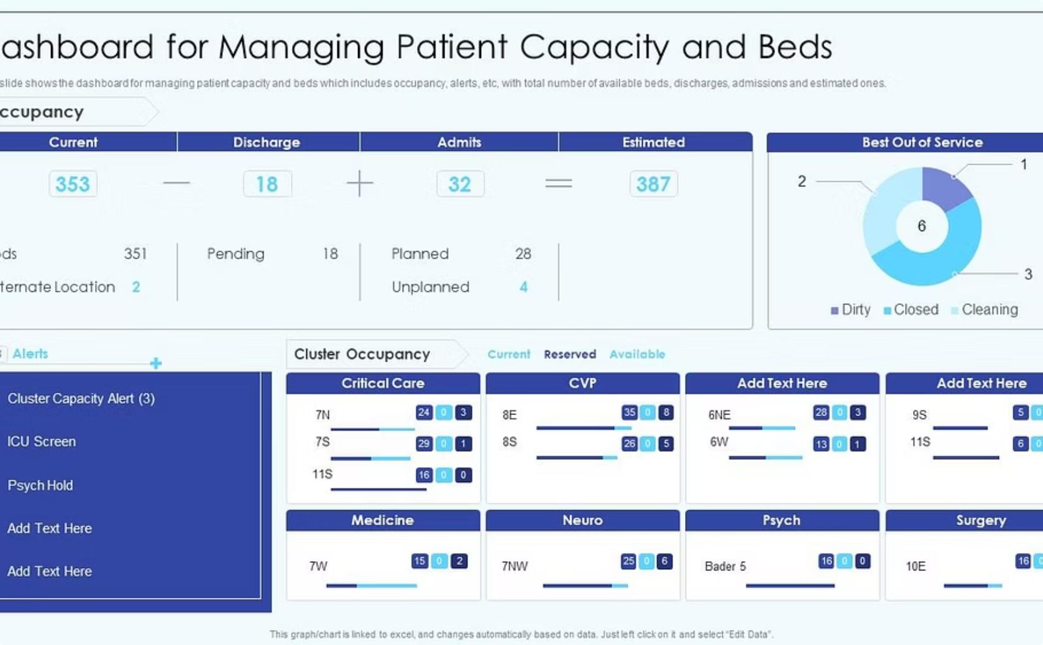
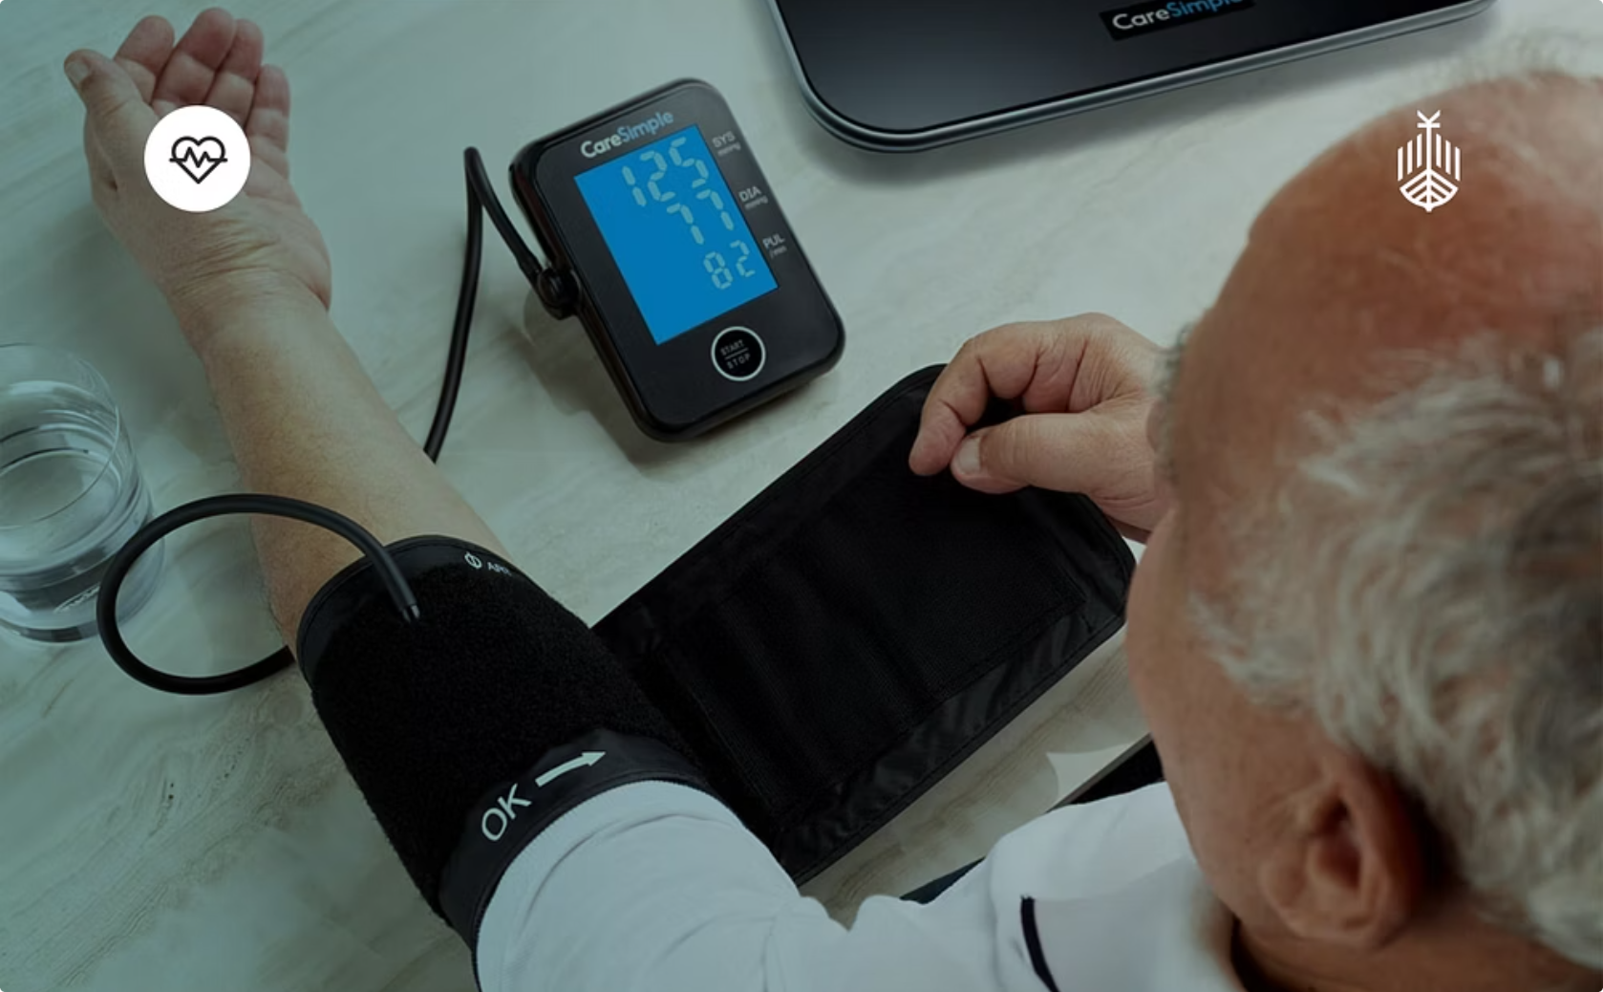
Hospital Management & Remote Patient Monitoring
Hospital Management Analytics
Remote Patient Monitoring
Patient flow prediction: Forecast admissions to optimize bed allocation and reduce wait times
ICU management: Predictive models anticipate deterioration, enabling proactive intervention
Resource optimization: AI schedules staff, manages inventory, and reduces operational costs by up to 25%
Readmission reduction: Identifies high-risk patients for targeted post-discharge care
IoT healthcare devices: Continuous ECG, glucose, and SpO₂ monitoring at home
Smart wearables: Apple Watch and Fitbit detect atrial fibrillation and falls in real time
Alert systems: Automated notifications to clinicians when vitals cross thresholds
Chronic disease management: Remote monitoring reduces hospitalizations for heart failure and COPD by 30%

Slide 7
AI Chatbots, Pandemic Analytics & Fraud Detection
🤖 AI Chatbots in Healthcare
🦠 Pandemic Prediction & Analysis
🔍 Fraud Detection in Healthcare
Virtual assistants (Babylon Health, Ada) provide 24/7 symptom checking
Automated appointment scheduling and patient triage
Reduces clinician workload and improves patient access
NLP models understand medical language with 90%+ accuracy
BlueDot's AI flagged COVID-19 outbreak 9 days before WHO announcement
SEIR models predicted infection spread curves for policy decisions
AI accelerated vaccine research by analyzing viral protein structures
Real-time dashboards tracked global case data and variant evolution
Healthcare fraud costs the U.S. over $300 billion annually
Anomaly detection models flag suspicious billing patterns instantly
Unsupervised learning identifies novel fraud schemes without labeled data
Insurance companies save millions through real-time claim validation

Slide 8





Technologies Powering Medical Data Science
A robust technology stack enables data scientists to build, train, and deploy healthcare AI systems at scale.
Python
Machine Learning
Deep Learning
The primary language for data science, with libraries like Pandas, NumPy, and Scikit-learn for data manipulation and modeling.
Algorithms including regression, decision trees, and ensemble methods power diagnostic and predictive models.
Neural networks, especially CNNs and RNNs, excel at image analysis, genomics, and time-series patient data.
TensorFlow / PyTorch
Power BI / Tableau
Industry-standard frameworks for building and deploying production-grade deep learning models in clinical settings.
Business intelligence tools visualize hospital KPIs, patient outcomes, and operational metrics for decision-makers.

Slide 9
Data Science in the Indian Healthcare System
India is rapidly embracing data science and AI to transform its diverse healthcare landscape, addressing unique challenges and fostering innovation.
Government Initiatives & Digital Health
AI & Data Science in Hospitals
The Ayushman Bharat Digital Mission aims to create a national digital health ecosystem, linking patient records, healthcare providers, and insurance companies. Data science is crucial for interoperability and insights.
Leading Indian hospitals leverage AI for predictive diagnostics (e.g., AI for early cancer detection, retinopathy screening) and operational efficiency, optimizing resource allocation and patient flow.
Thriving Healthcare Startups
COVID-19 Analytics Response
A vibrant startup ecosystem is emerging, with companies utilizing AI for telemedicine platforms, personalized health management, drug discovery, and medical imaging analysis, reaching millions.
Data science played a critical role in modeling COVID-19 spread, optimizing vaccine distribution through platforms like CoWIN, and providing real-time dashboards for public health decision-making.
Rural Healthcare & Telemedicine
Challenges & Future Scope
AI-powered telemedicine platforms bridge the gap for rural populations, enabling remote consultations, diagnostics, and specialist access, significantly improving healthcare accessibility in underserved areas.
Key challenges include data privacy, infrastructure limitations, and skilled workforce shortages. However, the future holds immense potential for AI to drive equitable and high-quality care across India.

Slide 10
Data Science in Traditional Indian Medicine
AI and data science are breathing new life into ancient healing systems like Ayurveda and Homeopathy, bringing scientific rigor and personalized insights to time-tested practices.
AI-Based Dosha Analysis
Herbal Medicine Analytics
AI algorithms analyze an individual's unique physical, mental, and emotional characteristics to determine their Prakriti (dosha constitution), offering personalized lifestyle and dietary recommendations.
Data science identifies active compounds in traditional herbs, predicts their efficacy, and optimizes formulations. It also helps detect potential interactions and standardize quality for wider adoption.
Homeopathy Symptom Prediction
Personalized Wellness
AI systems assist practitioners in homeopathy by analyzing complex symptom patterns to accurately match them with appropriate remedies, enhancing diagnostic precision and treatment outcomes.
Leveraging data from wearables and health records, AI provides bespoke wellness programs, integrating traditional wisdom with modern insights for diet, exercise, and mental well-being.
This integration promises benefits like enhanced personalization and efficacy, but also poses challenges around data standardization, ethical use, and validating traditional practices with modern scientific evidence.

Slide 11
Challenges & Ethical Considerations
Key Challenges
Ethical Principles to Uphold
Transparency: Patients must understand how AI influences their care
Consent: Informed consent frameworks must cover data usage for AI training
Accountability: Clear responsibility chains for AI-driven clinical decisions
Equity: Ensure AI benefits all populations, not just well-represented groups
Human Oversight: AI augments — never replaces — clinical judgment
Data Privacy
Security Risks
HIPAA and GDPR regulations govern how patient data is collected, stored, and shared. De-identification and federated learning are emerging solutions.
Healthcare is the #1 target for cyberattacks. Ransomware and data breaches threaten patient safety and institutional trust.
Algorithmic Bias
Interpretability
Models trained on non-representative data can perpetuate disparities in diagnosis and treatment across racial and socioeconomic groups.
Clinicians require explainable AI — "black box" models face resistance in high-stakes medical decision-making environments.

Slide 12


The Future of Data Science in Healthcare
1
Smart Hospitals
Fully integrated AI ecosystems managing patient flow, diagnostics, and resource
allocation in real time.
2
AI-Assisted Surgery
Robotic systems guided by computer vision perform precision procedures with
sub-millimeter accuracy.
3
Genomic Medicine at Scale
Population-wide sequencing enables preventative, personalized treatment
plans for every patient.
4
Global Health Equity
AI-powered diagnostics bring specialist-level care to underserved regions
via mobile devices.
$150B
40%
AI Healthcare Market
Cost Reduction
Projected global market size by 2026
Potential savings in administrative healthcare tasks via automation
300M
Patients Served
Estimated beneficiaries of AI-driven diagnostic tools by 2030
Sources: World Health Organization (WHO) · National Institutes of Health (NIH) · Google Health · IBM Watson Health · McKinsey Global Institute

Slide 13
Conclusion: Transforming Healthcare with Data Science
A New Era of Health and Well-being
Data science is not just an enhancement; it's the fundamental shift driving healthcare towards a future that is more intelligent, accessible, and patient-centric.
Precision & Personalized Care
Operational Excellence
Global Resilience & Access
AI optimizes hospital management, streamlines patient flow, and identifies fraud, leading to significant cost savings and more efficient resource allocation across the healthcare ecosystem.
Through pandemic analytics, remote monitoring, and AI chatbots, data science extends care beyond traditional boundaries, bolstering global health security and expanding access to underserved communities.
From genetic insights to tailored treatments and proactive disease prediction, data science crafts highly individualized health journeys, improving outcomes and reducing adverse events.
Embracing these advancements, while diligently navigating ethical challenges, is key to unlocking a healthier future for everyone.

