Slide 1

Domain name system
Global name system
Root name service (ICANN, US. Dept. of Commerce)
Name certification service(s)
Certificate search service(s)
2
TLD name service(s)
3
Managed authoritative DNS service(s)
Auspice global name service(s)
3
JohnSmith1956: phone1
(or keyword-based search)
Auth. name service(s)
4
1
GUID=X, GNS=Auspice
getAddress(X)
4
[IP₁, IP₂,…]
1
Local name service(s)
Local name service(s)
0
Hierarchical names with federation tightly bound to name structure
Arbitrary human-readable names and flat GUIDs with federation by indirection via certification services

Slide 2
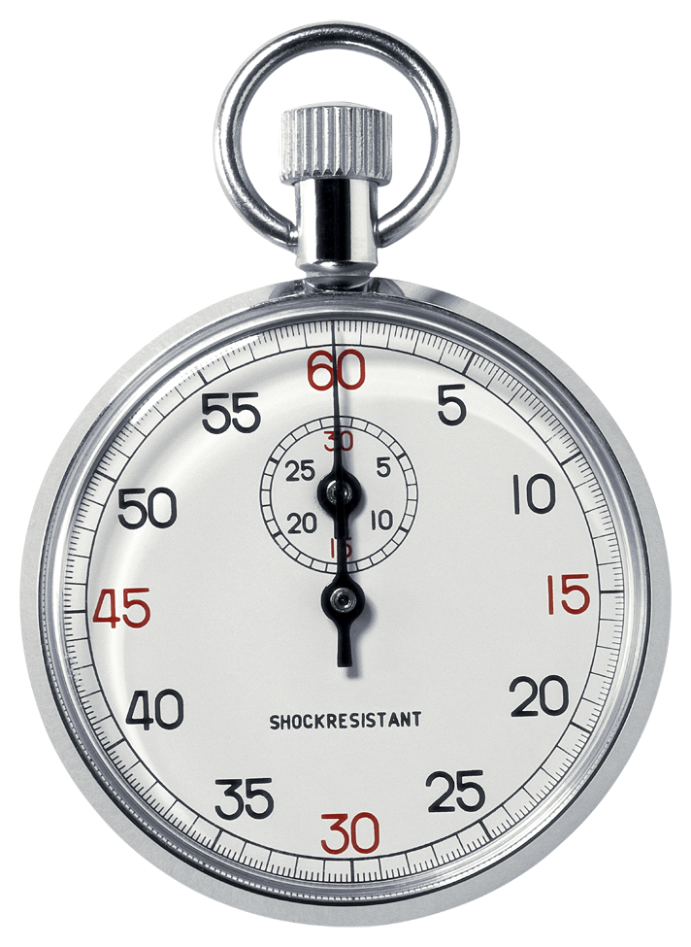
A, IP₀
Global name service
B, IP₁
1) Pre-lookup
mobility
B, IP₂
B, IP₂
B
2) Connect-time
mobility
IP₂
B, IP₃
B, IP₃
connect(B, IP₂)
X
Timeout
Time-to-connect
B
IP₃
connect(B, IP₃)
Connection established
3) Individual
mobility
Connection re-synchronized
B, IP₄
4) Simultaneous
mobility
A, IP₆
B, IP₅
B, IP₅
Timeout
B
IP₅
connect(B, IP₅)
Connection re-synchronized

Slide 3

A
A
FA
1
2
R
A
4
A
B
3
HA
(a)
Mobility event
(b)
Indirection
DNS
2
A
A
3
1
1
3
2
B
4
A
B
A
Name-to-address resolution
Pure name-based routing
(c)
(d)

Slide 4
Mobility event: 22.33.44.55 → 22.33.88.55
Prefix | Port
22.33.44.0/24 | 5
22.33.0.0/16 | 3
22.33.88.55 | 3
…
Prefix | Port
22.33.44.0/24 | 5
22.33.0.0/16 | 3
…
Mobility event: /20thCenturyFox/StarWarsIV → /Disney/StarWarsIV
Prefix | Port
/20thCenturyFox/* | 5
/Disney/* | 3
/20thCenturyFox/StarWarsIV
…
Prefix | Port
/20thCenturyFox/* | 5
/Disney/* | 3
…

Slide 5
Prefix | Port
yahoo.com | 2
travel.yahoo.com | 2
sports.yahoo.com | 5
cnn.com | 2
mit.edu
…

Slide 6
Placeholder

