Slide 1
A Global Name Service for a Highly Mobile Internetwork
Abhigyan Sharma, Xiaozheng Tie, Hardeep Uppal, Arun Venkataramani, David Westbrook, Aditya Yadav
School of Computer Science
University of Massachusetts Amherst
Notes:
I will talk about a global name service that enables support for mobility in the Internet.

Slide 2



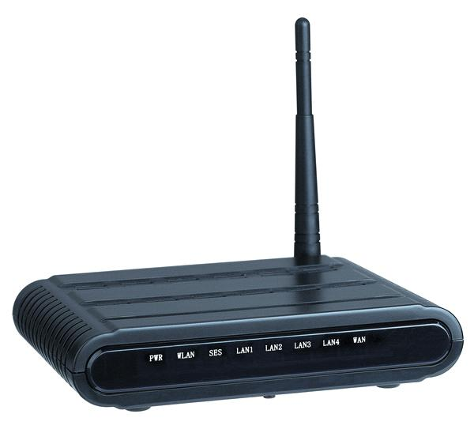

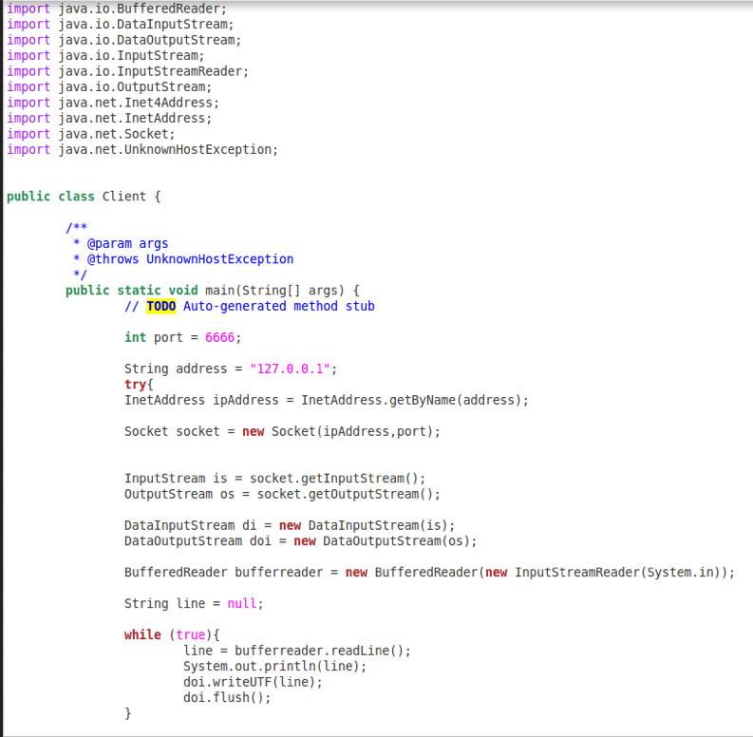

Mobile arrived, but Internet unmoved
Alice’s phone
Bob
?
Notification systems
VoIP/messaging
Cloud storage
Alice
Unidirectional communication initiation
Redundant app-specific mobility support
Ungraceful disruptions
Cleaner separation of location and identity commonly advocated wisdom
Notes:
Mobile devices are all around us, but the reality is that the Internet continues to provide poor intrinsic architectural support for mobility today. Today, it is difficult for applications to initiate general-purpose communication with mobiles as there is no global infrastructure to locate them. As a result, mobile communication initiation is unidirectional on the Internet, i.e., from the mobiles to fixed hosts. In the name of mobility support, what we have are redundant app-specific solutions developed by notification systems, VOIP and messaging applications, cloud storage systems, and many others.
It is easy to explain even to a lay person why the Internet has poor mobility support.
How many times have you faced this?
You are downloading a large file on your laptop, and you need to leave for somewhere.
And you think …should I let this file download complete and then leave or should I leave now and restart the download all over again later. Likewise for VoIP calls; popular VoIP apps drop calls instead of seamlessly switching from WiFi to cellular.
[Pause] Now each one of these problems can and often is addressed through a piecemeal solution, but the real is problem is a deeper architectural one, namely conflating location and identity by using an IP address for both.
[click]

Slide 3
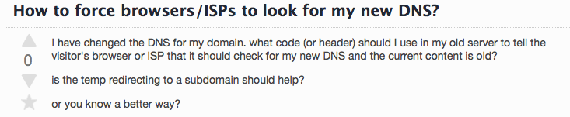
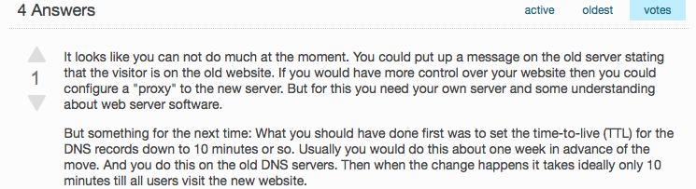
But DNS does separate identity / location
Domain names
IP addresses
+ connection migration techniques
Challenge: scaling to handle update cost of frequent mobility while returning up-to-date values
Example: 10B devices, 100 addresses/day ≈ 1M updates/sec
DNS update propagation can takes hours or days today!
Notes:
But, The Internet's DNS does separate identify from location by mapping domain names to IP addresses. And we know of connection migration techniques that can help handle mid-connection mobility.
[Pause]
However, a critical challenge that we believe has not been adequately addressed is the design of a scalable, distributed resolution infrastructure to map names to up-to-date addresses under frequent mobility. To appreciate this scale, consider 10B devices moving through 100 networks/day. That is an average load of 1M updates/sec,
[pause]
How might DNS fare at handling these updates? To handle mobility, we require up-to-date values. But, update propagation in DNS can take hours or even days. Today, it is not uncommon to see [click] such cries for help on operator forums wondering why "my clients can't reach my service" because of an unplanned server address migration.
[Transition: Our goal is to go beyond just DNS and IP to fix these problems.]

Slide 4
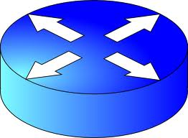
Scalable global name service (GNS)
Global name service (GNS)
f0:56:81:c1:c0:eb
node1.cs.umass.edu
dropbox.com
netflix.com/<object>
devices in [lat,long,radius]
interface
device
service
content
group of names
Goal: A massively scalable, logically centralized GNS to enable secure, name-based communication with flexible endpoint principals with arbitrary (fixed) names despite high mobility.
Notes:
We seek to develop a massively scalable, logically centralized Global Name Service to support secure, name-based communication without worrying about mobility or changing network addresses. This goal is also shared by many other network architectures, especially the MobilityFirst Future Internet Architecture that forms the context for this work. MobilityFirst’s design philosophy is that a logically centralized global name service can significantly enhance mobility, security, and transform network-layer functionality. Our paper explains in detail why a logically centralized GNS is the best approach to achieve this goal; in this talk I will take that for granted. The GNS design should allow us to communicate with a flexible set of endpoint principals [ennunciate exaggeratedly as princi-'pals so as to rhyme with pals] such as interfaces, devices, services, content and, recursively, groups of such names. The design should not restrict or dictate how principal names are represented, e.g., it could be a hierarchical name, a flat, self-certifying identifier, or other application-desired formats. And, of course, these principals could change network locations arbitrarily and frequently.
[pause]
The rest of this talk is about the design of such a GNS that scales to high mobility. I will begin by addressing a natural question,
[click]
"Why can't we make simple changes to DNS to achieve our goals?" Why do we need a next-generation GNS?

Slide 5
Outline
Poor intrinsic support for mobility today
Case for a next-generation GNS
Auspice GNS design
Implementation and evaluation
Related work, open issues, summary

Slide 6

GNS critical to handle mobility
Global name service
Pre-lookup mobility
Pre-lookup mobility
Bob’s address?
Bob
Connect-time mobility
IP₂
IP₅
IP₇
Alice’s address?
IP₃
Alice
Individual mobility
IP₁
IP₄
IP₆
Simultaneous mobility
GNS critical or can significantly benefit mobility handling in any network architecture
Notes:
I will start by explaining how our envisioned GNS provides support for handling mobility.
There are four types of mobility scenarios. The first is pre-lookup mobility, the only type ofmobility that DNS isdesigned to support. But there are three other cases: Connect-time mobility, in which Bob moves after Alice has queried the GNS but before the connection has been established such as through a 3-way handshake. In this case, the connection establishment will fail causing Alice to time out and revert back to the GNS to obtain Bob's fresh IP address,
[pause]
Once a connection has been established, we have two possibilities for mid-connection mobility. In individual mobility, only one of the two end-points moves mid-connection, say as Bob does here. This is one type of mobility that can be handled without a global name service. Bob, who knows Alice’s IP address, can resynchronize the connection in a purely bilateral manner, The last case is that of simultaneous mobility in which one endpoint moves and then, before it could successfully resynchronize the connection, the other endpoint also moves.
[pause]
All known schemes to handle simultaneous mobility require a global name service or an equivalent, third-party rendezvous service.
[pause]
Thus, out of the four types of mobility events, and a global name service is necessary to handle three of them.

Slide 7
DNS limitations
Authoritative name-server ns.xyz.net
DNS
Passive caching
.
Static placement
Single root of trust
Load α 1/TTL
Latency α 1/TTL
Mobility
cache
Mobility
com
edu
net
Hierarchical names
Federation
DNSSEC key chain
node1.xyz.net
“JohnSmith2178@Amherst”
“Living room chandelier”
“Taxis near Times Square”
yahoo
cnn
umass
cs
ece
Notes:
Nevertheless, in the current Internet, why is DNS poorly equipped to meet the needs of mobile applications? The first reason is DNS’s heavy reliance on passive caching based on TTLs, a mechanism widely recognized as the single most important for DNS’s scalability, as it helps reduce both system load and client-perceived latency.
[pause]
However, high mobility severely limits effectiveness of TTL-caching. Handling mobility requires up-to-date responses, so the load and client-perceived latency increase with the mobility rate irrespective of the TTL.
The next limitation of DNS is its static placement of authoritative name servers. In the common case, the latency to an authoritative name server determines client-perceived query latency. Today, authoritative name server locations are chosen statically irrespective of where the query demand is coming from, for example, even when the mobile and correspondents are next to each other.
The third limitation of DNS is its reliance on a hierarchical namespace that ironically is also one of its key strengths. DNS achieves scalability via federation by delegating parts of the name space to different organizations. so hierarchical naming is baked into its DNS’s design. This design raises two concerns. First, DNS depends on a single root of trust, a root that is tightly controlled today by ICANN and the US Department of Commerce, a state-of-affairs that is inherently anti-competitive and geo-politically problematic. Second, the hierarchy implies that DNS is not well suited to supporting arbitrary names, for example, for context-based endpoint principals such “Taxis in Times Square”. Forcing DNS to support arbitrary names poses a severe scalability challenge at the DNS root.
Our position is that how endpoint principals are named can affect application flexibility in subtle ways, so a name service must not restrict how applications choose names.
Transition: I will start by describing how our design decouples name certification from resolution unlike the current DNS so as to support arbitrary names.

Slide 8
Outline
Poor intrinsic support for mobility today
Case for a next-generation GNS
Auspice GNS design
Implementation and evaluation
Related work, open issues, summary
Notes:
In this part of the talk …
I will explain how a global name service can enable mobility support for arbitrary names and therefore provides a complete solution to mobility in any Internetwork.

Slide 9

GNS: Decoupling certification and resolution
Domain name system
Global name system
Root name service (ICANN, US. Dept. of Commerce)
Name certification services
Certificate search services
2
TLD name services
3
Auspice-like global name services
Managed DNS services
3
1
GUID=X, GNS=Auspice
Auth. name services
4
Name: “Alice’s phone”
getAddress(X)
[IP₁, IP₂,…]
1
4
Local name services
Local name services
0
Notes:
On the left here is the familiar DNS resolution hierarchy consisting of the root, TLD, and authoritative name servers. The authoritative name server is often outsourced to a cloud-based managed DNS provider. The end user contacts one of the authoritative name servers to obtain up to date network addresses. These resolution could happen either in an iterative or a recursive manner.
[pause]
The alternative “Global Name System” we are proposing does have a hierarchical organization like DNS. The design contains several GNS providers like Auspice and several name certification services or NCSes. An NCS binds an arbitrary, globally unique human-readable name to a globally unique self-certifying identifier or a GUID as well as one or more GNS providers from which the GUID obtains resolution service. The GNS provider such as Auspice actually resolves the GUID to its current network addresses or other communication-oriented attributes.
[You forgot to say anything about a certificate search service earlier]
A certificate search service may be optionally used to find out the globally unique human-readable name and its NCS provider based on keyword searches expressing intent.
We expect the first step of the resolution to happen infrequently because the public-key-GUID as well as the name resolution service provider is unlikely to change frequently.
It is important to note that the Auspice global name service maps arbitrary human-readable names to network addresses. Therefore, it can also resolve today domain names to its network addresses, which makes Auspice instantly deployable in the Internet as a scalable managed DNS provider.
Next, I will focus on Auspice’s design to resolve GUIDs to network attributes in a scalable manner.

Slide 10
Active replication cost-benefit tradeoff
Update cost for name i α (#replicas_{i}) x (update_rate_{i})
Lookup latency for name i ?
Replicate-at-all-locations
Auspice
Resource cost
Consistent hashing with (static) k-replication
Resource limit
Name lookup latency
Notes:
Auspice creates several active replicas of authoritative name servers in a globally geo-distributed manner to reduce latency of name lookups.
Placement of authoritative name servers is challenging due to a fundamental tradeoff between resource cost and performance of name lookups.
Each name in the system uses resources in processing updates, which depends on the update rate of name as well as the number of replicas of that name. Thus, if we create more replicas, we potentially reduce name lookup latency provided there is adequate system capacity, but we also increase resource cost for processing updates.
Let us examine a few candidate placement strategies. One strategy is to replicate each name at all locations. This is a poor choice. Why? This scheme can reduce name lookup latencies provided there is adequate system capacity but will incur excessively high update costs due to the large number of replicas. Consider another well-known alternative: consistent hashing with a small number of statically chosen replica locations. This scheme will have a much smaller, update cost compared the replicate-at-all-locations strategy. However, this scheme will have a high latency because replicas will be placed at randomly selected locations across the globe and not close to where the requests are coming from.
[pause]
The point is that simple static placement schemes such as these achieve a poor cost-performance tradeoff. We want auspice to give much better cost-performance tradeoff than static replication schemes. When the resource limit is low, so that creating only a small number of replicas of a name is feasible, Auspice should still provides much lower latency than a consistent hashing based scheme. On the other hand, when more resources are available, Auspice should use the available resources to further reduce lookup latencies.
Auspice achieves this cost-performance tradeoff...

Slide 11

Demand-aware active replication
#replicas of name i α (read_rate_{i}) / (update_rate_{i})
Geolocality-aware
i
Load-aware
i
i
j
j
j
NS₂
NS₆
NS₁
NS₅
NS₁₀
NS₃
j
NS₈
i
NS₉
i
NS₇
j
NS₄
NS₁₁
j
i
Notes:
… using a demand-aware placement strategy, i.e., by tailoring both the number and locations of a name-record’s replicas in accordance with demand patterns. The number of replicas of a name-record is determined proportional to its read rate, i.e., popular names are replicated more, and inversely proportional to its write rate so as to reduce the resource cost for replicating names with high write rates. The proportionality factor is determined dynamically in accordance with overall system capacity.
How do we choose the location of these replicas? Let us say these are our name servers and we need to choose three locations for a name’s replicas. The blue shaded circles show the region of demand for this name, i.e., this name is popular in North America, Europe and Australia, so replicas of that name-record are placed at those locations. However, locality-awareness alone may create load imbalances. For example, consider the yellow name that is popular in the regions as shown. Placing its replicas also in a locality-aware manner can cause load hotspots such as at NS5 in this example. Thus, Auspice places a fraction of the total number of replicas of each name as computed above randomly so as to balance locality and load balance. The details of this heuristic algorithm, other candidate heuristics, as well as an optimization formulation for the problem may be found in our paper.
Transition: I will focus here on the design of the placement engine or the mechanism that can be used to implement any planned placement policy.

Slide 12
Placement reconfiguration engine
name i
= name record for name i
i
i
= replica controller for name i
NS₂
NS₆
NS₁
i
NS₅
NS₈
NS₅
j
NS₁₀
i
NS₃
NS₈
NS₉
NS₃
i
NS₉
i
i
NS₇
i
NS₇
Paxos
j
NS₁₀
NS₂
NS₄
i
Demand
geo-distribution
NS₁₁
NS₁
NS₁₁
j
NS₄
i
Consistent hashing based placement control plane
Planned demand-aware placement for data plane
Notes:
We divide the functionality of the placement engine as well among the same set of name servers using consistent hashing.
Each name is hashed on to a circular keyspace and a fixed number of name servers are chosen as replica controllers for that name. We replicate replica-controllers across multiple nameservers to ensure fault-tolerance. The replicas provide the abstraction of a logically centralized, highly available replica-controller for the name by internally using Paxos to maintain a consistent view. This consistent view is necessary so as to ensure that a name-record’s replica locations are not permanently lost despite failures and asynchrony.
[pause]
For each name, the active replicas, i.e., the nameservers actually hosting the name-record periodically report the geo-distribution of the demand for that name to the corresponding replica controllers. The replica-controllers may change the active replica locations of the name-record if the demand geo-distribution is deemed to have changed significantly.
In summary, replica-controllers form Auspice’s control plane and are statically placed using consistent hashing and operate on slow time scales. The active replicas holding the actual name-record form the data plane, i.e., they server client requests, and their locations are chosen in a demand-aware manner by the replica controllers.

Slide 13
Outline
Poor intrinsic support for mobility today
Case for a next-generation GNS
Auspice GNS design
Implementation and evaluation
Related work, open issues, summary
Notes:
TODO: update after changing the simultaneous mid-connection mobility experiment.
Now let us see some experimental results.
First, I will show a comparison of Auspice to other managed DNS providers
And next, I will present an experiment demonstrating that Auspice can support connection re-establishment after a mid-connection mobility event.

Slide 14
Implementation
Geo-distributed key-value store
Name certification service
msocket user-level socket library with Auspice integration
GUID: {
{IPs: [123.45.67.89, 98.76.54.321]},
{geoloc:[lat, long]},
{TE_prefs: [“prefer WiFi”,…]},
{ACL: {whitelist: […]}},
…
}
Human-readable name: abhigyan@cs.umass.edu:phone
GUID: 21EC2020-3AEA-4069-A2DD-08002B30309D
MSocket socket = new MSocket(abhigyan@cs.umass.edu:phone);
MServerSocket socket = new MServerSocket(8080);
Notes:
We have implemented Auspice as a general purpose geo-distributed key-value store wherein the GUID acts as the primary key and the name-records can be essentially arbitrary objects stringified to a JSON format. At each nameserver, Auspice uses a NoSQL database for persistently storing records. Currently, we use MongoDB, but other NoSQL DBs are also pluggable. The NoSQL format gives users flexibility in defining attributes, such as their preferred interface, wifi or cellular, geo-location for context-based communication such as geocast, and ACLs to specify read or write privileges.
We have implemented a proof-of-concept name certification service which uses email-based identity verification instead of a realworld CA. The email address acts as a canonical human-readable user identifier and lets Auspice limit the number of HRN-GUID bindings per user so as to prevent DoS attacks.
Finally, we have developed msocket a user-level socket library in java that integrates with Auspice. The socket library provides an interface similar to the java BSD socket library but with transparent support for all types of mobility, multipath, and middlebox-agnostic communication.
Transition: Next, I will show how Auspice’s demand-aware placement can outperform static placement.

Slide 15
Placement schemes comparison
Testbed: 16 server cluster emulating with 80 NS an 80 local NS
Workload: 90% mobile names (geolocality 0.75), 10% service names
Auspice gives close to best throughput and
up to 9x lower latency than DHT+Popularity
Notes:
The testbed for this load-vs-response time experiment consists of a 16-server cluster which we used to emulate a 80 geo-distributed name servers, and 80 client locations.
X axis: request load
Y axis: lookup latency
Replicate-at-all-locations gives very small throughput because it uses all resources in pushing updates to all locations Random-K replicates each name at three name servers chosen randomly. It has high request latencies because it places replicas without considering locality of demand.
DHT+Popularity is worse than Random-M. Why? Random-M goes to closest replica of 3. DHT goes to replica selected using DHT routing which is often not the closest replica.
Auspice: Significantly lower request latencies because it places replicas close to regions of demand. Has high request throughput because it adapts number of replicas based on load on system.
Overall, Auspice’s throughput is close to the best achievable and its latency is up to 9x lower than DHT-based schemes in this experiment.

Slide 16
Managed DNS comparison
Ultra DNS (16 replicas) vs. Auspice 5/10/15 replicas out of 80 locations
One-third replication cost, similar latency
Auspice reduces cost/latency over
today’s managed DNS
60% less latency,
similar cost
Notes:
We have also compared Auspice against several best-of-breed commercial managed DNS providers that use geo-replication today.
This experiment compares auspice against a manager DNS provider, Ultra DNS. Ultra DNS has 16 locations across the globe and uses a replicate-at-all-locations policy.
Our workload consisted of domain names that are Ultra DNS’s customers.
And the geo-distribution of lookups for a name is taken from a well-known Alexa dataset.
First, we measured UltraDNS’s performance from planetlab locations around the globe.
Then, we deployed auspice on 80 planetlab nodes, and evaluate Auspice for three configurations with 5, 10, and 15 replicas of a name respectively.
Graph shows the distribution of latencies for ultra dns, and for different auspice configurations.
Because Auspice chooses replica locations based on demand geo-locality it can achieve similar median latencies as Ultra-DNS with one-third the number of replicas, or in other words, one third the replication cost.
If we allow Auspice to create similar number of replicas as UltraDNS, it achieves 60% lower median latencies.
This experiment shows that Auspice reduces cost and or latency over managed DNS providers that use a static placement.
[Pause]

Slide 17
Related work
Classical name services [Grapevine/ClearingHouse] used static replication
Context-based names like Lampson’s “descriptive names”
DHT-based DNS designs [CoDoNS] ensure load balance, oblivious to demand geo-locality
Locality-aware DHTs [SkipNet] (statically) place content close to origin, not near regions of its (dynamic) demand
Modern KV data stores support static geo-replication [Cassandra] or manually-configured policy [Spanner]
“the XEROX system [Grapevine] was then … the most sophisticated name service in existence, but it was not clear that its heavy use of replication, light use of caching ... were appropriate”
msocket.bind([lat, long, radius])
msocket.send(msg)
msg
msg
msg
msg
msg
Notes:
Mockapetris and Dunlap in their paper on DNS point to the Grapevine system and say that Grapevine’s use of active replication was perhaps not appropriate. We have turned back the clock and made use of Active Replication in Auspice to handle mobility. Auspice differs from systems such as Auspice differs from systems like Grapevine in its use of demand-aware, active replication; not to mention that it uses several other modern design elements such as consensus, key-value stores, consistent hashing, self-certifying IDs etc. Compared to Lampson’s guidelines on the design of a global name service, Auspice’s support for addresses some of the challenges on representing descriptive names. For example, Auspice allows an msocket to be bound to a geofence such as this; any subsequent messages sent to this socket will be multicast to all GUIDs in that geofence. Look at our paper for the context-based communication case study for details.
The automated demand-aware placement strategy in Auspice also distinguishes it from DHT-based designs that we have experimentally compared against as well as other state-of-the-art geo-distributed key-value stores.

Slide 18
Auspice GNS summary
Enables secure, name-based communication
arbitrary name/location representation
flexible endpoint principals
handles all types of mobility
Key differences from DNS for today’s Internet
federation decoupling certification and resolution
active replication
demand-aware placement
Get your GUID at: http://gns.name

