Slide 1
Frozen Foods Deck

Slide 2
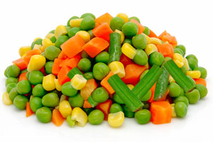

MIXED VEGETABLES (PKT)
Minimum
4
Notes:
https://www.google.com.au/imgres?imgurl=http%3A%2F%2Fajwa.com%2Fmedia%2F31473%2Fajwa-frozen-mix-veg-680x220.jpg&imgrefurl=http%3A%2F%2Fajwa.com%2Fproducts-and-services%2Ffrozen-fruit-and-vegetables%2Fmixed-vegetables&docid=9IrSctuNR5W74M&tbnid=CbyouWNxyk8JOM%3A&vet=10ahUKEwi418eqpJ_VAhXLEbwKHemcCcwQMwiyAigSMBI..i&w=680&h=220&hl=en&bih=612&biw=1087&q=mixed%20vegetables&ved=0ahUKEwi418eqpJ_VAhXLEbwKHemcCcwQMwiyAigSMBI&iact=mrc&uact=8

Slide 3
Consumables Deck

Slide 4
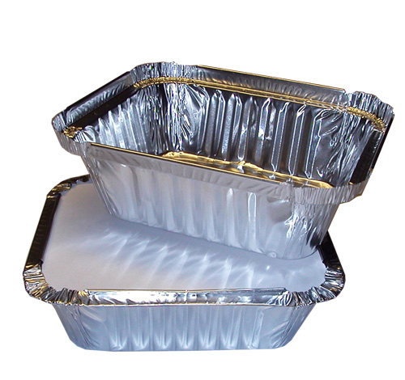
FOIL TRAYS (SML)
Minimum
7

Slide 5
Dry Goods Deck

Slide 6
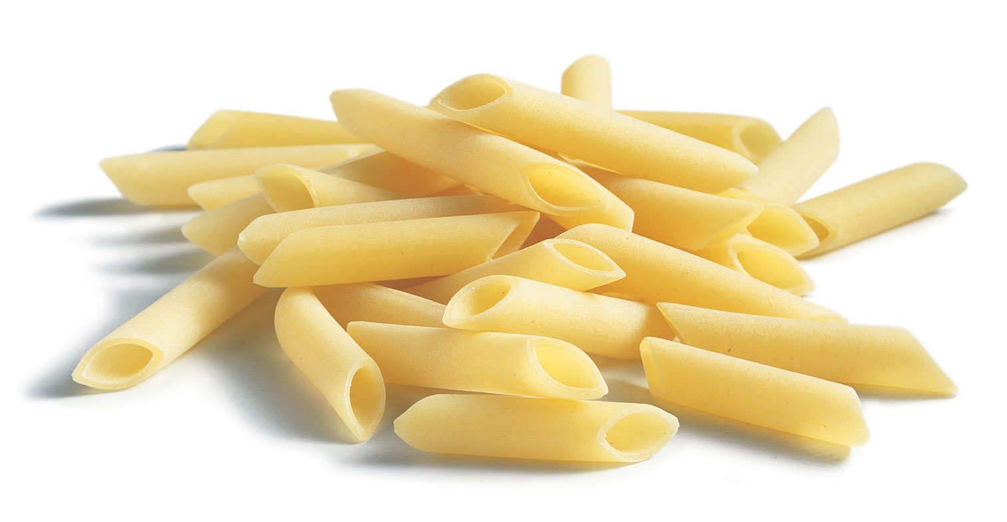
PENNE PASTA
Minimum
4

Slide 7
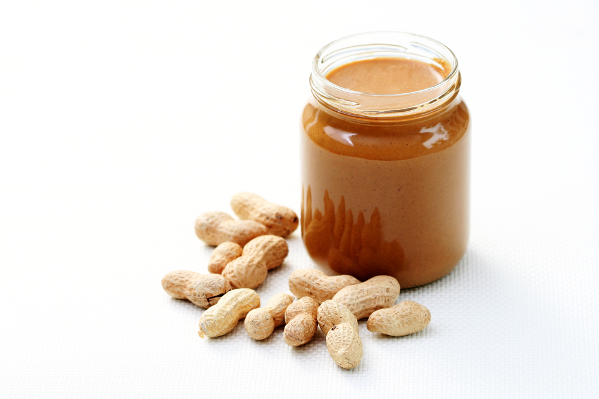
PEANUT BUTTER
Minimum
9

Slide 8
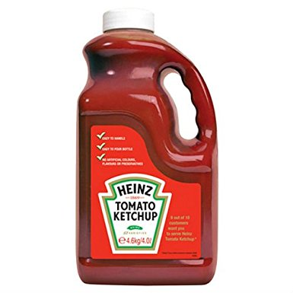
TOMATO SAUCE
Minimum
3

Slide 9
Fresh Foods Deck

Slide 10
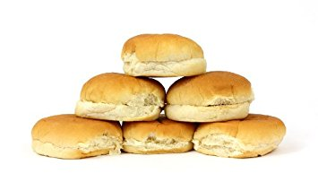
HAMBURGER BUNS (PKT)
Minimum
5

