Slide 1
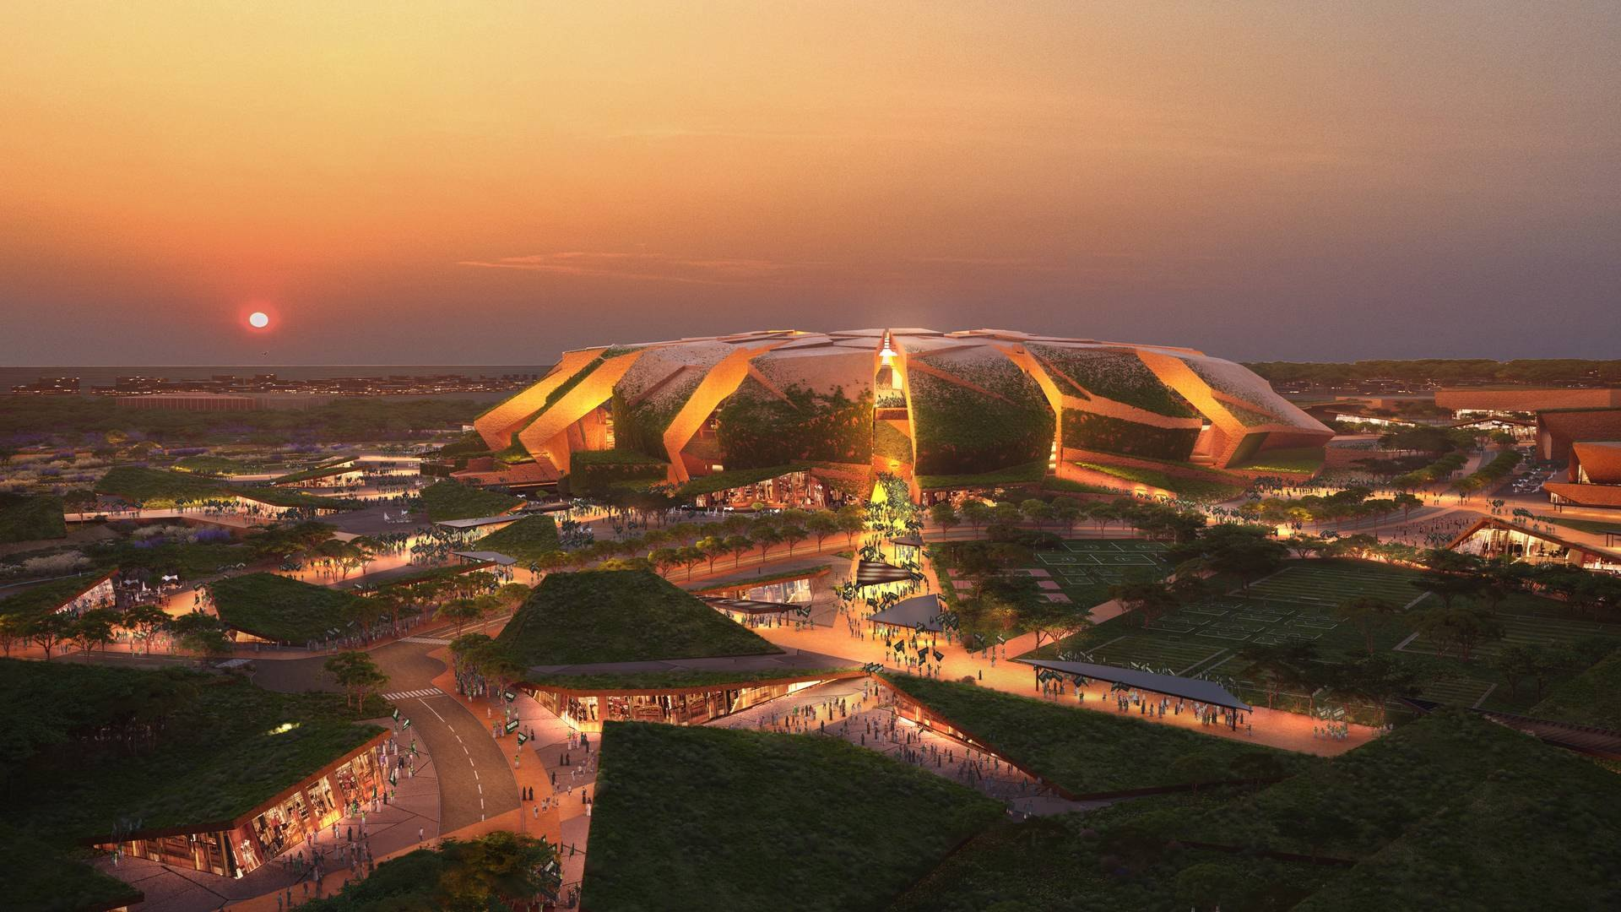

MBSC EMBA · ECN 511 Economics for Managers
Building King Salman Stadium: how much of the money stays in Saudi Arabia?
Construction and Infrastructure · Topic B: the multiplier effect of public capital spending, and where the money leaks
GROUP 8
Abdulmajeed Alajlan · Abdulrahman Aldahlawi · Salman Alfaris · Mohammed Alghamdi · Abdulaziz Alweheab · Nada Alyahya · Haifa Binnafisah
Cover image: King Salman Stadium concept rendering © Populous
Notes:
Shown before the timed talk. Twelve content slides, about eight minutes. Click, or press →, to drive in.

Slide 2

Our case
PART 1
What a World Cup stadium buys, and who supplies it
Notes:
Part 1: Our case. What a World Cup stadium buys, and who supplies it

Slide 3
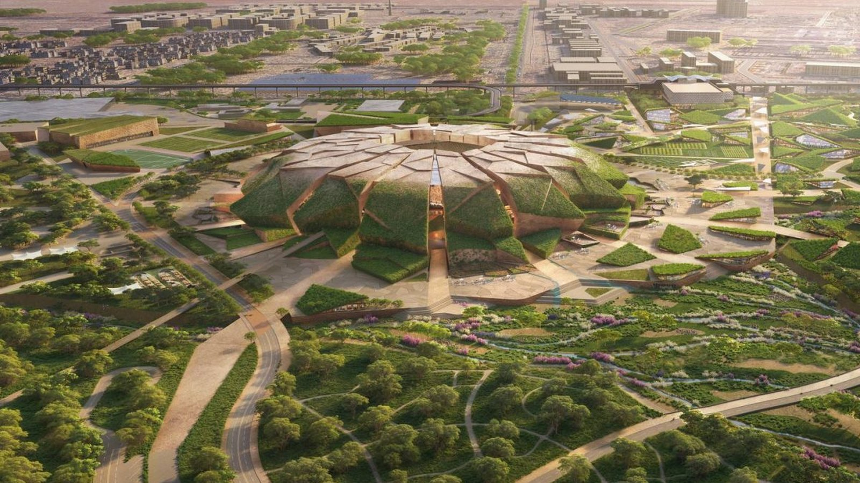
Our case: the 2034 World Cup stadium programme
01 · Construction and Infrastructure
AA
Abdulmajeed Alajlan · 40s · 01 / 12
A stadium buys civil works, materials, building systems and specialist expertise.
Ministry of Sport buys the works.
Populous designs the stadium.
Contractors and specialist suppliers deliver.
15
7.8%
SAR 646bn
92,760 planned seats · King Salman Stadium, Riyadh
stadiums in 5 host cities
of Saudi value added, 2023 sector scale
gross output, 2023
King Salman Stadium concept rendering © Populous
Sources: FIFA 2034 bid evaluation; GASTAT Supply and Use Tables 2023; Ministry of Sport; Populous [R01, R05, R02–R03, R53].
Notes:
Abdulmajeed Alajlan · 40 seconds
Our sector is Construction and Infrastructure. A stadium buys civil works, materials, building systems and specialist expertise. We use the 2034 stadium programme, with King Salman Stadium as our main example. The Ministry of Sport procures its works and Populous is the designer. FIFA’s 2024 bid baseline assessed fifteen stadiums across five cities. Construction generated 7.8 percent of Saudi value added in 2023. We ask how this public spending can leave Saudi firms able to supply the next project.

Slide 4
A World Cup stadium is a construction job inside a sector worth 7.8% of the Saudi economy
Part 1 · The sector
AA
Abdulmajeed Alajlan
7.8%
SAR 646bn
15
92,760
of Saudi value added comes from construction (SAR 338bn of SAR 4,333bn, 2023)
construction output in 2023, of which SAR 307.5bn is bought-in inputs
stadiums across 5 host cities in FIFA’s 2024 bid evaluation
planned seats at King Salman Stadium, Riyadh — our case
Stadium | Seats | Who buys | Who supplies | Published value
Prince Mohammed bin Salman Stadium, Qiddiya | 45,000 | Qiddiya Investment Co. | FCC (Spain) – Nesma (KSA); Elegancia: mechanical SAR 829m; IKK Fangda: facade SAR 997m ex-VAT | about SAR 4.0bn
Aramco Stadium, Al Khobar | 46,096 | Saudi Aramco | Besix (Belgium) – Albawani (KSA) | about SAR 3.7bn
King Salman Stadium, Riyadh — our case | 92,760 | Ministry of Sport | Main works prequalification notice (Nov 2025); design by Populous | Not published
International–Saudi joint ventures deliver the main works; specialist imported systems arrive through subcontracts.
Sources: R05 (sheet 6.3), R01, R02–R03, R57, R58, R23–R24. Calculation: construction gross value added 338.3bn ÷ total GVA 4,332.9bn = 7.81% (GASTAT 2023, sheet 6.3).
Notes:
Abdulmajeed Alajlan
Our sector is construction and infrastructure. In 2023 Saudi construction produced SAR 646 billion of output and SAR 338 billion of value added, which is 7.8% of all value added in the economy. The 2034 World Cup adds fifteen stadiums in five cities. Our case is King Salman Stadium in Riyadh, the largest, with 92,760 planned seats. The buyers are public: the Ministry of Sport for King Salman, Qiddiya Investment Company and Aramco for other venues. The suppliers are joint ventures of international and Saudi contractors, plus specialist firms for mechanical systems and facades. So who supplies matters: every package bought from abroad is money that leaves the Kingdom.

Slide 5

Multiplier and leakage
PART 2
Follow the riyal: where it is spent, and where it leaks
Notes:
Part 2: Multiplier and leakage. Follow the riyal: where it is spent, and where it leaks

Slide 6
One public payment creates income that people spend again
02 · The spending multiplier, in simple terms
AA
Abdulmajeed Alajlan · 45s · 02 / 12
spent again
GDP multiplier = extra GDP caused ÷ extra public spending
01
02
03
Public spending
Income and spending
More Saudi production
Illustration: SAR 100m extra spending causes SAR 120m extra GDP. Multiplier = 1.2.
The stadium pays a contractor.
Workers and suppliers spend part of their income again.
Later spending supports additional goods and services.
Micro
A firm chooses a supplier.
Imports and saving reduce later rounds.
Macro
The combined effect on GDP.
Our topic
The spending multiplier is macroeconomics.
Source: IMF, Fiscal Multipliers, 2014, section II [R69]. Teaching example, not a Saudi estimate.
Notes:
Abdulmajeed Alajlan · 45 seconds
The spending multiplier starts when one payment becomes income for someone else. A stadium contractor pays workers and suppliers. They spend some of that income again, creating later production. Imports and saving reduce the next round. A GDP multiplier compares additional GDP with additional public spending. If an extra one hundred million riyals causes one hundred and twenty million in extra GDP, the multiplier is one point two. That is only a teaching example. A company choosing a Saudi supplier is a microeconomic decision. The combined effect on GDP is macroeconomics. EP credit up to six belongs to a different calculation.
Qualification: the 100m / 120m example illustrates the definition only. GDP is incremental value added over a specified period, compared with the baseline. Imports, capacity, price changes and policy responses can reduce the effect.

Slide 7
Our sector creates assets and adds value through Saudi production
03 · Construction and Saudi GDP
SA
Salman Alfaris · 40s · 03 / 12
GASTAT 2023 [R05]
7.8%
Saudi construction, 2023 — SAR billion
of Saudi gross value added
GDP counts the extra value created at each Saudi stage once. A local supplier’s full invoice also includes inputs bought from other firms.
Academy link: qualified local suppliers can win orders and create extra Saudi value.
Source: GASTAT, Supply and Use Tables 2023, sheets 6.2–6.3 [R05]. Sector share describes scale, not a GDP multiplier.
Notes:
Salman Alfaris · 40 seconds
Our sector is construction and infrastructure. GASTAT reports six hundred and forty-five point eight billion riyals of construction output in 2023. Subtract three hundred and seven point five billion of bought-in inputs, and construction adds three hundred and thirty-eight point three billion of value. That is seven point eight percent of Saudi gross value added. GDP counts the extra value created in each Saudi stage once. Our academy can help qualified Saudi suppliers win orders, but the GDP effect depends on additional production, imported inputs, capacity and cost. Local invoices alone do not measure a GDP multiplier.
Qualification: 645.8 minus 307.5 equals 338.3bn, using rounded figures. Total Saudi gross value added is 4,332.9bn, so construction is 7.8%. The 52.4% accounting share is not a local-content score or a spending multiplier.

Slide 8
Construction’s two most imported inputs: basic metals (54.5%) and electrical machinery (50.3%)
Part 1 · How import-dependent it is
SA
Salman Alfaris · 40s
SAR 646bn construction output in 2023, of which SAR 307.5bn is bought-in inputs
Imported 19.7% · SAR 60.5bn
Made in Saudi Arabia 80.3% · SAR 247.0bn
Import leakage by input — as a share and as an amount (construction, 2023)
Metals and electrical machinery are half imported; by amount, chemical products and metals are the largest leaks.
Source: GASTAT, Supply and Use Tables 2023 [R05] — use: sheet 6.2 col. H; import rate: sheet 6.1 Total imports (AA) ÷ Supply at basic prices (AB). National ratios applied to construction purchases.
Notes:
Salman Alfaris · 40 seconds
Start with what construction buys: SAR 307.5 billion of inputs in 2023. Based on GASTAT, 19.7%, SAR 60.5 billion, is imported and 80.3% is made in Saudi Arabia — roughly one riyal in five. How import-dependent is construction? Among the inputs construction buys in volume, two stand out. More than half of the basic metals supplied in Saudi Arabia are imported, 54.5%, and half of the electrical machinery, 50.3%. Cement, glass and basic chemicals are mostly made here. These are national ratios: based on GASTAT, if we assume a stadium is built with the same input mix as Saudi construction, these are the inputs where it depends most on imports. A stadium is likely heavier in electrical and mechanical systems than the average building, so the real dependence may be higher.
Amount = construction use of the product (sheet 6.2 col. H) × its national import rate: basic metals 21.9 × 54.5% = 12.0; electrical machinery 4.0 × 50.3% = 2.0; other chemical products 31.1 × 43.2% = 13.4.

Slide 9
Applying a SAR 4.5bn stadium scenario
04 · Applying the multiplier to our case
AW
Abdulaziz Alweheab · 40s · 04 / 12
about SAR 4.0bn
about SAR 3.7bn
SAR 4.5bn
Qiddiya stadium · 45,000 seats
Aramco Stadium · 46,096 seats
Group scenario, not a published budget or a validated cost estimate
ROUND 1
Estimated purchases using GASTAT 2023 construction ratios
SAR 2,143m total purchases = 47.6% of the SAR 4.5bn
SAR 1,721m Purchases inside Saudi Arabia (80.3%) → next spending round
SAR 421m Purchases from abroad (19.7%) — the first leak
Sources: R57, R58 (benchmarks); GASTAT Supply and Use Tables 2023, sheets 6.1–6.2 [R05]. Group scenario using national ratios; figures are rounded.
FOLLOW THE RIYAL
SAR 4.5bn
SAR 2,143m
SAR 421m
SAR 177m
SAR 84m
SAR 44m
~SAR 36m
scenario
purchases
the leak
chem + metals
EP credit
Saudi buying
activity
Notes:
Abdulaziz Alweheab · 40 seconds
We apply the mechanism to a clearly labelled stadium scenario. The group assumes a value of four-and-a-half billion riyals, using other stadium contracts only as scale comparisons. GASTAT’s construction ratios imply about 2,143 million in intermediate purchases. The model estimates 1,721 million in domestic purchases and 421 million in imports. Local suppliers can spend their receipts again. The imports are the first purchase leakage. This is a first-round purchase split, not a measured total multiplier or all the value that stays in Saudi Arabia.

Slide 10
Estimated imports in the SAR 4.5bn stadium scenario
05 · The materials behind the import leakage
AW
Abdulaziz Alweheab · 40s · 05 / 12
STADIUM IMPORTS
SAR 421m
19.7% of the SAR 2,143m estimated purchases split by input
SAR 177m
Chemicals + metals · 42% of stadium’s imports
Actual item check
Grade, quantity, origin, certification and price from supplier schedules.
Examples under each group are illustrative. Each bar retains its whole GASTAT group value. Source: GASTAT, Supply and Use Tables 2023, sheets 6.1–6.2 [R05]. National product ratios applied to construction use; group scenario, not invoices.
FOLLOW THE RIYAL
SAR 4.5bn
SAR 2,143m
SAR 421m
SAR 177m
SAR 84m
SAR 44m
~SAR 36m
scenario
purchases
the leak
chem + metals
EP credit
Saudi buying
activity
Notes:
Abdulaziz Alweheab · 40 seconds
The chart now names the materials we mean. Protective coatings, sealants and adhesives sit within the chemicals group. Steel, aluminium and copper sit within the metals group. The largest modelled groups are ninety-four million and eighty-three million riyals, together forty-two percent of estimated imports. The amounts still describe whole statistical groups, not item-level invoices. We must confirm the exact grade, quantity, origin and price from supplier schedules. That lets the academy qualify a Saudi substitute rather than simply promise to localise all metals.

Slide 11

EPP and controls
PART 3
Turning the leak into an obligation
Notes:
Part 3: EPP and controls. Turning the leak into an obligation

Slide 12
Assessment basis: the official April 2026 consultation framework
06 · Stadium EPP at 20 percent, credit up to 6
MA
Mohammed Alghamdi · 50s · 06 / 12
SAR 421m
×
20%
=
SAR 84m
Estimated stadium imports · SAR 4.5bn scenario, slide 5
Second import tier · SAR 300m–500m per tender
Required EP credit · 421m × 20%
Import tiers (per tender) and the EP obligation
Draft category factors
Knowledge transfer / localisation 1–3
Technology transfer / exports 2–4
4 + 2 = 6
Qualifying base + approved bonus. Rare technology or other eligible grounds.
Assumption: one main contract with one company, so all SAR 421m counts.
Credit differs from cash, GDP and ROI.
Source: LCGPA, Economic Participation Policy Update, consultation text, Articles 6–9 [R63]; DGA Group, April 2026. Imports: group scenario [R05]. Actual tender terms control the applicable version.
FOLLOW THE RIYAL
SAR 4.5bn
SAR 2,143m
SAR 421m
SAR 177m
SAR 84m
SAR 44m
~SAR 36m
scenario
purchases
the leak
chem + metals
EP credit
Saudi buying
activity
Notes:
Mohammed Alghamdi · 50 seconds
We use the 2026 consultation framework requested for this assessment. Our SAR 4.5 billion stadium scenario has about 421 million riyals of estimated imports, which falls in the second band, 300 to 500 million, at twenty percent. That creates about eighty-four million riyals of required EP credit. We assume the stadium is one main contract awarded to one company, so the whole import value counts toward a single obligation. The first band, 75 to 300 million, is twenty-five percent, and above 500 million it is fifteen percent. The credit factor can reach six only for qualifying activities: a technology-transfer factor of four plus an approved bonus of two. Our proposal must earn that higher value through usable rights and new capability. Six is not a spending multiplier or a promised investment return.
Qualification: 421 × 20% = 84.2m, rounded to 84m. This applies the tier rate to the whole import value; the draft summaries do not say whether tiers are marginal. If marginal: 300 × 25% + 121 × 20% = 99.2m. The 421m covers modelled intermediate-input imports only, so imported equipment or foreign services could raise the EP base.

Slide 13
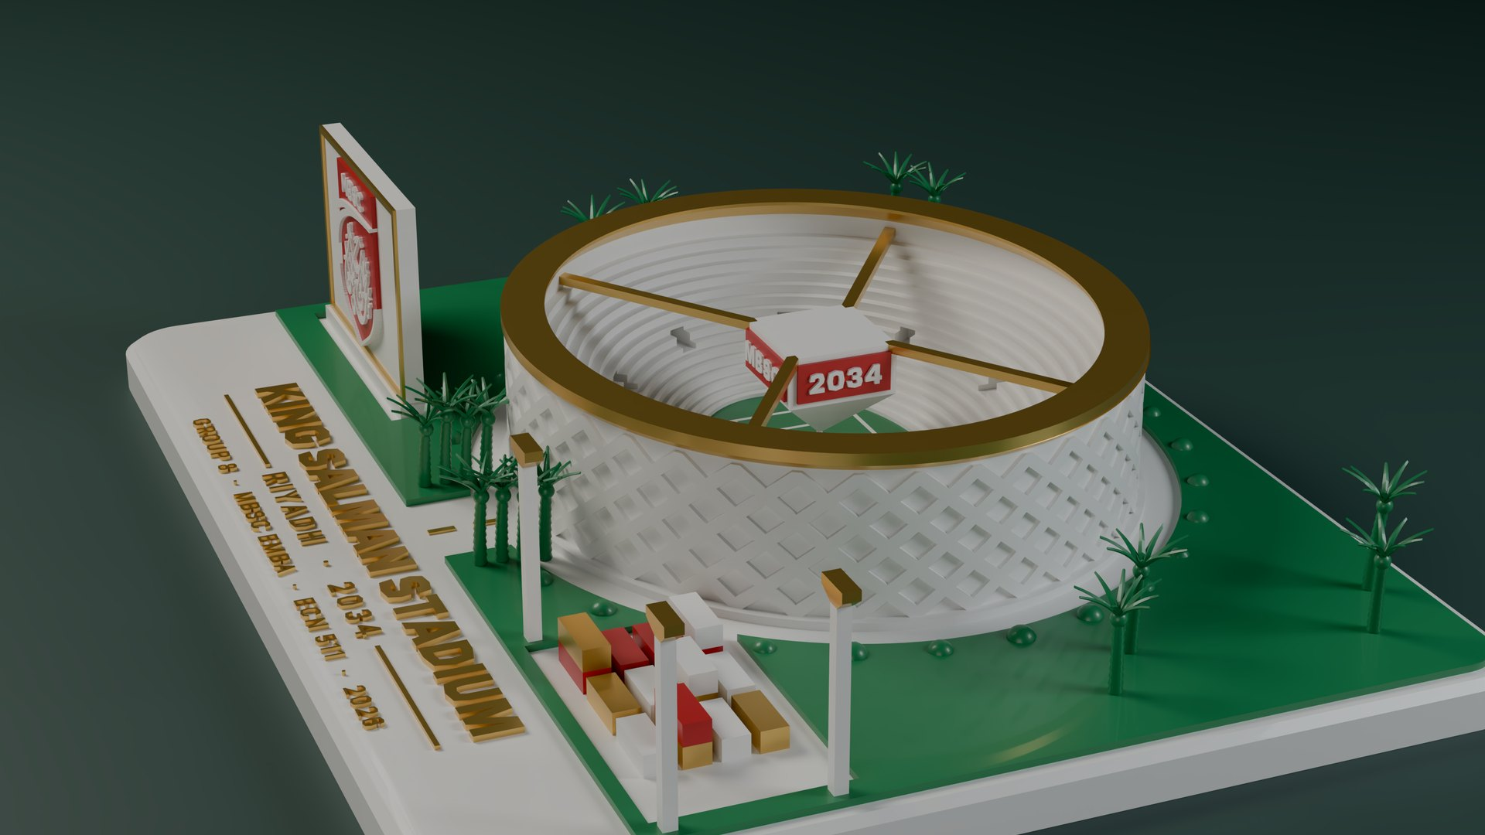
A fixed event deadline made live-site learning especially valuable
07 · London 2012 offers a construction skills lesson
AD
Abdulrahman Aldahlawi · 30s · 07 / 12
3,000+
408
training places
apprentices
✓ What worked
▲ What was weaker
Training connected to real construction jobs.
Encouragement without binding targets made skills objectives harder.
Saudi adaptation: paid practice, independent tests and a return-to-train commitment
Sources: UK DCMS, 2012 Games construction on track, 20 May 2012 [R12]; Crossrail Learning Legacy, 2018 [R13]. Counts do not prove retained jobs.
Notes:
Abdulrahman Aldahlawi · 30 seconds
London 2012 shows that a fixed-event construction programme can support a skills legacy. The UK government reported more than three thousand training places and four hundred and eight apprentices. Training connected people to live construction work. The weakness was relying on encouragement rather than binding skills requirements. Our adaptation puts paid practice, independent tests and trainer return into the delivery agreement. We measure what participants can do and where they work afterwards.

Slide 14
Five risks, five controls
08 · The controls that make the solution credible
AD
Abdulrahman Aldahlawi · 40s · 08 / 12
RISK
PROPOSED CONTROL
▲
Routine training earns extra credit
Record existing duties. Fund new competence, rights or tooling.
▲
IP cannot be used independently
Agree licences, diagnostic access, trainer rights and export territory.
▲
Shared delivery duplicates claims
Keep each supplier’s approved activities, cost allocation and ledger separate.
▲
Local substitutes or bulk buying fail
Test grades, capacity and full cost. Use fair lots and multiple suppliers.
▲
Skills have no work after handover
Confirm placements before training and contract the next site.
Evidence at three points
Before
baseline and rights
Completion
independent tests
6 / 12 months
work and trainer return
Sources: LCGPA consultation Arts. 8(3), 13–16 [R63]; WIPO licensing [R64]; OECD competition safeguards [R68]; UK additionality study [R54].
Notes:
Abdulrahman Aldahlawi · 40 seconds
The solution has to pass five tests. It must add capability beyond ordinary warranty training. The IP agreement must actually allow Saudi teams to use the tools and train others. Each supplier keeps its own approved obligation and credit record. Joint purchasing must preserve competition, quality and access for smaller suppliers. Finally, train before commissioning and confirm the next paid placement. We test skills at the start and completion, then check work and trainer return after six and twelve months. We stop or redesign a track that fails these tests.

Slide 15

The academy proposal
PART 4
Turning the obligation into Saudi capability
Notes:
Part 4: The academy proposal. Turning the obligation into Saudi capability

Slide 16
Shared delivery across eligible stadium suppliers, with separate EP obligations
09 · One academy with three connected functions
HB
Haifa Binnafisah · 30s · 09 / 12
Shared EPP proposal: eligible stadium vendors jointly fund ONE academy. Each vendor contributes approved funding, trainers, equipment or licensed know-how.
01
License and train
02
Qualify Saudi materials
03
Buy together
Licensed manuals and software
HVAC rigs and coating-test kits
Paid practice and Saudi trainers
Coatings, sealants and metals
Test specific grades and origin
Material passports for approvals
Common performance specifications
Competitive framework and call-offs
Verify discounts and full cost
Evidence: NITI training; WIPO licensing terms
Evidence: ALUPCO extrusion; Sika Saudi admixture production
Evidence: OECD purchasing efficiency and competition
One qualified host runs the programme. Sharing trainers, equipment and demand reduces duplicated training and keeps skills available across sites.
LCGPA approves vendor roles and cost allocations. Each vendor keeps its own EP obligation and ledger. Each activity earns credit once.
Later: export Saudi-owned courses, licensed services and qualified products.
Sources: NITI [R42]; official LCGPA draft Arts. 8–9 [R63]; WIPO [R64]; OECD [R65, R68]; ALUPCO [R66]; Sika [R67]. Candidate capabilities, not partner commitments.
Notes:
Haifa Binnafisah · 30 seconds
We propose one shared EP programme for eligible stadium vendors, subject to LCGPA approval. Vendors jointly support one academy with funding, trainers, equipment and licensed know-how. One qualified host runs training and material qualification. The authorised buyer coordinates competitive purchasing. Each vendor retains its own obligation and ledger, and each activity is credited once. Shared delivery reduces duplication and preserves capability for later projects and exports.
Extended: first, suppliers license technical manuals and diagnostic access, provide training equipment, and train Saudi trainers through paid site practice. Second, the hub tests and qualifies specified Saudi coatings, metal products and other materials against the project standard. Existing Saudi manufacturing evidence makes that plausible, but grades and capacity still need checking. Third, the authorised buyer coordinates standard specifications and competitive call-off orders across confirmed sites. This can improve negotiating power without guaranteeing discounts. Later, Saudi-owned training content and licensed services can be sold abroad within the agreed IP rights.

Slide 17
Begin inside real projects with an existing qualified training provider
10 · Hands-on training first, academy after evidence
HB
Haifa Binnafisah · 35s · 10 / 12
Joint agreement first: vendor commitments, LCGPA-approved activities and separate credit records.
1
Confirm demand
→
2
Run the pilot
→
3
Expand if proven
Employers identify the skills gap and sign paid site placements. Vendor roles and funding are agreed.
Supplier mentors teach on real equipment. Independent tests and trainer practice. Saudi trainers teach the next cohort.
Repeat cohorts build an academy. A permanent facility needs its own case. Use existing facilities where adequate.
Condition to proceed
Next-site work, budget, IP rights, tools and approvals are confirmed. Signed licences and EP cost allocations.
Condition to proceed
Verify practical competence, paid deployment and unit cost. Record extra capability beyond routine duties.
Condition to proceed
Continuing jobs and orders, proven results and acceptable quality and cost. Track work and trainer return at 6/12 months.
No confirmed paid demand: defer intake. Weak results: redesign or stop.
Suggested start: 24 learners, 6 trainer candidates, 2 eligible sites. Targets for agreement.
Basis: report Sections 5–8 and Appendix F. Sources: NITI [R42], training evaluation [R54], LCGPA draft [R63], WIPO [R64]. Proposed design.
Notes:
Haifa Binnafisah · 35 seconds
We start with hands-on training at real construction sites, hosted by an existing qualified provider. Before intake, employers must confirm paid placements, a skills gap and next-site work. We also need an affordable budget, usable technical rights, equipment and approvals. Supplier mentors teach practical tasks, independent assessors test skills and future Saudi trainers practise teaching. Only proven results and continuing employer demand justify repeat cohorts or a permanent academy. If jobs, rights or costs do not pass the test, we pause or redesign.
On-slide addition: the proposal is a joint EP delivery programme across participating eligible vendors. Obtain approval before committing shared delivery. Each company keeps its individual obligation and approved activity/cost records. Do not treat all fifteen venues as one legal tender or assume cross-company credit transfer.
Detail for questions: the 24 learners, six trainer candidates and two eligible sites are proposed design targets, not committed places or guaranteed jobs. At completion check independent practical tests, teaching ability, qualified material grades and full delivered costs. At 6 and 12 months verify paid work, return-to-train activity and repeat local orders. If pass conditions fail, reduce the cohort, renegotiate, redesign or stop.

Slide 18

What stays after the cranes leave
11 · Value now and after the stadium opens
NA
Nada Alyahya · 50s · 11 / 12
Value | During construction | After handover
Skills and academic capability | Paid practice, independent tests, manuals and trainer development | Next-site work, returning trainers and further recognised qualifications
Local products and IP | Approved local grades, tooling and usable technical rights | Repeat orders, deeper production and independent Saudi services
Buyer value | Joint offers, less duplicated buying and comparable full-cost prices | Reusable specifications and resilient multi-supplier sourcing
Export value | Saudi-authored content and rights prepared for later markets | Paid courses, licensed services and qualified products sold abroad
Illustrative materials opportunity 25% of the SAR 177m basket ≈ SAR 44m more domestic purchases
Source: GASTAT-based group scenario [R05]. Benefits are proposals. No discount or export revenue is assumed. Domestic purchases, savings and credit are separate.
FOLLOW THE RIYAL
SAR 4.5bn
SAR 2,143m
SAR 421m
SAR 177m
SAR 84m
SAR 44m
~SAR 36m
scenario
purchases
the leak
chem + metals
EP credit
Saudi buying
activity
Notes:
Nada Alyahya · 50 seconds
The value goes beyond attendance certificates. During construction, qualified Saudi teams perform defined work, local manufacturers can win approved orders, and the buyer can compare consolidated offers with the original price and full delivery cost. After handover, graduates return as trainers, work on the next contracted site and help suppliers sell new services or materials. Later exports could include Saudi-owned courses, licensed commissioning services and qualified products. These are proposed benefits. We verify orders, invoices, competence, repeat work and export receipts separately. The forty-four million assumes the two largest import groups, chemicals and metals, worth 177 million, go to one company, and a quarter of that shifts to Saudi supply. The illustrative forty-four million in extra domestic purchases is not GDP or a promised academy return.

Slide 19
A shared Materials and Systems Academy pilot
12 · The decision for LCGPA and the buyer
NA
Nada Alyahya · 40s · 12 / 12
Proposed joint programme for all participating eligible stadium vendors · one academy, agreed vendor contributions and individual compliance records.
LCGPA
Authorised buyer
Delivery partners
Approve extra activities, rights, factors and separate supplier ledgers.
Approve competitive joint procurement and construction gates.
Agree paid placements, material trials, trainer return and follow-up.
EP CREDIT PLAN
SAR 84m
SAR 84m from about SAR 36m of activity (average factor 2.33; SAR 63m at low-end factors)
EP credit = 36 + 24 + 24
Why these factors: LCGPA sets the final factor within each draft range. We start at the minimum and add 1 per condition met: usable licences (2→3), new skills with independent tests (1→2), approved Saudi materials with real orders (1→2). Not the maximum: no manufacturing rights, recognised qualification or new plant.
Proposed start: 24 learners, 6 trainer candidates, 2 confirmed eligible sites
Proposal targets for agreement, not forecasts or observed results. Scale on proven skills, demand, quality, cost and licensed rights. Policy basis: LCGPA [R63].
FOLLOW THE RIYAL
SAR 4.5bn
SAR 2,143m
SAR 421m
SAR 177m
SAR 84m
SAR 44m
~SAR 36m
scenario
purchases
the leak
chem + metals
EP credit
Saudi buying
activity
Notes:
Nada Alyahya · 40 seconds
We ask LCGPA to approve a pilot with clearly allocated supplier activities and evidence for any higher credit factor. The authorised buyer should approve a competitive shared purchasing process with separate contracts and fair supplier access. Our proposed starting design is twenty-four learners at two confirmed eligible sites, with six candidates returning as trainers. These are targets to agree, not results already achieved. To cover the SAR 84 million EP obligation, we plan about 36 million of approved activity: 12 million each on technology transfer at a factor of 3, knowledge transfer at 2 and localisation at 2. We use the middle of each draft range because the academy adds new, independently tested capability and usable licences, but no manufacturing rights or rare technology, so we claim no bonus. LCGPA sets the final factor. At the low end of every range we would need about 63 million, still below 84. Expand only when skills, paid demand, licensed rights, supplier quality and costs justify it. The goal is a Saudi capability that keeps working after the stadium opens.

Slide 20


GROUP 8 · MBSC EMBA · ECN 511
Thank you
Questions welcome
AA
AD
SA
MA
AW
NA
HB
Abdulmajeed
Alajlan
Abdulrahman
Aldahlawi
Salman
Alfaris
Mohammed
Alghamdi
Abdulaziz
Alweheab
Nada
Alyahya
Haifa
Binnafisah
King Salman Stadium · Riyadh 2034
Notes:
Closing. Thank the audience and invite questions. The four source pages follow in the appendix (press M).

Slide 21
Case, sector and stadium packages
Sources 1 of 4
R01
FIFA World Cup 2034 Bid Evaluation Report, 2024, pp 46–51
FIFA, 29 November 2024.
R03
MoS King Salman preliminary works notice, 7 April 2026
Prequalification invitation; deadline 28 April 2026.
R17
FIFA host appointment, 11 December 2024
Extraordinary FIFA Congress appoints hosts of 2030 and 2034 editions.
R53
Populous King Salman Stadium project and concept images
Undated project page. Designer identity.
R05
GASTAT Supply and Use Tables 2023, sheets 6.1–6.2
Supply and Use and Input-Output Tables by Sections 2023, released 2025; thousand SAR.
R23
Estithmar mechanical package announcement, 10 September 2026
Elegancia Arabia Trading awarded SAR 829m mechanical works, Prince Mohammed bin Salman Stadium.
R02
MoS King Salman main works notice, 25 November 2025
Prequalification invitation; deadline 16 February 2026.
R24
China Fangda facade package filing, 19 October 2026
Announcement 2026-41; SAR 1,146.9m incl. VAT / SAR 997.3m excl. VAT.
Evidence basis: report updated 21 October 2026. Course material: [C1] George, R. E., Assessment Guidelines for ECN 511, MBSC, 30 September 2026; [C2] MBSC, ECN 511 Course Syllabus Modular A1, 2026; [C3] George, R. E., EPP assessment update allowing supporting localisation evidence, email received 20 October 2026. No public URLs. References and backup material sit outside the eight-minute presentation.
Notes:
Source titles are clickable.

Slide 22
Policy, benchmark and training evidence
Sources 2 of 4
R09
LCGPA Economic Participation Policy, Unit 7, historical training material
PC-GEN-TM-ECP-EN-V12, pp. 4–5, 11–15, 21–22.
R42
NITI Apprenticeship Program, undated brochure
Candidate training capability only.
R11
Umm Al-Qura EPP consultation notice, 14 April 2026
Consultation notice; not an adoption notice.
R54
UK BIS Measuring Additionality in Apprenticeships, 2013
Research Paper 138, pp. 9–13.
R27
DGA analysis of the EPP consultation draft, April 2026
DGA Group / Albright Stonebridge Group, pp. 4–6.
R55
Local content preference regulation, Resolution 245, 2019
Articles 4, 11–16 and 18–22.
R12
UK government London 2012 construction release, 20 May 2012
2012 Games construction on track thanks to 12,000-strong workforce.
R56
LCGPA mechanisms for government entities, Unit 2
PC-GOV-TM-MCI-EN-V12.
R13
Crossrail Learning Legacy, contractual skills targets, 2018
Eldred and Blin, 17 August 2018, section 1.2.
R08
IMF Saudi Arabia Article IV, 2024, Box 1
Country Report 24/280, printed p. 10.
R14
EXPRO Operations Management Introduction Guideline, 2021
EOM-ZO0-GL-000001, Rev. 001, sections 6.3–6.7.
AI use: ChatGPT supported research, calculations, charts and drafting. Claude supported review. No original interviews or field data are claimed. Facts, teaching assumptions and proposals remain labelled. The submitting group remains responsible for source checks and final approval.
Notes:
Source titles are clickable.

Slide 23
Updated stadium comparisons
Sources 3 of 4
R57
Argaam, Qiddiya stadium contract, October 2024
Qiddiya awards SAR 4B stadium project contract to Saudi-Spanish consortium.
R58
MEED, Saudi Arabia selects Dammam stadium contractor, 26 February 2024
Besix–Albawani, est. SAR 3.7bn.
R59
StadiumDB, Aramco Stadium design and capacity, undated
R60
StadiumDB, Qiddiya stadium design and capacity, undated
R69
IMF, Fiscal Multipliers, 2014, section II
Batini, Eyraud, Forni and Weber, Technical Notes and Manuals 14/04. Definition and teaching example on slide 2.
Verification: GASTAT Supply and Use Tables 2023 downloaded 27 October 2026. The supplied ratios reproduce 60.507bn of modelled imported construction inputs by applying each national product import ratio to construction use — an estimate, not an observed industry import-use matrix. BESIX’s official project page confirms the Aramco client and BESIX–ALBAWANI JV. Official capacities are approximately 47,000; the retained 46,096 is the FIFA bid design scope. Current public procurement notices do not establish an awarded King Salman main package.
Notes:
Source titles are clickable.

Slide 24
Policy and solution evidence
Sources 4 of 4
R63
LCGPA, Economic Participation Policy Update, April 2026 consultation, Arts. 3–19
Official Arabic consultation text, read 28 October 2026. Consultation text, not an adoption notice.
R64
WIPO, Technology Transfer Agreements, licensing rights and scope
Licensing, territory, field of use and ownership.
R65
OECD, Government at a Glance 2025, section 11.5, centralised purchasing
R66
ALUPCO, Aluminium, Saudi extrusion, die-making and finishing capability
Capability evidence, not a commitment to this proposal.
R67
Sika, New Saudi admixture factory, 27 June 2018, official release
Historic capability evidence, not proof of every coating grade or current capacity.
R68
OECD, SMEs in Public Procurement, 2018, Box 2.4, competition safeguards
The primary draft was read directly from the official Istitlaa consultation HTML on 28 October 2026. It is a consultation text, not an adoption notice. The supporting sources establish mechanisms and existing capabilities, not committed project partners or guaranteed performance.
Notes:
Source titles are clickable.

