Slide 1
CP5310
JavaScript

Slide 2
Introduction
A scripting language.
A lightweight programming language.
Easy to learn.
Inserted into HTML pages
can be executed by all modern web browsers in order to control web pages on the client side.
commonly in combination with HTML, CSS, and AJAX
Server-side programs.
Mobile applications.
Notes:
A lightweight programming language is one that is designed to have very small memory footprint, is easy to implement (important when porting a language), and/or has minimalist syntax and features. (Wikipedia)

Slide 3
Examples
Writing Into HTML Output
document.write("<h1>This is a heading</h1>");
document.write("<p>This is a paragraph</p>");
document_write.html
Reacting to Events
<button type="button" onclick="alert('Welcome!')">
Click Me!
</button>
button_click.html
Changing HTML Content
function myFunction()
{
x=document.getElementById("demo"); // Find the element
x.innerHTML="Hello JavaScript!"; // Change the content
}
changeHtmlContent.html

Slide 4
Examples (cont.)
Changing HTML Images
function changeImage()
{
element=document.getElementById('myimage')
if (element.src.match("bulbon"))
element.src="pic_bulboff.gif";
else
element.src="pic_bulbon.gif";
}
changeHtmlImage
Validate User Input
Most commonly used
validate_input.html

Slide 5
Basic Syntax
Semicolon (;) is optional
Case sensitive
Single line comment (//…)
//This is a single line comment
Multi line comments /* … */
/* The code below will write to a heading and to a paragraph, and will represent the start of my homepage: */ document.getElementById("myH1").innerHTML="Welcome to my Homepage";
document.getElementById("myP").innerHTML="This is my first paragraph.";

Slide 6
Variables
Naming rule
Variable names must begin with a letter, _ or $
Space or hyphen are prohibited
Use keyword var (optional)to define a variable
var firstname="Tony";
JavaScript has dynamic types. This means that the same variable can be used as different types:
var x; // x is undefined var x = 5.5; // Now x is a Number var x = "John"; // Now x is a String
var x = true; // Now x has a Boolean value
All JavaScript variables are objects!
Notes:
Local JavaScript Variables: A variable declared (using var) within a JavaScript function becomes LOCAL and can only be accessed from within that function.
Global JavaScript Variables: Variables declared outside a function, become GLOBAL, and all scripts and functions on the web page can access it.
Assigning Values to Undeclared JavaScript Variables: If you assign a value to variable that has not yet been declared, the variable will automatically be declared as a GLOBAL variable.
This statement:
carname="Volvo";
will declare the variable carname as a global variable , even if it is executed inside a function.

Slide 7
Array
Array is a collection of elements having different data types!
var myArr=new Array(); myArr[0]="Saab"; myArr[1]=123; myArr[2]=Date.now;
var myCars=new Array("Saab","Volvo","BMW");
var myNums = [1, 2, 3, 4, 5];
Array Methods and Properties
var x=myCars.length // x is 3 var y=myCars.indexOf("Volvo")// y is 1
Notes:
C++ or Java: Array is a collection of elements having the same data type

Slide 8
A simple JavaScript
Let’s now write a simple JavaScript program that will display the words “Hello World!” on a web page.
1. Enter the following into your text editor (Notepad++ or Dreamweaver).
<!doctype html>
<html>
<body>
<title>A simple JavaScript</title>
<script>
document.write("<h1>Hello World!</h1>");
</script>
</body>
</html>
2. Save this with the file name displayHelloWorld.html.
3. You can optionally upload the file into your remote folder.
4. Open this file in the web browser.
JavaScripts in HTML must be inserted between <script> and </script> tags.
JavaScripts can be put in the <body> and in the <head> section of an HTML page.

Slide 9
JavaScript Objects
Almost "everything" in JavaScript is an object. Strings, Dates, Arrays, Functions etc.
You can also create your own objects. This example creates an object called "person", and adds 3 properties to it.
1. Enter the following into your text editor (Notepad++ or Dreamweaver).
<!doctype html>
<html>
<body>
<script>
var person=new Object();
person.firstname="John";
person.lastname="Doe";
person.age=50;
document.write(person.firstname +" is "+person.age+" years old.");
</script>
</body>
</html>
2. Save this with the file name creatObject.html.
3. Open this file in the web browser.

Slide 10
JavaScript Functions
A function is written as a code block (inside curly { } braces), preceded by the function keyword:
function functionname() { //JavaScript statements }
funtionWithNoArguments.html
Function with parameters
function functionname(var1, var2) { //JavaScript statements }
funtionWithArguments.html
Function with a returned value
function myFunction() { var x=5; return x; }

Slide 11
JavaScript Arithmetic Operators
Arithmetic operators are used to perform arithmetic between variables and/or values.
Given that y=5, the table below explains the arithmetic operators:
Operator | Description | Example | Result of x | Result of y
+ | Addition | x=y+2 | 7 | 5
- | Subtraction | x=y-2 | 3 | 5
* | Multiplication | x=y*2 | 10 | 5
/ | Division | x=y/2 | 2.5 | 5
% | Modulus (division remainder) | x=y%2 | 1 | 5
++ | Increment | x=++y | 6 | 6
 |  | x=y++ | 5 | 6
-- | Decrement | x=--y | 4 | 4
 |  | x=y-- | 5 | 4

Slide 12
JavaScript Assignment Operators
Assignment operators are used to assign values to JavaScript variables.
Given that x=10 and y=5, the table below explains the assignment operators:
Operator | Example | Same As | Result
= | x=y |  | x=5
+= | x+=y | x=x+y | x=15
-= | x-=y | x=x-y | x=5
*= | x*=y | x=x*y | x=50
/= | x/=y | x=x/y | x=2
%= | x%=y | x=x%y | x=0
If you add a number and a string, the result will be a string!

Slide 13
JavaScript Comparison Operators
Comparison operators are used in logical statements to determine equality or difference between variables or values.
Given that x=5, the table below explains the comparison operators:
Operator | Description | Comparing | Returns
== | is equal to | x==8 | false
 |  | x==5 | true
=== | is exactly equal to (value and type) | x==="5" | false
 |  | x===5 | true
!= | is not equal | x!=8 | true
!== | is not equal (neither value nor type) | x!=="5" | true
 |  | x!==5 | false
> | is greater than | x>8 | false
< | is less than | x<8 | true
>= | is greater than or equal to | x>=8 | false
<= | is less than or equal to | x<=8 | true

Slide 14
JavaScript Logical Operators
Logical operators are used to determine the logic between variables or values.
Given that x=6 and y=3, the table below explains the logical operators:
Operator | Description | Example
&& | and | (x < 10 && y > 1) is true
|| | or | (x==5 || y==5) is false
! | not | !(x==y) is true

Slide 15
JavaScript if statement
Similar to Java.
1. Enter the following into your text editor (Notepad++ or Dreamweaver).
<!doctype html>
<html>
<body>
<script>
var time = new Date().getHours();
if (time < 10)
document.write("Good morning");
else if (time < 20)
document.write("Good day");
else
document.write("Good evening");
</script>
</body>
</html>
2. Save this with the file name testIfStatement.html.
3. Open this file in the web browser.

Slide 16
JavaScript switch statement
Similar to Java.
1. Enter the following into your text editor (Notepad++ or Dreamweaver).
<!doctype html>
<html>
<body>
<script>
var animal = "cat";
switch(animal)
{
case "mouse":
document.write("It's a mouse");
break;
case "cat":
document.write("It's a cat");
break;
default:
document.write("I don't know what it is");
}
</script>
</body>
</html>
2. Save this with the file name testSwitchStatement.html.
3. Open this file in the web browser.

Slide 17
JavaScript for loop
Similar to Java.
1. Enter the following into your text editor (Notepad++ or Dreamweaver).
<!doctype html>
<html>
<body>
<script>
for (var i=0;i<5;i++)
{
document.write("The number is " + i + "<br>");
}
</script>
</body>
</html>
2. Save this with the file name testForLoop.html.
3. Open this file in the web browser.

Slide 18
JavaScript for/in loop
The JavaScript for/in statement loops through the properties of an object.
1. Enter the following into your text editor (Notepad if Windows).
<!doctype html>
<html>
<body>
<script>
var x;
var person={fname:"John",lname:"Doe",age:25}; //define an object
for (x in person)
{
document.write(person[x] + "<br>");
}
</script>
</body>
</html>
2. Save this with the file name testForInLoop.html.
3. Open this file in the web browser.

Slide 19
JavaScript while loop
Similar to Java.
1. Enter the following into your text editor (Notepad if Windows).
<!doctype html>
<html>
<body>
<script>
var i = 0;
while (i<5) {
document.write("The number is " + i + "<br>");
i++;
}
</script>
</body>
</html>
2. Save this with the file name testWhileLoop.html.
3. Open this file in the web browser.

Slide 20
JavaScript do-while loop
Similar to Java.
1. Enter the following into your text editor (Notepad++ or Dreamweaver).
<!doctype html>
<html>
<body>
<script>
var i=0;
do { document.write("The number is " + i + "<br> "); i++; } while (i<5);
</script>
</body>
</html>
2. Save this with the file name testDoWhileLoop.html.
3. Open this file in the web browser.

Slide 21

JavaScript HTML DOM
With the HTML DOM, JavaScript can access all the elements of an HTML document.
When a web page is loaded, the browser creates a Document Object Model of the page.

Slide 22
JavaScript HTML DOM (cont)
JavaScript can change all the HTML elements in the page
JavaScript can change all the HTML attributes in the page
JavaScript can change all the CSS styles in the page
JavaScript can react to all the events in the page

Slide 23
Finding HTML Elements
Finding HTML elements by id
var x=document.getElementById("intro");
Finding HTML elements by tag name
var x=document.getElementById("main");
// finds all <p> elements inside "main "
var y=x.getElementsByTagName("p");

Slide 24
HTML DOM - Changing HTML
document.write() can be used to write directly to the HTML output stream.
However, never use document.write() after the document is loaded. It will overwrite the document.
1. Enter the following into your text editor (Notepad++ or Dreamweaver).
<!doctype html>
<html>
<body>
<script>
document.write(Date()); </script>
</body>
</html>
2. Save this with the file name testDocumentWrite.html.
3. Open this file in the web browser.

Slide 25
HTML DOM - Changing HTML Content
The easiest way to modify the content of an HTML element is by using the innerHTML property.
1. Enter the following into your text editor (Notepad++ or Dreamweaver).
<!doctype html>
<html>
<body>
<p id="p1">Hello World!</p> <script> document.getElementById("p1").innerHTML="New text!"; </script> </body>
</html>
2. Save this with the file name testInnerHTML.html.
3. Open this file in the web browser.

Slide 26
HTML DOM - Changing HTML Attribute
To change the attribute of an HTML element, use this syntax:
document.getElementById(id).attribute = "new value"
Example:
<!doctype html>
<html>
<body>
<img id="image" src="smiley.gif"> <script> document.getElementById("image").src="landscape.jpg"; </script> </body>
</html>

Slide 27
HTML DOM - Changing CSS
To change the style of an HTML element, use this syntax:
document.getElementById(id).style.property = new style
1. Enter the following into your text editor (Notepad++ or Dreamweaver).
<!doctype html>
<html>
<body>
<h1 id="id1">My Heading 1</h1> <button type="button" onclick="document.getElementById('id1').style.color='red'"> Click Me!</button> </body>
</html>
2. Save this with the file name testChangeCSS.html.
3. Open this file in the web browser.

Slide 28

EXAMPLES – Mouse Over
To change another image when mouse over:
1. Create a file named example.html as follows:
<!doctype html>
<html>
<body>
<p>
<img src="btn_single1.png" id="single_bet"
onMouseOver="this.src='btn_single2.png'" onMouseOut="this.src='btn_single1.png'" />
</p>
</body>
</html>
2. Open this file on the web browser to test.

Slide 29
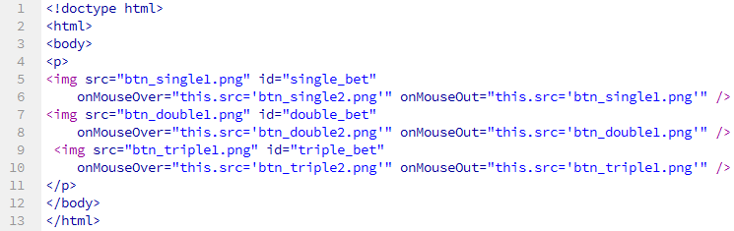

EXAMPLES – Mouse Over (cont.)
Similar to the <img> “single_bet”, create 2 more <img> “double_bet” and “triple_bet” (image files are all given).
1. Modify example.html to include 2 new <img>.
2. Open this file on the web browser to test.

Slide 30

EXAMPLES – Change Cursor Shape
Use CSS to change the shape of your mouse pointer:
#single_bet, #double_bet, #triple_bet { cursor:pointer; }
1. In example.html, insert the above statement between <style> and </style> .
<!doctype html>
<html>
<head>
<style>
#single_bet, #double_bet, #triple_bet { cursor:pointer; }
</style>
</head>
<body>
...
</body>
</html>
2. Open or refresh this file on the web browser to test.

Slide 31
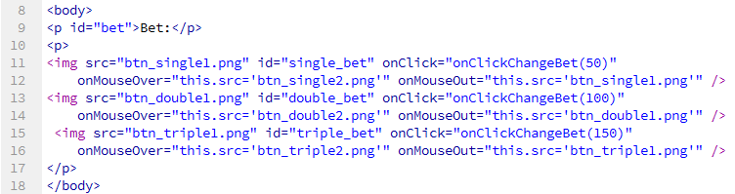
EXAMPLES – Change Values
We want to do such that whenever users click on “sing_bet”, “double_bet” or “triple_bet”, the bet’s value will be displayed 50, 100 or 150.
1. In example.html, insert <p id="bet">Bet:</p> just before the 3 bet buttons.
2. Insert onClick="onClickChangeBet(X)" in each <img> to handle the button’s click; X is 50, 100 or 150.

Slide 32
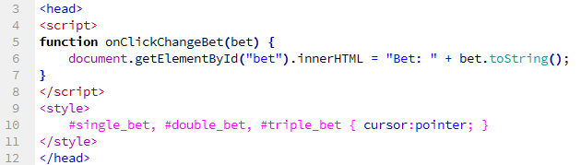
EXAMPLES – Change Values (cont.)
3. Implement onClickChangeBet(bet) as follows:
function onClickChangeBet(bet) {
document.getElementById("bet").innerHTML = "Bet: " + bet.toString();
}
4. put the function between <script> and </script>.

Slide 33
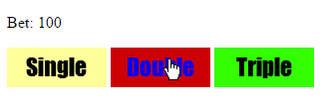
EXAMPLES – Change Values (cont.)
5. Open or refresh on the web browser to test.

Slide 34
JSON
What is JSON?
JavaScript Object Notation
a format for storing and transporting data
used when data is sent from a server to a web page
"self-describing" and easy to understand
JSON format is text → language independent
Alternative to XML
JSON is faster and easier than XML
Common use: read data from a web server, and display the data in a web page

Slide 35
JSON - Syntax
Simple rules
Data is in name/value pairs
"firstName":"John"
Objects contain multiple name/value pairs
{"firstName":"John", "lastName":"Doe"}
Array can contain objects
"employees":[ {"firstName":"John", "lastName":"Doe"}, {"firstName":"Anna", "lastName":"Smith"}, {"firstName":"Peter", "lastName":"Jones"} ]
Notes:
JSON names require double quotes. JavaScript names do not.

Slide 36
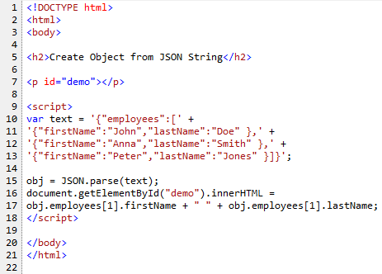
JSON – Convert JSON Array to JavaScript Object
See JSON_example.html, JSON_example2.html
Notes:
JSON names require double quotes. JavaScript names do not.

