Slide 1
𝚫
2h
L
𝚫
2L

Slide 2
r
2h
c
2L

Slide 3
Notes:
Referring to:
Krishnan, Hui, and Long, “Finite Strain Crack Tip Fields in Soft Incompressible Solids”, Langmuir (2008)
Top Left: If we consider the full range of dependence on C1 on stretch according to Figure 3 of paper above
Top Right: Same as top left except the first element (accounting for 8 points) has been removed. Motivated by the uncertainty around the crack tip. Note that the phase field is plotted 5 elements vertically above the center line and 5 elements horizontally past the center point.
Bottom Left: If we consider one value of C1 approximated from Figure 3. This is approximately 1.25 based on the stretch of 1.36 that we have.
Bottom Right: Same as bottom left except the first element (accounting for 8 points) has been removed.

Slide 4
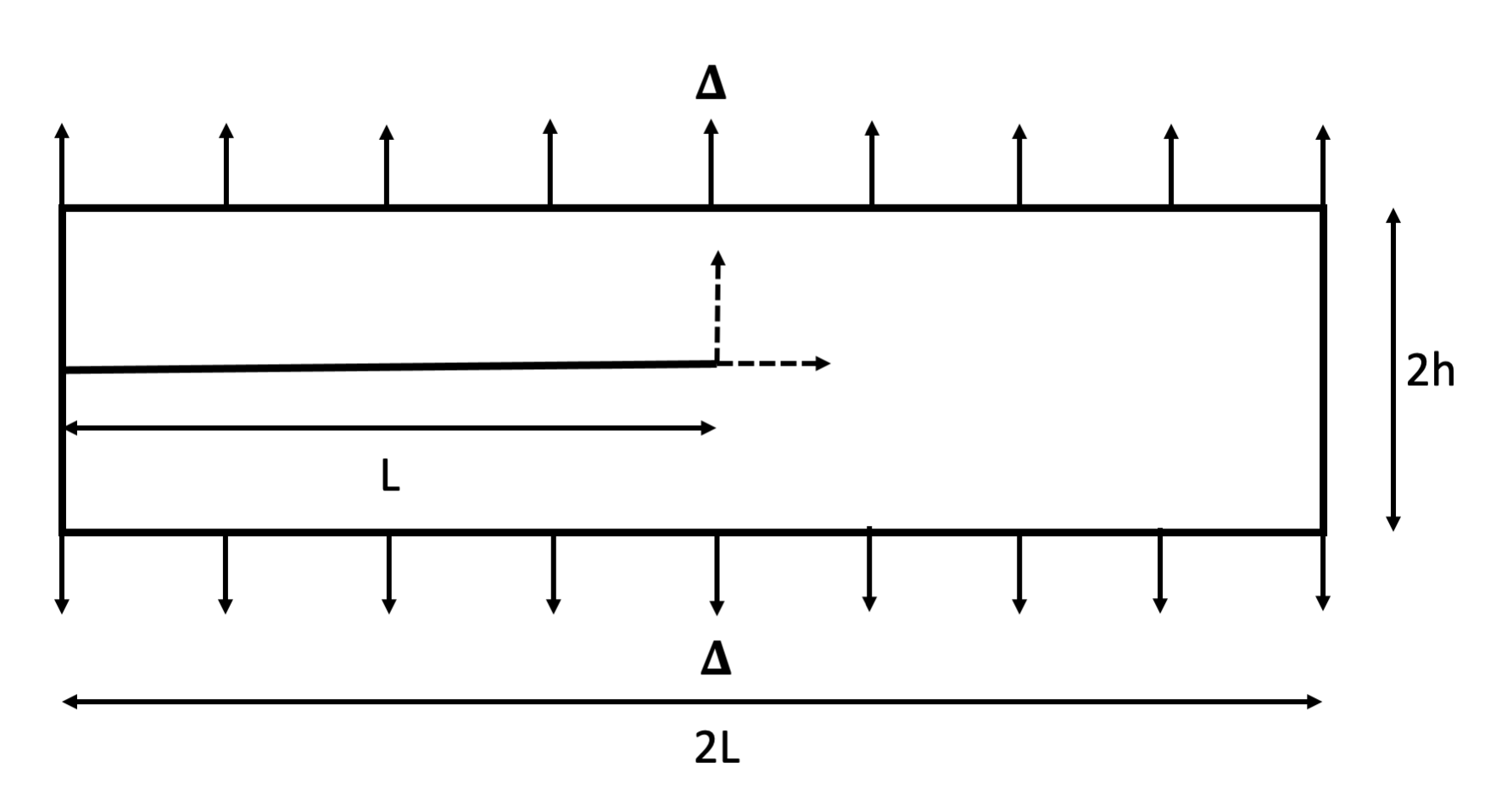
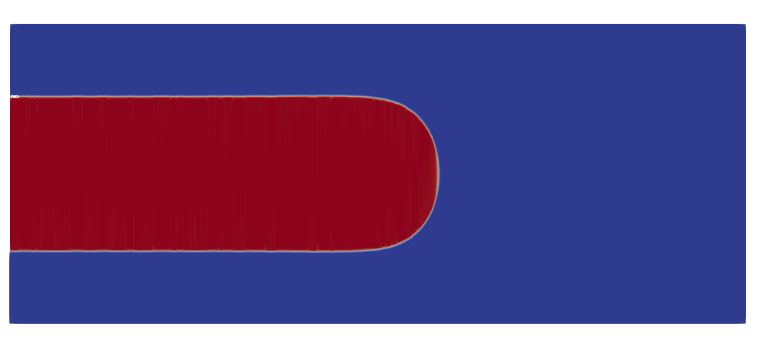
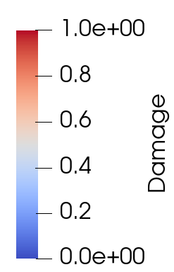
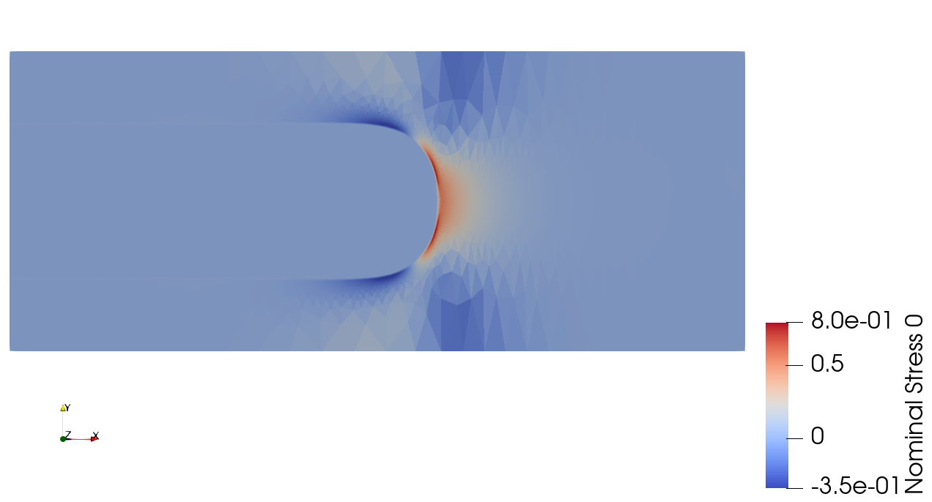
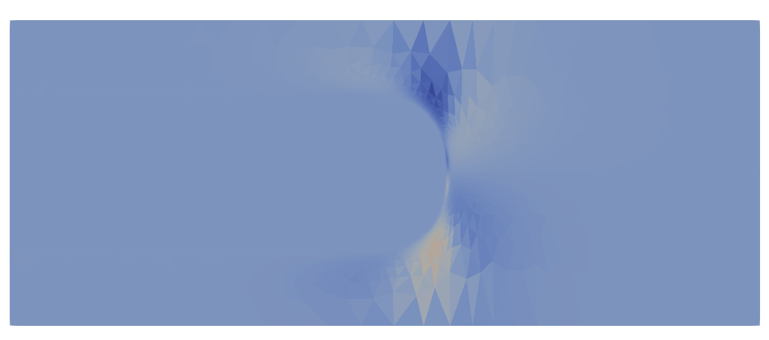
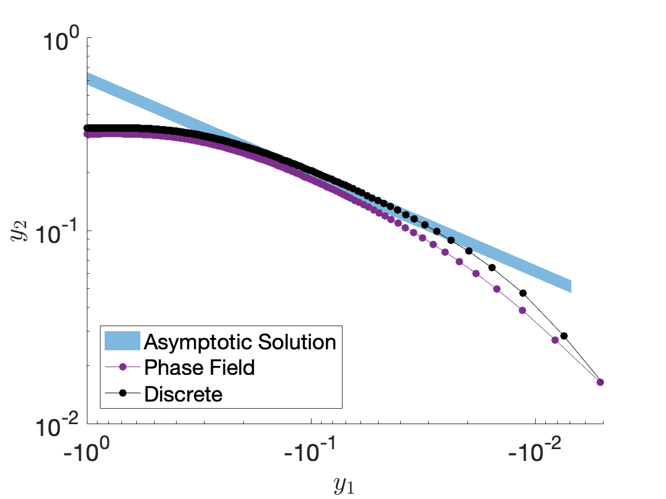
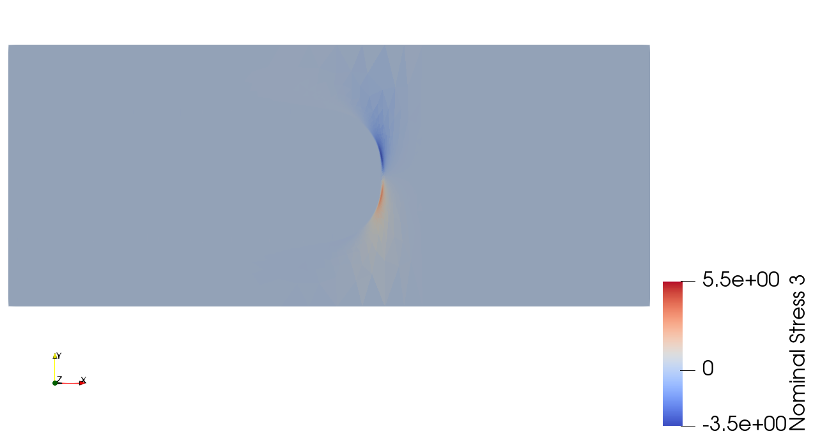
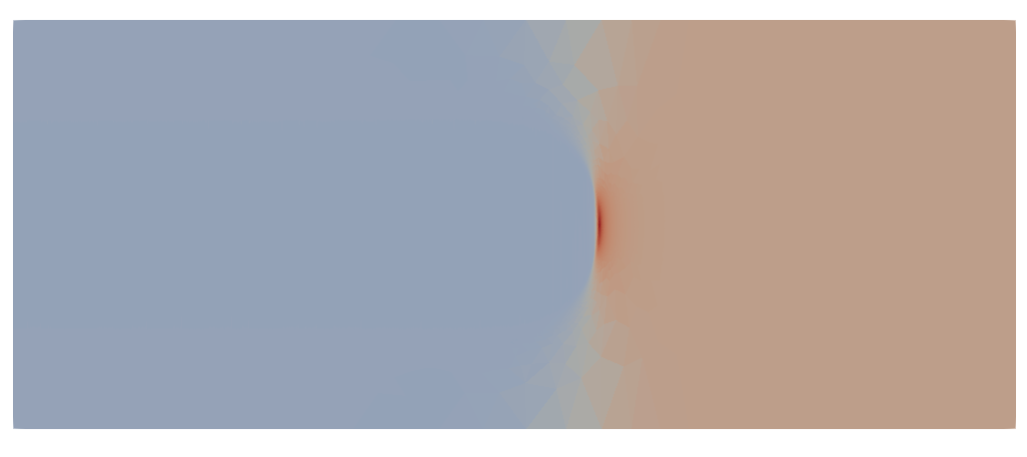
Width of Phase Field

Slide 5
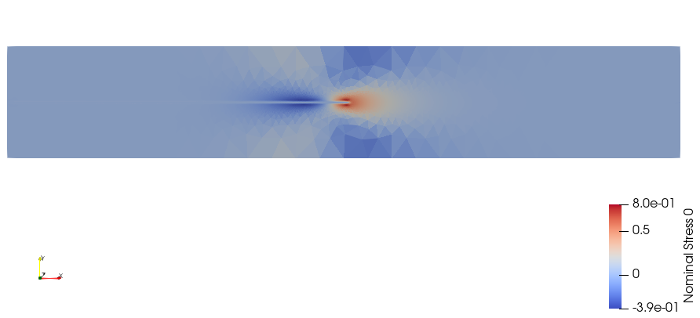
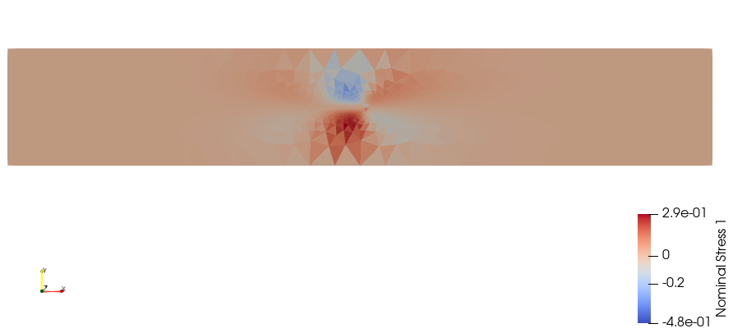
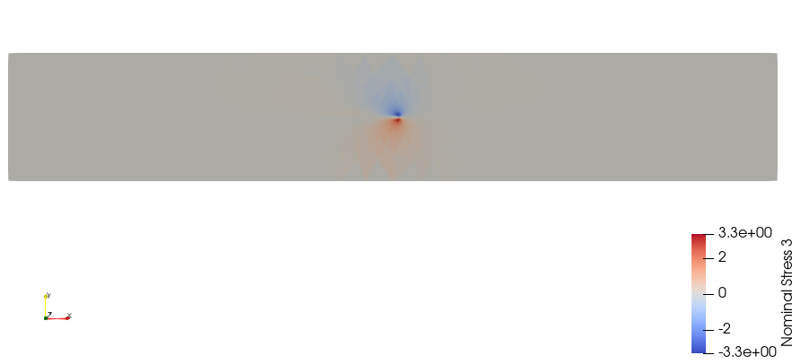
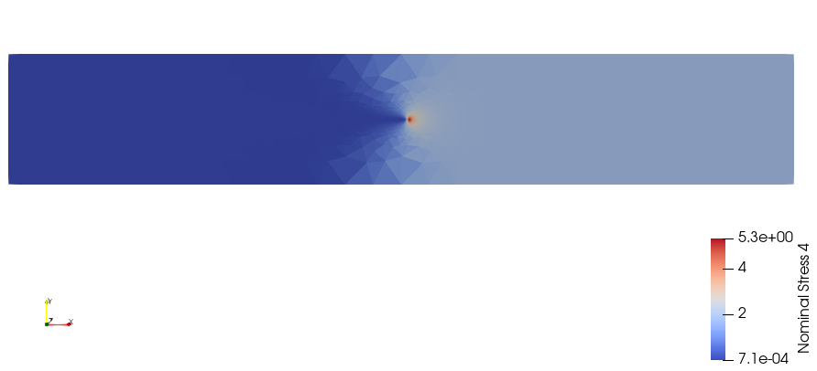
Width of Phase Field

Slide 6
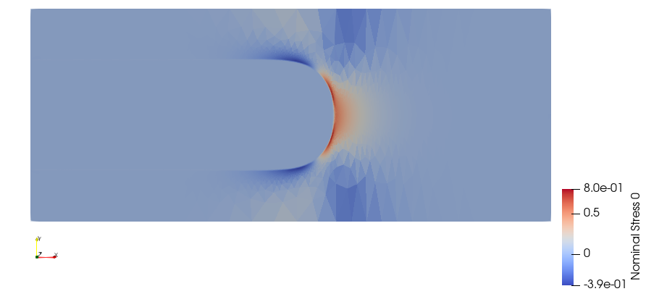
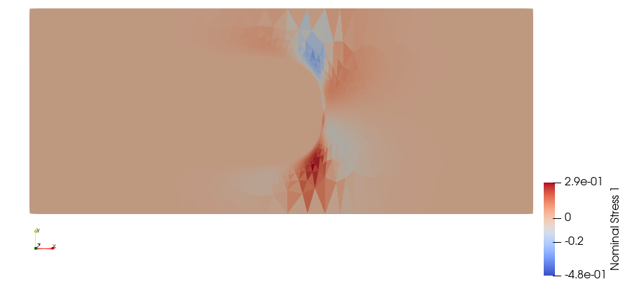
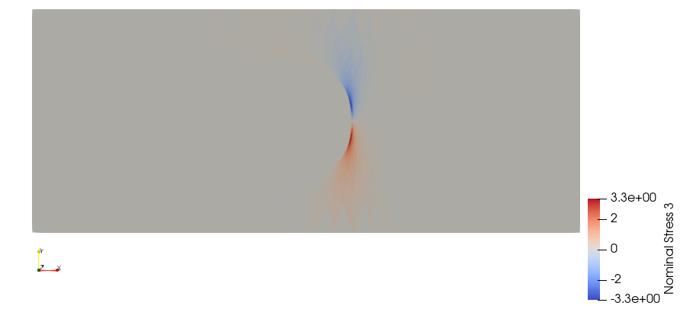
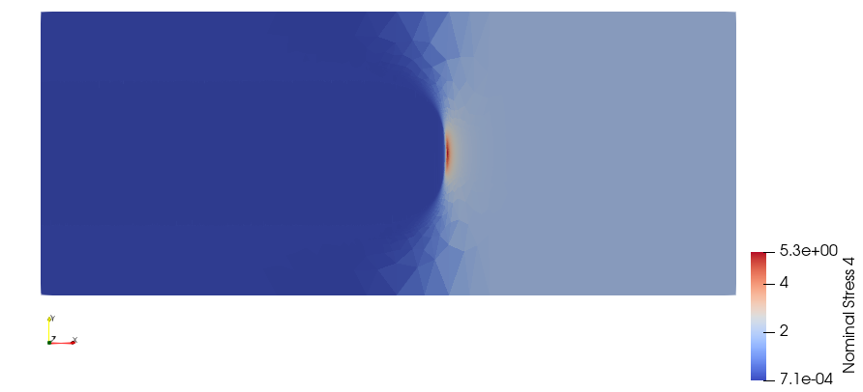
Width of Phase Field

Slide 7






$$x_{2}$$
$$x_{1}$$
Width of Phase Field
a)
b)
c)
$$P_{11}$$
$$P_{12}$$
$$P_{21}$$
$$P_{22}$$
d)

Slide 8
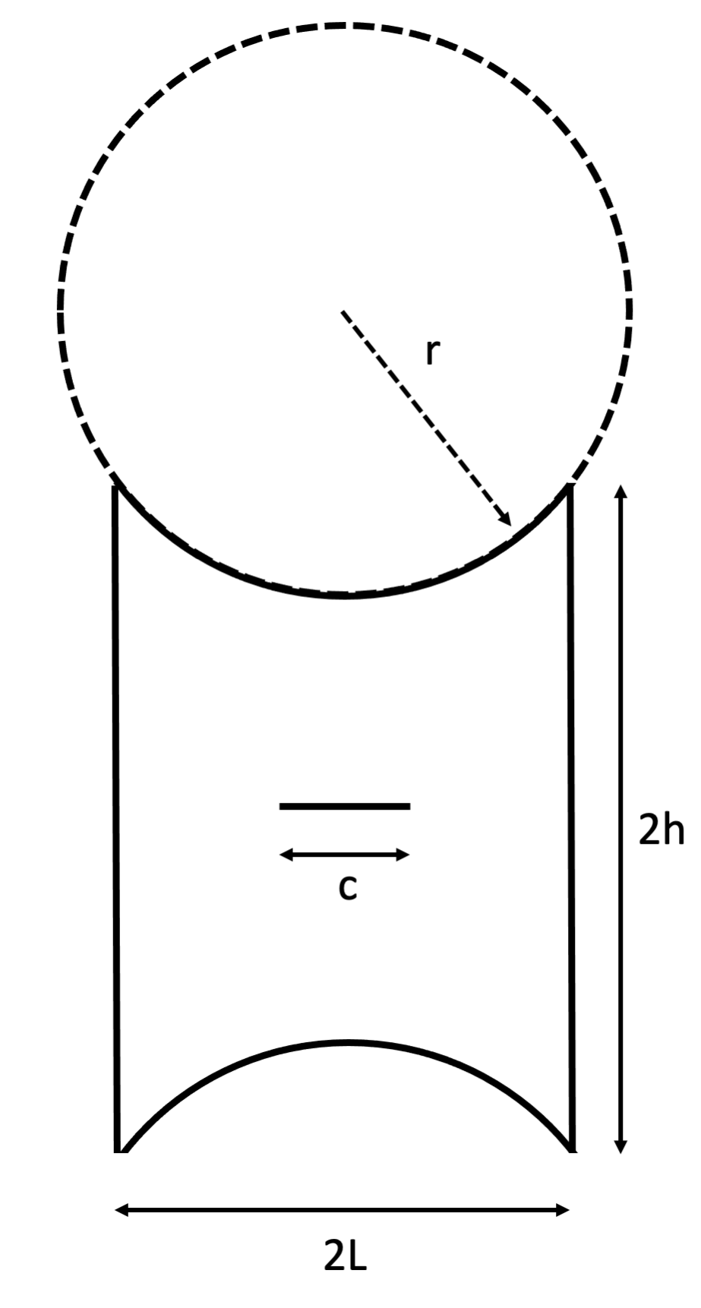
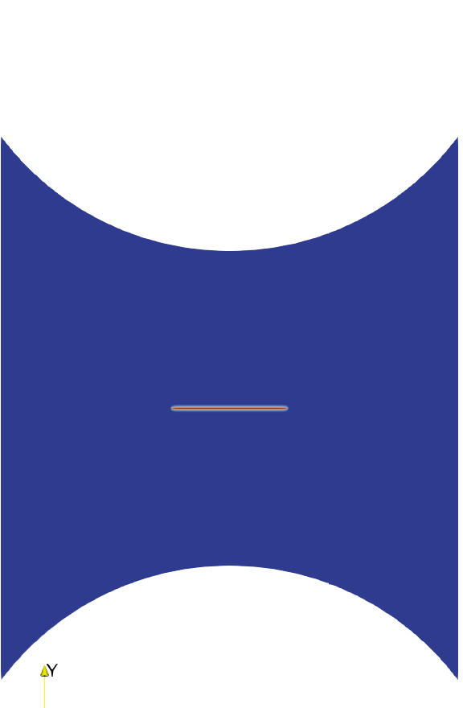
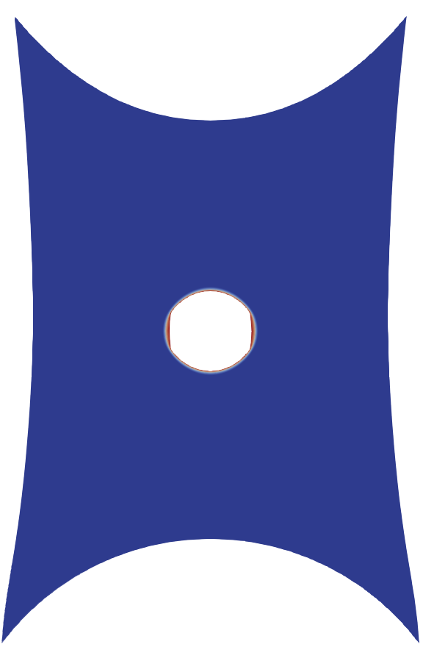
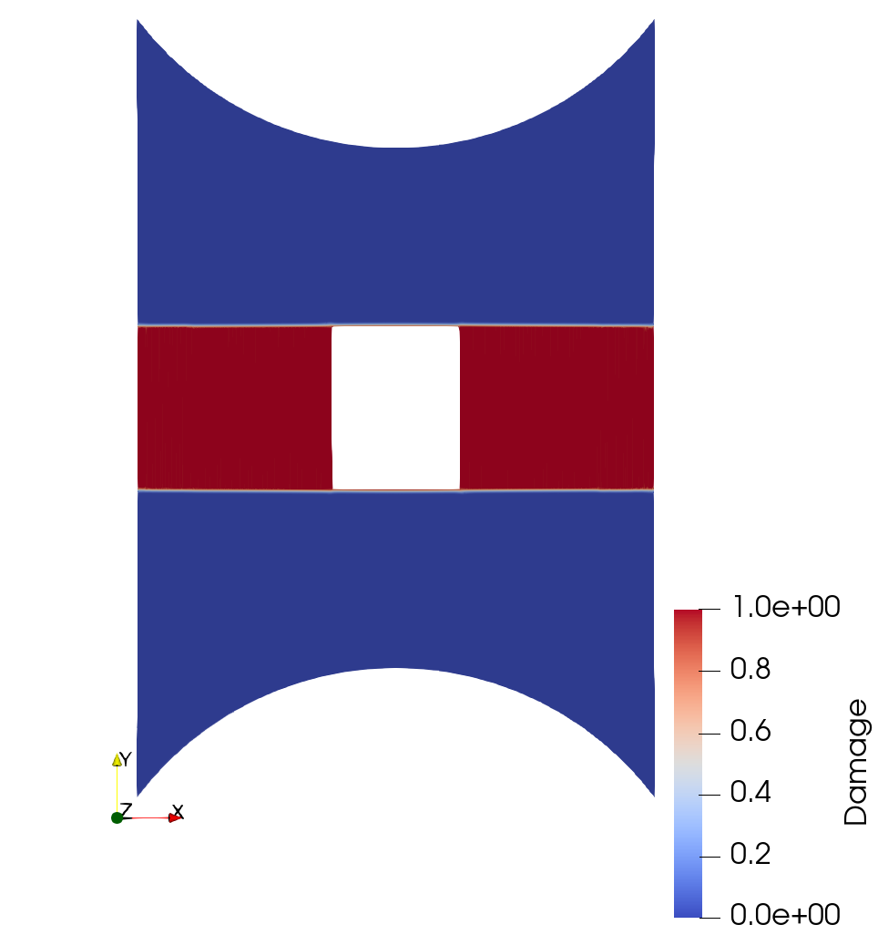
a)
b)
c)

