Slide 1
Natural Language Processing
Lecture 1: Introductions
Ross Deans Kristensen-McLachlan
rdkm@cas.au.dk

Slide 2
Plan for today
Introducing ourselves
Who am I and who are you?
Introducing the course
Course structure, studieordning, exam, etc
Introducing NLP
What is it? And why won’t people shut up about it?

Slide 3
Introducing ourselves
Tell me…
Your name (and any preferred name)
Any experiences you have of NLP (previous research, work experience)
Your main interest in cognitive science
And another interest you have!

Slide 4
Introducing the course
Lectures & classrooms
Exam format
Academic goals
Syllabus

Slide 5
Lectures & classrooms

Slide 6
Lectures & classrooms
Lectures are generally more theoretical and conceptual
How do we understand this model?

Slide 7
Lectures & classrooms
Lectures are generally more theoretical and conceptual
How do we understand this model?
Classrooms are generally more practical and applied
How do we actually implement or use this model?

Slide 8
Lectures & classrooms
Lectures are generally more theoretical and conceptual
How do we understand this model?
Classrooms are generally more practical and applied
How do we actually implement or use this model?
In both cases, the main source of content is GitHub
https://github.com/CHCAA-EDUX/NLP-E21
Brightspace will be kept synchronised

Slide 9
Exam format
The exam is an individual oral exam based on a written synopsis. The duration is 30 minutes including the student’s presentation of the synopsis project, followed by dialogue with the examinators and assessment.
The synopsis can be done as an individual or group assignment. If it is done as a group assignment, the final product must (i) form a coherent text and (ii) be organized so that it is possible to make individual assessments of the students contributing. In other words, the contribution of each individual student to the whole assignment must be clearly delineated (excluding the introduction, conclusion and bibliography).
A maximum of three students can take part in a group assignment. Length of individual synopsis: 4-7 standard pages (not including code and figures) Length of synopsis for 2 students: 8-14 standard (not including code and figures) Length of synopsis for 3 students: 12-21 standard (not including code and figures)

Slide 10
Academic goals
Knowledge:
contrast different natural language processing methods in terms of their strengths and weaknesses in different use contexts
explain how formal analysis of natural language can provide insights into human cognition and behaviour
discuss ethical and philosophical issues connected to natural language processing software and technology.

Slide 11
Academic goals
Skills:
identify relevant data sources for specific research and applied questions
correctly choose and apply tools for analysing natural language data.

Slide 12
Academic goals
Competences:
critically reflect on and discuss theoretical and empirical implications of using natural language processing techniques
justify the choice between relevant methods and analyses used for specific research questions within the field of natural language processing
clear oral presentation of complex analyses.

Slide 13
Syllabus
Week | Session | Lecture | Classroom | Reading
36 | 1 | Introductions | Work stack - Slack, UCloud, Github | --
 | 2 | Simple text processing | Tokenization, word counts, collocation | Hunston 2002, Chapters 1,2 4
 | 3 | From text processing to NLP | Lemmatization, part-of-speech, dependencies | spaCy documentation, Enevoldsen et al 2021
 | 4 | Classification 1 | Logistic regression and vectorization | Jurafsky & Martin 2020, Chapter 5
 | 5 | Classification 2 | Neural networks with pytorch | Nielsen 2019, Chapter 1 (and throughout!)
 | 6 | Word embeddings | Named Entity Recognition | Mikolov et al 2013; Pennington et al 2014
BREAK | BREAK | BREAK | BREAK | BREAK
43 | 7 | Language Modelling 1 | Recurrent Neural Networks, Long short-term memory networks | Urban & Gates 2020
 | 8 | Language Modelling 2 | Attention | Vaswani et al 2017; Lindsay et al 2020
 | 9 | BERT | Implementing (parts of) BERT | Devlin et al 2019
 | 10 | Project presentations | Implementing (parts of) BERT | Ettinger 2020; Rogers et al 2020
 | 11 | More BERT | Exploring layers | Coenen et al 2019
 | 12 | Data bias and ethics | Augmentation and data bias | van Miltenburg et al 2021

Slide 14
Break

Slide 15
Any questions?

Slide 16
Introducing NLP

Slide 17
Introducing NLP
The pre-history NLP
NLP and cognitive science(s)
What are we actually doing here?

Slide 18
The pre-history of NLP
Weaver’s memorandum (1949)
Chomsky’s Syntactic Structures (1957)
The first AI winter (Late 1970s)
Statistical models (Late 80s-Early 90s)

Slide 19
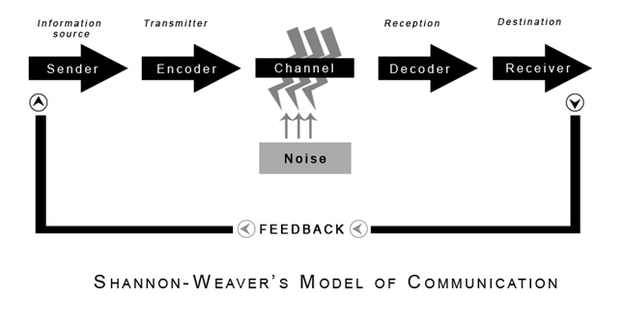
Weaver’s Memorandum (1949)
Weaver was a pioneer in information science
Along with Claude Shannon, he gives his name to the Shannon-Weaver model of communication
In the late 40s, Weaver suggested that computers could be used for automated natural language translation
In this short paper, Weaver made four proposals

Slide 20
Four proposals
1. Words can be disambiguated from context
2. Translation could be address as a problem of formal logic
3. Methods from cryptography could be useful for machine translation
4. Linguistic universals exist and these can be exploited to make translation simpler

Slide 21
Some problems
Perhaps unsurprisingly, this wasn’t terribly successful
It was cumbersome and time consuming to perform and the results were often nonsensical
Lexical and grammatical ambiguities in natural language weren’t taken into account
One of the main problems with early experiments was that they lacked an adequate theory of language

Slide 22
Chomsky’s Syntactic Structures (1957)

Slide 23
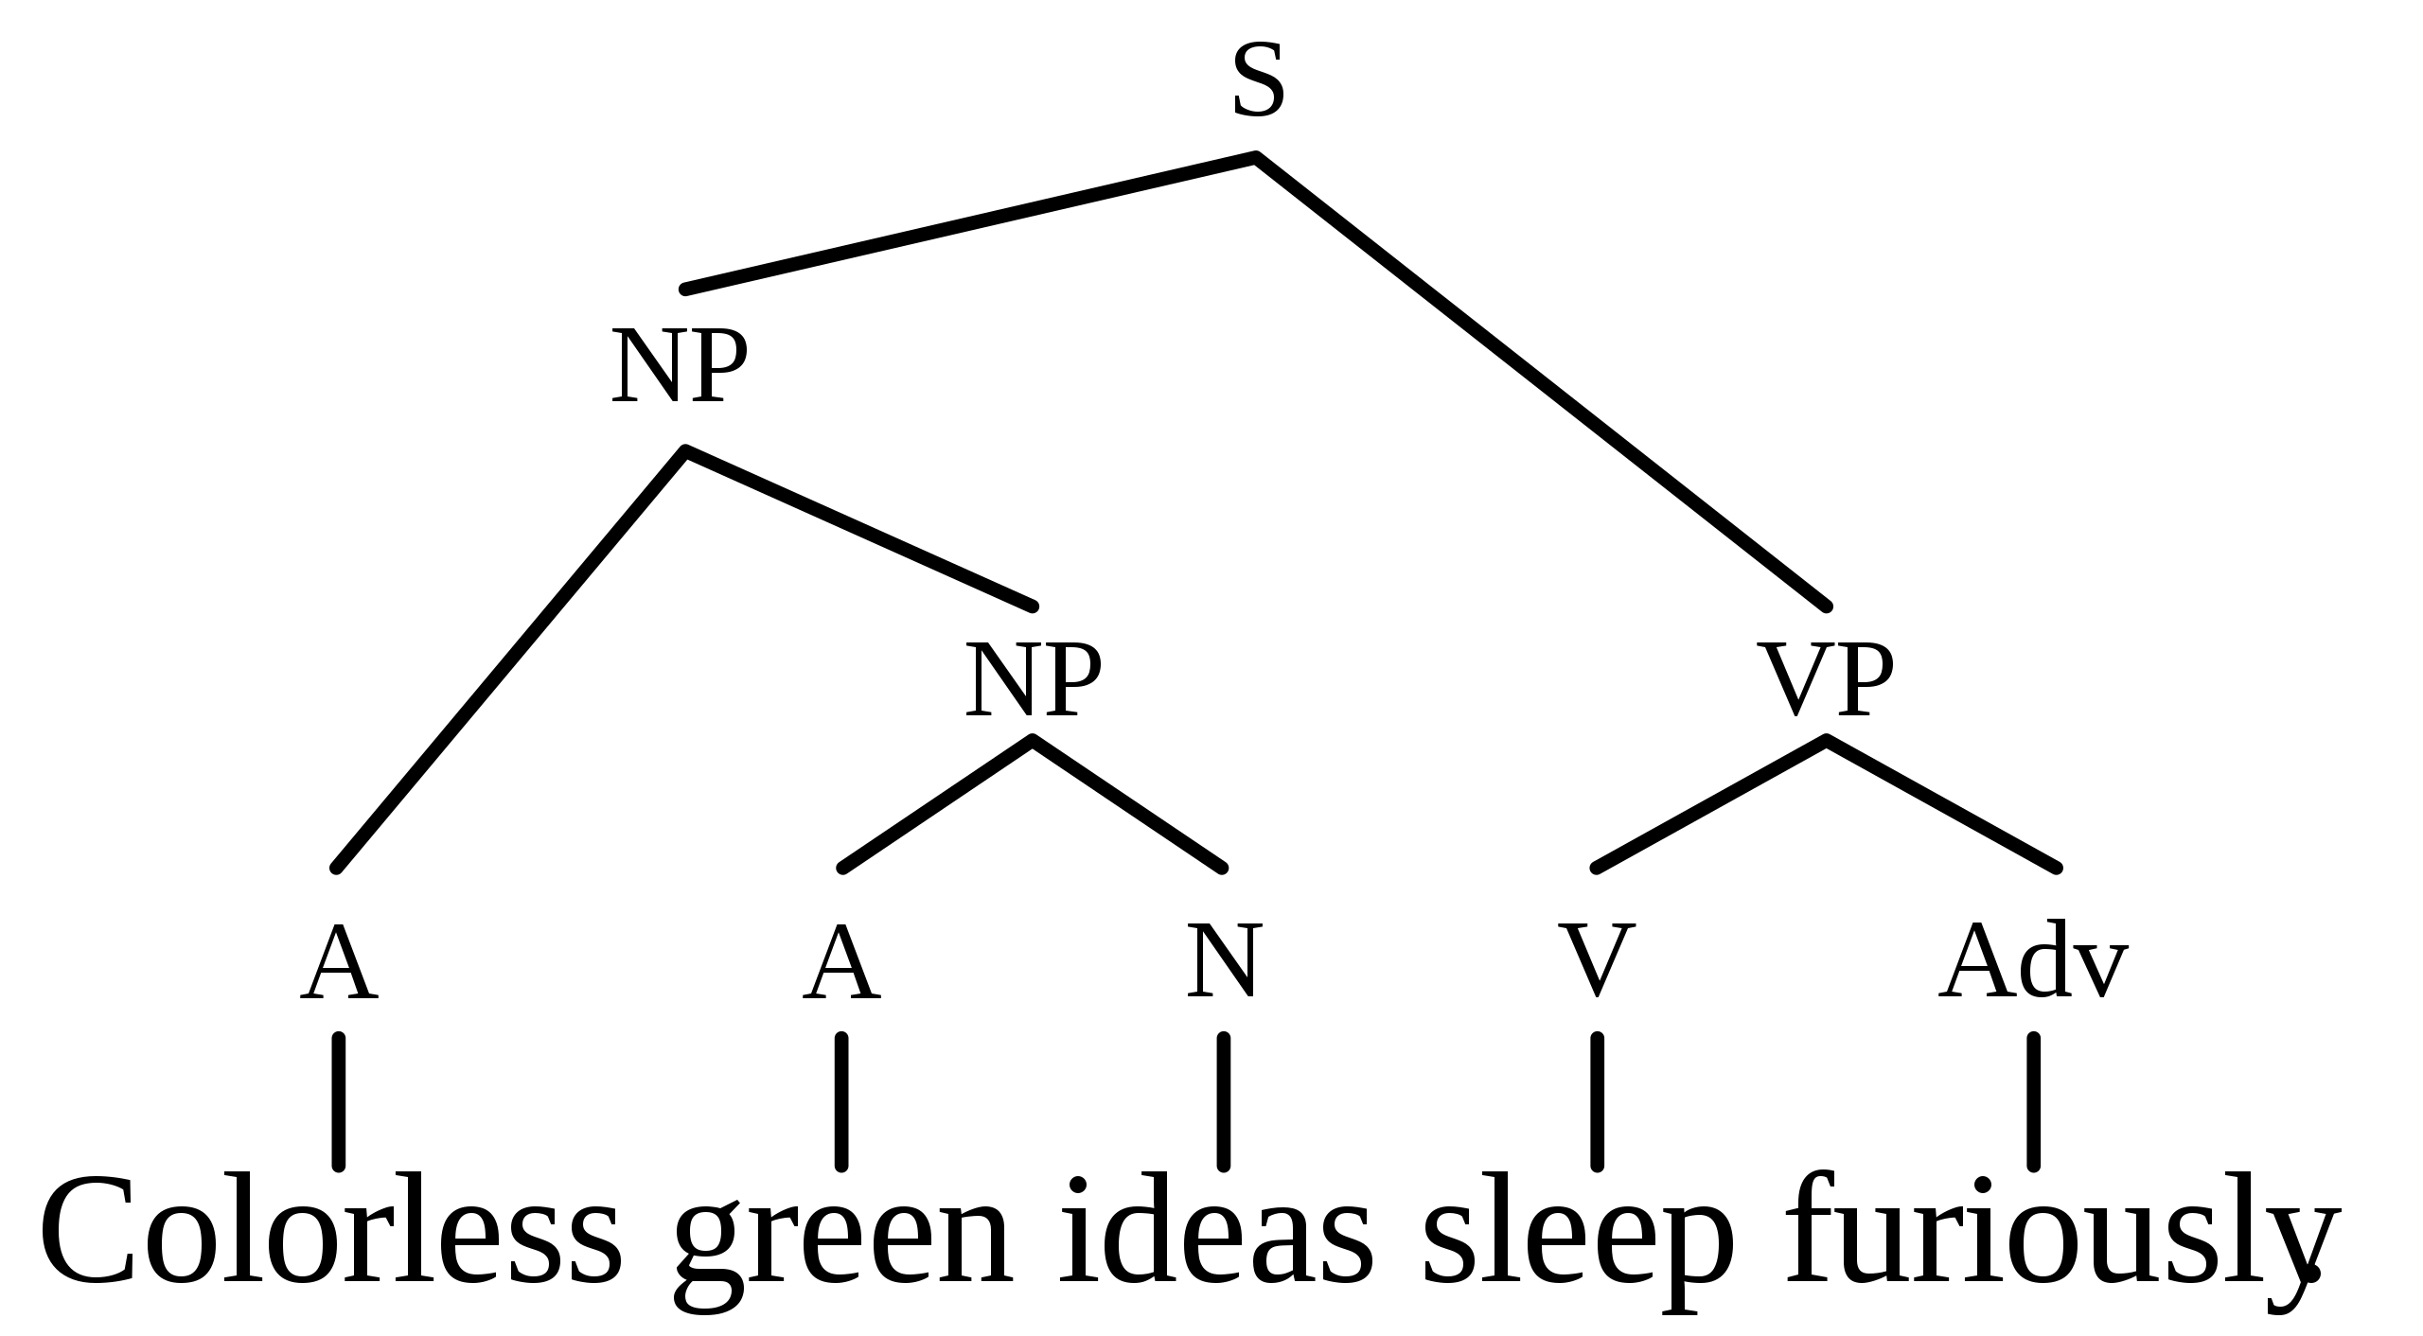
Chomsky’s Syntactic Structures (1957)
Chomsky argued that grammar was essentially a system of rules
These rules generate exactly all possible combinations of any grammatical sentences in any given language
The task of linguistics was to uncover and formalise this system of rules for any given language (and for Language generally)
For this to be the case, Chomsky assumes…

Slide 24
Chomsky’s Syntactic Structures (1957)
1. A grammatical sentence need not be included in any existing corpus
2. It need not be semantically meaningful
3. It does not need to be statistically likely

Slide 25
Chomsky’s Syntactic Structures (1957)
“Despite the undeniable interest and importance of semantic and statistical studies of language, they appear to have no direct relevance to the problem of determining or characterizing the set of grammatical utterances. I think we are forced to conclude that grammar is autonomous and independent of meaning, and that probabilistic models give no particular insight into some of the basic problems of syntactic structure”
Chomsky (1957:17)

Slide 26
The First AI winter (1970s-ish)
Chomsky insisted that grammar and semantics were separate. The goal of linguistics should be to model grammar
Naturally, this resulted in a huge effort to computationally represent meaning. Many argued that Chomsky was too syntactic
Around the same time, Minksy & Papert (1969) wrote what was - at the time - considered a crushing blow to the connectionist paradigm in AI (i.e. neural nets)
It’s difficult to summarise everything that went on in this period but a good example is Schank & Abelson’s (1977) Script Theory

Slide 27
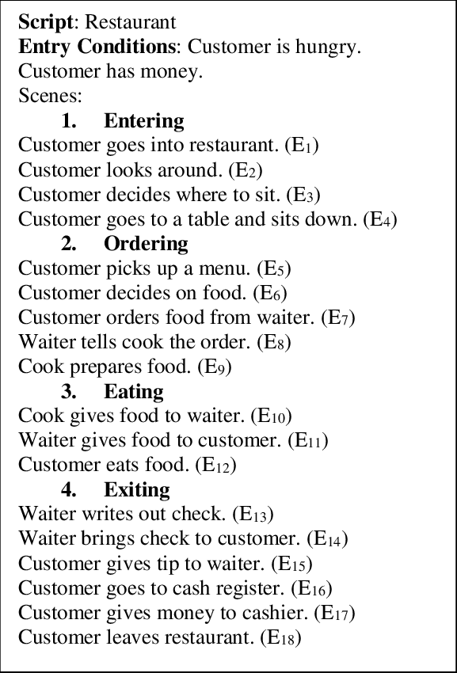
Schank & Abelson (1977)
Schank & Abelson (and others) began to develop a cognitive psychological theory based around the notion of scripts
Scripts are structured, organised representation of a stereotyped sequence of events
These structure scripts allow AI to understand aspects of language which go beyond syntactic processing and approach the level of discourse
Scenario mapping theory, Sanford & Garrod (1981);
Mental models, Johnson-Laird (1983);
Rhetorical processing framework, Sanford & Emmott (2012)

Slide 28
Statistical models (Late 80s, early 90s)
Scripts/schemata/scenarios/frames are (usually) context specific

Slide 29
Statistical models (Late 80s, early 90s)
Scripts/schemata/scenarios/frames are (usually) context specific
From an AI or NLP perspective, this means we need to have some kind of representation of every possible context we are likely to encounter

Slide 30
Statistical models (Late 80s, early 90s)
Scripts/schemata/scenarios/frames are (usually) context specific
From an AI or NLP perspective, this means we need to have some kind of representation of every possible context we are likely to encounter
From an engineering perspective, computers should learn from language data, rather than us hand-coding knowledge representations ahead of time

Slide 31
Statistical models (Late 80s, early 90s)
“Rather than starting off by dividing sentences into grammatical and ungrammatical ones, we instead ask, What are the common patterns that occur in language use? […] While practical utility is something different from the validity of a theory, the usefulness of statistical models of language tends to confirm that there is something right about the basic approach”
Manning & Schütze (1999:4)

Slide 32
NLP and cognitive science(s)

Slide 33
NLP and cognitive science(s)
It’s… complicated

Slide 34
NLP and cognitive science(s)
It’s… complicated
NLP does not strictly commit to any cognitive theory
Broadly speaking ‘connectionist’. But what does that mean?

Slide 35
NLP and cognitive science(s)
It’s… complicated
NLP does not strictly commit to any cognitive theory
Broadly speaking ‘connectionist’. But what does that mean?
Neither NLP or cognitive science are monolithic practices

Slide 36
NLP and cognitive science(s)
It’s… complicated
NLP does not strictly commit to any cognitive theory
Broadly speaking ‘connectionist’. But what does that mean?
Neither NLP or cognitive science are monolithic practices
NLP and computational linguistics share a similar domain but different goals
Think of the physicist vs the engineer

Slide 37
So what are we doing here?

Slide 38
So what are we doing here?
Well, we’re doing natural language processing!

Slide 39
So what are we doing here?
Well, we’re doing natural language processing!
We’ll primarily be working in the dominant paradigm of deep learning and neural language models

Slide 40
So what are we doing here?
Well, we’re doing natural language processing!
We’ll primarily be working in the dominant paradigm of deep learning and neural language models
We’ll be learning how to build these models from scratch and how can we fine tune these models for specific purposes

Slide 41
Questions?

Slide 42
Bibliography
Chomsky, N. (1957). Syntactic Structures. The Hague: Mouton de Gruyter.
Johnson-Laird, P.N. (1983). Mental Models. Cambridge: Cambridge University Press.
Manning, C.D. & Schütze, H. (1999). Foundations of Statistical Natural language Processing. Cambridge, MA: MIT Press.
Minksy, M. & Papert, S. (1969). Perceptrons. Cambridge, MA: MIT Press.
Sanford, A.J. & Emmott, C. (2012). Mind, Brain and Narrative. Cambridge: Cambridge University Press.
Sanford, A. & Garrod, S.C. (1981). Understanding Written Language: Explorations in Comprehension Beyond the Sentence. Chichester: John Wiley & Sons.
Schank, R.C. & Abelson, R.P. (1977). Scripts, Plans, Goals, and Understanding: An Inquiry into Human Knowledge Structures. Hillsdale, NJ: Psychology Press.
Weaver, W. (1949). ‘Translation’, Reproduced in: Locke, W.N.; Booth, D.A., eds. (1955), Machine Translation of Languages. Cambridge, MA: MIT Press, 15–23.

