Slide 1
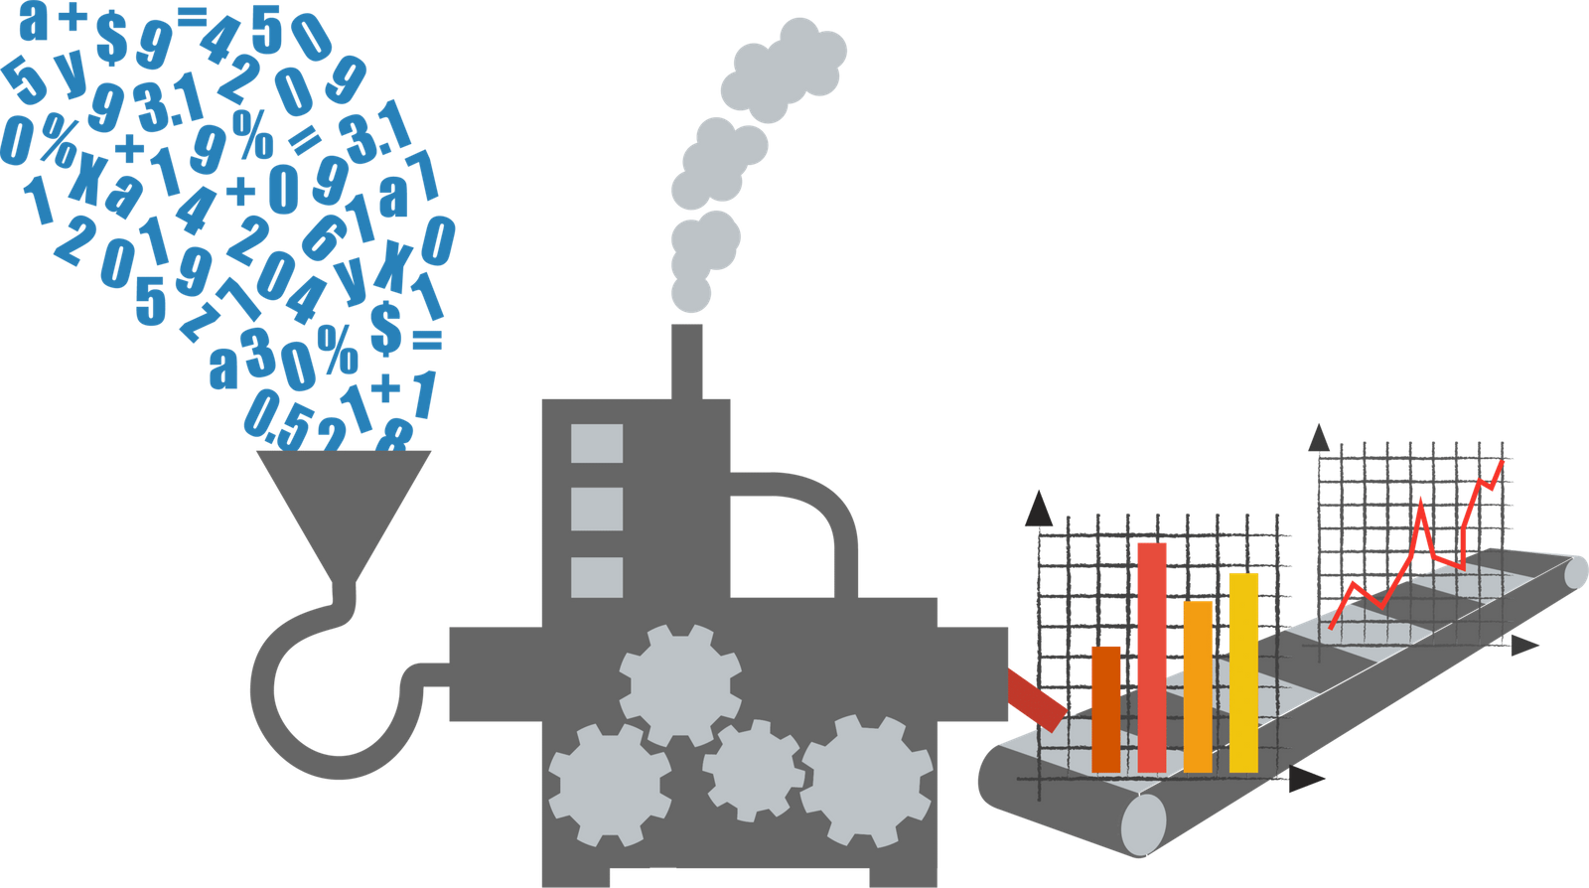

SENSOR
EMBEDDINGS TO
IMPROVE RECOGNITION
Jagdishkumar Katariya
Justin Kim
Theo Medeiros
Ryan Moye
Notes:
Type your notes

Slide 2




Data Understanding
Human Activity Recognition (HAR)
We are using the Human Activity Recognition (HAR) Dataset.
1
2
This dataset consists of 561 variables and 7351 observations
HAR Dataset
3
The data is separated into a test and train file which contains the x, y, and z accelerometer and gyroscope data.
4
Some of the movements include Standing, Walking, Walking upstairs, Walking downstairs, Laying, and Sitting.
5
The movements were collected using an android smartphone and used its accelerometer/gyroscope data to gather the test and train data.
Notes:
Type your notes

Slide 3
Dimensionality Reduction
PCA | Autoencoders
Convert the correlations of multiple datasets into a 2d graph | Autoencoders are divided into two parts, an encoder and a decoder.
Takes in multiple cells of data and translate it into a coordinate plane where the axis labels the principal components | The encoder takes an input of size n and reduces it to size m, where m <= n.
Visually see each color coded cells and determine its relation to each other. | The decoder reconstructs the data into the original n-space and then checked for accuracy.
Notes:
Type your notes

Slide 4
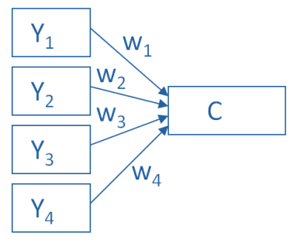
Dimensionality Reduction (PCA)
Notes:
Type your notes

Slide 5
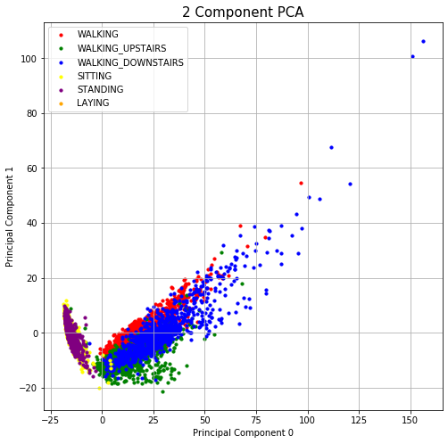
Dimensionality Reduction (PCA)
Notes:
Type your notes

Slide 6
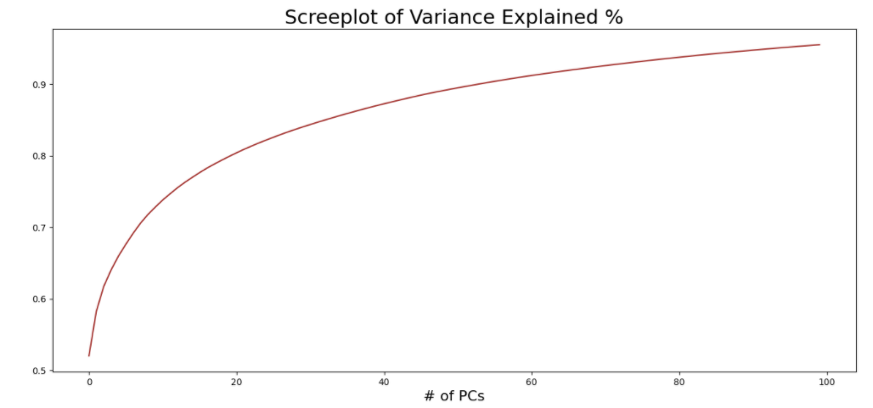
Dimensionality Reduction (PCA)
Notes:
Type your notes

Slide 7
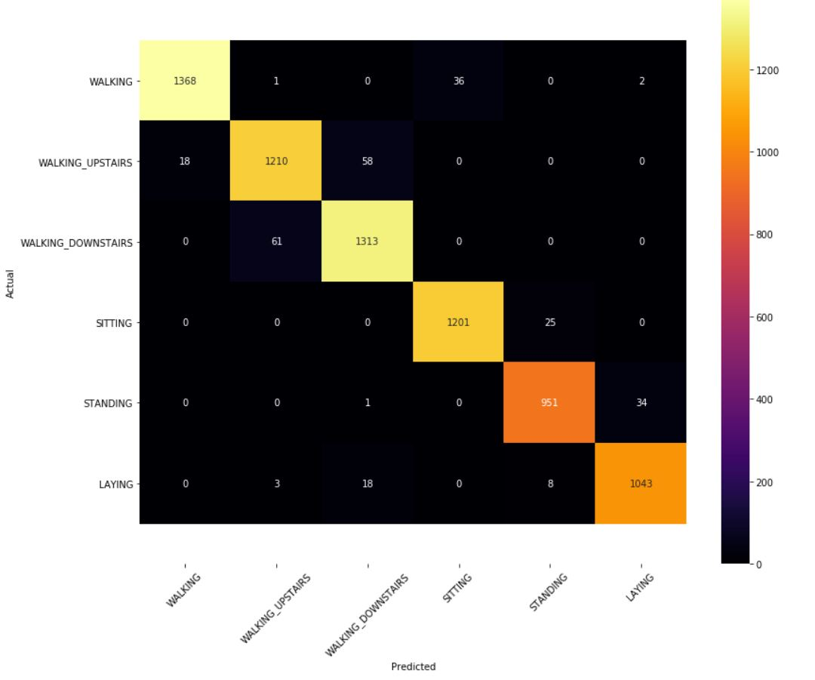
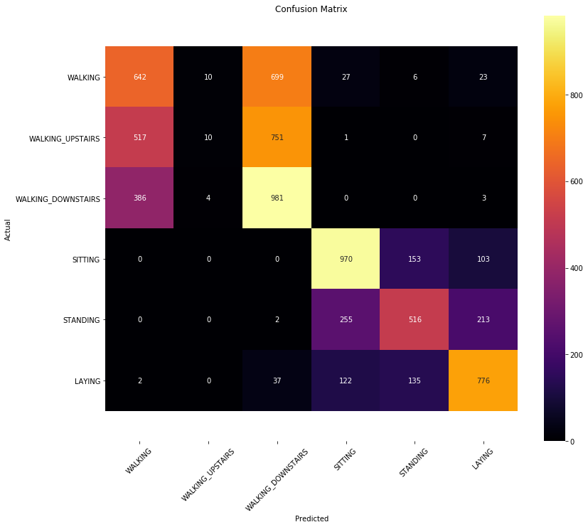
Confusion Matrix (PCA)
Confusion matrix for 2 components
Confusion matrix for 100 components
Notes:
Type your notes

Slide 8
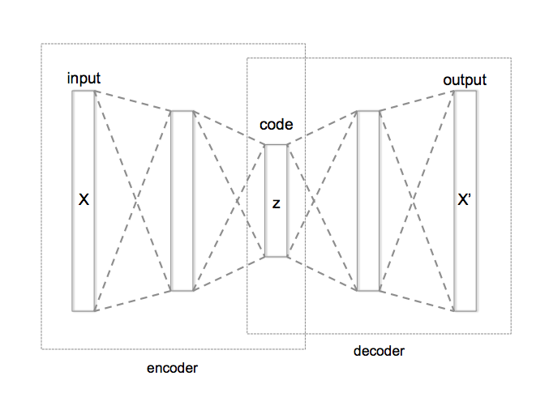
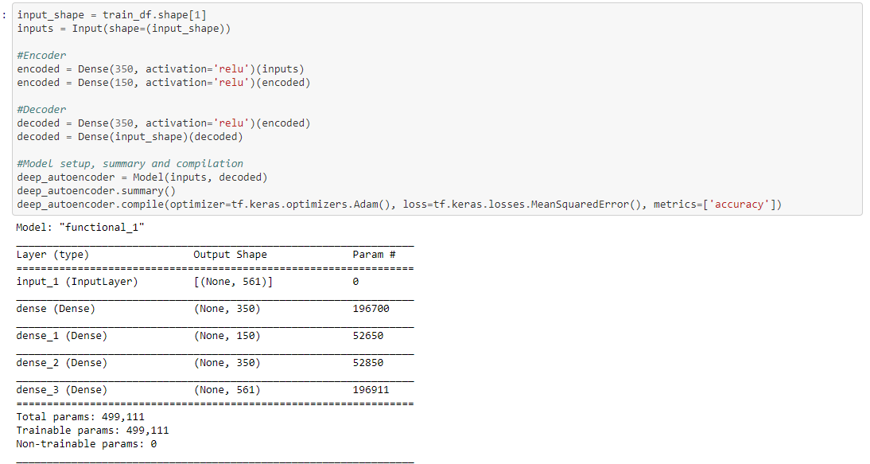
Example of an Autoencoder Model
Autoencoder Representation
Autoencoder to test Har Dataset

Slide 9
Predicted Outcome of the Autoencoder
PCA is linear and therefore not always capable of representing the data
Autoencoder is typically non-linear and therefore better at representing the data
We predicted that the autoencoder would have a higher explained variance compared to the PCA implementation with the same latent dimensions

Slide 10
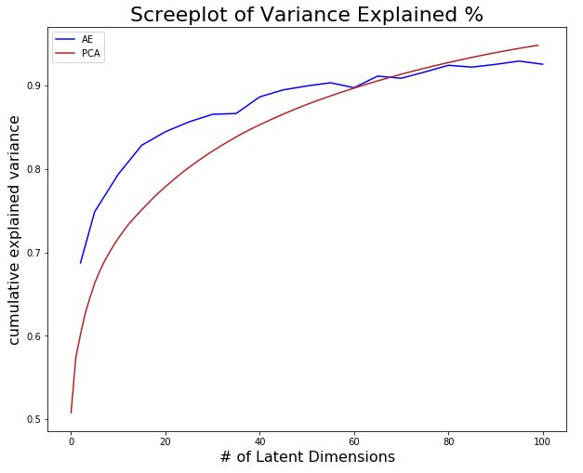
Variance Explained: PCA vs Autoencoder

Slide 11
Future Steps for the Project
Application of the PCA and Autoencoder model to a larger dataset with more activities represented
Reframing window sizes
Use the reduced representations for classification
Tuning the autoencoder

