Slide 1
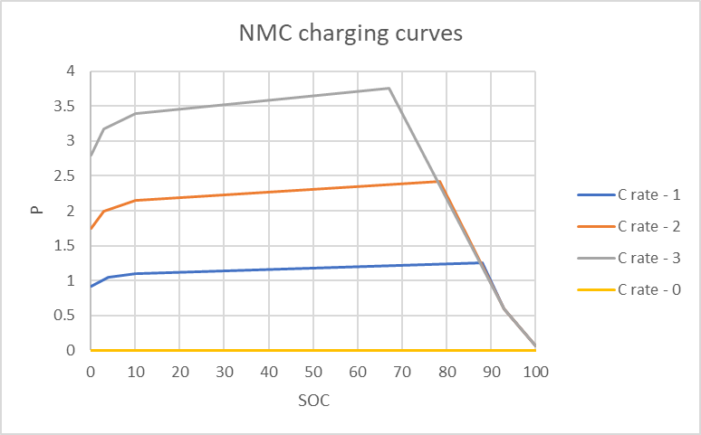
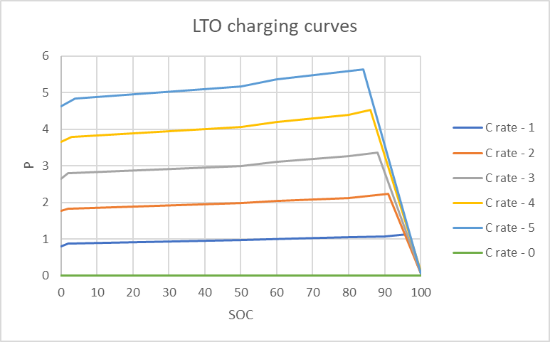
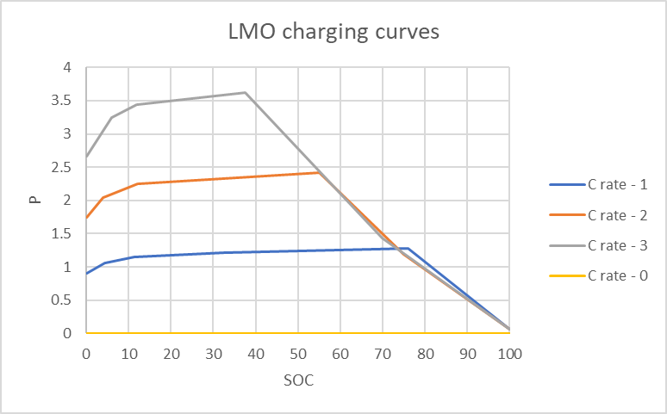

Slide 2
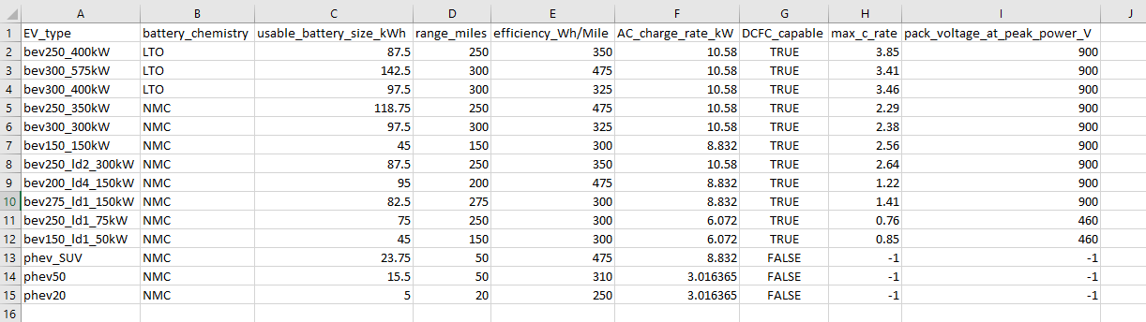
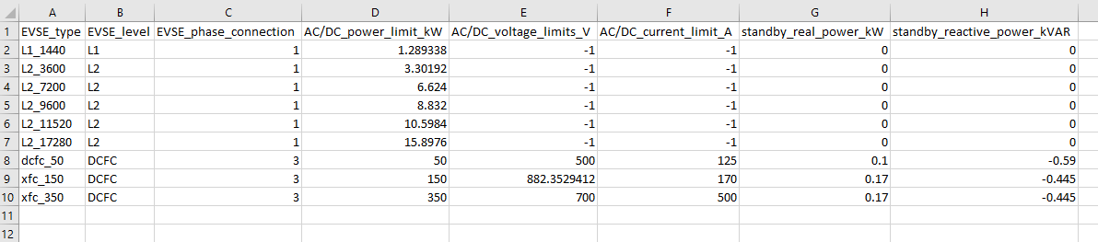

Slide 3
Battery size in Amp hours for 1C is computed for EV
Find equivalent W per Whr in charging curves for given c-rate
Multiply by battery size(kWh) to get peak power.
Divide by pack voltage at peak power and max crate to get Amp hours at 1C
E.g.
Battery chemm = NMC, battery size = 100kWh, Max crate = 2.5, voltage at peak power = 900 V
Equivalent max W per Whr from the charging curves for 2.5 C is 3.088
2.42 + (3.75 – 2.42)/2 = 3.088
Peak power (P) = 3.088 * 100 = 308.8 kW
Bat size in Ah (1C) = P/V*max C-rate = 308.8*1000/ 900*2.5 = 137.2 Ah

Slide 4
Build Soc vs P2 curves are created for each EV – EVSE combination
For L2, L2 charge power e.g. 11 KW, SOC at which power goes back to 0 is interpolated between final 2 soc points in the 1C charging curve.
For XFC,
EV current limit is computed, EV c-rate * battery capacity (Ah) at 1 C
EVSE current limit is provided in the input file
Min of the 2 current limits are chosen.
Find where the current limit falls between the charging curves and interpolate between those 2 curves.
Multiply by battery size to get SOC vs Power profile

Slide 5
Similarly, we have other inputs,
Power vs inverter efficiency for different EVSE levels (L1, L2, DCFC)
Pu Voltage vs pu Power
Power vs battery efficiency
Charging transitions (delay, ramping, etc)
Off to Positive
Positive to off
Moving towards positive
Moving towards negative

