Slide 1

HERON Workshop Examples
A case-by-case training in running HERON
INL/MIS-22-65661

Slide 2
Learning by Example
HERON cases from basic to complex
Exercises, follow-alongs
Examples found in HERON/tests/workshop/
This case can be found in workshop/simple/

Slide 3
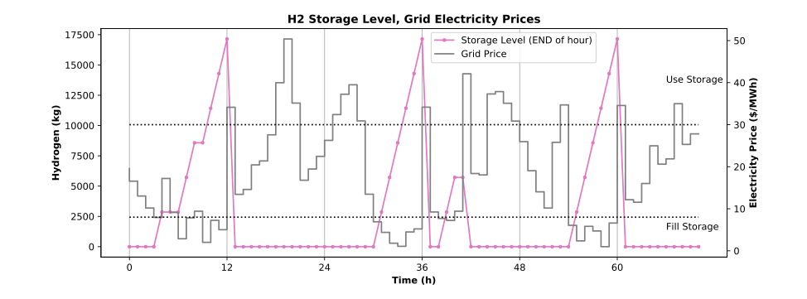
HERON Calculation Flow
HERON:
Workflow Writer
RAVEN Outer
RAVEN Inner
Ensemble:
DispatchManager
Sample
SynthHist
Loop Structure
Portfolio
Sample
Sample
Optimize Capacity
Sample
Sample
Dispatch
Optimize Dispatch
Technology
Characteristics
E[NPV]
Postprocess
TEAL
DispatchManager
For each year …
For each cluster …
… optimize dispatch
Optimization Window
Time History

Slide 4
Example 1
As Simple As They Come

Slide 5




Starter Case
Components
NGCC (natural gas electricity generator)
Import (imports electricity from external)
Grid (demand to be met)
Objective
How big should the NGCC be built to minimize costs?

Slide 6
Starter Case
Guiding Physics/Economics (Drivers)
Grid
fixed demand to be met
NGCC
Capital cost for sizing
Variable cost for dispatching
Import
Variable cost (expensive!) for providing electricity

Slide 7



Translating to HERON
See HERON/tests/workshop/simple/heron_input.xml
Case
Global information about the problem
Time shape, discount rates, solvers, etc.
Components
Technical and economic properties of each component
Produces and Demands
Dispatch: Independent and Fixed
DataGenerators
Synthetic History Data Source

Slide 8
Component by Component
Grid
Technical Specs
Action | Demands electricity
Flexibility | Fixed (must meet demand)
Capacity | From synthetic time series (trained separately)
Economics
None | System is regulated market; minimize cost to meet demand, so there is no sales profit at the grid

Slide 9
Component by Component
NGCC
Technical Specs
Action | Produces electricity
Flexibility | Independent (0 to [Capacity] each hour)
Capacity | Variable from 10 to 60 GW (note: units not included)
Economics
Capex | Overnight cost of building component per GW installed
Variable O&M | Operation and fuel costs per GWh produced
Notes:
Talk about ValuedParams, Fixed Value
Depreciation, DiscountRate
resource conventions

Slide 10
Component by Component
Import
Technical Specs
Action | Produces electricity
Flexibility | Independent (0 to [Capacity] each hour)
Capacity | Large number (infinite source)
Economics
Variable O&M | Operation costs per GWh imported

Slide 11

Consider the Case
Why Import?
Why not just have NGCC?
If NGCC not enough to meet demand, solve “fails”
This doesn’t provide useful feedback to optimizer; it doesn’t know what’s wrong
Instead, provide large incentive to meet demand with NGCC
Example:
GW
Demand
Import
NGCC

Slide 12
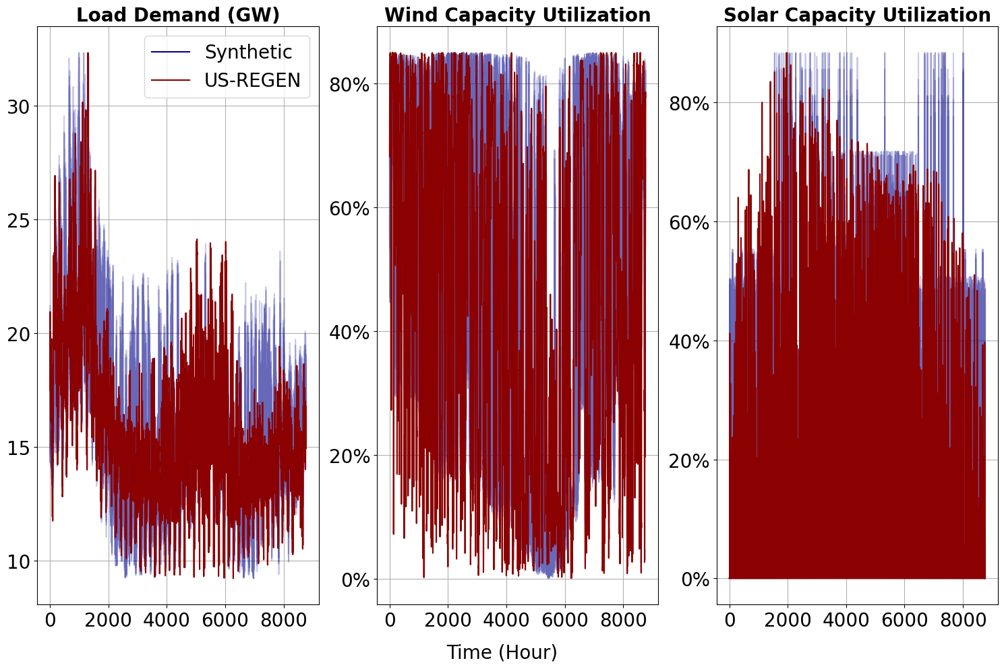
Demand
Stochastically Trained
Based on NYISO projections from EPRI
See INL/EXT-21-65473,
“A Technical and Economic Assessment of LWR Flexible Operation for Generation/Demand Balancing to Optimize Plant Revenue”, Dec 2021

Slide 13
Running the Case
Sweeping over 6 build sizes
~90 seconds, results may vary by OS, machine
Things to look at (see following slides):
Screen Output
1_simple_o/sweep.csv (spreadsheet) progress
> /path/to/heron heron_input.xml
> /path/to/raven_framework outer.xml

Slide 14
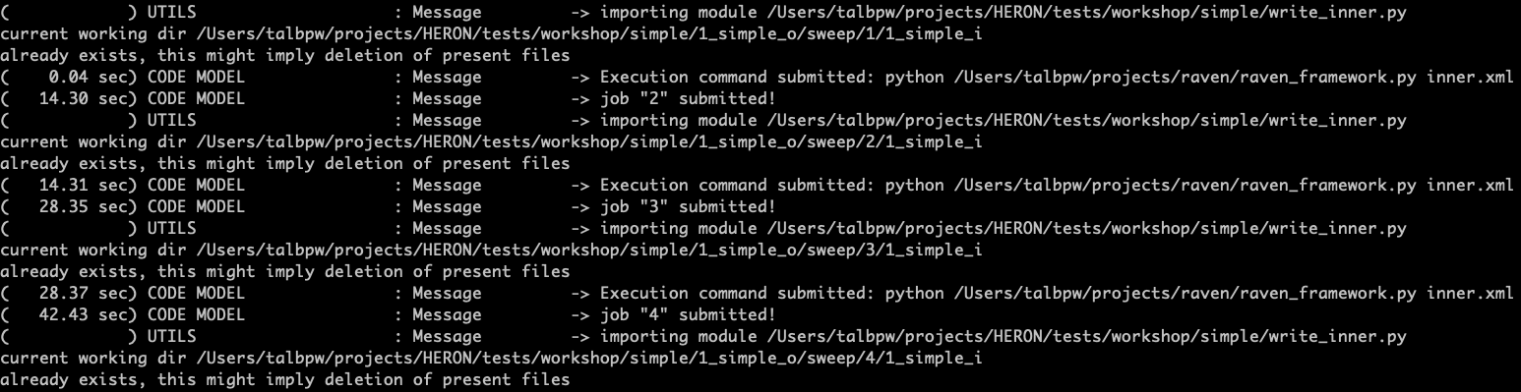
Things to Look At While Running
Screen Output: How To Read the Matrix
Sweep Sample
Submission of each individual parametric sweep value

Slide 15
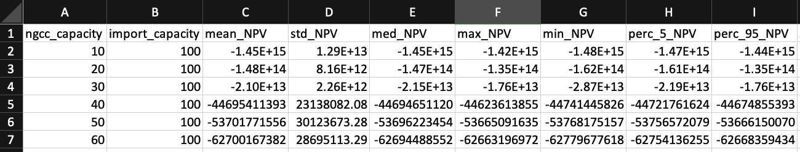
Things to Look At While Running
1_simple_o/sweep.csv – progress of the sampler
case name
outer
sampling record
Mean NPV
(objective)
Statistics
Component Sizes
(opt variables)
Inflection Point

Slide 16
Converting to Optimization
Converting Input
Change <mode> to opt
Swap from <sweep_values> to <opt_bounds>
Use sweep results to establish bounds
Optimization requires many more “outer” samples!
~90 minutes for this case to converge
Time may vary by OS, machine
~250 iterations

Slide 17
Running the Case
Optimizing size (takes some time!)
Things to look at (see following slides):
Screen Output
1_simple_o/opt_soln_0.csv (spreadsheet) optimizer progress
> /path/to/heron heron_input.xml
> /path/to/raven_framework outer.xml

Slide 18
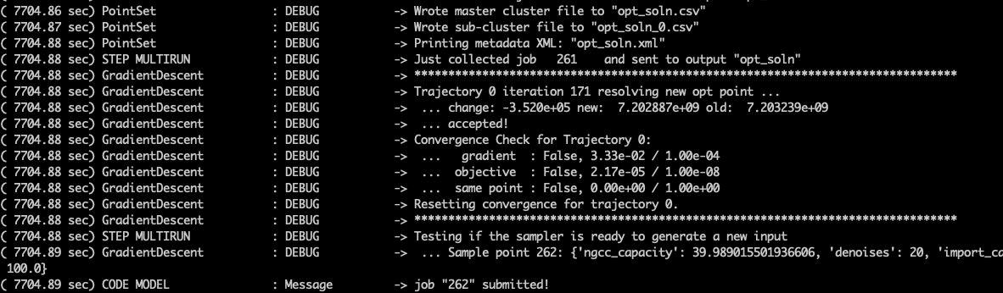
Things to Look At While Running
Screen Output: How To Read the Matrix
Accepted Sample
This means a new optimal point has been found!

Slide 19
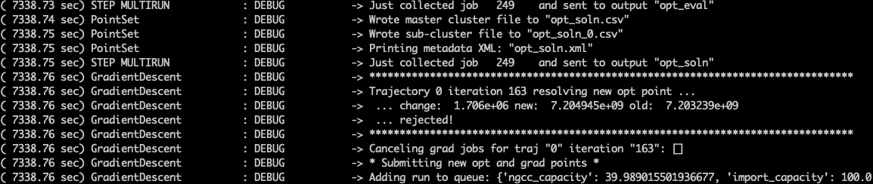
Things to Look At While Running
Screen Output: How To Read the Matrix
Rejected Sample
This means the new proposed opt point is worse than the old opt point
Reasons: inaccurate gradient, too large step, no better points nearby
Happens frequently, especially near the end

Slide 20
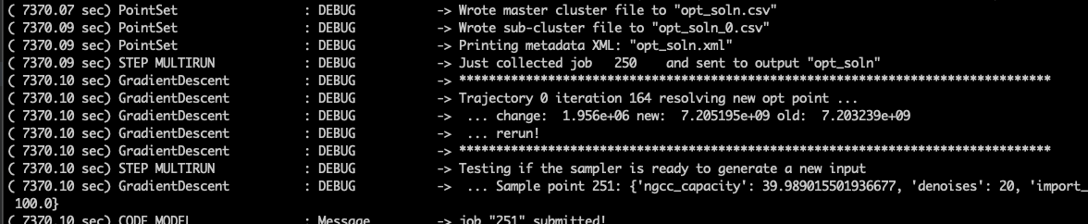
Things to Look At While Running
Screen Output: How To Read the Matrix
Rerun Sample
Return to best-so-far opt point and rerun the gradient, cut step size
Helps to resolve two reasons for rejecting proposed opt points

Slide 21
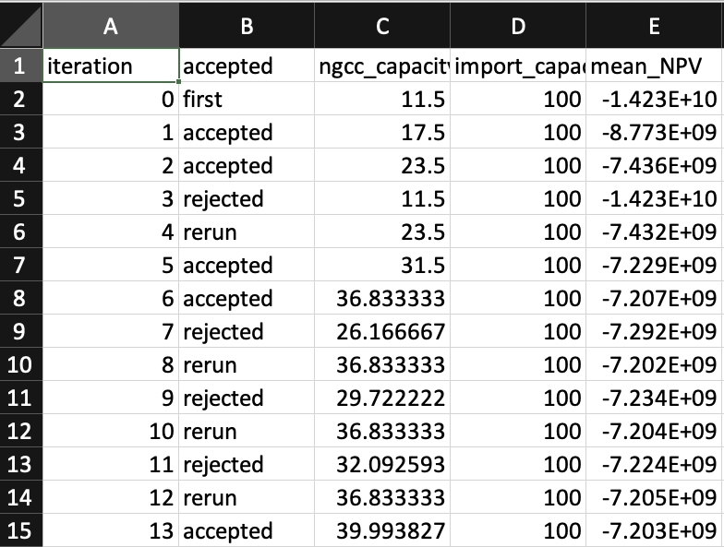
Things to Look At While Running
1_simple_o/opt_soln_0.csv – progress of the optimizer
case name
outer
optimization record
Component Sizes
(opt variables)
Mean NPV
(objective)
Optimizer Steps
(sets of samples)
Status of each step
Accepted: improvement!
Rejected: went too far
Rerun: re-check gradient
Note our losses are getting smaller!

Slide 22
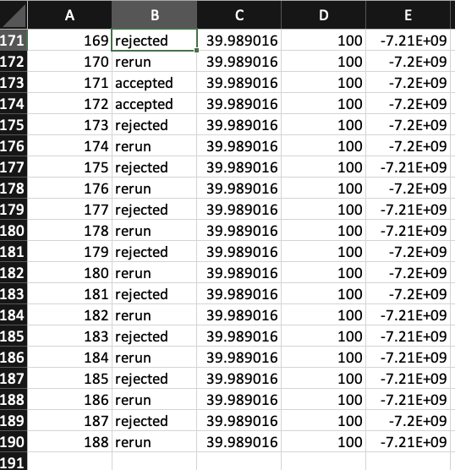
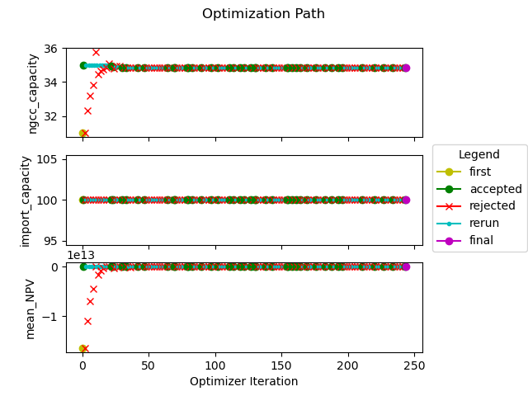
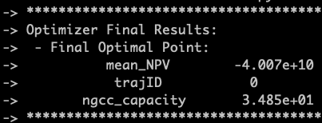
Now that it’s done …
Things to look at (see next slides)
opt_soln_0.csv
filter opt CSV by “accepted” to see acceptance path
final solution is the last “accepted” point in the CSV
opt_path.png
visualization of opt_soln_0.csv
screen output

Slide 23
Things to look at now that it’s done
Screen Output
Summary of optimizer status
Trajectory that found best point
Objective value
Opt Vars values
objective
opt var

Slide 24
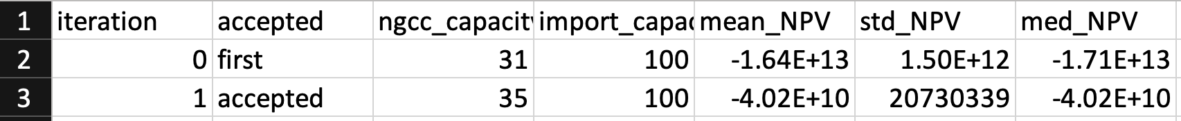
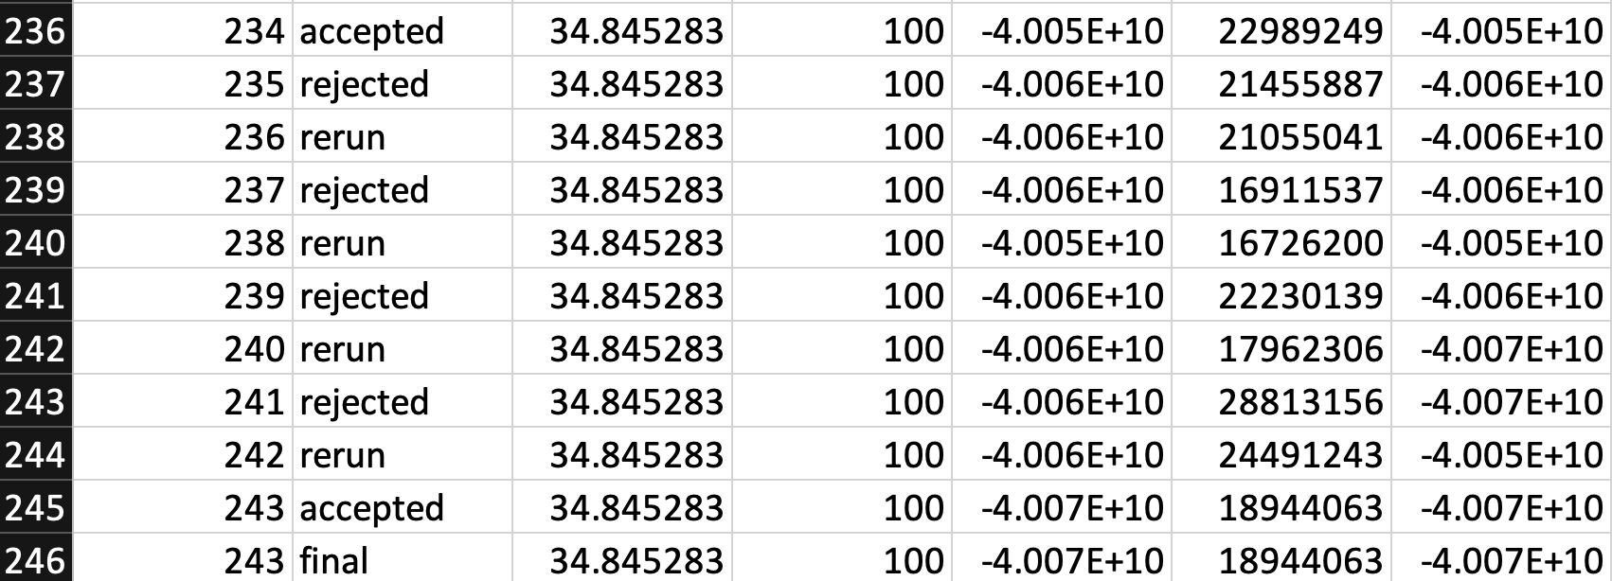
Things to look at now that it’s done
1_simple_o/opt_soln_0.csv
“final” point is solution
243 iterations is low (good!)
opt var
objective

Slide 25
Things to look at now that it’s done
1_simple_o/opt_path.png
Messy plot
Many plots are bad
but some are useful
Not intended for report quality
Indicative of process
towards the end only small changes
capacities
(opt vars)
E[NPV]
(objective)
most optimization happens in the first
few time steps

Slide 26
Wrap up Example 1
That’s it!
Takeaways:
3-unit problem, single resource
Setting up feasible problems
Running and observing HERON runs
Viewing results

