Slide 1

Changing Data Object API
RAVEN Sprint, November 2017

Slide 2
Outline
Scope
New Structure
Realizations
New API
Conversion

Slide 3
Scope
The current Data Objects are good, but limited
1000 variables
5000 samples
Reworked DataObjects improve by:
Removing loops over variables
Adding data by rows/columns instead of single entries
Accessing powerful data structure management tools
Pandas, Xarray, Dask
Sprint work:
Convert RAVEN entities to use new API
Simple API conversion
Rethinking implementation

Slide 4
New Structure
BaseType
DataObject
DataSet
Database
PointSet
HistorySet

Slide 5
New Structure
Base Class: XDataObject.DataObject( BaseType )
Input specifications, readMoreXML, setPivotParams
ND set: XDataSet.DataSet( DataObject )
General implementation, works for arbitrary ragged data
API is fully defined here, not customized in other objects
Point set: XPointSet.PointSet( DataSet )
Requires all single-value entries for inputs, outputs
Specialization of DataSet
History set: XHistorySet.HistorySet( DataSet )
Requires single-value inputs, shared-pivot outputs
Specialization of DataSet

Slide 6
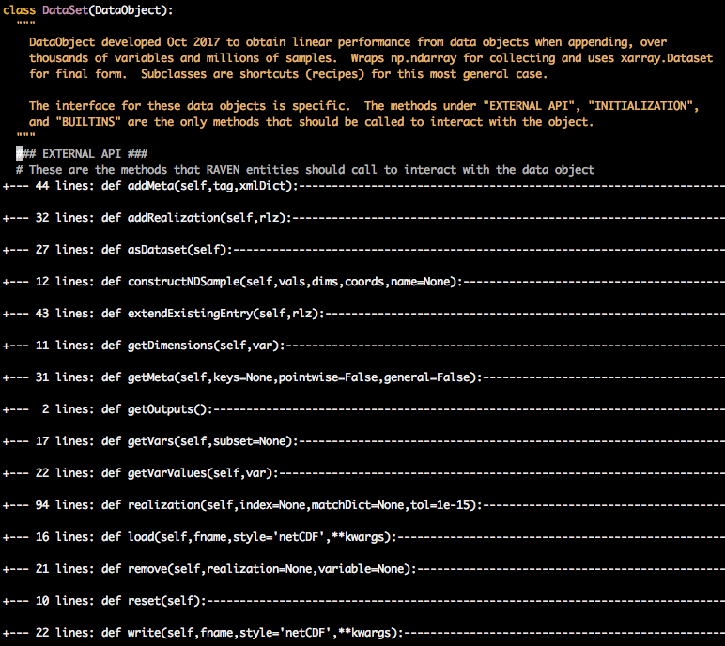
New API
Defined in the first part of DataSet class in XDataSet.py
No overlap with existing API
When transitioning, all old DataObject calls will error
Most methods only do 1 action
Call sub-methods for other actions

Slide 7

New API – Adding Data
Want to add a realization?
data.addRealization(rlz)
Takes a dictionary of np.array (1-d for single-value)
Coordinates added separate from dependents
Example:
Want to add a new variable?
data.addVariable(varName,values)
name is string name
values is np.ndarray of:
float,str for single-valued (scalars)
xr.DataArray for histories/ND samples

Slide 8

New API – Adding Data
Want to add metadata?
General Data (not pointwise, once per data object)
data.addMeta(tag,xmlDict)
tag says which meta key to store under
e.g. BasicStastics, DataSet, Optimizer, HSPS
xmlDict are the data to add
e.g.
Pointwise Data
Include the data in addRealization dictionary
variables not in input, output are added to metadata

Slide 9

New API – Accessing Data
Get pivot parameter(s)
data.getDimensions(varName)
Get metadata information
data.getMeta(keys,pointwise,general)
tell it to search in pointwise or general metadata
Get list of variable names
data.getVars(subset)
input, output, metadata; or None for all
Get variable values
Best to access directly
For more methods, see “Xarray Operations”, or http://xarray.pydata.org/en/stable/indexing.html#dataset-indexing
Slower, as dictionary
data.getVarValues(var)
“var” can be list or single variable name

Slide 10
New API – Get A Realization/Sample
By index
data.realization(index=6)
Returns dictionary realization (IndexError if past bounds)
Negative indices count back from the end
By matching value
data.realization(matchDict={…})
matchDict can include inputs, outputs, pointwise metadata
Returns (index, dict) of the first match found
Returns (0,None) if not found

Slide 11
New API – Get Each Realization
By slices
data.sliceByRealization(index=data.sampleTag)
Returns a list of each realization (as an xarray)
Fills in NaN if variable has missing values for a realization
This is the best way to see what value a pivot parameter has for an unsynchonized DataSet or HistorySet

Slide 12
New API – Properties
len(data) gives number of realizations (rows)
data.size also gives number of realizations
data.vars gives list of all input, output, pointwise metadata
data.indexes gives list of dependent coordinates (pivotParameters)

Slide 13
Xarray Operations
ds = data.asDataset()
Select the entries at the “7th” burnup entry:
Select the entry where time is 15:
Nearest neighbor lookup
Values of “x” between 0.2 and 0.8
Get the np.array of values for “a”:
Elementwise Operations:
Many builtin functions: mean, std, where

Slide 14

Realizations
Old way:
Used dictionaries of ‘inputs’, ‘outputs’, ‘metadata’
Each entry is c1darray or np.ndarray
New way:
All inputs, outputs, pointwise metadata in same space
Each entry is still np.ndarray (or c1darray)
size 1 if scalar (float, str, unicode, int)
longer if history

Slide 15
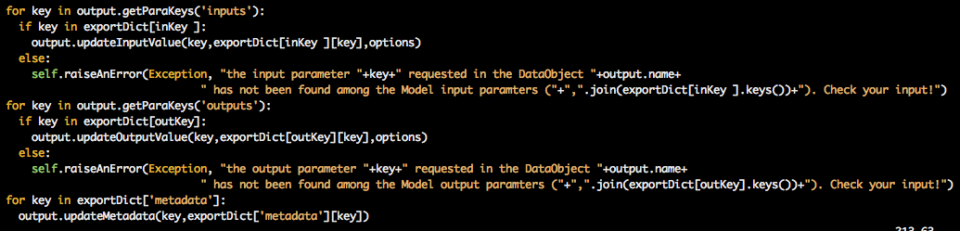

Example Conversion: Adding Realization
Old way, taken from Dummy.collectOutputFromDict
New way:

Slide 16

Common Issues – object dtype
Data is stored in np.ndarray with dtype=object
Most tools are fine with this. However,
sklearn ROMs demand dtype=float or similar
How to fix this? Convert type when obtaining data

Slide 17

Common Issues – Obtaining pivot values
Pivot values are stored in the coordinates of the variables that depend on them
They are not stored as variables themselves
Example: Retrieving “time” from inside an ExternalModel:
From inside RAVEN can access on the data object directly:
‘time’ should not be listed as input or output variables in the new dataobjects

