Slide 1

Auto Regressive Moving Average (ARMA) Modeling
RAVEN workshop
Location and Date

Slide 2
Outline
Brief introduction on ARMA models
RAVEN workflow:
Learn how to run and write RAVEN inputs
Understand RAVEN workflow
Perform statistic analysis of the RAVEN samples
Why ARMA:
Synthetic signals (combined with Fourier and segmentation) :
wind speed, solar resource, price histories, electricity loads, seismic signals
What to analyze:
Dynamic and probabilistic behavior energy systems
Optimization strategies:
cyber security decisions, marketing choices, etc

Slide 3
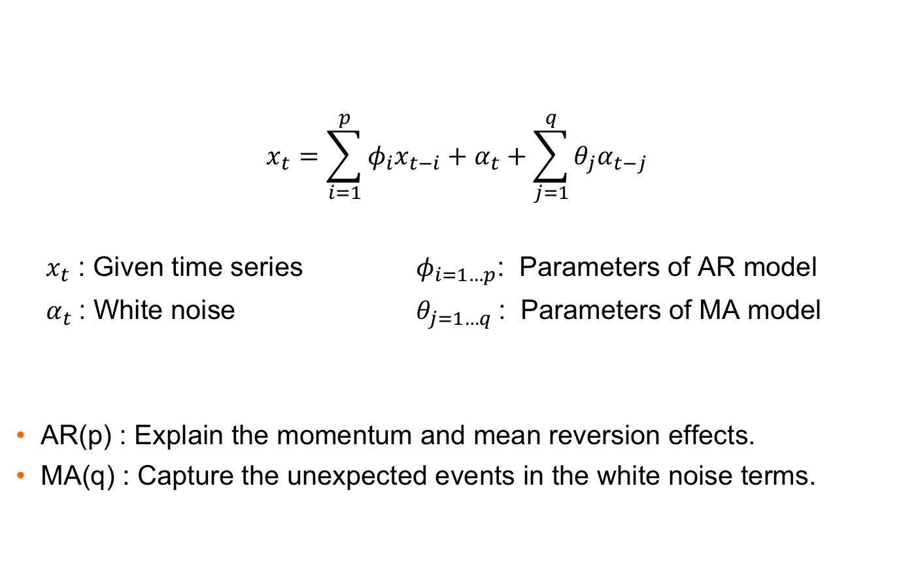
Auto Regressive Moving Average (ARMA) Models
$$x_{t}=\sum_{i=1}^{p}{φ_{i}x_{t−i}+α_{t}+\sum_{j=1}^{q}{θ_{j}α_{t−j}}}$$
$x_{t}$ : Given time series $φ_{i=1…p}$: Parameters of AR model
$α_{t}$: White noise $θ_{j=1…q}$: Parameters of MA model
AR(p) : Explain the momentum and mean reversion effects.
MA(q) : Capture the unexpected events in the white noise terms.

Slide 4
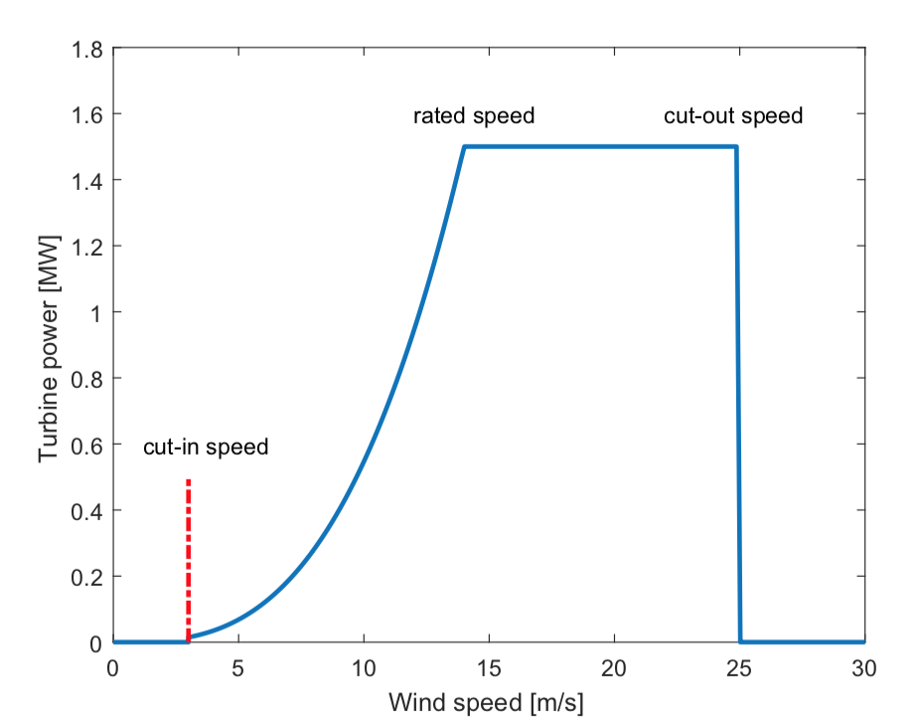
Example Case
Extracted from Ref.
Wind Speed → Power
Power → Actual Power
Ref: Chen, J., & Rabiti, C. (2017). Synthetic wind speed scenarios generation for probabilistic analysis of hybrid energy systems. Energy, 120, 507-517.

Slide 5
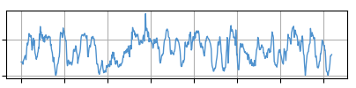
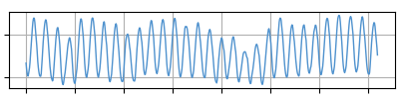
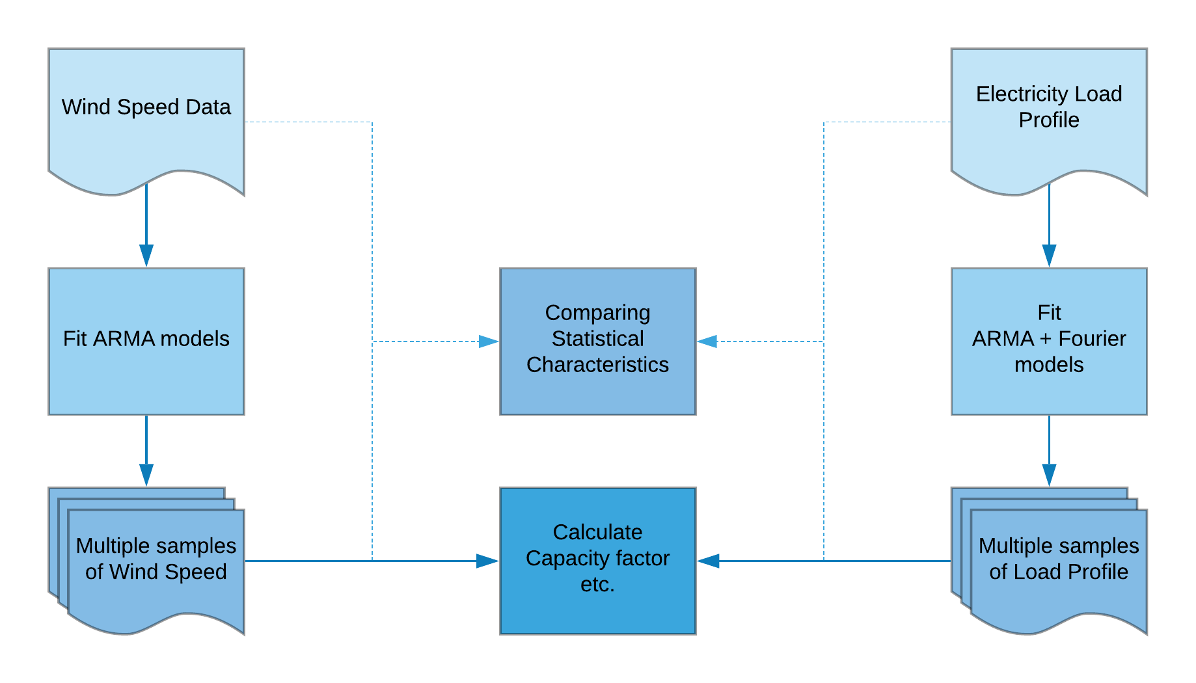
Example Case

Slide 6
RAVEN workflow
Samples generation:
<RunInfo> Set up the environment, sequence
<Steps> Assemble different Entities
<Samplers> Decide specific sampling strategy
<DataObjects> Container of data objects of various types
<Models> ARMA model
<Files> Files needed in RAVEN run
<OutStreams> Print or plot your Results

Slide 7
Exercise 1
Wind Speed Synthetic Samples (ARMA)

Slide 8
Edit your RAVEN input
raven/
Starting from
Change the p from 0 to 1
[user@yourdevice ]$ cd raven/doc/workshop/ARMA/inputs
[user@yourdevice ]$ vim 1_arma.xml
<Models>
<ROM name="arma" subType="ARMA">
…
<P>…</P>
<Q>1</Q>
</ROM>
</Models>
<Models>
<ROM name="arma" subType="ARMA">
…
<P>1</P>
<Q>1</Q>
</ROM>
</Models>

Slide 9
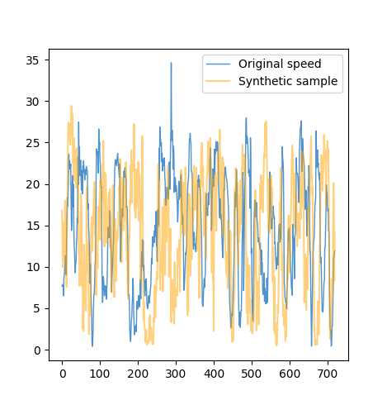
Run your RAVEN input
Move to console
After Run completed
You should have :
romMeta.csv
romMeta.xml
synData.csv
synData.xml
synData_0.csv
(synthetic sample)
[user@yourdevice ]$ cd raven/doc/workshop/ARMA/inputs
[user@yourdevice ]$ ~/projects/raven/raven_framework 1_arma.xml
[user@yourdevice ]$ cd r1
Time | Speed
0 | 16.7889539
3600 | 13.9436282
7200 | 9.93010073
10800 | 15.4630286
14400 | 11.5997842
18000 | 10.7994055
21600 | 10.5823889
25200 | 12.4671013
28800 | 17.9856903
32400 | 12.8642076
36000 | 9.18476219

Slide 10
Exercise 2
Load Profiles Synthetic Samples (ARMA + Fourier)

Slide 11
Edit your RAVEN input
raven/
Starting from
Change <Fourier> node with based periods:
1 week, half week,1 day and 12 hours (Hint: 1 hour is represent as 3600s in data)
604800, 302400, 86400, 43200
[user@yourdevice ]$ cd raven/doc/workshop/ARMA/inputs
[user@yourdevice ]$ vim 2_arma_Fourier.xml
<Models>
<ROM name="arma" subType="ARMA">
…
<Fourier>…</Fourier>
…
</ROM>
</Models>
<Models>
<ROM name="arma" subType="ARMA">
…
<Fourier>BASE_PERIODS</Fourier>
…
</ROM>
</Models>

Slide 12
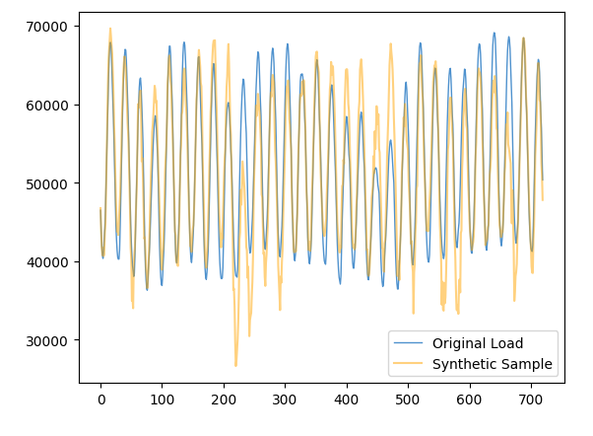
Run your RAVEN input
Move to console
After Run completed
You should have :
romMeta.csv
romMeta.xml
synData.csv
synData.xml
synData_0.csv
(synthetic sample)
[user@yourdevice ]$ cd raven/doc/workshop/ARMA/inputs
[user@yourdevice ]$ ~/projects/raven/raven_framework 2_arma_Fourie.xml
[user@yourdevice ]$ cd r2
Time | Load
0 | 46755.8343
3600 | 43807.8169
7200 | 41742.6612
10800 | 40757.66
14400 | 41722.4036
18000 | 40656.0647
21600 | 40895.8673
25200 | 43632.5641
28800 | 44833.4384
32400 | 49408.1522
36000 | 53353.0964

Slide 13
Exercise 3
Pickle your trained ARMA

Slide 14
Edit your RAVEN input
raven/
Starting from
Create your I/O step to save your trained ARMA model into a pickle file:
1) Add the I/O step in <Steps>
[user@yourdevice ]$ cd raven/doc/workshop/ARMA/inputs
[user@yourdevice ]$ vim 3_arma_pk.xml
<Steps>
…
<IOstep name="…" >
<Input class="…" type="…">…</Input>
<Output class="…" type="…">…</Output>
</IOstep>
…
</Steps>
Your pickle ‘step’ entity name
Class, type, name of arma model
Class, type, name of the pickled file
(Hint: Class <Files> do not have a type)

Slide 15
Edit your RAVEN input
2) Add the file in <Files>
3) Add the I/O step in <RunInfo>
4) Set the seed of ARMA model:
<Files>
…
<Input name="…">…</Input>
</Files>
Pickle ‘Files’ entity name in <Steps>
Actual pickle file name
<RunInfo>
…
<Sequence> read,train,print,…,sample,write </Sequence>
</RunInfo>
Your pickle ‘step’ entity name in <Steps>
<Models>
<ROM name=”arma” subtype=”ARMA”>
…
<Seed>…</Seed>
…
</ROM>
</Models>
Pick a integer seed

Slide 16
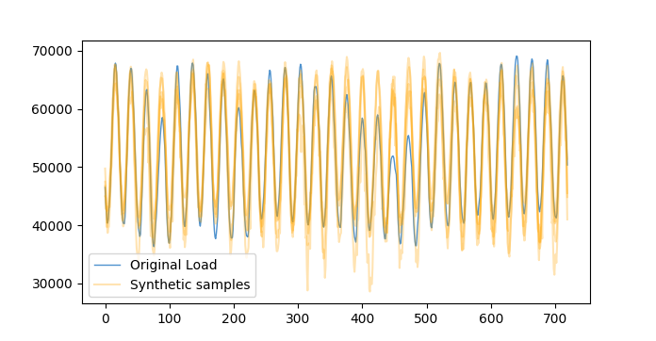
Run your RAVEN input
Move to console
After Run completed
You should have :
romMeta.csv synData_0.csv
romMeta.xml synData_1.csv
synData.csv synData_2.csv
synData.xml synData_3.csv
yourPickleFile (synthetic samples)
[user@yourdevice ]$ cd raven/doc/workshop/ARMA/inputs
[user@yourdevice ]$ ~/projects/raven/raven_framework 3_arma_pk.xml
[user@yourdevice ]$ cd r3

Slide 17
Exercise 4
Unpickle your trained model

Slide 18
Edit your RAVEN input
raven/
Starting from
Specify the pickled file in <Steps> and <Files>
[user@yourdevice ]$ cd raven/doc/workshop/ARMA/inputs
[user@yourdevice ]$ vim 4_arma_unpk.xml
<Steps>
<IOStep name="read">
<Input class=”Files” Type=”” >…</Input>
…
</Steps>
<Files>
…
<Input name=”” >../r3/…</Input>
</Files>
Pickle ‘Files’ entity name in <Steps>
Actual pickle file name

Slide 19
Run your RAVEN input
Move to console
After Run completed
You should have :
unpksynData.xml
unpksynData.csv
unpksynData_0.csv
unpksynData_1.csv
unpksynData_2.csv
unpksynData_3.csv
(synthetic samples)
[user@yourdevice ]$ cd raven/doc/workshop/ARMA/inputs
[user@yourdevice ]$ ~/projects/raven/raven_framework 4_arma_unpk.xml
[user@yourdevice ]$ cd r4

Slide 20
Exercise 5
Ensemble Model of the ARMA model

Slide 21
Edit your RAVEN input
raven/
Starting from
Specify the pickled file in <Steps> and <Files>
Specify the Turbine number:
[user@yourdevice ]$ cd raven/doc/workshop/ARMA/inputs
[user@yourdevice ]$ vim 5_arma_Ensemblemodel.xml
<Steps>
<IOStep name=”unpkload">
<Input class=”Files” Type=”” >…</Input>
…
</Steps>
<Files>
…
<Input name=”” >../r3/…</Input>
</Files>
Pickle ‘Files’ entity name in <Steps>
Actual pickle file name
<Sampler>
…
<constant name=”turbinenumber”> …</constant>
…
</Sampler>
20000, 30000, 40000, etc

Slide 22
Run your RAVEN input
Move to console
After Run completed
You should have :
synData.xml
synData.csv
Compare your results (Capacity Factor)
using different turbine number
[user@yourdevice ]$ cd raven/doc/workshop/ARMA/inputs
[user@yourdevice ]$ ~/projects/raven/raven_framework 5_arma_Ensemblemodel.xml
[user@yourdevice ]$ cd r5
scaling | CapF | engDiff | prefix | Probability Weight | Point Probability
1 | 0.54743743 | 18778.7345 | 1 | 1 | 1
1 | 0.55351886 | 19448.5672 | 2 | 1 | 1
1 | 0.56122459 | 17971.5056 | 3 | 1 | 1
1 | 0.58209605 | 17383.6656 | 4 | 1 | 1
1 | 0.550292 | 18921.0886 | 5 | 1 | 1
1 | 0.61501829 | 15645.612 | 6 | 1 | 1
1 | 0.58417661 | 18186.6269 | 7 | 1 | 1
1 | 0.55410979 | 19350.7194 | 8 | 1 | 1
1 | 0.5117472 | 20479.4335 | 9 | 1 | 1
1 | 0.59288992 | 15918.5558 | 10 | 1 | 1

