Slide 1

Time Dependent Data Mining
RAVEN Workshop

Slide 2
Overview
Time-series post-processors
Time dependent basic statistics
Time slice clustering
Time dependent clustering
Approach 1: time series transformation (K-Means)
Approach 2: time dependent metrics (Hierarchical)
Euclidean
Dynamic Time Warping

Slide 3
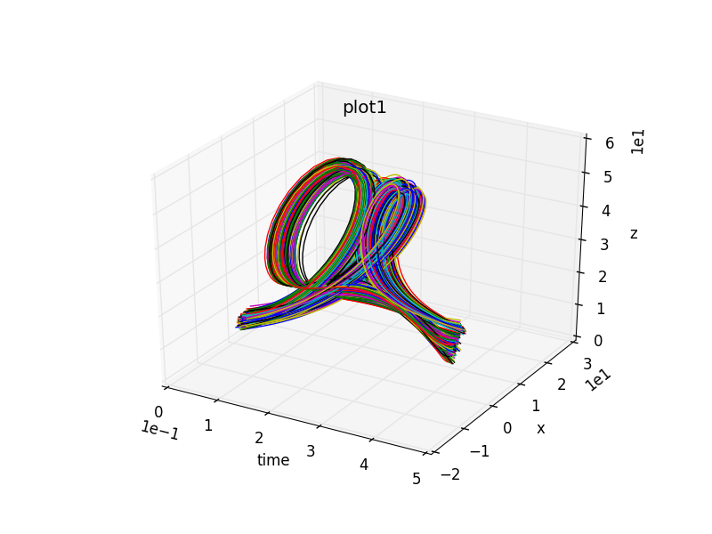
Clustering: Time-Dependent Data
Objective: analyze time-dependent data
Similarity can be subjective
Challenges
Different time lengths
Different sample rates
Presence of noise or missing data
Time delays
time

Slide 4
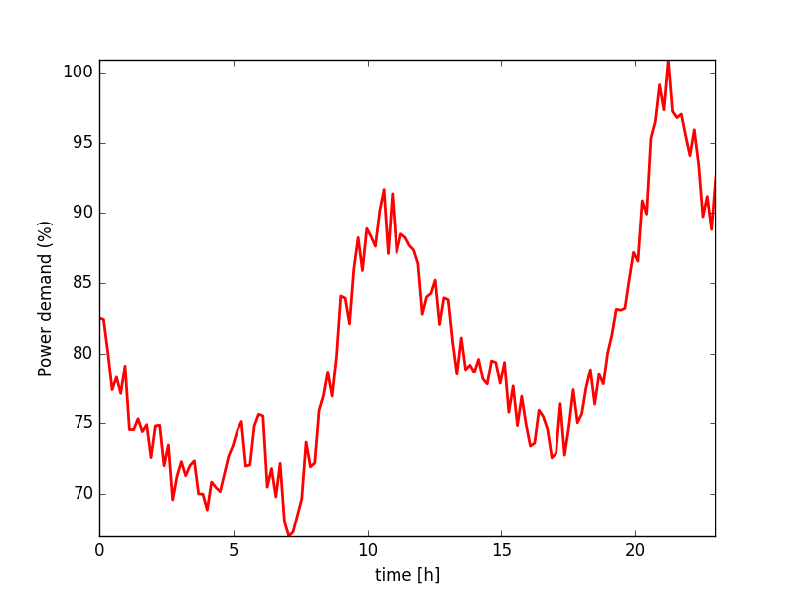
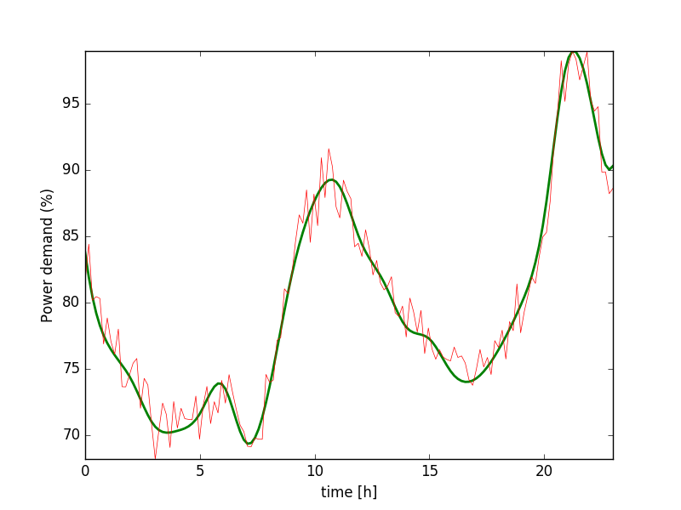
Data Pre-Processing: Smoothing
Data filtering (e.g., KDE regression)
Data Source: The UCR Time Series Classification Archive, www.cs.ucr.edu/~eamonn/time_series_data/

Slide 5
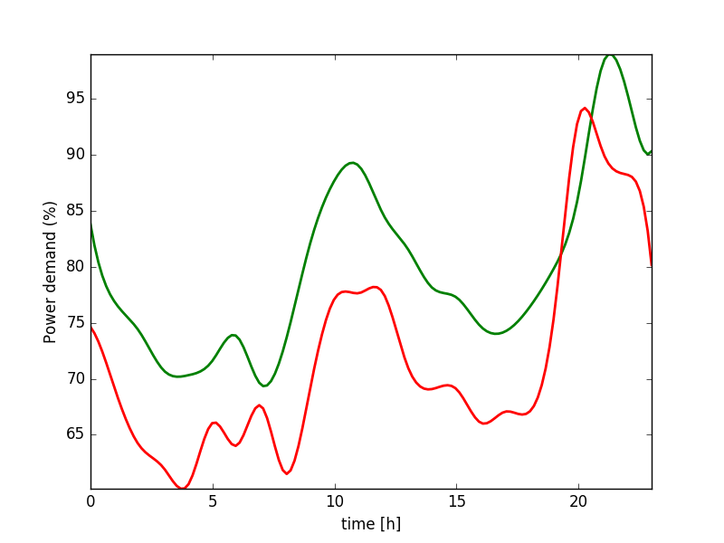
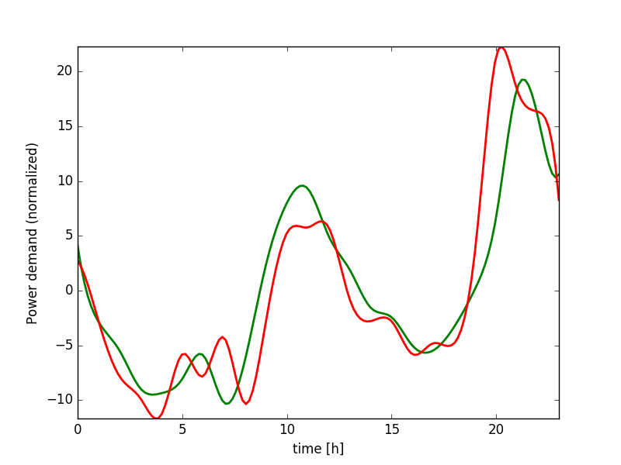
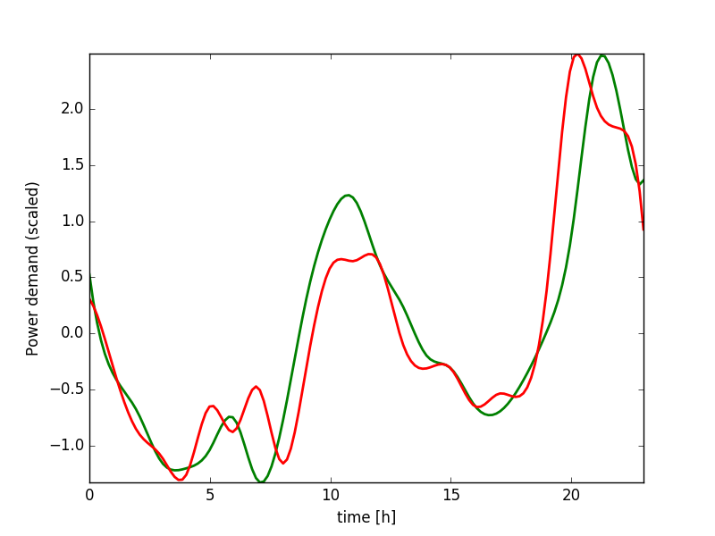
Data Pre-Processing: Normalization
Offset
Translation
Amplitude
Scaling

Slide 6
Data Pre-Processing: Re-Sampling
Objective: reduce memory space of each time series
Method: re-sampling the time series
Smartly locate sample points on strategically important regions
e.g. high derivative (gradient) regions
Uniform sampling
First-order derivative sampling

Slide 7
RAVEN Time-Series Post-Processors
Class: Interfaced Post-Processors
RAVEN provides a generic interface to create user-defined generic Post-Processors
Act on both PointSets and HistorySets

Slide 8
RAVEN Time-Series Post-Processors: Examples
HSPS: it converts an HistorySet into a PointSet
Each history is converted into a multi-dimensional vector
HistorySetSampling
Original HistorySet is re-sampled accordingly to a specific sampling strategy
HistorySetSync
Time series contained in the original HistorySet are synchronized in time
Identical initial and final time
Identical number of samples
dataObjectLabelFilter
Filter the dataObject for a specific value of the clustering label

Slide 9
RAVEN Example 1 Time Dependent Basic Statistics

Slide 10
RAVEN Example 1: Time-Dep. Basic Statistics
Steps
Generate time-dependent data
Post-Process the data
Create a dataObject (PointSet) from processed data

Slide 11
RAVEN Example 1: Time-Dep. Basic Statistics
Distributions
Models
Samplers
Databases
DataObjects
Steps
<Models>
...
<PostProcessor name="timeDepBasicStat" subType="BasicStatistics">
<pivotParameter>time</pivotParameter>
<expectedValue>x,y,z</expectedValue>
<percentile_5>x,y,z</percentile_5>
<percentile_95>x,y,z</percentile_95>
</PostProcessor>
<PostProcessor name="readStats" subType="RavenOutput">
<dynamic>true</dynamic>
<File ID="0" name="output_TD_BS.xml">
<output name="mean" >x | expectedValue </output>
<output name="percentile_5" >x | percentile_5 </output>
<output name="percentile_95" >x | percentile_95 </output>
</File>
</PostProcessor>
</Models>
Input file name: time_dep.xml

Slide 12
RAVEN Example 1: Time-Dep. Basic Statistics
Distributions
Models
Samplers
Databases
DataObjects
Steps
<Steps>
<MultiRun name="FirstMRun">
<Input class="DataObjects" type="PointSet" >inputPlaceHolder</Input>
<Model class="Models" type="ExternalModel" >PythonModule</Model>
<Sampler class="Samplers" type="MonteCarlo" >MC_external</Sampler>
<Output class="DataObjects" type="HistorySet" >HistorySet</Output>
</MultiRun>
<PostProcess name="timeDepBasicStatPP">
<Input class="DataObjects" type="HistorySet" >HistorySet</Input>
<Model class="Models" type="PostProcessor" >timeDepBasicStat</Model>
<Output class="Files" type="" >output_TD_BS.csv</Output>
<Output class="Files" type="" >output_TD_BS.xml</Output>
<Output class="DataObjects" type="HistorySet" >HistorySet</Output>
</PostProcess>
<PostProcess name="readStats">
<Input class="Files" type="" >output_TD_BS.xml</Input>
<Input class="DataObjects" type="HistorySet" >HistorySet</Input>
<Model class="Models" type="PostProcessor" >readStats</Model>
<Output class="DataObjects" type="PointSet" >stats</Output>
<Output class="OutStreams" type="Plot" >Plotdata</Output>
<Output class="OutStreams" type="Plot" >PlotRawdata</Output>
</PostProcess>
</Steps>
Input file name: time_dep.xml

Slide 13
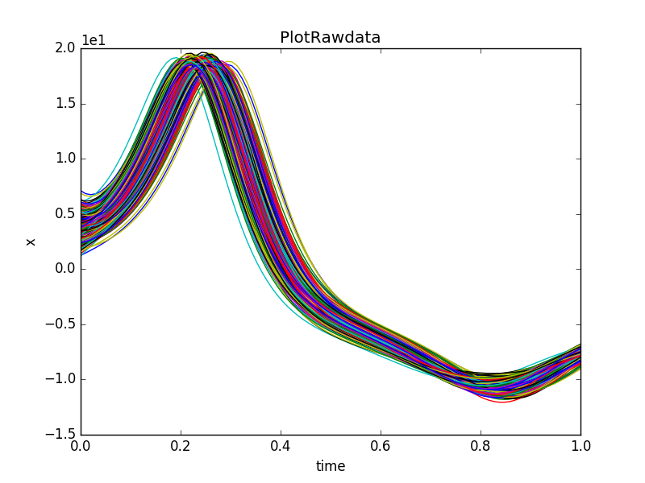
RAVEN Example 1: Time-Dep. Basic Statistics
Input file name: time_dep.xml

Slide 14
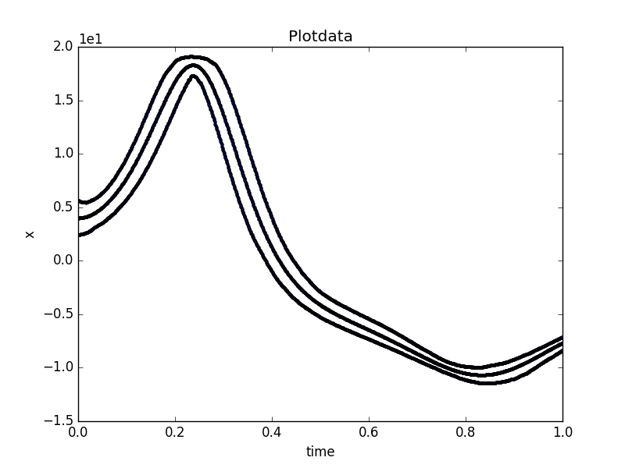
RAVEN Example 1: Time-Dep. Basic Statistics
Input file name: time_dep.xml

Slide 15
RAVEN Example 2 Time Slice Clustering

Slide 16
RAVEN Example 2: Time Slice Clustering
Steps:
Generate time-dependent data
Cluster time-dependent data

Slide 17
RAVEN Example 2: Time Slice Clustering
Distributions
Models
Samplers
Databases
DataObjects
Steps
<Steps>
<MultiRun name="FirstMRun”>
<Input class="DataObjects" type="PointSet" >inputPlaceHolder</Input>
<Model class="Models" type="ExternalModel" >PythonModule</Model>
<Sampler class="Samplers" type="MonteCarlo" >MC_external</Sampler>
<Output class="DataObjects" type="HistorySet" >outMC</Output>
</MultiRun>
<PostProcess name=”clustering">
<Input class="DataObjects" type="HistorySet" >outMC</Input>
<Model class="Models" type="PostProcessor" >KMeans1</Model>
<SolutionExport class="DataObjects" type="HistorySet” >clusterInfo
</SolutionExport>
<Output class="DataObjects" type="HistorySet" >outMC</Output>
</PostProcess>
</Steps>
Input file name: timeSliceKMeans.xml

Slide 18
RAVEN Example 2: Time Slice Clustering
Distributions
Models
Samplers
Databases
DataObjects
Steps
<Models>
...
<PostProcessor name="KMeans1" subType="DataMining">
<KDD lib="SciKitLearn" labelFeature="labels">
<SKLtype>cluster|KMeans</SKLtype>
<Features>x,y,z</Features>
<n_clusters>2</n_clusters>
<max_iter>1000</max_iter>
<random_state>1</random_state>
<init>k-means++</init>
</KDD>
<pivotParameter>time</pivotParameter>
</PostProcessor>
</Models>
Input file name: timeSliceKMeans.xml

Slide 19
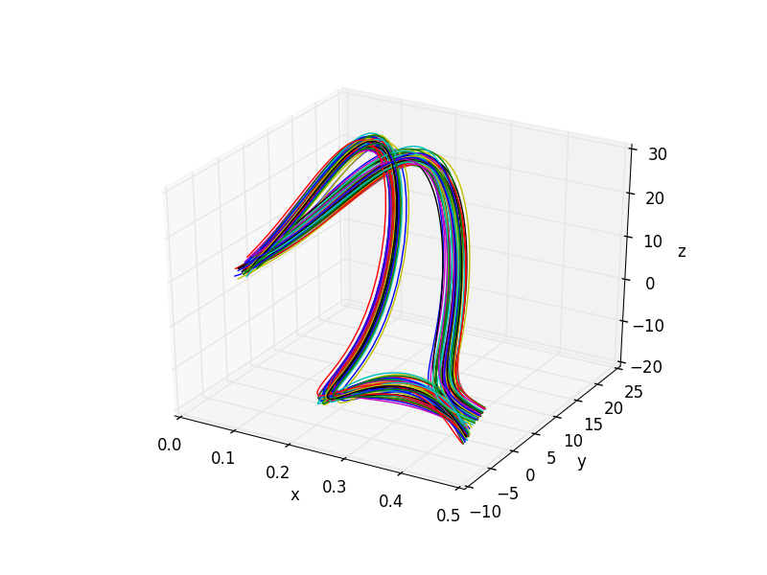
RAVEN Example 2: Time Slice Clustering
Input file name: timeSliceKMeans.xml

Slide 20
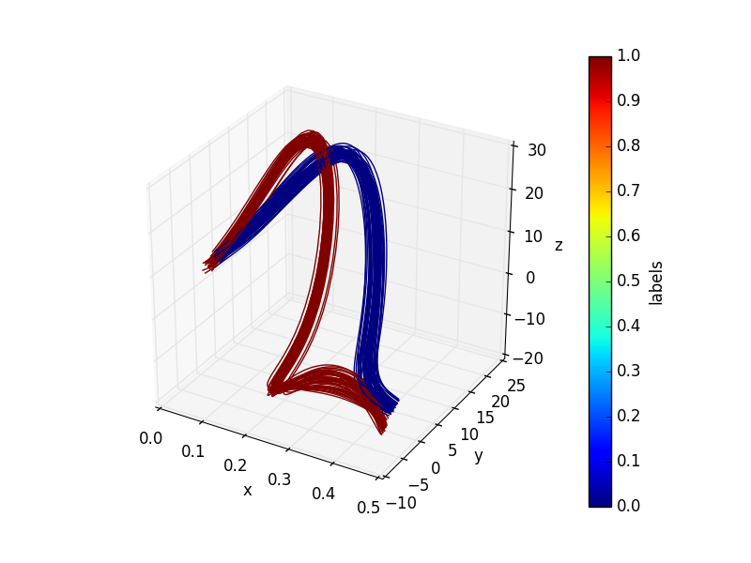
RAVEN Example 2: Time Slice Clustering
Input file name: timeSliceKMeans.xml

Slide 21
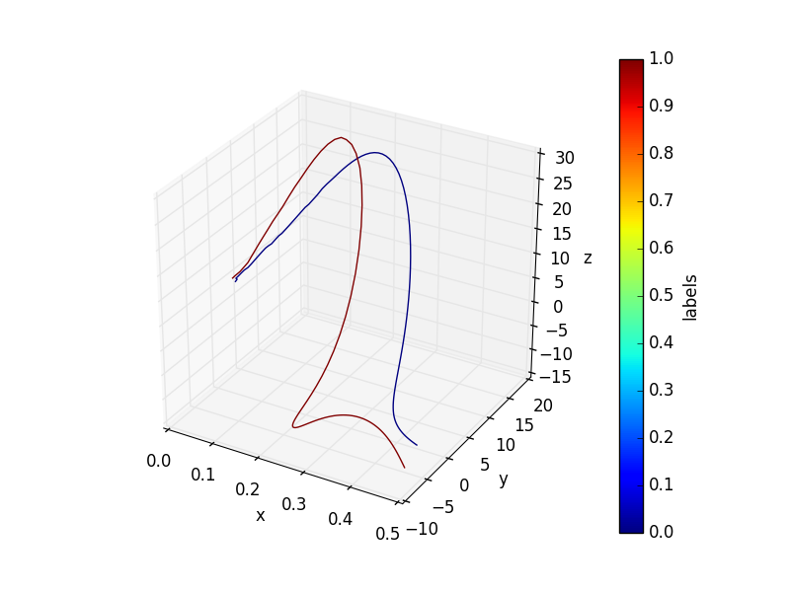
RAVEN Example 2: Time Slice Clustering
Input file name: timeSliceKMeans.xml

Slide 22
RAVEN Example 3 Time Dependent Clustering Approach 1: Time Series Transformation

Slide 23
RAVEN Example 3: Time Dependent Clustering (1)
Objective
Analyze time series not at each time step
Consider the whole time series as a whole
Recall clustering
Operate on PointSets
Consider each time series as a “data-point”
(μ₁,σ₁²)
Y
(μ₂,σ₂²)
X
time

Slide 24
RAVEN Example 3: Time Dependent Clustering (1)
Approach:
Convert each time series as a multi-dimensional vector
Convert HistorySet into PointSet
Perform Clustering
Convert clustering results from PointSet to HistorySet
Static data
K-Means
Mean-Shift
…
Clustering
Pre-Processing
Real value
Polynomial
Hermite
Chebyshev
Laguerre
Legendre
SVD
Fourier
Raw data
Re-Sampling
Data Representation
Time-dependent data

Slide 25
RAVEN Example 3: Time Dependent Clustering (1)
Distributions
Models
Samplers
Databases
DataObjects
Steps
<Models>
...
<PostProcessor name="dataPreProc" subType="InterfacedPostProcessor">
<method>HS2PS</method>
<pivotParameter>time</pivotParameter>
</PostProcessor>
<PostProcessor name="KMeans1" subType="DataMining">
<PreProcessor class="Models" type="PostProcessor">dataPreProc</PreProcessor>
<KDD lib="SciKitLearn">
<SKLtype>cluster|KMeans</SKLtype>
<Features>output</Features>
<n_clusters>2</n_clusters>
<tol>1E-10</tol>
<random_state>1</random_state>
<init>k-means++</init>
<precompute_distances>True</precompute_distances>
</KDD>
</PostProcessor>
</Models>
Input file name: TD_KMeans.xml

Slide 26
RAVEN Example 3: Time Dependent Clustering (1)
Distributions
Models
Samplers
Databases
DataObjects
Steps
<Steps>
<MultiRun name="FirstMRun">
<Input class="DataObjects" type="PointSet" >inputPlaceHolder</Input>
<Model class="Models" type="ExternalModel" >PythonModule</Model>
<Sampler class="Samplers" type="MonteCarlo" >MC_external</Sampler>
<Output class="DataObjects" type="HistorySet" >outMC</Output>
</MultiRun>
<PostProcess name="clustering">
<Input class="DataObjects" type="HistorySet" >outMC</Input>
<Model class="Models" type="PostProcessor" >KMeans1</Model>
<SolutionExport class="DataObjects" type="HistorySet" >clusterInfo
</SolutionExport>
<Output class="DataObjects" type="HistorySet" >outMC</Output>
</PostProcess>
</Steps>
Input file name: TD_KMeans.xml

Slide 27
RAVEN Example 3: Time Dependent Clustering (1)
Distributions
Models
Samplers
Databases
DataObjects
Steps
<Steps>
<PostProcess name="filter0">
<Input class="DataObjects" type="HistorySet" >outMC</Input>
<Model class="Models" type="PostProcessor" >filter0</Model>
<Output class="DataObjects" type="HistorySet" >outMC0</Output>
</PostProcess>
</Steps>
<Models>
...
<PostProcessor name="filter1" subType="InterfacedPostProcessor">
<method>dataObjectLabelFilter</method>
<dataType>HistorySet</dataType>
<label>KMeans1Labels</label>
<clusterIDs>1</clusterIDs>
</PostProcessor>
</Models>
Input file name: TD_KMeans.xml

Slide 28
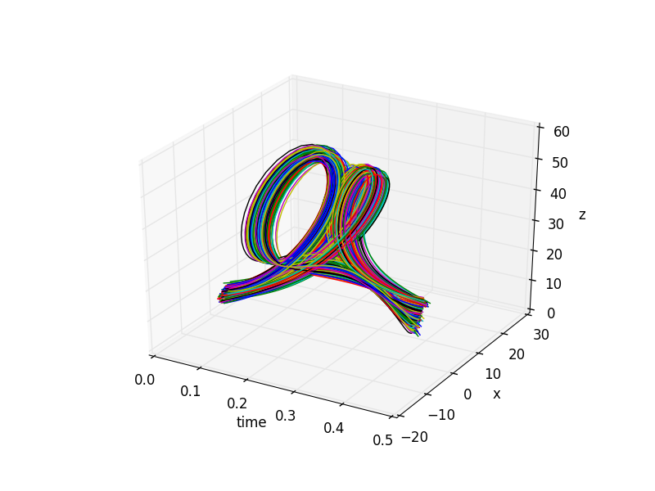
RAVEN Example 3: Time Dependent Clustering (1)
Input file name: TD_KMeans.xml

Slide 29
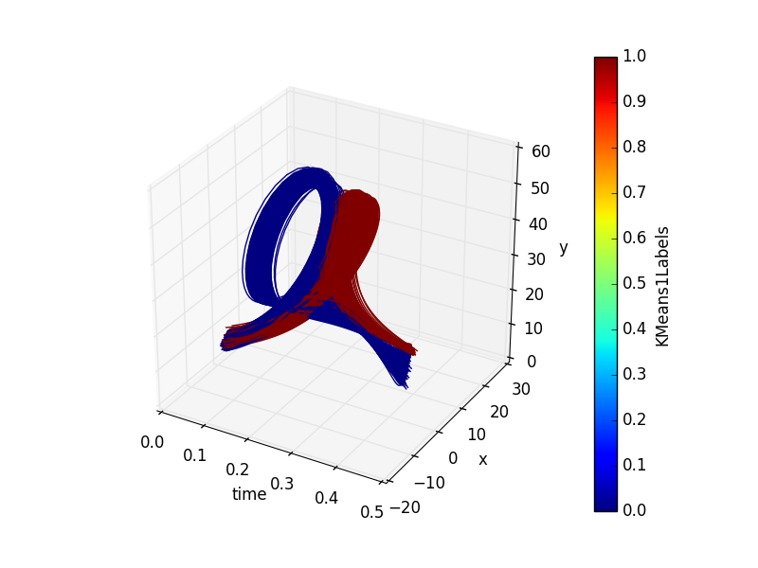
RAVEN Example 3: Time Dependent Clustering (1)
Input file name: TD_KMeans.xml

Slide 30
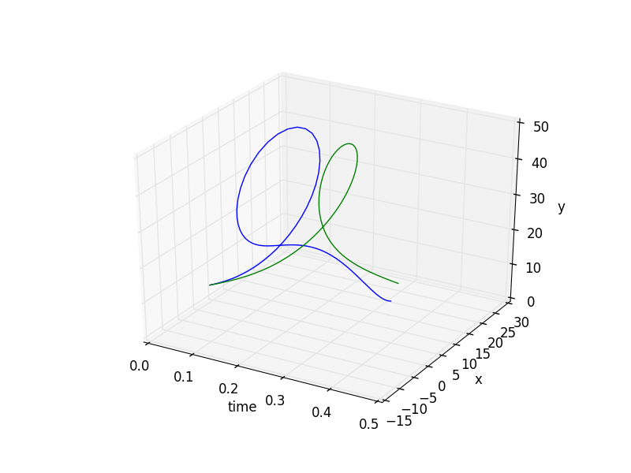
RAVEN Example 3: Time Dependent Clustering (1)
Input file name: TD_KMeans.xml

Slide 31
RAVEN Example 4 Time Dependent Clustering Approach 2: Time Dependent Metrics

Slide 32
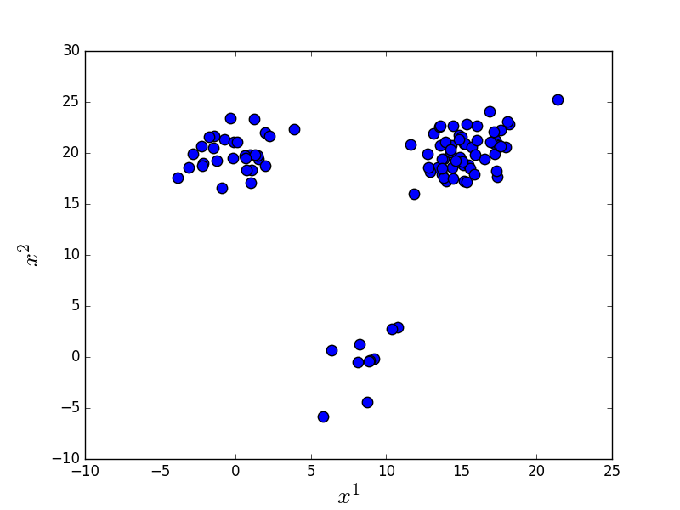
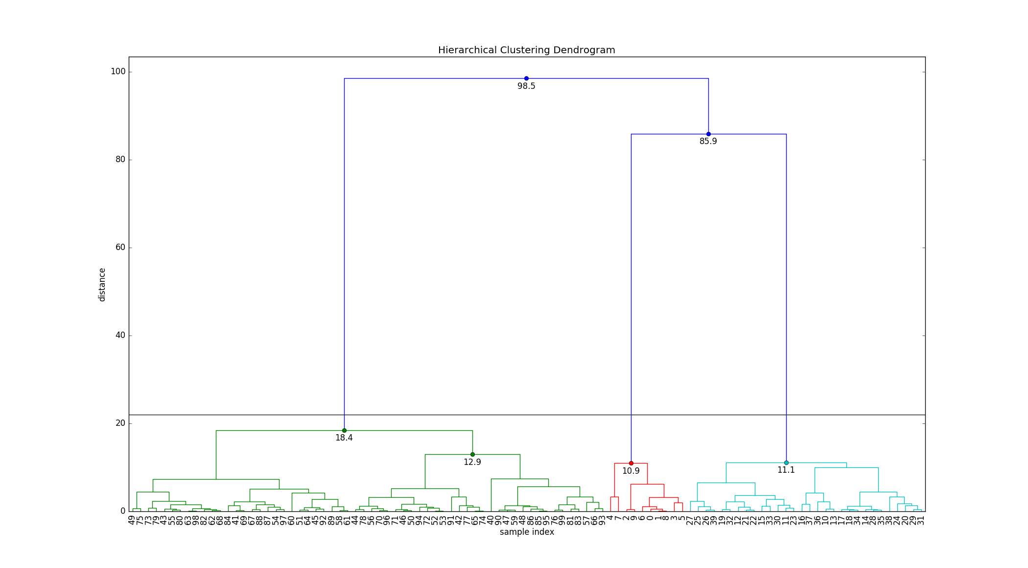
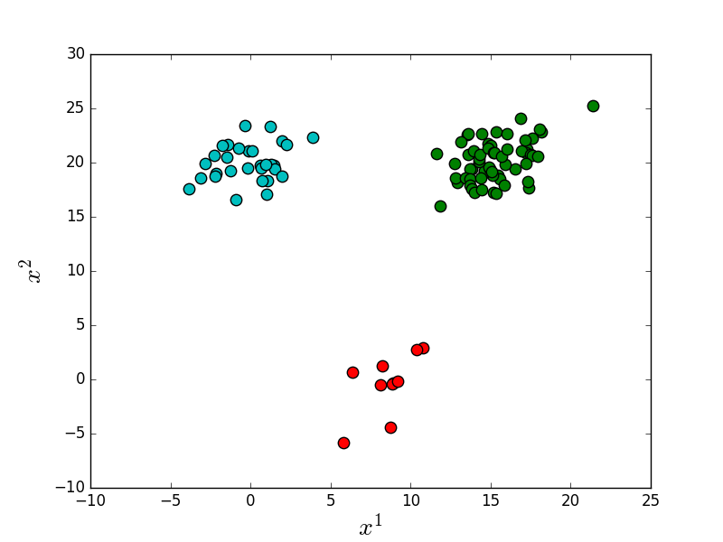
RAVEN Example 4: Time Dependent Clustering (2)
Few clustering algorithms accepts as input a distance metric
E.g.: Hierarchical clustering

Slide 33
RAVEN Example 4: Time Dependent Clustering (2)
Distance matrix based clustering
Given N time series
Input is a NxN dimensional matrix
is the distance between the S^{th} and Q^{th} time series
Pre-Processing
Raw data
Re-Sampling
Time-dependent data
Distance Matrix Clustering
Hierarchical
DBSCAN
Minkowski
DTW
Time-Dependent Metrics

Slide 34
RAVEN Example 4: Time Dependent Clustering (2)
Euclidean distance
The good
Fast computation
The bad
Sensitive to offset translation (time delays)
Requires time series with identical lengths

Slide 35
RAVEN Example 4: Time Dependent Clustering (2)
Dynamic Time Warping (DTW)
Each element of S is linked to the closest element of Q through a global minimization problem
The good: handling of
Small time shifts (i.e., delays)
Time series with different time lengths
The bad: much slower computation

Slide 36
RAVEN Example 4: Time Dependent Clustering (2)
Distributions
Models
Samplers
Metrics
DataObjects
Steps
<Metrics>
<DTW name="example">
<order>0</order>
<localDistance>euclidean</localDistance>
<pivotParameter>time</pivotParameter>
</DTW>
<Minkowski name="example">
<p>2</p>
<pivotParameter>time</pivotParameter>
</Minkowski>
</Metrics>
Input file name: TD_hierarchical_dtw.xml

Slide 37
RAVEN Example 4: Time Dependent Clustering (2)
Distributions
Models
Samplers
Metrics
DataObjects
Steps
<Models>
...
<PostProcessor name="hierarchical" subType="DataMining">
<Metric class="Metrics" type="DTW">example</Metric>
<KDD lib="Scipy" labelFeature=“labels”>
<Features>output</Features>
<SCIPYtype>cluster|Hierarchical</SCIPYtype>
<method>single</method>
<metric>euclidean</metric>
<level>2</level>
<criterion>distance</criterion>
<dendrogram>true</dendrogram>
<truncationMode>lastp</truncationMode>
<p>20</p>
<leafCounts>True</leafCounts>
<showContracted>True</showContracted>
<annotatedAbove>10</annotatedAbove>
</KDD>
</PostProcessor>
</Models>
Input file name: TD_hierarchical_dtw.xml

Slide 38
RAVEN Example 4: Time Dependent Clustering (2)
Distributions
Models
Samplers
Metrics
DataObjects
Steps
<Steps>
<MultiRun name="FirstMRun">
<Input class="DataObjects" type="PointSet" >inputPlaceHolder</Input>
<Model class="Models" type="ExternalModel" >PythonModule</Model>
<Sampler class="Samplers" type="MonteCarlo" >MC_external</Sampler>
<Output class="DataObjects" type="HistorySet" >outMC</Output>
</MultiRun>
<PostProcess name="clustering">
<Input class="DataObjects" type="HistorySet" >outMC</Input>
<Model class="Models" type="PostProcessor" >hierarchical</Model>
<Output class="DataObjects" type="HistorySet" >outMC</Output>
</PostProcess>
</Steps>
Note: no solution export
Input file name: TD_hierarchical_dtw.xml

Slide 39
RAVEN Example 4: Time Dependent Clustering (2)
Cluster 0
Cluster 1
Specified level in the PP

Slide 40
RAVEN Example 4: Time Dependent Clustering (2)
Cluster 0
Cluster 1

