Slide 1

Optimizing
RAVEN Workshop

Slide 2
Getting on the same page
This workshop will include interactive examples
Slides are provided as well:
~/projects/raven> git pull
raven/doc/workshop/optimizer

Slide 3
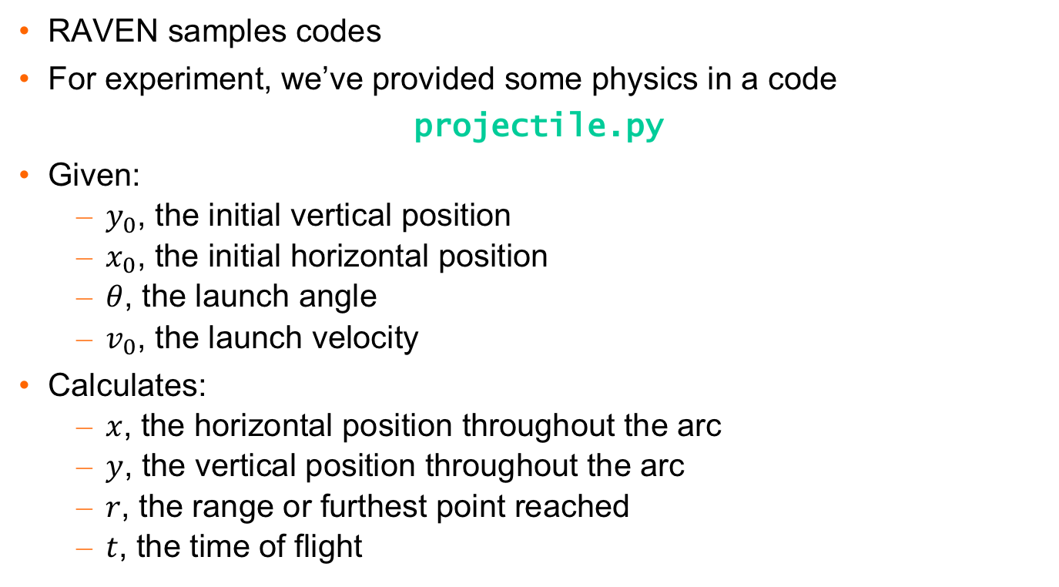
Example Code
RAVEN samples codes
For experiment, we’ve provided some physics in a code
projectile.py
Given:
$y_{0}$, the initial vertical position
$x_{0}$, the initial horizontal position
$θ$, the launch angle
$v_{0}$, the launch velocity
Calculates:
$x$, the horizontal position throughout the arc
$y$, the vertical position throughout the arc
$r$, the range or furthest point reached
$t$, the time of flight

Slide 4
1) Optimizing: Cooler than Sampling
SPSA
Zero-Dimensional Walk
Gradient-based approach
Single-point gradient estimation
Handles stochastic systems
Step growth, shrink based on performance
Multiple trajectories

Slide 5
1) Optimizing: Cooler than Sampling
Open up
(move to console: input, run, output, csv, xml)
> cd raven/doc/workshop/optimizer/exercises
> vim 1_optimize.xml

Slide 6
1) Now try running it
Steps to run
Use raven to run “1_optimize.xml”
See path taken in “to_file_1.csv”
Things to play with
gainGrowthFactor
gainShrinkFactor
Convergence criteria
See user manual, section 11 (13 in old one)
Ready? Go!
Extra: Use EnsembleModel, get the maximum range without exceeding a height of 20 feet

