Slide 1

Ensemble, Logical, and Hybrid Models

Slide 2
RAVEN Models
Codes:
Aimed to interface with physical codes (e.g., RELAP5-3D, etc.)
ROMs:
Aimed to emulate the response of a system based on a simplified mathematical representation (e.g., Gaussian process, neural networks, etc.)
External Models:
Aimed to provide to the user an easy way to implement sets of equations
Post-Processors:
Aimed to analyze the generated datasets (e.g., statistical moments, data mining, etc.)
Ensemble Models:
Aimed to assemble multiple models
Logical models:
Select model execution based on logic function
Hybrid Models:
Automatic model selections

Slide 3
Ensemble Model

Slide 4
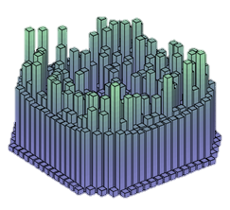
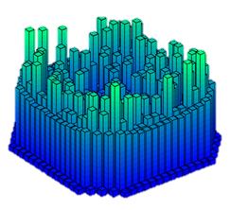
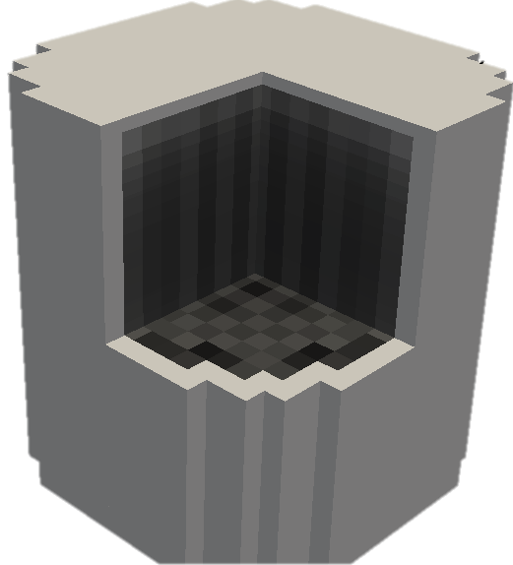
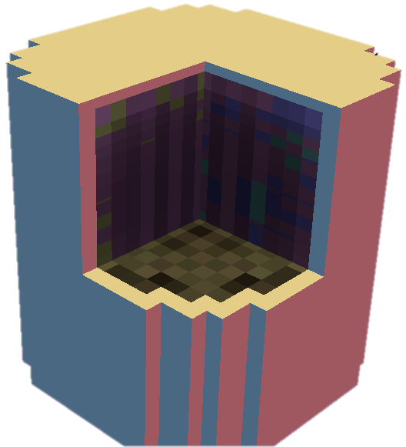
Motivations
In several cases multiple models need to interface with each other since the initial conditions of some are dependent on the outcomes of others
In order to face this “problem” in the RAVEN framework, a new model category has been developed: EnsembleModel
This class assembles multiple RAVEN models by identifying
Input/output connections
Order of execution
Parallel execution strategy for each sub-model
Physics 1
EnsembleModel
Physics 2

Slide 5
Ensemble Model Characteristics
Ability to link all the RAVEN models
Codes, ROMs, external models
No limit on the number of considered models
Capability to link the different RAVEN models through both scalar and vector variables
Scalars (e.g., max cladding temperature)
Vectors (e.g., power history)
Capability to transfer meta-data from the different models (e.g., restart files, etc.)

Slide 6
Ensemble Model: Chain of Models
Model 1
Model N-1
Model N
Model 2
Model 1
Model 3

Slide 7
Ensemble Model: Iterations

Slide 8
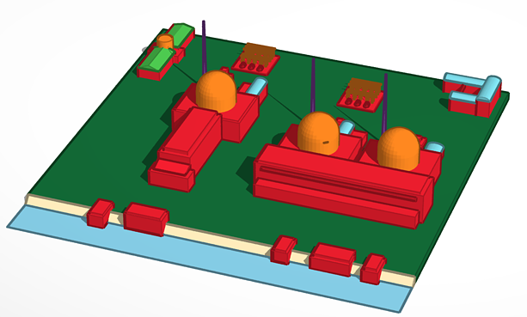
Ensemble Model for Multi-Unit Power Plant
Simulation of a multi-unit plant during a station black out
RAVEN ensemble model
PWR1
Unit 1
SFP1
Plant Logic Model
PWR2
Unit 2
SFP2
PWR3
Unit 3
SFP3

Slide 9
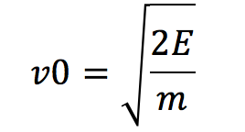
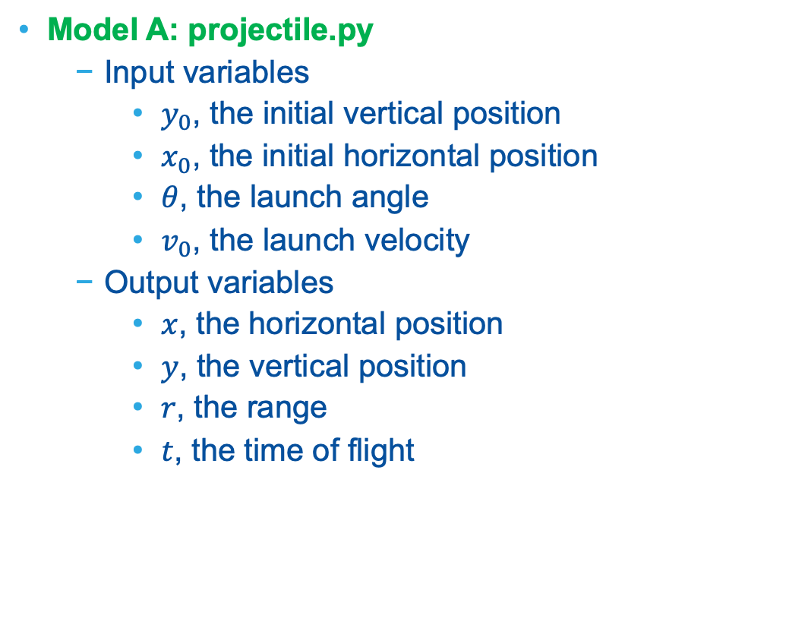
Example
Model A: projectile.py
Input variables
$y_{0}$, the initial vertical position
$x_{0}$, the initial horizontal position
$θ$, the launch angle
$v_{0}$, the launch velocity
Output variables
$x$, the horizontal position
$y$, the vertical position
$r$, the range
$t$, the time of flight
Model B: kineticEnergy.py
Input variables
E, energy
m, mass
Output variable:
v0, velocity
Model B
v0
Model A

Slide 10
Workflow
Create EnsembleModel
Sample the model
Plot results

Slide 11
Create an Ensemble model
Distributions
Models
Samplers
Databases
DataObjects
OutStreams
Steps
<Distributions>
<Normal name=’angle_d'>
<mean>45</mean>
<sigma>5</sigma>
<upperBound>5</upperBound>
<lowerBound>85</lowerBound>
</Normal>
</Distributions>
Distribution parameters

Slide 12
Create an Ensemble model
Distributions
Models
Samplers
Databases
DataObjects
OutStreams
Steps
<Models>
...
<ExternalModel name=’projectile’ subType=’’ ModuleToLoad=’../../projectile’>
<variables>x0,v0,y0,angle,x,y,r,t</variables>
</ExternalModel>
<ExternalModel name=’kineticEnergy’ subType=’’ ModuleToLoad=’../../kineticEnergy’>
<variables>energy,mass,v0</variables>
</ExternalModel>
...
</Models>
List of models we are using

Slide 13
Create an Ensemble model
Distributions
Models
Samplers
Databases
DataObjects
OutStreams
Steps
<Models>
...
<EnsembleModel name=’ensembleModel’ subType=’’>
<Model class=’Models’ type=’ExternalModel’>
projectile
<Input class=’DataObjects’ type=’PointSet’>inputHolder</Input >
<TargetEvaluation class=’DataObjects’ type=’PointSet’>
projectileContainer</TargetEvaluation>
</Model>
<Model class=’Models’ type=’ExternalModel’>
kineticEnergy
<Input class=’DataObjects’ type=’PointSet’>inputHolder</Input >
<TargetEvaluation class=’DataObjects’ type=’PointSet’>
KEnergyContainer</TargetEvaluation>
</Model>
</EnsembleModel>
...
</Models>
Inputs of this model
Exclusive output

Slide 14
Create an Ensemble model
Distributions
Models
Samplers
Databases
DataObjects
OutStreams
Steps
<DataObjects>
<PointSet name=’projectileContainer'>
<Input>x0,y0,v0,angle</Input>
<Output>r,t</Output>
</PointSet>
<PointSet name=’KEnergyContainer’>
<Input>mass,energy</Input>
<Output>v0</Output>
</PointSet>
</DataObjects>
Link

Slide 15
Create an Ensemble model
/raven/doc/workshop/ensembleModels/inputs/ensembleExample/1_ensemble_model.xml
Create an ensemble model: section 15.6
Add DataObjects for TargetEvaluation
Plot using OutStreams
r ~ f(v0, angle, t)

Slide 16
Create An Ensemble Model
/raven/doc/workshop/ensembleModels/inputs/ensembleExample/1_ensemble_model.xml
Create an ensemble model: section 15.6
Update DataObjects and Steps

Slide 17
Let’s run the code…

Slide 18
Hybrid Model

Slide 19
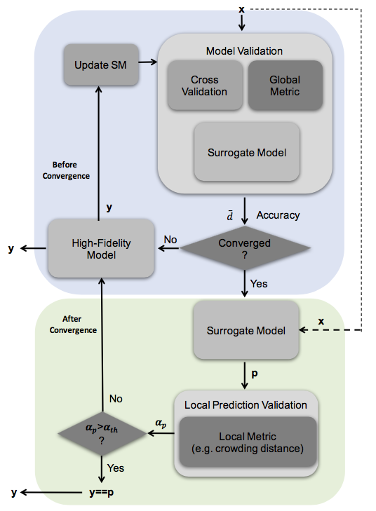
Hybrid-Model: Automatic Selection ROM/Physical Model
HybridModel leverages the EnsembleModel infrastructure
Link models
HybridModel is designed to combine
Low fidelity model (i.e., ROM), and
High fidelity model (i.e., code, external model)
HybridModel decides which model needs to be evaluated
Selection based on the model validation score

Slide 20
Cross-Validation for Assessing Surrogate Models Performance
Starting point: dataset
Workflow
Partition original dataset in two portions: training and testing
Train ROM on training set
Test ROM on training set
Compute a score (e.g., R²)
Dataset
Train
Test

Slide 21
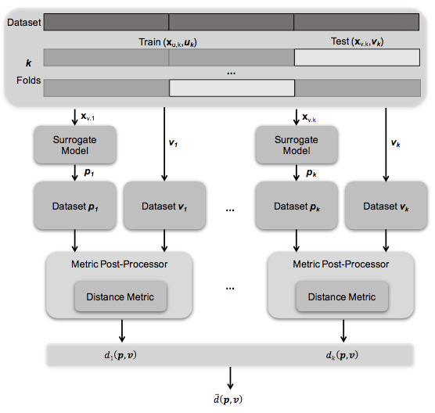
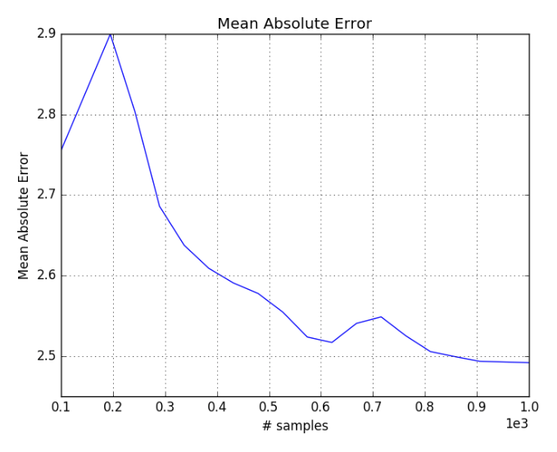
RAVEN: Model Validation Scheme
Mean Absolute Error score (Cross-validation) as function of # samples

Slide 22
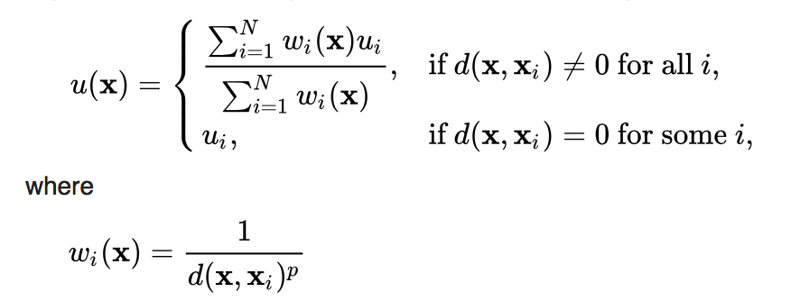

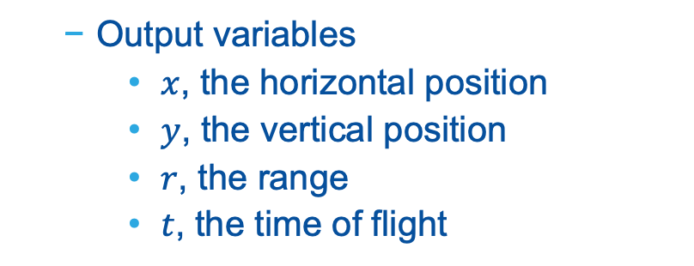
External Model and ROM
External model: projectile.py
Input variables
$y_{0}$, the initial vertical position
$x_{0}$, the initial horizontal position
$θ$, the launch angle
$v_{0}$, the launch velocity
ROM: NDinvDistWeight
Interpolating function
Output variables
$x$, the horizontal position
$y$, the vertical position
$r$, the range
$t$, the time of flight

Slide 23
Workflow
Create HybridModel
Sample the model
Plot results

Slide 24
Create a Hybrid model
Distributions
Models
Samplers
Databases
DataObjects
OutStreams
Metrics
Steps
<Models>
...
<ExternalModel name=’projectile’ subType=’’ ModuleToLoad=’../../projectile’>
<variables>angle,x,y,r,t</variables>
</ExternalModel>
<ROM name=’IDW’ subType=’’>
<Features>angle</Features>
<Target>r</Target>
<p>3</p>
<CV class=’Models’ type=’PostProcessor’>pp1</CV>
</ROM>
...
</Models>
Cross validation processor (see next slide)

Slide 25
Create a Hybrid model
Distributions
Models
Samplers
Databases
DataObjects
OutStreams
Metrics
Steps
<PostProcessor name=’pp1’ subType=’CrossValidation’ >
<SciKitLearn>
<SKLtype>KFold</SKLtype>
<n_splits>10</n_splits>
<shuffle>False</shuffle>
</SciKitLearn>
<Metric class=’Metrics’ type=’SKL’>m1</Metric>
</PostProcessor>
Global cross validation processor settings
Validation Metric
<Metrics>
<SKL name=’m1’ subtype=’SKL’ >
<metricType>regression|mean_absolute_error</metricType>
</SKL>
</Metrics>

Slide 26
Create a Hybrid model
Distributions
Models
Samplers
Databases
DataObjects
OutStreams
Metrics
Steps
<HybridModel name=’hybrid’ subType=’’ >
<Model class=’Models’ type=’ExternalModel’>projectile</Model>
<ROM class=’Models’ type=’ROM’ >IDW</ROM>
<TargetEvaluation class=’DataObjects’ type=’PointSet’>
projectileContainer</TargetEvaluation>
<CV class=’Models’ type=’PostProcessor’>pp1</CV>
<settings>
<tolerance>0.005</tolerance>
<maxTrainSize>1000</maxTrainSize>
<minInitialTrainSize>10</minInitialTrainSize>
</settings>
<validationMethod name=’CrowdingDistance’>
<threshold>0.2</threshold>
</validationMethod>
</HybridModel>
The coupled models (high fidelity model and ROM)
Cross validation processor: measure ROM accuracy
Settings
Local validation metric: high vs. low fidelity model

Slide 27
Create a Hybrid model
Distributions
Models
Samplers
Databases
DataObjects
OutStreams
Metrics
Steps
<DataObjects>
<PointSet name=’outMC’>
<Input>angle</Input>
<Output>r</Output>
</PointSet>
<PointSet name=’projectileContainer’>
<Input>angle</Input>
<Output>r</Output>
</PointSet>
</DataObjects>
Link

Slide 28
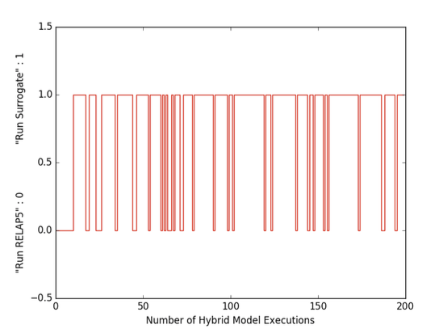
Hybrid Model Application
Example: automatic model selection for a PWR SBO sequence, using RELAP5-3D and a SVM surrogate model
Analysis: 1000 Monte Carlo samples
200 were run using the RELAP5-3D model
Computational time reduction: 800*4 = 3200 CPU hours

Slide 29
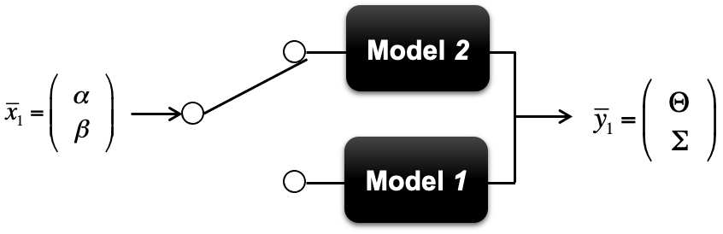

RAVEN Logical Model
The LogicalModel is a model that execute a RAVEN model via a user provided control function
Control function utilizes the inputs generated by RAVEN
Control function determines which model to execute
All models listed under LogicalModel should have the same inputs and outputs
Control function

Slide 30
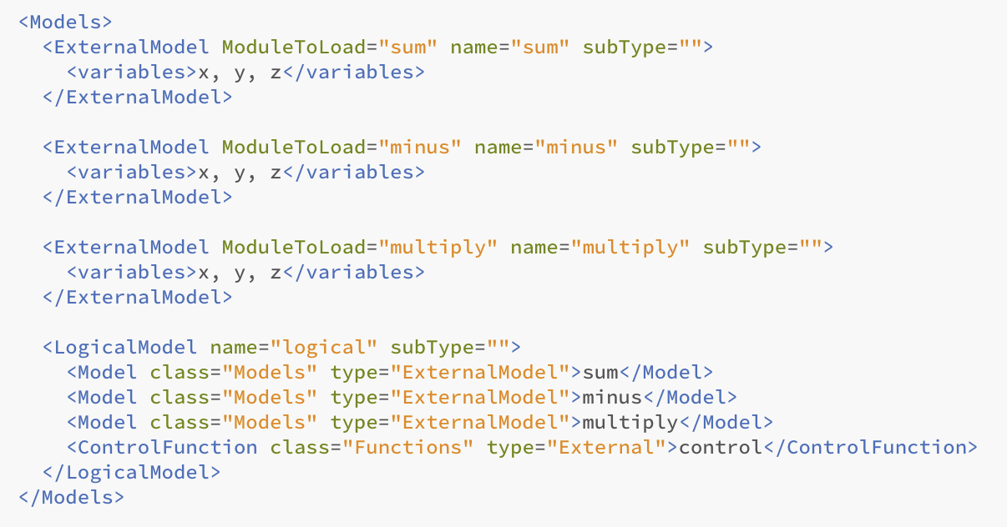
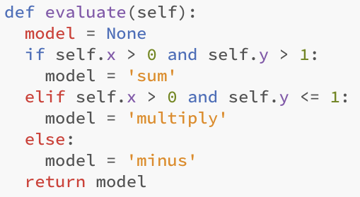
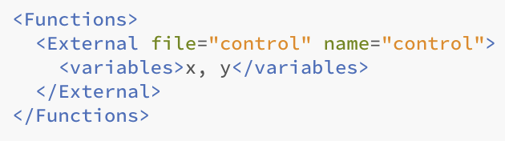
RAVEN Logical Model
Distributions
Samplers
Optimizers
DataObjects
Outstreams
Models
Databases
RunInfo
Steps
Functions

Slide 31
Create A Hybrid Model
/raven/doc/workshop/ensembleModels/inputs/hybridExample/test_hybrid_model.xml
Create a hybrid model: section 15.7
Create a cross validation PostProcessor: section 15.5.13
Create a metric: section 17
Update DataObjects and Steps

