Slide 1

RAVEN Workshop Wrap Up

Slide 2
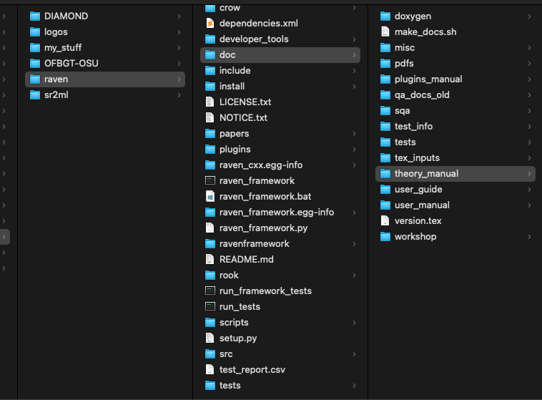
RAVEN Documentation
User guide: a brief guide on how to use RAVEN
Workshop materials: slide sets and examples of specific RAVEN test cases
User manual: detailed guide regarding all RAVEN entities
Theory manual: detailed mathematical description of some RAVEN entities

Slide 3
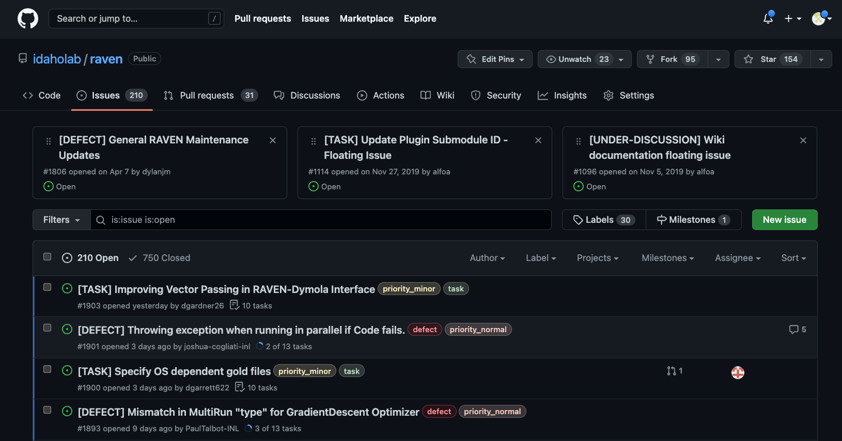
Report an Issue

Slide 4
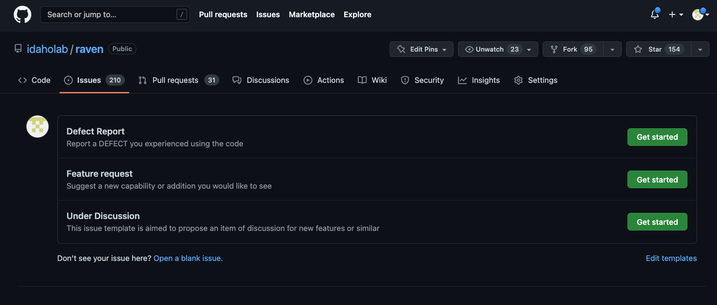
Report an Issue

Slide 5
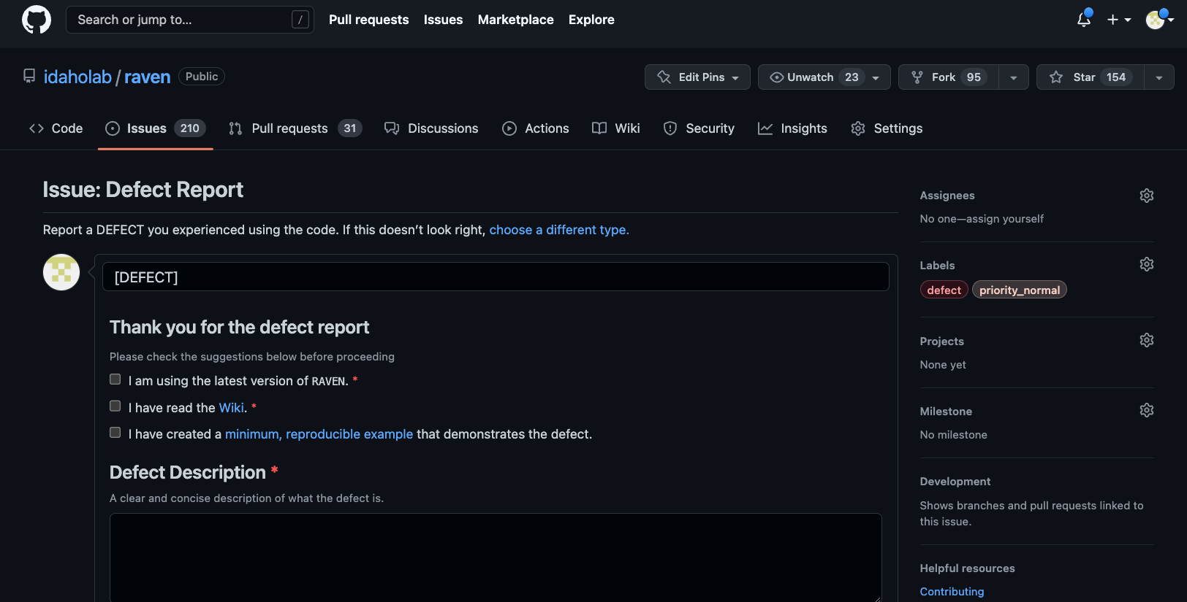
Report an Issue

Slide 6

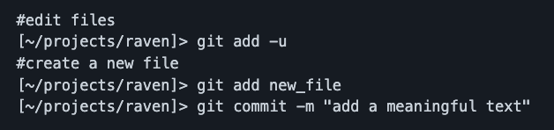

Contributing to RAVEN Development
Developer information
https://github.com/idaholab/raven/wiki/Developer_Information
Steps
Create a new development branch
Perform development
Push development

Slide 7
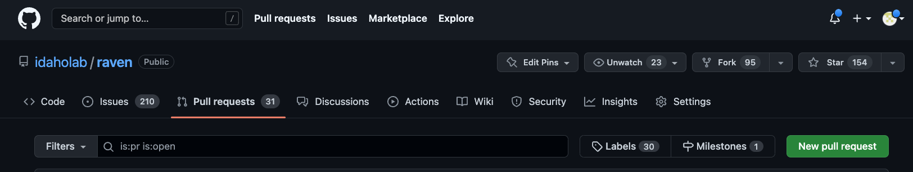
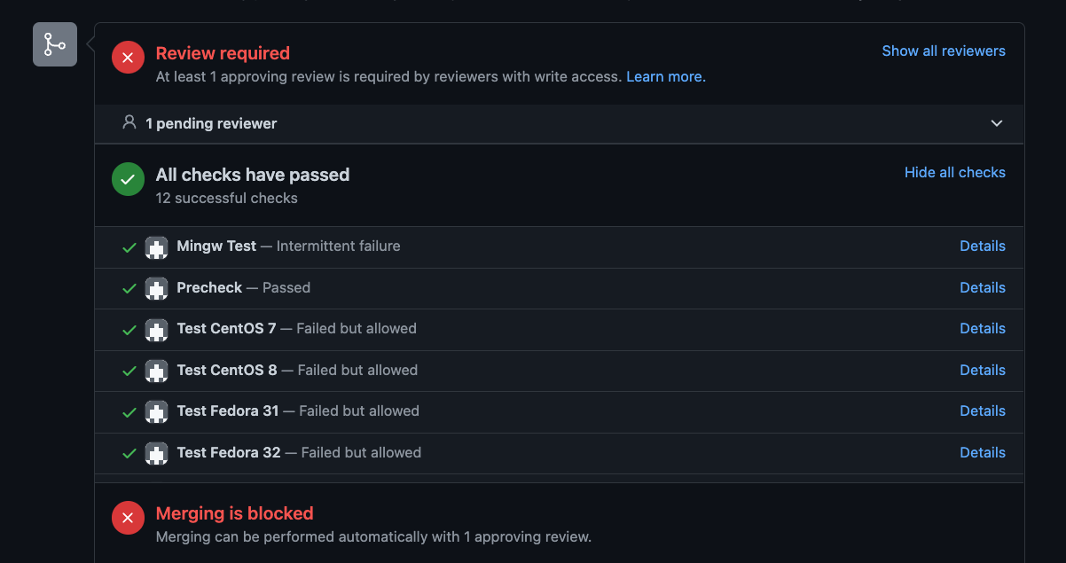
Contributing to RAVEN Development
Create a pull request on GitHub

