Slide 1

RAVEN interaction with External Applications
RAVEN Workshop

Slide 2
Outline
Overview of RAVEN interaction with external Applications
Available APIs: External Model and Code APIs
Coupling a new Application through a Code Interface
Introduction
Code requirements
Interfaces that need to be implemented
Interaction with RAVEN
Practical example of coupling a new code
Code overview
Creation of the input parser (coding)
Creation of the output parser (coding)
Execution of the interface (terminal)

Slide 3
Overview

Slide 4
RAVEN Interaction with External Applications
RAVEN has two preferential APIs to interact with external Applications
External Model: An external Python “entity” that can act as a system model
External Code: API to drive external codes
Both APIs are written in PYTHON
RAVEN
External Model
External Code

Slide 5
Coupling an Application through a code interface

Slide 6
Coupling an Application with RAVEN: Introduction
The procedure of coupling a new Application with RAVEN is a straightforward process
The coupling is performed through a Python Interface
The Interface has two functions:
Interpret the information coming from RAVEN
Translate such information in the input of the driven code
The coupling procedure does not require any modification of RAVEN
embedded
External Code
RAVEN
Interpreting information coming from RAVEN
Translating them in the Application Input

Slide 7
Choose how to couple your Application to RAVEN
External Code
Structured text input file?
Create Code Interface (Input)
no
yes
No need to create an interface: GenericCode
CSV output?
CSV output?
Create an output parser
yes
no
no
yes
Inherit from GenericCode and create an output parser
No need to create an output parser: RAVEN reads CSVs

Slide 8
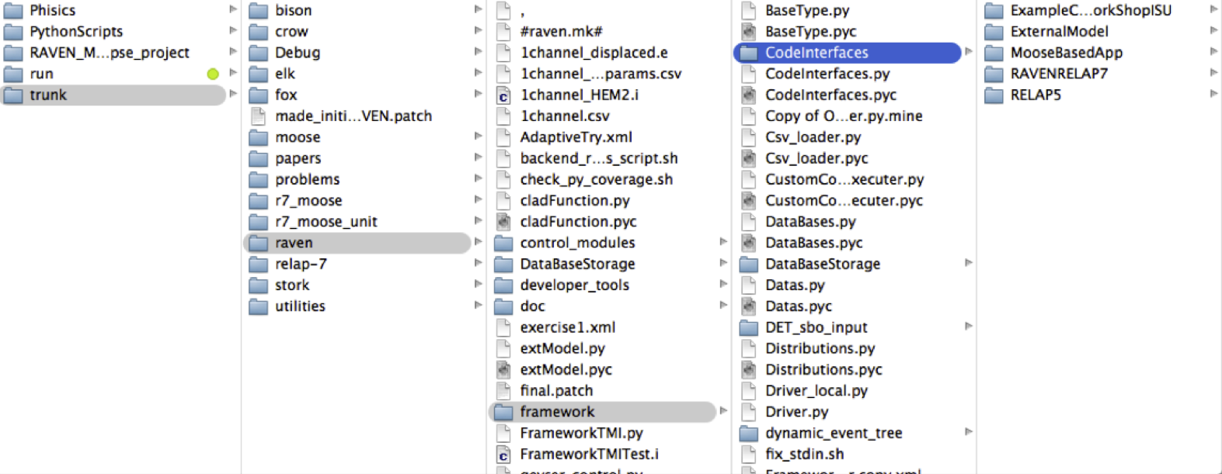
Coupling an Application with RAVEN: Interfaces
RAVEN becomes aware of the codes it can use as Models only at run-time
RAVEN looks for code interfaces and loads them automatically
The code interface needs to be placed in a new folder under the directory “./raven/framework/CodeInterfaces”

Slide 9
Coupling strategy: GenericCode interface
The GenericCode interface is meant to handle a wide variety of generic codes. The GenericCode interface can be used if the code:
Accepts a keyword-based input file with no cross dependent inputs
The outputs are stored in a CSV file
Variable needs to be marked in the original input file
External Code
<variableToChange>
$RAVEN-variableName$
</variableToChange>
Structured text input file?
<Code>
<executable>path/to/exe</executable>
<inputExtcensions>
.xml,.aux
</inputExtcensions>
<clargs type=’prepend’ arg=’python’/>
<clargs type=’input’ arg=’-i’
extension=’.xml’/>
<clargs type=’input’ arg=’-aux’
extension=’.aux’/>
<clargs type=’output’ arg=’-o’/>
</Code>
yes
No need to create an interface: GenericCode
CSV output?
yes

Slide 10
Coupling strategy: No text-based input format
If the code input file is not text-based (e.g. binary) or too complicated to handle with “wild-cards”, the GenericCode interface can not be used:
An input-parser needs to be created
If the output file is a CSV, no other parsers are needed
External Code
Structured text input file?
Create Code Interface (Input)
no
class parserBinaryInput():
def __init__(self,filen):
bytes=open(filen,”rb”).read() self.unPack = struct.unpack(”FMT”, bytes)
def perturbTheInput(self,inDictionary):
# perturb the binary file
def writeNewInput(self,filen):
fileObj = open(filen, ”wb”)
fileObj.write(struct.pack(”FMT”, self.unPack))
CSV output?
yes
No need to create an output parser: RAVEN reads CSVs

Slide 11
Coupling strategy: Text input but no CSV output
External Code
If the code input file is text-based, the GenericCode interface can be used for the input perturbation
If the output file is not a CSV, an output parser needs to be created
Structured text input file?
def convertOutputFileToCSV(outfile):
keyDict = {}
CSVfile = open(outputfile + ’.csv’)
lines = open(outputfile).readlines()
for line in lines:
values = line.split("=")
key,val = values[0], values[1]
keyDict[key] = val
CSVfile.write(’,’.join(keyDict.keys()))
CSVfile.write(’,’.join(keyDict.values()))
yes
CSV output?
no
Inherit from GenericCode and create an output parser

Slide 12
Coupling strategy: Brand-new interface
If the input structure is too complicated or the interface developer prefers a more specific perturbation syntax and the output file is not a CSV, a new code interface needs to be created:
Input Parser, for the input reading and perturbation
Output Parser, for converting the output file(s) into a single CSV
External Code
Structured text input file?
Create Code Interface (Input)
no
CSV output?
Create an output parser
no

Slide 13
Coupling an App with RAVEN: Methods
RAVEN imports all the “Code Interfaces” at run-time, without actually knowing the syntax of the driven codes
In order to make RAVEN able to drive a new Application, a Python module containing few methods (strict syntax) needs to be implemented:
class newApplication(CodeInterfaceBase):
def generateCommand(self,input,exe,clargs,fargs)
Required
def createNewInput(self,inputs,oinputs,samplerType,**Kwargs)
Required
def initialize(self,runInfo, oinputs)
Optional
def finalizeCodeOutput(self,command,output,workDir)
Optional
def checkForOutputFailure(self,output,workDir)
Optional
def getInputExtension(self)
Optional
def setInputExtension(self, exts)
Optional
def setRunOnShell(self, shell=True)
Optional

Slide 14
Coupling an Application with RAVEN: generateCommand
Used to:
retrieve the command needed to launch the driven Application
retrieve the root of the output file
The return data type must be a TUPLE
def generateCommand(self,inputs,exe,clargs,fargs):
(…)
return (executeCommand,outfile)
Required
Arguments:
inputs: list of current input files
exe: executable absolute path
clargs: dictionary of command line flags the user can specify under the <Code> block
fargs: dictionary of command line flags for identifying auxiliary
input files that the user can specify under the <Code> block

Slide 15
Coupling an Application with RAVEN: createNewInput
Used to generate an input based on the information that RAVEN s
This method needs to return a list containing the path and filenames of the modified input files
def createNewInput(self,inputs,oinputs,samplerType,**Kwargs):
(…)
return newInputFiles
Required
Arguments:
inputs : list of current input files (the one that should be modified)
oinputs : list of original input files (unperturbed ones)
samplerTyp: sampler type (e.g. None, MonteCarlo, Grid, etc.)
Kwargs : dictionary of all the information needed to create an input. Eg:
executable: executable absolute path
SampledVars: dictionary of the sampled variables ({’var1”:newValue}
ProbabilityWeight: float representing the Pb weight of this realization
crowDist: dictionary containing the info regarding the distributions associated to the variables
etc.
Notes:
It needs to modify the input file, accordingly with respect to the variables RAVEN is providing.

Slide 16
Coupling an Application with RAVEN: initialize
This method is called, if present, by RAVEN at the begin of each Step. It can be used, for example, to retrieve info from the input files before an actual perturbation (sampling) begins.
def initialize(self,runInfo, oinputs):
(…)
Optional
Arguments:
runInfo : dictionary of the info contained in the <RunInfo> XML block of the RAVEN input file
oinputs : list of the Step origianl input files

Slide 17
Coupling an Application with RAVEN: finalizeCodeOutput
This method is called, if present, by RAVEN at the end of each run. It can be used, for example, to convert the whatever Application output format into a CSV
RAVEN checks if a string is returned
RAVEN interprets that string as the new output file root
def finalizeCodeOutput(self,command,output,workDir):
(…)
return newOutputRoot
Optional
Arguments:
command : the command that has been generated by
generateCommand method
output : the current output root (from generateCommand method)
workDir : the current working directory (where the code is currently outputting)
Notes:
It needs to modify the input file, accordingly with respect to the variables RAVEN is providing.

Slide 18
Coupling an App with RAVEN: checkForOutputFailure
Used to check if a run failed even if the returncode = 0
This method is called, if present, by RAVEN at the end of each run.
It must return a Boolean value. True if failure, False otherwise
def checkForOutputFailure(self,output,workDir):
(…)
return failure
Optional
Optional
Arguments:
output : the current output root (from generateCommand method)
workDir : the current working directory (where the code is currently outputting)
Notes:
This method is called by RAVEN at the end of each run if the return code is == 0.
This method needs to be implemented by the codes that, if the run fails, return a return code that is 0
This can happen in those codes that record the failure of the job (e.g. not converged, etc.) as normal termination (returncode == 0)
This method can be used, for example, to parse the outputfile looking for a special keyword that testifies that a particular job got failed

Slide 19
Practical example

Slide 20
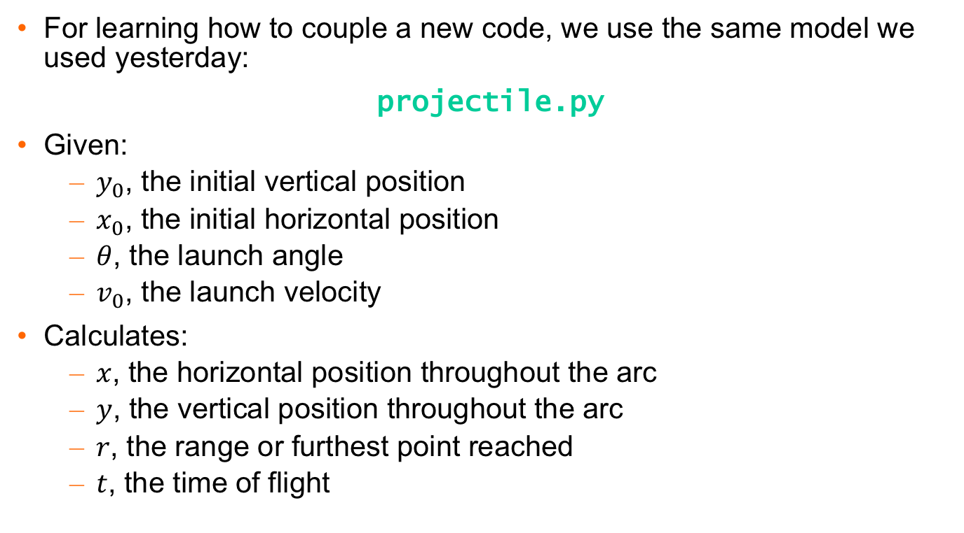
Practical example: the code we want to couple…
For learning how to couple a new code, we use the same model we used yesterday:
projectile.py
Given:
$y_{0}$, the initial vertical position
$x_{0}$, the initial horizontal position
$θ$, the launch angle
$v_{0}$, the launch velocity
Calculates:
$x$, the horizontal position throughout the arc
$y$, the vertical position throughout the arc
$r$, the range or furthest point reached
$t$, the time of flight

Slide 21
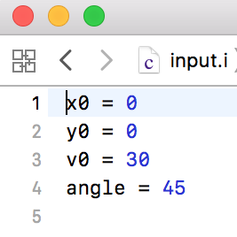
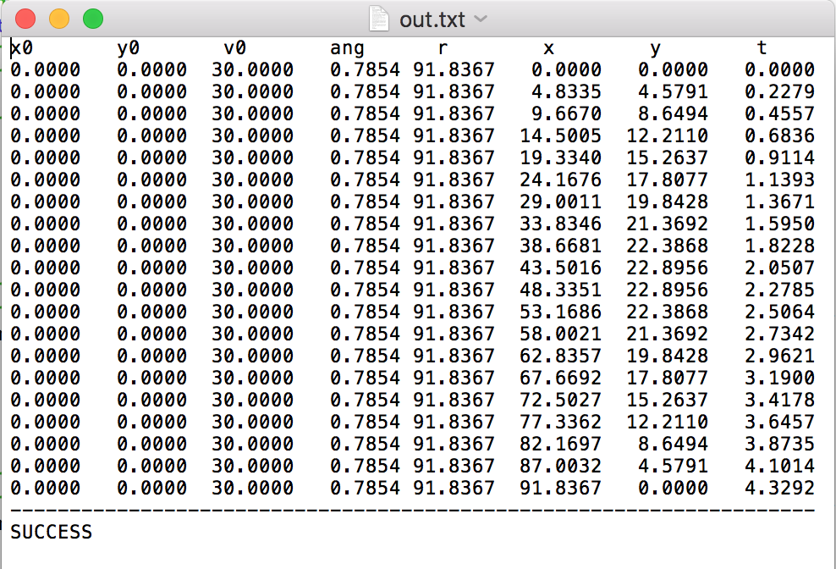
Practical example: Simple code I/O overview
Input File
Text output
> cd doc/workshop/ExternalModels
> python projectile.py -i input.i -o out -text

Slide 22
Practical example: 2 Options… One choice…
This simple code allows to test two distinct examples:
Creation of a brand new interface (parsing the Text input and the Text Output)
Usage of the GenericCode interface since the Text input can be perturbed with “wild-cards” and the code can already generate CSV files
External Code
External Code
Structured text input file?
Create an output parser
Structured text input file?
yes
no
no
No need to create an interface: GenericCode
CSV output?
Create Code Interface (Input)
CSV output?
yes

Slide 23
What we want RAVEN to do
Create a code interface
Code a Python input parser (method) to perturb the projectile.py input file
Code a Python output parser (method) to perturb the projectile.py output file
Code a Python method to generate the nomenclature of the command needed to execute the projectile.py code
How do we tell RAVEN to do this?

Slide 24
Exercise 1
Sample and Plot

Slide 25
Thank you Questions?

