Slide 1

Introduction to RAVEN Machine Learning Models and External Models
RAVEN Workshop

Slide 2
Focus of This Slide Set: Models
External models: Python-based modules
Reduced order models (ROMs): Surrogate models
Codes: Through code interfaces
Distributions
Samplers
Optimizers
Models
Outstreams
DataObjects
Databases
RunInfo
Steps

Slide 3
Focus of This Slide Set: Models
RAVEN has two preferential APIs to interact with external applications
External Model: An external Python “entity” that can act as a system model
External Code: API to drive external codes
Both APIs are written in Python
RAVEN
External Model
External Code

Slide 4
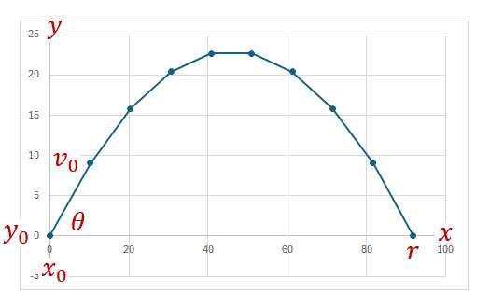

External Models
Example model: projectile.py
Input:
$y_{0}$, the initial vertical position
$x_{0}$, the initial horizontal position
$θ$, the launch angle
$v_{0}$, the launch velocity
Output:
$x$, the horizontal position throughout the arc
$y$, the vertical position throughout the arc
$r$, the range or furthest point reached
$t$, the time of flight

Slide 5
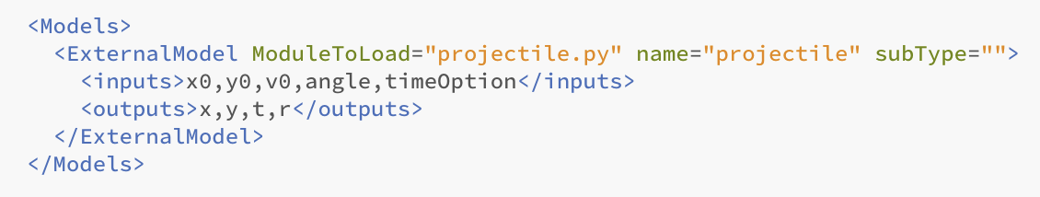
External Models
User manual reference: Section 15.4
Models coded in Python in an external file
XML node ID: ExternalModel
Distributions
Samplers
ID in RAVEN input file
Optimizers
File to be loaded
Models
Outstreams
DataObjects
Databases
RunInfo
Steps
Set of output variables
Set of input variables
Note: <variables> node is deprecated

Slide 6
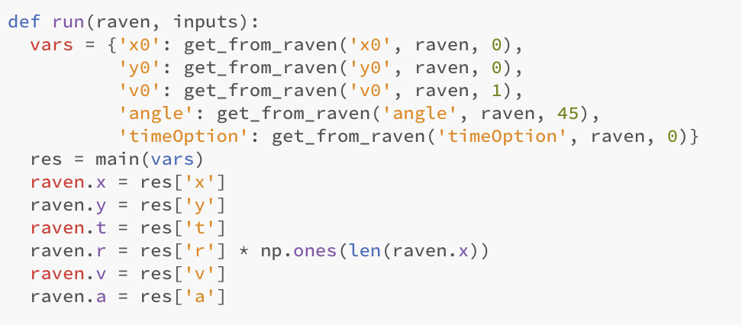
External Models
Required methods
run
Optional methods
initialize
_readmoreXML
createNewInput
Retrieve input variables from RAVEN
Alternative:
inputs.get('x0', 1.0)
Internal computation method(s)
Pass output variables to RAVEN

Slide 7
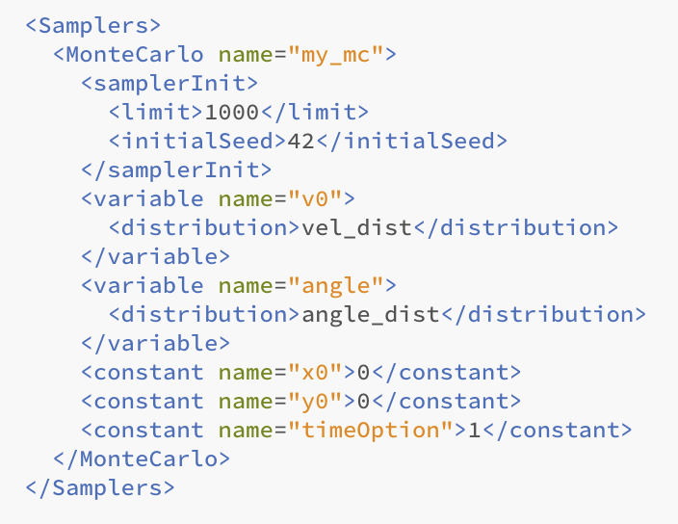
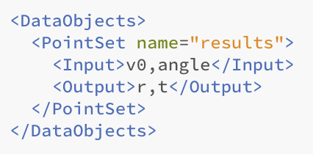
External Models
Distributions
Samplers
Optimizers
Models
Outstreams
DataObjects
Databases
RunInfo
Steps

Slide 8
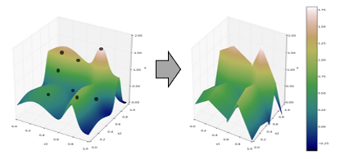



Reduced Order Models
Consider a set of N data points
Build a ROM $G\left(x\right):x_{i}→$ $G\left(x_{i}\right)≅F\left(x_{i}\right)$
Output: Simulation outcome (success or failure, max clad temperature)
Data
Inputs: Initial and boundary conditions
$$F\left(x\right)$$
$$G\left(x\right)$$

Slide 9
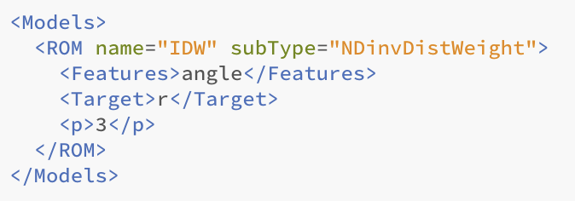
Reduced Order Models in RAVEN
Distributions
ID in RAVEN input file
Type of ROM
Samplers
Optimizers
Models
Outstreams
DataObjects
Databases
RunInfo
ROM parameters (check user_manual)
Steps

Slide 10
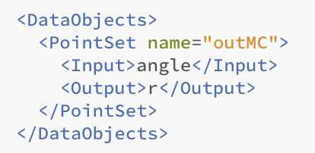
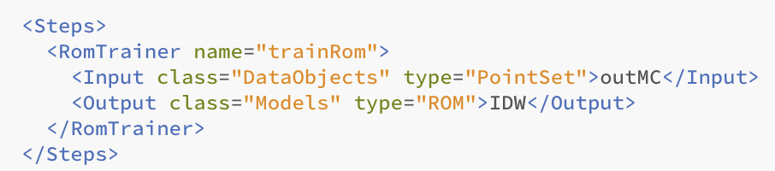
Reduced Order Models
Distributions
Samplers
Optimizers
Models
Outstreams
DataObjects
Databases
RunInfo
Steps

Slide 11
Codes
The procedure of coupling a new application with RAVEN is a straightforward process
The coupling is performed through a Python interface
Interpret the information generated by RAVEN
Pass such information to the code
Retrieve data generated by the code
The coupling procedure does not require any modification of RAVEN
Distributions
Samplers
Optimizers
Models
Outstreams
Sampled values
DataObjects
Databases
RAVEN
External Code
RunInfo
Steps
Code output

Slide 12
Codes: Code Interfaces
RAVEN imports all the “Code Interfaces” at run-time (without actually knowing the syntax of the driven codes)
In order to make RAVEN able to drive a new code, a Python module containing a few methods (strict syntax) needs to be implemented
class newApplication(CodeInterfaceBase):
def generateCommand(self,input,exe,clargs,fargs)
Required
def createNewInput(self,inputs,oinputs,samplerType,**Kwargs)
Required
def initialize(self,runInfo, oinputs)
Optional
def finalizeCodeOutput(self,command,output,workDir)
Optional
def checkForOutputFailure(self,output,workDir)
Optional
def getInputExtension(self)
Optional
def setInputExtension(self, exts)
Optional
def setRunOnShell(self, shell=True)
Optional

Slide 13
Codes: GenericCode Interface
The GenericCode interface is designed to handle a wide variety of generic codes
User manual reference: Section 19.1
The GenericCode interface can be used if the code
Accepts a keyword-based input file with no cross dependent inputs
Stores the outputs in a CSV file
Distributions
Samplers
Optimizers
<variableToChange>
$RAVEN-variableName$
</variableToChange>
Variable needs to be marked in the original input file
Models
Outstreams
<Code>
<executable>path/to/exe</executable>
<inputExtensions>.xml,.aux</inputExtensions>
<clargs type=’prepend’ arg=’python’/>
<clargs type=’input’ arg=’-i’
extension=’.xml’/>
<clargs type=’input’ arg=’-aux’
extension=’.aux’/>
<clargs type=’output’ arg=’-o’/>
</Code>
DataObjects
Databases
RunInfo
Steps

