Slide 1

Static Data Analysis and Mining with RAVEN
RAVEN workshop

Slide 2
Getting on the same page
This workshop will include interactive examples
paths given starting at raven (raven/)
Slides are provided as well:
~> cd projects/raven
~/projects/raven> git checkout devel
~/projects/raven> git pull
raven/doc/workshop/staticDataAnalysis

Slide 3
Outline
Introduction
Clustering methods in RAVEN
Dimensionality reduction in RAVEN
Clustering example
Dimensionality reduction example

Slide 4
Data Mining
Extraction of implicit, previously unknown and potentially useful information from data
Exploration and analysis, by automatic or semi-automatic means, of large quantities of data in order to discover meaningful patterns
Alternative names
Knowledge discovery (mining) in databases (KDD)
Knowledge extraction
Data/pattern analysis
Data archeology
Information harvesting

Slide 5
Why Data Mining?
Data mining is fairly new in the context considered here….
Opportunity
In uncertainty quantification/sensitivity analysis large data is generated
Computers and electronic storage are cheaper and faster
Needs
Understand/gain knowledge on both input and output space
Drowning in data but starving knowledge
Extraction of interesting knowledge (rules, regularities, patterns, constraints) from data in large databases

Slide 6
Clustering
Partitioning large data sets in different groups (i.e., clusters)
Useful for finding different regions in the output with “similar behavior”
In RAVEN several clustering methods are available (scikit-learn):
Gaussian mixture models
K-Means
Affinity
Mean shift
Spectral clustering
DBSCAN

Slide 7
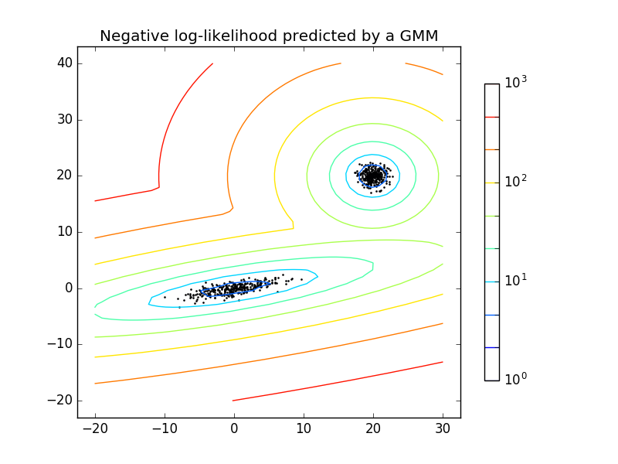
Gaussian Mixture Model
Probabilistic model that assumes all the data points are generated from a mixture of a finite number of Gaussian distributions with unknown parameters
It incorporates information about the covariance structure of the data as well as the centers of the latent Gaussians
Two-component Gaussian mixture model: data points, and
equi-probability surfaces of the model [source sklearn]

Slide 8
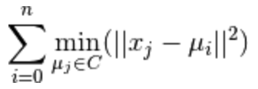
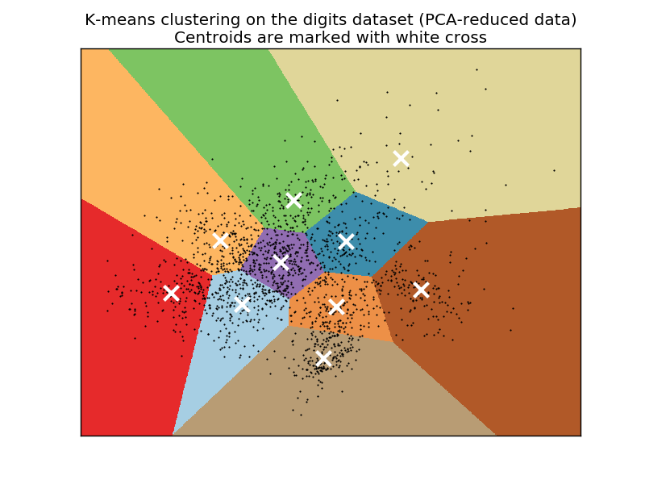
K-Means
Method to cluster data by trying to separate samples in n groups of equal variance, minimizing a criterion known as the inertia
The algorithm divides a set of N samples X into K disjoint clusters C, each described by the mean μ_{i} of the samples in the cluster (centroids)
The K-means algorithm chooses centroids that minimize the inertia:

Slide 9
Dimensionality Reduction
Used when datasets have many dimensions
Used to avoid the “curse of dimensionality”
Available methods in RAVEN
Principle Component Analysis
Truncated Singular Value Decomposition and Latent Semantic Analysis
Independent Component Analysis

Slide 10
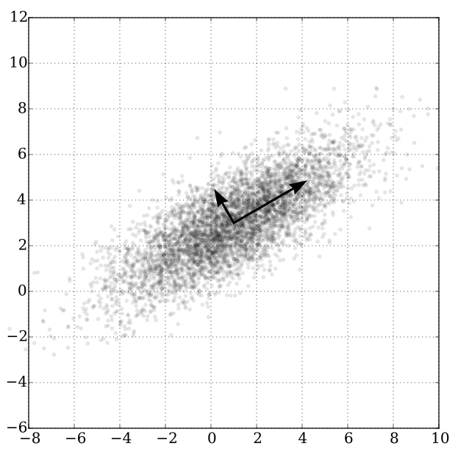
Principal Component Analysis
PCA is used to decompose a multivariate dataset in a set of successive orthogonal components that explain a maximum amount of the variance

Slide 11
RAVEN Example 1 Gaussian Mixture Clustering

Slide 12
RAVEN Example 1: Gaussian Mixture Clustering
Steps
Load data-set
Post-Process the data
Create a dataObject (PointSet) and plot the results

Slide 13
RAVEN Example 1: Gaussian Mixture Clustering
Distributions
Models
Samplers
Databases
DataObjects
Steps
<Models>
<PostProcessor name="GuassianMixtureBlobs" subType="DataMining">
<KDD lib="SciKitLearn">
<Features>x1,x2</Features>
<SKLtype>mixture|GMM</SKLtype>
<covariance_type>full</covariance_type>
<n_components>3</n_components>
<n_iter>10000</n_iter>
<init_params>wc</init_params>
</KDD>
</PostProcessor>
</Models>
Input file name: test_dataMiningGaussianMixture.xml

Slide 14
RAVEN Example 1: Gaussian Mixture Clustering
Distributions
Models
Samplers
Databases
DataObjects
Steps
<Steps>
<IOStep name="readIn">
<Input class="Files" type="" >DataSetsFile</Input>
<Output class="DataObjects" type="PointSet" >DataSets</Output>
</IOStep>
<PostProcess name="GaussianMixtureBlobs">
<Input class="DataObjects" type="PointSet" >DataSets</Input>
<Model class="Models" type="PostProcessor” >GaussianMixtureBlobs</Model>
<Output class="DataObjects" type="PointSet" >DataSets</Output>
<Output class="OutStreams" type="Plot" >Plotdata</Output>
</PostProcess>
<IOStep name="output">
<Input class="DataObjects" type="PointSet" >DataSets</Input>
<Output class="OutStreams" type="Plot" >PlotGaussianMixtureBlobs</Output>
</IOStep>
</Steps>
Input file name: test_dataMiningGaussianMixture.xml

Slide 15
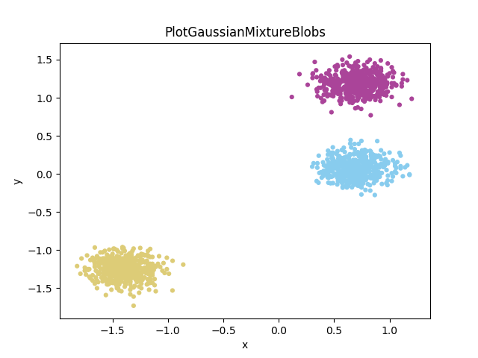
RAVEN Example 1: Gaussian Mixture Clustering

Slide 16
RAVEN Example 2 K-Means Clustering

Slide 17
RAVEN Example 2: K-Means Clustering
Steps
Load data-set (fuel performance)
Post-Process the data
Create a dataObject (PointSet) and plot the results

Slide 18
RAVEN Example 2: K-Means Clustering
Distributions
Models
Samplers
Databases
DataObjects
Steps
<Models>
<PostProcessor name="KMeans1" subType="DataMining">
<KDD lib="SciKitLearn">
<Features>output</Features>
<SKLtype>cluster|KMeans</SKLtype>
<n_clusters>5</n_clusters>
<precompute_distances>True</precompute_distances>
<init>k-means++</init>
</KDD>
</PostProcessor>
</Models>
Input file name: test_dataMiningKMeans.xml

Slide 19
RAVEN Example 2: K-Means Clustering
Distributions
Models
Samplers
Databases
DataObjects
Steps
<Steps>
<IOStep name="readIn">
<Input class="Files" type="" >bisonDBCSV</Input>
<Output class="DataObjects" type="PointSet" >bisonData</Output>
</IOStep>
<PostProcess name="GaussianMixtureBlobs">
<Input class="DataObjects" type="PointSet" >bisonData</Input>
<Model class="Models" type="PostProcessor" >KMeans1</Model>
<Output class="DataObjects" type="PointSet" >bisonData</Output>
<Output class="OutStreams" type="Plot" >PlotKMeans1</Output>
<Output class="OutStreams" type="Plot" >PlotAll</Output>
<Output class="OutStreams" type="Print" >dump_data</Output>
</PostProcess>
</Steps>
Input file name: test_dataMiningKMeans.xml

Slide 20
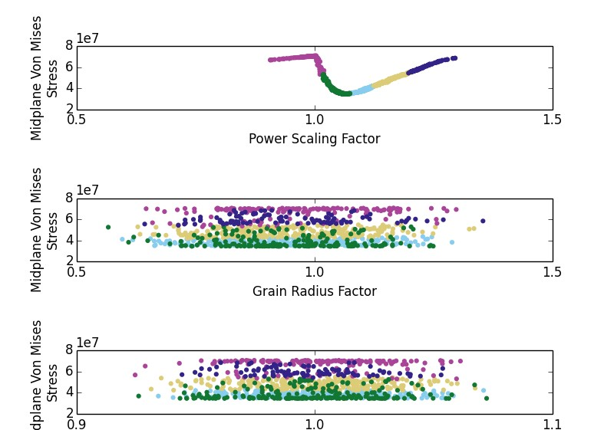
RAVEN Example 2: K-Means Clustering

Slide 21
RAVEN Example 3 PCA Dimensionality Reduction

Slide 22
RAVEN Example 3: Dimensionality Reduction
Steps
Load data-set (iris database)
Post-Process the data
Create a dataObject (PointSet) and plot the results

Slide 23
RAVEN Example 3: Dimensionality Reduction
Distributions
Models
Samplers
Databases
DataObjects
Steps
<Models>
<PostProcessor name="PCA" subType="DataMining">
<KDD lib="SciKitLearn">
<Features>x1,x2,x3,x4</Features>
<SKLtype>decomposition|PCA</SKLtype>
<n_components>2</n_components>
</KDD>
</PostProcessor>
</Models>
Input file name: test_dataMiningExactPCA.xml

Slide 24
RAVEN Example 3: Dimensionality Reduction
Distributions
Models
Samplers
Databases
DataObjects
Steps
<Steps>
<IOStep name="readIn">
<Input class="Files" type="" >DataSetsFile</Input>
<Output class="DataObjects" type="PointSet" >DataSets</Output>
</IOStep>
<PostProcess name="PCAIris">
<Input class="DataObjects" type="PointSet" >DataSets</Input>
<Model class="Models" type="PostProcessor" >PCA</Model>
<Output class="DataObjects" type="PointSet" >DataSets</Output>
<Output class="OutStreams" type="Plot" >Plotdata</Output>
</PostProcess>
<IOStep name=”output">
<Input class="DataObjects" type="PointSet" >DataSets</Input>
<Output class="OutStreams" type="Plot" >PlotGaussianMixtureBlobs</Output>
</IOStep>
</Steps>
Input file name: test_dataMiningExactPCA.xml

Slide 25
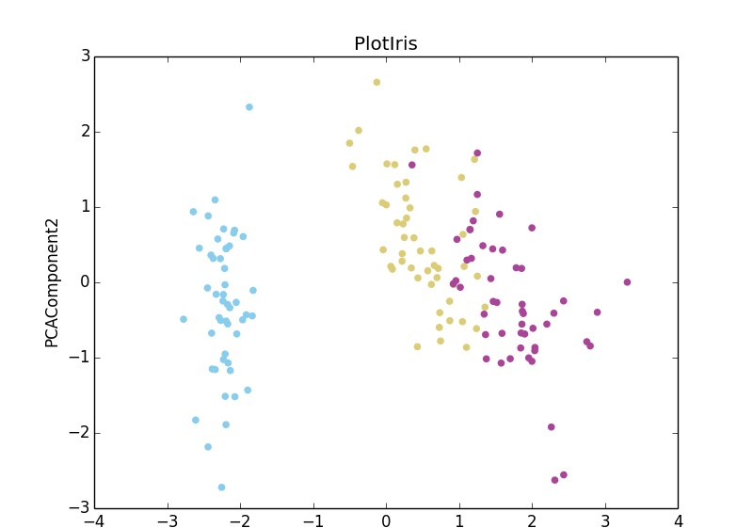
Exact PCA Dimensionality Reduction Example Output

Slide 26
Exercises
Look at:
File: test_dataMiningMeanShift.xml
Folder: /MeanShift/
Performs the following:
Load data
Cluster the data using Meanshift algorithm
Raw data: /MeanShift/PlotAll_scatter.png
Cluster Colored: /MeanShift/PlotClustered_scatter.png

Slide 27
Hands-On Exercise: Projectile
Copy a new file:
From raven/doc/workshop/forwardSampling/exercises/1_sample_and_plot.xml
To raven/doc/workshop/staticDataMining/inputs/prj_cluster.xml
Add a PostProcess step to the Steps to cluster Projectile output
Input is ”results” data object
Model and Output are a new model and new data object
Also add an Outstream Plot to the Outputs
Add a PostProcesser model to the Models to do the clustering
KMeans with 3 clusters, or choose your own!
Cluster on “r”, or “t”, or both!
Add the output DataObject, just like “results” but with the labels
Add a plot to show the results of the clustering
Plot angle and v0 on x, y axis
Plot cluster labels as colors
Can we derive information from the clustering?

