Slide 1

INL/MIS-22-68227
RAVEN Interaction with
External Codes

Slide 2
RAVEN Interaction with External Applications
Overview of RAVEN interaction with external codes
Available APIs: External model and code APIs
RAVEN has two preferential APIs to interact with external applications
External Model: An external Python “entity” that can act as a system model
External Code: API to drive external codes
Both APIs are written in Python
Coupling a code through a code interface
Introduction
Code requirements
Interfaces that need to be implemented
Interaction with RAVEN
RAVEN
External Model
External Code

Slide 3
Coupling a Code with RAVEN: Introduction
The procedure of coupling a new application with RAVEN is a straightforward process
The coupling is performed through a Python interface
Interpret the information generated by RAVEN
Pass such information to the code
Retrieve data generated by the code
The coupling procedure does not require any modification of RAVEN
embedded
External Code
RAVEN

Slide 4
How to Couple a Code to RAVEN
External Code
Structured text input file?
Create code interface (Input)
no
yes
No need to create an interface: GenericCode
CSV output?
CSV output?
Create an output parser
yes
no
no
yes
Inherit from GenericCode and create an output parser
No need to create an output parser: RAVEN reads CSVs

Slide 5
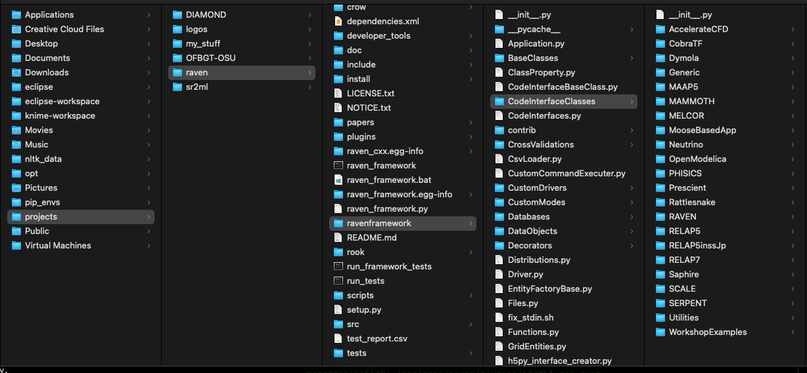
Coupling a Code with RAVEN: Interfaces
RAVEN becomes aware of the codes it can use as “Models” only at run-time
RAVEN looks for code interfaces and loads them automatically
Code interface needs to be placed in a new folder under the directory
./raven/framework/CodeInterfaces

Slide 6
Coupling Strategy: GenericCode Interface
The GenericCode interface is designed to handle a wide variety of generic codes
The GenericCode interface can be used if the code
Accepts a keyword-based input file with no cross dependent inputs
Stores the outputs in a CSV file
External Code
<variableToChange>
$RAVEN-variableName$
</variableToChange>
Variable needs to be marked in the original input file
Structured text input file?
<Code>
<executable>path/to/exe</executable>
<inputExtensions>.xml,.aux</inputExtensions>
<clargs type=’prepend’ arg=’python’/>
<clargs type=’input’ arg=’-i’
extension=’.xml’/>
<clargs type=’input’ arg=’-aux’
extension=’.aux’/>
<clargs type=’output’ arg=’-o’/>
</Code>
yes
No need to create an interface: GenericCode
CSV output?
yes

Slide 7
Coupling Strategy: No Text-Based Input Format
If the code input file is not text-based (e.g., binary) or too complicated to handle with “wild-cards,” the GenericCode interface cannot be used
An input-parser needs to be created
If the output file is a CSV, no other parsers are needed
External Code
Structured text input file?
Create Code Interface (Input)
no
class parserBinaryInput():
def __init__(self,filen):
bytes=open(filen,”rb”).read() self.unPack = struct.unpack(”FMT”, bytes)
def perturbTheInput(self,inDictionary):
# perturb the binary file
def writeNewInput(self,filen):
fileObj = open(filen, ”wb”)
fileObj.write(struct.pack(”FMT”, self.unPack))
CSV output?
yes
No need to create an output parser: RAVEN reads CSVs

Slide 8
Coupling Strategy: Text Input but No CSV Output
If the code input file is text-based, the GenericCode interface can be used for the input perturbation
If the output file is not a CSV, an output parser needs to be created
External Code
Structured text input file?
def convertOutputFileToCSV(outfile):
keyDict = {}
CSVfile = open(outputfile + ’.csv’)
lines = open(outputfile).readlines()
for line in lines:
values = line.split("=")
key,val = values[0], values[1]
keyDict[key] = val
CSVfile.write(’,’.join(keyDict.keys()))
CSVfile.write(’,’.join(keyDict.values()))
yes
CSV output?
no
Inherit from GenericCode and create an output parser

Slide 9
Coupling Strategy: Brand-New Interface
A new code interface needs to be created if
The input structure is too complicated
The developer prefers a more specific perturbation syntax
The code output file is not a CSV
Functionalities needed
Input parser, for the input reading and perturbation
Output parser, for converting the output file(s) into a single CSV
External Code
Structured text input file?
Create Code Interface (Input)
no
CSV output?
no
Create an output parser

Slide 10
Coupling a Code with RAVEN: Methods
RAVEN imports all the “Code Interfaces” at run-time (without actually knowing the syntax of the driven codes)
In order to make RAVEN able to drive a new code, a Python module containing a few methods (strict syntax) needs to be implemented
class newApplication(CodeInterfaceBase):
def generateCommand(self,input,exe,clargs,fargs)
Required
def createNewInput(self,inputs,oinputs,samplerType,**Kwargs)
Required
def initialize(self,runInfo, oinputs)
Optional
def finalizeCodeOutput(self,command,output,workDir)
Optional
def checkForOutputFailure(self,output,workDir)
Optional
def getInputExtension(self)
Optional
def setInputExtension(self, exts)
Optional
def setRunOnShell(self, shell=True)
Optional

Slide 11
Coupling a Code with RAVEN: generateCommand
Used to
Retrieve the command needed to launch the code
Retrieve the root of the output file
The return data type must be a TUPLE
Arguments
inputs: List of current input files
exe: Executable absolute path
clargs: Dictionary of command line flags the user can specify under the <Code> block
fargs: Dictionary of command line flags for identifying auxiliary
input files that the user can specify under the <Code> block
def generateCommand(self,inputs,exe,clargs,fargs):
(…)
return (executeCommand,outfile)
Required

Slide 12
Coupling a Code with RAVEN: createNewInput
Used to generate an input based on the information generated by RAVEN
This method returns a list containing the path and filenames of the modified input files
Arguments
inputs : List of current input files (the one that should be modified)
oinputs : List of original input files (unperturbed ones)
samplerType : Sampler type (e.g., None, MonteCarlo, Grid, etc.)
Kwargs : Dictionary of all the information needed to create an input:
executable: Executable absolute path
SampledVars: Dictionary of the sampled variables {’var1”:newValue}
ProbabilityWeight: Float representing the Pb weight of this realization
crowDist: Dictionary containing the distributions associated with the variables
etc.
def createNewInput(self,inputs,oinputs,samplerType,**Kwargs):
(…)
return newInputFiles
Required

Slide 13
Coupling a Code with RAVEN: Initialize
This method is called by RAVEN at the begin of each Step
It can be used, for example, to retrieve info from the input files before an actual perturbation (sampling) begins
Arguments
runInfo : Dictionary of the info contained in the <RunInfo> XML block of the RAVEN input file
oinputs : List of the step original input files
def initialize(self,runInfo, oinputs):
(…)
Optional

Slide 14
Coupling a Code with RAVEN: finalizeCodeOutput
This method is called by RAVEN at the end of each run
It can be used, for example, to convert the code output format into a CSV
RAVEN checks if a string is returned
RAVEN interprets that string as the new output file root
Arguments
command: The command that has been generated by the generateCommand method
output: The current output root (from generateCommand method)
workDir: The current working directory (where the code is currently outputting)
Output
newOutputRoot: either dictionary or root of .csv file
def finalizeCodeOutput(self,command,output,workDir):
(…)
return newOutputRoot
Optional

Slide 15
Coupling a Code with RAVEN: checkForOutputFailure
Used to check if a run failed even if the returncode = 0
This method is called by RAVEN at the end of each run
It must return a Boolean value
True if failure occurred
False otherwise
Arguments
output : The current output root (from generateCommand method)
workDir : The current working directory (where the code is currently outputting)
Output
Boolean variable
def checkForOutputFailure(self,output,workDir):
(…)
return failure
Optional

