Slide 1

July 25th, 2022
Forward Sampling
RAVEN Workshop

Slide 2
Objectives
Run and Write your first RAVEN input files
Understand Entities in RAVEN inputs
Understand how Steps govern the RAVEN workflow
See how RAVEN uses Samplers to collect data
Use RAVEN to perform statistical analysis
Learn how to visualize output

Slide 3
Getting on the same page
File paths for this workshop start at raven (raven/)
Your actual path depends on where you installed raven
For example, ~/projects/raven/
Workshop Materials are provided at:
raven/doc/workshop/forwardSampling

Slide 4
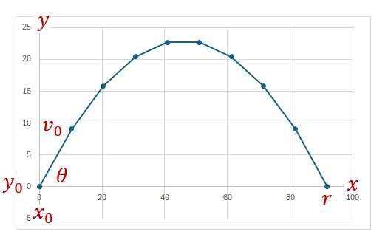
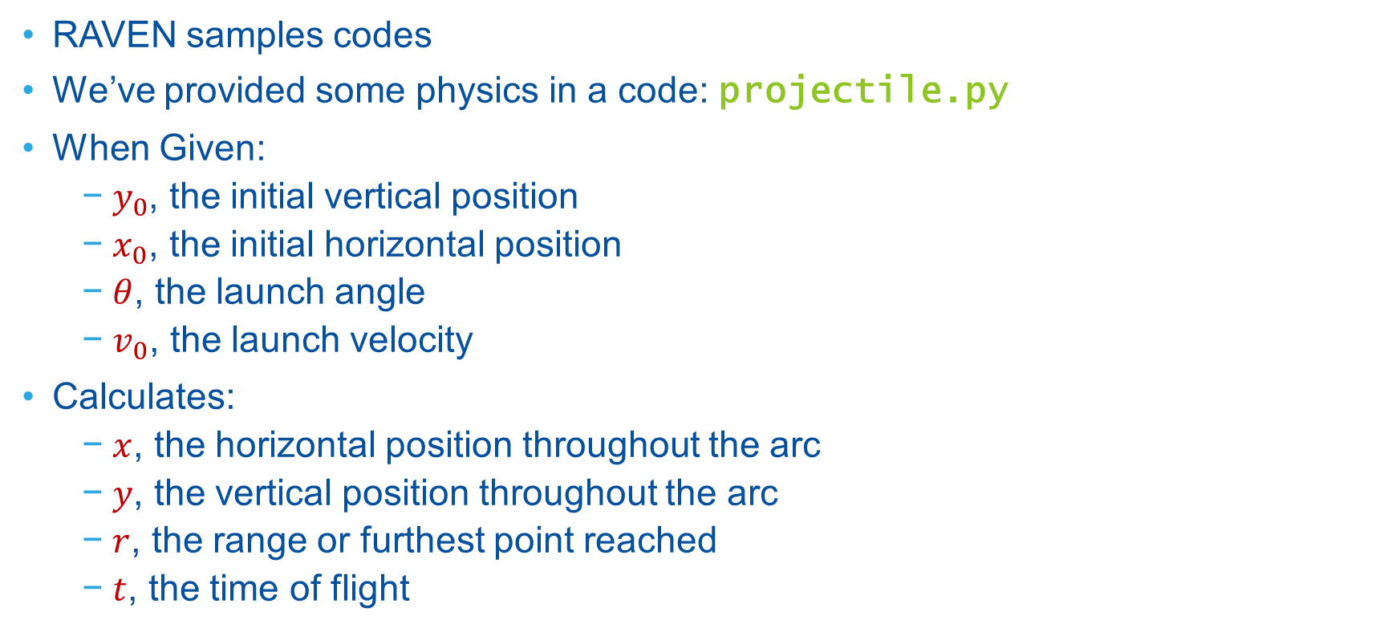
Example Code
RAVEN samples codes
We’ve provided some physics in a code: projectile.py
When Given:
$y_{0}$, the initial vertical position
$x_{0}$, the initial horizontal position
$θ$, the launch angle
$v_{0}$, the launch velocity
Calculates:
$x$, the horizontal position throughout the arc
$y$, the vertical position throughout the arc
$r$, the range or furthest point reached
$t$, the time of flight
Note: this isn’t RAVEN; this is just a simple code model we’ll be using for demos

Slide 5
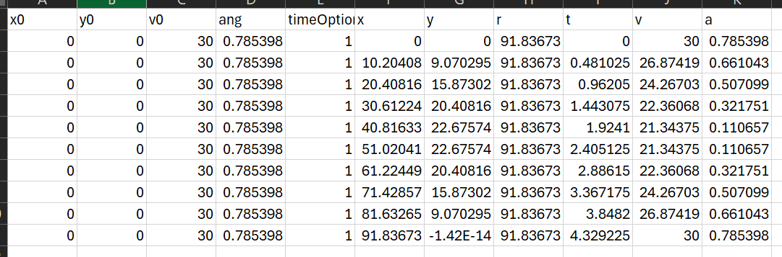
Running “projectile.py”
Navigate to:
Then run:
Output created in “out.csv”
raven/doc/workshop/ExternalModels/
> conda activate raven_libraries
> python projectile.py -i input.i –o out

Slide 6

What we want RAVEN to do
Run my projectile code 1000 times
perturb launch angle $θ$ and velocity $v_{0}$
see how range $r$ and time of flight $t$ change
How do we tell RAVEN to do this?

Slide 7
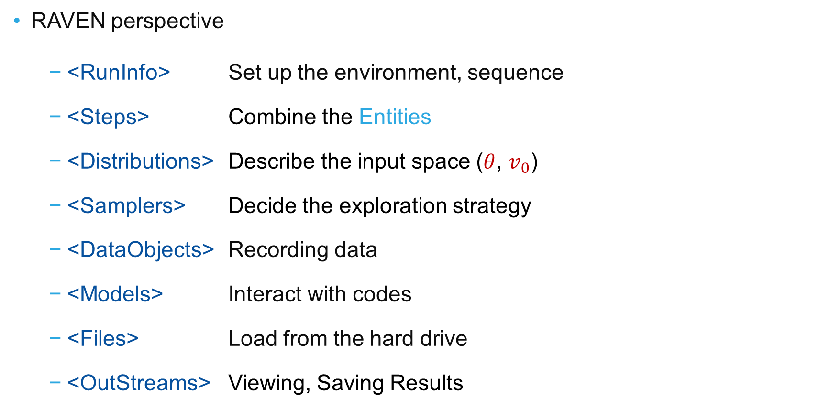
How to Think About the Task
RAVEN perspective
<RunInfo> Set up the environment, sequence
<Steps> Combine the Entities
<Distributions> Describe the input space ($θ$, $v_{0}$)
<Samplers> Decide the exploration strategy
<DataObjects> Recording data
<Models> Interact with codes
<Files> Load from the hard drive
<OutStreams> Viewing, Saving Results

Slide 8
Exercise 1
Sample & Plot

Slide 9
1) Your First RAVEN Input
Open up
Optional: Instead of “vim”, use whatever program you like to edit XMLs
Visual Studio Code
Atom
Sublime
Notepad++
Gedit
vim
(move to console: input, run, output, csv, xml)
> cd raven/doc/workshop/forwardSampling/exercises
> vim 1_sample_and_plot.xml

Slide 10
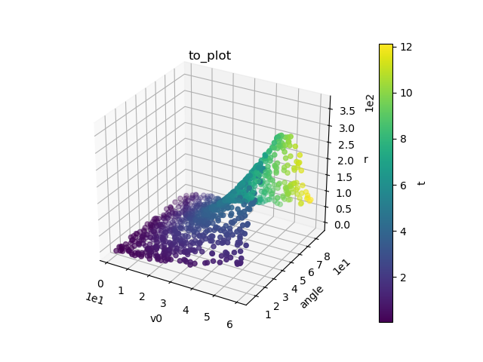
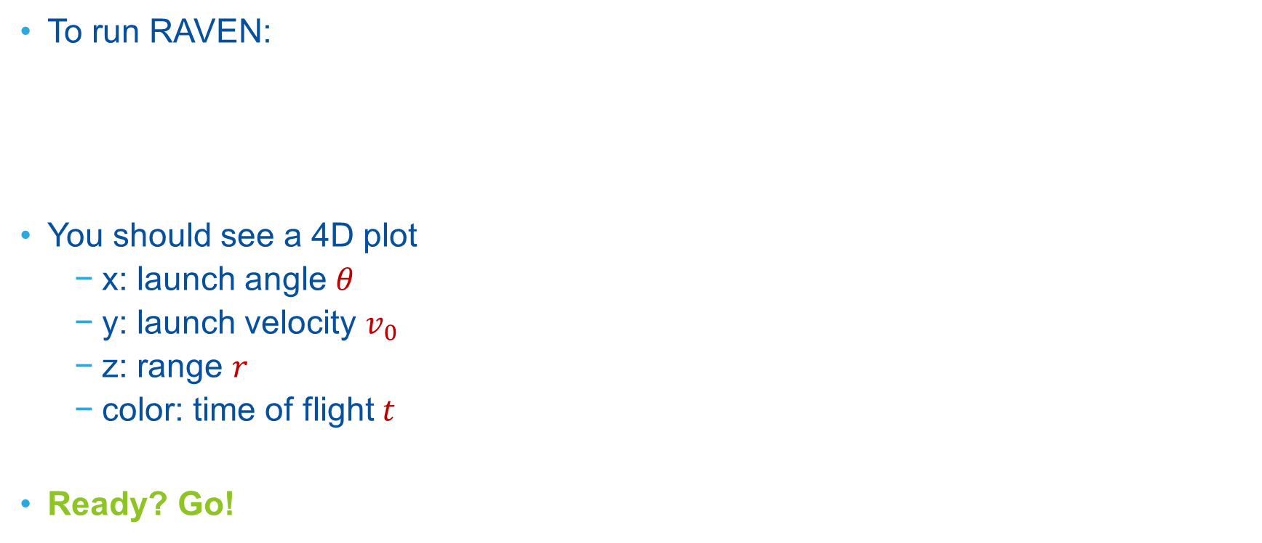
1) Now try running it
To run RAVEN:
You should see a 4D plot
x: launch angle $θ$
y: launch velocity $v_{0}$
z: range $r$
color: time of flight $t$
Ready? Go!
> cd doc/workshop/forwardSampling/exercises
> ~/projects/raven/raven_framework 1_sample_and_plot.xml

Slide 11
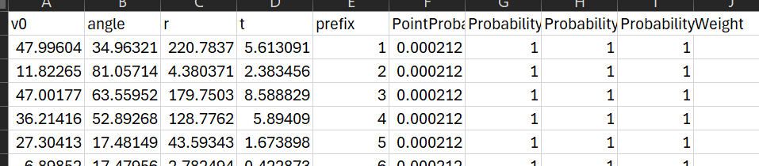
1) Discussion
DataObjects: PointSets
Stores one row per sample
Metadata: ProbabilityWeight, Prefix, PointProbability
OutStreams
Nothing is written to file without an OutStream Print or Plot!
Steps and Sequence
Steps define possible actions to take
<Sequence> defines order to run Steps

Slide 12
Exercise 2
Changing Distributions

Slide 13
2) Now how to change some things
Open up the RAVEN user manual
Download from RAVEN wiki
https://github.com/idaholab/raven/wiki
under Documents, Raven user manual
Navigate manual to help with Exercise 2
New input file:
> cd raven/doc/workshop/forwardSampling/exercises
> vim 2_normal_distribution.xml

Slide 14
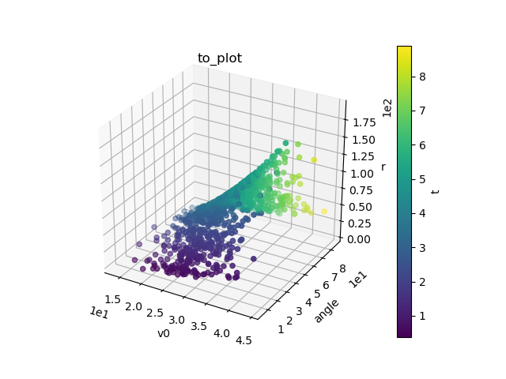
2) What if …
Say we want the velocity to be normally-distributed instead of uniform
Entities to change in input file:
Distributions
Change vel_dist from Uniform to Normal
Uniform XML has been commented out
RAVEN User Manual
See section 9.1.1.8
Use a mean of 30 and sigma of 5
Run the case. What changed between the two plots?

Slide 15
Exercise 3
Changing Variables

Slide 16
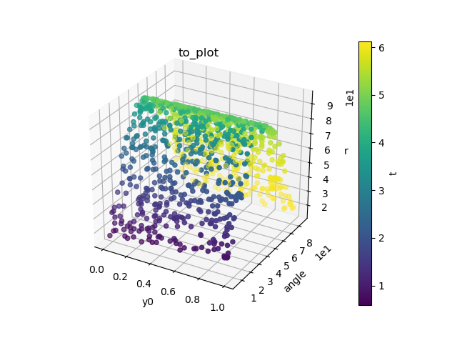
3) Changing the Variables
What if I don’t care about launch velocity, and instead want to consider initial height?
Entities to adjust:
RunInfo:
Change the working directory to ‘r3’
Models:
Add y0 to variables
NOTE: Do not remove v0. v0 is required in the variable specification in order to set it as a constant in Samplers. Otherwise, it will silently use the default v0=1 m/s specified in the external model.
Samplers:
Change variable name v0 to y0
Change distribution name vel_dist to y0_dist
Change constant y0 to v0 with value of 30
Distributions
Change the distribution vel_dist to y0_dist and make it Uniform, 0 to 1
DataObjects & OutStreams
Replace v0 with y0
Run the case. Plot should have y0 instead of v0.
> cd doc/workshop/forwardSampling/exercises
> cp 2_normal_distribution.xml 3_initial_height.xml

Slide 17
Exercise 4
Changing Samplers

Slide 18
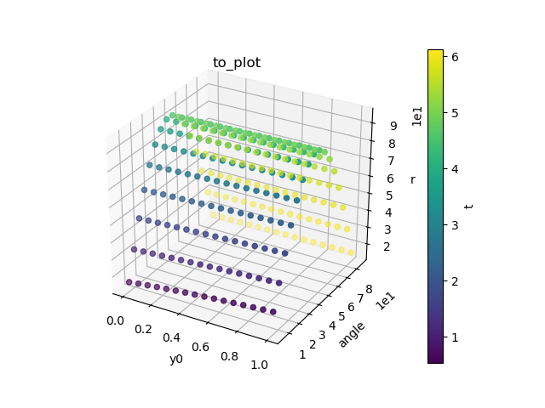
4) Changing Samplers
So far, we’ve used the Monte Carlo sampler
Samples randomly each time from variable distributions
Other sampling strategies exist:
Grid
Takes uniformly-spaced samples across the variable’s domain
Samples uniformly in:
Value space
Probability space
Copy exercise 3 to “4_grid_sampler.xml”, set <WorkingDir> to “r4”
Add a Grid sampler and call it “my_grid”
Change Steps to use the Grid sampler you make
Don’t remove the Monte Carlo sampler!
See user manual section 10.1.2
Don’t forget the <grid> nodes, also remove <samplerInit> node
Choose how you want to space samples (try a couple of options!)
Run the case. How are the samples dispersed differently?

Slide 19
Skipping some Exercises
See the full workshop:
Forward Sampling
raven/doc/workshop/forwardSampling/
ForwardSampling.pptx
2) Changing Variable Distributions
3) Changing Sampled Variables
4) Changing Sampling Strategy
Try these on your own!

Slide 20
Exercise 5
Computing Simple Statistics

Slide 21
5) Statistical Analysis
Looking at plots is great
Let’s quantify data instead
New model: BasicStatistics PostProcessor
Calculates statistics
Mean, standard deviation, variance, skewness, kurtosis
Percentiles, minimum, maximum
Calculation sensitivities and relationships
Sensitivity
Covariance
Pearson correlation

Slide 22
5) Basic Statistics in RAVEN
Results of statistics are stored in a DataObject
Names of statistics are:
metric_variable
variance_r
relation_variable_variable
covariance_y0_ang
prefixes can be manually set
expectedValue_t
mean_t
expv_t
Relationships can be between any two variables
Inputs-Outputs
Inputs-Inputs
Outputs-Outputs

Slide 23
5) Now try running it
To run RAVEN:
Ready? Go!
Statistics in r5/stats_file.csv
> cd raven/doc/workshop/forwardSampling/exercises
> ~/projects/raven/raven_framework 5_short.xml

Slide 24
5) Exercise Steps
Add BasicStatistics Postprocessor to Models block
See 17.5.1 in user manual for syntax
Get mean, variance for range and time of flight
Get sensitivity of range with respect to launch height, angle
Add a new DataObject
Inputs are mean, variance for range, time of flight
Outputs are sensitivities of r to y0, angle (What happens if all are in outputs)
Add a new OutStream Print for the statistics data object
Add a PostProcessor step to Steps block (20.5 in user manual)
Input will be the results data object
Model is the BasicStatistics PostProcessor
Output is the new PointSet DataObject
Also add the OutStream Print for the new DataObject
Don’t forget to add Step to Sequence in RunInfo

Slide 25
A Brief Pause…
How’s it going?
Questions about cases run?
Concerns?
High-level questions?
Curious results?
Coming up next:
time-dependent statistics
task-oriented input design

